Slide 1

Bootstrap

Slide 2

Bootstrap
CSS framework
Web layout and design made easy
Predefined CSS classes

Slide 3
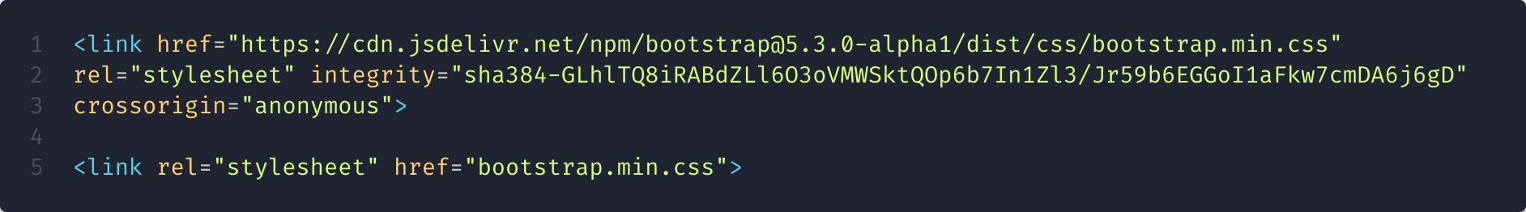
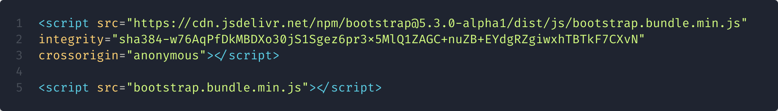
Bootstrap - Import
4 files need to be imported
Import in the <head> tag
Import before </body> tag
In this specifically order

Slide 4
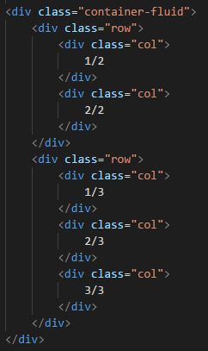
Bootstrap - Grid
Built with Flexbox
Fully responsive layout system
Needs to be inside .container
For more information -> https://getbootstrap.com/docs/4.1/layout/grid/

Slide 5
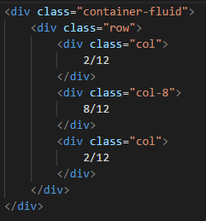
Bootstrap - Grid
Each row is separated in 12 fractions
You can define the column width
For more information -> https://getbootstrap.com/docs/4.1/layout/grid/

Slide 6
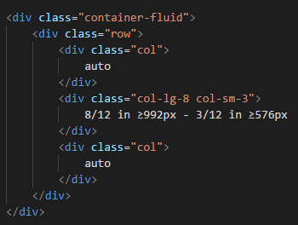

Bootstrap - Grid
Column width depending on the viewport width
For more information -> https://getbootstrap.com/docs/4.1/layout/grid/

Slide 7
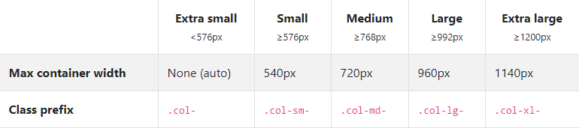
Bootstrap - Grid
For more information -> https://getbootstrap.com/docs/4.1/layout/grid/

Slide 8
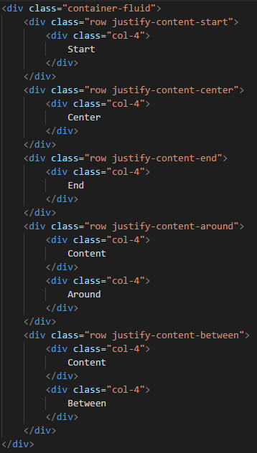
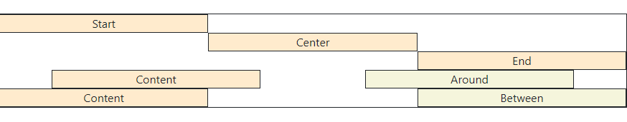
Bootstrap - Grid
Set column position
For more information -> https://getbootstrap.com/docs/4.1/layout/grid/

Slide 9
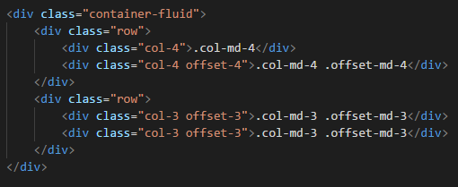

Bootstrap - Grid
Set column offset
For more information -> https://getbootstrap.com/docs/4.1/layout/grid/

Slide 10


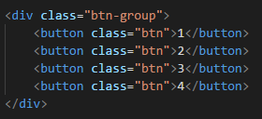

Bootstrap - Buttons
Basic web component
3 sizes
For more information -> https://getbootstrap.com/docs/4.1/components/buttons/

Slide 11
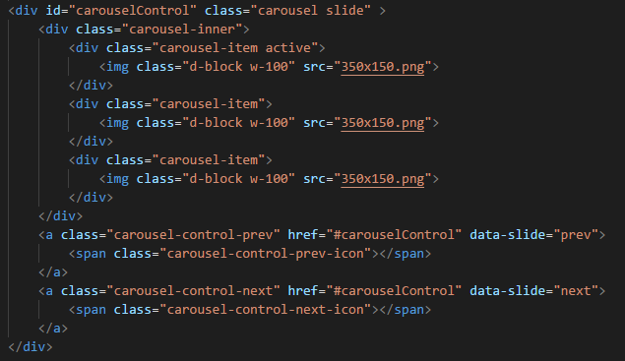

Bootstrap - Carousel
Important
data-slide = “{prev | next}”
id = href of controls
set 1 active item
For more information -> https://getbootstrap.com/docs/4.1/components/carousel/

Slide 12


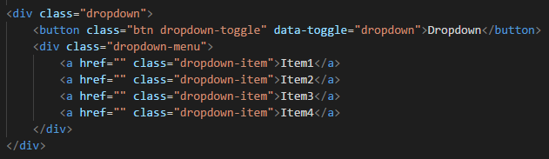
Bootstrap - Dropdown
Important
data-toggle = “dropdown”
Menu direction can be changed {dropdown | dropright | … }
For more information -> https://getbootstrap.com/docs/4.1/components/dropdowns/

Slide 13
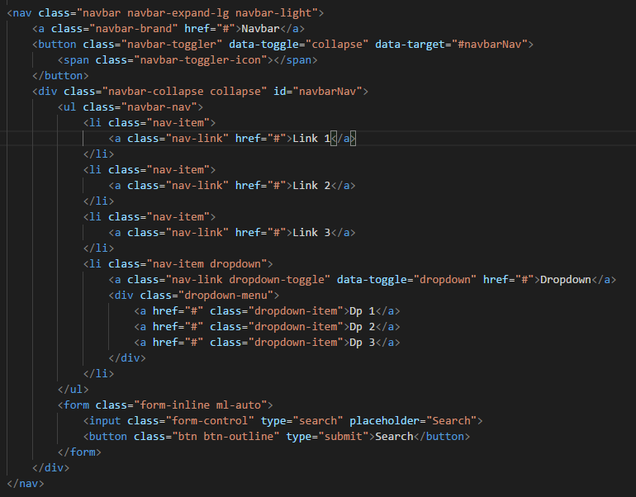
Bootstrap - Navbar
Important
Inside <nav> tag
. navbar-expand-{sm | md | lg | xl}
.collapse
.navbar-toggler
data-target = navbar-collapse id
data-toggle = “collapse”
For more information -> https://getbootstrap.com/docs/4.1/components/navbar/

Slide 14

Bootstrap - Navbar

Slide 15
More components in https://getbootstrap.com/docs/5.3/components/

Slide 16
Bootstrap - Utilities
Spacing
m -> margin
p -> padding
-
l -> left
r -> right
b -> bottom
t -> top
x -> horizontal
y -> vertical
values: 1 | 2 | 3 | 4 | 5 | auto
-
Examples : ml-3 / mx-auto / py-4 / mr-0 / p-4 / m-0
Sizing
w -> width
h -> height
mw -> max-width
mh -> max-height
-
values: 25 | 50 | 75 | 100
-
Examples : h-50 / w-25 / h-auto / mw-100
For more information -> https://getbootstrap.com/docs/4.1/utilities

Slide 17
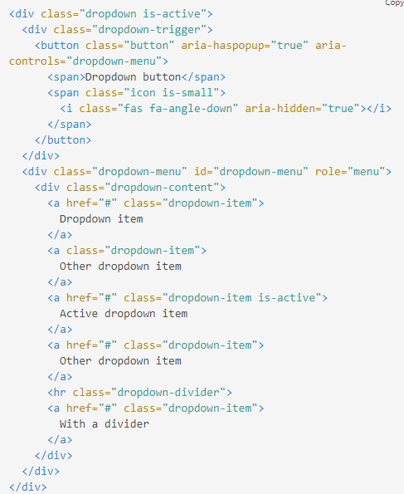
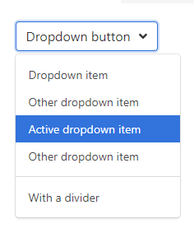


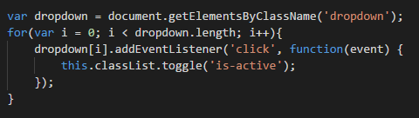
Bulma.io
Bootstrap alternative
No JS
No JQ
Minimalistic
Easy to understand
Grid System

