Slide 1


HTML, CSS, JS
Introduction
Notes:
- Buenos dias
- Nombre
- Classroom
- Horarios
- Nivel clase?

Slide 2
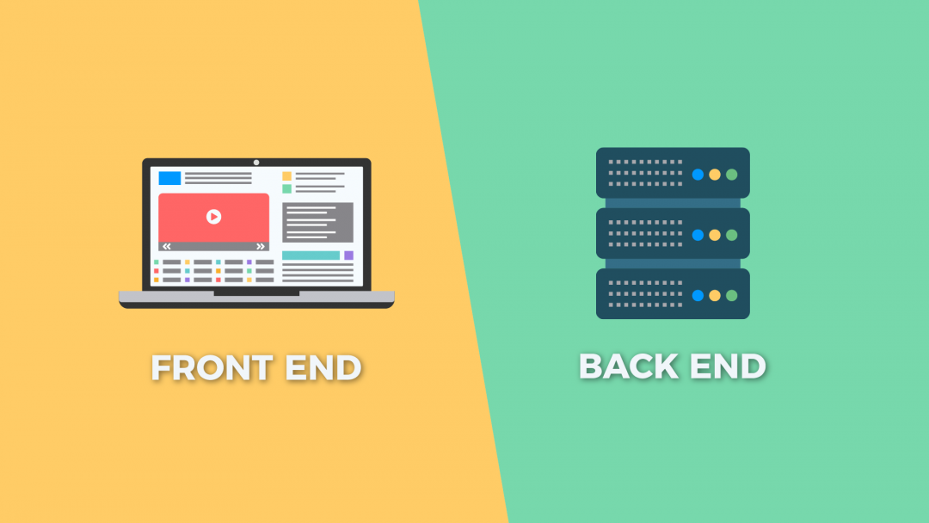
Building a webpage

Slide 3
List of topics
List of topics:
HTML
Javascript
Good Practices
CSS
JQuery
Deploy
Bootstrap
Axios (API’s)

Slide 4

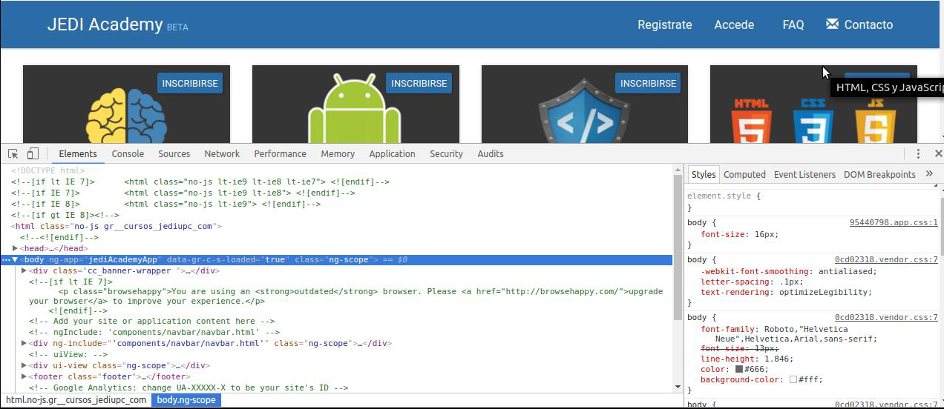

Tools
Sublime Text/VSCode + Web Inspector

Slide 5


Version control

Slide 6
Practice
Exercises
In class
Deliverable
Final project
At least 10’ each class
To deliver a week after classes are over

Slide 7
Final project
Must use
HTML5 tags
CSS
Responsiveness
JS
API calls (Axios)
Extra points
Good practices
Bootstrap
CSS Animations
JQuery
Deploy

Slide 8
Pass + ECTS
In order to pass this course and obtain 2 ECTS, you must:
80% attendance
A mark of 5 or more in the final project

Slide 9
Last but not least
Arrival time
Respect platform rules (Discord / Meet)
Schedule & deliverables
Communication & help

