Slide 1
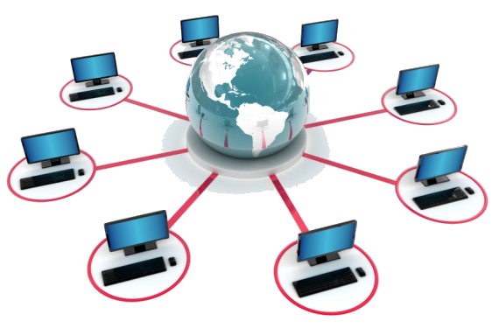

WELCOME TO DISTRIBUTED java
Programming for the Web and Other Networks
Instructor: Andy Biewer

Slide 2
introductions
Andy Biewer, Instructor
Distributed Java, Course #152-198
Pre-requisites:
Registered (gets you on my roster)
Completion of Intro Java #152-134 & Advanced Java #152-135 with grade of “C” or better, or academic/commercial equivalents
Student Introductions: your name, career goal and what you’ve been working on (code)

Slide 3
ABOUT THIS COURSE
What do we mean by the phrase “Distributed Java”
A computer software program, often polyglot, split into modules or tiers, where each module/tier runs on a different computer
The web is a distributed execution environment: client tier + server tier (>= 2 computers needed)
But regular, non-web apps can also be distributed among multiple computers on a LAN: grid computing, remote method invocation (RMI), etc.

Slide 4
ABOUT THIS COURSE
Why Java?
Many developers use PHP, C#.Net, VB.Net, Ruby on Rails and other languages to develop web apps
All are good choices, depending on the job. Pick the right tool for the job.
Java Advantages:
Portability across Operating Systems
Powerful JVM (performance and scalability)
Huge number of features., E.g., Java has built-in messaging via JMS and remoting via EJBs. Many others do not.
Large Ecosystem of third-party libraries
Solves problems others cannot

Slide 5
ABOUT THIS COURSE
Who Uses Java for Web Development?
Large and Small companies
Large Organizations such as: Johnson Controls, GE, Wells Fargo, US Bank, Twitter, Kohls, NM Ins.
Small Organizations such as: Guardian Business Solutions, Boar’s Head Deli Products …
World-wide #1 language in world: http://www.tiobe.com/tiobe-index// http://pypl.github.io/PYPL.html

Slide 6
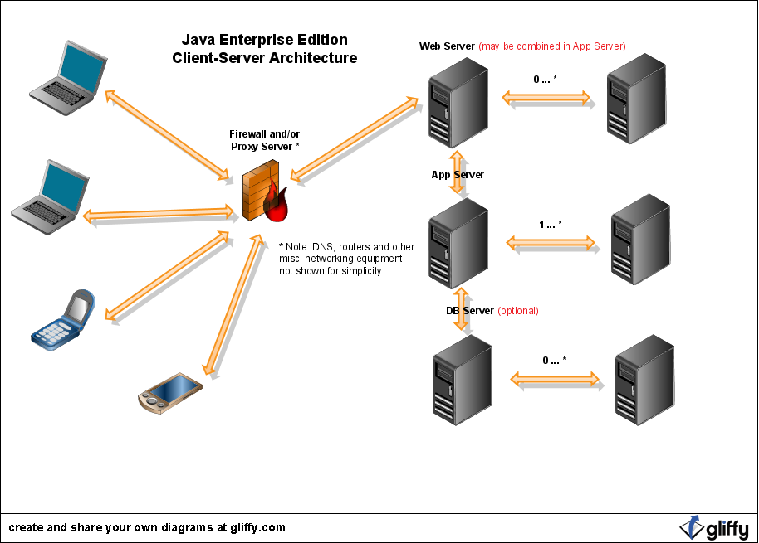
Distributed WEB APP example (N-tier)

Slide 7

Rack mounted servers

Slide 8
ABOUT THIS COURSE
Why Should We Bother to Create Distributed Applications that Use Multiple Computers?
Service more users, run faster, process more data
More computers means more processing power
Decoupling of modules/tiers: more flexible
Reuse common functionality among different programs
Horizontally scalable (easily adapt to increased processing demands)

Slide 9
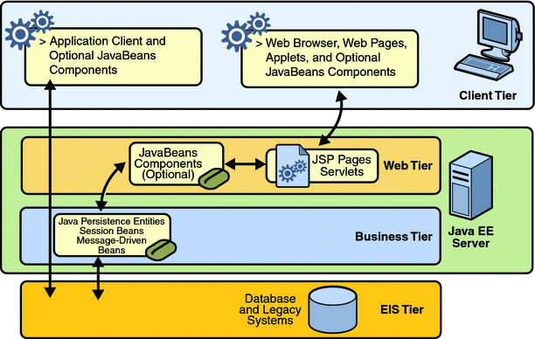
Java EE WEB APP SERVICE TIERS

Slide 10
ABOUT THIS COURSE
Why Should We Bother to Create Web Applications?
That’s where the work/jobs are
Economies of scale:
Faster time to market
Centralized server install vs. many users machines
No printing or distribution costs
Users get 24x7 availability, anywhere in world, with only Internet access & Web Browser software required
It’s a distributed environment!

Slide 11
The skills you will need
What Do You Need to Know to Create Distributed Apps?
Design Patterns for Flexibility, Quality
Some Networking Tech
How Servers, Especially Web Servers, work
How Clients, especially Web clients, work
At least 4 languages: Java*, HTML, CSS, JavaScript
Frameworks for the Web and Other types of Distributed Application Development
*Or VB, C#, PHP, etc.

Slide 12
architecture impacts WEB APP quality
As you learned in Advanced Java, architecture plays a big role in the overall quality of your application
Same metrics apply: a quality app has: non-rigid, non-fragile and highly portable (flexible) modules
Even more important with a distributed app. Why? Because modules now live on multiple computers. Deciding where and how many computers requires careful consideration

Slide 13
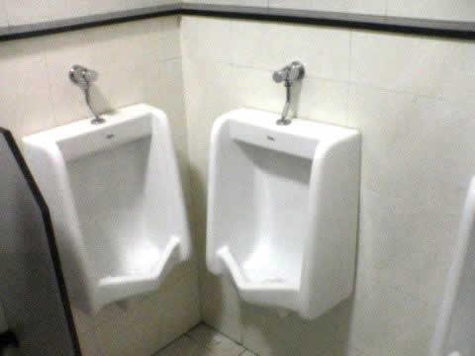
Example of A POOR architecture
You don’t want your app to work like this:

Slide 14
ABOUT THIS COURSE
You will need to learn two Java frameworks to build web apps in Java
What’s a Framework?
Software libraries that make development easier
Standard, built-in to JEE, plus 3rd Party
100s in Java World: more choice, more freedom, more challenge
Only 2 in Microsoft World (ASP & ASP.Net): vendor lock-in, only the Microsoft way, licensing costs
PHP also very limited
How to Choose:
Avoid dogma, choose best tool for job
Learn legacy and modern techniques
3rd Party Perspective

Slide 15
ABOUT THIS COURSE
You will need to learn two Java frameworks to build web apps in Java:
Legacy (JSPs and Servlets with HTML5, CSS and JavaScript) (F-A-S-T, total control, but labor-intensive)
Ultra-Modern (RESTful Web Services with HTML5, CSS and JavaScript) (decouples server-side technology from client-side)
Many others (50+): JSF, ZK, Vaadin, Struts, etc.

Slide 16
About this course
Each week will introduce a new topic
Each week you will then be required to work on and submit a project related to the new topic
Each project will be worth 50 points:
25 points for effort (i.e, requirements satisfied)
20 points for quality
5 points for timeliness (10% late penalty)
There will be no tests or quizzes
Those who do the work, do the learning

Slide 17
RECENT UPDATES
Java Web Application developers use the Java Enterprise Edition (JEE) on top of the Java Standard Edition (JSE).
Unlike JSE you don’t download a JDK for JEE. Instead, the software libraries are embedded in the JEE Server – in our case that will be Glassfish.
JEE v7 was released (Summer 2013). Many new features; some challenges. We’ll focus on v7.

Slide 18
Projects
Throughout the semester, you will build a web application, using the MVC design pattern
A store front application of your choosing which implements a shopping cart with ordering functionality
Samples of Real World Web Apps
There’s the amazing technology out there called Google
Research different applications and see what you like and don’t like
Incorporate these ideas into your application

Slide 19
Course syllabus
How are points earned or lost in this course (be specific)?
What is the attendance policy and why is it so strict?
What is the policy regarding late assignments?
How should work be submitted?

Slide 20
Github.com
Each student needs to create a github.com account
Each weekly project will be committed to git as a new branch
Branches will be merged into master so the culmination of your semester’s work is in master
Let’s get you all setup now!

Slide 21
HTML/javascript/css
Review of the materials on Blackboard
Multitude of resources online
Really cool tools that build content for you!

Slide 22
Next activity
Go to the Week 1 project on Blackboard and continue there
For next time…
Read chapters 1 and 2 of the Java Servlet Tutorial (on Blackboard)

