Slide 1
Distributed Java
Week 2 : Web Applications

Slide 2
Agenda
Demos – looking for volunteers
Review git and IntelliJ integration
Dive into what is a Java web application
HTTP request/response verbs
Project 2 (done in class this time)

Slide 3
Git Ignore
.gitignore file
File and directory patterns
Used to ignore any files you don’t want to show up in your list of files to be commited to github.com
It’s up to you which files you want to commit
There are some predefined .gitignore files for various types of projects
Google: “.gitignore intellij java web application”
You can use them or just borrow from them

Slide 4
What is a Java web application
Servlets, filters, listeners
JSPs (another type of servlet)
Static content (images, CSS, JavaScript)
Metadata information
Library dependencies

Slide 5
Servlets
Receive web (i.e., HTTP) requests
In the case of a web application, request contains data submitted from HTML forms
Process the request (logic, data model, database, other services)
Respond with an HTTP response
In the case of a web application, the response is HTML
NOTE: servlets are singletons
Q: How does a web server handle multiple simultaneous requests?
A: Threads
Therefore: DO NOT store state (instance data) which should not be shared between requests

Slide 6
Java Server Pages (JSPs)
Think of a JSPs as an executable HTML with code
Embedded code can be Java (we’ll see this is pretty ugly)
Embedded code can also be tags from standard tag libraries or custom tags
JSPs are compiled at runtime by the web server
First to Java
Second to bytecode
Basically, JSPs are another form of servlet

Slide 7
Metadata
Web applications contain WEB-INF
web.xml file which contains definitions of
Servlets
Filters
Listeners
Welcome pages
Resources
etc…
WEB-INF also contains
Compiled classes
JAR files that your application requires

Slide 8
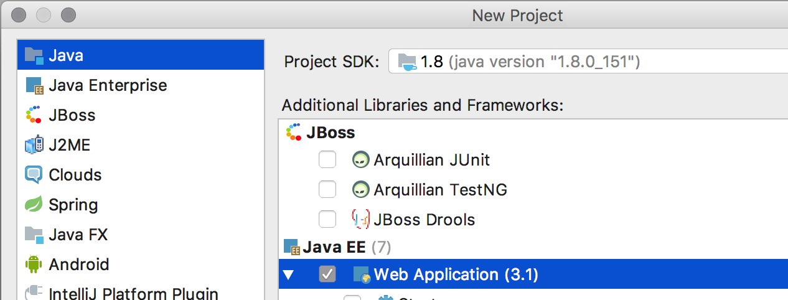
Creating a Java web application in IntelliJ
File / New Project…
We will do it this way this week (no guarantees next week)

Slide 9
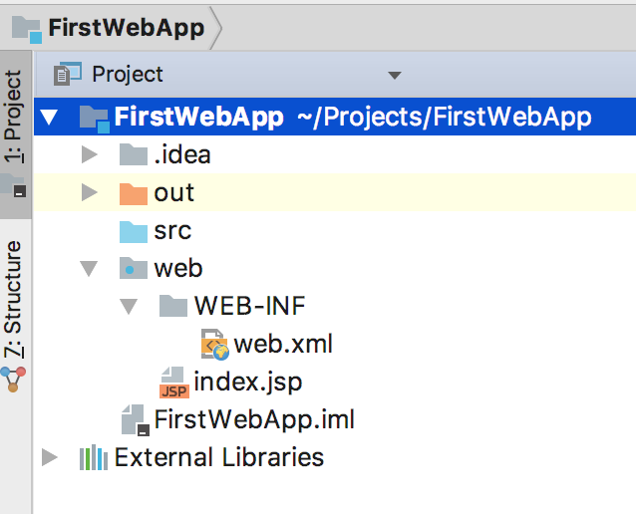
Structure of a Java web application

Slide 10
How web applications work
Request/response
HTTP Verbs
GET
Data can be sent on the same line as the URL
POST
Another way to request a response from the server
Data is sent as part of the request message itself
There are more which we will revisit with REST services but these will suffice for now

Slide 11
HTTP GET Example
https://www.google.com/search?source=hp&ei=Ii1uWvb0HMG10ASQz7eYBQ&q=html5+doctype&oq=&gs_l=psy-ab.3.0.35i39k1l6.12164.13002.0.17705.5.4.0.0.0.0.329.329.3-1.2.0..2..0...1.1.64.psy-ab..3.2.1564.6..0j0i20i264k1j0i131i67k1j0i67k1j0i131k1.1235.yvXebgTk2Qw
Everything in red after the question mark is the content (aka parameters)
Disadvantages
Limited length to the URL
Insecure
User can see this data in the address bar

Slide 12
HTTP POST Example
headers
verb + requested resource + http version
POST / HTTP/1.1
Host: foo.com
Content-Type: application/x-www-form-urlencoded
Content-Length: 13
say=Hi&to=Mom
Advantages
Larger amounts of data (unlimited) can be sent
Secure
content

Slide 13
Project
Do the following for the project for this week
Follow the remaining slides step by step to create a web application
Copy your HTML pages from week 1 into the web folder
Redploy and make sure you can open your web pages from the browser
Figure out how you can change the application context in the browser URL
Right now, it’s pretty ugly (e.g., FirstWebApp_war_exploded)
There is an IntelliJ setting in the Run configuration
Commit and push all of your work to a ‘week2’ branch on github.com
You should be able to accomplish this all in class
Make sure to do it in class since I’m sure you will run into some issues and we can resolve them as they come up!

Slide 14
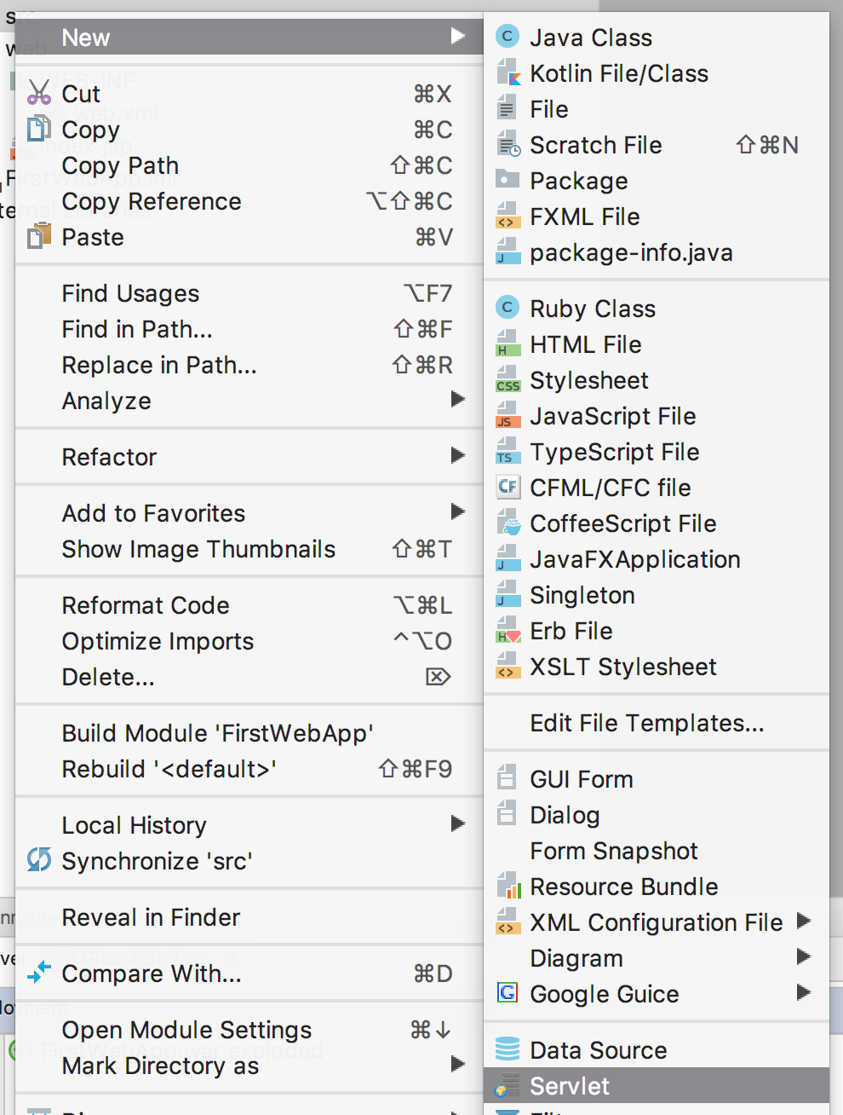
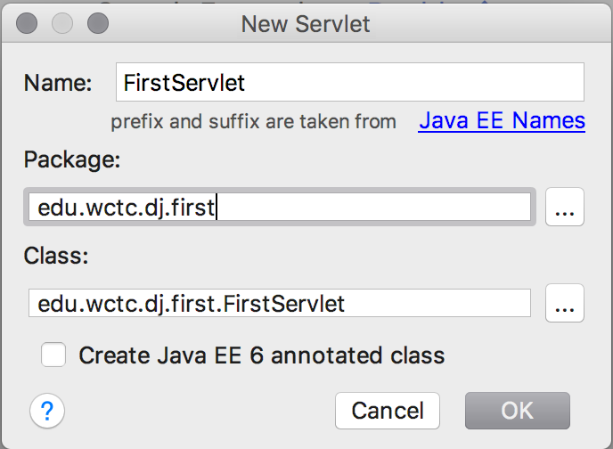
Create a Servlet

Slide 15
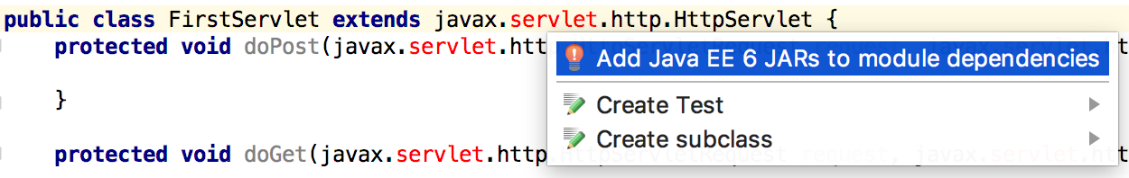
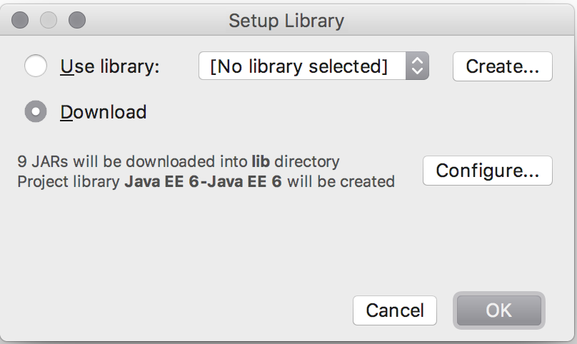
Create a Servlet
Open FirstServlet.java and add Java EE 6 JARs to module dependencies

Slide 16
Create a Servlet
Open web.xml and add servlet mapping
<servlet-mapping> <servlet-name>FirstServlet</servlet-name> <url-pattern>/first</url-pattern> </servlet-mapping>

Slide 17
HTML Page
Create web/test.html
<!DOCTYPE html> <html lang="en"> <head> <meta charset="UTF-8"> <title>Title</title> </head> <body> <form method="get" action="first"> <input type="text" name="param1"><br/> <input type="submit" value="GET"/> </form> <form method="post" action="first"> <input type="text" name="param1"><br/> <input type="submit" value="POST"/> </form> </body> </html>

Slide 18
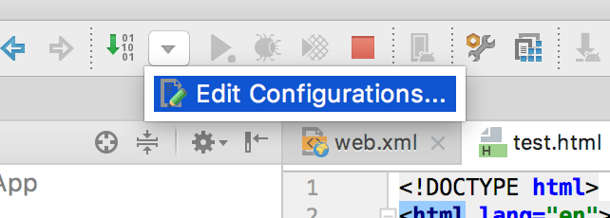
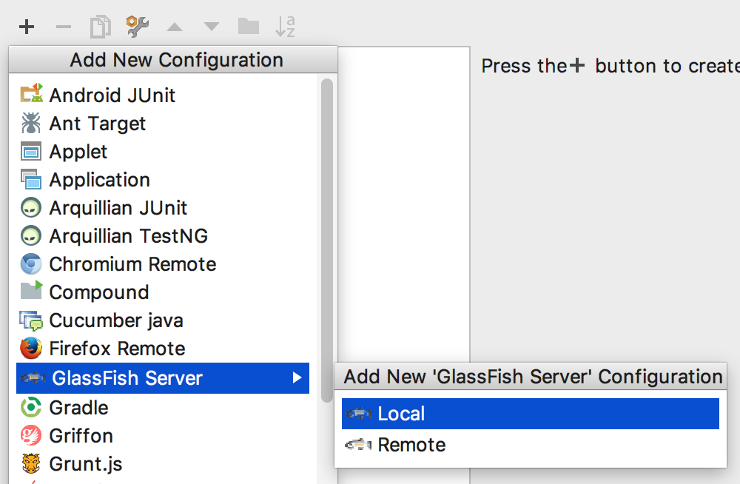
Run and Test
click the +
Assumption: Glassfish is installed!
Create run configuration

Slide 19
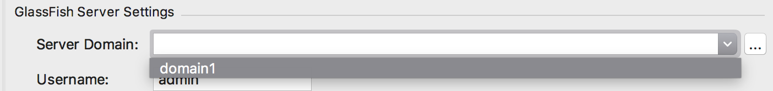

Run and Test
Select the Glassfish domain

Slide 20
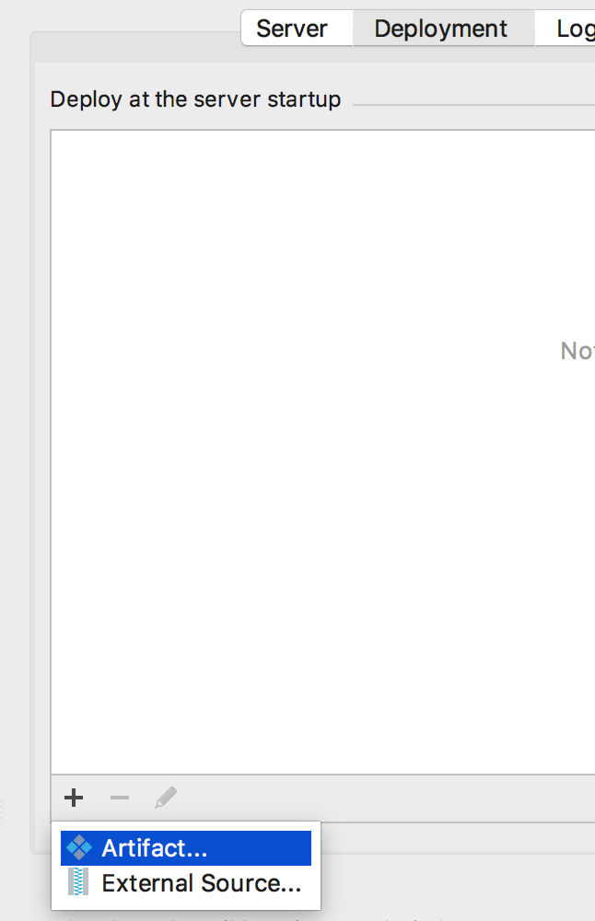
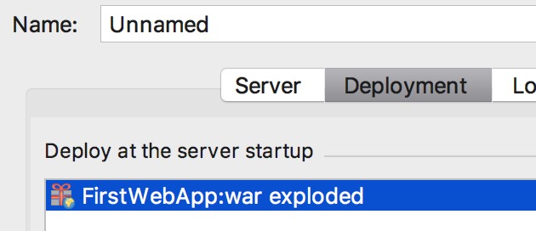

Run and Test
Add your web application to the deployments
click the +
Hit OK!

Slide 21

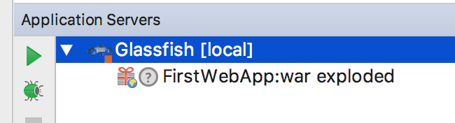
Run and Test
Run
Here or here

Slide 22
Open test.html from Browser
Enter URL
http://localhost:8080/FirstWebApp_war_exploded/test.html
View Page Source if you want
You should see your forms
Enter data in first text box and click GET
Should take you to an empty page but look at the address bar!
Hit the back button and do the same for POST
Should take you to an empty page and look at the address bar

Slide 23
Generate a Response from Servlet
Implement doGet and doPost
protected void doPost(HttpServletRequest request, HttpServletResponse response) throws ServletException, IOException { String html = "<html><body>Hi. I received param1=" + request.getParameter("param1") + " via POST</body><html>"; response.getOutputStream().println(html); } protected void doGet(HttpServletRequest request, HttpServletResponse response) throws ServletException, IOException { String html = "<html><body>Hi. I received param1=" + request.getParameter("param1") + " via GET</body><html>"; response.getOutputStream().println(html); }
NOTE: When you makes changes you need to either redploy your application or restart the Glassfish server completely.

Slide 24
Alternatives?
Obviously using println’s to output HTML is less than optimal
Think about alternatives
Can you implement an alternative using FileReader?
Such as reading an HTML file that is stored under the project and writing that out on the response
Give it a try
Can you identify limitations to this new approach?
Next week, we’ll look at another alternative: JSPs

Slide 25
Next
Read chapters 1, 3 and 4 from the book
We will be working on converting your HTML pages to Java Server Pages
Anyone who wants to work ahead on this is entirely welcome but don’t submit that as part of the ‘week2’ branch on github.com

