Slide 1
Distributed Java
Week 8

Slide 2
Agenda
Midterm Status
Cookies and Sessions
AJAX and JSF
Project 6

Slide 3
Cookies and Sessions
Java servers use a session cookie called JSESSIONID as the key to sessions maintained within the server
The first time the user accesses a site and the application attempts to access the session, a new HttpSession object is created and a new JSESSIONID is generated
The JSESSIONID is returned to the browser as an HTTP response header
Every subsequent request, the browser sends the JSESSIONID cookie along with the HTTP request as a header
The server recognizes the JSESSIONID cookie and looks up the existing HttpSession and makes it available to the application
Thus, you can store objects in the HttpSession which can then be accessed via your controllers, beans, and pages

Slide 4
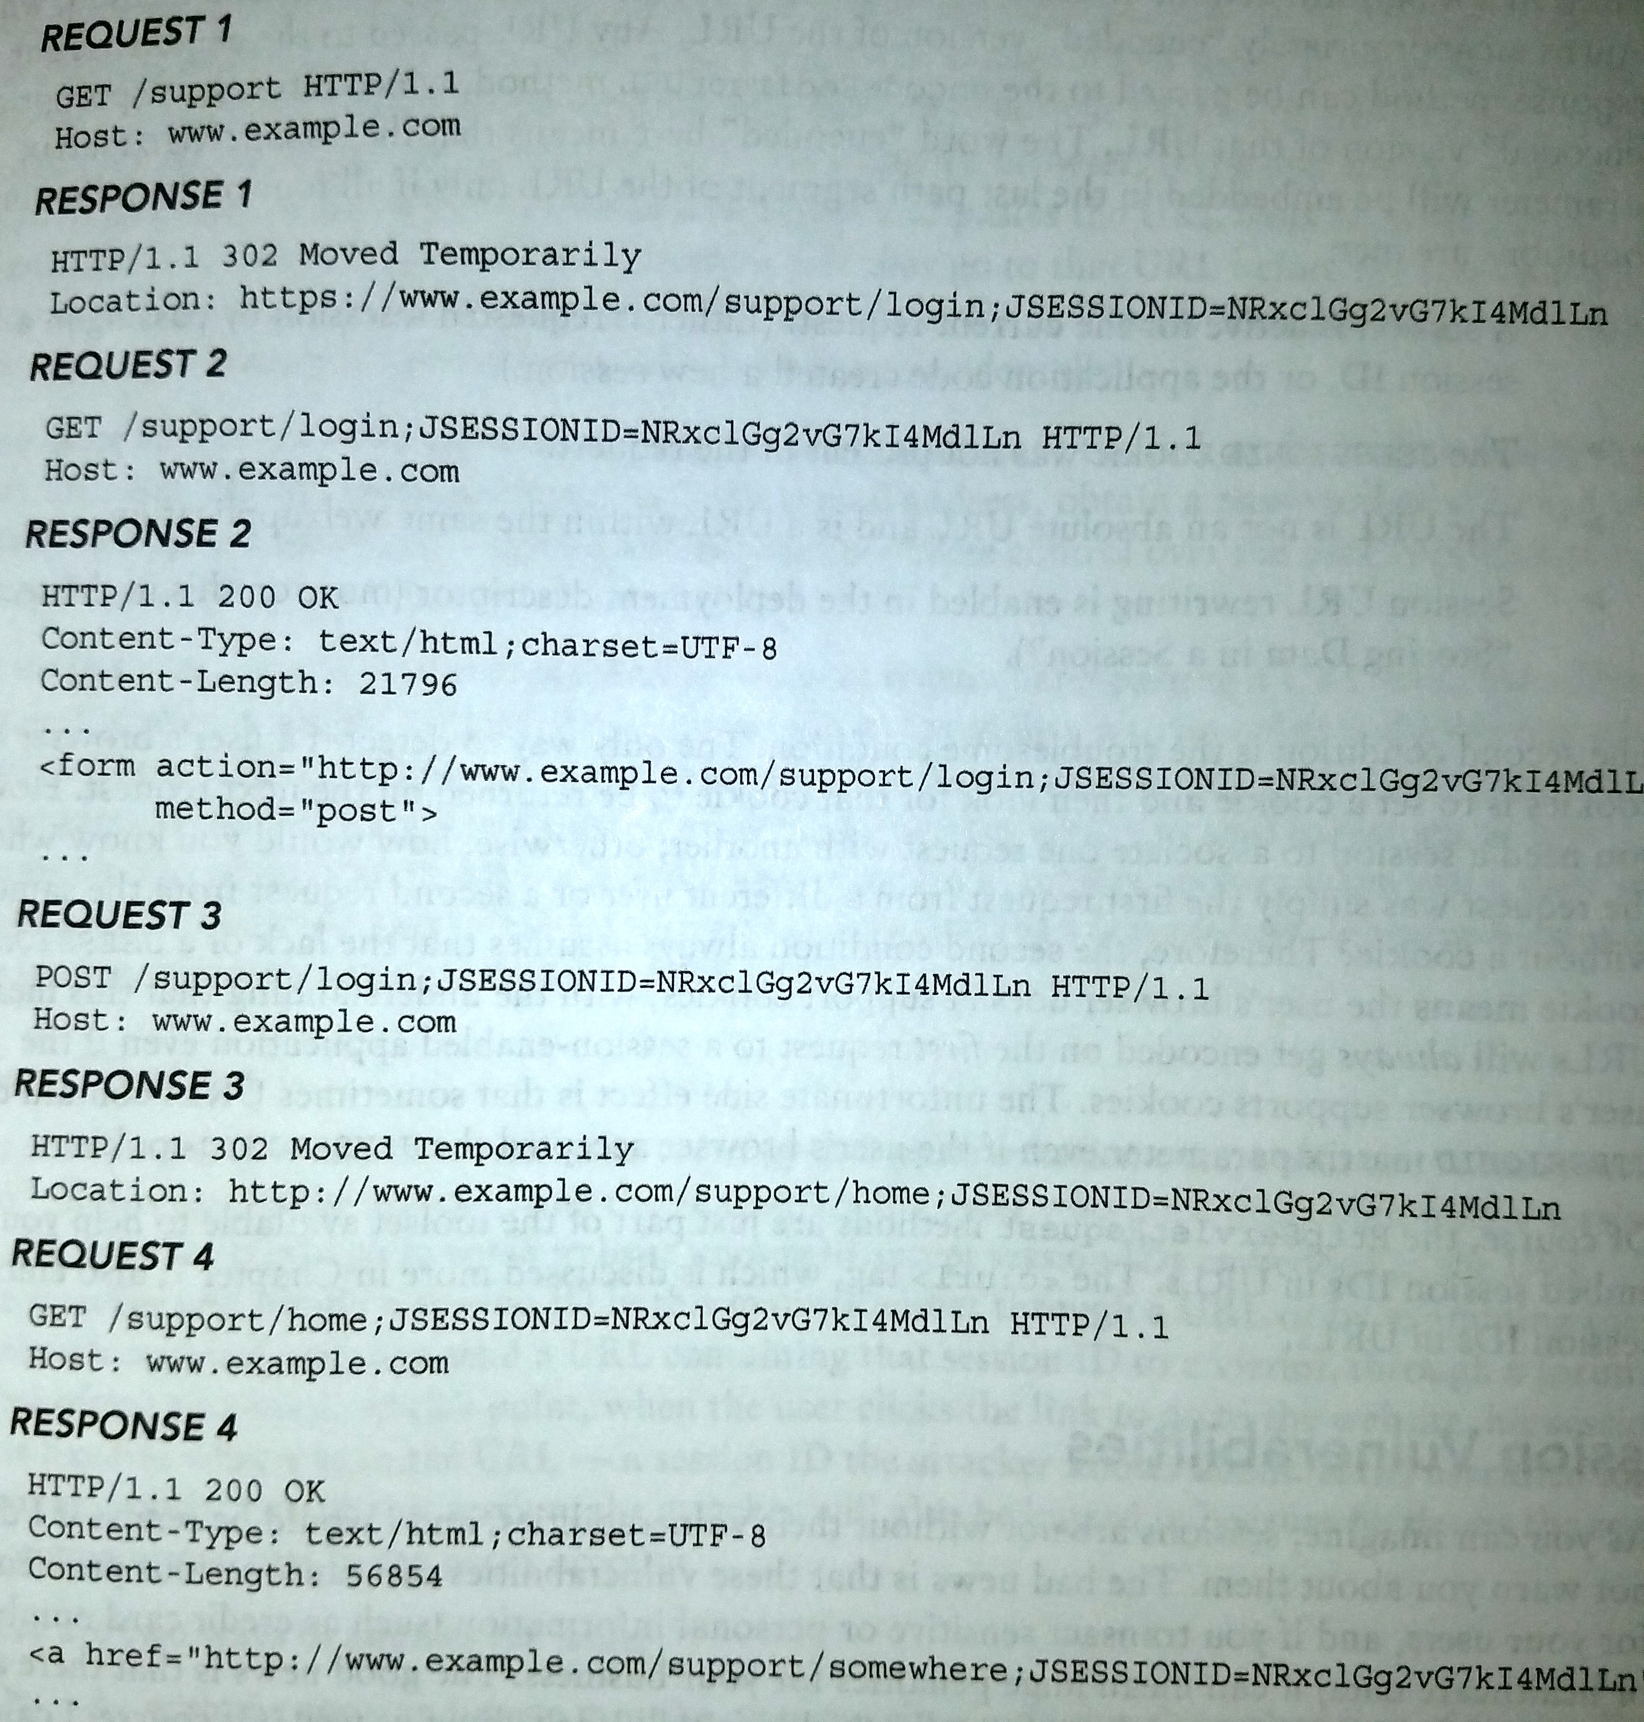
Typical JSESSIONID Exchange

Slide 5
Accessing the Session from a JSP
You can use the HttpServletRequest object to access the session:
HttpSession session = request.getSession();
String sessionId = session.getId(); // This is the JSESSIONID
session.setAttribute(“cart”, ….);
ShoppingCart cart = (ShoppingCart) session.getAttribute(“cart”);

Slide 6
Accessing the Session in JSF
Simply annotate your backing bean with @SessionScoped
Now, every field you store in that bean will be stored (along with the bean itself) in the session

Slide 7
AJAX and JSF Agenda
Define AJAX
XMLHttpRequest
<f:ajax>
PrimeFaces AJAX support
WebSockets

Slide 8
What is AJAX
AJAX = Asynchronous JavaScript And XML
Allows a browser to send an HTTP request to a server and process the response, all while staying on the same page
Originally intended to be used for XML (thus, the name) but today any type of response can be received
Later, we will use AJAX to add names to the shopping cart without leaving the names list page

Slide 9
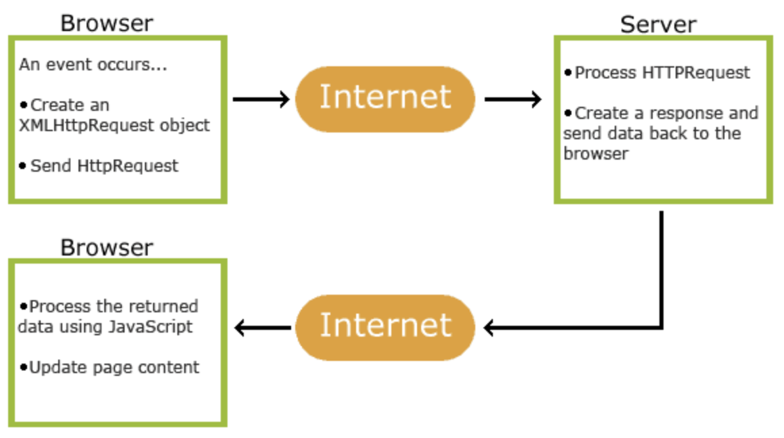
How AJAX Works
Image: https://www.w3schools.com/xml/ajax_intro.asp

Slide 10
XMLHttpRequest
This is the API that the browser exposes for your JavaScript code to send AJAX requests
To use XMLHttpRequest
Create a new XMLHttpRequest object
Set the onreadystatechange function on the object
This function receives a response which contains the data coming from the server
Use this data to update an element on the page
Open the URL you want to send to
Invoke the send() method

Slide 11
XMLHttpRequest
XMLHttpRequest is a browser object that has methods for sending and receiving
<div id="demo"> <h2>Let AJAX change this text</h2> <button type="button" onclick="loadDoc()">Change Content</button> </div>
function loadDoc() { var xhttp = new XMLHttpRequest(); xhttp.onreadystatechange = function() { if (this.readyState == 4 && this.status == 200) { document.getElementById("demo").innerHTML = this.responseText; } }; xhttp.open("GET", ”DocumentController?id=1234", true); xhttp.send(); }

Slide 12
How JSF does AJAX
One way is with <f:ajax>
“execute” attribute specifies the input fields that will get sent to the bean
“render” attribute specifies the output field that gets updated when the bean returns
<h:form>
<h:inputText id="inputName" value="#{userData.name}"></h:inputText>
<h:commandButton value="Show Message">
<f:ajax execute="inputName" render="outputMessage" />
</h:commandButton>
<h2><h:outputText id="outputMessage"
value="#{userData.welcomeMessage ! = null ?
userData.welcomeMessage : ''}"
/></h2>
</h:form>

Slide 13
How PrimeFaces does AJAX
Another way, for example, with commandButton:
<h:form id=“form”>
<p:outputLabel for="cartQuantity" value="Cart:" />
<h:outputText id="cartQuantity" value="#{cartBean.itemsInCart} "/>
<p:commandButton value="Add” update=”:form:cartQuantity”
actionListener="#{cartBean.addToCart(name)}" />
This is contained in <h:form> … </h:form>
The “update” attribute specifies which component(s) should be updated once the response arrives (separate multiple components with a comma)

Slide 14
WebSockets
The main problem with AJAX is that it’s one way from browser to server
There are techniques for going the other way but none of them are a true “push” from the server
WebSockets were introduced as a true connected socket technology

Slide 15
NamesApp: Adding Shopping Cart
Here’s what we’re going to do
Create shopping cart and shopping cart service class
The cart will be responsible for holding the names in the cart
The service will be responsible for loading/saving carts (eventually to a database)
Create a shopping cart bean
The bean will be responsible for actions related to adding/removing names to/from the cart
Add an “Add” button to the nameList.xhtml page
The button will use AJAX to add a name to the session cart
After the name is added to the cart, a new text field on the page will be updated with the number of names in the cart

Slide 16
ShoppingCart
Responsible for holding the actual items
public class ShoppingCart {
private final List<Name> contents = new ArrayList<>();
public List<Name> getContents()
public int getItemsInCart()
public void add(Name name)
public void remove(Name name)
public void removeAll()
}

Slide 17
ShoppingCartService
Responsible for loading and saving shopping carts
public class ShoppingCartService {
private static final Map<String, ShoppingCart> contents = new HashMap<>();
public ShoppingCart getContents(String sessionId)
public void update(String sessionId, ShoppingCart cart)
public void delete(String sessionId)
}

Slide 18
CartBean
Responsible for interactions with the pages for adding/removing items to/from the cart
@Named(value = "cartBean")
@SessionScoped
public class CartBean implements Serializable {
private final String sessionId;
private final ShoppingCart cart;
private final ShoppingCartService cartService = new ShoppingCartService();
public int getItemsInCart()
public void addToCart(Name name)
}

Slide 19
nameList.xhtml
<h:form id="form">
<p:outputLabel for="cartQuantity" value="Cart:" />
<h:outputText id="cartQuantity" value="#{cartBean.itemsInCart} "/>
<p:dataTable …>
…
<p:column>
<p:commandButton value="Add” update=":form:cartQuantity”
actionListener="#{cartBean.addToCart(name)}" />
</p:column>
</p:dataTable>
</h:form>

Slide 20
Project 8
Create a new week8 branch
Make sure you have committed everything beforehand
Follow the same steps we did to implement the shopping cart except now for your products
Add cart and service model classes
Add cart bean
Modify your product list page to provide some way for the user to add a product to the cart
Modify your product list page to reflect the number of items in the cart
Use AJAX to add products to the cart

Slide 21
Next
Readings from book
Nothing this time
Enjoy the break

