Slide 1
Distributed Java
Week 4

Slide 2
Agenda
.gitignore
Maven
JSTL and EL
Project

Slide 3
Git
.gitignore
Make sure you commit and push everything from week3 branch
Create week4 branch from the week3 branch

Slide 4
Maven
Build and dependency management tool
Advantages
Manages dependent libraries
IDEs can load Maven projects
Create Maven projects going forward

Slide 5
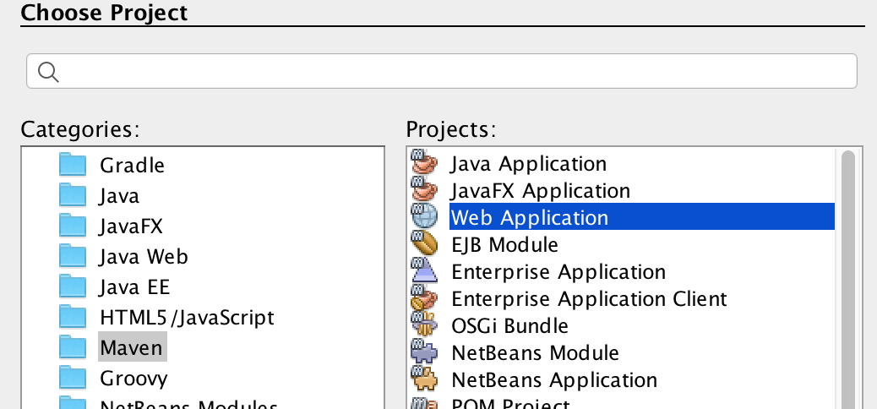
Maven
Create a new Maven Web Application

Slide 6
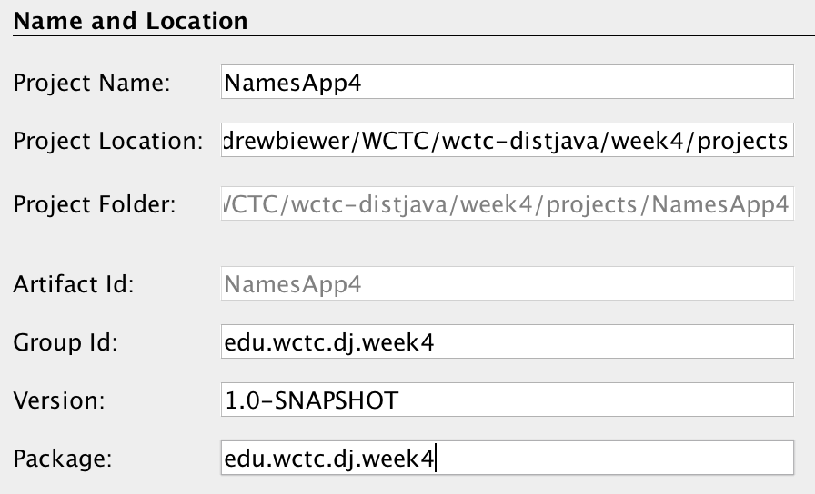
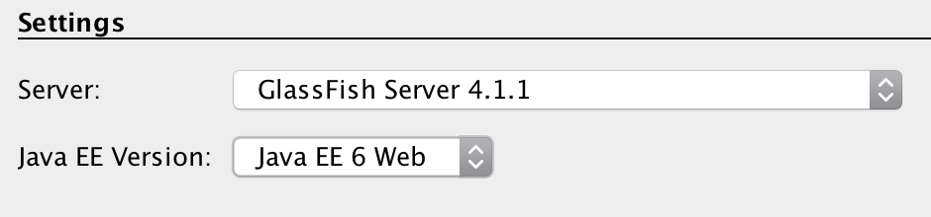
Maven
Call it NamesApp4 (for week 4)

Slide 7
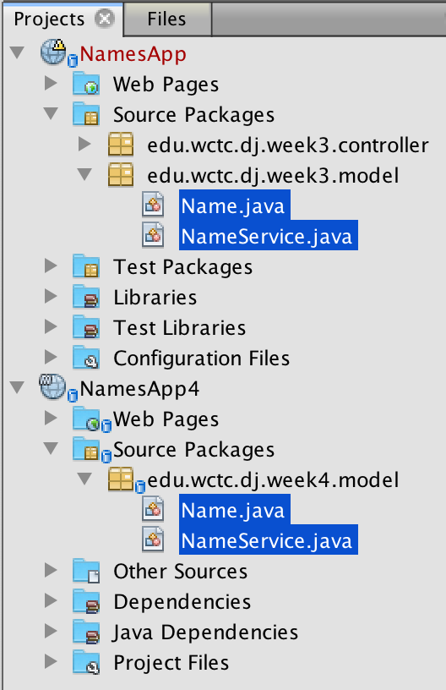
Maven
Copy model classes

Slide 8
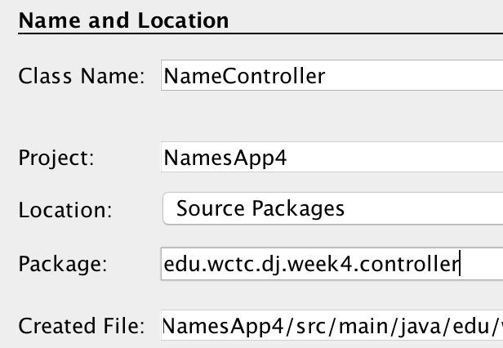
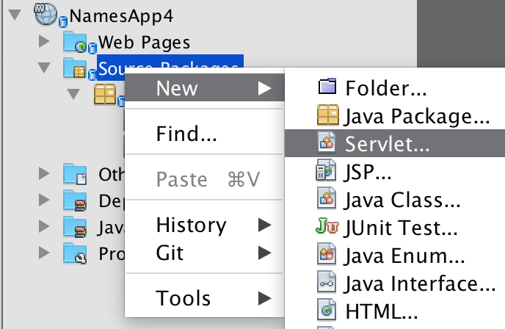
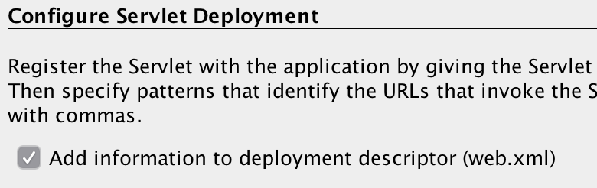
Maven
Recreate controller
Copy code from week 3 controller

Slide 9
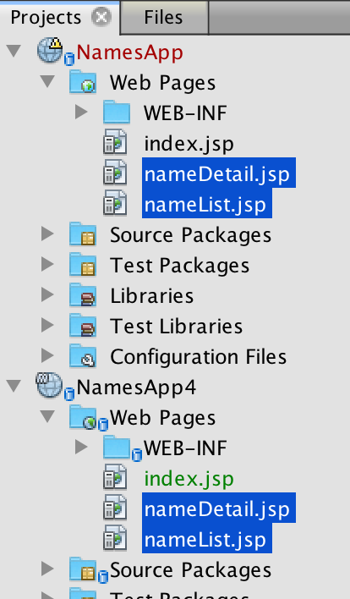
Maven
Copy over nameList.jsp and nameDetail.jsp

Slide 10
JSP Standard Tag Library
https://www.tutorialspoint.com/jsp/jsp_standard_tag_library.htm
Core tags
Formatting tags
JSTL functions
There are others but you don’t want to use them in the front end

Slide 11
JSTL Core
<%@ taglib prefix = "c" uri = "http://java.sun.com/jsp/jstl/core" %>
<c:out>
<c:set>
<c:remove>
<c:if>
<c:choose>
<c:when>
<c:otherwise>
<c:forEach>
<c:url>

Slide 12
JSTL Formatting
<%@ taglib prefix = "fmt" uri = "http://java.sun.com/jsp/jstl/fmt" %>
<fmt:formatNumber>
<fmt:formatDate>

Slide 13
JSTL Functions
<%@ taglib prefix = "fn"uri = "http://java.sun.com/jsp/jstl/functions" %>
fn:contains()
fn:endsWith()
etc…there’s a bunch

Slide 14
Expression Language (EL)
Variables and their methods can be accessed in an abbreviated format
Examples:
${nameList} == the entire list of names in the request
${name.first} == invokes the getFirst() method on the “name” object
${name.address.city} == invokes the getCity() method of the getAddress() method of the “name” object

Slide 15
Variable Scopes
Page
Local variables to the page only
Request
Parameters and attributes set by the controller
Session
These survive from page to page
We’ll learn about session state in a couple of weeks

Slide 16
Let’s use some JSTL
Summary list of tasks
Add JSTL libraries to project (Maven dependency)
Convert nameList.jsp to use JSTL tags
Add Address class to model
Add Address field to Name class
Convert nameDetail.jsp to use JSTL tags
The goal is to have zero embedded Java in your JSP

Slide 17
Add JSTL to Project
Maven dependency
<!-- https://mvnrepository.com/artifact/jstl/jstl --> <dependency> <groupId>jstl</groupId> <artifactId>jstl</artifactId> <version>1.2</version> </dependency>

Slide 18
Convert nameList.jsp to JSTL
Use <c:forEach> instead of embedded Java
<c:forEach var=“name” items=“${nameList}”>
Use <c:out> to print out name
<c:out value=“${name.first}”/>
etc…

Slide 19
Create Address model class
Address class with
Street
City
State
Zip
Add Address field to Name class
Getter/setter
Mock data in NameService

Slide 20
Convert nameDetail.jsp to JSTL
Use <c:out> to display name details
Use EL to output name and address

Slide 21
Project
Create a new week4 branch
Make sure you have committed everything beforehand
Convert your JSPs to use JSTL
You should have a list and detail page by now
Others including shopping cart page, payment information, shipping address
I want to see more pages for this week
You should be thinking about enhancing the model classes of your project
Things to consider (these are guidelines only)
Do you have a Product class yet?
Are there related products?
ShoppingCart class?
Customer class?
Consider creating a UML diagram to capture the classes and their relationships. This is only a suggestion but I find that creating a diagram helps me think through the problem
I want to see more classes in your model for this week

Slide 22
Next
Readings from book
Continue reading Chapters 5, 6, and 7

