Slide 1
Distributed Java
Week 9

Slide 2
Agenda
Interacting with Databases using JDBC
Project 7 - JDBC

Slide 3
Java Database Connectivity (JDBC)
Consistent interfaces
java.sql.Connection
java.sql.Statement
java.sql.ResultSet
Vendor-specific drivers
Oracle, MSSQL, MySQL, etc

Slide 4
Connection Pools
Enterprise Apps, such as Web Apps, utilize connection pools
Motivation: Connecting to databases is an "expensive" operation
Maintain a pool of connected database connections
When a connection is needed, grab one from the pool
When done with a connection, return it to the pool

Slide 5
DataSource
Java interface for obtaining a java.sql.Connection
Connection#close() returns a connection to the pool
We will use an API called JNDI (Java Naming and Directory Interface)
Setup a JDBC resource and connection pool
JDBC resource is named, such as jdbc/myNames
Use JNDI to lookup jdbc/myNames

Slide 6
How to Execute a Query using JDBC
Obtain a connection
Prepare a statement via the connection
For example: SELECT * FROM ADDRESS WHERE NAMEID = ?
Bind parameters, if required
Execute the statement and get a result set
Iterate over the result set to get the data
Close the result set, statement, and connection

Slide 7
Activity Agenda
Create week9 branch
Copy NamesApp8 to NamesApp9
Update project properties name and group id
Rename packages to week9
Setup a connection pool
Add the pool to the Glassfish server (i.e., not just the project)
Create a reference to the database in the web application
Create the classes to communicate with the database
Update the service to use the new classes

Slide 8
Copy NamesApp8 to NamesApp9
Project Properties, rename project, group id, etc
Rename packages from week8 to week9, etc

Slide 9
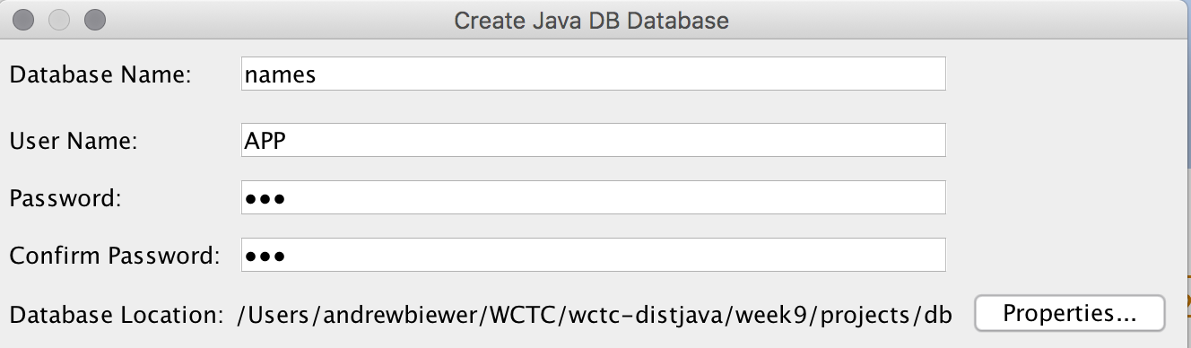
Create Names Database
In NetBeans, Services tab
Expand Databases
Right-click Java DB, Create Database…

Slide 10
Create Tables
create table name (
id varchar(5) primary key,
firstname varchar(50),
lastname varchar(50)
);
create table address (
id varchar(5) primary key,
nameid varchar(5),
street varchar(50),
city varchar(50),
state varchar(2),
zip varchar(5)
);

Slide 11
Insert Data into Tables
insert into name (id, firstname, lastname) values ('1', 'Joe', 'Smith');
insert into name (id, firstname, lastname) values ('2', 'Mary', 'Jones');
insert into address (id, nameid, street, city, state, zip)
values ('1', '1', '123 Main St', 'Springfield', 'WI', '54321');
insert into address (id, nameid, street, city, state, zip)
values ('2', '2', '456 Miller Blvd', 'Asheville', 'NC', '12345');

Slide 12
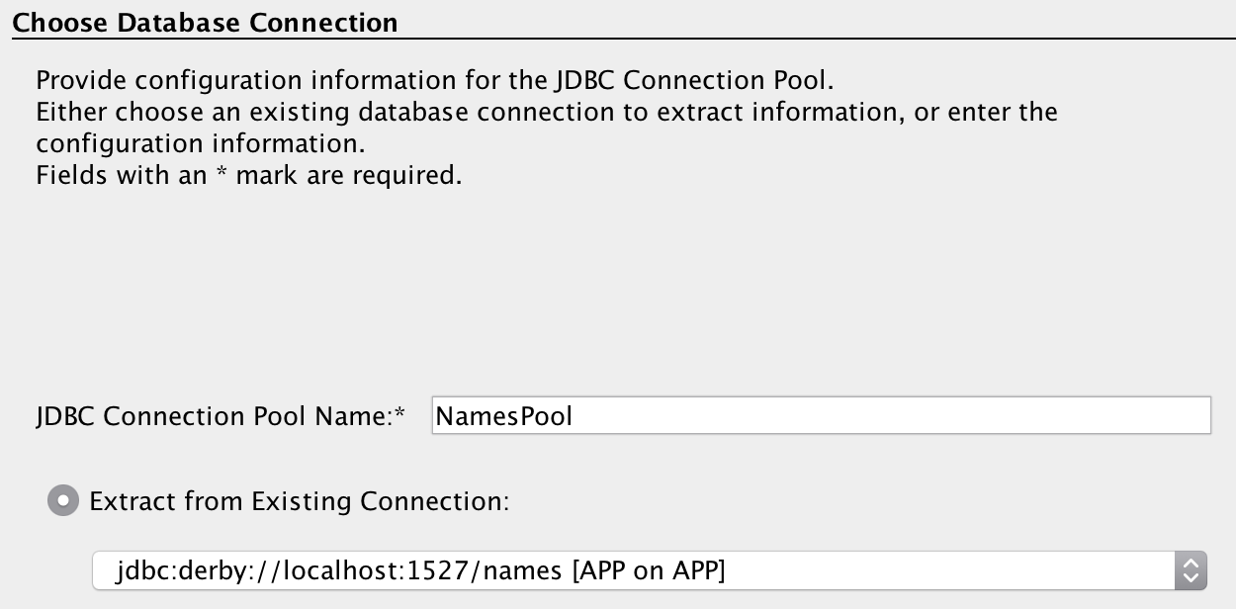
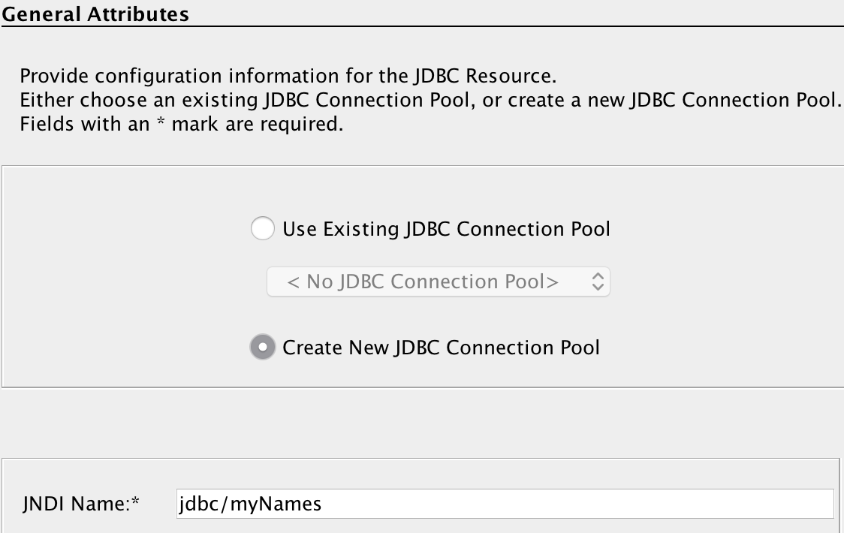
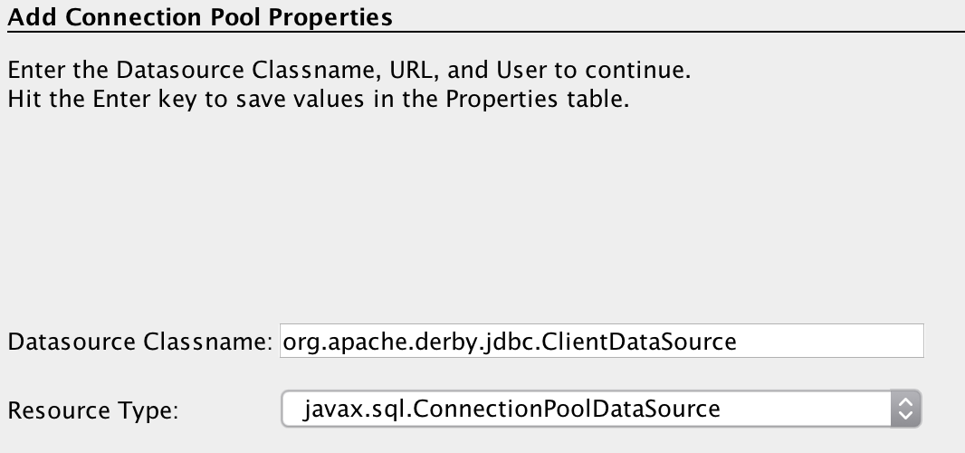
Create JDBC Resource and Connection Pool
Click New file
Glassfish → JDBC Resource

Slide 13
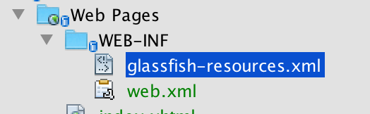
Add glassfish-web.xml to Glassfish
Open Glassfish admin console
Add glassfish-resources.xml to resources
Set user=APP
Set password=APP
Ping (test)
Remove glassfish-resources.xml from project

Slide 14
Add JDBC Resource to web.xml
Open web.xml
Under References tab, add JDBC reference
Click on Source tab and change javax.sql.DataSource to javax.sql.ConnectionPoolDataSource

Slide 15
Create ConnectionUtil Class
public static Connection getConnection() throws Exception {
Context initContext = new InitialContext();
Context webContext = (Context) initContext.lookup("java:comp/env");
DataSource ds = (DataSource) webContext.lookup("jdbc/myNames");
return ds.getConnection();
}
Test JNDI lookup

Slide 16
Create NameDAO and AddressDAO
NameDAO
public List<Name> getNames()
AddressDAO
public Address getAddress(Name name)

Slide 17
Update NameService to use DAOs

Slide 18
Project 7
Create a new week9 branch
Make sure you have committed everything beforehand
Implement JDBC in your application to retrieve products
Include the name of your database and the SQL script for creating your database

