Slide 1
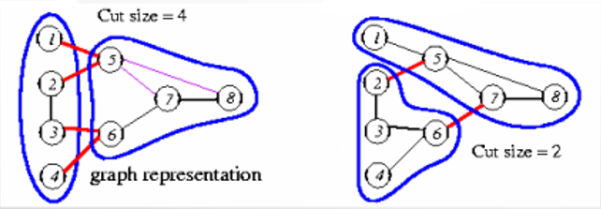
Two-way Partition
The two-way partitioning problem is to divide a set of numbers into two subsets. As a result of this dividing process, the sums of netcuts in the netlist must be as small as possible. The two-way number partitioning problem is NP-complete.

Slide 2
Fiduccia and Mattheyses Algorithm
Aims at reducing net-cut costs.
Only a single vertex is moved across the cut in a single move.
Can handle “unbalanced” partitions; a balance factor is introduced.
Time complexity O(P), where P is the total # of cells in Net.
Ref: Fiduccia, C. M. and Mattheyses, R. M. (1982). A linear time heuristic for improving network partitions. In In Proc. 19th IEEE Design Automation Conference, pages 175–181.

Slide 3
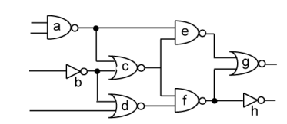
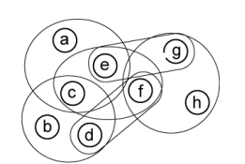
Example
Perform FM algorithm on the following circuit:
Area constraint = [3,5]

Slide 4
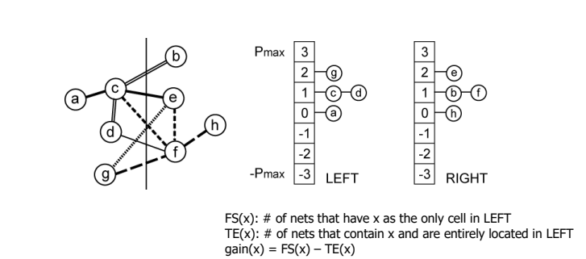
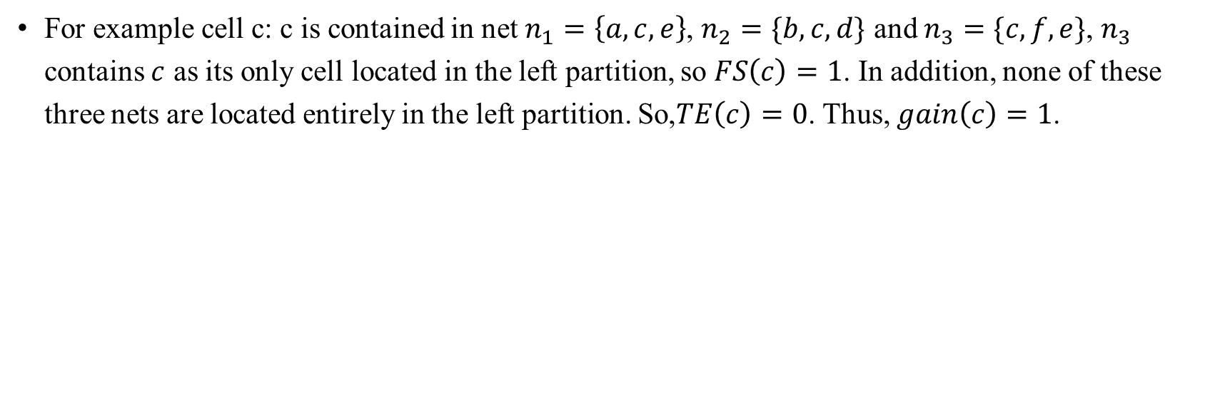
Computation and Bucket Set Up
For example cell c: c is contained in net $n_{1}=\left\{a,c,e\right\}$, $n_{2}=\{b,c,d\}$ and $n_{3}=\{c,f,e\}$, $n_{3}$ contains $c$ as its only cell located in the left partition, so $FS\left(c\right)=1$. In addition, none of these three nets are located entirely in the left partition. So,$TE\left(c\right)=0$. Thus, $gain\left(c\right)=1$.

Slide 5
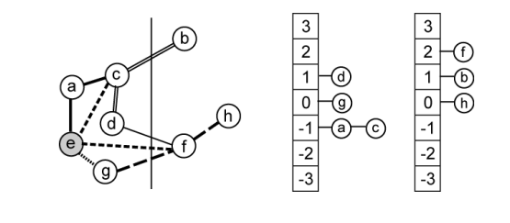
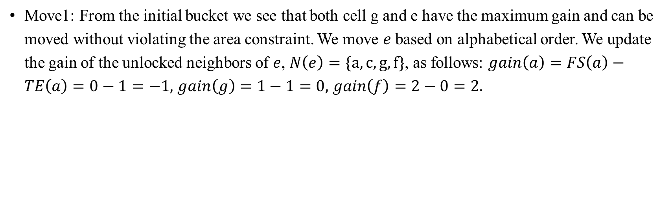
First Move
Move1: From the initial bucket we see that both cell g and e have the maximum gain and can be moved without violating the area constraint. We move $e$ based on alphabetical order. We update the gain of the unlocked neighbors of $e$, $N\left(e\right)=\{a,c,g,f\}$, as follows: $gain\left(a\right)=FS\left(a\right)−TE\left(a\right)=0−1=−1,$ $gain\left(g\right)=1−1=0,$ $gain\left(f\right)=2−0=2.$
Notes:
"Alphabetical order"（字母顺序）是指按照字母表中字母的顺序排列的方式。在英语字母表中，字母的顺序是从 A 到 Z。因此，按照字母顺序排列的单词列表将以 A 开头的单词排在最前面，以 Z 开头的单词排在最后面。这种排序方式是常见的，并且在许多不同的情况下被使用，包括字典、索引、文件目录等。

Slide 6
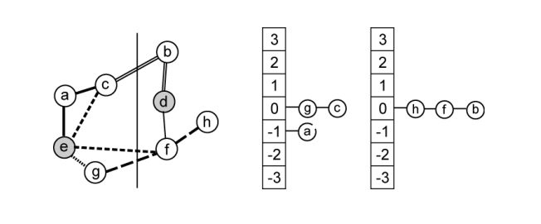
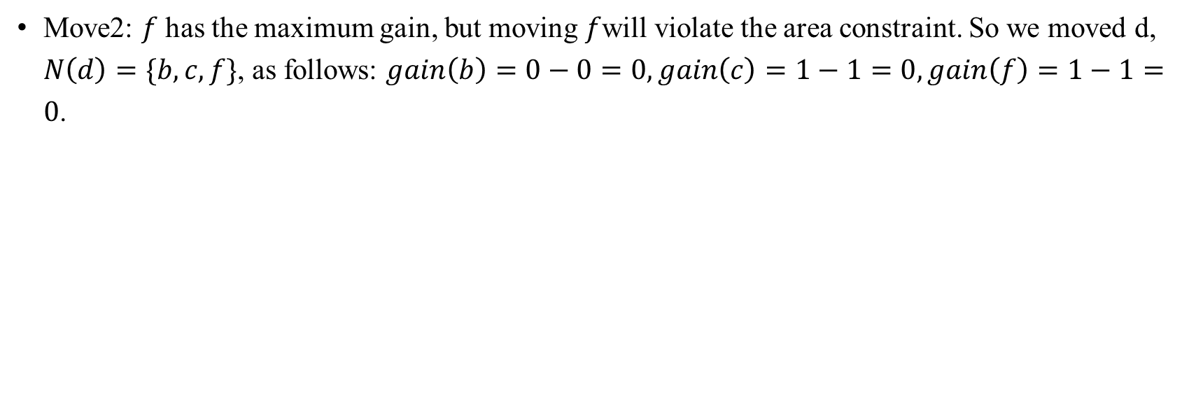
Second Move
Move2: $f$ has the maximum gain, but moving $f$will violate the area constraint. So we moved d, $N\left(d\right)=\{b,c,f\}$, as follows: $gain\left(b\right)=0−0=0,gain\left(c\right)=1−1=0,gain\left(f\right)=1−1=0$.
Notes:
"Alphabetical order"（字母顺序）是指按照字母表中字母的顺序排列的方式。在英语字母表中，字母的顺序是从 A 到 Z。因此，按照字母顺序排列的单词列表将以 A 开头的单词排在最前面，以 Z 开头的单词排在最后面。这种排序方式是常见的，并且在许多不同的情况下被使用，包括字典、索引、文件目录等。

Slide 7
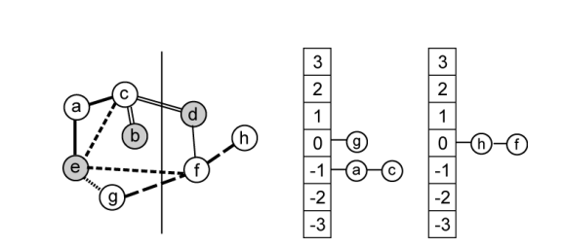
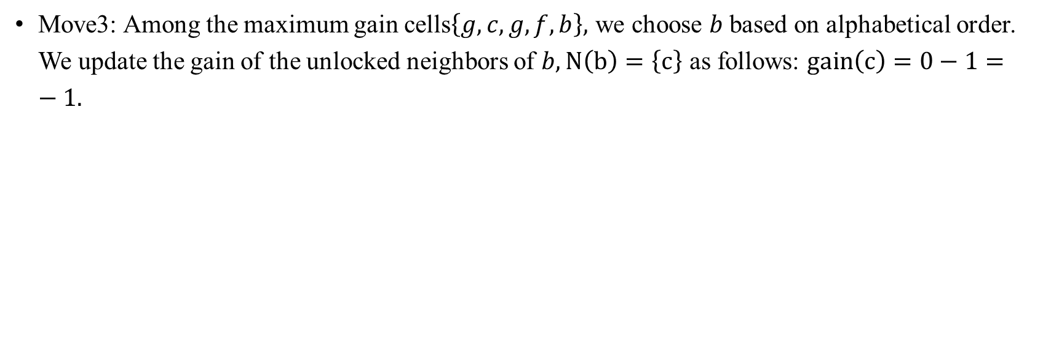
Third Move
Move3: Among the maximum gain cells$\left\{g,c,g,f,b\right\},$ we choose $b$ based on alphabetical order. We update the gain of the unlocked neighbors of $b,N\left(b\right)=\left\{c\right\}$ as follows: $gain\left(c\right)=0−1=−1.$
Notes:
"Alphabetical order"（字母顺序）是指按照字母表中字母的顺序排列的方式。在英语字母表中，字母的顺序是从 A 到 Z。因此，按照字母顺序排列的单词列表将以 A 开头的单词排在最前面，以 Z 开头的单词排在最后面。这种排序方式是常见的，并且在许多不同的情况下被使用，包括字典、索引、文件目录等。

Slide 8
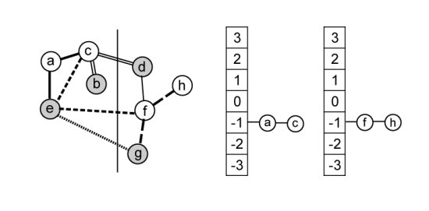
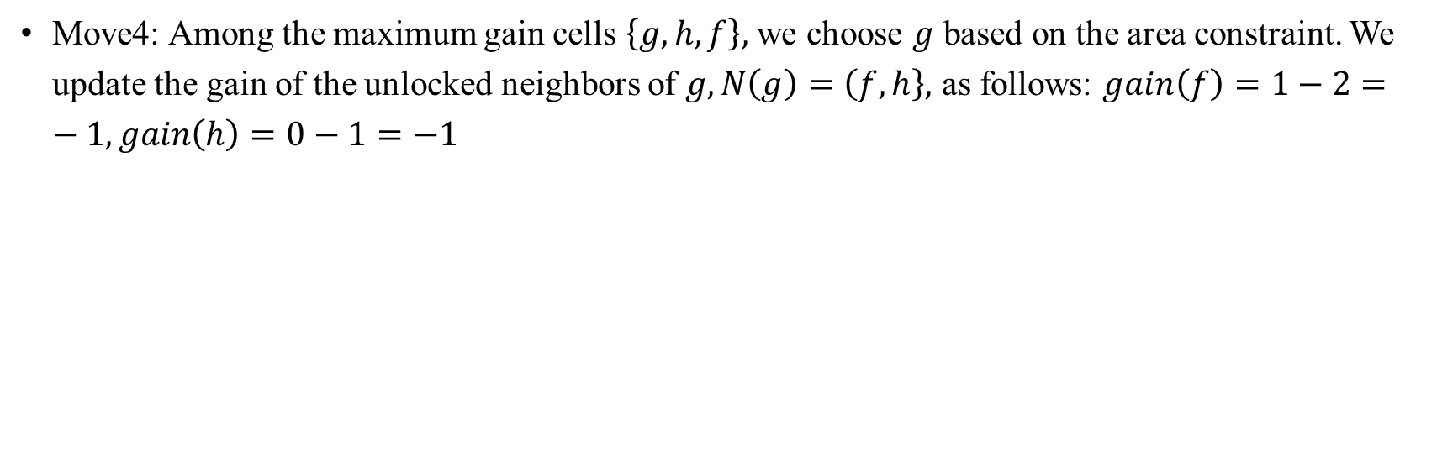
Fourth Move
Move4: Among the maximum gain cells $\left\{g,h,f\right\},$ we choose $g$ based on the area constraint. We update the gain of the unlocked neighbors of $g,N\left(g\right)=\left(f,h\right\},$ as follows: $gain\left(f\right)=1−2=−1,gain\left(h\right)=0−1=−1$
Notes:
"Alphabetical order"（字母顺序）是指按照字母表中字母的顺序排列的方式。在英语字母表中，字母的顺序是从 A 到 Z。因此，按照字母顺序排列的单词列表将以 A 开头的单词排在最前面，以 Z 开头的单词排在最后面。这种排序方式是常见的，并且在许多不同的情况下被使用，包括字典、索引、文件目录等。

Slide 9
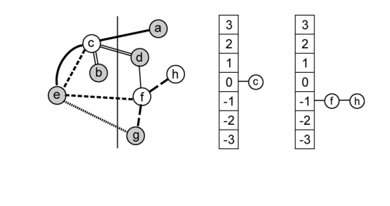
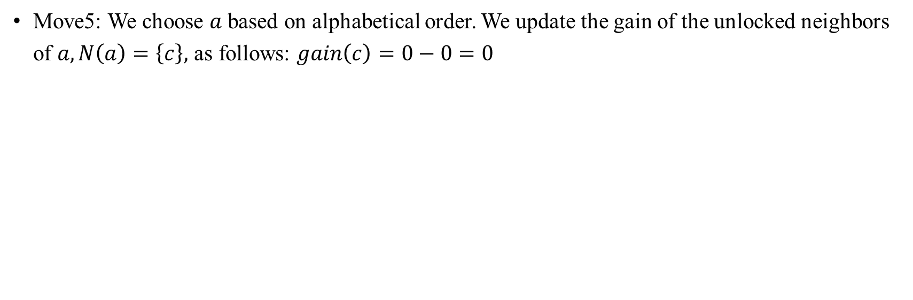
Fifth Move
Move5: We choose $a$ based on alphabetical order. We update the gain of the unlocked neighbors of $a,N\left(a\right)=\left\{c\right\},$ as follows: $gain\left(c\right)=0−0=0$
Notes:
"Alphabetical order"（字母顺序）是指按照字母表中字母的顺序排列的方式。在英语字母表中，字母的顺序是从 A 到 Z。因此，按照字母顺序排列的单词列表将以 A 开头的单词排在最前面，以 Z 开头的单词排在最后面。这种排序方式是常见的，并且在许多不同的情况下被使用，包括字典、索引、文件目录等。

Slide 10
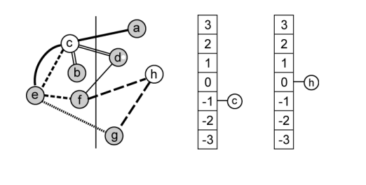
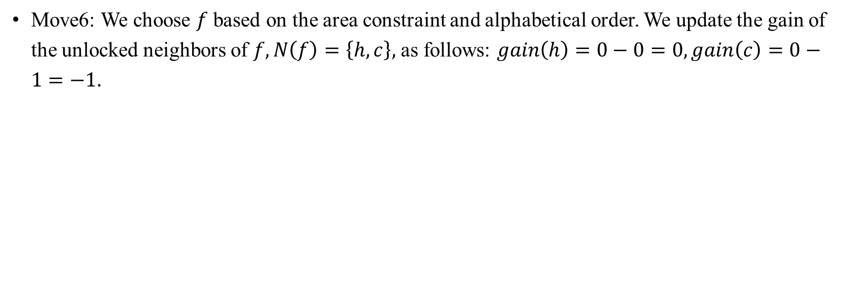
Sixth Move
Move6: We choose $f$ based on the area constraint and alphabetical order. We update the gain of the unlocked neighbors of $f,N\left(f\right)=\left\{h,c\right\},$ as follows: $gain\left(h\right)=0−0=0,gain\left(c\right)=0−1=−1.$
Notes:
"Alphabetical order"（字母顺序）是指按照字母表中字母的顺序排列的方式。在英语字母表中，字母的顺序是从 A 到 Z。因此，按照字母顺序排列的单词列表将以 A 开头的单词排在最前面，以 Z 开头的单词排在最后面。这种排序方式是常见的，并且在许多不同的情况下被使用，包括字典、索引、文件目录等。

Slide 11
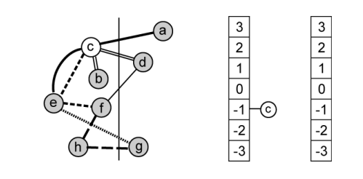
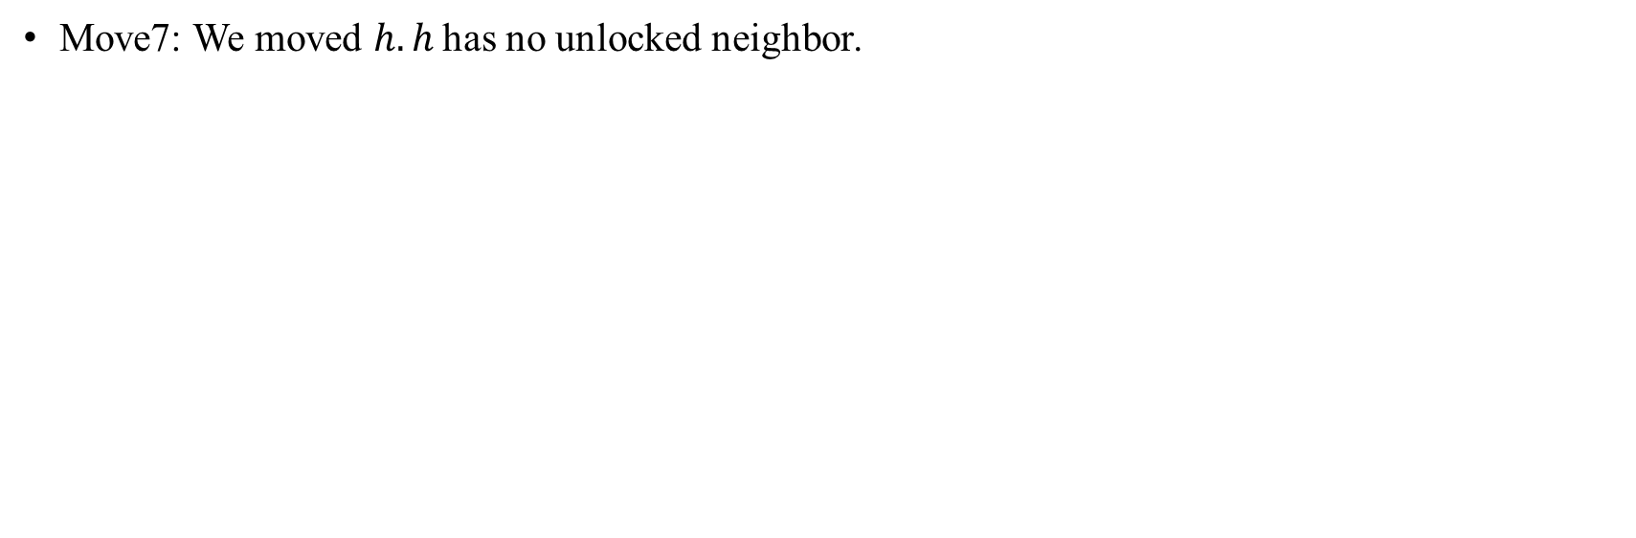
Seventh Move
Move7: We moved $h. h$has no unlocked neighbor.
Notes:
"Alphabetical order"（字母顺序）是指按照字母表中字母的顺序排列的方式。在英语字母表中，字母的顺序是从 A 到 Z。因此，按照字母顺序排列的单词列表将以 A 开头的单词排在最前面，以 Z 开头的单词排在最后面。这种排序方式是常见的，并且在许多不同的情况下被使用，包括字典、索引、文件目录等。

Slide 12
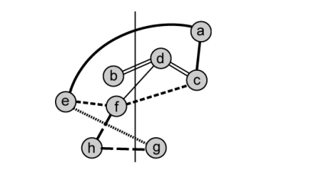
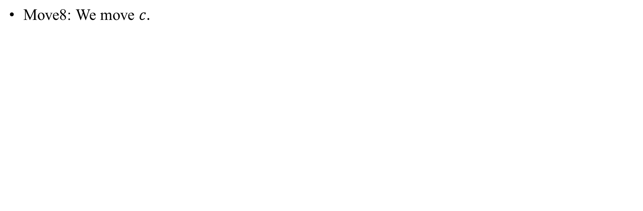
Last Move
Move8: We move $c.$
Notes:
"Alphabetical order"（字母顺序）是指按照字母表中字母的顺序排列的方式。在英语字母表中，字母的顺序是从 A 到 Z。因此，按照字母顺序排列的单词列表将以 A 开头的单词排在最前面，以 Z 开头的单词排在最后面。这种排序方式是常见的，并且在许多不同的情况下被使用，包括字典、索引、文件目录等。

Slide 13
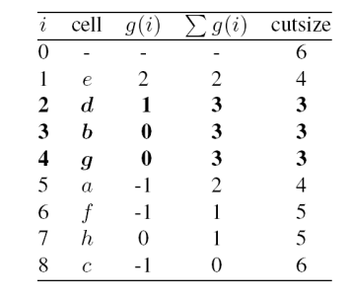

Summary
Found three best solutions
CutSize reduced from 6 to 3$.$
Solutions after moved 2 and 4 are better balanced.
Notes:
"Alphabetical order"（字母顺序）是指按照字母表中字母的顺序排列的方式。在英语字母表中，字母的顺序是从 A 到 Z。因此，按照字母顺序排列的单词列表将以 A 开头的单词排在最前面，以 Z 开头的单词排在最后面。这种排序方式是常见的，并且在许多不同的情况下被使用，包括字典、索引、文件目录等。

Slide 14
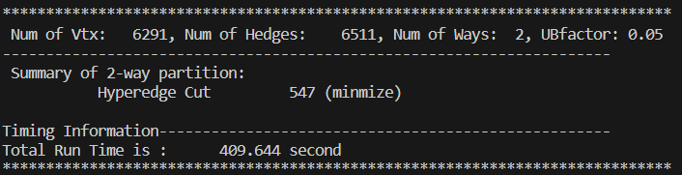
Question
If the num of netlist is large, the FM Algorithm will not be efficient.
If the num of netlist is large, the result cut will be very large.

Slide 15
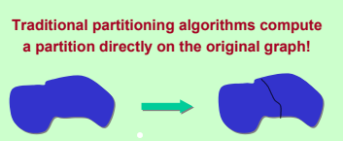
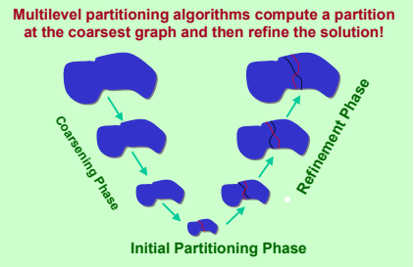
V-Cycle Architecture
These algorithms are often too slow and/or produce poor quality partitions
These algorithms reduce the size of the graph (or hypergraph) by collapsing vertices and edges (during the coarsening phase), partition the smaller graph (initial partitioning phase), and then uncoarsen it to construct a partition for the original graph.

Slide 16
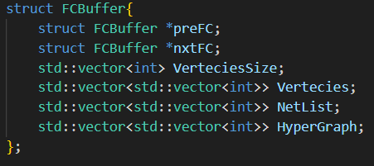
Coarsening Phase
Reduce netlist size
Reduce vertex size
Special data structure

Slide 17
Coarsening Phase Parameter
K : How many ways?
C : Last coarsening when the number of vertices is less than c*k
factor : When the reduced number of vertex is factor times less than the original one, the coarsening ends this time.
RATIO : When the number of cells in the net is less than RATIO, the weight can be added. The purpose is to first exclude some nets with a large number of cells in the net.
RATIOACCELERATOR : The amount of increase in ratio at the end of each coarsening

Slide 18
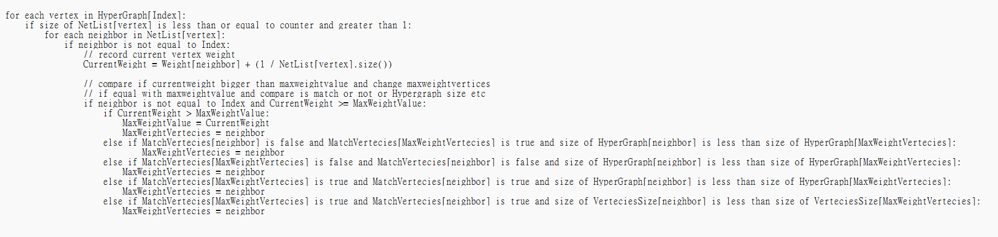
First Choice
Notes:
再來就要介紹我們使用的Coarsing的方式

Slide 19
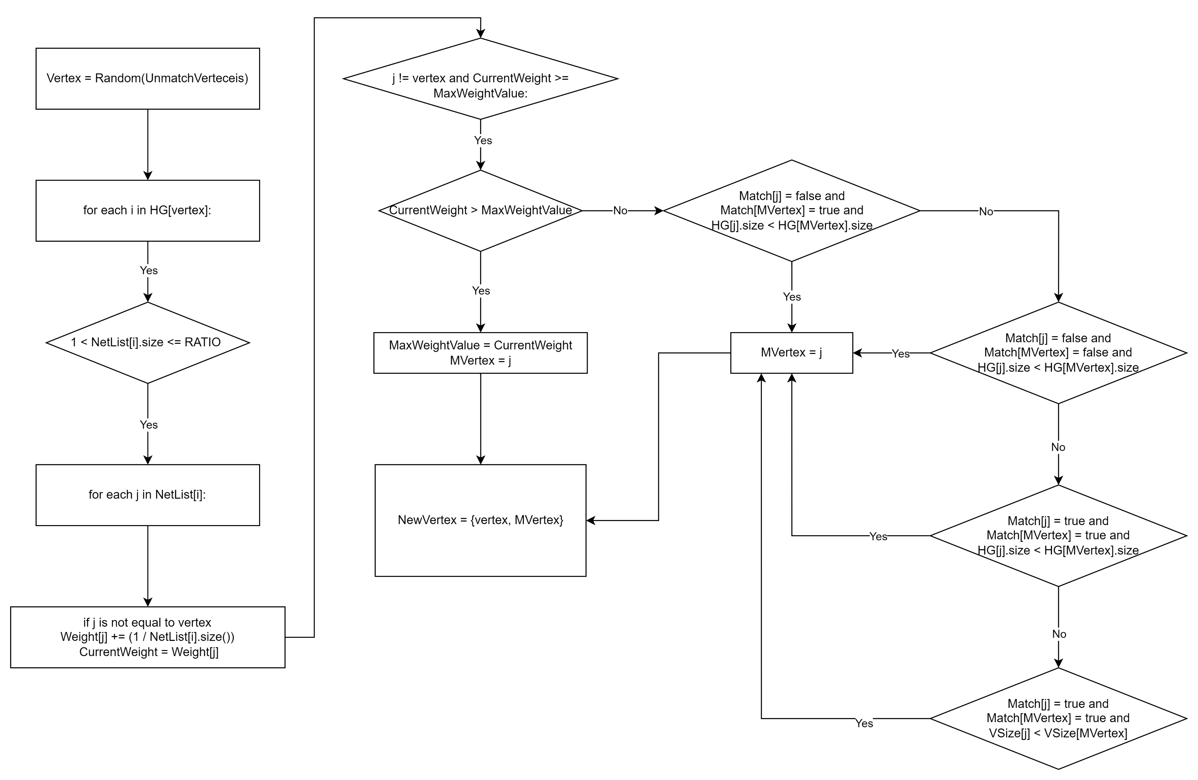
Notes:
再來就要介紹我們使用的Coarsing的方式

Slide 20
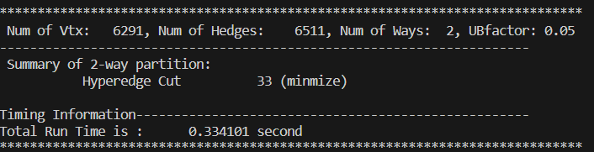
Result with V-cycle
The number of vertices is 6291, the number of hyperedges (netlist) is 6511, and UBfactor represents the balance factor. This implies that one set of vertices contains 45% of the total number of vertices, while the other set contains 55% of the total number of vertices.

Slide 21
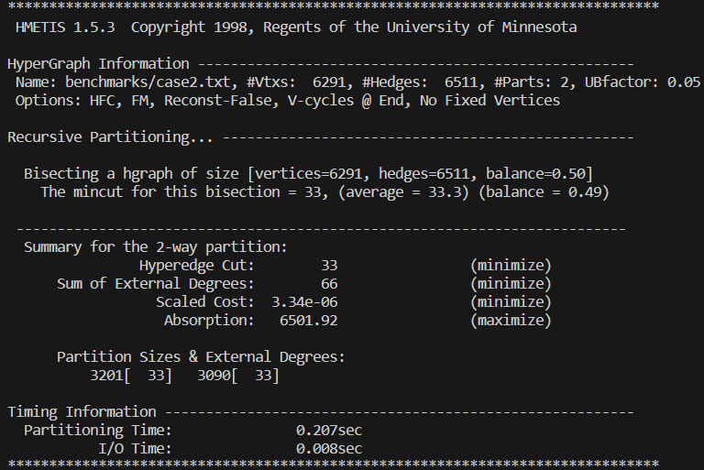
Compare with HMETIS
I get same result with HMETIS,HMETIS is the popular partition tools in the world.

Slide 22
Thank you for your time
劉必凡

