Slide 1
Analytics Project Symposium - Fall 2016
Analytics Project: Analysis of road accidents in NYC and their contributing factors
Team: Girish Ganesh Prabhu (ggp234)
Rahul Ramesh Kumar (rrk310)
Abstract: In this paper we have developed an analytic that aims to extract valuable information about road accidents and its co-relation with external factors such as street conditions, vehicle types, seasons etc. We do this by applying a K-mode clustering algorithm followed by Association rule mining thereby achieving as much accuracy as possible from the data set without making any assumptions about the size of the data.

Slide 2
Analysis of road accidents in NYC and their contributing factors
Motivation
Who are the users of this analytic?
NYS DOT and NYC Road Safety Department
Who will benefit from this analytic? Drivers/Pedestrians
Why is this analytic important?
There are a number of accidents in NYC whose reasons are not properly accounted for. In this analytic, we aim to provide an accurate description for the reason that attributed to the accidents so that it can be used further to improve the road safety conditions and bring safety awareness to people.

Slide 3
Analysis of road accidents in NYC and their contributing factors
Goodness
What steps were taken to assess the ‘goodness’ of the analytic?
The input data was taken from NYC OpenData – NYPD Motor Vehicle collisions.
Appropriate data cleaning measures were taken to preserve the originality of data.
The big data tools used to developed the analytic are highly scalable and fault tolerant.
The intermediate results obtained after K-mode clustering showed distinct results which is required to make a strong analytic .
The final rules were obtained by using a very high confidence of 80% thereby providing accurate results.

Slide 4
Analysis of road accidents in NYC and their contributing factors
Data Sources
Name: NYPD Motor Vehicle Collision Data
Description: Data source contains date time, location, vehicles involved and the factors involving the accident. It also contains extra information just as street name, zip code, fatalities/injuries etc.
Size of data: 11 MB
Name: NYC Street Assessment Rating
Description: Data source contains the geometry, length, width of the various streets in NYC. The rating of each street is mentioned in this dataset along with the date of the assessment. Size of data: 6 MB

Slide 5
Analysis of road accidents in NYC and their contributing factors
Design Diagram
Next Slide
Platform(s) on which the analytic ran:
Quickstart Cloudera VM and NYU HPC cluster

Slide 6
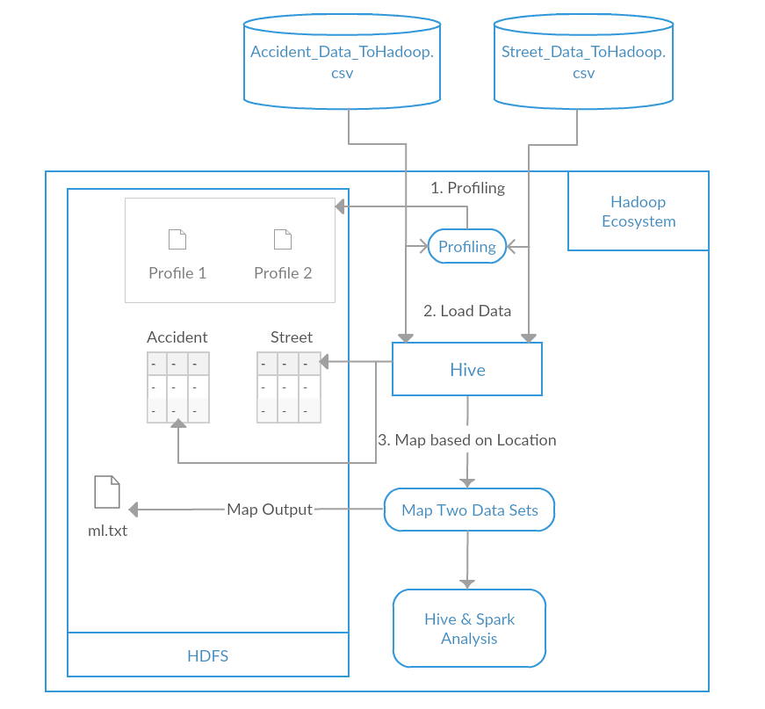
Analysis of road accidents in NYC and their contributing factors

Slide 7
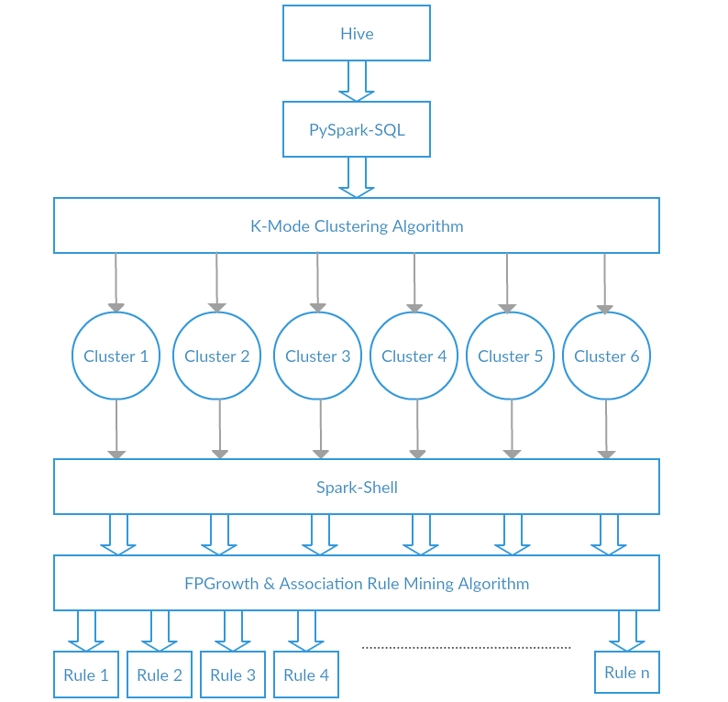
Analysis of road accidents in NYC and their contributing factors

Slide 8
Analysis of road accidents in NYC and their contributing factors
Results
Top 5 Reasons for accidents are Driver inattention, Other Vehicular, Failure to yield right-of-way, Fatigue and Lost consciousness.
2. Evenings => [Fair, Queens, Summer] ,
Manhattan => [Passenger Vehicle, Winter, Good]
Sport utility/ Station Wagons => [ Queens, Fall, Morning]
3. Brooklyn => [Fair, Fall, Driver inattention]
Good => [Brooklyn, Passenger Vehicle, Morning]

Slide 9
Analysis of road accidents in NYC and their contributing factors
Obstacles
1. Determining if a particular accident occurred in a street required us to understand the Geographic Coordinate System which took some time to implement and verify the results.
2. The Location mapping of accident data set to the Street data set required large computational time hence we removed irrelevant rows that did not contribute to the MLlib Rule mining algorithm.

Slide 10
Analysis of road accidents in NYC and their contributing factors
Summary
We have demonstrated how an analytic can be implemented using heterogeneous data. The results have been carefully assessed and we have performed various iterations to provide the final results. The tools used to develop the analytic are Hadoop, Hive, Spark, MLlib which are highly recognized in the Big data open source world.
Acknowledgements
We thank Professor Suzanne McIntosh for introducing us to the various big data tools and providing valuable feedback and advice during the course of our project.
We would also like to thank NYU HPC for providing the Dumbo cluster for performing computation of our Analytic.

Slide 11
Analysis of road accidents in NYC and their contributing factors
References
A data mining framework to analyze road accident data, 2015
A data mining approach to identify key factors of traffic injury severity, 2010
Big Data Analytics and Visualization with Spatio-Temporal Correlations for Traffic Accidents
Using logistic regression to estimate the influence of accident factors on accident severity
Spark: Cluster Computing with Working Sets
Resilient Distributed Datasets: A Fault-Tolerant Abstraction for In-Memory Cluster Computing
Apache Hive. http://hadoop.apache.org/hive.

Slide 12
Analysis of road accidents in NYC and their contributing factors
Thank you!

