Slide 1
gradient
Hessian

Slide 2

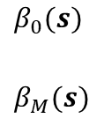




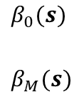



Functional effects with GBDTs
Functional effects with DNNs
$$s_{1}$$
$$s_{Q}$$
$$β_{0}(s)$$
$$β_{M}(s)$$
$$s_{1}$$
$$s_{Q}$$
$$β_{0}(s)$$
$$β_{M}(s)$$
Functional effects models
Functional slopes
no, with non-linearities
no, without non-linearities
yes
$$V=β_{0}+\sum_{m=1}^{M}{{f_{m}(x}_{m})}$$
$$V=β_{0}+\sum_{m=1}^{M}{{β_{m}x}_{m}}$$
$$V=β_{0}+\sum_{m=1}^{M}{{β_{m}(s)x}_{m}}$$
no
Functional intercept
yes
$$V=β_{0}(s)+\sum_{m=1}^{M}{f_{m}(x_{m})}$$
$$V=β_{0}(s)+\sum_{m=1}^{M}{{β_{m}x}_{m}}$$
$$V=β_{0}(s)+\sum_{m=1}^{M}{{β_{m}(s)x}_{m}}$$

Slide 3
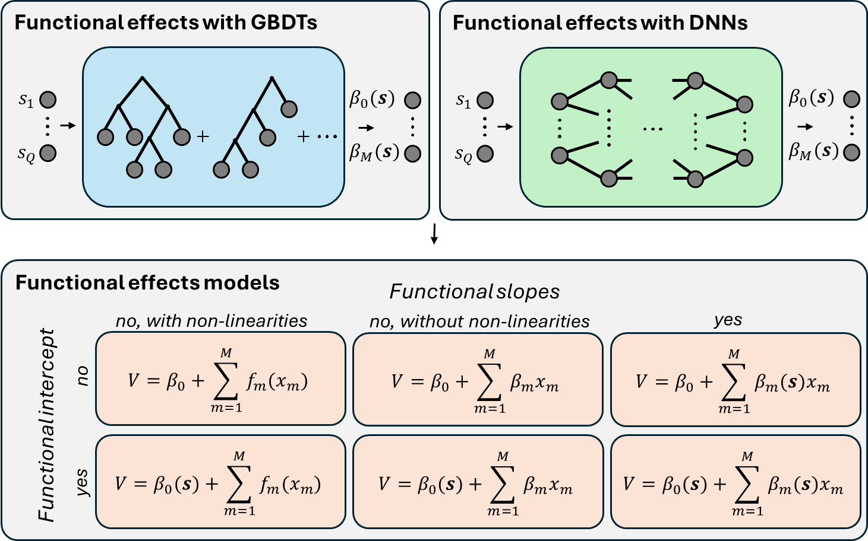

Slide 4

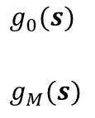



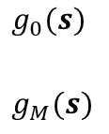


Functional effects with GBDTs
Functional effects with DNNs
$$s_{1}$$
$$s_{Q}$$
$$g_{0}(s)$$
$$g_{M}(s)$$
$$s_{1}$$
$$s_{Q}$$
$$g_{0}(s)$$
$$g_{M}(s)$$
Functional effects models
Functional slopes
no, with linear coefficients
no, with non-linear coefficients
yes
$$V=α_{0}+\sum_{m=1}^{M}{{β_{m}x}_{m}}$$
$$V=α_{0}+\sum_{m=1}^{M}{{f_{m}(x}_{m})}$$
$$V=α_{0}+\sum_{m=1}^{M}{{g_{m}(s)x}_{m}}$$
i)
ii)
iii)
no
Functional intercept
$$V=g_{0}(s)+\sum_{m=1}^{M}{{β_{m}x}_{m}}$$
v)
vi)
yes
iv)
$$V=g_{0}(s)+\sum_{m=1}^{M}{f_{m}(x_{m})}$$
$$V=g_{0}(s)+\sum_{m=1}^{M}{{g_{m}(s)x}_{m}}$$

Slide 5
