Slide 1
gradient
Hessian

Slide 2


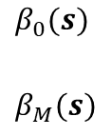





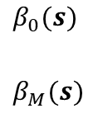





Functional effects with GBDT
Functional effects with DNNs
$$s_{1}$$
$$s_{Q}$$
$$β_{0}(s)$$
$$β_{M}(s)$$
$$s_{1}$$
$$s_{Q}$$
$$β_{0}(s)$$
$$β_{M}(s)$$
Models
$$Functional slopes$$
$$no$$
$$yes$$
$$V=β_{0}+\sum_{m=1}^{M}{{β_{m}x}_{m}}$$
$$V=β_{0}+\sum_{m=1}^{M}{{β_{m}(s)x}_{m}}$$
$$no$$
$$Functional intercept$$
$$yes$$
$$V=β_{0}(s)+\sum_{m=1}^{M}{{β_{m}x}_{m}}$$
$$V=β_{0}(s)+\sum_{m=1}^{M}{{β_{m}(s)x}_{m}}$$

Slide 3
