Slide 1
Doodle
Generation
Ishaan Singh, Aditya Ashvin, Steven Lu, Abhigyan Singh

Slide 2
The problem statement and why?
Why do we want to work on this?
This model will help children learn to draw common things like birds, vehicles, fruits.
Snapping ink to shapes for drawing apps.
This project topic gives us a chance to explore transformers, RNNs and see how sequential generation models work.
Build an assistive teaching model that can perform the following tasks:
Given a label, and an incomplete sketch of the label, suggest a continuation of that drawing, so that the final image looks like that label.
Given a sketch, predict what the sketch looks like and how far away it is from the label.

Slide 3
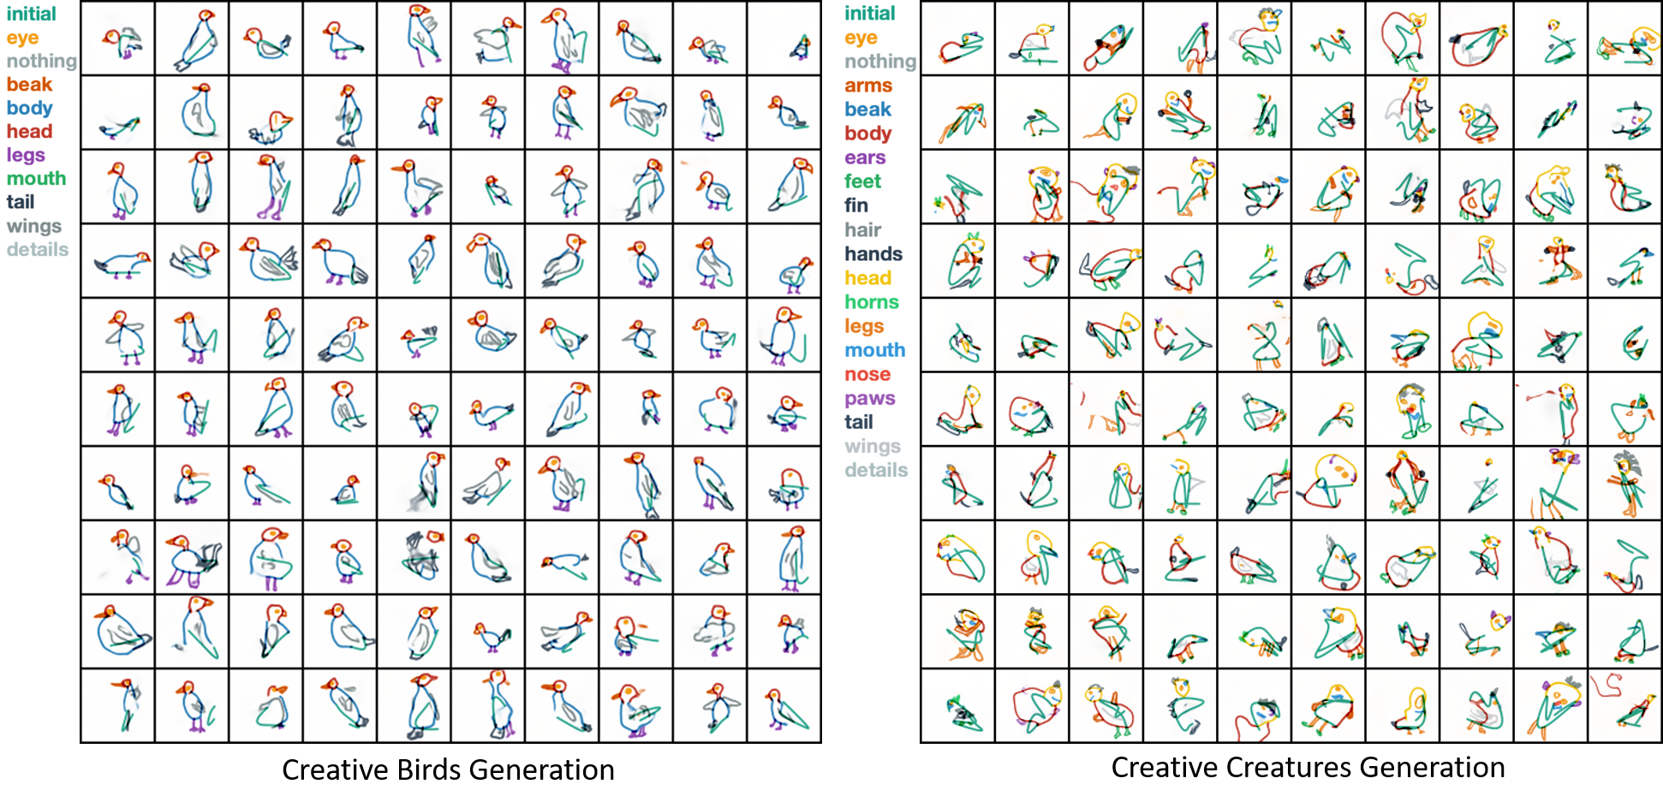
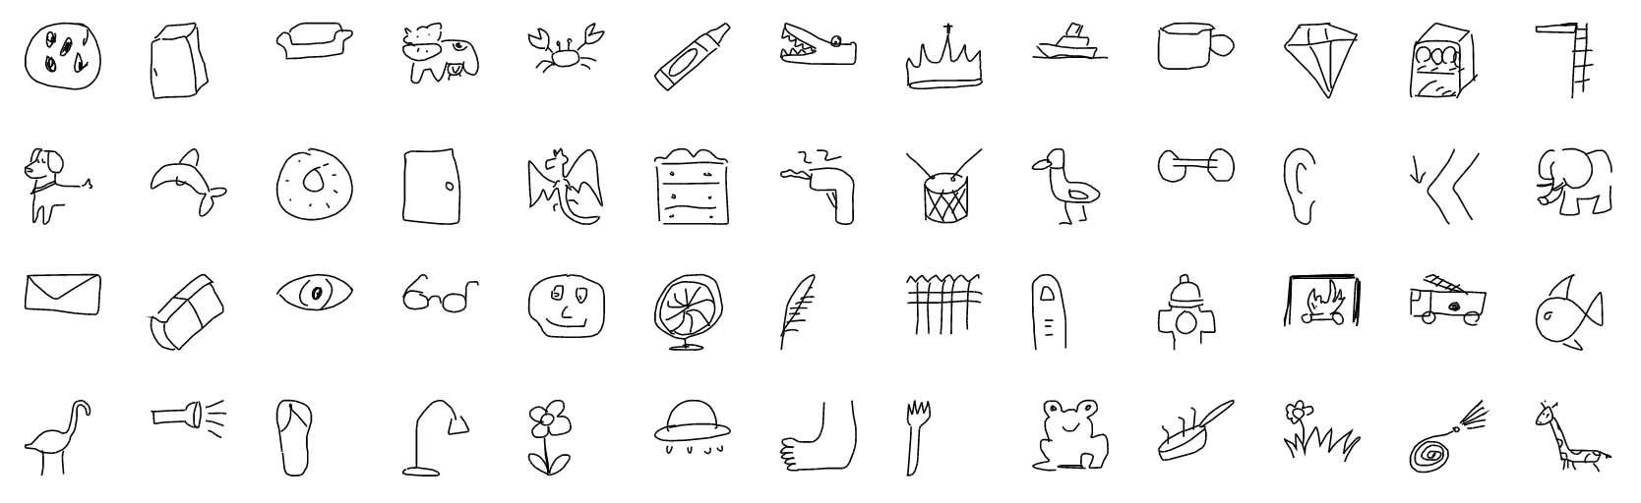
Datasets we will be using
Google Quickdraw - Bucket
Quick! Draw - GitHub
Facebook Doodler GAN

Slide 4
Algorithms we will try
Neural networks with any of the following architectures (may use multiple for comparisons):
[Question for mentor] Transformers or (and) CNN for the encoding task
NN (CNN / Transformer based) for the classification task
RNN/GAN for the sketch generator model
Encoder RNN / CNN
Latent Space Vector
Decoder RNN
Output Continuation Sequence
Input Doodle Sequence
Classification of input doodle
Output Class Probabilities

Slide 5
Experiments and analysis we will run
Encoding Task:
Understand the effect of changing pooling and number of hidden layers, activation functions, and regularization on the model’s performance on the classification task.
Understand the effect of learning rate and various optimization techniques.
Classification Task - performance evaluation using accuracy and loss metrics:
This task is a multiclass classification problem.
Cross entropy between the predicted probability distribution and the true label is a useful loss function.
Sketch Generation Task:
Compare the performance with already existing GAN sketch generator (benchmark).
Experiment with different model architectures to see which one best fits our goal.
[Question for mentor] How do we evaluate our gen model?

Slide 6
Plan until midterm report
Prepare the dataset for the task.
Decide and finalize the datasets we will use.
Compile the final dataset for our tasks.
Complete the sketch classification (recognition) task.
Complete training of the sketch classification model on the dataset.
Have a working classification model that can classify and give an output based on the input image.
Have 1 or more iterations of a working RNN model with appropriate encoders, for sketch generation.

Slide 7
2 Baselines

Slide 8
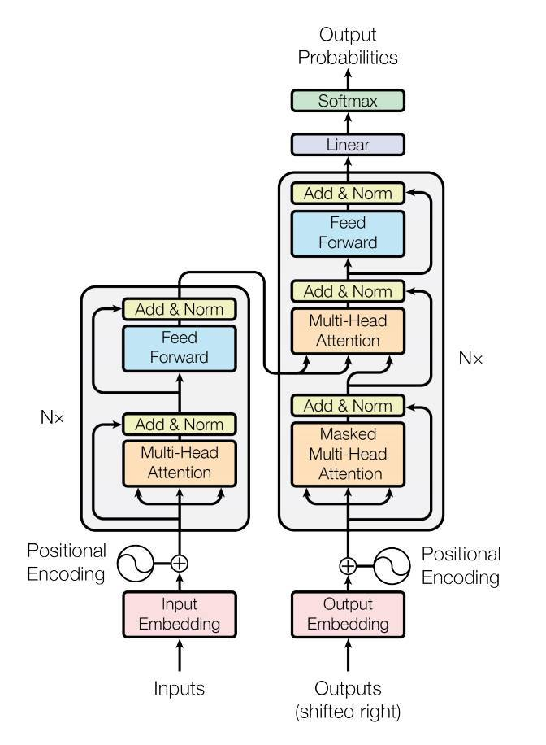
Objective of the
Baseline
To justify the complexity of the required model.
To play with the dataset structure.
To semantically fit the dataset into the model.
Understand dimensionality of the input, output and hidden states involved.
To build all required util functions before diving into the complex model.

Slide 9
The Dataset
Dataset
Doodle
Stroke
…
…
…
x₁
y₁
x₂
y₂
x_{n}
y_{n}

Slide 10
Challenges

Slide 11
Challenges Faced and Solutions
Pre-processing data for Baseline Model was time-consuming. We had to make decisions regarding the input shape, the training process and the expected output of our model.
Converted Doodle<Stroke<x[], y[], timestamp[]>[]>[] into Doodle<Stroke<Coordinate<x, y>[]>[]>[]
Decided to drop the timestamp information as it is not relevant to our project.
Baseline Model did not show loss reductions per epoch. It justified that we needed a more complex model to learn the structure of our data, however, for a very long time, we did not have a running model and only analyzed our failures.
Colab does not inherently support user input within the notebook. This makes human evaluation very difficult, without HTML embedding, which took time to write.

Slide 12
Preliminary Analysis

Slide 13
Learnings from the Baseline
The objective function used is MSE, along with (upto):
8 attention heads
6 encoding and decoding layers
512 dimensional feature space
Just a linear deep model does not work as position data is essential. It is similar to the case study presented in the lecture, where training a vanilla NN on image data is the same as training the model on noisy images, as it does not understand locality. Hence, attention is what we need, indeed!
Just positional encoding does not work as it does not seem to learn the structure of our data, even though our data implicitly stores [x,y] coordinates for every stroke.
This analysis concludes that we need an RNN/CNN component along with the transformer encoder-decoder to learn on our dataset of doodles so that the model can capture the structure as well as locality (attention) when it comes to drawing strokes.
Demo

Slide 14
Towards the Goal

Slide 15
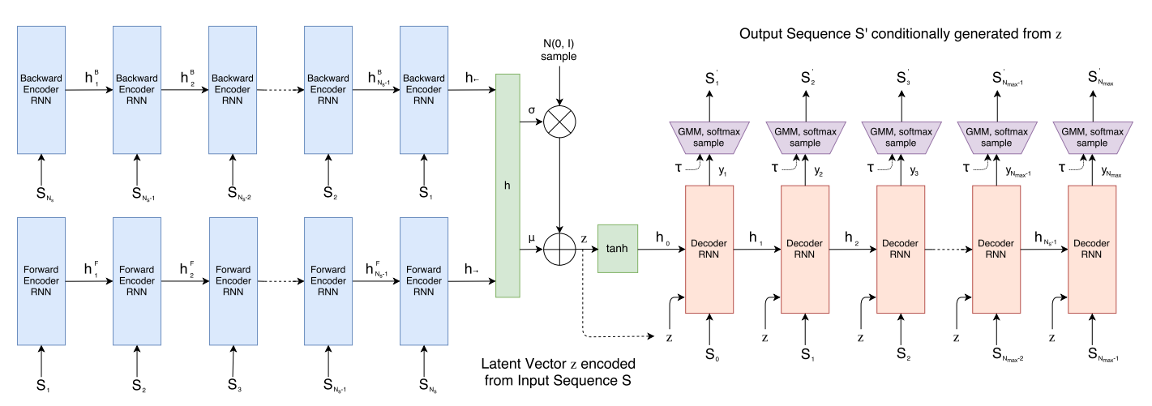
The new SketchRNN Model
Demo

Slide 16
Results and Analysis

Slide 17
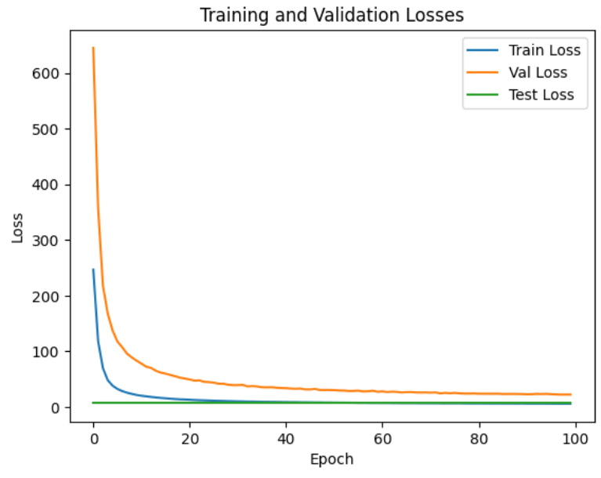
Observations
Loss curves are as expected for MSELoss over 100 epochs.
The dataset has:
train data: 86760
test data: 12050
val data: 21690
We were not able to run the model to the point of overfitting (time).

Slide 18
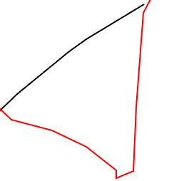
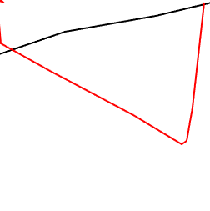
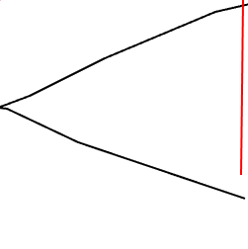
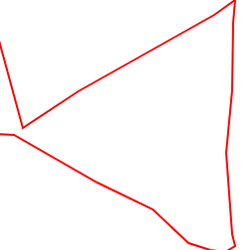
Observations
The model performs well with 0-stroke inputs as well, generating triangles in a single stroke.

Slide 19
Final Report

Slide 20
Plans Until End of Sem
Maximize performance out of the Sketch RNN model, and prepare it for evaluation against an objective metric rather than human evaluation.
Ability to generate more than 1 stroke, per test case.
Implement some evaluation metrics like GAN (discriminator model) - a novelty to the Google paper.
Perform hyperparameter tuning using the validation set, instead of working with heuristics.

Slide 21
Thank you

