Slide 1
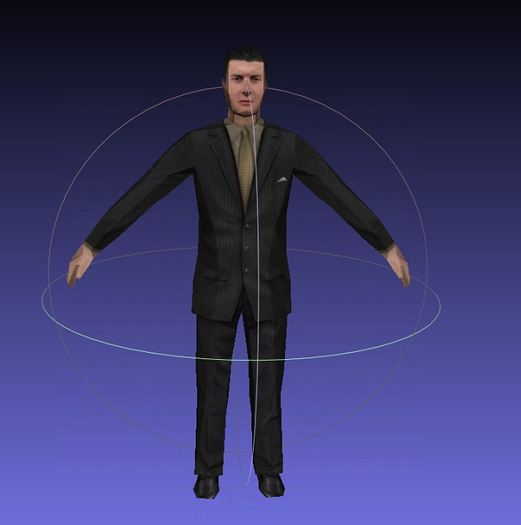
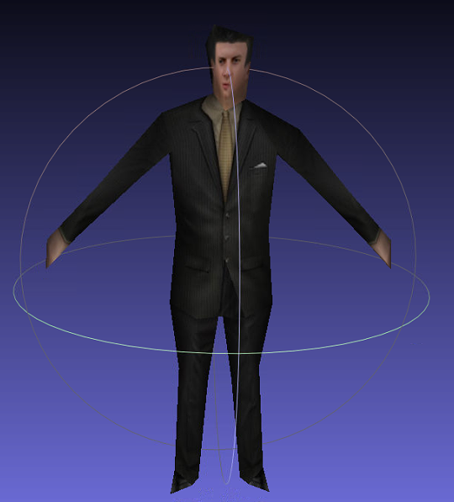

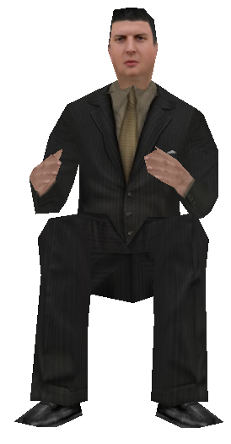


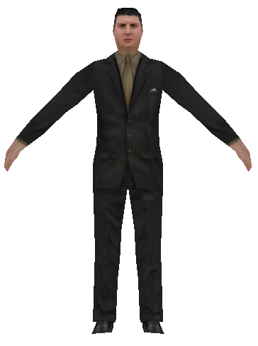



server
transmission
client
Transmission base mesh
Mesh fineness improvements
Model geometry
Mesh simplification
Transmission stream of records
三角面数:592
三角面数：140
三角面数：140
三角面数:420
三角面数:592
Hierarchical preprocessing of texture mapping
skeleton animation extraction
Texture mapping
Skeleton animation
贴图像素:1×1
贴图像素:26×26
贴图像素:512×512

Slide 2
server
transmission
client
Transmission base mesh
Mesh fineness improvements
Model geometry
Mesh simplification
Transmission stream of records
三角面数:592
三角面数：140
三角面数：140
三角面数:420
三角面数:592
Hierarchical preprocessing of texture mapping
skeleton animation extraction
Texture mapping
Skeleton animation
贴图像素:1×1
贴图像素:26×26
贴图像素:512×512

