Slide 1

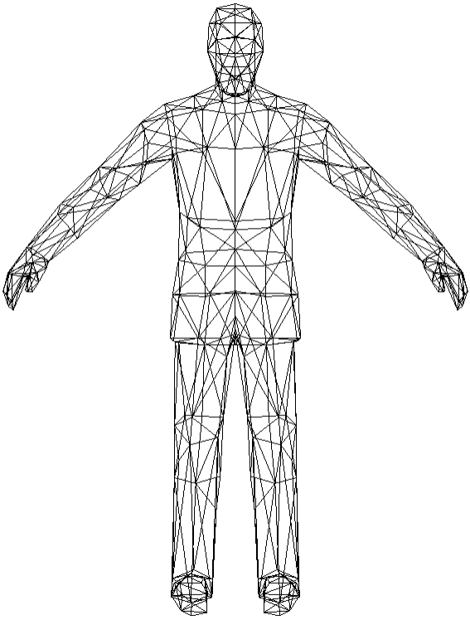
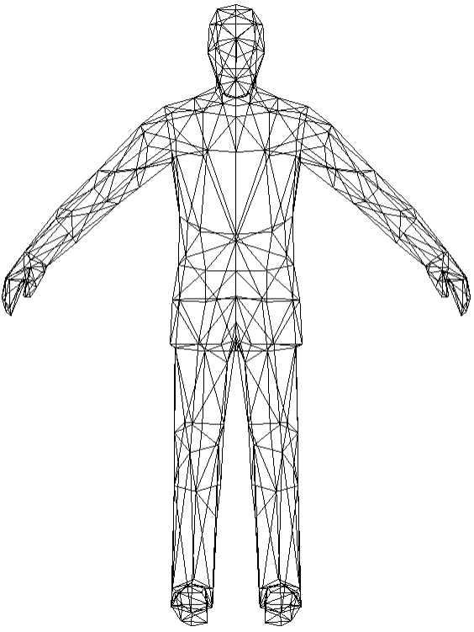
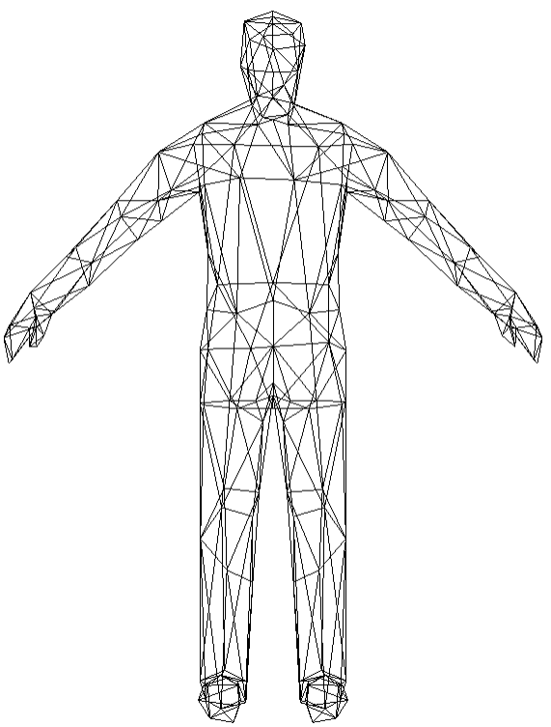
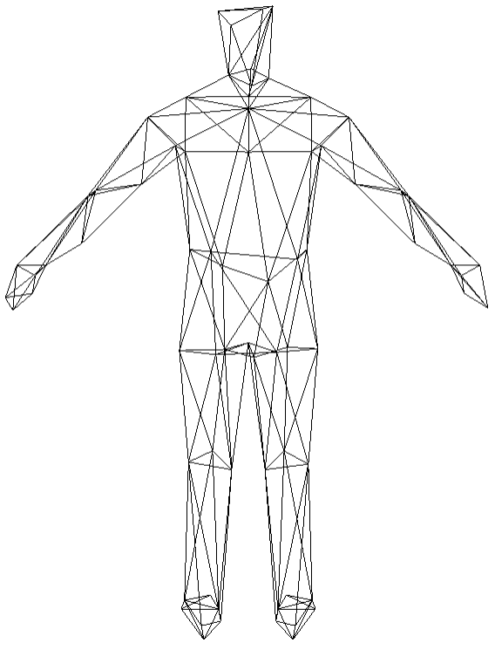
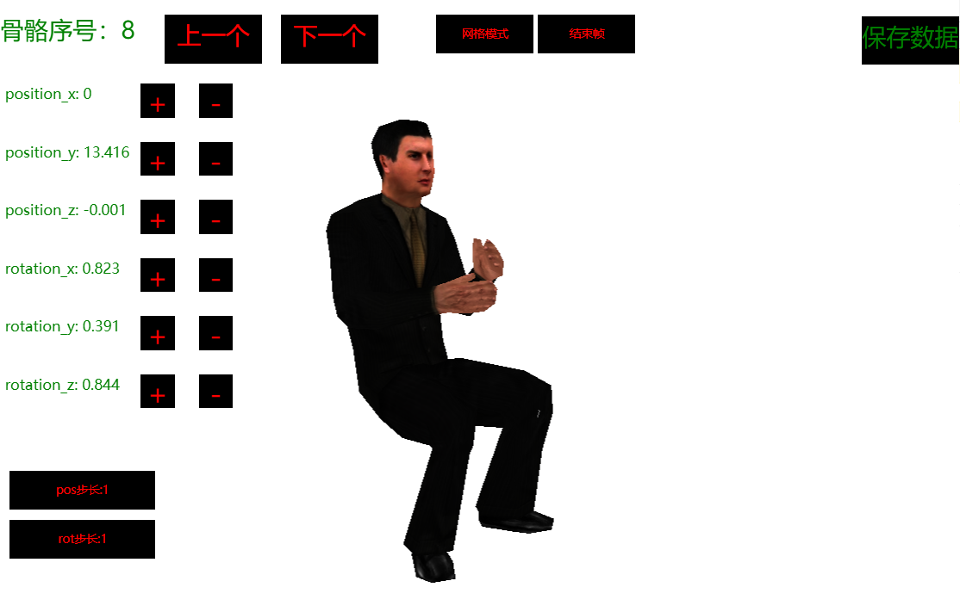





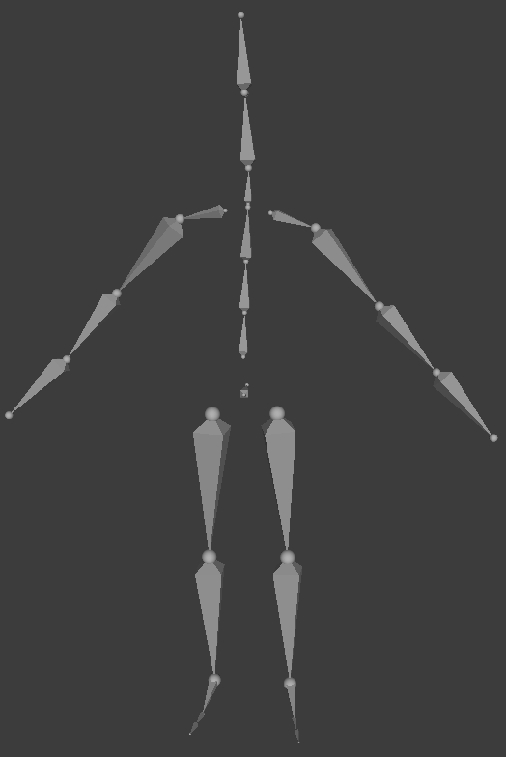



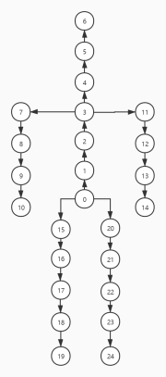




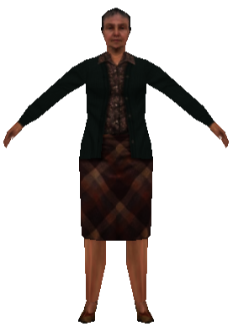






Server
Transmission
Browser
Mesh Merging
Mesh Spliting
Mesh Stream
BM
Record₁
PM3: 592
PM2: 540
PM1: 340
Base Mesh: 140
Record₂
PM0:140
PM1:340
PM2:540
PM3:592
Record₃
Record₂
Record₁
Record₃
Record₁
Record₂
Record₃
-
-
-
+
+
+
Server
Transmission
Browser
edit start frame
Skeleton analysis
Motion Generator
Skeleton extraction
Calculate transition frame
edit end frame
Motion Generator

