Slide 1
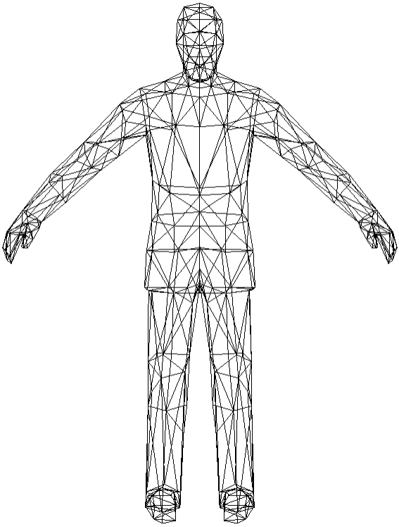
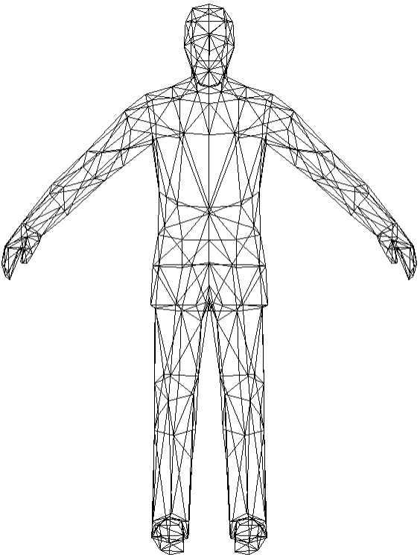
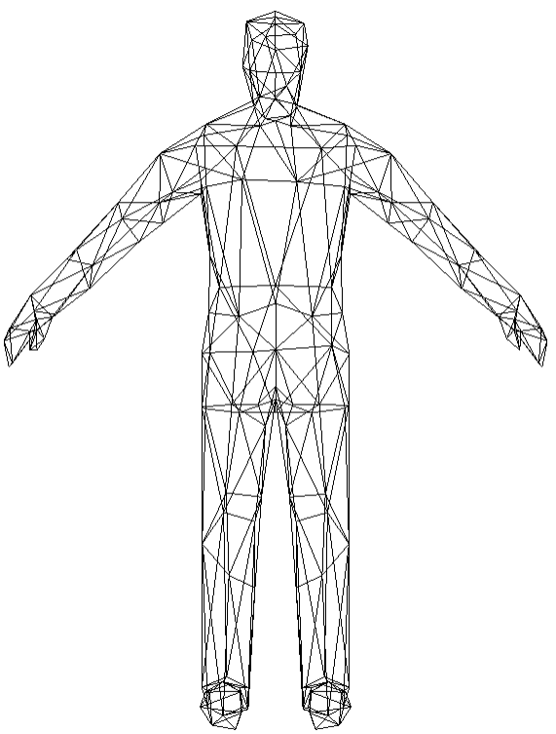
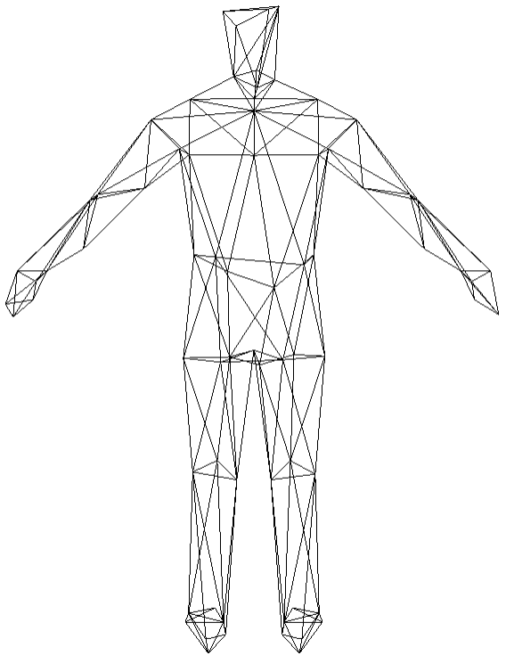
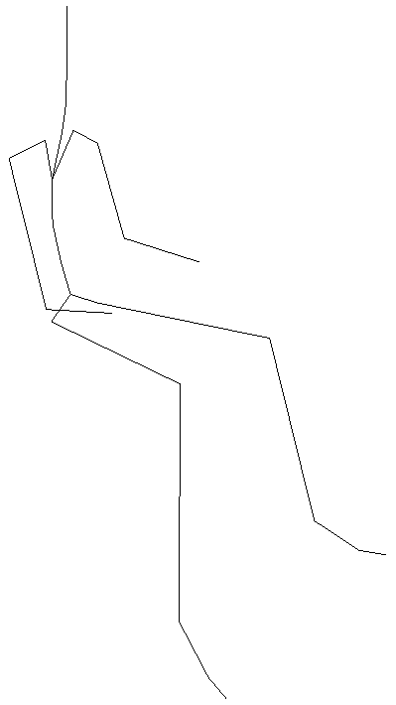



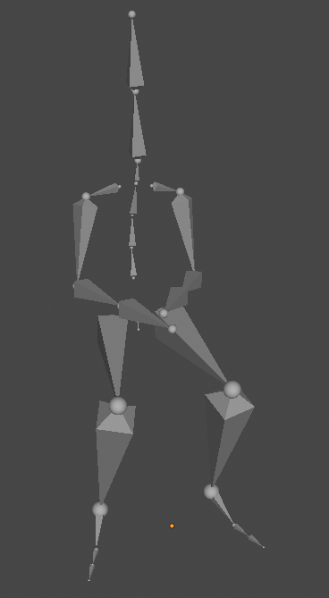





Server
Transmission
Client
Mesh simplification
data stream
Mesh fineness improvements
PM0
Model geometry
record1
PM3:592
PM2:540
PM1:340
PM0(base mesh):140
record2
PM0:140
PM1:340
PM2:540
PM3:592
record3
-
record3
-
record2
-
record1
+
record1
+
record2
+
record3
Hierarchical preprocessing of texture mapping
Skeleton animation
skeleton animation extraction
Texture mapping
Parameter adjustment
pixel:32×32
pixel:64×64
pixel:128×128
pixel:512×512

Slide 2
server
transmission
browser
mesh splits
data stream
mesh rebuilds
PM0
Model geometry
record1
PM3:592
PM2:540
PM1:340
PM0(base mesh):140
record2
PM0:140
PM1:340
PM2:540
PM3:592
record3
-
record3
-
record2
-
record1
+
record1
+
record2
+
record3
Hierarchical preprocessing of texture mapping
Skeleton animation
skeleton animation extraction
Texture mapping
Parameter adjustment
pixel:32×32
pixel:64×64
pixel:128×128
pixel:512×512

Slide 3
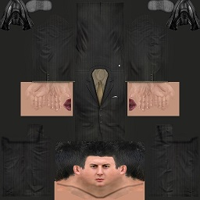
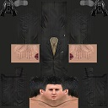

Server
Transmission
Browser
mesh splits
data stream
mesh rebuilds
PM0
record1
PM3:592
PM2:540
PM1:340
PM0(base mesh):140
record2
PM0:140
PM1:340
PM2:540
PM3:592
record3
-
record3
-
record2
-
record1
+
record1
+
record2
+
record3
Hierarchical preprocessing of texture mapping
Skeleton animation
skeleton animation extraction
Parameter adjustment
level0
level1
level2

Slide 4
Server
Transmission
Browser
mesh splits
mesh rebuilds
data stream
PM0
record1
record2
PM0:140
PM1:340
PM2:540
PM3:592
PM3:592
PM2:540
PM1:340
PM0(base mesh):140
record3
+
record1
+
+
-
record3
-
record2
-
record1
record2
record3
Hierarchical preprocessing of texture mapping
Skeleton animation
skeleton animation extraction
Parameter adjustment
level0
level1
level2

Slide 5
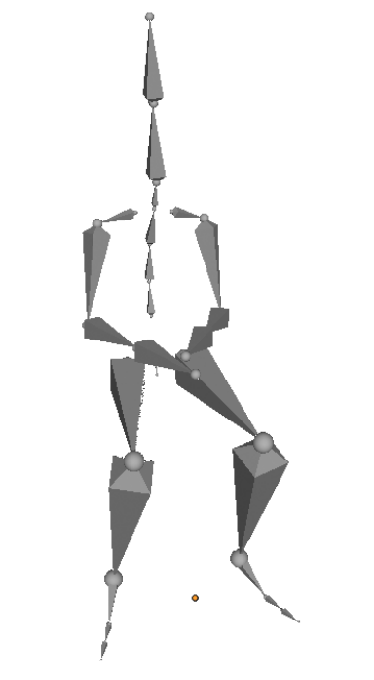


Server
Transmission
Browser
mesh splits
mesh rebuilds
data stream
PM0
record1
record2
PM0:140
PM1:340
PM2:540
PM3:592
PM3:592
PM2:540
PM1:340
PM0(base mesh):140
record3
+
record1
+
+
-
record3
-
record2
-
record1
record2
record3
Hierarchical preprocessing of texture mapping
Parameter adjustment
skeleton extraction
level2
level1
level0

