Slide 1
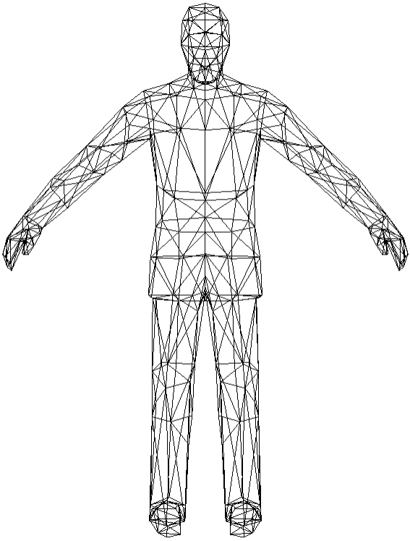
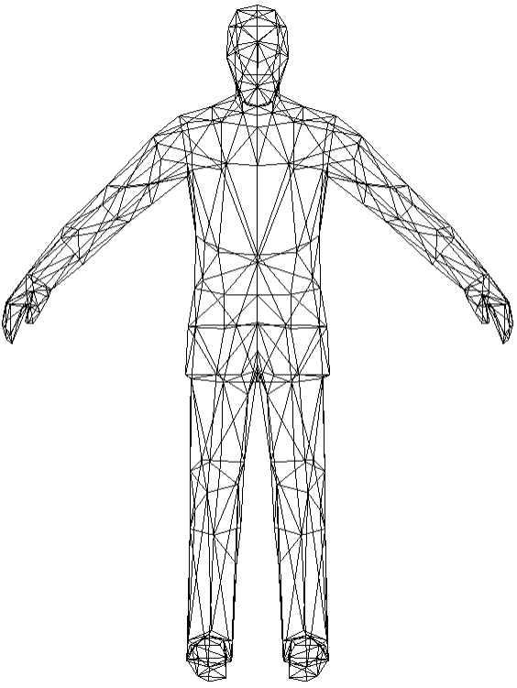
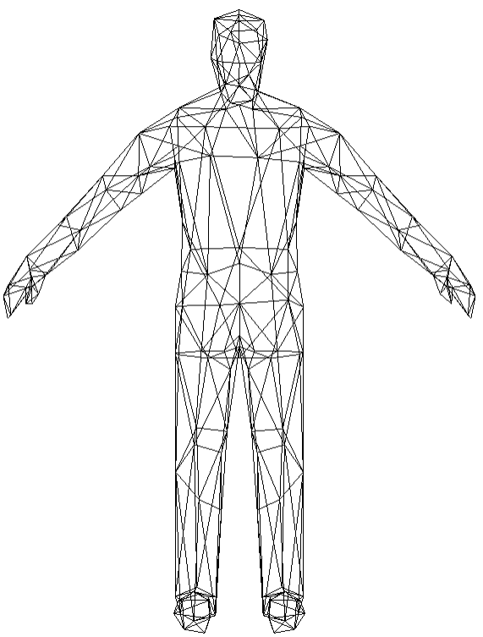
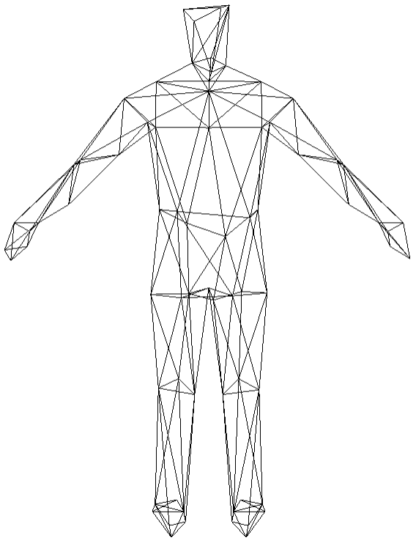


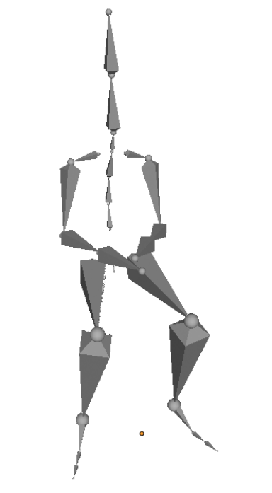






Server
Transmission
Browser
mesh splits
mesh rebuilds
data stream
PM0
record1
record2
PM0:140
PM1:340
PM2:540
PM3:592
PM3:592
PM2:540
PM1:340
PM0(base mesh):140
record3
+
record1
+
+
-
record3
-
record2
-
record1
record2
record3
Hierarchical preprocessing of texture mapping
Parameter adjustment
skeleton extraction
level2
level1
level0

