Slide 1
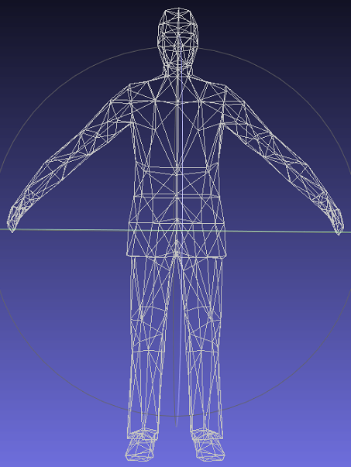
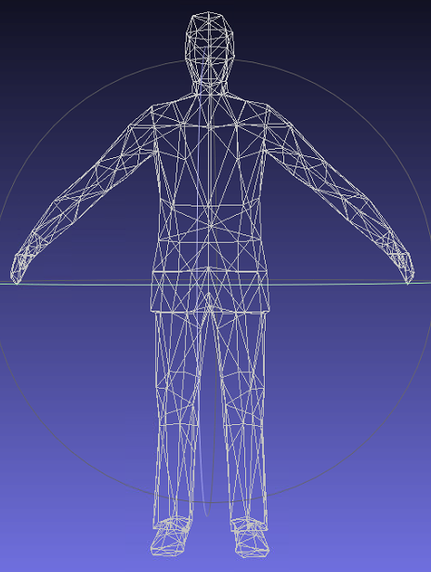
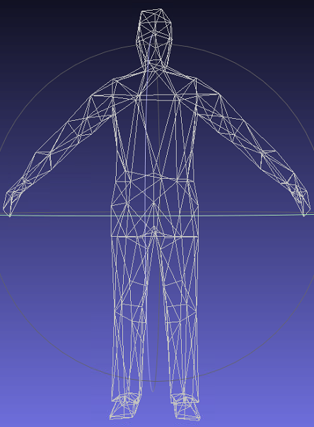
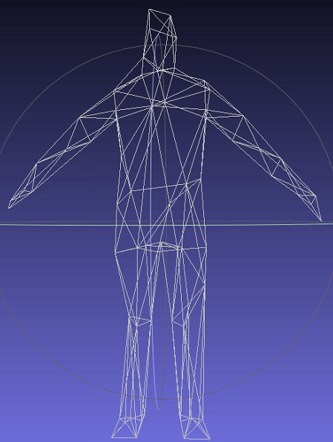
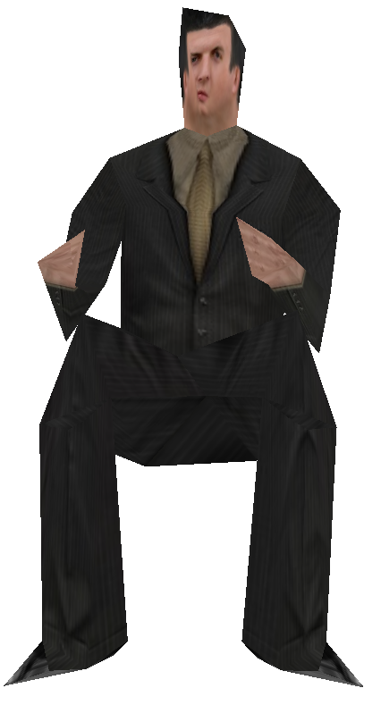



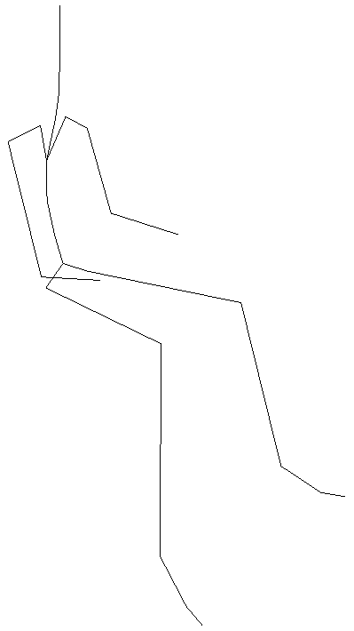

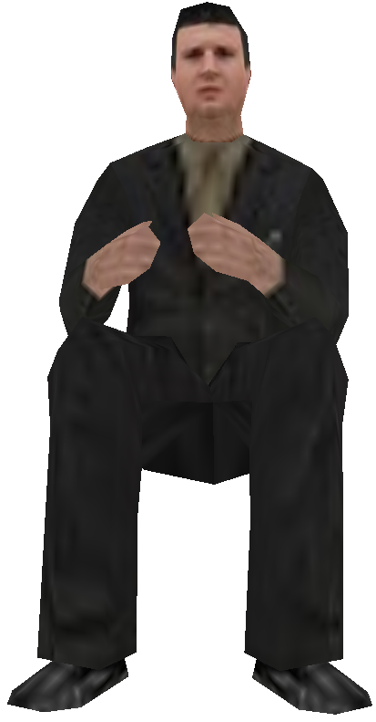

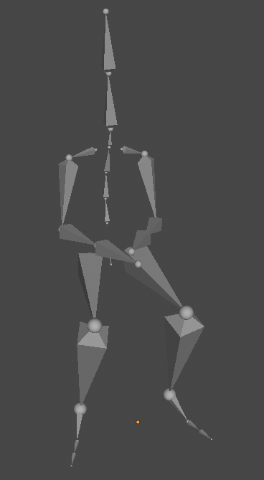

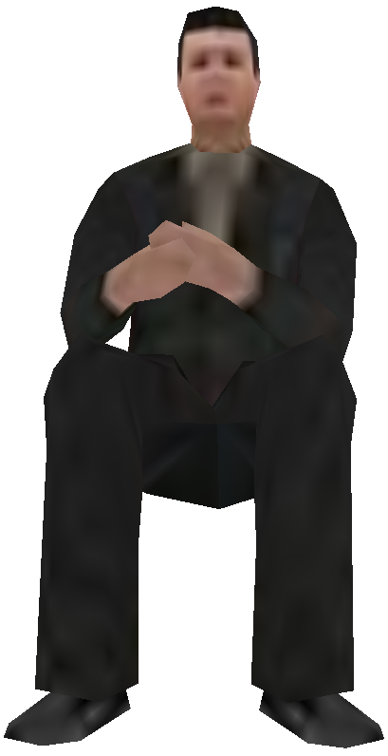
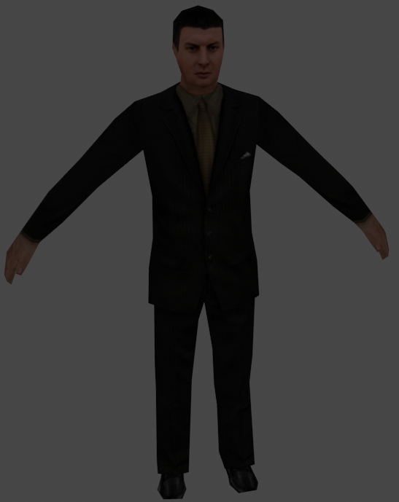
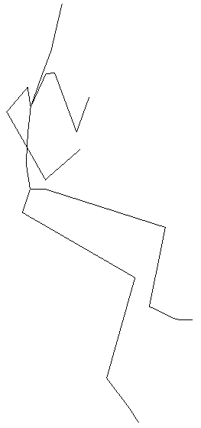

server
transmission
client
Mesh simplification
data stream
Mesh fineness improvements
base mesh
Model geometry
packet1
packet2
Faces:592
Faces：540
Faces：340
Faces：140
Faces：140
Faces：340
Faces：540
Faces:592
packet3
record3
record2
record1
increment1
increment2
increment3
Hierarchical preprocessing of texture mapping
Skeleton animation
skeleton animation extraction
Texture mapping
Parameter adjustment
pixel:32×32
pixel:64×64
pixel:128×128
pixel:512×512

