Slide 1
Lightweight Preprocess of 3D Conference Scenes
Static scene
Exterior extraction
Repetitions removal
Lightmap baking
Dynamic scenario
parametering variation of crowd behavior
Lightweighting of skeleton animation
Lightweighting of texture maps
Networking Progressive Transmission
Static scene
Fine-grained transmission
Incremental transmission
Bandwidth adaptive transmission
Dynamic scenario
Progressive transmitting avatars
Transmission of animation data
Transmission of texture maps
Lightweitght Web3D Rendering
Static scenes
Online parsing
Online assemblying
instance rendering
Dynamic scenario
Hierarchically reusing resources
lightweight animation using fragment shader
Diversing crowd behavior using vertex shader

Slide 2
server
transmission
client
Model geometry
Mesh simplification
Transmission base mesh
Mesh fineness improvements
Transmission stream of records
Texture mapping
Hierarchical preprocessing of texture mapping
Skeleton animation
skeleton animation extraction
注释: 这张图画的不够饱满 建议相应地插入一些示意图在每个步骤 图文并茂

Slide 3
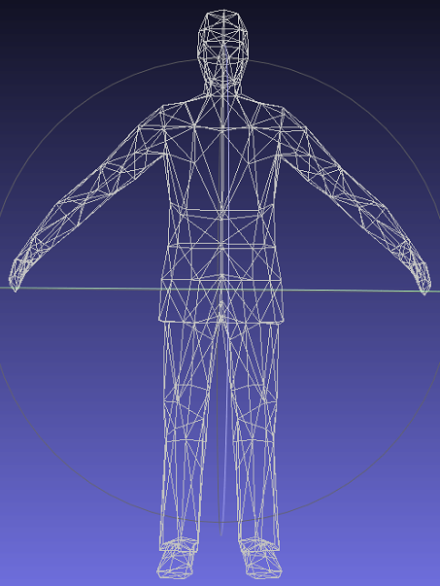
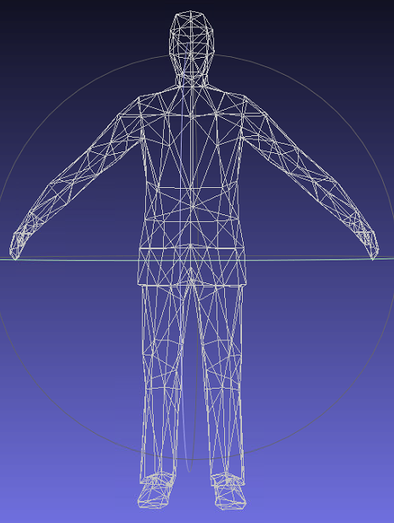
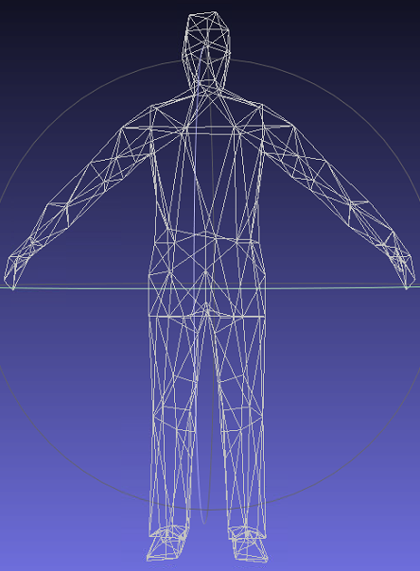
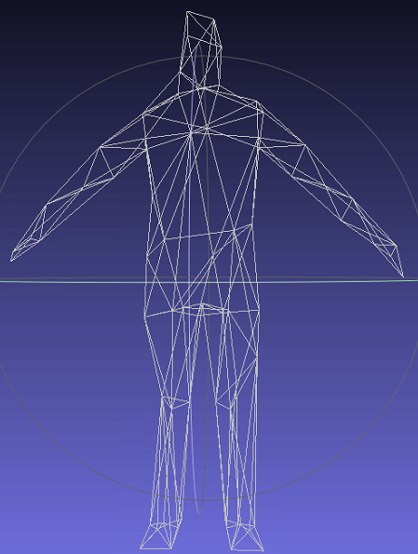
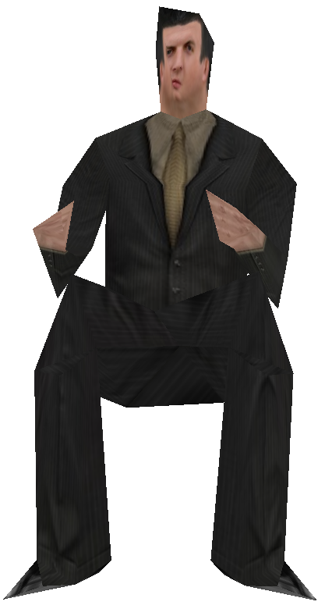
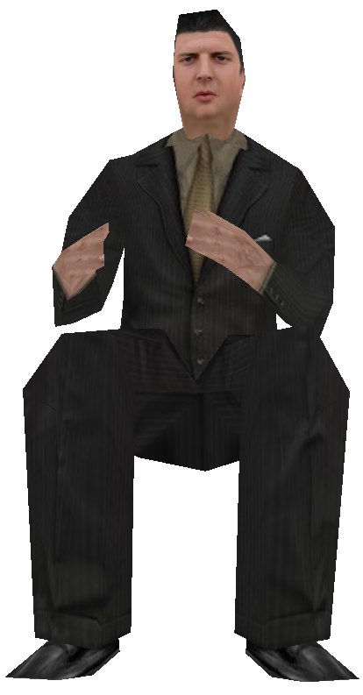
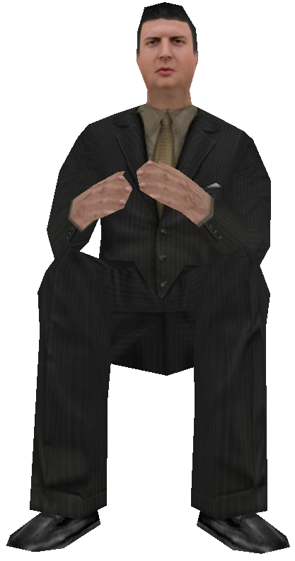
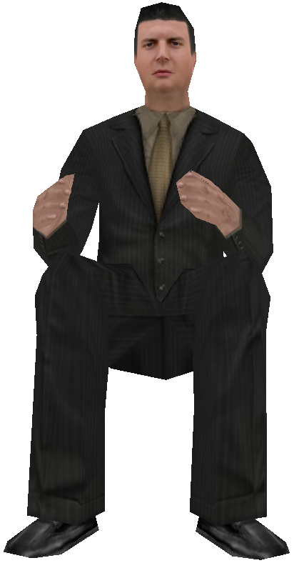
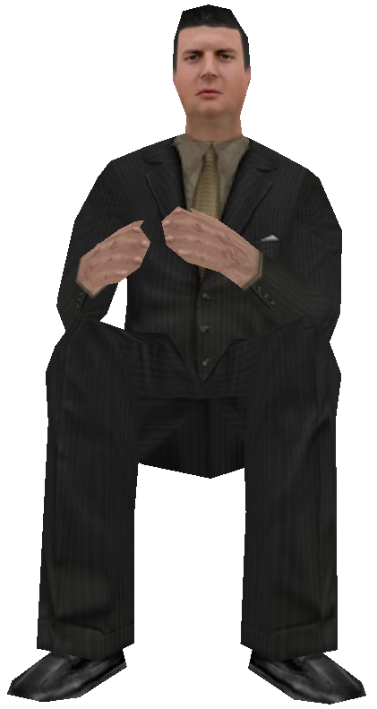
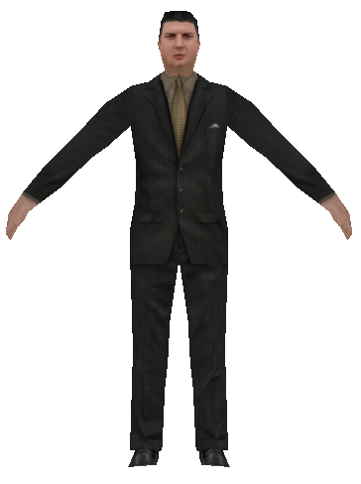

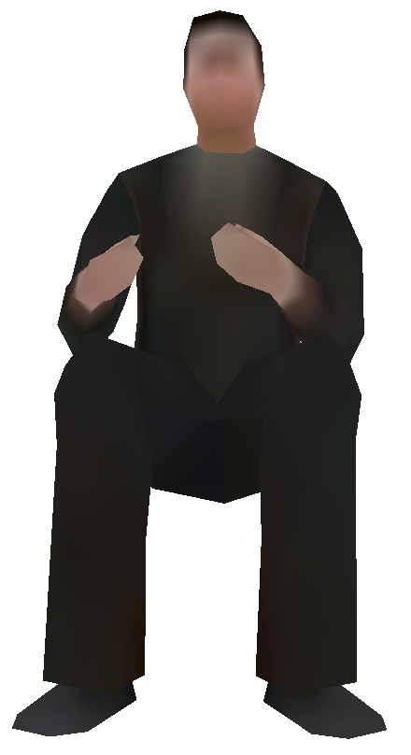
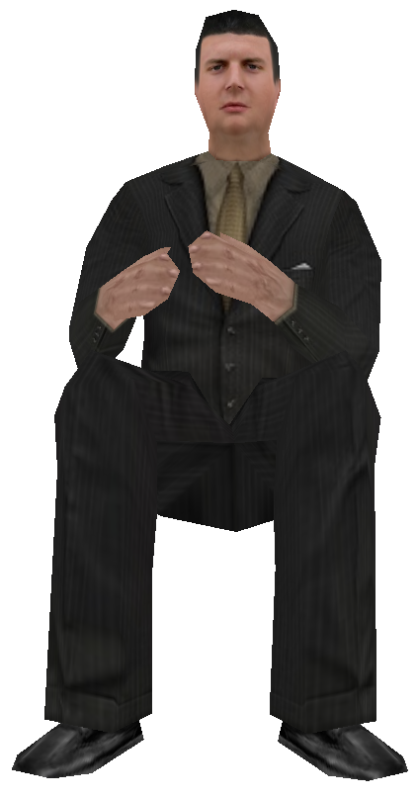
server
transmission
client
Mesh simplification
Mesh fineness improvements
base mesh
Model geometry
Transmission stream of records
Faces:592
Faces：540
Faces：340
Faces：140
Faces：140
Faces：340
Faces：540
Faces:592
record3
record2
record1
increment1
increment2
increment3
Hierarchical preprocessing of texture mapping
skeleton animation extraction
Texture mapping
Skeleton animation
贴图像素:1×1
贴图像素:26×26
贴图像素:512×512

Slide 4
server
transmission
client
Mesh simplification
data stream
Mesh fineness improvements
base mesh
Model geometry
packet1
packet2
Faces:592
Faces：540
Faces：340
Faces：140
Faces：140
Faces：340
Faces：540
Faces:592
packet3
record3
record2
record1
increment1
increment2
increment3
Hierarchical preprocessing of texture mapping
skeleton animation extraction
Texture mapping
Skeleton animation
贴图像素:1×1
贴图像素:26×26
贴图像素:512×512

Slide 5
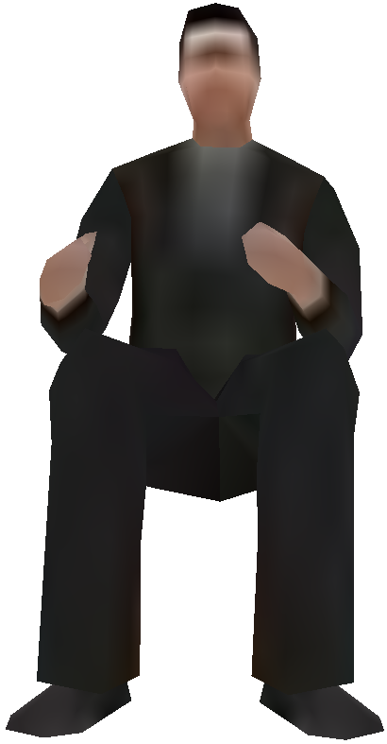
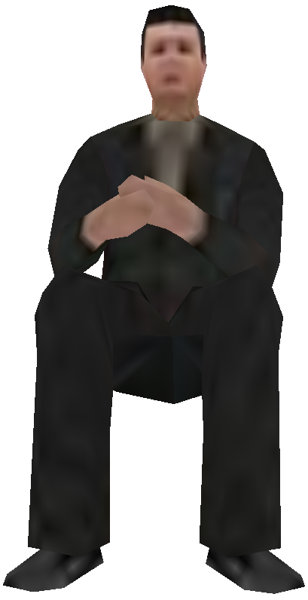
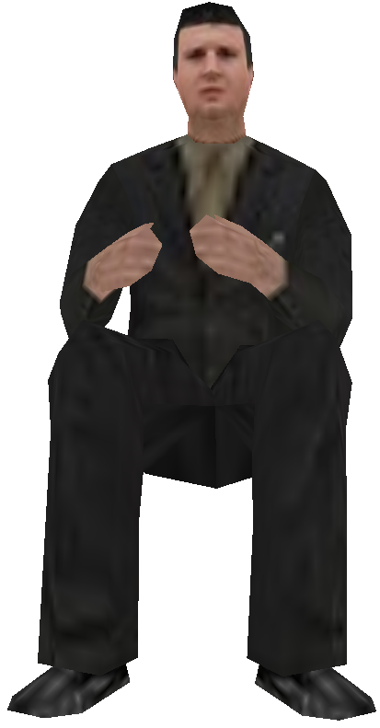
server
transmission
client
Mesh simplification
data stream
Mesh fineness improvements
base mesh
Model geometry
packet1
packet2
Faces:592
Faces：540
Faces：340
Faces：140
Faces：140
Faces：340
Faces：540
Faces:592
packet3
record3
record2
record1
increment1
increment2
increment3
Hierarchical preprocessing of texture mapping
skeleton animation extraction
Texture mapping
Skeleton animation
pixel:32×32
pixel:64×64
pixel:128×128
pixel:512×512

Slide 6
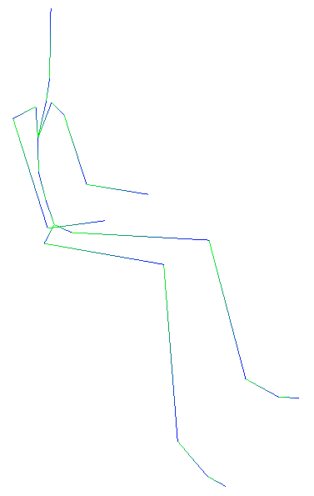
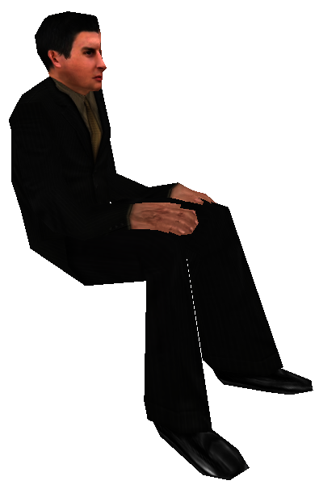
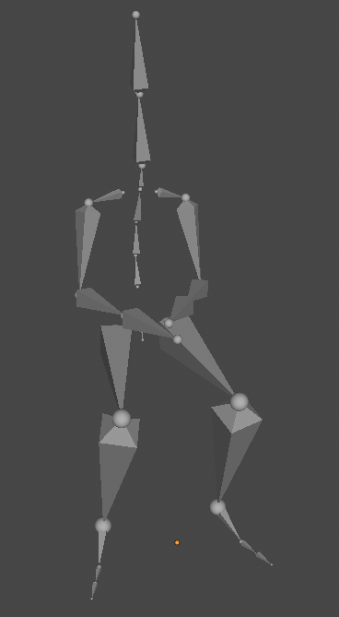
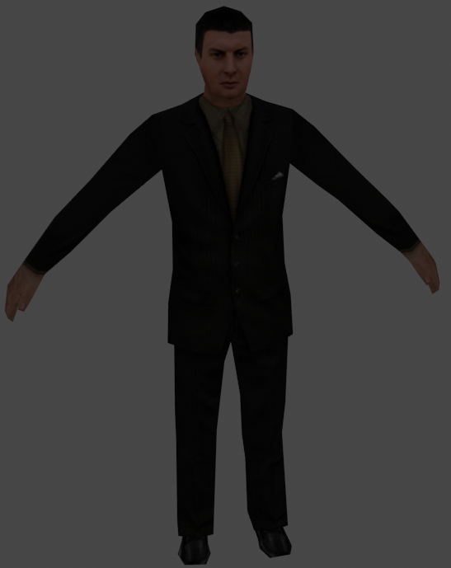
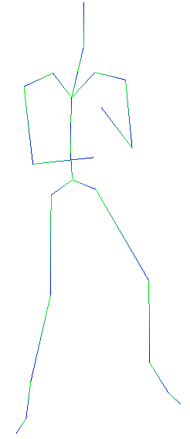
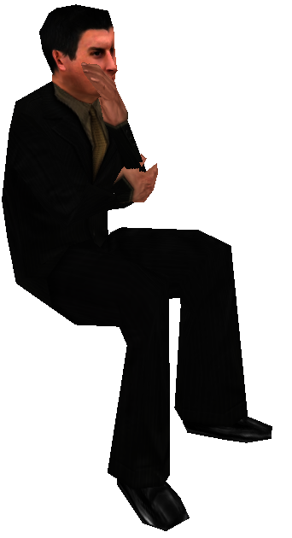
server
transmission
client
Mesh simplification
data stream
Mesh fineness improvements
base mesh
Model geometry
packet1
packet2
Faces:592
Faces：540
Faces：340
Faces：140
Faces：140
Faces：340
Faces：540
Faces:592
packet3
record3
record2
record1
increment1
increment2
increment3
Hierarchical preprocessing of texture mapping
Skeleton animation
skeleton animation extraction
Texture mapping
Parameter adjustment
pixel:32×32
pixel:64×64
pixel:128×128
pixel:512×512

Slide 7
Uniform一致变量
采样器
Uniform一致变量
采样器
模型视图矩阵
投影矩阵
时间
骨骼动画数据
纹理贴图
贴图个数
Attribute属性变量
顶点着色器
片元着色器
顶点数据
Varying变量
顶点的原坐标
顶点的UV
骨骼索引
顶点所在部位
贴图类型
色调
对象数据
对象的变换矩阵
动画播放速度
动画类型
贴图类型
色调
1. 插入示意图
2. 用一个实例将算法的流程的步骤一部展示出来
内建输出变量
内建输出变量
顶点屏幕坐标
片元颜色

Slide 8


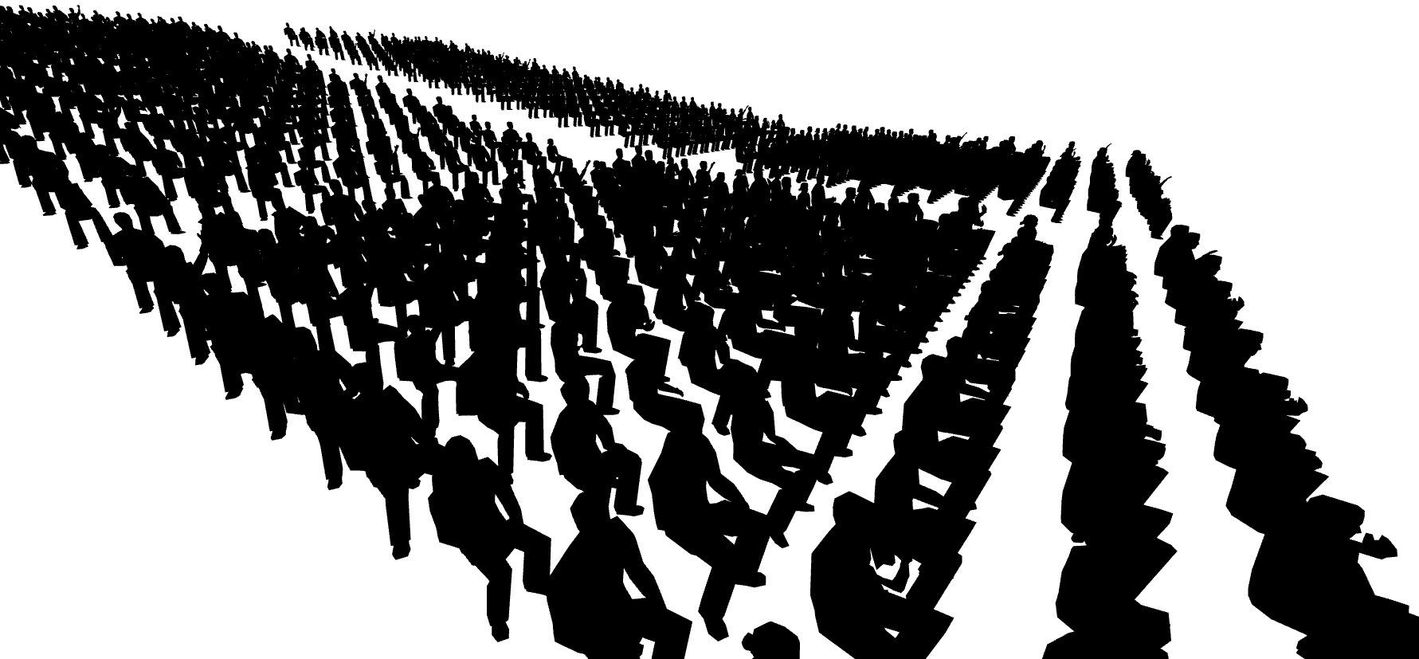
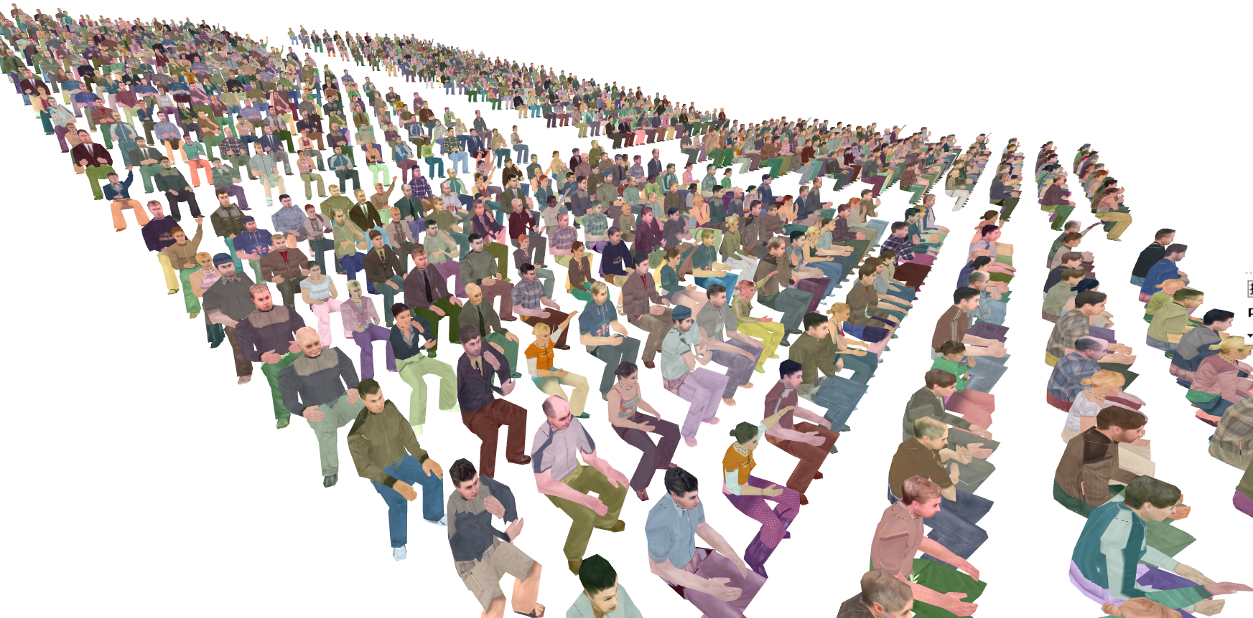
vextex shader
fragment shader
sampler
纹理贴图
sampler
对象attribute data
顶点attribute data
对象的变换矩阵
动画播放速度
动画类型
贴图类型
色调
骨骼动画数据
Uniform data
顶点的原坐标
顶点的UV
骨骼索引
贴图个数
Uniform data
模型视图矩阵
投影矩阵
时间
varying data
vating data
贴图类型
色调

