Slide 1
Parallel N-Grams Analysis
with OpenMP
Parallel Computing
Andrea Bigagli 7036221
A.A. 2025/2026

Slide 2
Introduction
N-grams are a fundamental building block in text analysis and NLP
Used in applications such as language modeling, search, and text mining
Computing n-grams on large datasets is computationally expensive
Parallel computing can help reduce execution time

Slide 3

Problem Definition
The problem addressed in this project consists in computing the frequency of n-grams extracted from a large textual corpus.
An n-gram is defined as a contiguous sequence of n elements extracted from text, where the elements can be either words or characters.
Given a text corpus T, the objective is to generate and count all the n-grams appearing in the dataset for fixed values of n.
where T represents the input text and gi​ is an n-gram of size n.

Slide 4
Project Goal
The goal of this project is to compare a sequential and a parallel implementation of n-gram counting using OpenMP.
In this project, the analysis is limited to bigrams and trigrams, both word-based and character-based n-grams are considered.
The objective is to evaluate the impact of parallelization on execution time and speedup when processing large textual datasets.

Slide 5
Dataset
  Textual datasets in English were selected from the Leipzig Corpora Collection,
  Two different dataset sizes were considered in order to study scalability:
  • 100K sentences
  • 1M sentences
  This choice allows the evaluation of parallel overhead on small inputs
  and scalability on larger datasets.

Slide 6
Text Preprocessing
  Before computing n-grams, the input text is normalized in order to
  ensure consistent tokenization and fair performance comparisons.
  The preprocessing pipeline includes:
  • Conversion to lowercase
  • Removal of non-ASCII characters
  • Punctuation handling and apostrophe removal
  • Preservation of internal hyphens (e.g., t-shirt)
  • Tokenization into words
  The same preprocessing steps are applied to both the sequential
  and parallel implementations.

Slide 7
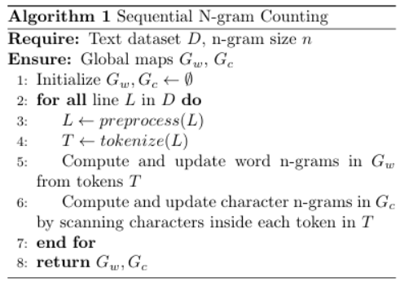
Sequential Implementation
  The sequential implementation represents the baseline version of the project.
  The input dataset is processed line by line.
  For each line, the text is preprocessed and tokenized.
  Word-based and character-based n-grams are generated and counted using hash-based frequency maps.
  This implementation is used as a reference to evaluate the performance of the parallel solution.

Slide 8
Parallel Implementation - Overview
  The parallel implementation is based on OpenMP and targets shared-memory architectures.
  The overall logic follows the sequential version, but the workload is distributed among multiple threads.
  Each thread processes an independent portion of the input data, enabling thread-level data parallelism.
  Parallelization key ideas:
  • Same algorithmic structure
  • Independent data chunks
  • Thread-level parallelism

Slide 9
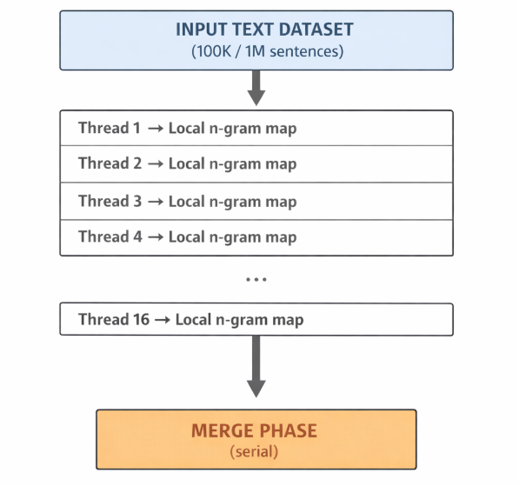
Parallelization Strategy
  The parallelization is applied to the outer loop that processes the input dataset.
  Each thread works on an independent subset of the data and maintains its own local n-gram maps.
  This design avoids synchronization during the counting phase and eliminates data races.

Slide 10
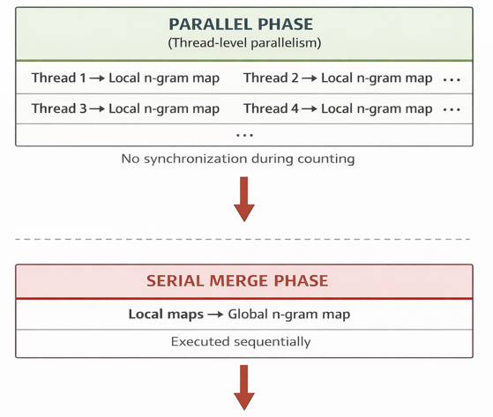
Merge Phase
  After the parallel counting phase, the local n-gram maps produced by each thread are merged into a single global map.
  The merge operation is executed sequentially and represents the only serial section of the timed counting workflow.
  The merge is performed once for each n-gram category (4 merges in total).
  This phase introduces overhead and limits the maximum achievable speedup, according to Amdahl’s Law.

Slide 11
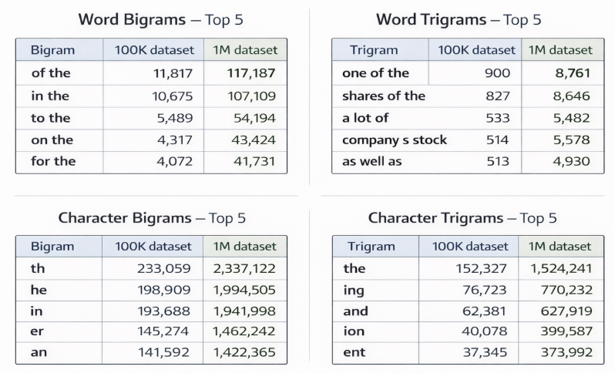
Most Frequent N-grams (100K vs 1M datasets)
The ranking of the most frequent n-grams remains stable across dataset sizes.

Slide 12
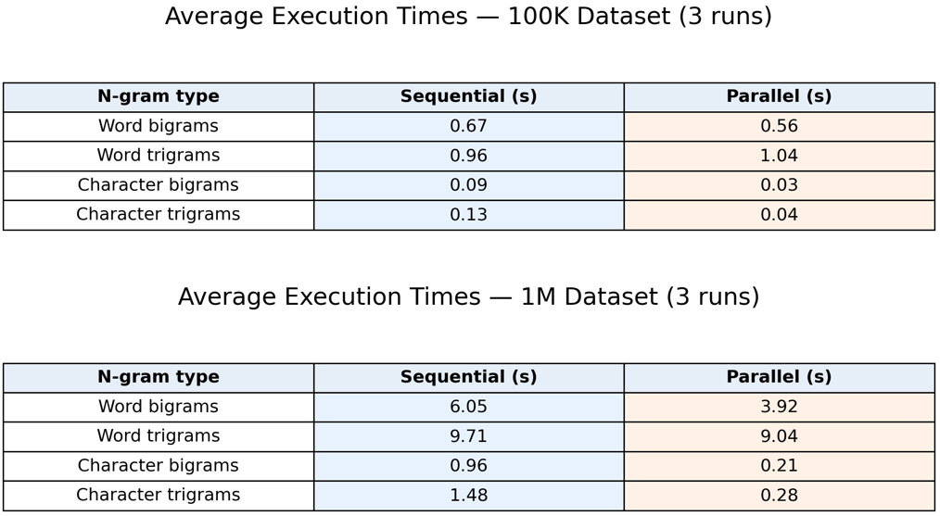
Execution Times (Averaged Results)
• 3 independent runs were executed for each dataset
• Execution times were measured for each n-gram category
• Reported values are averages over the 3 runs
• Speedup is computed from averaged times

Slide 13
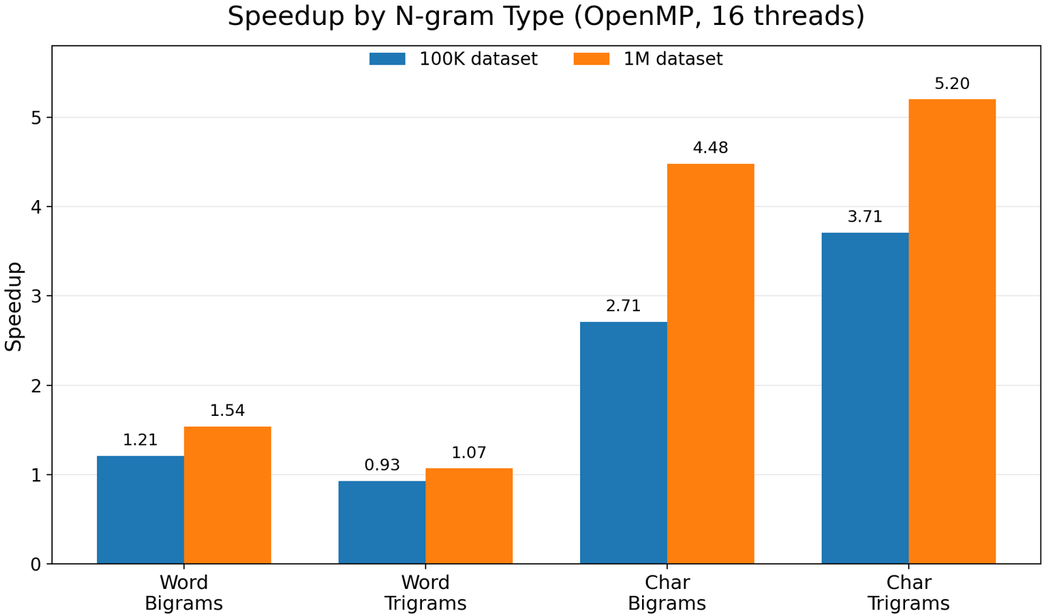
Results: Speed Up
Character n-grams achieve significantly higher speedup
Speedup increases when moving from 100K to 1M sentences
Word trigrams show limited improvement due to overhead

Slide 14
Performance Analysis
The experimental results show a clear difference between word-based and character-based n-grams.
Character n-grams achieve higher speedup due to shorter keys,
a smaller number of distinct n-grams, and more regular workloads.
Word trigrams generate many unique keys and require more memory operations during the merge phase, which increases overhead and limits scalability.
Increasing the dataset size from 100K to 1M sentences amortizes parallel overhead, leading to higher speedup values.
Key observations:
• Character n-grams scale better
• Word trigrams are merge-bound
• Merge phase is the main serial bottleneck
• Speedup follows Amdahl’s Law

Slide 15
Conclusions
• Parallelization Strategy:
OpenMP parallelization is effective when applied to independent data chunks, as in n-gram counting over large text corpora.
• Data Characteristics:
Character-based n-grams scale better due to shorter keys and fewer distinct elements, while word-based
n-grams suffer from higher memory and merge overhead.
• Scalability Limits:
The merge phase represents the main serial bottleneck and limits speedup, consistently with Amdahl’s Law.

