Slide 1
Pattern Recognition on Time Series with CUDA and Python
Parallel Computing
Andrea Bigagli 7036221
A.A. 2025/2026

Slide 2
Introduction
Pattern recognition on time series is a common task in signal processing and biomedical analysis
Brute-force pattern matching is computationally expensive on large signals
Each window comparison is independent
The problem is naturally data-parallel and well suited for parallel architectures
Goal: compare different parallel programming models on the same algorithm and dataset

Slide 3


Problem Definition
Input:
Long time series S of length N
Short query pattern Q of length M
For each valid position start ∈ [0,N−M] , compute:
Output:

Slide 4
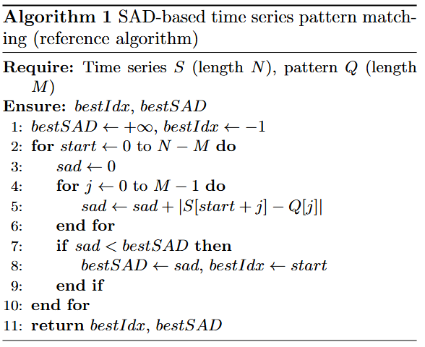

Algorithm Overview
Sliding-window pattern matching:
For each valid position:
  compute SAD
  update global minimum
  Two nested loops
  Time complexity:
  Same reference algorithm for all implementations

Slide 5
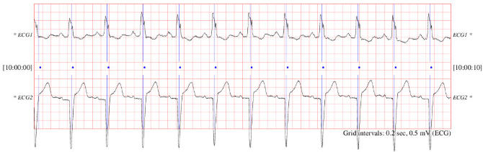
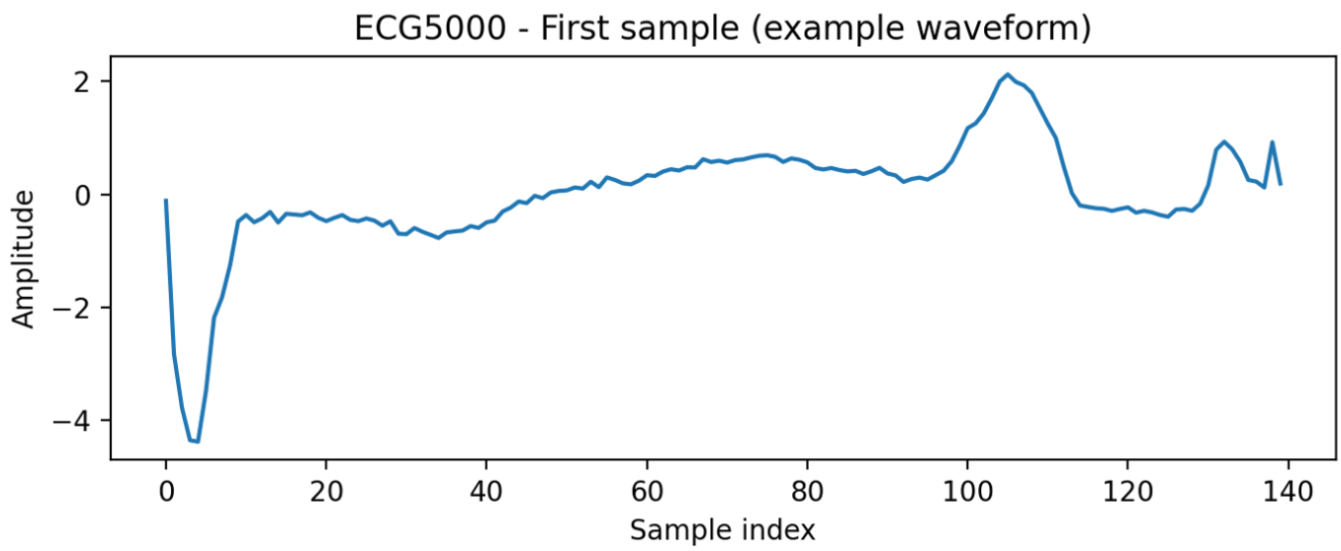
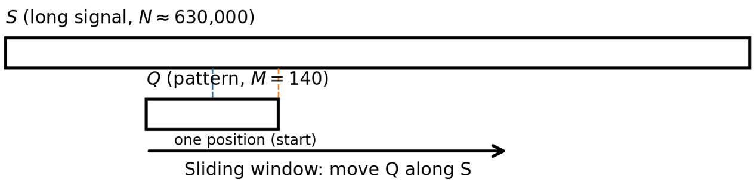

Dataset: ECG5000
The dataset used in this project is :
  Dataset: ECG5000 (UCR Time Series Classification Archive)
  Each sample: 140 values (single heartbeat)
  Real ECG signals (biomedical time series)
  Pattern 𝑄: one ECG sample
  Signal 𝑆: concatenation of many ECG samples
  Final size:
Source: UCR Time Series Classification Archive (ECG5000)

Slide 6
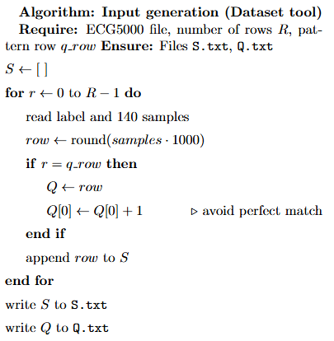

Input Generation (Dataset Tool)
Dedicated C++ tool to generate inputs for all implementations
Reads ECG5000 rows (label + 140 samples)
Converts samples from float to int:
Builds
  𝑆: concatenation of many rows (es, 5000)
  𝑄: one selected row (es, row 10)
Adds a small perturbation to 𝑄 to avoid a perfect match
Outputs two files: S.txt and Q.txt (one integer for line)

Slide 7
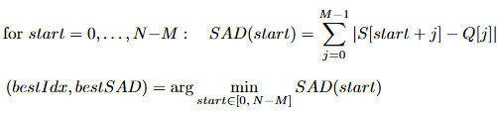
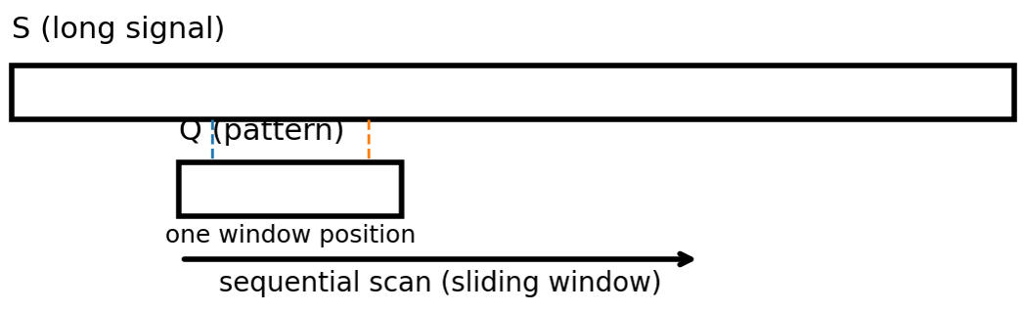

CPU Sequential Baseline
Reference implementation (correctness + baseline)
Direct implementation of the reference algorithm
Sliding-window SAD computation
One window processed at a time
Used as correctness reference
Used as baseline for speedup computation
Worst-case complexity:

Slide 8
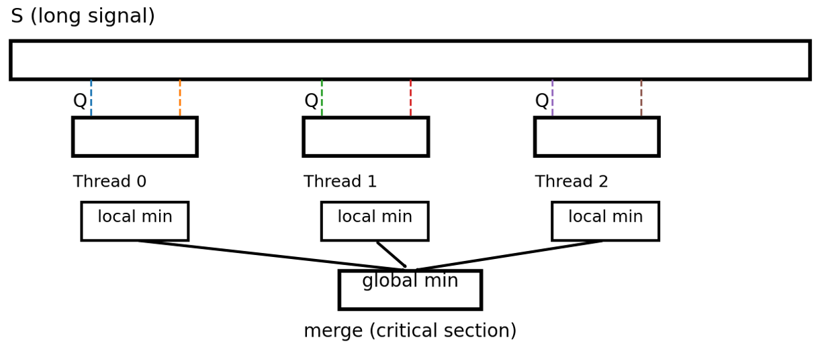

CPU Parallel Implementation (OpenMP)
Parallelize the outer loop over window start positions
Each thread computes SAD on its assigned windows
Thread-local minimum
Global minimum obtained by merging local minima
Synchronization only in the merge step (critical section)
Scalability limited by synchronization + memory bandwidth
Independent windows processed in parallel; final minimum obtained by merging thread-local results.

Slide 9
CUDA Implementation
C++ / CUDA implementation details
CUDA Runtime API for kernel launch and memory management
(cudaMalloc, cudaMemcpy, cudaMemcpyToSymbol)
Host-side containers: std::vector<int> for S and Q
Kernel timing: cudaEvent_t to measure kernel execution time only
End-to-end timing: std::chrono::high_resolution_clock (H2D + kernel + D2H + CPU reduction)
Output type: long long to safely accumulate M = 140 absolute differences
Multiple memory variants implemented:
Global memory (baseline), Constant memory, Shared memory
Parallelize the outer loop over window start positions (start)
1 GPU thread = 1 window → computes one value SAD(start)
Inner loop sequential inside each thread (j = 0..M-1, with M = 140 in ECG5000)
Each thread writes one output value:
→ out[start] = SAD(start) (output size = N - M + 1)
No synchronization required during SAD computation
(windows are independent → no shared state)
CPU post-processing: final reduction on out[]
→ bestIdx = argmin(out), bestSAD = min(out)

Slide 10
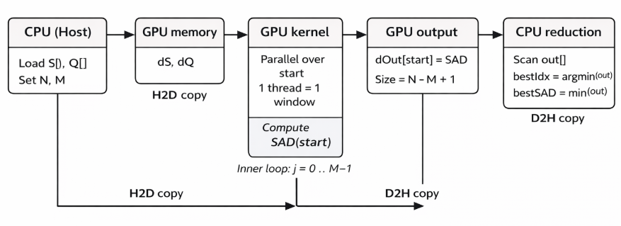
CUDA Implementation: Execution Flow

Slide 11
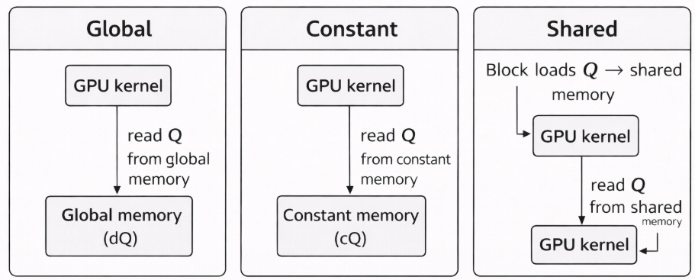
CUDA Memory Variants (Global vs Constant vs Shared)
The same CUDA kernel is evaluated using three different memory placements for the pattern Q, to analyze the impact of memory access on performance.
Same kernel logic in all versions
→ only the memory placement of Q changes
Global (baseline): read Q from global memory
Constant: read Q from constant memory (cached, broadcast)
Shared: load Q into shared memory (per block)
Performance differences due to memory access patterns
Q is small and read-only → ideal for constant memory.

Slide 12
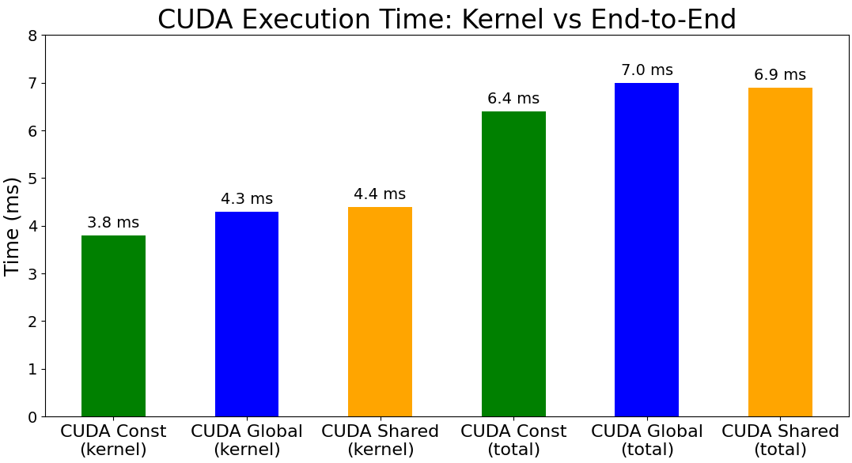
CUDA Execution Time (Kernel vs End-to-End)
Kernel time isolates pure GPU computation.
End-to-end (total) includes transfers + CPU reduction.
Constant memory is the fastest kernel variant.

Slide 13
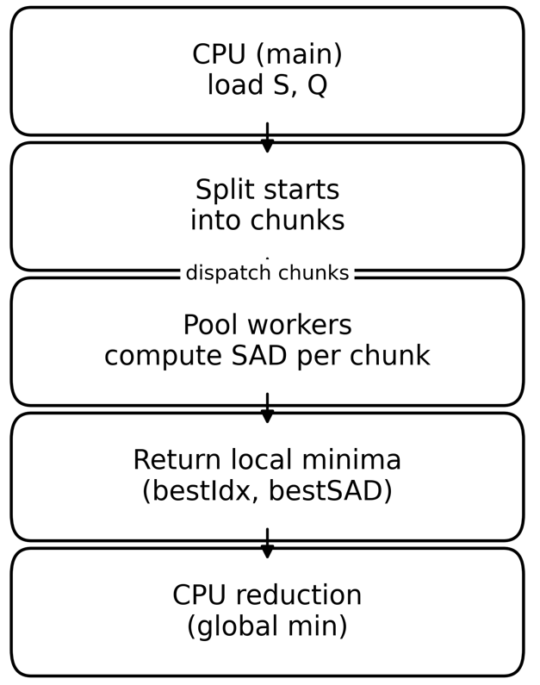
Python Multiprocessing Implementation
Parallelize the outer loop over window start positions
Use multiprocessing.Pool to run workers on multiple CPU cores
Split the search space into chunks of windows
Each worker computes SAD on its chunk and returns a local minimum
Main process performs the final reduction to get (bestIdx, bestSAD)
Avoids the GIL, but introduces process and communication overhead
Same algorithm as C++ versions, different parallel model

Slide 14
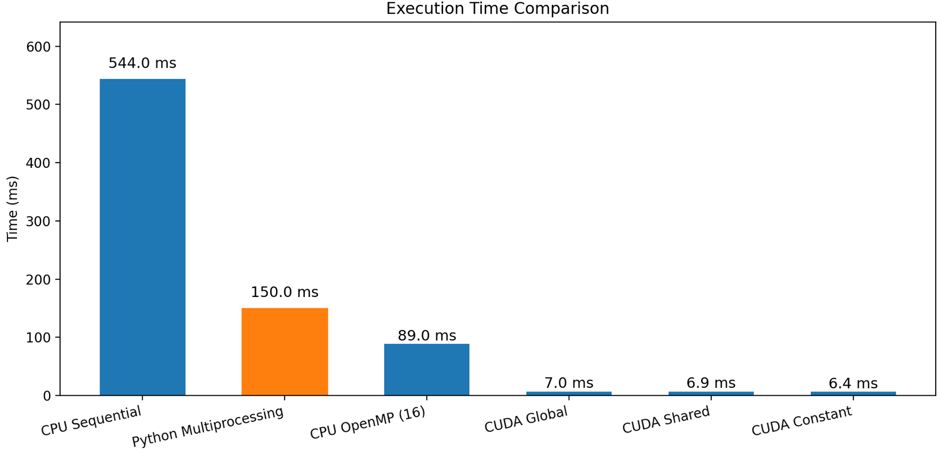
Overall Performance Comparison (Execution Time)
CUDA achieves orders-of-magnitude lower execution time than CPU and Python
OpenMP improves over sequential, but is limited by CPU parallelism
Python multiprocessing reduces time vs sequential, but overhead dominates
ECG5000, M = 140, end-to-end execution time

Slide 15
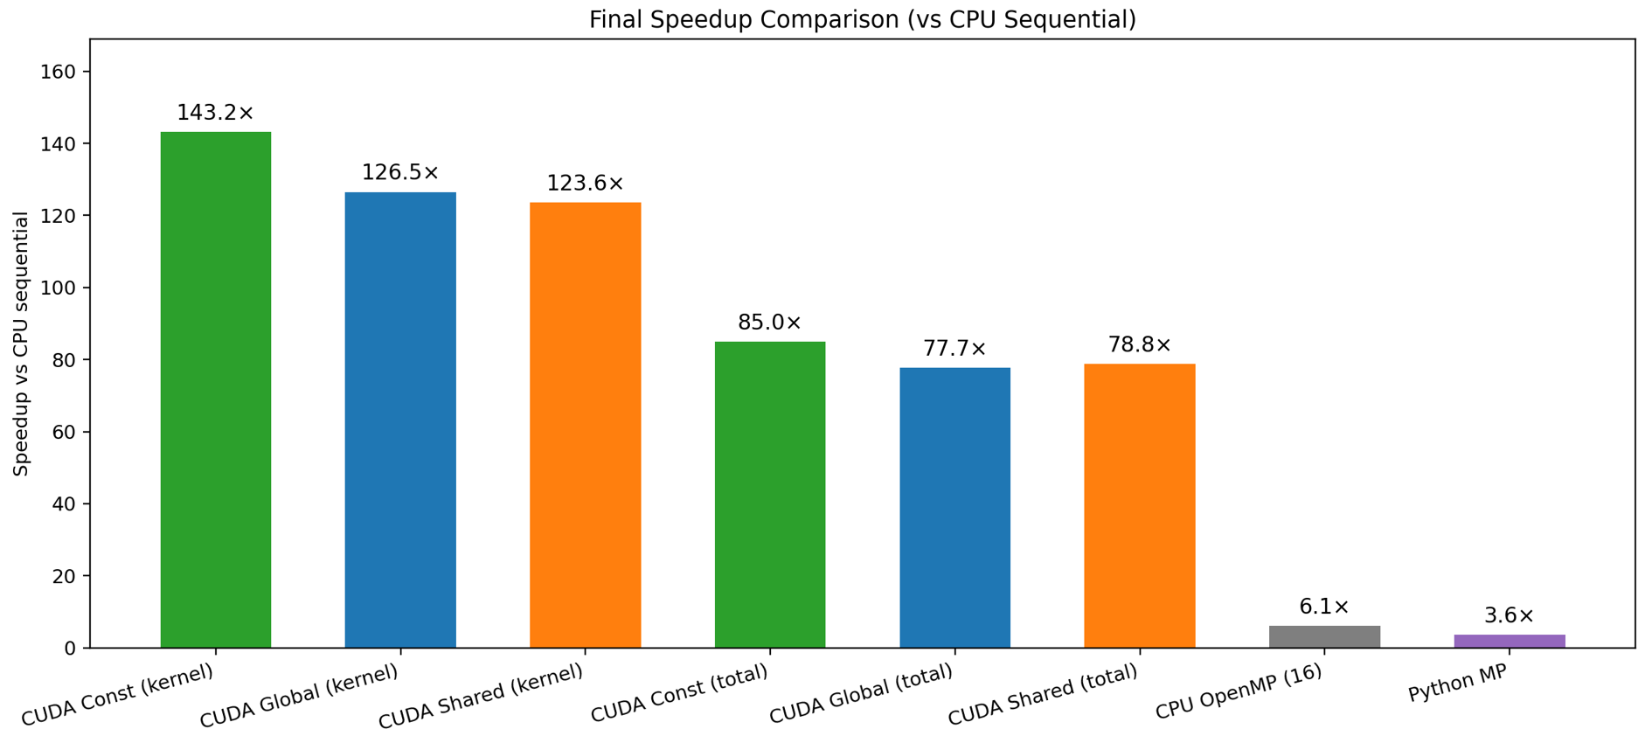
Final Speedup Comparison

Slide 16
Conclusions
Parallelization Strategy: Outer-loop dominates
Parallelizing the window start positions (outer loop) exposes massive data-parallelism and scales well on both CPU (OpenMP) and GPU (CUDA).
The inner loop remains sequential inside each thread and does not limit scalability.
Memory Placement (GPU): Constant > Global ≈ Shared
Placing the small, read-only pattern Q in constant memory yields the best performance due to caching and broadcast.
Shared memory does not provide benefits in this scenario because loading and synchronization overhead outweigh potential gains.
System & Overhead Limits: Transfers and reduction dominate end-to-end time
Performance plateaus beyond 8–16 threads due to bandwidth saturation and efficiency drops monotonically, consistent with Amdahl’s Law.

