Slide 1
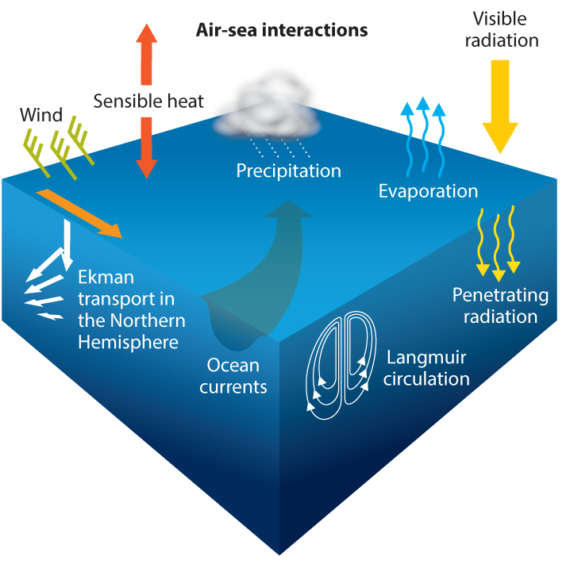

Slide 2
Model A
Model B
0
1
2
3
0
1
2
4
5
6
7
3
4
5
8
9
10
11
6
7
8
12
13
14
15

Slide 4
Model A
Model B
Model B
T₀
T₀
Model A
Model A
Model B
Model B
T₁
T₁
Model A
Model A
Model B
Model B
T₂
T₂
Model A
Model A
Model B
Model B
T₃
T₃
serial execution
concurrent execution

Slide 5
MODEL A
MODEL B
MODEL C

Slide 6
MPI_COMM_WORLD
MPI_COMM_WORLD
COMM_A
COMM_B
COMM_C

Slide 7
R(p)
S(i+1)
S(i)
Cs(i+1)
Cs(i)
Cs(i+2)
Cs(i+4)
Cs(i+3)
S(i+4)
S(i+2)
S(i+3)

Slide 8
MODEL A
MODEL B
moj_init(comp_name, namelist_file)
Initialize the coupler
moj_init(comp_name, namelist_file)
Initialize the coupler
MPI_MY_COMM = moj_get_comm_local()
MPI_MY_RANK = moj_get_irank_local()
Obtain MPI information from MOJ
MPI_MY_COMM = moj_get_comm_local()
MPI_MY_RANK = moj_get_irank_local()
Obtain MPI information from MOJ
multiple call permitted
single call only
moj_def_grid(grid_name, nx, ny, nz, grid_index)
Set grid point index of own region
moj_def_grid(grid_name, nx, ny, nz, grid_idex)
Set grid point index of own region
moj_end_grid_def()
Finish grid point index setting
moj_end_grid_def()
Finish grid point index setting
moj_set_interpolation_table(send_comp_name, send_grid_name, recv_comp_name, recv_grid_name, send_grid, recv_grid, coef)
Set mapping table(global region)
moj_set_interpolation_table(send_comp_name, send_grid_name, recv_comp_name, recv_grid_name)
Set mapping table
moj_init_time(time)
Set initial time
moj_init_time(time)
Set initial time
moj_put_data(data_name, data)
Put initial data (time step = 0)
moj_put_data(data_name, data)
Put initial data
Time integration loop
Time integration loop
moj_finalize(is_exchange_data, is_call_finalize)
Finalize coupling
moj_finalize(is_exchange_data, is_call_finalize)
Finalize coupling

Slide 9
MODEL A
MODEL B
multiple call permitted
Time step loop start
Time step loop stat
single call only
moj_set_time(time, delta_t)
Set current time and ΔT
moj_set_time(time, delta_t)
Set current time and ΔT
Exchange data
Exchange data
Interpolation calculation
(call interpolate_data)
Interpolation calculation
(call interpolate_data)
moj_get_data(data_name, data, is_get_ok)
Get data from the coupler
moj_get_data(data_name, data, is_get_ok)
Get data from the coupler
Model calculation
Model calculation
moj_put_data(data_name, data)
Put data to the coupler
moj_put_data(data_name, data)
Put data to the coupler
Time step loop end
Time step loop end
Notes:
これが時間積分ループの中で用いられるJcupのサブルーチン
Jcup_set_time,
Jcup_put_data
Jcup_get_data
の3種類。
Jcup_set_timeは現在時刻を設定するサブルーチン。
このルーチン内でデータ交換、補間計算が行われる。
Jcup_put_dataはデータをカップラに与えるサブルー林
Jcup_get_dataはカップラからデータを受け取るサブルーチン

Slide 10
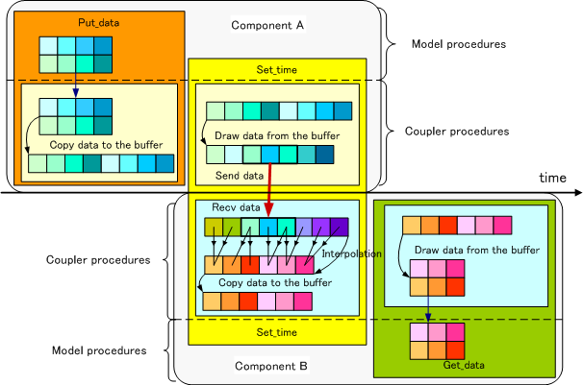
Data flow
Notes:
Put_dataでJcup内部のデータバッファにデータを蓄積
Set_timeでデータの送受信と補間計算が行われた後、
データバッファにデータを保存
Get_dataでデータバッファからデータを取り出しモデルに渡す。

