Slide 1
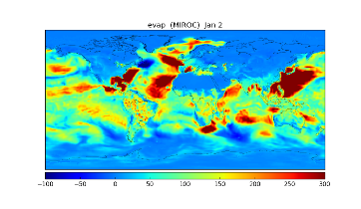
External data for driving the models
Time Interpolation of the external data
Grid remapping by Jcup
MATSIRO
TIME
IO Component
MOJ
Data exchange between MATSIRO and CaMa through Jcup
Output the model Data
CaMa
TIME

Slide 2
matio_main
main program of ILS IO
matio_exchange
data exchange module
moj_api
MOJ API module
Data Exchange layer
mio_api
IO API module
File IO layer
mio_mpi
MPI IO module
mio_gather
plane binary IO module
mio_netcdf_json
Json file handling module
mio_netcdf
NetCDF IO module
mio_root
mio_file_type
file definition module
mio_field
field_type
grid definition module
mio_base
basic utility module

Slide 3
&nam_mio init_data_dir = "../../ILS_data/test/bnd/", /
&nam_mio init_grid_name = "io_grid", /
&nam_mio init_file_name = "lon.bin", data_name = "lon", /
&nam_mio init_file_name = "lat.bin", data_name = "lat", /
&nam_mio init_file_name = "add_data.bin", data_name = "add_data", /
&nam_moj comp_put = "MATIO", comp_get = "MATSIRO",
grid_put ='io_grid', grid_get ='matsiro_grid', /
&nam_moj var_put = 'lon' , var_get ='lon' , time_intpl_tag = 5, grid_intpl_tag = 1,
intvl=3600 , lag=0, flag='SNP' /
&nam_moj var_put = 'lat' , var_get ='lat' , time_intpl_tag = 5, grid_intpl_tag = 1,
intvl=3600 , lag=0, flag='SNP' /
&nam_moj var_put = 'add_data' , var_get ='add_data' , time_intpl_tag = 5, grid_intpl_tag = 1,
intvl=3600 , lag=0, flag='SNP' /

Slide 4
! Longitudes
call moj_get_initial_data("lon", lon)
!
! Latitudes
call moj_get_initial_data("lat", lat)
!
! add initial data
call moj_get_initial_data(“add_data", initial_data)

