Slide 1
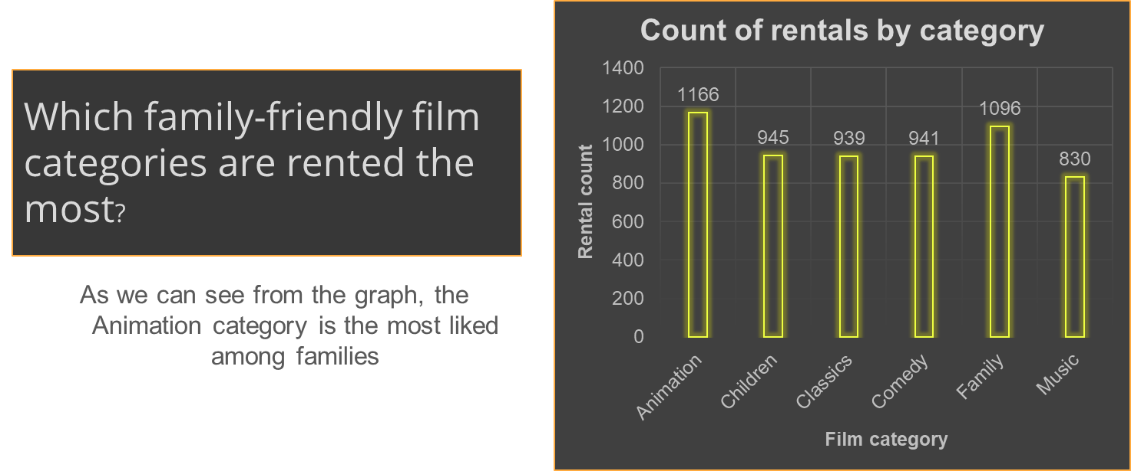
Notes:
Question #1

Slide 2
What is the trend in rental rates in both stores?
We can see that rental rates for both stores is in a steady decline
Notes:
Question #4

Slide 3
How much did each of the top 10 paying customers pay during 2007?
We can see from the graph how much each customer paid and that Eleanor Hunt paid the most during that year
Notes:
Question #5

Slide 4
How many movies are in each quartile of rental duration?
We split the movies into 4 quartiles according to their rental time, and found how many movies are in each quartile
Notes:
Question #3

