Slide 1
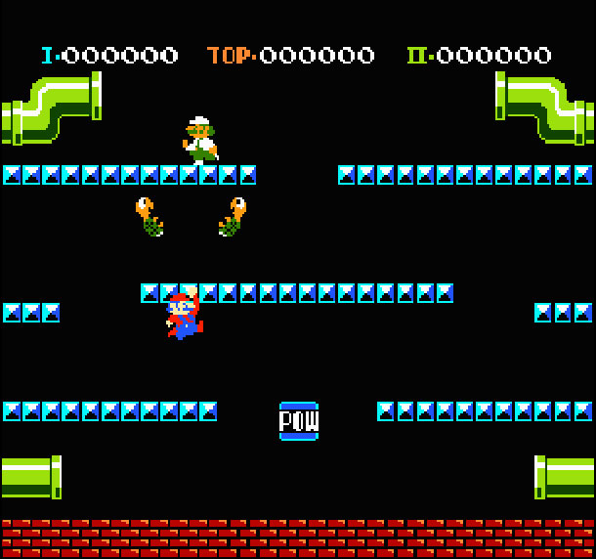
Group 2
Mario Brothers
C++
Group Members
Cole Deushane
Russell Sullivan
Lauren Curtis
Riley Peterson
Sam Hobbs
Github Repository: https://github.com/ColeDeushane/Group2
November 30, 2018

Slide 2
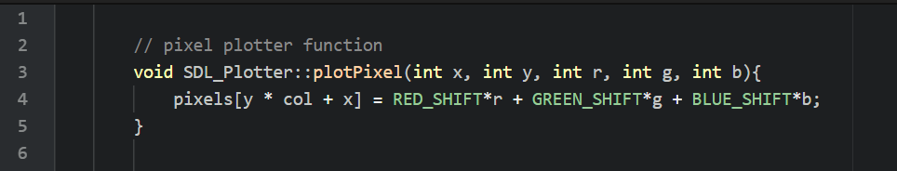
SDL_Plotter function plotPixel() used to draw images to the screen.
Used an infinite while loop to keep the game window open throughout gameplay.

Slide 3
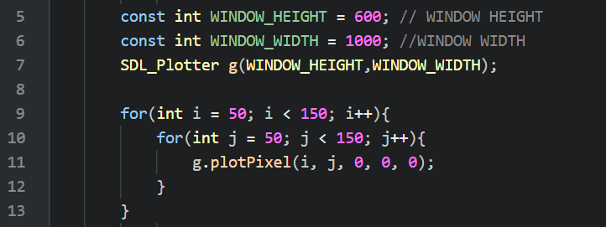
Use nested for loops to draw using SDL Plotter
This code draws a black square with a length and width of 100, at coordinates (50, 50).

Slide 4
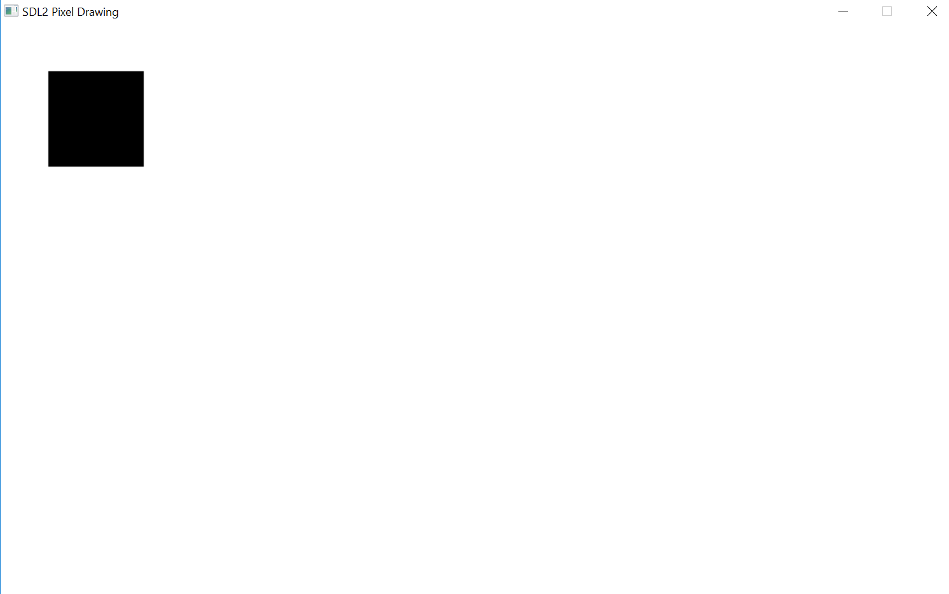

Slide 5
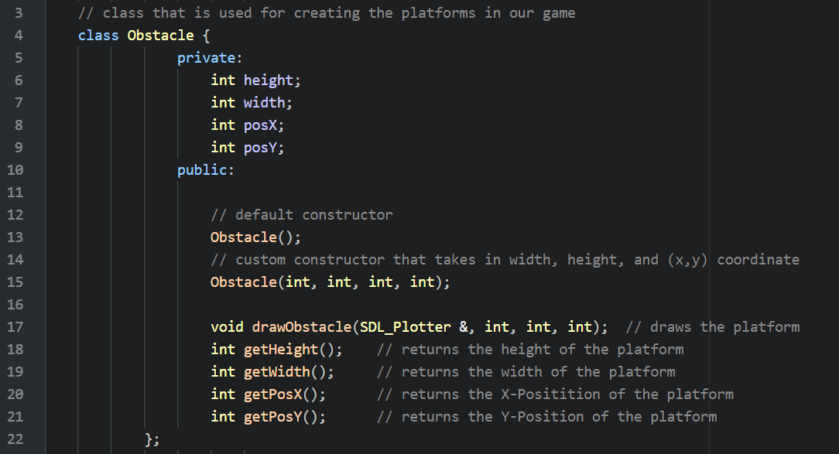
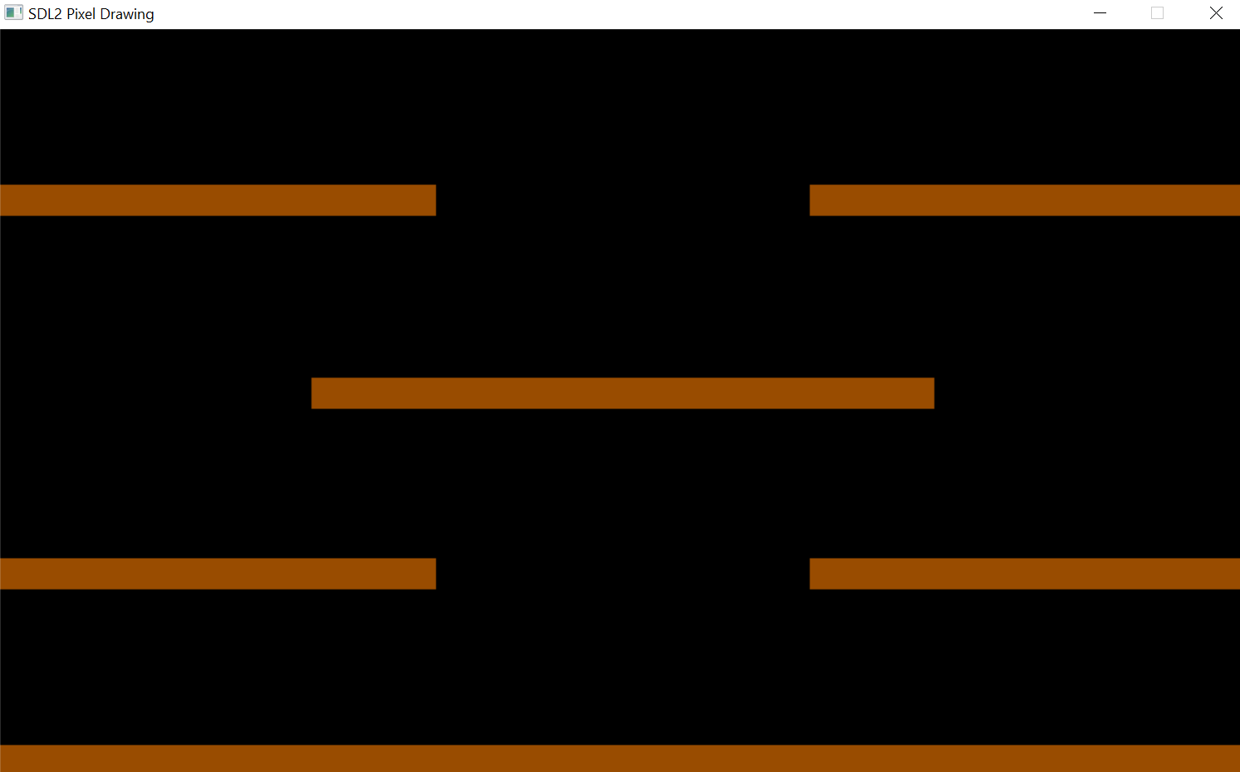
Making the Platforms
We created a class named “Obstacle” that was used to create and write all of our platforms to the screen.

Slide 6
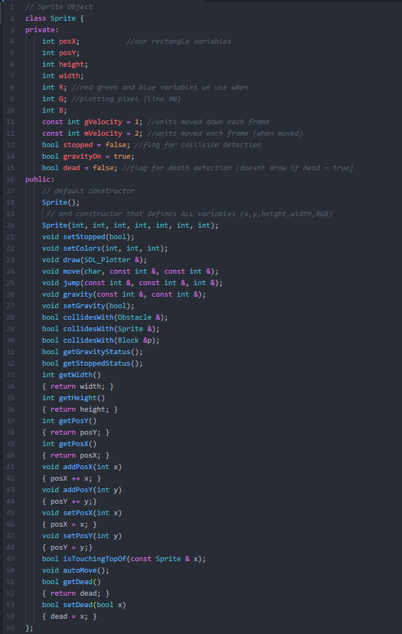
Sprite Class
Private Members:
int posX; // x-position
int posY; // y-position
int height; // height
int width; // width
int R; // red
int G; // green
int B; // blue
const int gVelocity = 1; // gravity velocity (pixels per iteration)
const int mVelocity = 2; // movement velocity (pixels per iteration)
bool stopped = false; // boolean used to stop the sprites movement
bool gravityOn = true; // boolean used to turn gravity on and off
bool dead = false; // boolean used to determine if the sprite is dead
// if sprite is dead, don’t draw to the screen

Slide 7
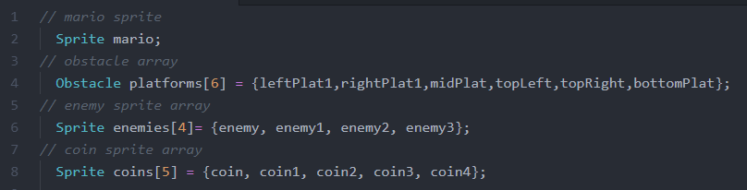
Sprites
We created a Sprite class to create Mario, the coins, and all of the enemies and we stored multiple sprites in arrays.

Slide 8
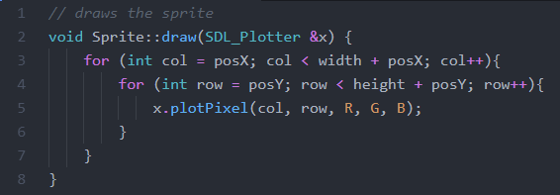
Drawing our Sprites
Nested for loop used for drawing sprites to the screen.
The SDL_Plotter class is passed by reference.

Slide 9
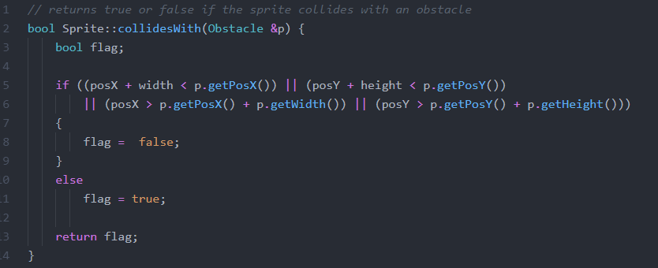
Collision Detection

Slide 10
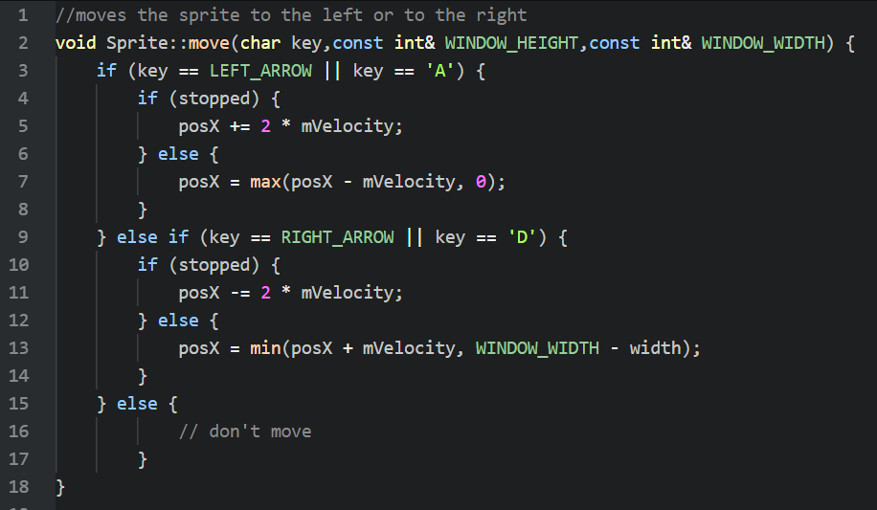
Mario’s Movement
We created a class named “Sprite” that was used to control Mario and the other enemies in the game.
The only way Mario can be moved (without jumping) is by using the left/right arrow keys or the ‘A’ and ‘D’ keys.
“stopped” is a Boolean used to determine if Mario runs into an obstacle. If stopped is true Mario is prevented from moving.

Slide 11
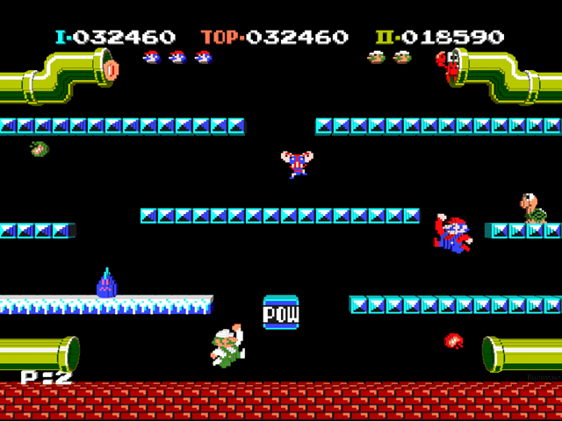
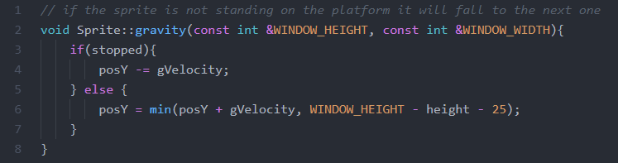
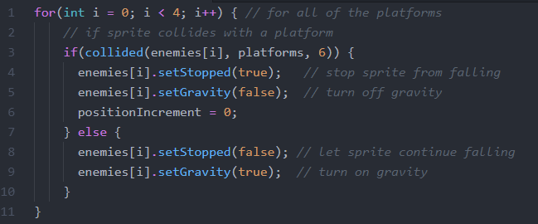
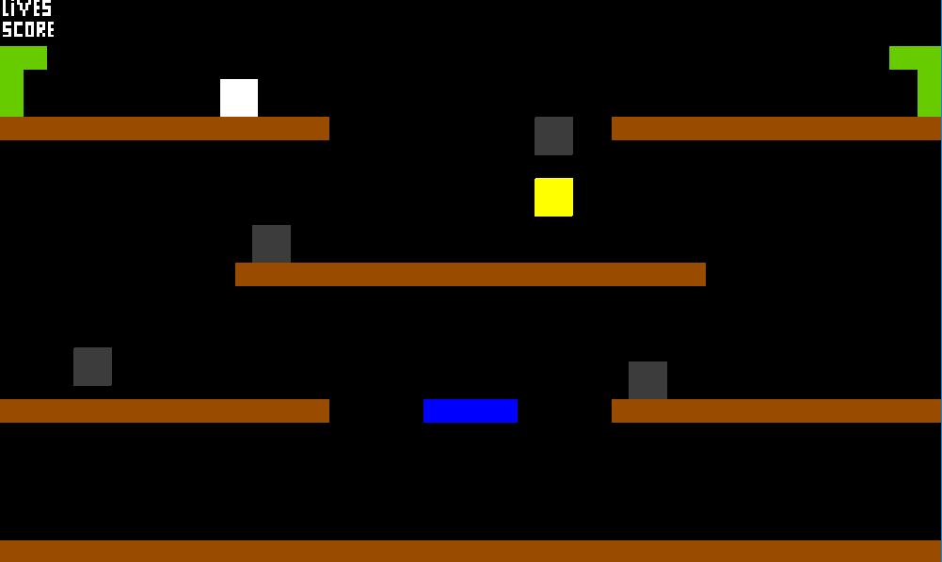
Gravity
*in functions.cpp*
*what we wished our game looked like*
*in main.cpp*
*what our game actually looked like*

