Slide 1

CineMatch
Movie recommendation web app
Personalized discovery powered by ratings, favorites, comments, and catalog metadata
github.com/bigbadcyborg/movie-recommendation-app
React + Vite
Express API
SQLite + sql.js

Slide 2
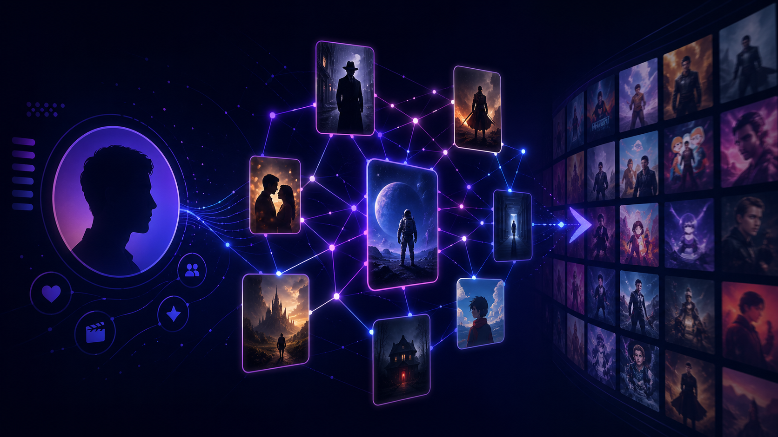
Problem and Goal
Move users from “what should I watch?” to a confident choice.
Choosing a movie is overwhelming.
Generic top lists ignore personal taste.
People have to use their intuitive/subconscious memory to think of ratings, favorites, comments.
Goal: turn engagement into useful recommendations.
User behavior + movie metadata = better discovery
CineMatch | 2

Slide 3
What users can do
Four core flows in the browser experience.
Browse & search
Movie details
Engage
Recommend
Browse movies, search by title or director, filter by genre, and sort by year or rating.
Open a movie to view poster, description, genres, rating average, and comments.
Create an account, rate movies, favorite titles, and post or manage comments.
Get a personalized list based on ratings, favorites, genre preferences, and similar users.
CineMatch | 3

Slide 4
Live demo
1
2
3
4
Home / browse
Movie detail
Demo Onboarding
Recommendations
Open app, show catalog grid, search, filter, and sort.
Open a title to show poster, genres, details, and comments.
Sign in with demo user, then rate, favorite, and comment.
Sign in with another user to showcase data saved across the app
Open recommendations or home feed and explain why titles appear.
CineMatch | 4

Slide 5
Recommendation approach
Hybrid logic makes the app useful even with limited user history.
Content-based signal
Learns genre preferences from ratings and favorites, then ranks matching titles.
Collaborative signal
Compares users with cosine similarity to surface movies liked by similar users.
Fallback signal
Uses popular movies and catalog metadata when a user has not rated enough titles yet.
CineMatch | 7

Slide 6
Data model
Catalog data and user behavior live together in one SQLite file.
Catalog
User activity
Recommendation inputs
movies
genres
similarity pairs
poster URLs
metadata for search and detail pages
accounts
ratings
favorites
comments
profile preferences
genre preferences from behavior
content-based matching
collaborative cosine similarity
popular fallback behavior
CineMatch | 6

Slide 7
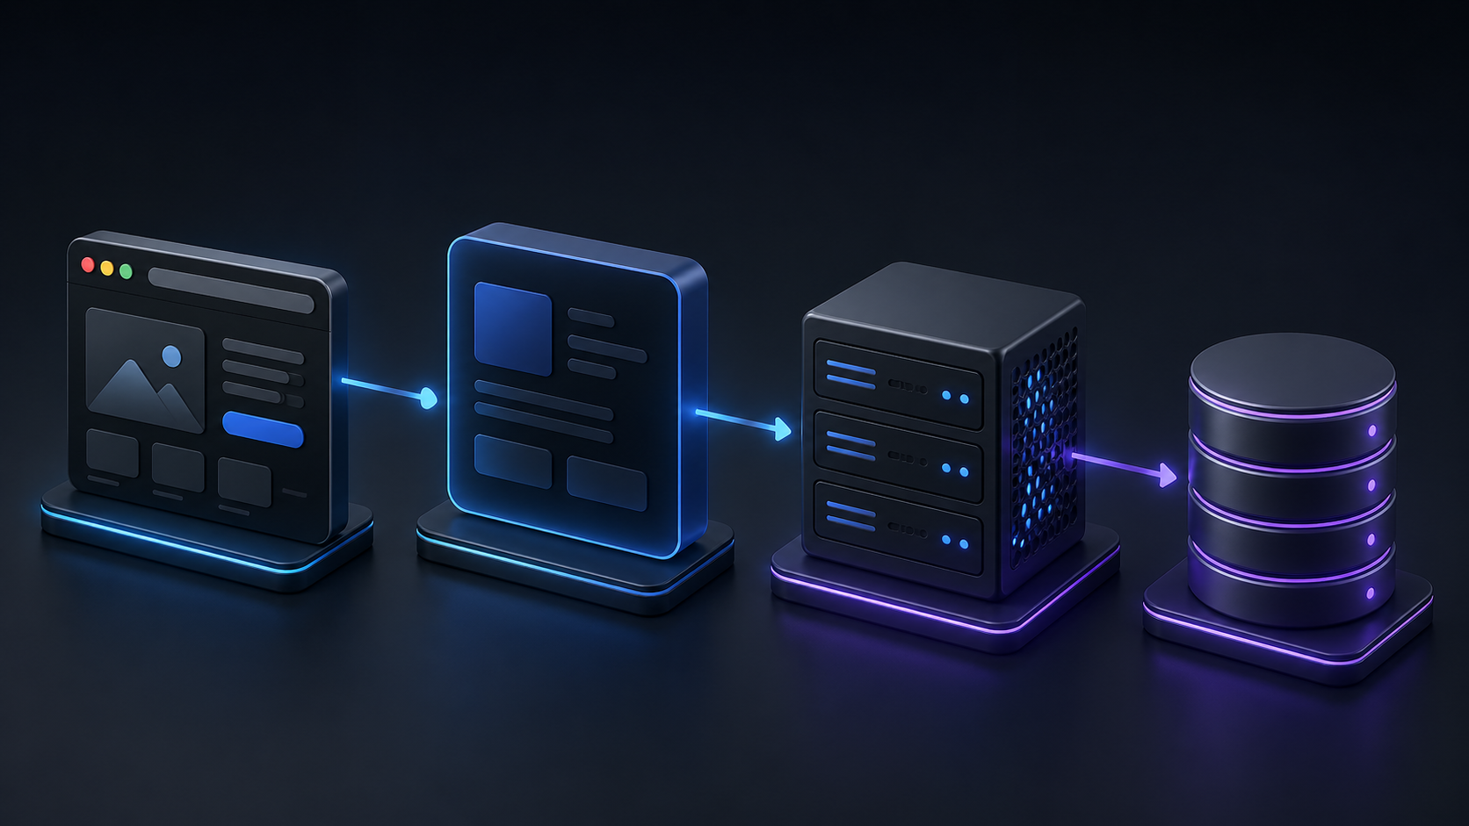
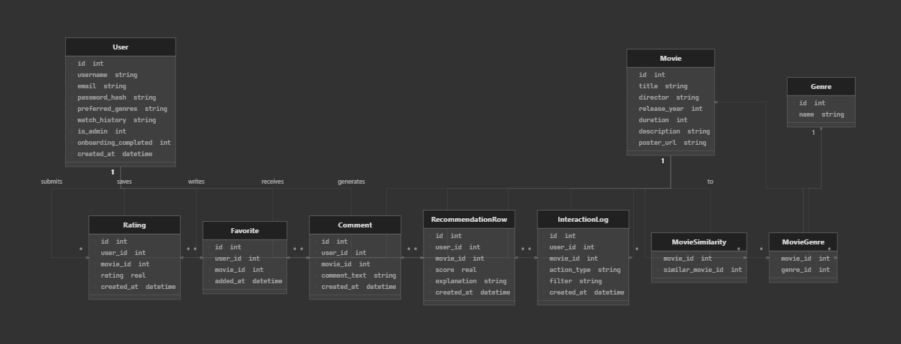
Architecture / Class Diagram
A simple full-stack flow from browser actions to persistent data.
Browser
React app
Express REST API
SQLite movies.db
/api proxy in development, JWT for protected routes, bcryptjs for password hashing
CineMatch | 5

Slide 8
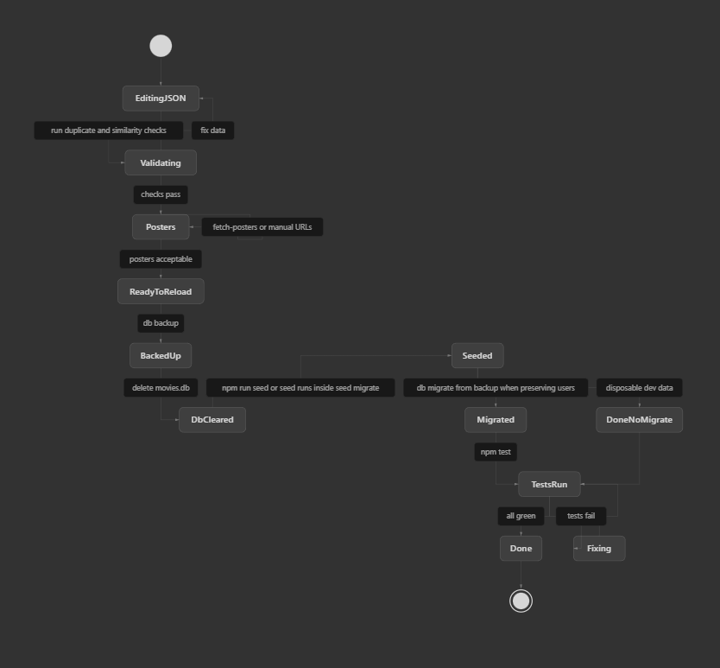
Movie update workflow
The project includes a safe operational path for refreshing movie data.
1
2
3
4
5
Edit JSON sources
Validate data
Fetch and verify posters
Backup movies.db
Seed + migrate user rows
`@agent use @UPDATE_MOVIES_AGENT.md to verify/add the following movies before running npm run test in backend:`
`@agent use @UPDATE_MOVIES_AGENT.md to add 10 movies and similarities`
npm seed:migrate preserves accounts, ratings, favorites, and comments by merging from backups after catalog changes.
CineMatch | 8

Slide 9
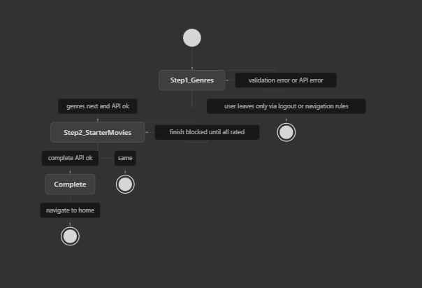
Statecharts: Onboarding Wizard
CineMatch | 5

Slide 10
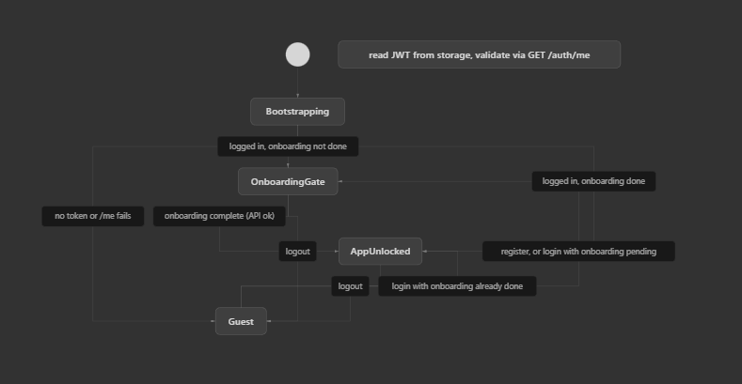
Statecharts: Client Session and Route Gating (Auth)
CineMatch | 5

Slide 11
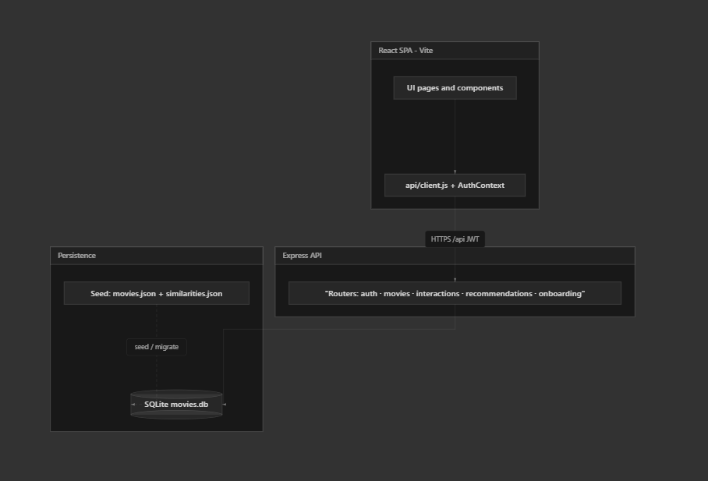
Statecharts: API Flow ( CLient -> API -> Persistent DB )
CineMatch | 5

Slide 12
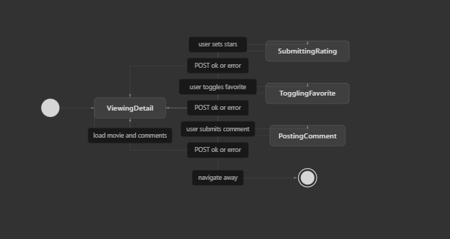
Statecharts: User-Interaction (Conceptual)
CineMatch | 5

Slide 13
Quality and testing
Backend tests keep API changes from quietly breaking user flows.
Jest backend tests
Regression control
Demo readiness
`npm test` validates key API behavior and stores test reports under tests/history/.
Tests are most valuable around auth, movie endpoints, interactions, and recommendation responses.
Known demo accounts make repeatable presentations easier and reduce live setup risk.
CineMatch | 9

Slide 14
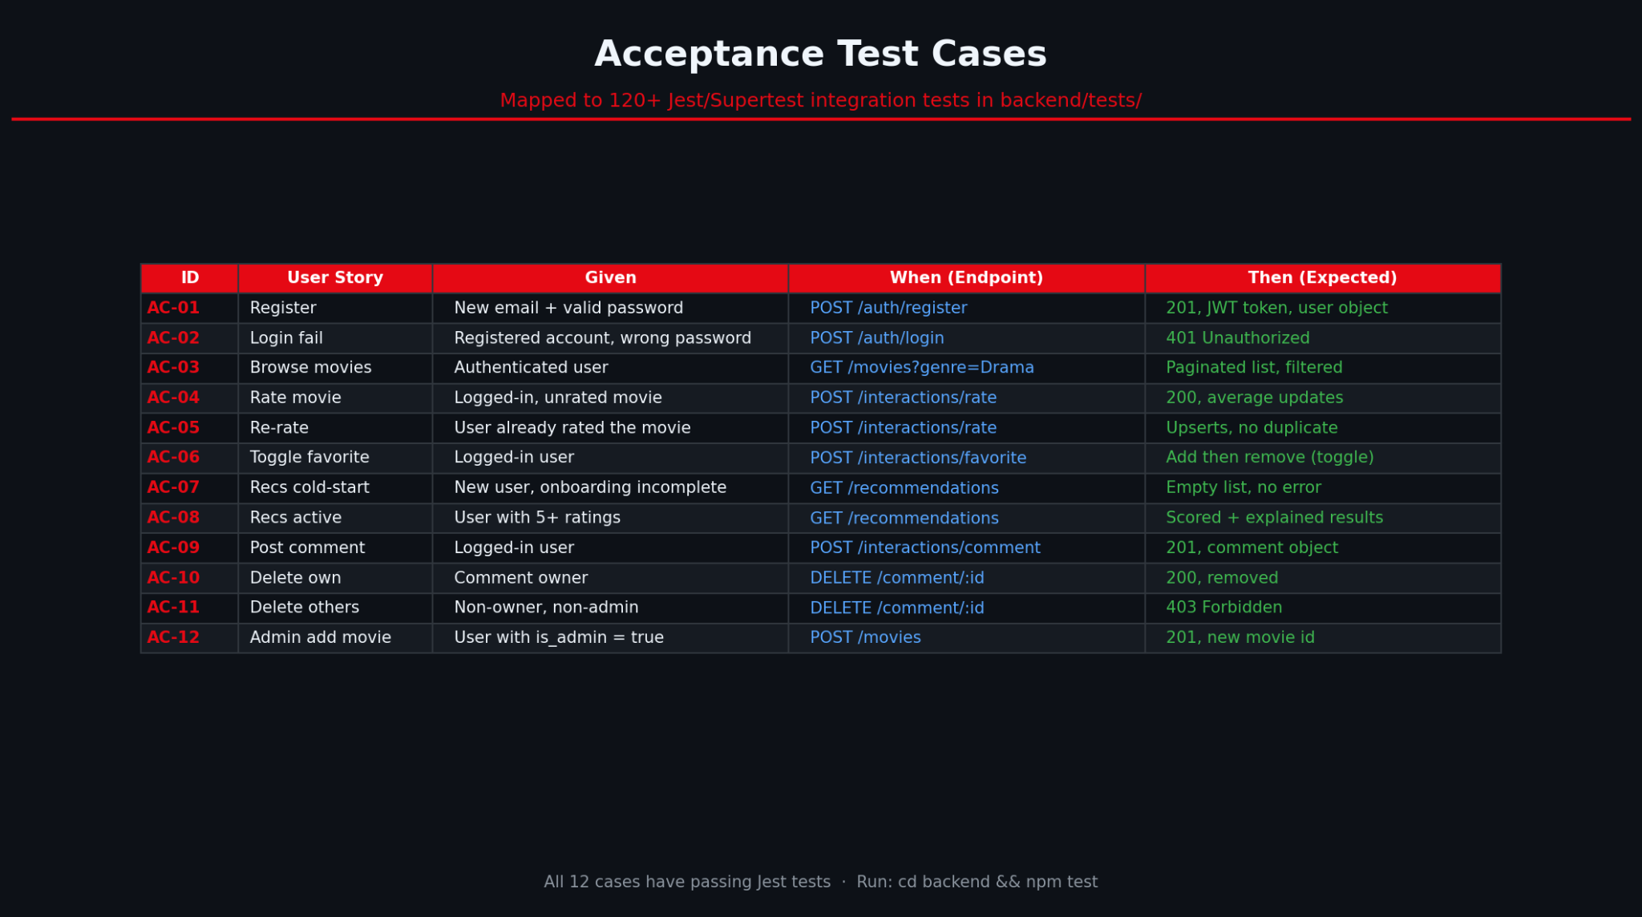
Acceptance Test Cases
Mapped to 120+ Jest/Supertest integration tests in backend/tests/
Jest backend tests
Regression control
Demo readiness
`npm test` validates key API behavior and stores test reports under tests/history/.
Tests are most valuable around auth, movie endpoints, interactions, and recommendation responses.
Known demo accounts make repeatable presentations easier and reduce live setup risk.
CineMatch | 9

Slide 15
Challenges and design decisions
The memorable engineering tradeoffs behind the app.
Single SQLite file keeps deployment simple, but destructive scripts need backups.
sql.js is file-backed, so the backend should be stopped before risky database scripts.
Movie IDs can shift after reseed, requiring migration by stable fields.
Poster quality depends on OMDb coverage and fallback validation. Using `@agent use @UPDATE_MOVIE_LIST.md fix movieName’s poster` mitigates this, depending on the model used
CineMatch | 10

Slide 16
What comes next
Logical extensions after the working full-stack baseline.
Smarter ranking
Deployment
Admin tools
Tune hybrid weights, add more signals, and support cold-start onboarding.
Package backend + DB carefully and host the frontend with environment-aware API URLs.
Project will be containerized within a Docker image for easy deployment
Add catalog editor, poster repair workflow, and safer one-click backups.
CineMatch | 11

Slide 17
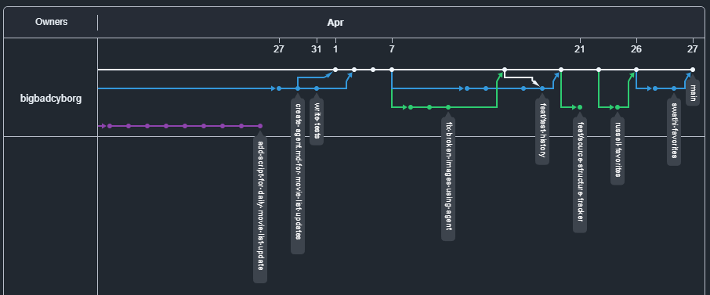
Network Graph
CineMatch | 11

Slide 18
Summary
Full-stack app for browsing, engagement, and recommendations.
React + Express + SQLite keeps the project understandable and demoable.
Catalog refresh workflow protects user data as the app evolves.
Q&A
GitHub: bigbadcyborg/movie-recommendation-app

