Slide 1
A real child. A checkpoint that does not work. A three-tier plan.
Mosaic Variegated Aneuploidy (MVA). Cells lose and gain chromosomes.
Embryonal rhabdomyosarcoma. Severe growth failure. Nephrocalcinosis.
Team bigbag. Rare Disease, Real Kid: MVA Hackathon 2026.

Slide 2
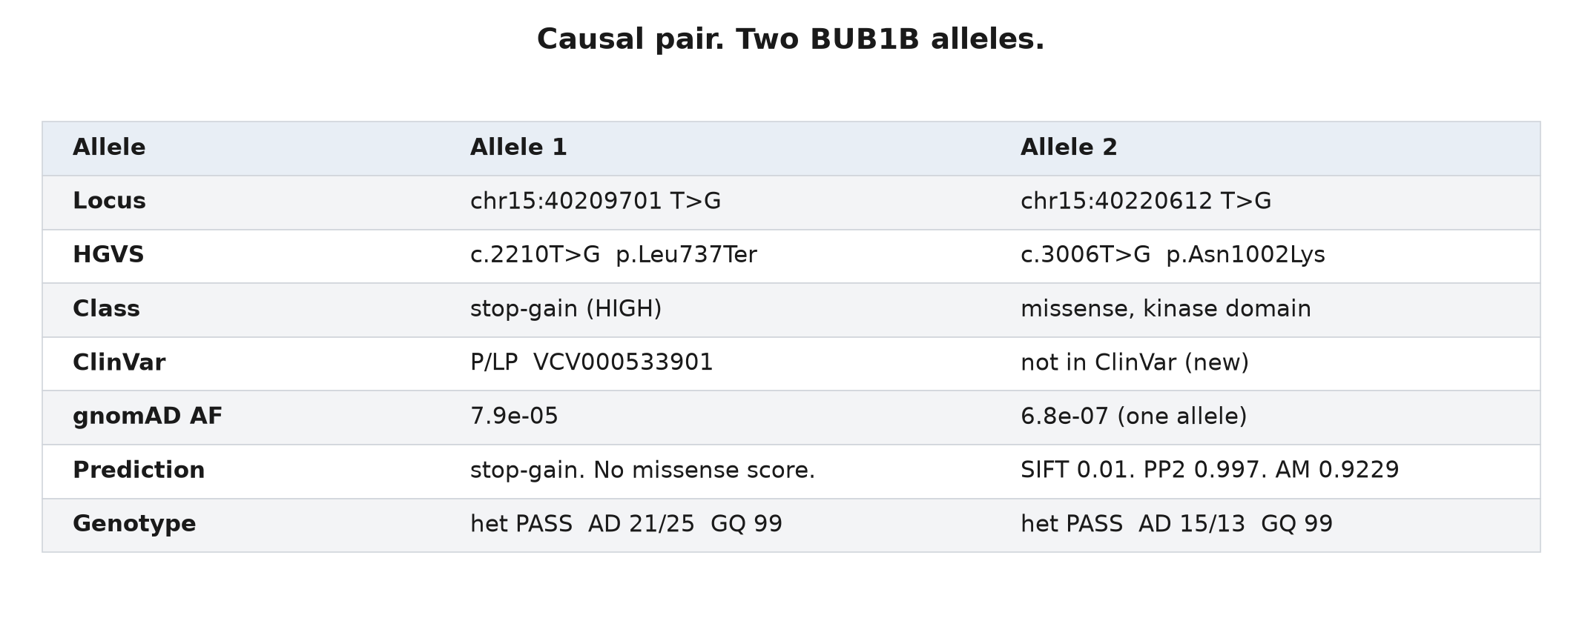
The cause. Confirmed.
Track 1 score: 100.0 rank points. F-max 1.000. Full match.

Slide 3
The constraint
No approved drug increases BubR1.
We must not decrease checkpoint function more. The checkpoint already does not work.
We map three target groups: the tumor, the stress, and the protein.

Slide 4
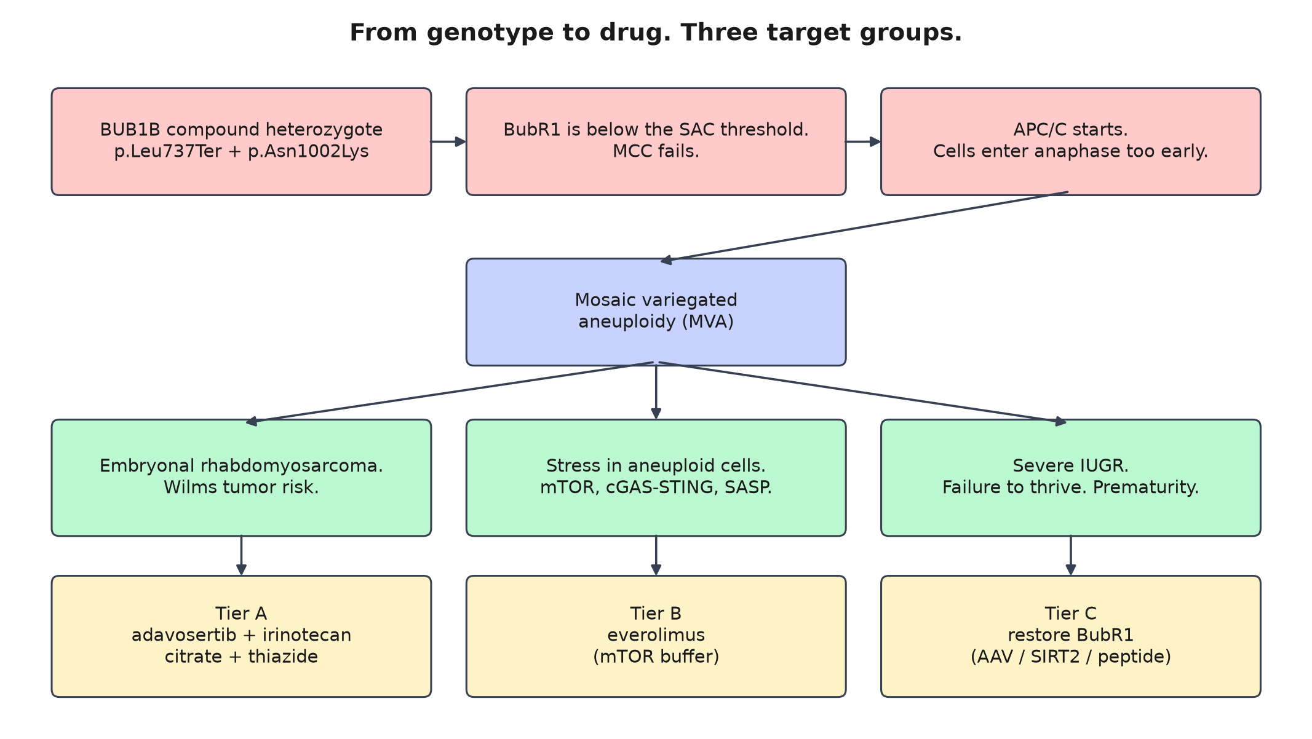
Mechanism. From genotype to drug.

Slide 5
Tier A. Treat the signs that we see today.
Adavosertib plus irinotecan
Cole et al. https://doi.org/10.1002/cncr.34786. National Cancer Institute https://clinicaltrials.gov/study/NCT02095132.
Potassium citrate plus a thiazide
Weigert and Hoppe. https://doi.org/10.3389/fped.2018.00098. Safe in children. Protects bone.
Alisertib
Mossé et al. https://doi.org/10.1158/1078-0432.CCR-18-2675.

Slide 6
Tier B. Decrease the stress.
Aneuploid cells increase mTOR.
These cells release inflammatory signals.
Everolimus decreases that signal.
Franz et al. https://doi.org/10.1371/journal.pone.0158476.
Honest claim
This drug decreases damage. This drug does not repair the checkpoint.

Slide 7
Tier C. Restore the protein.
Mouse data (Baker et al.)
More BubR1 repairs the checkpoint. https://doi.org/10.1038/ncb2643
This child still makes weakened BubR1 from the missense allele.
A small increase in BubR1 level can restore checkpoint function.
Three routes. One goal.
AAV. SIRT2-axis. Peptide rescue. Zhang et al. https://doi.org/10.1038/s43587-023-00361-w.

Slide 8
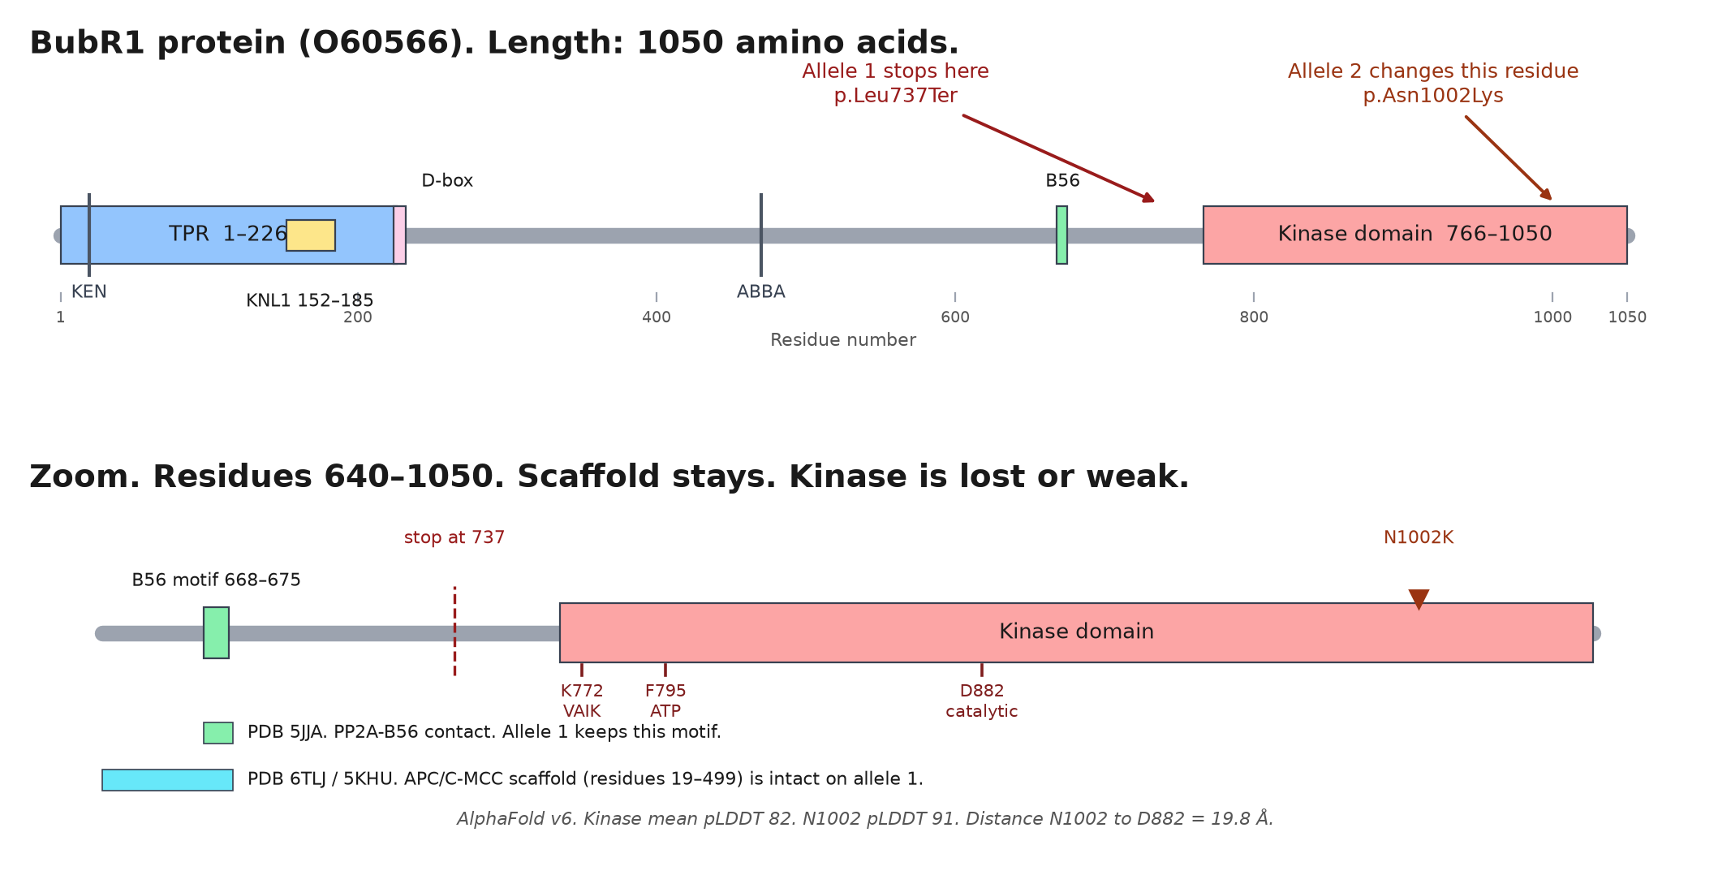
Both alleles change the kinase domain. The scaffold stays.

Slide 9
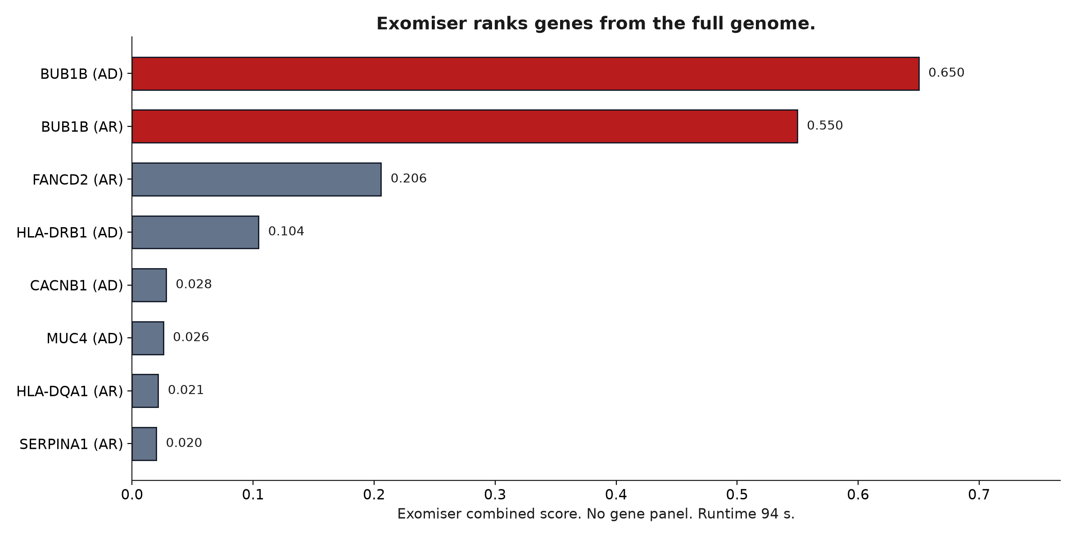
Rigor. Three independent methods agree.
Panel scan. Exomiser on the full genome (94 s, no panel). Clinical databases. All point to BUB1B.

Slide 10
Scale. A laptop runs the pipeline.
Open Targets https://platform.opentargets.org/target/ENSG00000156970. DGIdb https://www.dgidb.org/. ChEMBL https://www.ebi.ac.uk/chembl/explore/target/CHEMBL5491. everycure/matrix-scores https://huggingface.co/datasets/everycure/matrix-scores.
Full pipeline: about 6 hours and 1 USD of electricity. Genome-wide check: 94 seconds.
The method applies to other recessive chromosomal-instability disorders.
Code: https://github.com/bigbag/mva-hackathon-2026

Slide 11
The request
Give standard symptom care now.
Use trial-controlled cancer options when needed.
Start a research program on BubR1 restoration.
This family shared the genome of their child. We give them a clear plan.

Slide 12
Works Cited (MLA)
Baker, Darren J., et al. "Increased Expression of BubR1 Protects against Aneuploidy and Cancer and Extends Healthy Lifespan." Nature Cell Biology, vol. 15, no. 1, 2013, pp. 96-102. https://doi.org/10.1038/ncb2643.
bigbag. "mva-hackathon-2026." GitHub, 2026, https://github.com/bigbag/mva-hackathon-2026.
ChEMBL. "Wee1-like Protein Kinase (CHEMBL5491)." ChEMBL, EMBL-EBI, https://www.ebi.ac.uk/chembl/explore/target/CHEMBL5491.
Cole, Kristina A., et al. "Pediatric Phase 2 Trial of a WEE1 Inhibitor, Adavosertib (AZD1775), and Irinotecan for Relapsed Neuroblastoma, Medulloblastoma, and Rhabdomyosarcoma." Cancer, vol. 129, no. 14, 2023, pp. 2245-55. https://doi.org/10.1002/cncr.34786.
DGIdb. The Drug Gene Interaction Database, Washington University School of Medicine, https://www.dgidb.org/.
everycure. "matrix-scores." Hugging Face, https://huggingface.co/datasets/everycure/matrix-scores.
Franz, David Neal, et al. "Long-Term Use of Everolimus in Patients with Tuberous Sclerosis Complex: Final Results from the EXIST-1 Study." PLOS ONE, vol. 11, no. 6, 2016, e0158476. https://doi.org/10.1371/journal.pone.0158476.

Slide 13
Works Cited (MLA), continued
Mossé, Yaël P., et al. "A Phase II Study of Alisertib in Children with Recurrent/Refractory Solid Tumors or Leukemia: Children's Oncology Group Phase I and Pilot Consortium (ADVL0921)." Clinical Cancer Research, vol. 25, no. 11, 2019, pp. 3229-38. https://doi.org/10.1158/1078-0432.CCR-18-2675.
National Cancer Institute. "Adavosertib and Irinotecan Hydrochloride in Treating Younger Patients with Relapsed or Refractory Solid Tumors." ClinicalTrials.gov, NCT02095132, U.S. National Library of Medicine, https://clinicaltrials.gov/study/NCT02095132.
Open Targets Platform. "BUB1B (ENSG00000156970)." Open Targets, https://platform.opentargets.org/target/ENSG00000156970.
Sage Bionetworks. "mva-hackathon-2026-data." Hugging Face Datasets, 2026, https://huggingface.co/datasets/SageBio/mva-hackathon-2026-data.
———. "Rare Disease, Real Kid: MVA Hackathon 2026." Hugging Face Spaces, 2026, https://sagebio-rare-disease-real-kid-mva-hackathon-2026.hf.space/.
Weigert, Alexander, and Bernd Hoppe. "Nephrolithiasis and Nephrocalcinosis in Childhood—Risk Factor-Related Current and Future Treatment Options." Frontiers in Pediatrics, vol. 6, 2018, p. 98. https://doi.org/10.3389/fped.2018.00098.
Zhang, Na, et al. "Unique Progerin C-Terminal Peptide Ameliorates Hutchinson-Gilford Progeria Syndrome Phenotype by Rescuing BUBR1." Nature Aging, vol. 3, no. 2, 2023, pp. 185-201. https://doi.org/10.1038/s43587-023-00361-w.

Slide 14
Thank you
Team bigbag. https://github.com/bigbag/mva-hackathon-2026
Hackathon: https://sagebio-rare-disease-real-kid-mva-hackathon-2026.hf.space/
Data: https://huggingface.co/datasets/SageBio/mva-hackathon-2026-data
Organizers: Sage Bionetworks, MVA Society, Hugging Face, BEACON. Sponsors: AWS and Anthropic.
Above all, the family.

