Slide 1
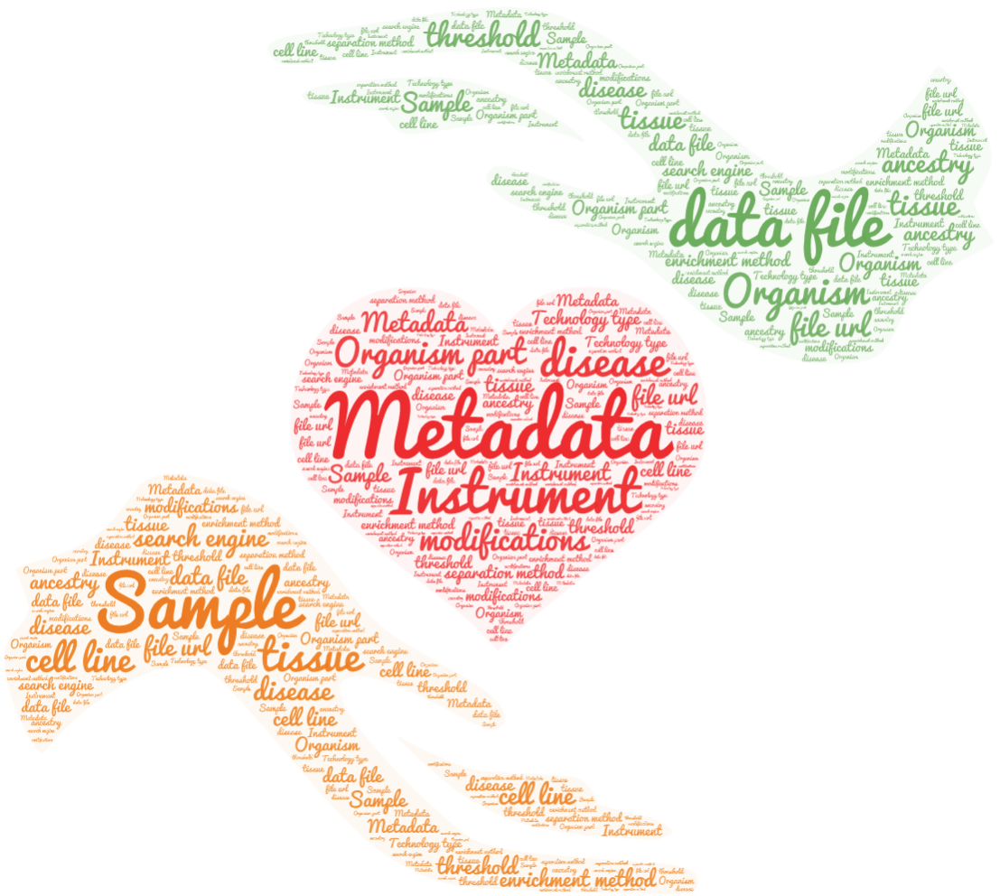
Proteomics Sample Metadata Experimental Design
Yasset Perez-Riverol PhD
Team Coordinator, PRIDE, EMBL-EBI
https://github.com/bigbio/proteomics-metadata-standard

Slide 2
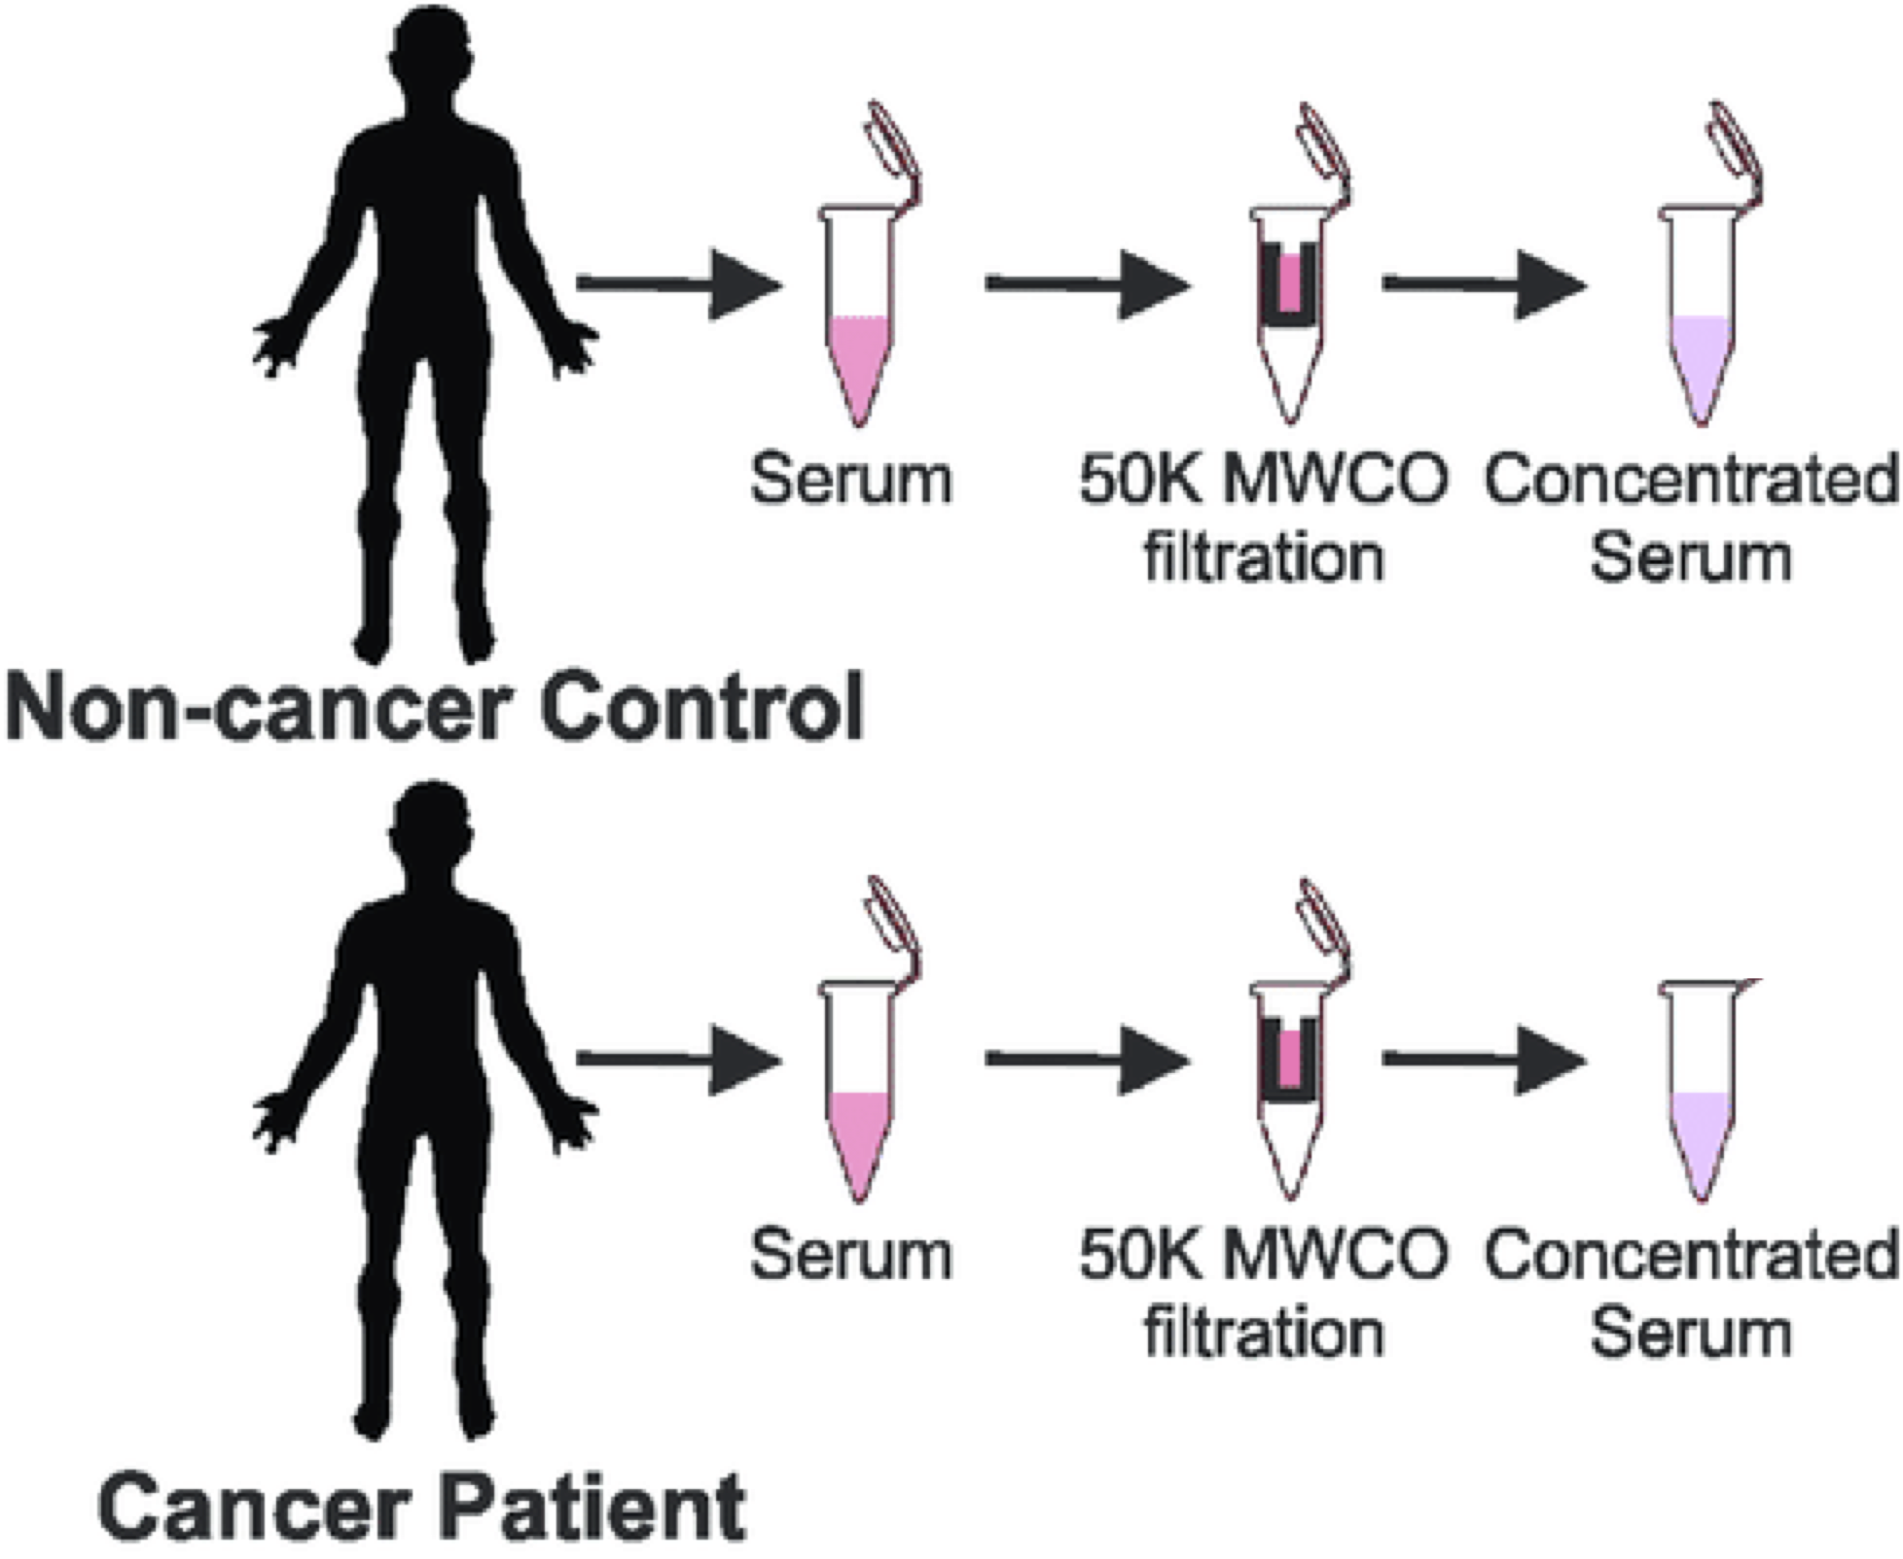
The Problem
Data Files
Instrument files
Result files
Intermediate files
Plots
config files
Dataset general description
Sample
To
Data files
PX summary file

Slide 3
Use cases and requirements
Support sample to file relations
Easy to use by submitters (manual annotation) and software tools.
Compatible with existing ProteomeXchange formats submission.px, mzTab, mzIdentML, mzML
Ontology-based

Slide 4
MAGE-TAB for Proteomics
Support sample to file relations
Easy to use by submitters (manual annotation) and software tools.
Compatible with existing ProteomeXchange formats submission.px, mzTab, mzIdentML, mzML
Ontology-based
Well-known in the transcriptomics community allowing multi-omics studies in the future.
Existing tooling framework to validate and curate the files.
Ongoing work to represent more complex cases in like single cell RNA experiments (future of proteomics)
Tab-delimited format compatible with existing tools in Proteomics like MsStats.

Slide 5
MAGE-TAB Version 1.1 Investigation Title Ultra-deep human phosphoproteome reveals different regulatory nature of Tyr and Ser/Thr-based signaling Experiment Description Regulatory protein phosphorylation controls nearly every normal and pathophysiological signaling system in eukaryotic cells. Date of Experiment 2014-08-06 Public Release Date 2014-08-06 Protocol Name P-MTAB-Sample-PXD000612 P-MTAB-Data-PXD000612 Protocol Type sample collection protocol data analysis protocol Protocol Description HeLa S3 cells were subjected to a double thymidine block in combination with nocodazole Raw mass spectrometric data was analyzed in the MaxQuant environment version 1.5.0.0, and employed Andromeda for database search. Protocol Parameters Protocol Hardware Q Exactive Protocol Software Protocol Contact Person Last Name Oroshi Mann Person First Name Mario Matthias Person Mid Initials Person Email oroshi@biochem.mpg.de mmann@biochem.mpg.de Person Phone Person Fax Person Affiliation Proteomics Department of Proteomics and Signal Transduction Max Planck Institute of Biochemistry Person Address Person Roles submitter principal investigator Person Roles Term Source REF Person Roles Term Accession Number Experimental Factor Name compound enrichment process SDRF File PXD000612.sdrf.tsv Comment[SDRF-Proteomics version] 1.1 Comment[TemplateType] proteomics Comment[ProteomeXchange accession number] PXD000612

Slide 6
Sample to Data format: SDRF
sample properties
data file properties
study variables
source name | characteristics[organism] | characteristics[disease] | characteristics[phenotype] | … | assay name | comment[fraction identifier] | comment[label] | comment[data file] | factor value[phenotype]
sample 1 | homo sapiens | gastric carcinoma | control |  | Run 1 | 1 | label free | fileRAW_Control_F1.raw | control
sample 2 | homo sapiens | gastric carcinoma | primary tumor |  | Run 2 | 1 | label free | fileRAW_Tumor_F1.raw | primary tumor
….
Sample properties: Attributes related for the sample (tissue, disease, etc.). The sample properties are annotated with the prefix characteristics.
Data file properties: Attributes for the assay / data file / msrun (fraction identifier, label, etc.). The data file properties are annotated with the prefix comment.
Study variable: Variables under study that should be present in the sample characteristics. The study variables are annotated with the prefix factor value

Slide 7
SDRF: experimental Design
Biological replicates should be annotated with the sample sample identifier and characteristics. biological replicate can be use as optional column.
Sample 1
Msrun 1
Sample 2
Msrun 2
.
.
.
Sample n
Msrun m
label: Type of labeling: Label free sample, TMT16
fraction identifier: identifier of the fraction 1, 2..
technical replicate (optional): identifier of the technical replicate

Slide 8
Sample properties
Data file properties
Study variables
source name | characteristics [organism] | … | characteristics [disease] | characteristics [phenotype] | characteristics [biological replicate] | assay name | comment [fraction identifier] | comment [label] | comment [technical replicate] | … | comment [data file] | factor value [phenotype]
Sample 1 | homo sapiens | … | liver cancer | necrotic tissue | 1 | Run 1 | 1 | AC=MS:1002038;NT=label free sample | 1 | … | 01.raw | necrotic tissue
Sample 1 | homo sapiens | … | liver cancer | necrotic tissue | 1 | Run 2 | 1 | AC=MS:1002038;NT=label free sample | 2 | … | 02.raw | necrotic tissue
Sample 2 | homo sapiens | … | liver cancer | necrotic tissue | 2 | Run 3 | 1 | AC=MS:1002038;NT=label free sample | 1 | … | 03.raw | necrotic tissue
Sample 2 | homo sapiens | … | liver cancer | necrotic tissue | 2 | Run 4 | 1 | AC=MS:1002038;NT=label free sample | 2 | … | 04.raw | necrotic tissue
Sample 3 | homo sapiens | … | liver cancer | normal | 1 | Run 5 | 1 | AC=MS:1002038;NT=label free sample | 1 | … | 05.raw | normal
Sample 3 | homo sapiens | … | liver cancer | normal | 1 | Run 6 | 1 | AC=MS:1002038;NT=label free sample | 2 | … | 06.raw | normal
Sample 4 | homo sapiens | … | liver cancer | normal | 2 | Run 7 | 1 | AC=MS:1002038;NT=label free sample | 1 | … | 07.Raw | normal
Sample 4 | homo sapiens | … | liver cancer | normal | 2 | Run 8 | 1 | AC=MS:1002038;NT=label free sample | 2 | … | 08.raw | normal
factor value[phenotype]
necrotic tissue
normal
source name
Sample accession
assay name
Data file accession
Run 1
01.raw
Sample 1
Sample 1
Technical replicates
necrotic tissue
biological replicate 1
Run 2
02.raw
Run 3
03.raw
Sample 2
Sample 2
Technical replicates
necrotic tissue
biological replicate 2
Run 4
04.raw
necrotic tissue
Run 5
05.raw
Sample 3
Sample 3
Technical replicates
normal tissue
biological replicate 1
Run 6
06.raw
Run 7
07.raw
Sample 4
Sample 4
Technical replicates
normal tissue
biological replicate 2
Run 8
08.raw
normal tissue
Label free experiment with no fractions

Slide 9
SDRF: Column and values
Column name: The column name MUST be an existing CvTerm name. Examples:
characteristics[disease] -> http://www.ebi.ac.uk/efo/EFO_0000408
characteristics[compound] -> http://purl.obolibrary.org/obo/NCIT_C43366
Values: The values of each column + sample can be:
free text: Name corresponding to OLS term. For example:
Homo sapiens
HCC1576
CvTerm URI: the URI of the corresponding CVTerm.
http://purl.obolibrary.org/obo/NCBITaxon_9606
http://www.ebi.ac.uk/efo/EFO_0006429
Complex key-value pairs: Some values CAN be represented by key-value pairs combinations. For example post-translational modifications or Enzymes:
NM=Glu→pyro-Glu; MT=fixed; PP=Anywhere; AC=Unimod:27; TA=E
NE=Trypsin; AC=MS:1001251

Slide 10
SDRF: Key-value pairs values
Property | Key | Example | Mandatory(✅)/Optional()
Name of the modification | NT | NT=Acetylation | ✅
Database Accession | AC | AC=UNIMOD:1
Chemical Formula | CF | CF=H(2)C(2)O
Modification type | MT | MT=Fixed
Position of the modification in the polypeptide | PP | PP=Any N-term | ✅
Target Amino acid | TA | TA=S,T,Y | ✅
Monoisotopic mass | MM | MM=42.010565
NM=Glu→pyro-Glu; MT=fixed; PP=Anywhere; AC=Unimod:27; TA=E

Slide 11
SDRF: Some additional rules
Unknown values: In some cases the column is Mandatory (✅) but for some samples the value is unknown. In those cases users SHOULD use not available.
Not Applicable values: In some cases the column is Mandatory (✅) but for some samples the value is not applicable: In those cases users SHOULD use not applicable.
Case sensitive: By specification, the SDRF is case insensitive, but we RECOMMEND to use lower cases throughout all the text (Column names and values).
Spaces: By specification, the SDRF is insensitive to spaces (SourceName == source name). We RECOMMENDED to use the space representation because is more human readable (e.g source name).

Slide 12
SDRF: Sample templates
 | Default | Human | Vertebrates | Non-vertebrates | Plants | Cell lines
Source Name | ✅ | ✅ | ✅ | ✅ | ✅ | ✅
characteristics[organism] | ✅ | ✅ | ✅ | ✅ | ✅ | ✅
characteristics[strain/breed]
characteristics[ecotype/cultivar]
characteristics[ethnicity] |  | ✅
characteristics[age] |  | ✅
characteristics[developmental stage] |  | ✅
characteristics[sex] |  | ✅
characteristics[disease] | ✅ | ✅ | ✅ | ✅ |  | ✅
characteristics[organism part] | ✅ | ✅ | ✅ | ✅ | ✅ | ✅
characteristics[cell type] | ✅ | ✅ | ✅ | ✅ | ✅ | ✅
characteristics[individual] |  | ✅
characteristics[cell line] |  |  |  |  |  | ✅
comment[data file] | ✅ | ✅ | ✅ | ✅ | ✅ | ✅
comment[fraction identifier] | ✅ | ✅ | ✅ | ✅ | ✅ | ✅
comment[label] | ✅ | ✅ | ✅ | ✅ | ✅ | ✅

Slide 13
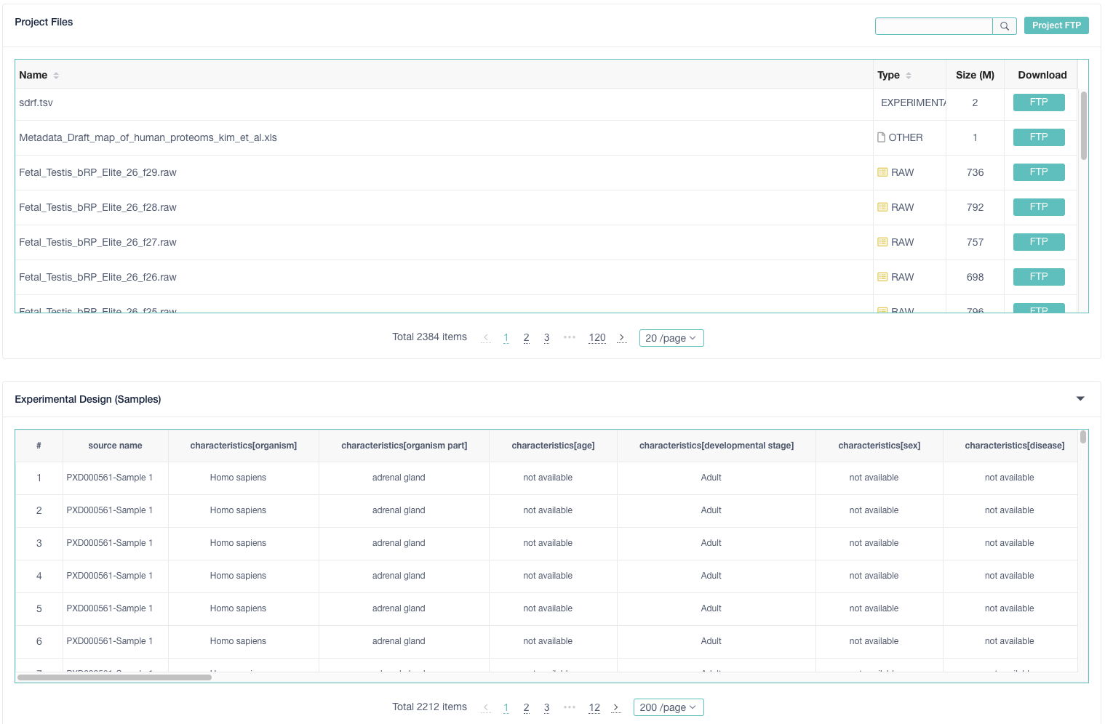


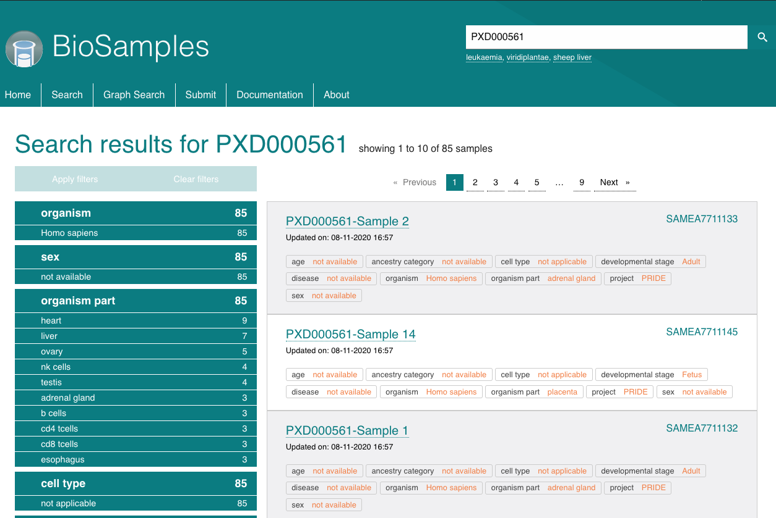
Validation
MAGE-TAB Proteomics
components
Conversion
configuration parameters
OpenMS
sdrf-pipelines (Python)
MaxQuant
SDRF
Proteomics
https://github.com/bigbio/sdrf-pipelines
MSstats
PRIDE Archive Web
jSDRF (Java)
IDF
https://github.com/bigbio/sdrf-pipelines
MAGE-TAB Proteomics
Bio-MAGETAB (Perl)
https://metacpan.org/release/Bio-MAGETAB
PRIDE Submission Tool
Annotation
PRIDE Submission
Pipelines
https://www.ebi.ac.uk/pride/archive/projects/PXD000561
RAWs
Results
Others
SDRF-Proteomics
RAWs
Results
Others
SDRF-Proteomics
Generated IDF
BioSamples Web
jSDRF (Java)
{ BioSamples API }
https://www.ebi.ac.uk/biosamples/samples?text=PXD000561

Slide 14
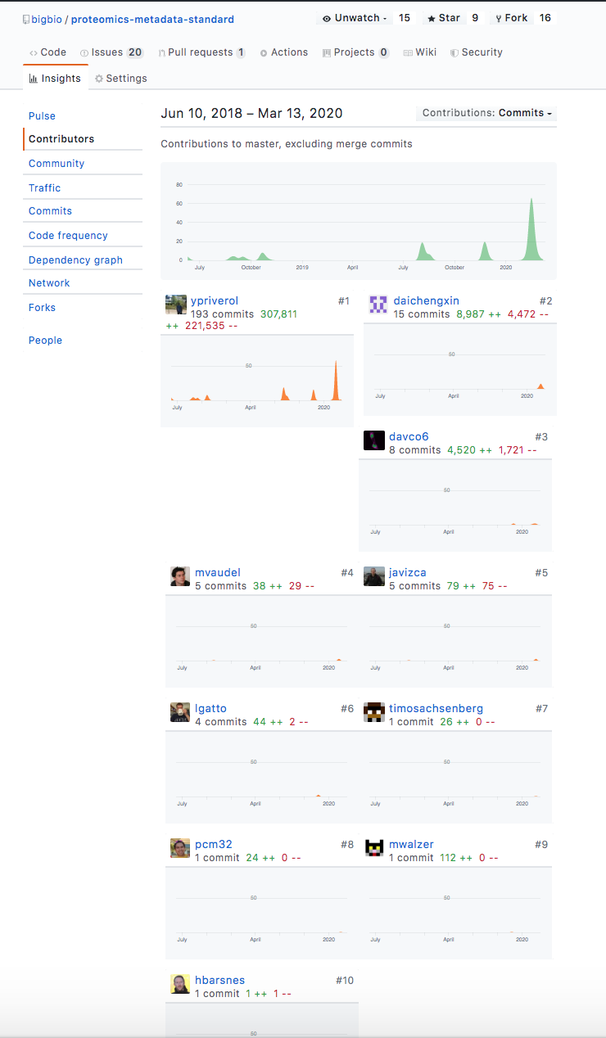
Community-oriented
Issues are discussed here: https://github.com/bigbio/proteomics-metadata-standard/issues
Examples: https://github.com/bigbio/proteomics-metadata-standard/tree/master/annotated-projects
CI validation of the files using Cirecle-CI for PRs.

Slide 15
sdrfcheck: SDRF validator
sdrfcheck: https://github.com/bigbio/sdrf-pipelines
Python validator and Install using pip: pip install sdrf-pipelines
parse_sdrf validate-sdrf --sdrf_file {here_the_path_to_sdrf_file}

