Slide 1
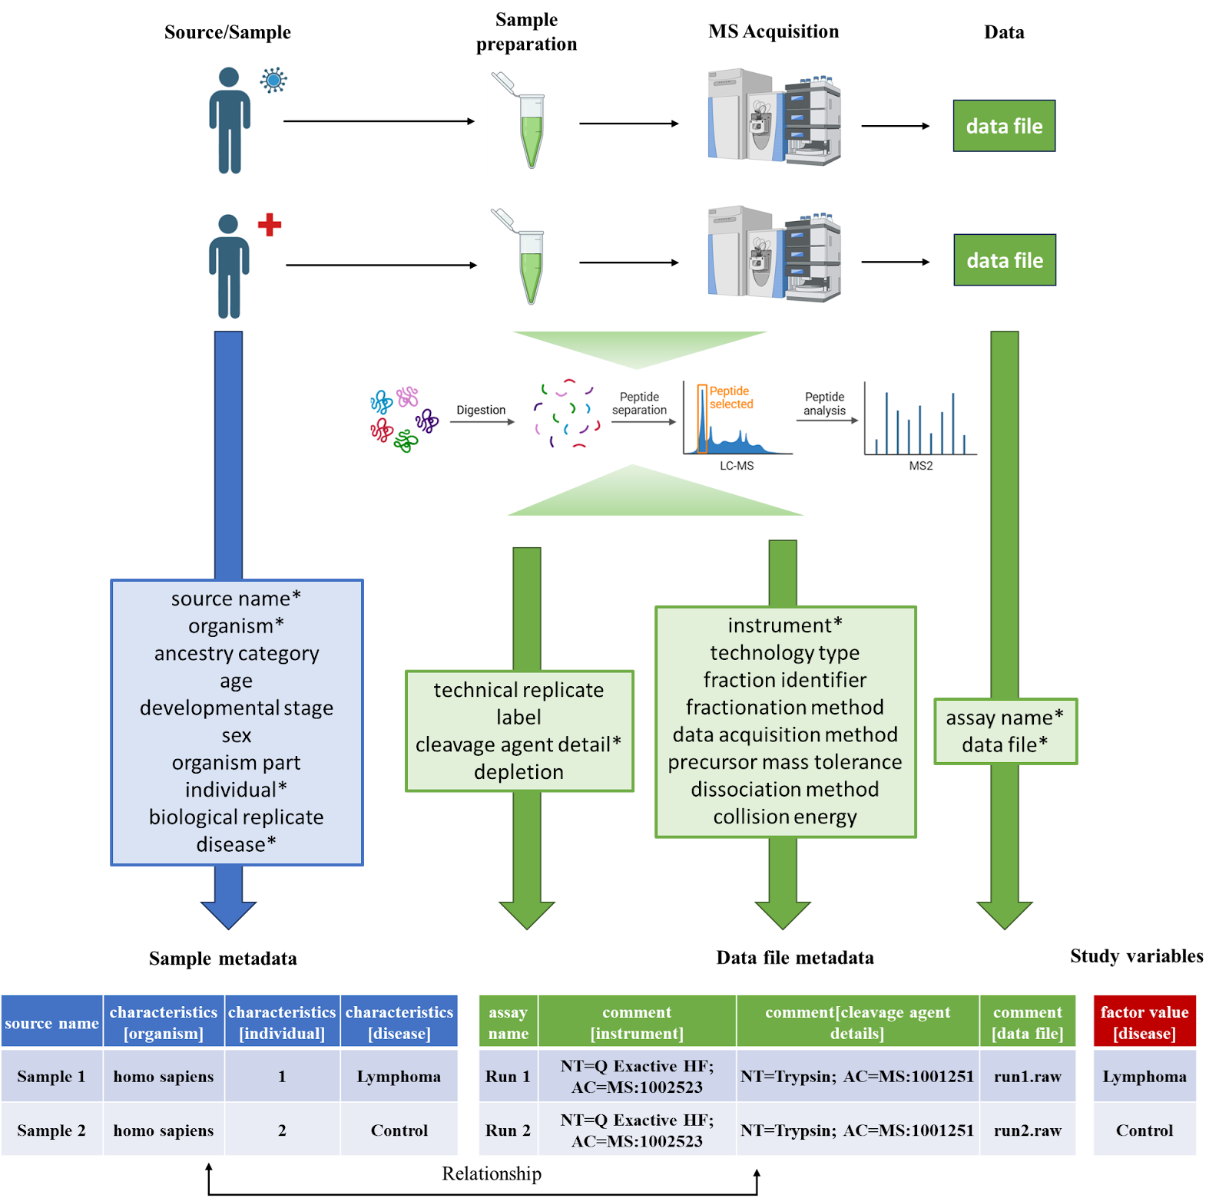
https://github.com/bigbio/proteomics-sample-metadata
https://github.com/bigbio/sdrf-pipelines
Resources support:
SDRF validator (service coming in the future)
PRIDE
MaxQuant
lesSDRF
CUPCAKE
Wombat
quantms ecosystem (pmultiqc, quantms)

Slide 2
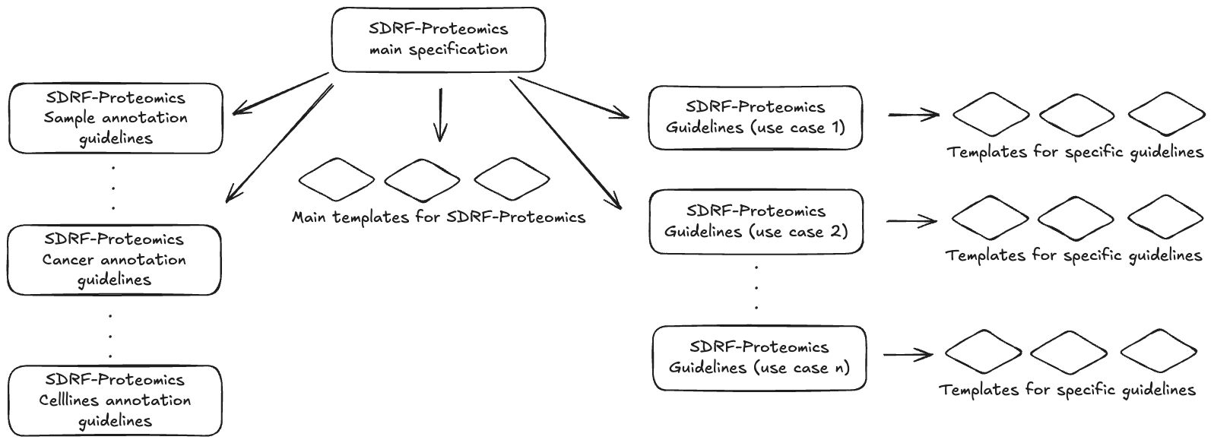

Slide 3
What’s Changed / Added
Restructured Spec & Versioning
Core specification separated from “use-case guidelines/templates” (e.g. Immunopeptidomics, Single Cell, Crosslinking, Affinity, Metaproteomics). GitHub
Documentation reorganised: new README, clearer framing (motivation, spec structure), updated external links and ontology references. GitHub
Use-Case Guidelines & Templates
For each special type of proteomics experiment (e.g. single cell, immunopeptidomics, crosslinking etc.), there are now dedicated guideline docs plus templates. GitHub
Each guideline defines:
Additional required metadata columns
Optional/recommended columns
Examples (SDRF files)
Best practices. GitHub
Data Analysis Metadata Convention
Previously part of core spec; now moved to a new directory (“metadata-conventions”). GitHub
Defined version 1.0.0 for that convention. GitHub
Documentation & Contribution Tools
New issue template (.github/ISSUE_TEMPLATE/request-guidelines-creation.md) to standardise requests for new use-case guidelines. GitHub
Overhauled examples directory, use-case readmes, templates, README-TEMPLATE files. GitHub
Technical & CI Updates
Bumped version to 1.1.0. GitHub
Updated CI workflows: e.g. changed GitHub Actions runner versions (Python 3.8 → 3.10) and checkout actions. GitHub
https://github.com/bigbio/proteomics-sample-metadata/pull/733

Slide 4
Refinements and issues: uniqueness
source name + assay name + label: unique combination
assay name + comment[data file]: unique combination
source name: unique to the sample characteristics
assay name: unique to the data comments
https://github.com/bigbio/proteomics-sample-metadata/issues/749

Slide 5
Refinements and issues: technology type
technology type: technology type is used to differentiate between experiment types, mass spectrometry from, for example, other omics experiments, or in the future, affinity proteomics.
Make the technology type right after the assay name.
https://github.com/bigbio/proteomics-sample-metadata/issues/727

Slide 6
Refinements and issues: pooled samples
Problem: In multiplex experiments, there are “Reference” or “Pooled” samples. The current validator requires metadata fields like age, sex, etc. for all samples. But for reference/pooled samples, those fields are often not applicable. GitHub
Consequence: As is, many experiments fail validation because for pooled/reference samples, “age = not applicable” or leaving those fields blank causes validation errors. GitHub
Proposed Solutions:
Flag reference/pooled samples in the metadata so that different validation rules apply to them (i.e. relax requirements when a sample is marked as reference/pooled). GitHub
Relax rules: explicitly allow “not applicable” or make some fields optional when the sample is pooled/reference. GitHub
Importance: Without this change, many valid multiplex experiments will be blocked by the validator even when the lack of specific metadata is expected for pooled/reference samples.
https://github.com/bigbio/proteomics-sample-metadata/issues/754

Slide 7
Refinements and issues: DDA mode
What it is:
In proteomics, there are different strategies for acquiring data — notably Data-Dependent Acquisition (DDA) vs Data-Independent Acquisition (DIA). GitHub
The issue proposes that metadata property “proteomics data acquisition method” should always be specified using an ontology term (for example: PRIDE terms like PRIDE:0000627 for DDA; PRIDE:0000450 for DIA). GitHub
Default behavior:
If this acquisition method is unspecified, the spec would assume DDA as the default.
https://github.com/bigbio/proteomics-sample-metadata/issues/755

Slide 8
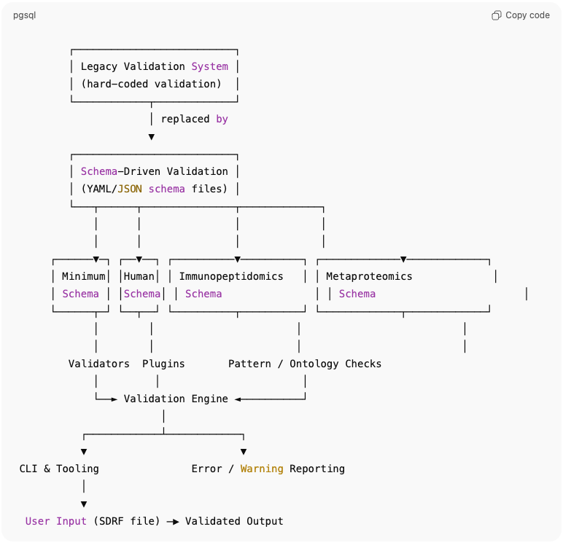
Component | What’s new / changed
Schema-Driven Validation | Use YAML/JSON schema definitions for SDRF validation rather than ad hoc code. Multiple organism- and use-case-specific schemas (e.g. minimum, default, human, plants, vertebrates, cell lines, non-vertebrates). Schemas support inheritance (templates extending other schemas). (GitHub)
Modular Validators & Plugins | Validation is now done through modular validators (ontology validation, pattern matching, checks on minimum required columns, empty cells, unique combinations etc.), allowing more flexibility and extensibility. (GitHub)
CLI Improvements | A simplified validation command (validate-sdrf-simple) with more informative help text, colored error / warning output. Documentation improved. (GitHub)
Code Refactoring & Modernization | Replaced legacy parts: DataFrame / column handling modernised, type annotations added, better error handling, replaced pkg_resources with pathlib.Path, removed deprecated modules. (GitHub)
Build / Dependency Changes | Switched to Poetry for packaging / dependency management. Cleaned up dependencies: removed deprecated or redundant ones. Updated Python version support. (GitHub)
Testing & Documentation | Substantially expanded tests covering the new validation system, ontology utilities, converters, etc. Documentation (README, CONTRIBUTING) updated to reflect new schema-based workflows. (GitHub)
https://github.com/bigbio/sdrf-pipelines/pull/219

Slide 9
Other issues next week

