Slide 1

Bioinformatics Bootcamp
Fall 2020: “Programming Fundamentals and RNA-Seq analysis”
Week 3: The Tidyverse

Slide 2
How do we analyze data?

Slide 3
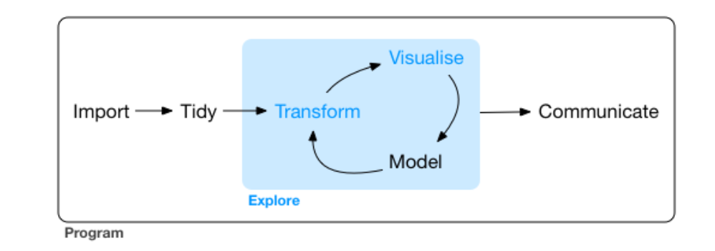
Data Analysis Workflow
https://r4ds.had.co.nz/explore-intro.html

Slide 4
Data Analysis Workflow
https://r4ds.had.co.nz/explore-intro.html

Slide 5
Data Analysis Workflow
https://r4ds.had.co.nz/explore-intro.html

Slide 6
Data Analysis Workflow
https://r4ds.had.co.nz/explore-intro.html

Slide 7
Data Analysis Workflow
https://r4ds.had.co.nz/explore-intro.html

Slide 8
Data Analysis Workflow
https://r4ds.had.co.nz/explore-intro.html

Slide 9

https://www.tidyverse.org/images/hex-tidyverse.png

Slide 10
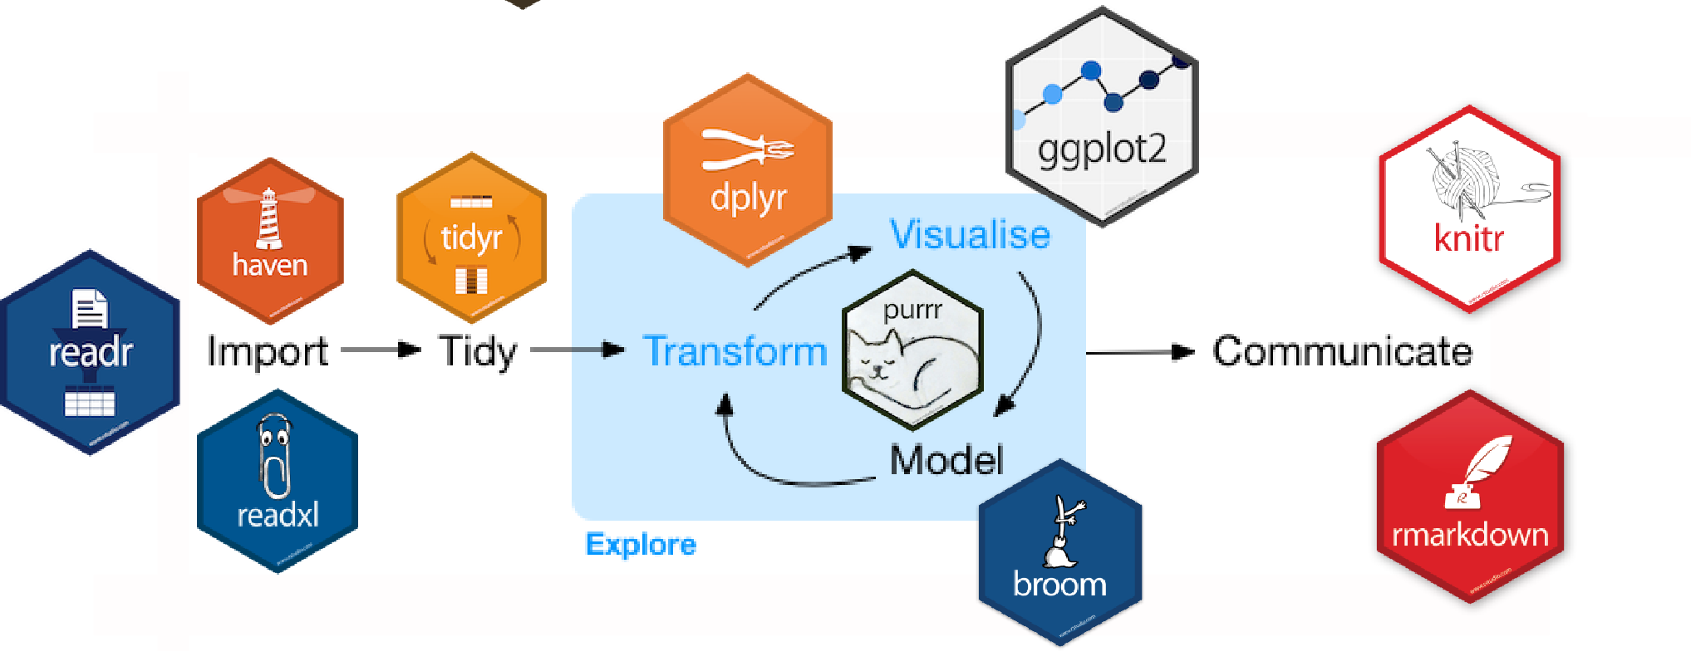
The Tidyverse
https://beanumber.github.io/tidy-databases/tidy_databases_slides.html#section

Slide 11
The Tidyverse
https://beanumber.github.io/tidy-databases/tidy_databases_slides.html#section

Slide 12
The Tidyverse
https://beanumber.github.io/tidy-databases/tidy_databases_slides.html#section

Slide 13
The Tidyverse
https://beanumber.github.io/tidy-databases/tidy_databases_slides.html#section

Slide 14
Getting started with Tidyverse

Slide 15
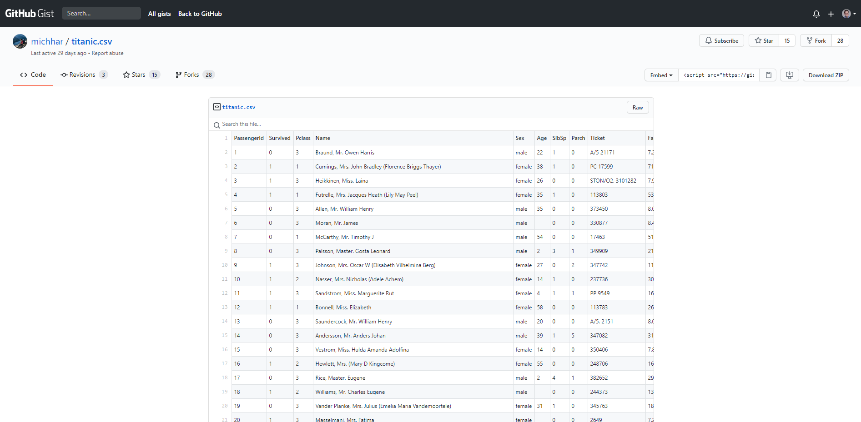

Slide 16
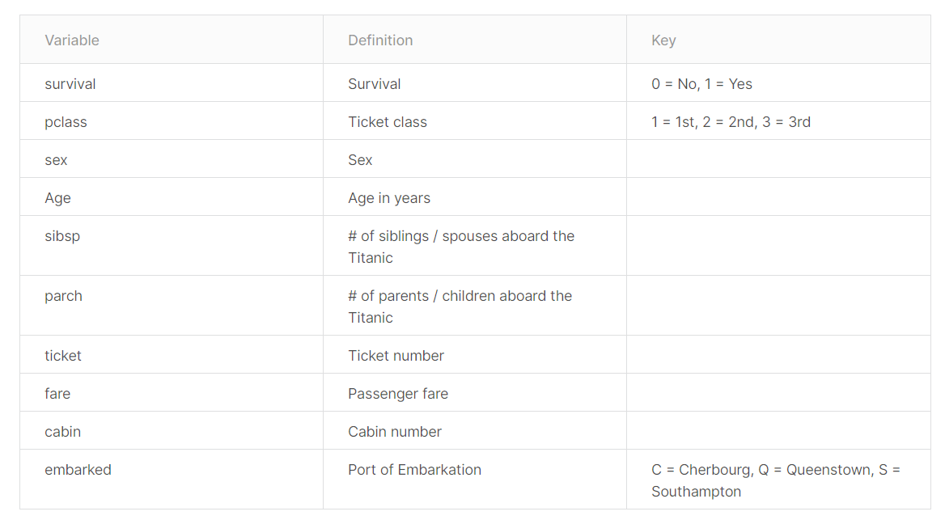

Slide 20
Installing Packages
install.packages("tidyverse")
install.packages("ggpubr")

Slide 21
Loading Tidyverse
library(tidyverse)
## -- Attaching packages -------------------------------------------------------------------------------- tidyverse 1.3.0 --
## v ggplot2 3.3.2 v purrr 0.3.4 ## v tibble 3.0.3 v dplyr 1.0.1 ## v tidyr 1.1.1 v stringr 1.4.0 ## v readr 1.3.1 v forcats 0.5.0
## -- Conflicts ----------------------------------------------------------------------------------- tidyverse_conflicts() -- ## x dplyr::filter() masks stats::filter() ## x dplyr::lag() masks stats::lag()

Slide 22
The Tidyverse
https://beanumber.github.io/tidy-databases/tidy_databases_slides.html#section

Slide 23
The Tidyverse
https://beanumber.github.io/tidy-databases/tidy_databases_slides.html#section

Slide 24
Getting the data (readr)
tidy_titanic <- read_csv("https://gist.githubusercontent.com/michhar/2dfd2de0d4f87
27f873422c5d959fff5/raw/fa71405126017e6a37bea592440b4bee94bf7b9e/titanic.csv")

Slide 25
Getting the data (readr)
tidy_titanic <- read_csv("https://gist.githubusercontent.com/michhar/2dfd2de0d4f87
27f873422c5d959fff5/raw/fa71405126017e6a37bea592440b4bee94bf7b9e/titanic.csv")
tidy_titanic

Slide 26
Getting the data (readr)
tidy_titanic <- read_csv("https://gist.githubusercontent.com/michhar/2dfd2de0d4f8727f873422c5d959fff5/raw/fa7
1405126017e6a37bea592440b4bee94bf7b9e/titanic.csv")
tidy_titanic
## # A tibble: 891 x 12 ## PassengerId Survived Pclass Name Sex Age SibSp Parch Ticket Fare Cabin ## <dbl> <dbl> <dbl> <chr> <chr> <dbl> <dbl> <dbl> <chr> <dbl> <chr> ## 1 1 0 3 Brau~ male 22 1 0 A/5 2~ 7.25 <NA> ## 2 2 1 1 Cumi~ fema~ 38 1 0 PC 17~ 71.3 C85 ## 3 3 1 3 Heik~ fema~ 26 0 0 STON/~ 7.92 <NA> ## 4 4 1 1 Futr~ fema~ 35 1 0 113803 53.1 C123 ## 5 5 0 3 Alle~ male 35 0 0 373450 8.05 <NA> ## 6 6 0 3 Mora~ male NA 0 0 330877 8.46 <NA> ## 7 7 0 1 McCa~ male 54 0 0 17463 51.9 E46 ## 8 8 0 3 Pals~ male 2 3 1 349909 21.1 <NA> ## 9 9 1 3 John~ fema~ 27 0 2 347742 11.1 <NA> ## 10 10 1 2 Nass~ fema~ 14 1 0 237736 30.1 <NA> ## # ... with 881 more rows, and 1 more variable: Embarked <chr>

Slide 27
The Tidyverse
https://beanumber.github.io/tidy-databases/tidy_databases_slides.html#section

Slide 28
The Tidyverse
https://beanumber.github.io/tidy-databases/tidy_databases_slides.html#section

Slide 29
The filter verb
tidy_titanic

Slide 30
The filter verb
tidy_titanic %>%

Slide 31
The filter verb
tidy_titanic %>% filter()

Slide 32
The filter verb
tidy_titanic %>% filter(Age > 12)

Slide 33
The filter verb
tidy_titanic %>% filter(Age > 12)
## # A tibble: 645 x 12 ## PassengerId Survived Pclass Name Sex Age SibSp Parch Ticket Fare Cabin ## <dbl> <dbl> <dbl> <chr> <chr> <dbl> <dbl> <dbl> <chr> <dbl> <chr> ## 1 1 0 3 Brau~ male 22 1 0 A/5 2~ 7.25 <NA> ## 2 2 1 1 Cumi~ fema~ 38 1 0 PC 17~ 71.3 C85 ## 3 3 1 3 Heik~ fema~ 26 0 0 STON/~ 7.92 <NA> ## 4 4 1 1 Futr~ fema~ 35 1 0 113803 53.1 C123 ## 5 5 0 3 Alle~ male 35 0 0 373450 8.05 <NA> ## 6 7 0 1 McCa~ male 54 0 0 17463 51.9 E46 ## 7 9 1 3 John~ fema~ 27 0 2 347742 11.1 <NA> ## 8 10 1 2 Nass~ fema~ 14 1 0 237736 30.1 <NA> ## 9 12 1 1 Bonn~ fema~ 58 0 0 113783 26.6 C103 ## 10 13 0 3 Saun~ male 20 0 0 A/5. ~ 8.05 <NA> ## # ... with 635 more rows, and 1 more variable: Embarked <chr>

Slide 34
The filter verb
tidy_titanic %>% filter(Age > 12)
## # A tibble: 645 x 12 ## PassengerId Survived Pclass Name Sex Age SibSp Parch Ticket Fare Cabin ## <dbl> <dbl> <dbl> <chr> <chr> <dbl> <dbl> <dbl> <chr> <dbl> <chr> ## 1 1 0 3 Brau~ male 22 1 0 A/5 2~ 7.25 <NA> ## 2 2 1 1 Cumi~ fema~ 38 1 0 PC 17~ 71.3 C85 ## 3 3 1 3 Heik~ fema~ 26 0 0 STON/~ 7.92 <NA> ## 4 4 1 1 Futr~ fema~ 35 1 0 113803 53.1 C123 ## 5 5 0 3 Alle~ male 35 0 0 373450 8.05 <NA> ## 6 7 0 1 McCa~ male 54 0 0 17463 51.9 E46 ## 7 9 1 3 John~ fema~ 27 0 2 347742 11.1 <NA> ## 8 10 1 2 Nass~ fema~ 14 1 0 237736 30.1 <NA> ## 9 12 1 1 Bonn~ fema~ 58 0 0 113783 26.6 C103 ## 10 13 0 3 Saun~ male 20 0 0 A/5. ~ 8.05 <NA> ## # ... with 635 more rows, and 1 more variable: Embarked <chr>

Slide 35
The select verb
tidy_titanic %>% filter(Age > 12)

Slide 36
The select verb
tidy_titanic %>% filter(Age > 12) %>% select()

Slide 37
The select verb
tidy_titanic %>% filter(Age > 12) %>% select(Survived, Sex)

Slide 38
The select verb
tidy_titanic %>% filter(Age > 12) %>% select(Survived, Sex)
## # A tibble: 645 x 2 ## Survived Sex ## <dbl> <chr> ## 1 0 male ## 2 1 female ## 3 1 female ## 4 1 female ## 5 0 male ## 6 0 male ## 7 1 female ## 8 1 female ## 9 1 female ## 10 0 male ## # ... with 635 more rows

Slide 39
The select verb
tidy_titanic %>% filter(Age > 12) %>% select(Survived, Sex)
## # A tibble: 645 x 2 ## Survived Sex ## <dbl> <chr> ## 1 0 male ## 2 1 female ## 3 1 female ## 4 1 female ## 5 0 male ## 6 0 male ## 7 1 female ## 8 1 female ## 9 1 female ## 10 0 male ## # ... with 635 more rows

Slide 40
The group_by verb
tidy_titanic %>% filter(Age > 12) %>% select(Survived, Sex)

Slide 41
The group_by verb
tidy_titanic %>% filter(Age > 12) %>% select(Survived, Sex) %>% group_by()

Slide 42
The group_by verb
tidy_titanic %>% filter(Age > 12) %>% select(Survived, Sex) %>% group_by(Sex)

Slide 43
The group_by verb
tidy_titanic %>% filter(Age > 12) %>% select(Survived, Sex) %>% group_by(Sex, Survived)

Slide 44
The group_by verb
tidy_titanic %>% filter(Age > 12) %>% select(Survived, Sex) %>% group_by(Sex, Survived)
## # A tibble: 645 x 2 ## # Groups: Sex, Survived [4] ## Survived Sex ## <dbl> <chr> ## 1 0 male ## 2 1 female ## 3 1 female ## 4 1 female ## 5 0 male ## 6 0 male ## 7 1 female ## 8 1 female ## 9 1 female ## 10 0 male ## # ... with 635 more rows

Slide 45
The group_by verb
tidy_titanic %>% filter(Age > 12) %>% select(Survived, Sex) %>% group_by(Sex, Survived)
## # A tibble: 645 x 2 ## # Groups: Sex, Survived [4] ## Survived Sex ## <dbl> <chr> ## 1 0 male ## 2 1 female ## 3 1 female ## 4 1 female ## 5 0 male ## 6 0 male ## 7 1 female ## 8 1 female ## 9 1 female ## 10 0 male ## # ... with 635 more rows

Slide 46
The summarise verb
tidy_titanic %>% filter(Age > 12) %>% select(Survived, Sex) %>% group_by(Sex, Survived)

Slide 47
The summarise verb
tidy_titanic %>% filter(Age > 12) %>% select(Survived, Sex) %>% group_by(Sex, Survived) %>% summarise()

Slide 48
The summarise verb
tidy_titanic %>% filter(Age > 12) %>% select(Survived, Sex) %>% group_by(Sex, Survived) %>% summarise(n())

Slide 49
The summarise verb
tidy_titanic %>% filter(Age > 12) %>% select(Survived, Sex) %>% group_by(Sex, Survived) %>% summarise(num_sex_survive = n())

Slide 50
The summarise verb
tidy_titanic %>% filter(Age > 12) %>% select(Survived, Sex) %>% group_by(Sex, Survived) %>% summarise(num_sex_survive = n())
## `summarise()` regrouping output by 'Sex' (override with `.groups` argument)
## # A tibble: 4 x 3 ## # Groups: Sex [2] ## Sex Survived num_sex_survive ## <chr> <dbl> <int> ## 1 female 0 51 ## 2 female 1 178 ## 3 male 0 344 ## 4 male 1 72

Slide 51
The summarise verb
tidy_titanic %>% filter(Age > 12) %>% select(Survived, Sex) %>% group_by(Sex, Survived) %>% summarise(num_sex_survive = n())
## `summarise()` regrouping output by 'Sex' (override with `.groups` argument)
## # A tibble: 4 x 3 ## # Groups: Sex [2] ## Sex Survived num_sex_survive ## <chr> <dbl> <int> ## 1 female 0 51 ## 2 female 1 178 ## 3 male 0 344 ## 4 male 1 72

Slide 52
The summarise verb
tidy_titanic %>% filter(Age > 12) %>% select(Survived, Sex) %>% group_by(Sex, Survived) %>% summarise(num_sex_survive = n())
## `summarise()` regrouping output by 'Sex' (override with `.groups` argument)
## # A tibble: 4 x 3 ## # Groups: Sex [2] ## Sex Survived num_sex_survive ## <chr> <dbl> <int> ## 1 female 0 51 ## 2 female 1 178 ## 3 male 0 344 ## 4 male 1 72

Slide 53
The summarise verb
tidy_titanic %>% filter(Age > 12) %>% select(Survived, Sex) %>% group_by(Sex, Survived) %>% summarise(num_sex_survive = n())
## `summarise()` regrouping output by 'Sex' (override with `.groups` argument)
## # A tibble: 4 x 3 ## # Groups: Sex [2] ## Sex Survived num_sex_survive ## <chr> <dbl> <int> ## 1 female 0 51 ## 2 female 1 178 ## 3 male 0 344 ## 4 male 1 72
Percent?

Slide 54
The mutate verb
tidy_titanic %>% filter(Age > 12) %>% select(Survived, Sex) %>% group_by(Sex, Survived) %>% summarise(num_sex_survive = n())

Slide 55
The mutate verb
tidy_titanic %>% filter(Age > 12) %>% select(Survived, Sex) %>% group_by(Sex, Survived) %>% summarise(num_sex_survive = n()) %>% mutate()

Slide 56
The mutate verb
tidy_titanic %>% filter(Age > 12) %>% select(Survived, Sex) %>% group_by(Sex, Survived) %>% summarise(num_sex_survive = n()) %>% mutate(num_sex_survive)

Slide 57
The mutate verb
tidy_titanic %>% filter(Age > 12) %>% select(Survived, Sex) %>% group_by(Sex, Survived) %>% summarise(num_sex_survive = n()) %>% mutate(num_sex_survive/sum(num_sex_survive)

Slide 58
The mutate verb
tidy_titanic %>% filter(Age > 12) %>% select(Survived, Sex) %>% group_by(Sex, Survived) %>% summarise(num_sex_survive = n()) %>% mutate(num_sex_survive/sum(num_sex_survive) * 100)

Slide 59
The mutate verb
tidy_titanic %>% filter(Age > 12) %>% select(Survived, Sex) %>% group_by(Sex, Survived) %>% summarise(num_sex_survive = n()) %>% mutate(pct_sex_survive = num_sex_survive/sum(num_sex_survive) * 100)

Slide 60
The mutate verb
tidy_titanic %>% filter(Age > 12) %>% select(Survived, Sex) %>% group_by(Sex, Survived) %>% summarise(num_sex_survive = n()) %>% mutate(pct_sex_survive = num_sex_survive/sum(num_sex_survive) * 100)
## `summarise()` regrouping output by 'Sex' (override with `.groups` argument)
## # A tibble: 4 x 4 ## # Groups: Sex [2] ## Sex Survived num_sex_survive pct_sex_survive ## <chr> <dbl> <int> <dbl> ## 1 female 0 51 22.3 ## 2 female 1 178 77.7 ## 3 male 0 344 82.7 ## 4 male 1 72 17.3

Slide 61
The mutate verb
tidy_titanic %>% filter(Age > 12) %>% select(Survived, Sex) %>% group_by(Sex, Survived) %>% summarise(num_sex_survive = n()) %>% mutate(pct_sex_survive = num_sex_survive/sum(num_sex_survive) * 100)
## `summarise()` regrouping output by 'Sex' (override with `.groups` argument)
## # A tibble: 4 x 4 ## # Groups: Sex [2] ## Sex Survived num_sex_survive pct_sex_survive ## <chr> <dbl> <int> <dbl> ## 1 female 0 51 22.3 ## 2 female 1 178 77.7 ## 3 male 0 344 82.7 ## 4 male 1 72 17.3

Slide 62
The mutate verb
tidy_titanic %>% filter(Age > 12) %>% select(Survived, Sex) %>% group_by(Sex, Survived) %>% summarise(num_sex_survive = n()) %>% mutate(pct_sex_survive = num_sex_survive/sum(num_sex_survive) * 100)

Slide 63
The mutate verb
tidy_titanic %>% filter(Age > 12) %>% select(Survived, Sex) %>% group_by(Sex, Survived) %>% summarise(num_sex_survive = n()) %>% mutate(pct_sex_survive = num_sex_survive/sum(num_sex_survive) * 100) %>% filter(Survived == 1)

Slide 64
The mutate verb
tidy_titanic %>% filter(Age > 12) %>% select(Survived, Sex) %>% group_by(Sex, Survived) %>% summarise(num_sex_survive = n()) %>% mutate(pct_sex_survive = num_sex_survive/sum(num_sex_survive) * 100) %>% filter(Survived == 1)
## `summarise()` regrouping output by 'Sex' (override with `.groups` argument)
## # A tibble: 2 x 4 ## # Groups: Sex [2] ## Sex Survived num_sex_survive pct_sex_survive ## <chr> <dbl> <int> <dbl> ## 1 female 1 178 77.7 ## 2 male 1 72 17.3

Slide 65
Save in variable
pct_surv <- tidy_titanic %>% filter(Age > 12) %>% select(Survived, Sex) %>% group_by(Sex, Survived) %>% summarise(num_sex_survive = n()) %>% mutate(pct_sex_survive = num_sex_survive/sum(num_sex_survive) * 100) %>% filter(Survived == 1)
pct_surv

Slide 66
Save in variable
pct_surv <- tidy_titanic %>% filter(Age > 12) %>% select(Survived, Sex) %>% group_by(Sex, Survived) %>% summarise(num_sex_survive = n()) %>% mutate(pct_sex_survive = num_sex_survive/sum(num_sex_survive) * 100) %>% filter(Survived == 1)
pct_surv
## # A tibble: 2 x 4 ## # Groups: Sex [2] ## Sex Survived num_sex_survive pct_sex_survive ## <chr> <dbl> <int> <dbl> ## 1 female 1 178 77.7 ## 2 male 1 72 17.3

Slide 67
Hands-on activity #1
15 minutes

Slide 68
The Tidyverse
https://beanumber.github.io/tidy-databases/tidy_databases_slides.html#section

Slide 69
The Tidyverse
https://beanumber.github.io/tidy-databases/tidy_databases_slides.html#section

Slide 70
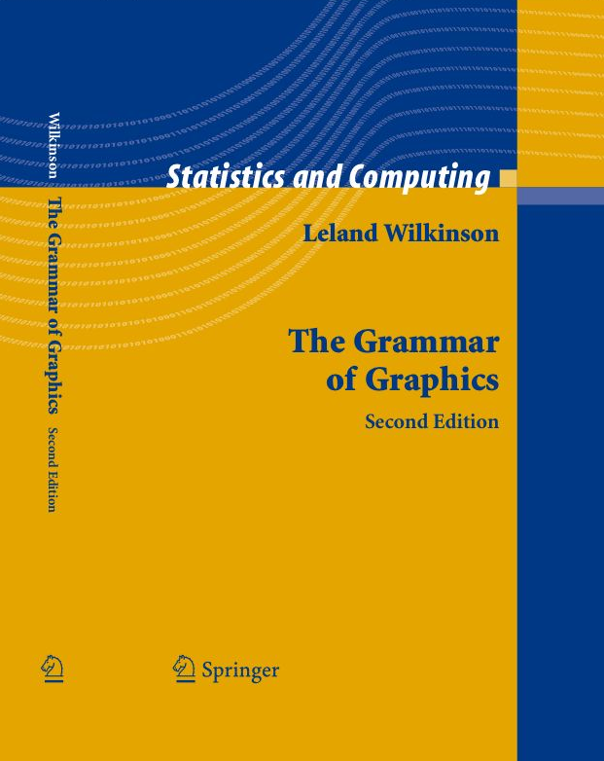
The Grammar of Graphics
A structured language for plotting
All plots follow this language
Key components:
Data
Aesthetics
Geometries
Facets
Statistics
Coordinates
Theme
https://www.cs.uic.edu/~wilkinson/TheGrammarOfGraphics/gog2.jpg

Slide 71
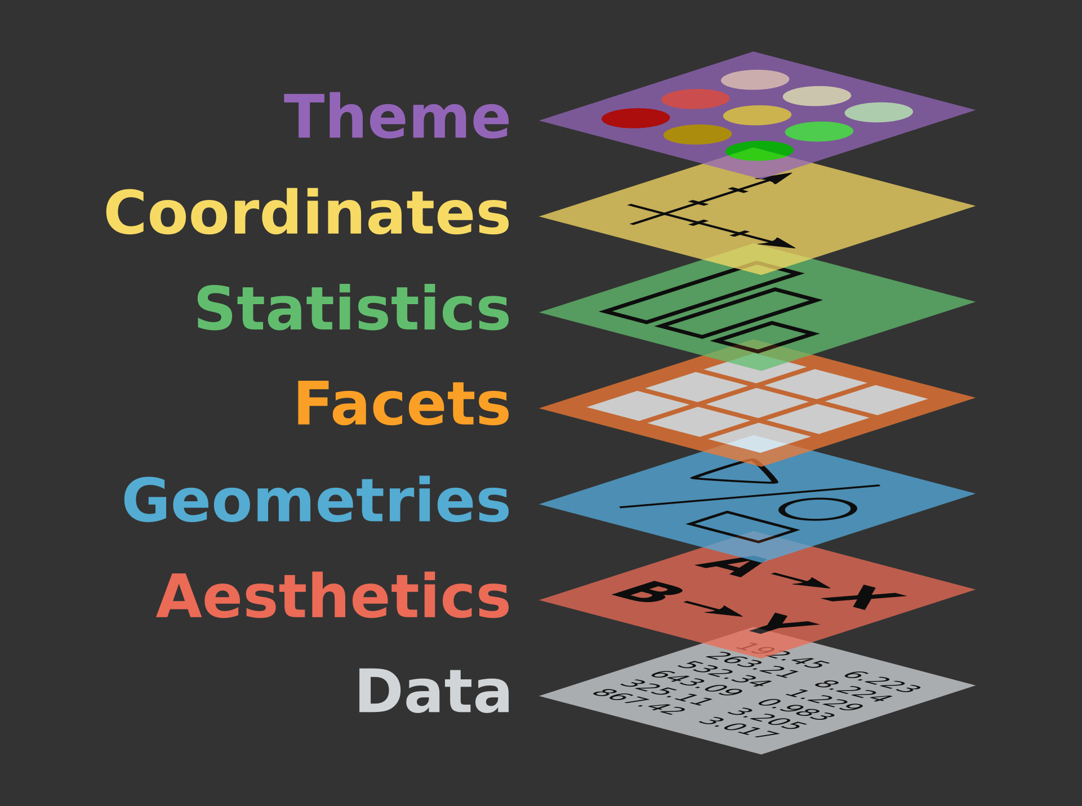
https://www.catallaxyservices.com/media/Grammar-Of-Graphics/#/3/3

Slide 72
https://www.catallaxyservices.com/media/Grammar-Of-Graphics/#/3/3

Slide 73
https://www.catallaxyservices.com/media/Grammar-Of-Graphics/#/3/3

Slide 74
https://www.catallaxyservices.com/media/Grammar-Of-Graphics/#/3/3

Slide 75
https://www.catallaxyservices.com/media/Grammar-Of-Graphics/#/3/3

Slide 76
https://www.catallaxyservices.com/media/Grammar-Of-Graphics/#/3/3

Slide 77
https://www.catallaxyservices.com/media/Grammar-Of-Graphics/#/3/3

Slide 78
https://www.catallaxyservices.com/media/Grammar-Of-Graphics/#/3/3

Slide 79
ggplot2: elegant plots using the grammar of graphics

Slide 80
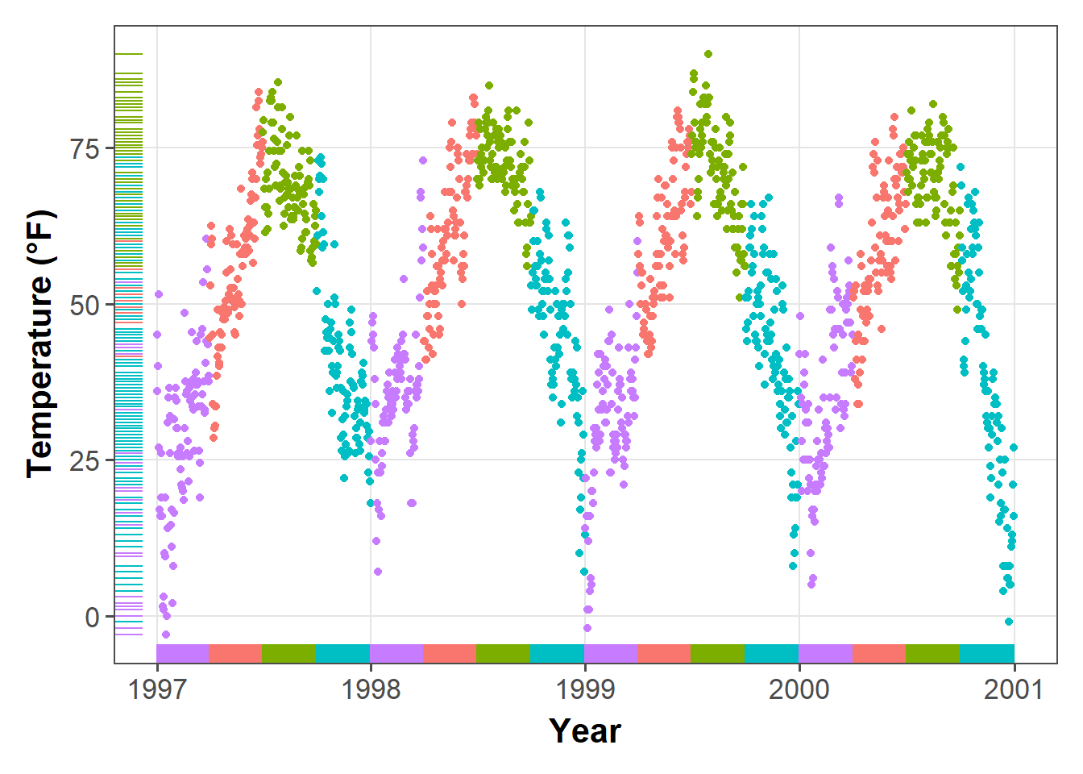
ggplot2: elegant plots using the grammar of graphics
https://d33wubrfki0l68.cloudfront.net/b6c4ce171dc7d21658771efb445b7b24b6850755/afafc/post/2019-08-05_ggplot2-tutorial_files/figure-html/rug-1.png

Slide 81
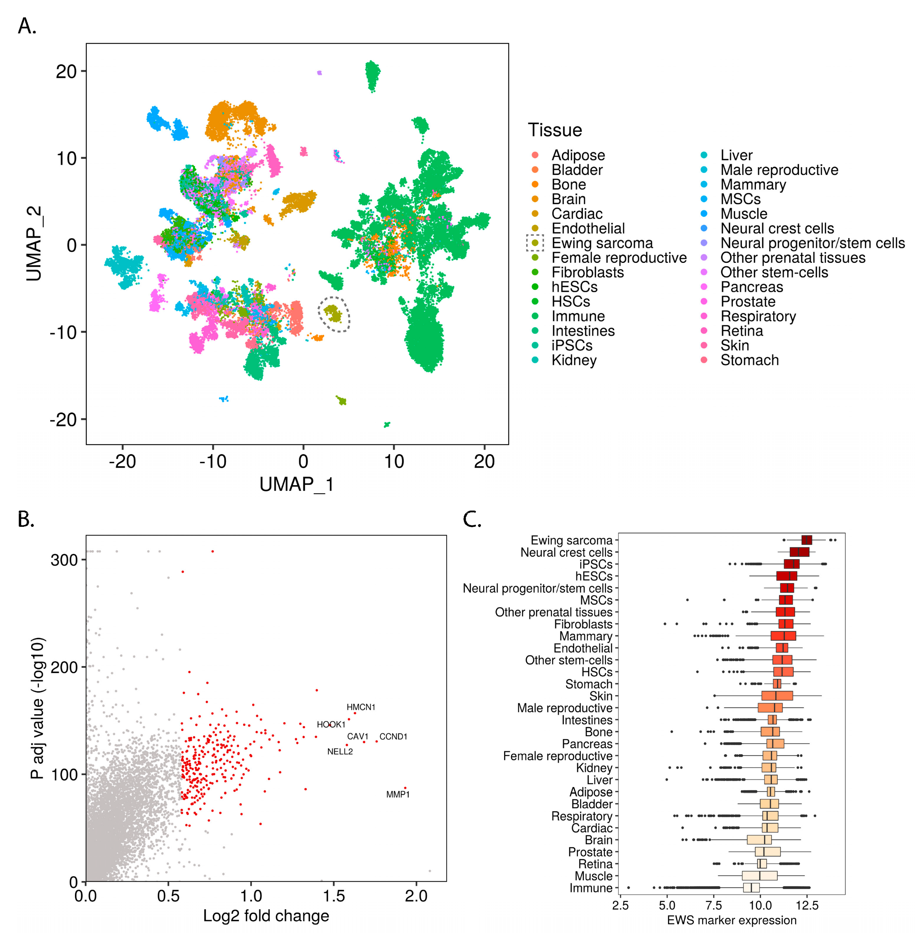
ggplot2: elegant plots using the grammar of graphics

Slide 82
https://www.catallaxyservices.com/media/Grammar-Of-Graphics/#/3/3

Slide 83
https://www.catallaxyservices.com/media/Grammar-Of-Graphics/#/3/3

Slide 84
Setting the data layer
pct_surv <- tidy_titanic %>% filter(Age > 12) %>% select(Survived, Sex) %>% group_by(Sex, Survived) %>% summarise(num_sex_survive = n()) %>% mutate(pct_sex_survive = num_sex_survive/sum(num_sex_survive) * 100) %>% filter(Survived == 1)
pct_surv
## # A tibble: 2 x 4 ## # Groups: Sex [2] ## Sex Survived num_sex_survive pct_sex_survive ## <chr> <dbl> <int> <dbl> ## 1 female 1 178 77.7 ## 2 male 1 72 17.3

Slide 85
Setting the data layer

Slide 86
Setting the data layer
ggplot(data = pct_surv)

Slide 87


Slide 88
https://www.catallaxyservices.com/media/Grammar-Of-Graphics/#/3/3

Slide 89
https://www.catallaxyservices.com/media/Grammar-Of-Graphics/#/3/3

Slide 90
Setting the aesthetic layer
ggplot(data = pct_surv)

Slide 91
Setting the aesthetic layer
ggplot(data = pct_surv, mapping = aes(x = Sex, y = num_sex_survive))

Slide 92
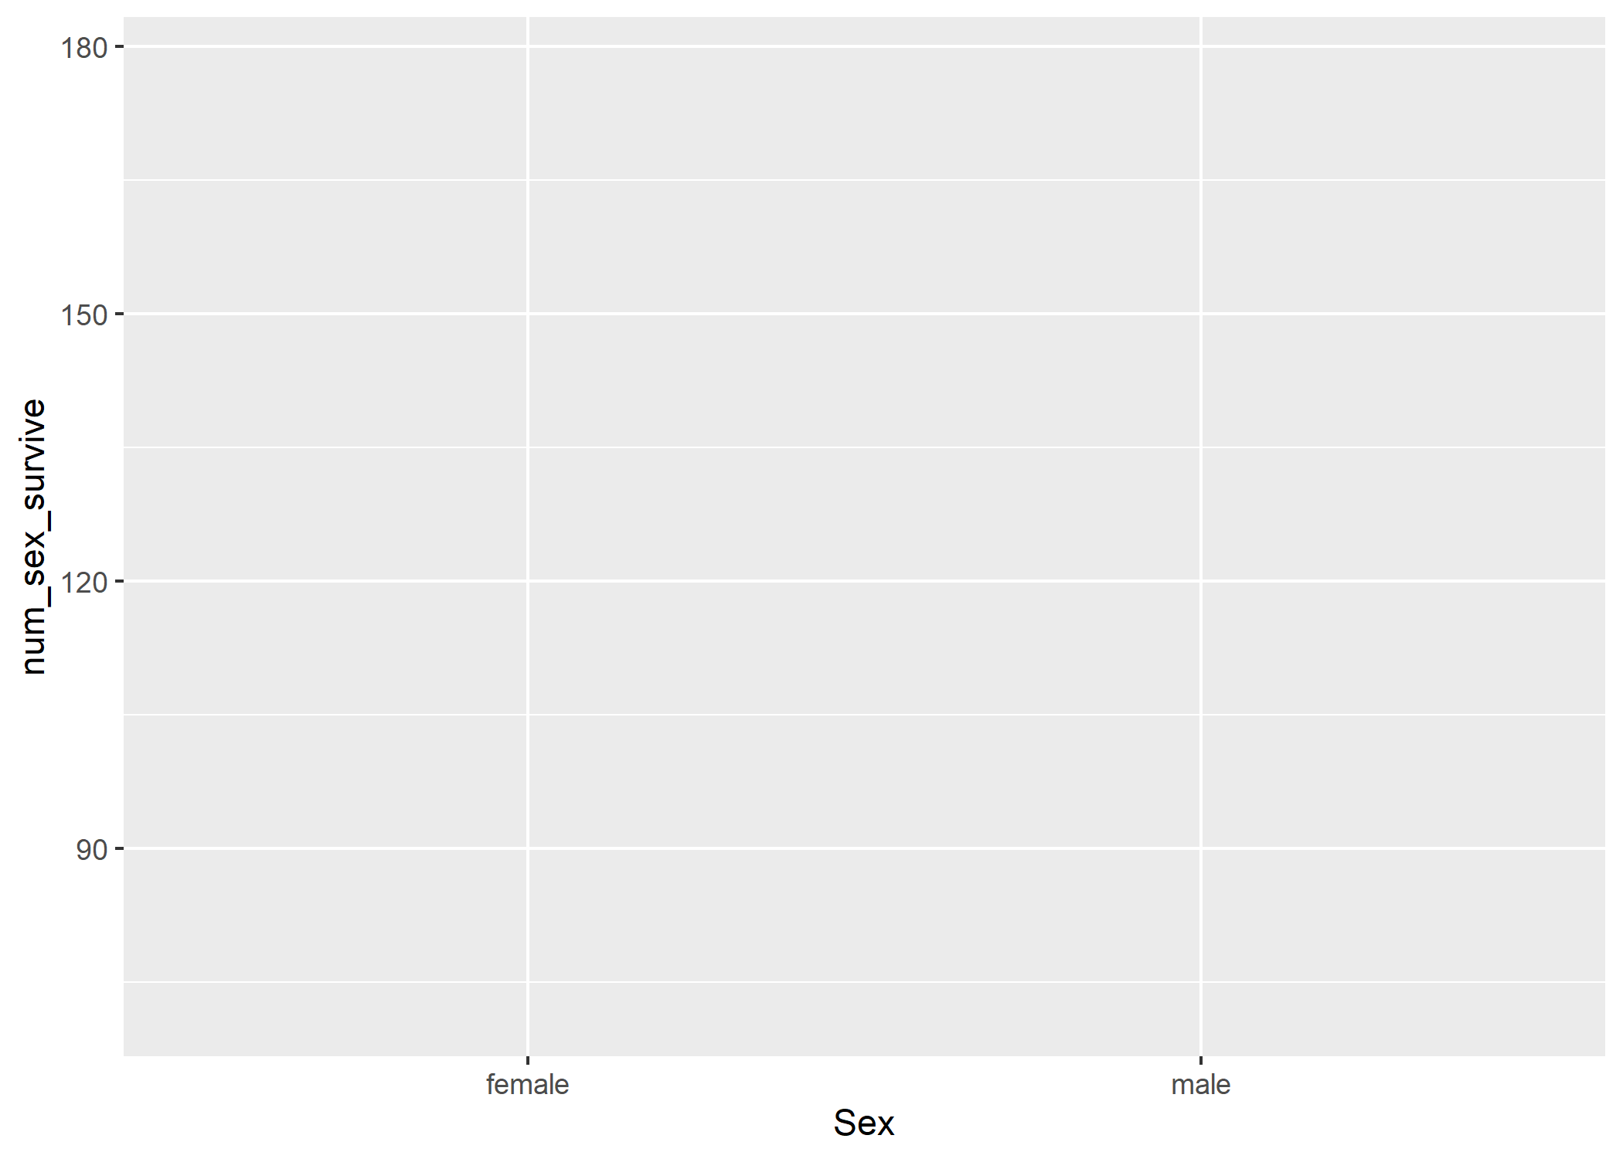

Slide 93
https://www.catallaxyservices.com/media/Grammar-Of-Graphics/#/3/3

Slide 94
https://www.catallaxyservices.com/media/Grammar-Of-Graphics/#/3/3

Slide 95
Setting the geometry layer
ggplot(data = pct_surv, mapping = aes(x = Sex, y = num_sex_survive))

Slide 96
Setting the geometry layer
ggplot(data = pct_surv, mapping = aes(x = Sex, y = num_sex_survive)) + geom_bar(stat = "identity")

Slide 97
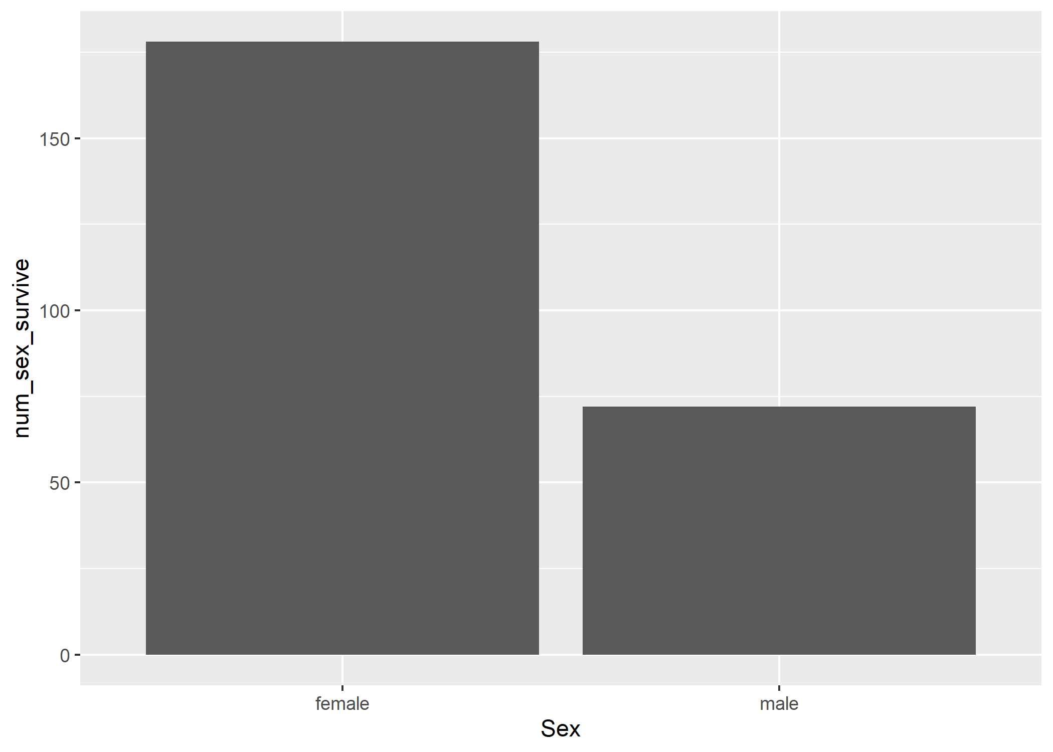

Slide 98
Switching the aesthetics with aes()
ggplot(data = pct_surv, mapping = aes(x = Sex, y = num_sex_survive)) + geom_bar(stat = "identity")

Slide 99
Switching the aesthetics with aes()
ggplot(data = pct_surv, mapping = aes(x = Sex, y = pct_sex_survive)) + geom_bar(stat = "identity")

Slide 100
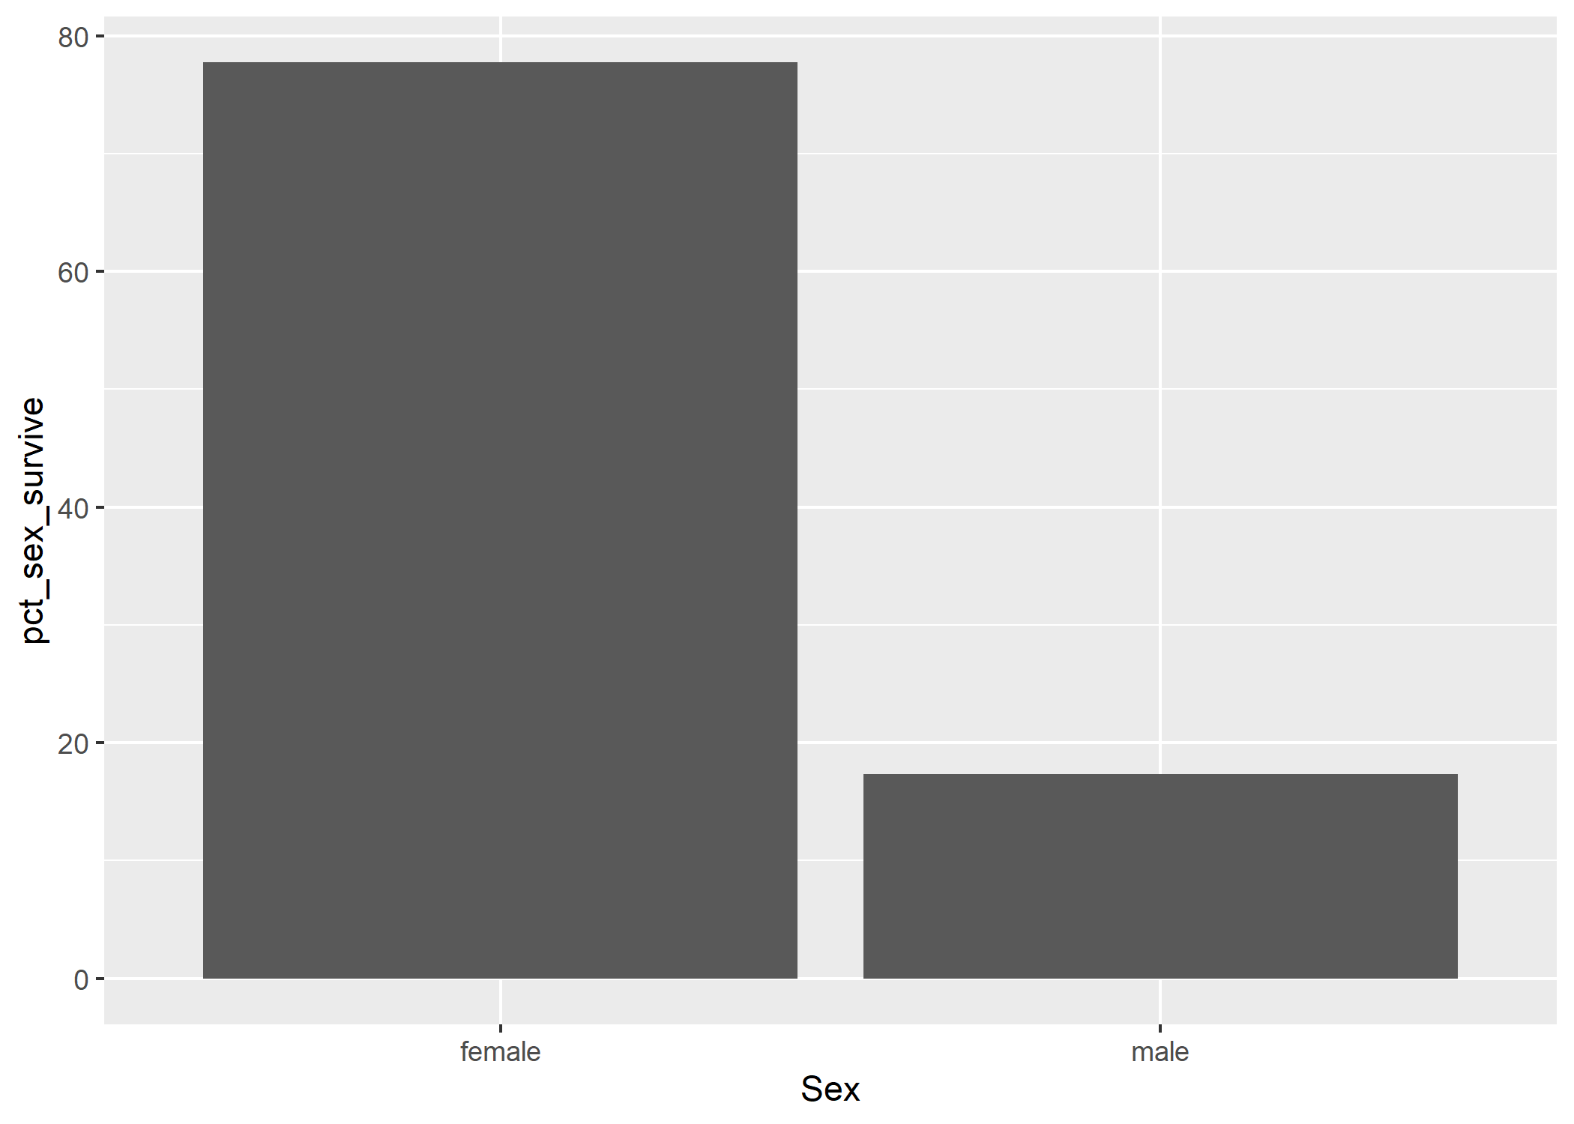

Slide 101
https://www.catallaxyservices.com/media/Grammar-Of-Graphics/#/3/3

Slide 102
https://www.catallaxyservices.com/media/Grammar-Of-Graphics/#/3/3

Slide 106
Theme: Changing the y-axis label
ggplot(data = pct_surv, mapping = aes(x = Sex, y = pct_sex_survive)) + geom_bar(stat = "identity")

Slide 107
Theme: Changing the y-axis label
ggplot(data = pct_surv, mapping = aes(x = Sex, y = pct_sex_survive)) + geom_bar(stat = "identity") + ylab("Percentage Surviving")

Slide 108
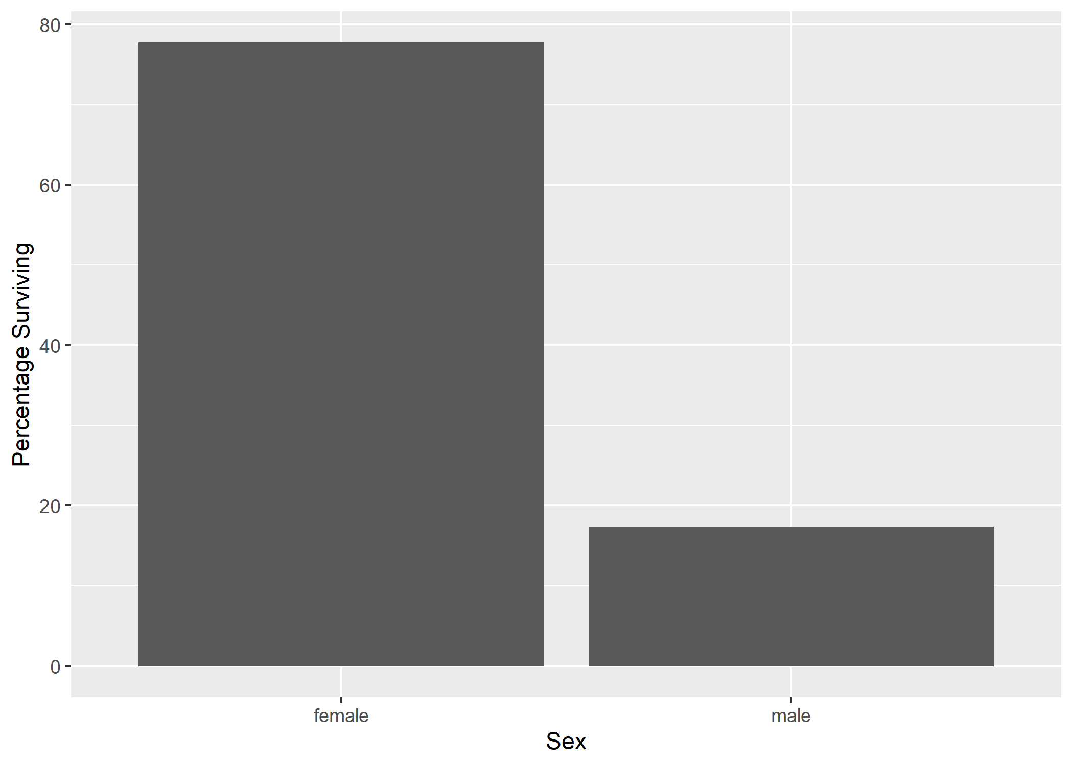

Slide 110
Theme: Adding a title
ggplot(data = pct_surv, mapping = aes(x = Sex, y = pct_sex_survive)) + geom_bar(stat = "identity") + ylab("Percentage Surviving")

Slide 111
Theme: Adding a title
ggplot(data = pct_surv, mapping = aes(x = Sex, y = pct_sex_survive)) + geom_bar(stat = "identity") + ylab("Percentage Surviving") + labs(title = "Effect of Sex on Survival aboard the Titanic")

Slide 112
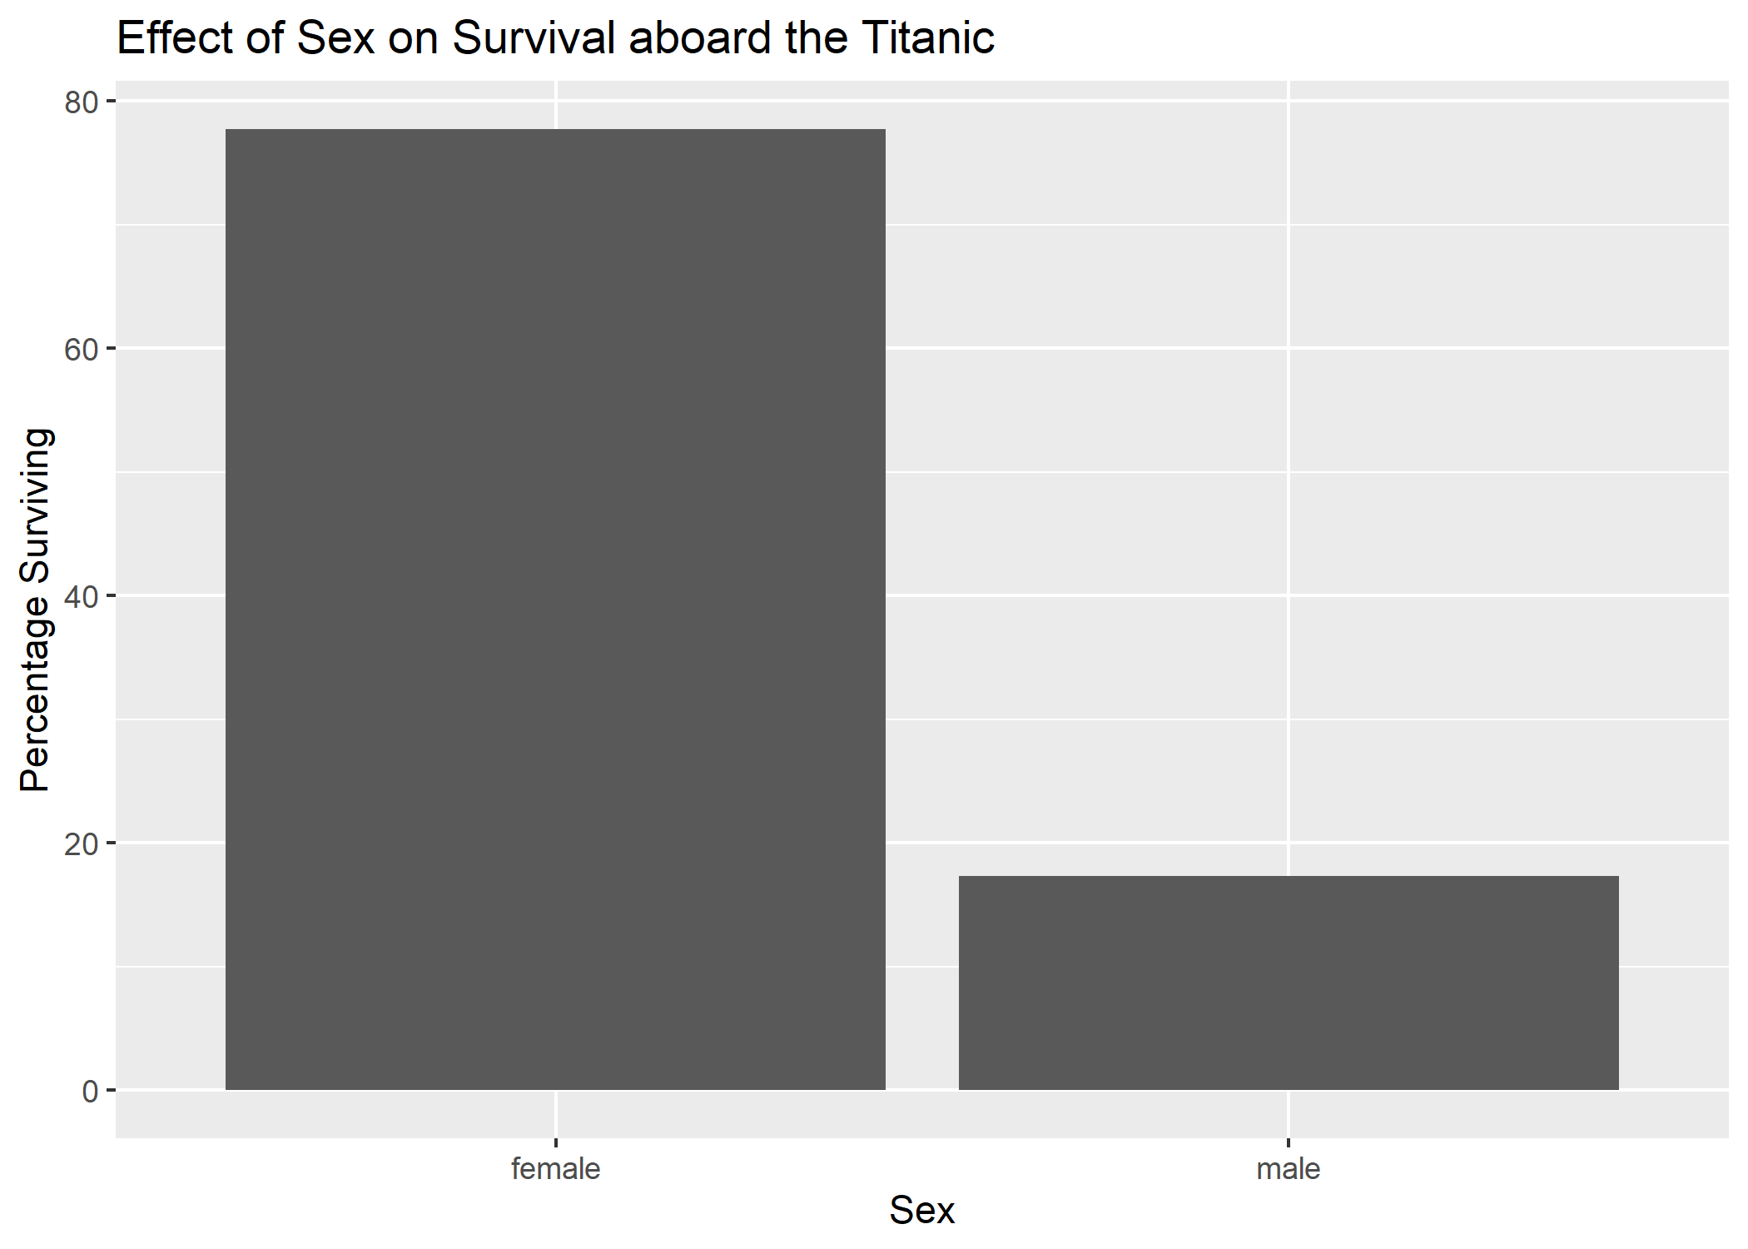

Slide 114
Theme: changing the overall style
ggplot(data = pct_surv, mapping = aes(x = Sex, y = pct_sex_survive)) + geom_bar(stat = "identity") + ylab("Percentage Surviving") + labs(title = "Effect of Sex on Survival aboard the Titanic")

Slide 115
Theme: changing the overall style
ggplot(data = pct_surv, mapping = aes(x = Sex, y = pct_sex_survive)) + geom_bar(stat = "identity") + ylab("Percentage Surviving") + labs(title = "Effect of Sex on Survival aboard the Titanic") + theme_classic()

Slide 116
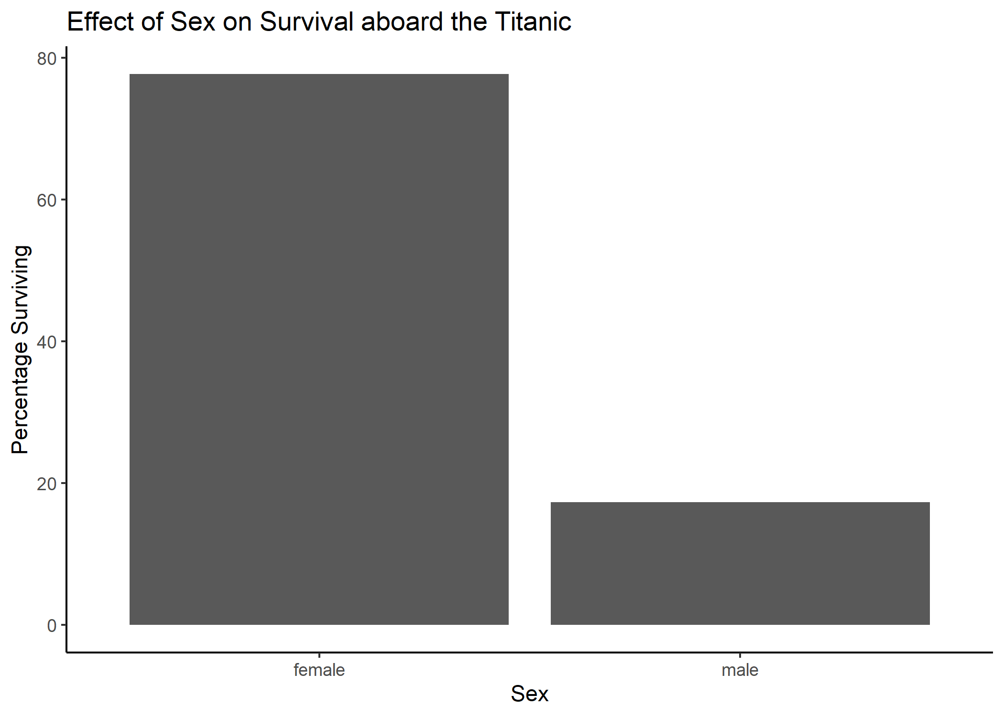

Slide 118
Adding a fill aesthetic
ggplot(data = pct_surv, mapping = aes(x = Sex, y = pct_sex_survive)) + geom_bar(stat = "identity") + ylab("Percentage Surviving") + labs(title = "Effect of Sex on Survival aboard the Titanic") + theme_classic()

Slide 119
Adding a fill aesthetic
ggplot(data = pct_surv, mapping = aes(x = Sex, y = pct_sex_survive, fill = Sex)) + geom_bar(stat = "identity") + ylab("Percentage Surviving") + labs(title = "Effect of Sex on Survival aboard the Titanic") + theme_classic()

Slide 120
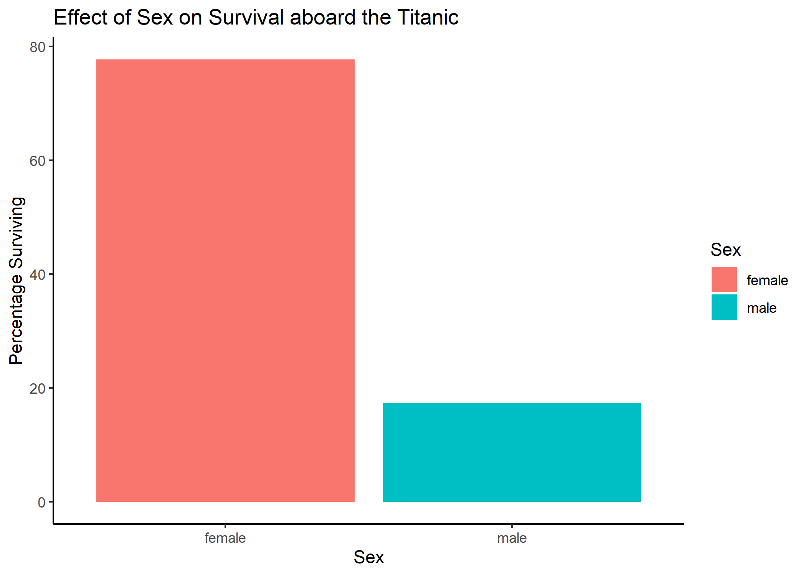

Slide 122
Theme: Remove the x-axis label
ggplot(data = pct_surv, mapping = aes(x = Sex, y = pct_sex_survive, fill = Sex)) + geom_bar(stat = "identity") + ylab("Percentage Surviving") + labs(title = "Effect of Sex on Survival aboard the Titanic") + theme_classic()

Slide 123
Theme: Remove the x-axis label
ggplot(data = pct_surv, mapping = aes(x = Sex, y = pct_sex_survive, fill = Sex)) + geom_bar(stat = "identity") + ylab("Percentage Surviving") + labs(title = "Effect of Sex on Survival aboard the Titanic") + theme_classic() + xlab(NULL)

Slide 124
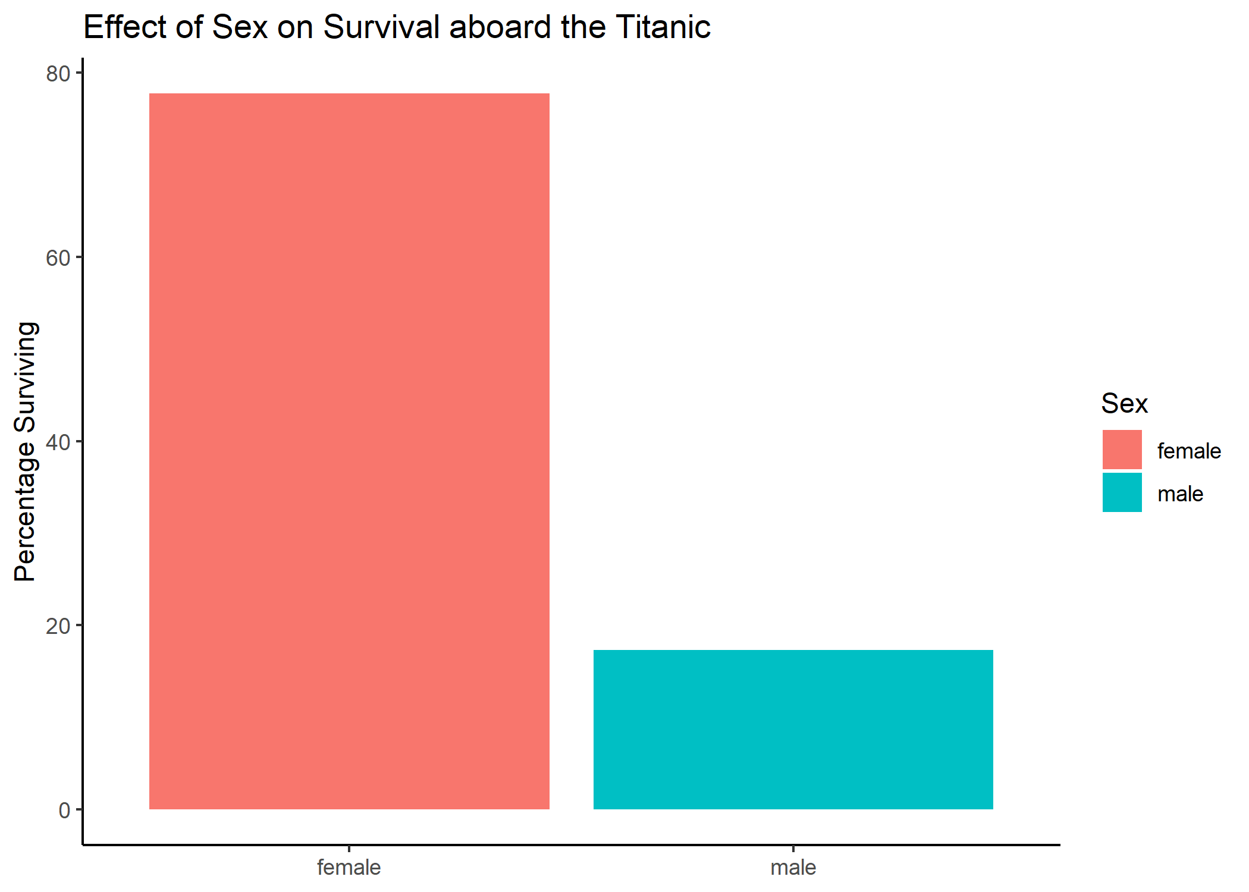

Slide 126
Theme: removing a legend
ggplot(data = pct_surv, mapping = aes(x = Sex, y = pct_sex_survive, fill = Sex)) + geom_bar(stat = "identity") + ylab("Percentage Surviving") + labs(title = "Effect of Sex on Survival aboard the Titanic") + theme_classic() + xlab(NULL)

Slide 127
Theme: removing a legend
ggplot(data = pct_surv, mapping = aes(x = Sex, y = pct_sex_survive, fill = Sex)) + geom_bar(stat = "identity") + ylab("Percentage Surviving") + labs(title = "Effect of Sex on Survival aboard the Titanic") + theme_classic() + xlab(NULL) + theme(legend.position = "none")

Slide 128
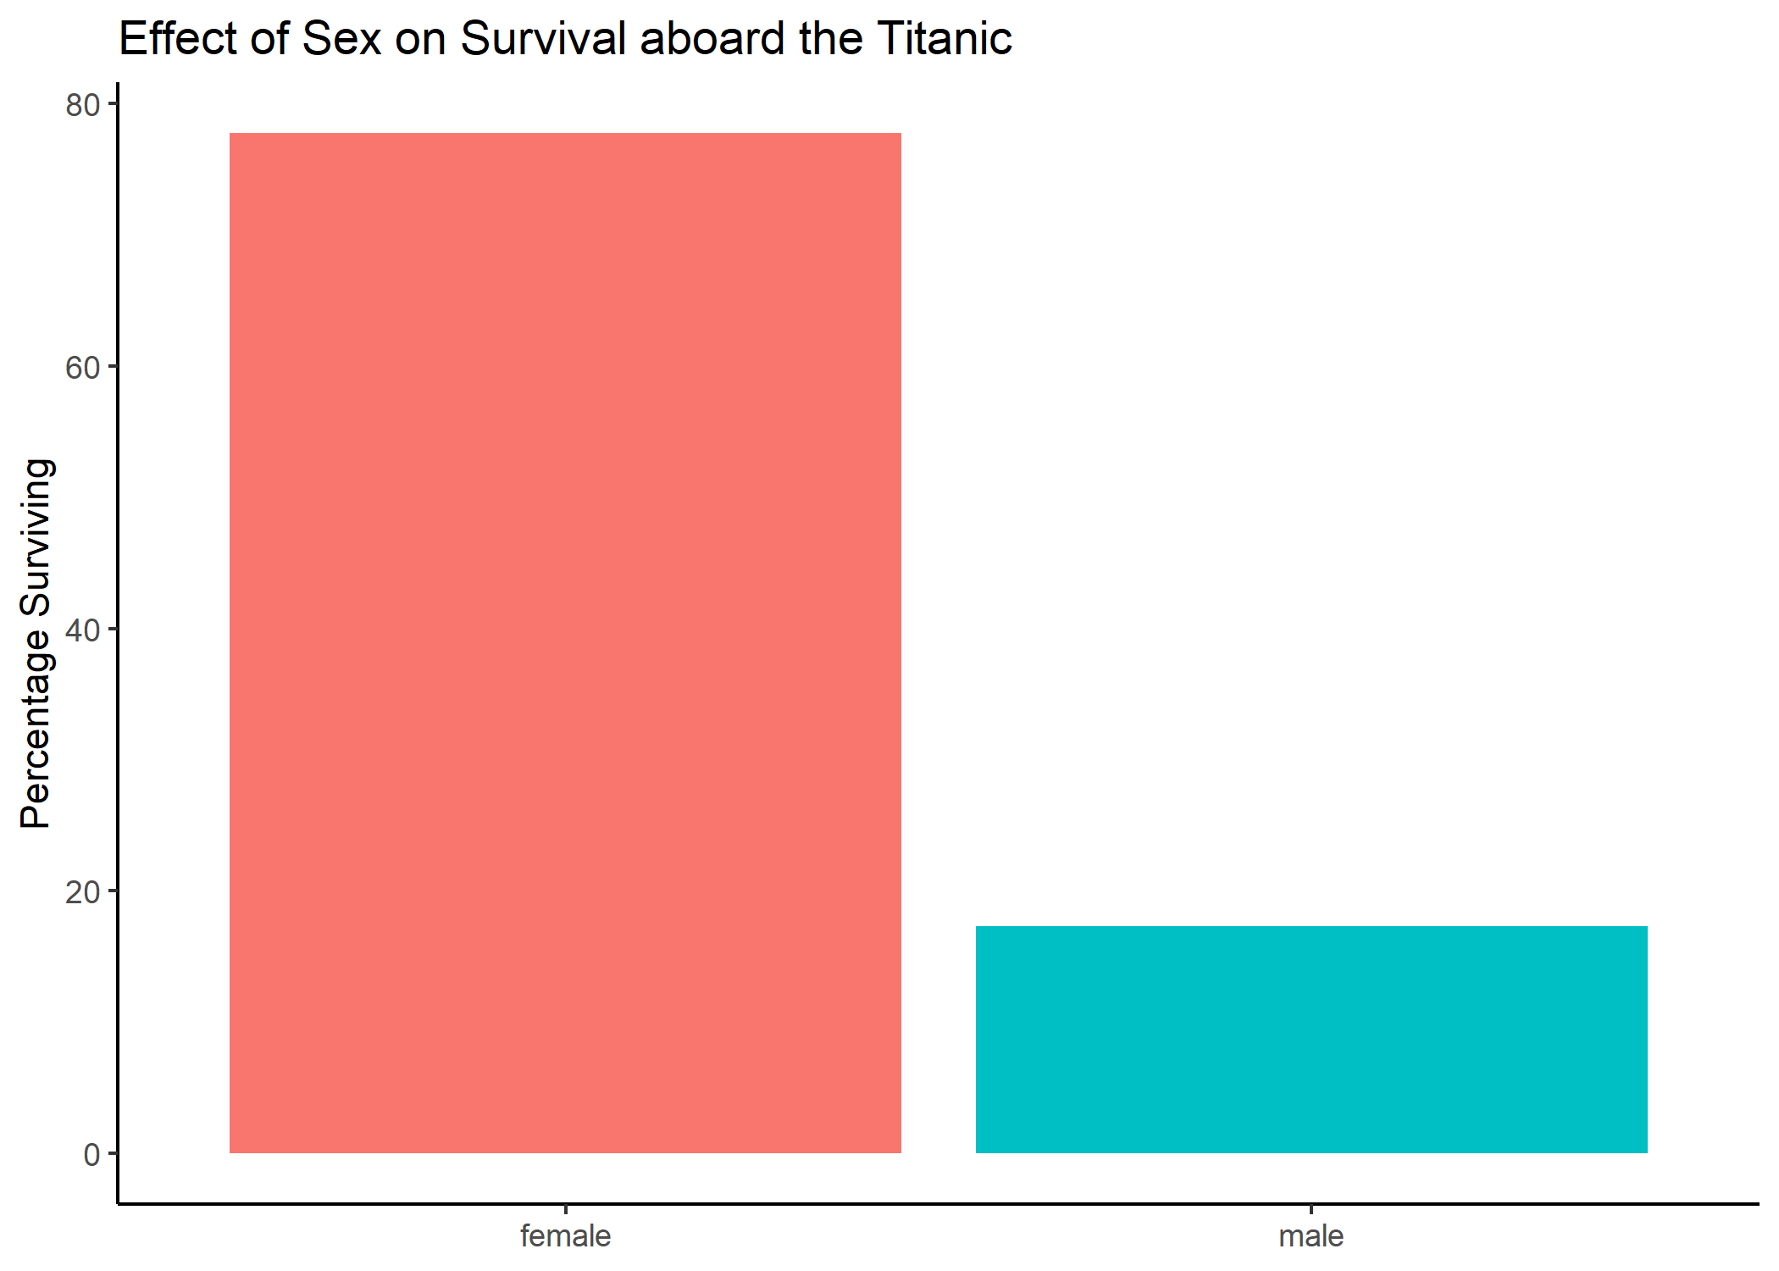

Slide 131
https://www.catallaxyservices.com/media/Grammar-Of-Graphics/#/3/3

Slide 132
https://www.catallaxyservices.com/media/Grammar-Of-Graphics/#/3/3

Slide 133
Coordinates: adjusting the y-axis scale
ggplot(data = pct_surv, mapping = aes(x = Sex, y = pct_sex_survive, fill = Sex)) + geom_bar(stat = "identity") + ylab("Percentage Surviving") + labs(title = "Effect of Sex on Survival aboard the Titanic") + theme_classic() + xlab(NULL) + theme(legend.position = "none")

Slide 134
Coordinates: adjusting the y-axis scale
ggplot(data = pct_surv, mapping = aes(x = Sex, y = pct_sex_survive, fill = Sex)) + geom_bar(stat = "identity") + ylab("Percentage Surviving") + labs(title = "Effect of Sex on Survival aboard the Titanic") + theme_classic() + xlab(NULL) + theme(legend.position = "none") + scale_y_continuous(limits = c(0, 100), expand = c(0, 0))

Slide 135
Coordinates: adjusting the y-axis scale
ggplot(data = pct_surv, mapping = aes(x = Sex, y = pct_sex_survive, fill = Sex)) + geom_bar(stat = "identity") + ylab("Percentage Surviving") + labs(title = "Effect of Sex on Survival aboard the Titanic") + theme_classic() + xlab(NULL) + theme(legend.position = "none") + scale_y_continuous(limits = c(0, 100), expand = c(0, 0))

Slide 136
Coordinates: adjusting the y-axis scale
ggplot(data = pct_surv, mapping = aes(x = Sex, y = pct_sex_survive, fill = Sex)) + geom_bar(stat = "identity") + ylab("Percentage Surviving") + labs(title = "Effect of Sex on Survival aboard the Titanic") + theme_classic() + xlab(NULL) + theme(legend.position = "none") + scale_y_continuous(limits = c(0, 100), expand = c(0, 0))

Slide 137
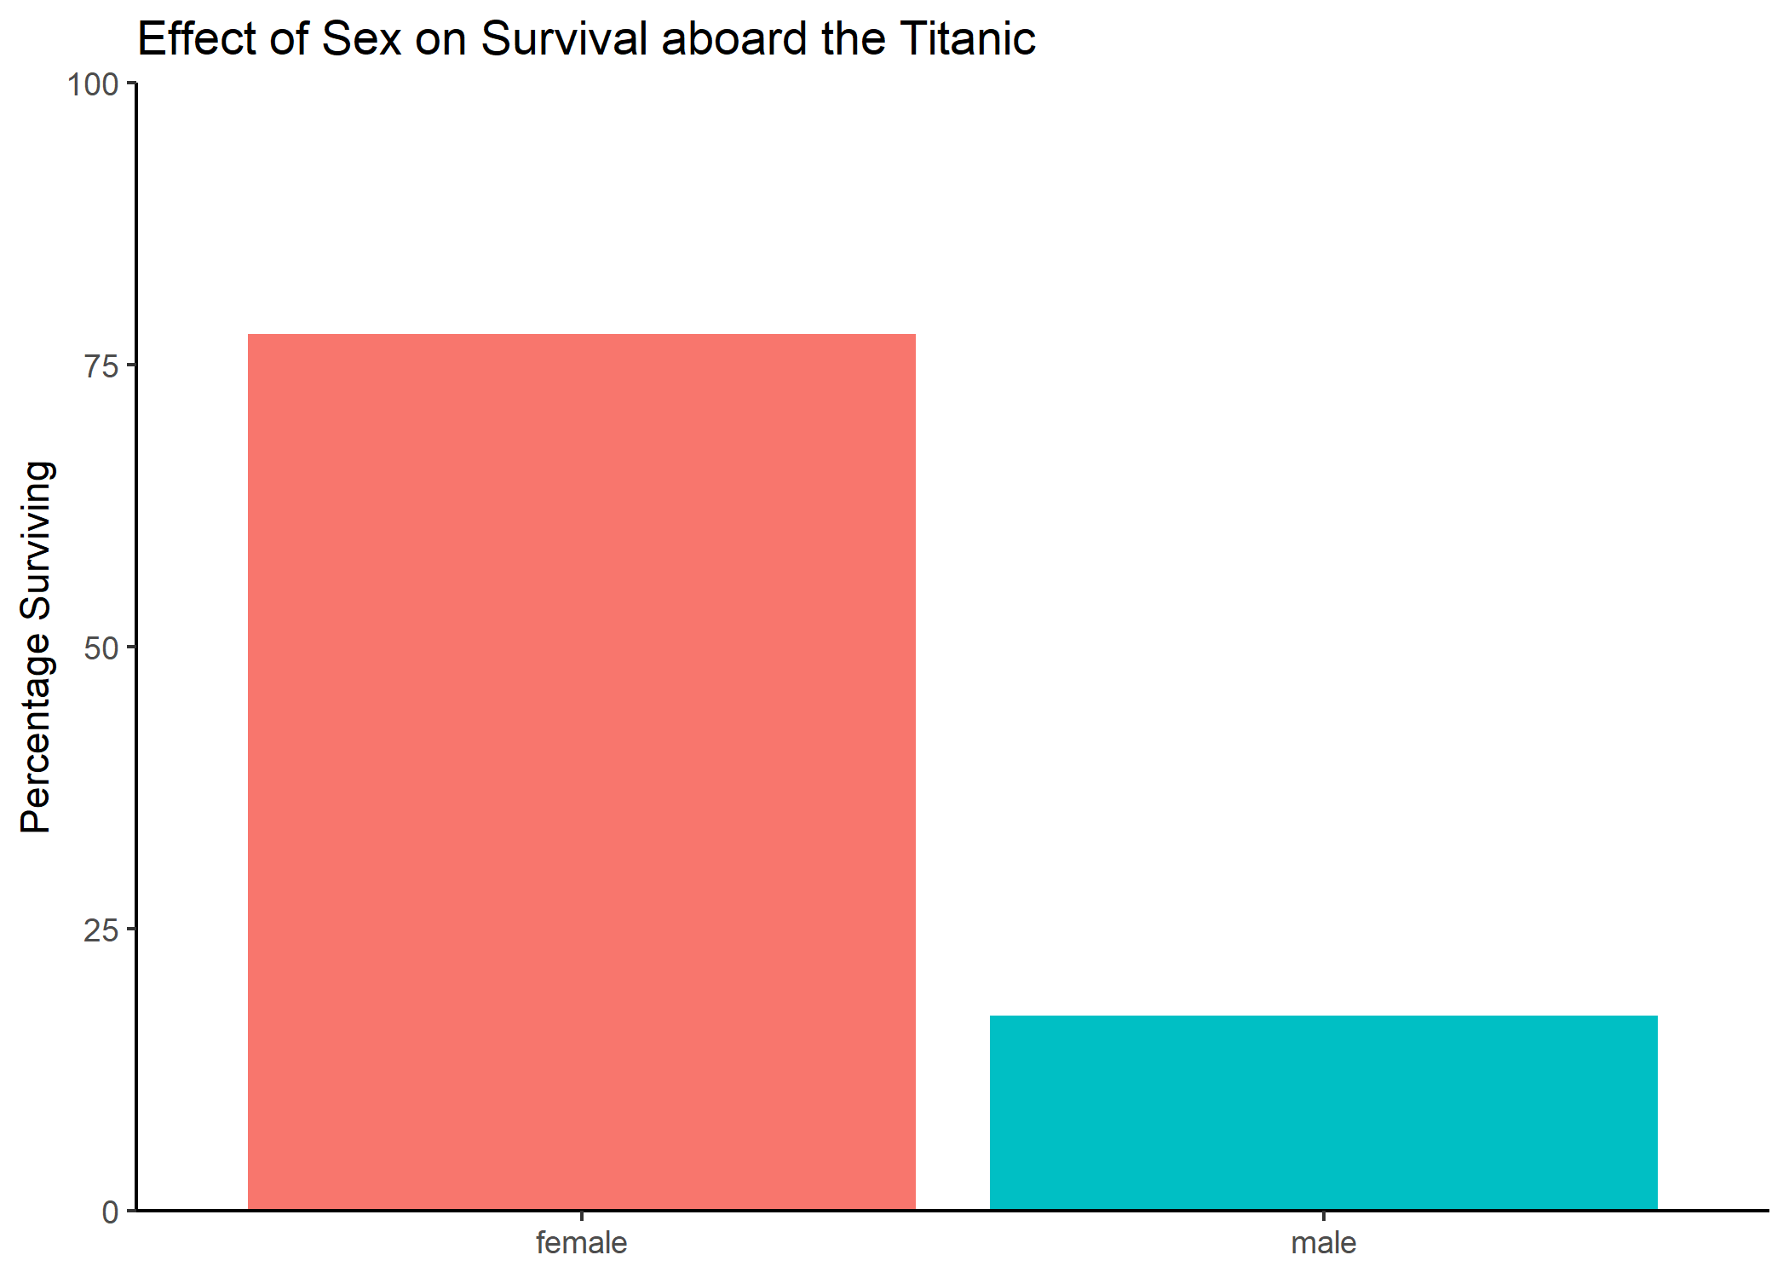

Slide 139
Coordinates: adjust the x-axis text labels
ggplot(data = pct_surv, mapping = aes(x = Sex, y = pct_sex_survive, fill = Sex)) + geom_bar(stat = "identity") + ylab("Percentage Surviving") + labs(title = "Effect of Sex on Survival aboard the Titanic") + theme_classic() + xlab(NULL) + theme(legend.position = "none") + scale_y_continuous(limits = c(0, 100), expand = c(0, 0))

Slide 140
Coordinates: adjust the x-axis text labels
ggplot(data = pct_surv, mapping = aes(x = Sex, y = pct_sex_survive, fill = Sex)) + geom_bar(stat = "identity") + ylab("Percentage Surviving") + labs(title = "Effect of Sex on Survival aboard the Titanic") + theme_classic() + xlab(NULL) + theme(legend.position = "none") + scale_y_continuous(limits = c(0, 100), expand = c(0, 0)) + scale_x_discrete(labels = c("Female", "Male"))

Slide 141


Slide 143
Theme: Setting the font size
ggplot(data = pct_surv, mapping = aes(x = Sex, y = pct_sex_survive, fill = Sex)) + geom_bar(stat = "identity") + ylab("Percentage Surviving") + labs(title = "Effect of Sex on Survival aboard the Titanic") + theme_classic() + xlab(NULL) + theme(legend.position = "none") + scale_y_continuous(limits = c(0, 100), expand = c(0, 0)) + scale_x_discrete(labels = c("Female", "Male"))

Slide 144
Theme: Setting the font size
ggplot(data = pct_surv, mapping = aes(x = Sex, y = pct_sex_survive, fill = Sex)) + geom_bar(stat = "identity") + ylab("Percentage Surviving") + labs(title = "Effect of Sex on Survival aboard the Titanic") + theme_classic(base_size = 17) + xlab(NULL) + theme(legend.position = "none") + scale_y_continuous(limits = c(0, 100), expand = c(0, 0)) + scale_x_discrete(labels = c("Female", "Male"))

Slide 145
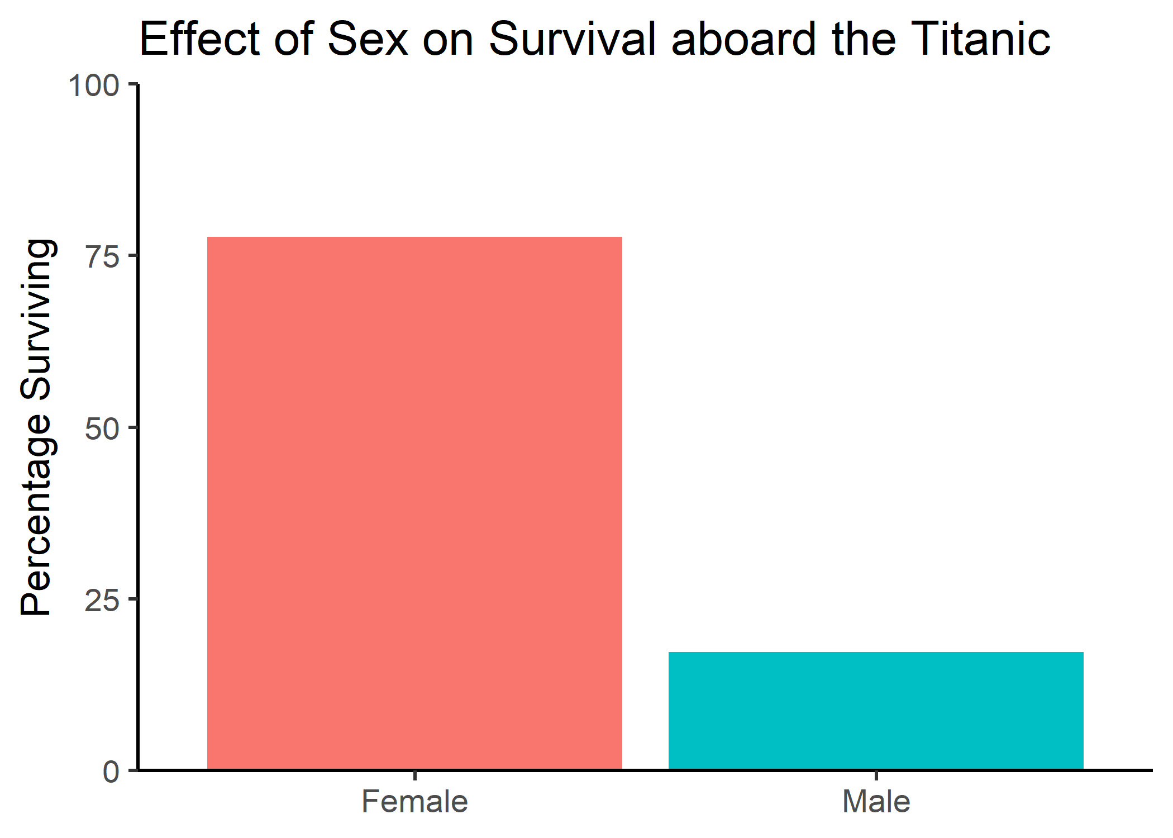

Slide 146
Assigning ggplots to a variable
my_figure <- ggplot(data = pct_surv, mapping = aes(x = Sex, y = pct_sex_survive, fill = Sex)) + geom_bar(stat = "identity") + ylab("Percentage Surviving") + labs(title = "Effect of Sex on Survival aboard the Titanic") + theme_classic(base_size = 17) + xlab(NULL) + theme(legend.position = "none") + scale_y_continuous(limits = c(0, 100), expand = c(0, 0)) + scale_x_discrete(labels = c("Female", "Male")) my_figure

Slide 148
Saving a plot with ggsave()
ggsave(plot = my_figure, filename = "my_fig.png", width = 7, height = 4.5)

Slide 150
All together now
read_csv("https://gist.githubusercontent.com/michhar/2dfd2de0d4f8727f873422c5d959fff5/raw/fa71405126017e6a37bea592440b4bee94bf7b9e/titanic.csv") %>% filter(Age > 12) %>% select(Survived, Sex) %>% group_by(Sex, Survived) %>% summarise(num_sex_survive = n()) %>% mutate(pct_sex_survive = num_sex_survive/sum(num_sex_survive) * 100) %>% filter(Survived == 1) %>% ggplot(mapping = aes(x = Sex, y = pct_sex_survive, fill = Sex)) + geom_bar(stat = "identity") + ylab("Percentage Surviving") + labs(title = "Effect of Sex on Survival aboard the Titanic") + theme_classic(base_size = 17) + xlab(NULL) + theme(legend.position = "none") + scale_y_continuous(limits = c(0, 100), expand = c(0, 0)) + scale_x_discrete(labels = c("Female", "Male")) + ggsave(filename = "my_fig.png", width = 7, height = 4.5)

Slide 151
All together now
read_csv("https://gist.githubusercontent.com/michhar/2dfd2de0d4f8727f873422c5d959fff5/raw/fa71405126017e6a37bea592440b4bee94bf7b9e/titanic.csv") %>% # Read the data into a tibble filter(Age > 12) %>% # Only keep passengers with known Age select(Survived, Sex) %>% # Only keep the Survived and Sex columns group_by(Sex, Survived) %>% # Group by Sex and then Survived summarise(num_sex_survive = n()) %>% # Count the number of passengers in these groups mutate(pct_sex_survive = num_sex_survive/sum(num_sex_survive) * 100) %>% # Calculate the percent surviving filter(Survived == 1) %>% # Only keep the surviving passengers ggplot(mapping = aes(x = Sex, y = pct_sex_survive, fill = Sex)) + # Build the data and aesthetic layers geom_bar(stat = "identity") + # Build the geometric layer as a bar plot ylab("Percentage Surviving") + # Make a Y axis label labs(title = "Effect of Sex on Survival aboard the Titanic") + # Add a title theme_classic(base_size = 17) + # Increase the font size and set a nice theme xlab(NULL) + # Remove the X axis label theme(legend.position = "none") + # Remove the legend scale_y_continuous(limits = c(0, 100), expand = c(0, 0)) + # Set Y axis limits and remove the expansion scale_x_discrete(labels = c("Female", "Male")) + # Capitalize the X axis Sex labels ggsave(filename = "my_fig.png", width = 7, height = 4.5)

Slide 152
Hands-on activity #2
15 minutes

Slide 153
Does Fare predict Survival?
read_csv("https://gist.githubusercontent.com/michhar/2dfd2de0d4f8727f873422c5d959fff5/raw/fa71405126017e6a37bea592440b4bee94bf7b9e/titanic.csv") %>% ggplot(mapping = aes(x = Survived, y = Fare))

Slide 154
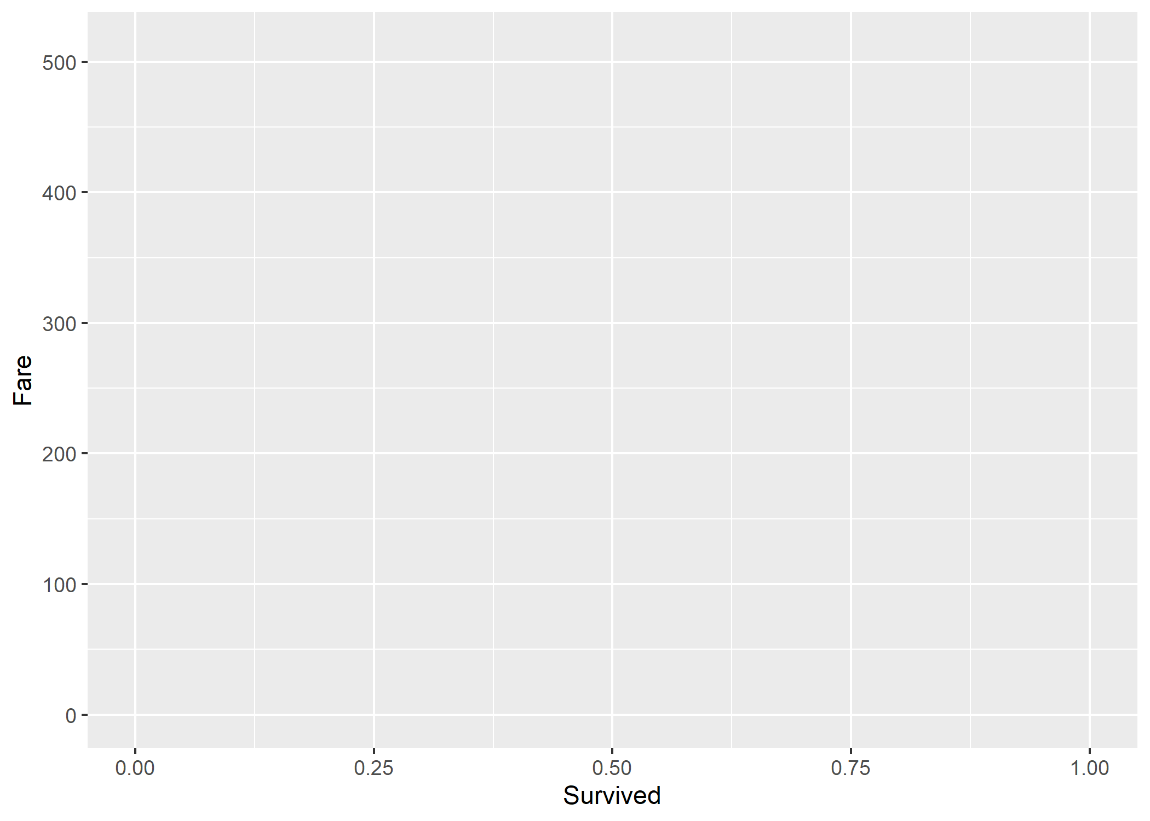

Slide 155
Survived is being treated as a continuous variable
read_csv("https://gist.githubusercontent.com/michhar/2dfd2de0d4f8727f873422c5d959fff5/raw/fa71405126017e6a37bea592440b4bee94bf7b9e/titanic.csv") %>% # Read the data into a tibble select(Survived)

Slide 156
Survived is being treated as a continuous variable
read_csv("https://gist.githubusercontent.com/michhar/2dfd2de0d4f8727f873422c5d959fff5/raw/fa71405126017e6a37bea592440b4bee94bf7b9e/titanic.csv") %>% # Read the data into a tibble select(Survived)
## # A tibble: 891 x 1 ## Survived ## <dbl> ## 1 0 ## 2 1 ## 3 1 ## 4 1 ## 5 0 ## 6 0 ## 7 0 ## 8 0 ## 9 1 ## 10 1 ## # ... with 881 more rows

Slide 157
Factorizing Survived to make it discrete
read_csv("https://gist.githubusercontent.com/michhar/2dfd2de0d4f8727f873422c5d959fff5/raw/fa71405126017e6a37bea592440b4bee94bf7b9e/titanic.csv") %>% ggplot(mapping = aes(x = Survived, y = Fare))

Slide 158
Factorizing Survived to make it discrete
read_csv("https://gist.githubusercontent.com/michhar/2dfd2de0d4f8727f873422c5d959fff5/raw/fa71405126017e6a37bea592440b4bee94bf7b9e/titanic.csv") %>% ggplot(mapping = aes(x = factor(Survived), y = Fare))

Slide 159
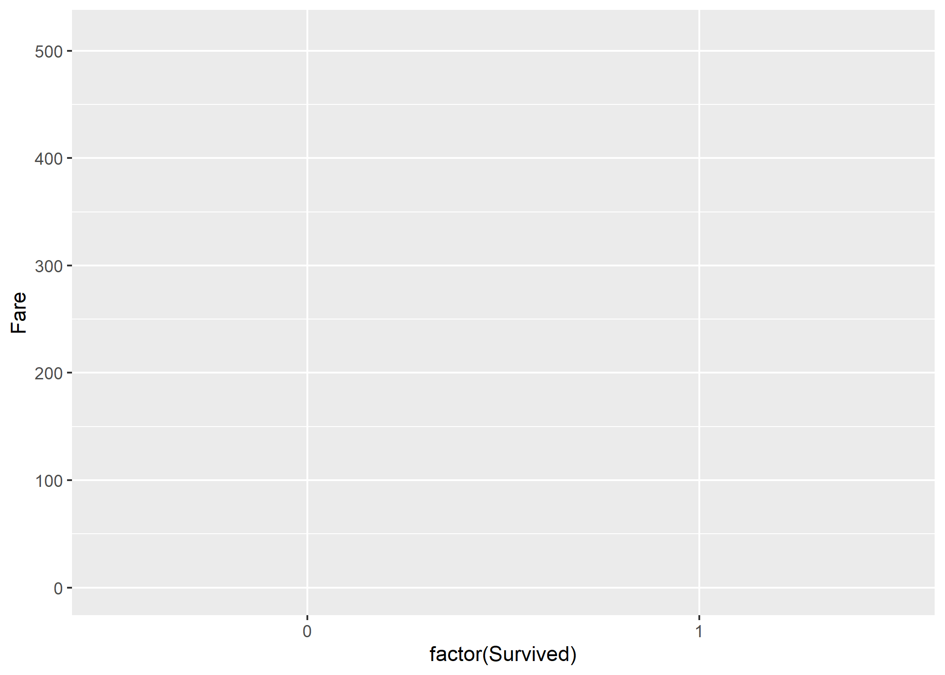

Slide 160
Add factor labels to improve readability
read_csv("https://gist.githubusercontent.com/michhar/2dfd2de0d4f8727f873422c5d959fff5/raw/fa71405126017e6a37bea592440b4bee94bf7b9e/titanic.csv") %>% ggplot(mapping = aes(x = factor(Survived), y = Fare))

Slide 161
Add factor labels to improve readability
read_csv("https://gist.githubusercontent.com/michhar/2dfd2de0d4f8727f873422c5d959fff5/raw/fa71405126017e6a37bea592440b4bee94bf7b9e/titanic.csv") %>% ggplot(mapping = aes(x = factor(Survived, labels = c("Died", "Survived")), y = Fare))

Slide 162
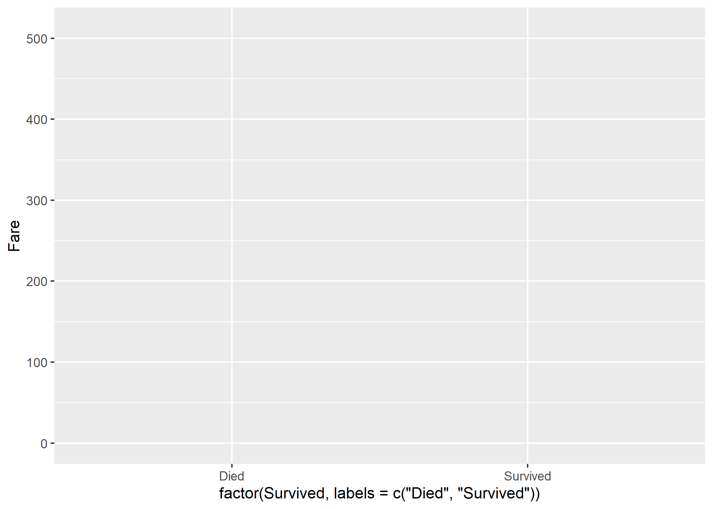

Slide 163
Add the geometry layer
read_csv("https://gist.githubusercontent.com/michhar/2dfd2de0d4f8727f873422c5d959fff5/raw/fa71405126017e6a37bea592440b4bee94bf7b9e/titanic.csv") %>% ggplot(mapping = aes(x = factor(Survived, labels = c("Died", "Survived")), y = Fare))

Slide 164
Add the geometry layer
read_csv("https://gist.githubusercontent.com/michhar/2dfd2de0d4f8727f873422c5d959fff5/raw/fa71405126017e6a37bea592440b4bee94bf7b9e/titanic.csv") %>% ggplot(mapping = aes(x = factor(Survived, labels = c("Died", "Survived")), y = Fare)) + geom_boxplot()

Slide 165
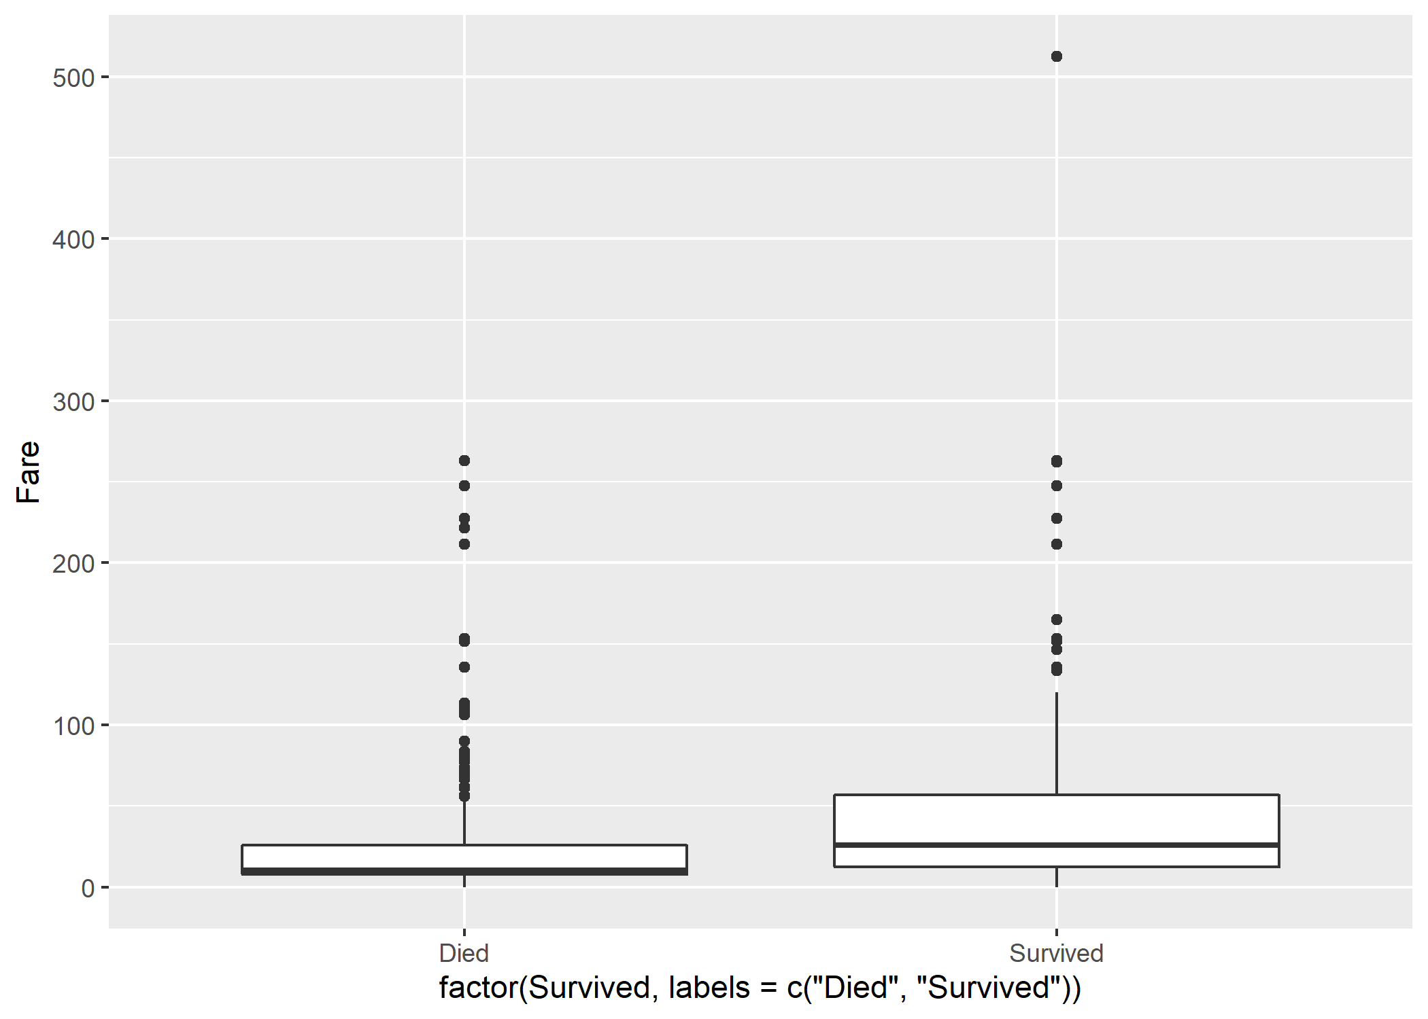

Slide 167
https://www.catallaxyservices.com/media/Grammar-Of-Graphics/#/3/3

Slide 168
Coordinates: log-scale for y-axis
read_csv("https://gist.githubusercontent.com/michhar/2dfd2de0d4f8727f873422c5d959fff5/raw/fa71405126017e6a37bea592440b4bee94bf7b9e/titanic.csv") %>% filter(Fare > 0) %>% ggplot(mapping = aes(x = factor(Survived, labels = c("Died", "Survived")), y = Fare)) + geom_boxplot()

Slide 169
Coordinates: log-scale for y-axis
read_csv("https://gist.githubusercontent.com/michhar/2dfd2de0d4f8727f873422c5d959fff5/raw/fa71405126017e6a37bea592440b4bee94bf7b9e/titanic.csv") %>% filter(Fare > 0) %>% ggplot(mapping = aes(x = factor(Survived, labels = c("Died", "Survived")), y = Fare)) + geom_boxplot() + scale_y_log10()

Slide 170
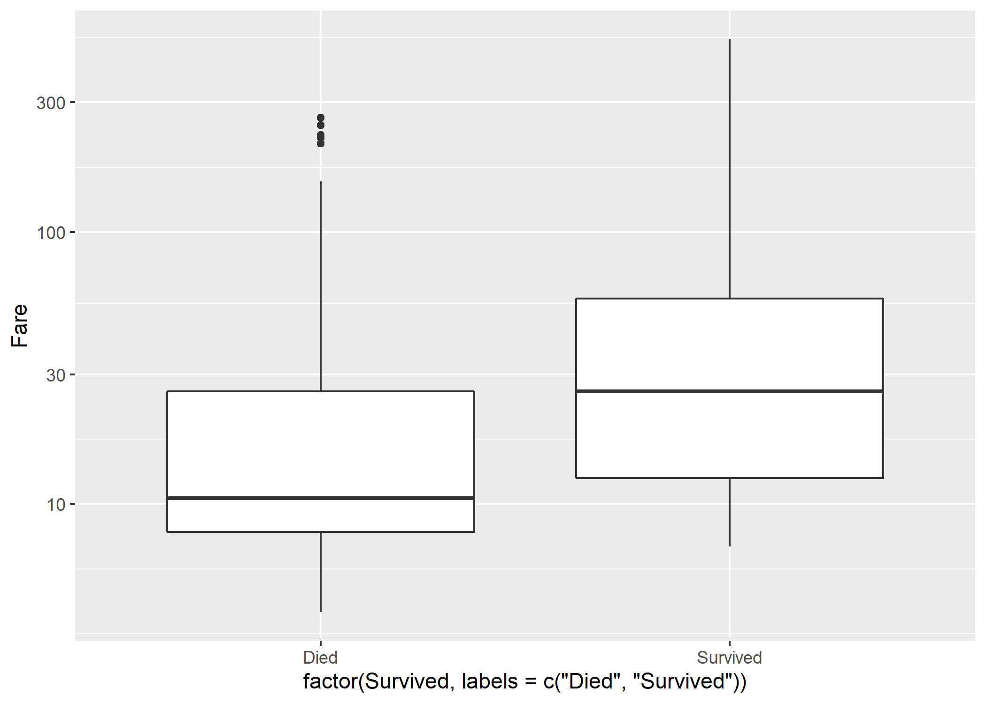

Slide 171
https://www.catallaxyservices.com/media/Grammar-Of-Graphics/#/3/3

Slide 172
Is age a confounding variable here?
read_csv("https://gist.githubusercontent.com/michhar/2dfd2de0d4f8727f873422c5d959fff5/raw/fa71405126017e6a37bea592440b4bee94bf7b9e/titanic.csv") %>% filter(is.numeric(Age) & Fare > 0) %>% mutate(Age_bracket = case_when( Age > 60 ~ "Senior", Age < 16 ~ "Child", TRUE ~ "Adult" # This TRUE is equivalent to "else" in if...else ))

Slide 173
Facets: split the plot by age bracket
read_csv("https://gist.githubusercontent.com/michhar/2dfd2de0d4f8727f873422c5d959fff5/raw/fa71405126017e6a37bea592440b4bee94bf7b9e/titanic.csv") %>% filter(is.numeric(Age) & Fare > 0) %>% mutate(Age_bracket = case_when( Age > 60 ~ "Senior", Age < 16 ~ "Child", TRUE ~ "Adult" # This TRUE is equivalent to "else" in if...else )) %>% ggplot(mapping = aes(x = factor(Survived, labels = c("Died", "Survived")), y = Fare)) + geom_boxplot() + scale_y_log10()

Slide 174
Facets: split the plot by age bracket
read_csv("https://gist.githubusercontent.com/michhar/2dfd2de0d4f8727f873422c5d959fff5/raw/fa71405126017e6a37bea592440b4bee94bf7b9e/titanic.csv") %>% filter(is.numeric(Age) & Fare > 0) %>% mutate(Age_bracket = case_when( Age > 60 ~ "Senior", Age < 16 ~ "Child", TRUE ~ "Adult" # This TRUE is equivalent to "else" in if...else )) %>% ggplot(mapping = aes(x = factor(Survived, labels = c("Died", "Survived")), y = Fare)) + geom_boxplot() + scale_y_log10() + facet_wrap(~ Age_bracket)

Slide 175
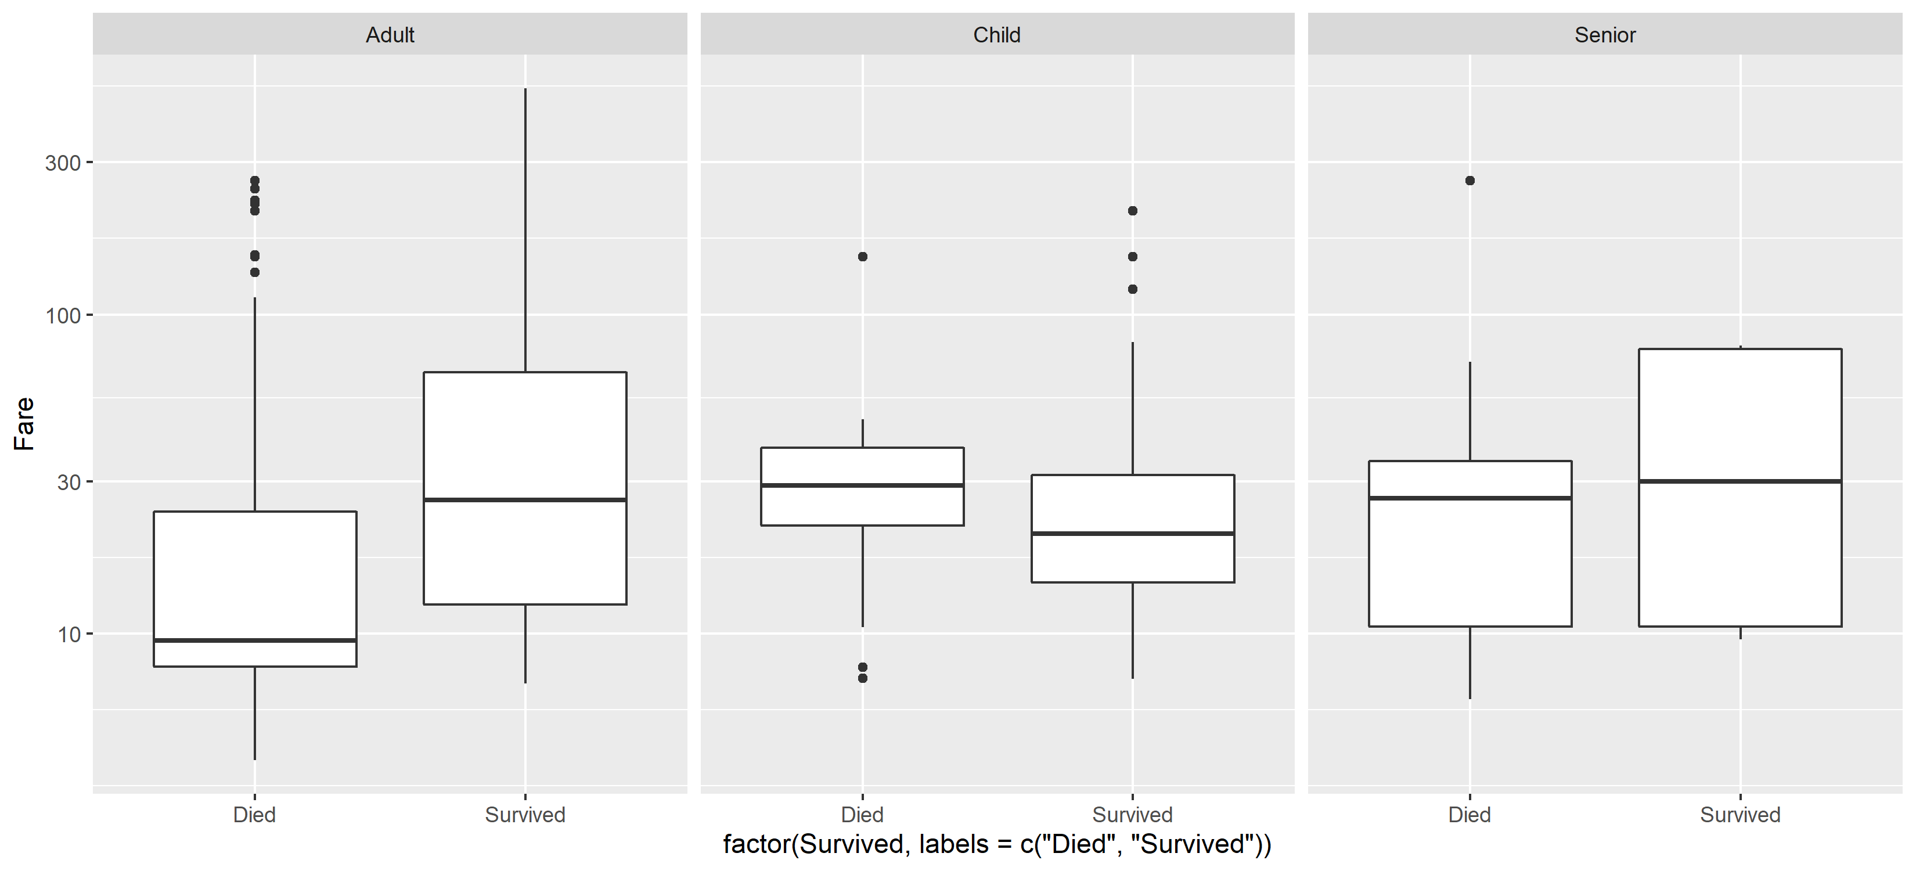

Slide 176
https://www.catallaxyservices.com/media/Grammar-Of-Graphics/#/3/3

Slide 177
https://www.catallaxyservices.com/media/Grammar-Of-Graphics/#/3/3

Slide 178
Install and load ggpubr
# install.packages("ggpubr") library(ggpubr)

Slide 179
Statics: t-test to determine p values
read_csv("https://gist.githubusercontent.com/michhar/2dfd2de0d4f8727f873422c5d959fff5/raw/fa71405126017e6a37bea592440b4bee94bf7b9e/titanic.csv") %>% filter(is.numeric(Age) & Fare > 0) %>% mutate(Age_bracket = case_when( Age > 60 ~ "Senior", Age < 16 ~ "Child", TRUE ~ "Adult" # This TRUE is equivalent to "else" in if...else )) %>% ggplot(mapping = aes(x = factor(Survived, labels = c("Died", "Survived")), y = Fare)) + geom_boxplot() + scale_y_log10() + facet_wrap(~ Age_bracket)

Slide 180
Statics: t-test to determine p values
read_csv("https://gist.githubusercontent.com/michhar/2dfd2de0d4f8727f873422c5d959fff5/raw/fa71405126017e6a37bea592440b4bee94bf7b9e/titanic.csv") %>% filter(is.numeric(Age) & Fare > 0) %>% mutate(Age_bracket = case_when( Age > 60 ~ "Senior", Age < 16 ~ "Child", TRUE ~ "Adult" # This TRUE is equivalent to "else" in if...else )) %>% ggplot(mapping = aes(x = factor(Survived, labels = c("Died", "Survived")), y = Fare)) + geom_boxplot() + scale_y_log10() + facet_wrap(~ Age_bracket) + stat_compare_means(method = "t.test")

Slide 181
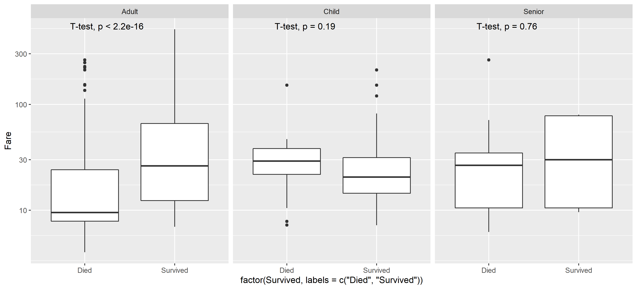

Slide 184
Relationship between Age and Fare Price3
read_csv("https://gist.githubusercontent.com/michhar/2dfd2de0d4f8727f873422c5d959fff5/raw/fa71405126017e6a37bea592440b4bee94bf7b9e/titanic.csv") %>% filter(is.numeric(Age) & Fare > 0) %>% mutate(Age_bracket = case_when( Age > 60 ~ "Senior", Age < 16 ~ "Child", TRUE ~ "Adult" # This TRUE is equivalent to "else" in if...else )) %>% ggplot(mapping = aes(x = factor(Survived, labels = c("Died", "Survived")), y = Fare)) + geom_boxplot() + scale_y_log10() + facet_wrap(~ Age_bracket) + stat_compare_means(method = "t.test")

Slide 185
Relationship between Age and Fare Price3
read_csv("https://gist.githubusercontent.com/michhar/2dfd2de0d4f8727f873422c5d959fff5/raw/fa71405126017e6a37bea592440b4bee94bf7b9e/titanic.csv") %>% filter(is.numeric(Age) & Fare > 0) %>% mutate(Age_bracket = case_when( Age > 60 ~ "Senior", Age < 16 ~ "Child", TRUE ~ "Adult" # This TRUE is equivalent to "else" in if...else )) %>% ggplot(mapping = aes(x = factor(Survived, labels = c("Died", "Survived")), y = Fare)) + geom_boxplot() + scale_y_log10() + facet_wrap(~ Age_bracket) + stat_compare_means(method = "t.test", label = "p.signif")

Slide 186


Slide 187
Relationship between Age and Fare Price4
read_csv("https://gist.githubusercontent.com/michhar/2dfd2de0d4f8727f873422c5d959fff5/raw/fa71405126017e6a37bea592440b4bee94bf7b9e/titanic.csv") %>% filter(is.numeric(Age) & Fare > 0) %>% mutate(Age_bracket = case_when( Age > 60 ~ "Senior", Age < 16 ~ "Child", TRUE ~ "Adult" # This TRUE is equivalent to "else" in if...else )) %>% ggplot(mapping = aes(x = factor(Survived, labels = c("Died", "Survived")), y = Fare)) + geom_boxplot() + scale_y_log10() + facet_wrap(~ Age_bracket) + stat_compare_means(method = "t.test", label = "p.signif")

Slide 188
Relationship between Age and Fare Price4
read_csv("https://gist.githubusercontent.com/michhar/2dfd2de0d4f8727f873422c5d959fff5/raw/fa71405126017e6a37bea592440b4bee94bf7b9e/titanic.csv") %>% filter(is.numeric(Age) & Fare > 0) %>% mutate(Age_bracket = case_when( Age > 60 ~ "Senior", Age < 16 ~ "Child", TRUE ~ "Adult" # This TRUE is equivalent to "else" in if...else )) %>% ggplot(mapping = aes(x = factor(Survived, labels = c("Died", "Survived")), y = Fare)) + geom_boxplot() + scale_y_log10() + facet_wrap(~ Age_bracket) + stat_compare_means(method = "t.test", label = "p.signif", comparisons = list(c("Died", "Survived")))

Slide 189
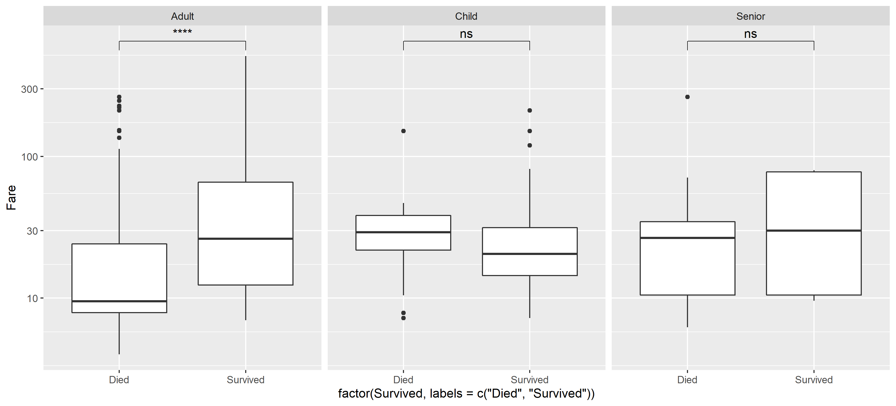

Slide 190
Relationship between Age and Fare Price5
read_csv("https://gist.githubusercontent.com/michhar/2dfd2de0d4f8727f873422c5d959fff5/raw/fa71405126017e6a37bea592440b4bee94bf7b9e/titanic.csv") %>% filter(is.numeric(Age) & Fare > 0) %>% mutate(Age_bracket = case_when( Age > 60 ~ "Senior", Age < 16 ~ "Child", TRUE ~ "Adult" # This TRUE is equivalent to "else" in if...else )) %>% ggplot(mapping = aes(x = factor(Survived, labels = c("Died", "Survived")), y = Fare, fill = factor(Survived, labels = c("Died", "Survived")))) + geom_boxplot() + scale_y_log10(limits = c(2, 1000)) + facet_wrap(~ Age_bracket) + stat_compare_means(method = "t.test", label = "p.signif", comparisons = list(c("Died", "Survived"))) + xlab(NULL) + ylab("Ticket Price (log scale)") + theme_bw(base_size = 17) + theme(legend.position = "none") + scale_fill_manual(values = c("goldenrod", "skyblue")) + ggsave(filename = "my_figure.png", height = 5, width = 11)

Slide 191
Relationship between Age and Fare Price5
read_csv("https://gist.githubusercontent.com/michhar/2dfd2de0d4f8727f873422c5d959fff5/raw/fa71405126017e6a37bea592440b4bee94bf7b9e/titanic.csv") %>% filter(is.numeric(Age) & Fare > 0) %>% mutate(Age_bracket = case_when( Age > 60 ~ "Senior", Age < 16 ~ "Child", TRUE ~ "Adult" # This TRUE is equivalent to "else" in if...else )) %>% ggplot(mapping = aes(x = factor(Survived, labels = c("Died", "Survived")), y = Fare, fill = factor(Survived, labels = c("Died", "Survived")))) + geom_boxplot() + scale_y_log10(limits = c(2, 1000)) + facet_wrap(~ Age_bracket) + stat_compare_means(method = "t.test", label = "p.signif", comparisons = list(c("Died", "Survived"))) + xlab(NULL) + ylab("Ticket Price (log scale)") + theme_bw(base_size = 17) + theme(legend.position = "none") + scale_fill_manual(values = c("goldenrod", "skyblue")) + ggsave(filename = "my_figure.png", height = 5, width = 11)

Slide 192
Relationship between Age and Fare Price5
read_csv("https://gist.githubusercontent.com/michhar/2dfd2de0d4f8727f873422c5d959fff5/raw/fa71405126017e6a37bea592440b4bee94bf7b9e/titanic.csv") %>% filter(is.numeric(Age) & Fare > 0) %>% mutate(Age_bracket = case_when( Age > 60 ~ "Senior", Age < 16 ~ "Child", TRUE ~ "Adult" # This TRUE is equivalent to "else" in if...else )) %>% ggplot(mapping = aes(x = factor(Survived, labels = c("Died", "Survived")), y = Fare, fill = factor(Survived, labels = c("Died", "Survived")))) + geom_boxplot() + scale_y_log10(limits = c(2, 1000)) + facet_wrap(~ Age_bracket) + stat_compare_means(method = "t.test", label = "p.signif", comparisons = list(c("Died", "Survived"))) + xlab(NULL) + ylab("Ticket Price (log scale)") + theme_bw(base_size = 17) + theme(legend.position = "none") + scale_fill_manual(values = c("goldenrod", "skyblue")) + ggsave(filename = "my_figure.png", height = 5, width = 11)

Slide 193
Relationship between Age and Fare Price5
read_csv("https://gist.githubusercontent.com/michhar/2dfd2de0d4f8727f873422c5d959fff5/raw/fa71405126017e6a37bea592440b4bee94bf7b9e/titanic.csv") %>% filter(is.numeric(Age) & Fare > 0) %>% mutate(Age_bracket = case_when( Age > 60 ~ "Senior", Age < 16 ~ "Child", TRUE ~ "Adult" # This TRUE is equivalent to "else" in if...else )) %>% ggplot(mapping = aes(x = factor(Survived, labels = c("Died", "Survived")), y = Fare, fill = factor(Survived, labels = c("Died", "Survived")))) + geom_boxplot() + scale_y_log10(limits = c(2, 1000)) + facet_wrap(~ Age_bracket) + stat_compare_means(method = "t.test", label = "p.signif", comparisons = list(c("Died", "Survived"))) + xlab(NULL) + ylab("Ticket Price (log scale)") + theme_bw(base_size = 17) + theme(legend.position = "none") + scale_fill_manual(values = c("goldenrod", "skyblue")) + ggsave(filename = "my_figure.png", height = 5, width = 11)

Slide 194
Relationship between Age and Fare Price5
read_csv("https://gist.githubusercontent.com/michhar/2dfd2de0d4f8727f873422c5d959fff5/raw/fa71405126017e6a37bea592440b4bee94bf7b9e/titanic.csv") %>% filter(is.numeric(Age) & Fare > 0) %>% mutate(Age_bracket = case_when( Age > 60 ~ "Senior", Age < 16 ~ "Child", TRUE ~ "Adult" # This TRUE is equivalent to "else" in if...else )) %>% ggplot(mapping = aes(x = factor(Survived, labels = c("Died", "Survived")), y = Fare, fill = factor(Survived, labels = c("Died", "Survived")))) + geom_boxplot() + scale_y_log10(limits = c(2, 1000)) + facet_wrap(~ Age_bracket) + stat_compare_means(method = "t.test", label = "p.signif", comparisons = list(c("Died", "Survived"))) + xlab(NULL) + ylab("Ticket Price (log scale)") + theme_bw(base_size = 17) + theme(legend.position = "none") + scale_fill_manual(values = c("goldenrod", "skyblue")) + ggsave(filename = "my_figure.png", height = 5, width = 11)

Slide 195
Relationship between Age and Fare Price5
read_csv("https://gist.githubusercontent.com/michhar/2dfd2de0d4f8727f873422c5d959fff5/raw/fa71405126017e6a37bea592440b4bee94bf7b9e/titanic.csv") %>% filter(is.numeric(Age) & Fare > 0) %>% mutate(Age_bracket = case_when( Age > 60 ~ "Senior", Age < 16 ~ "Child", TRUE ~ "Adult" # This TRUE is equivalent to "else" in if...else )) %>% ggplot(mapping = aes(x = factor(Survived, labels = c("Died", "Survived")), y = Fare, fill = factor(Survived, labels = c("Died", "Survived")))) + geom_boxplot() + scale_y_log10(limits = c(2, 1000)) + facet_wrap(~ Age_bracket) + stat_compare_means(method = "t.test", label = "p.signif", comparisons = list(c("Died", "Survived"))) + xlab(NULL) + ylab("Ticket Price (log scale)") + theme_bw(base_size = 17) + theme(legend.position = "none") + scale_fill_manual(values = c("goldenrod", "skyblue")) + ggsave(filename = "my_figure.png", height = 5, width = 11)

Slide 196
Relationship between Age and Fare Price5
read_csv("https://gist.githubusercontent.com/michhar/2dfd2de0d4f8727f873422c5d959fff5/raw/fa71405126017e6a37bea592440b4bee94bf7b9e/titanic.csv") %>% filter(is.numeric(Age) & Fare > 0) %>% mutate(Age_bracket = case_when( Age > 60 ~ "Senior", Age < 16 ~ "Child", TRUE ~ "Adult" # This TRUE is equivalent to "else" in if...else )) %>% ggplot(mapping = aes(x = factor(Survived, labels = c("Died", "Survived")), y = Fare, fill = factor(Survived, labels = c("Died", "Survived")))) + geom_boxplot() + scale_y_log10(limits = c(2, 1000)) + facet_wrap(~ Age_bracket) + stat_compare_means(method = "t.test", label = "p.signif", comparisons = list(c("Died", "Survived"))) + xlab(NULL) + ylab("Ticket Price (log scale)") + theme_bw(base_size = 17) + theme(legend.position = "none") + scale_fill_manual(values = c("goldenrod", "skyblue")) + ggsave(filename = "my_figure.png", height = 5, width = 11)

Slide 197
Relationship between Age and Fare Price5
read_csv("https://gist.githubusercontent.com/michhar/2dfd2de0d4f8727f873422c5d959fff5/raw/fa71405126017e6a37bea592440b4bee94bf7b9e/titanic.csv") %>% filter(is.numeric(Age) & Fare > 0) %>% mutate(Age_bracket = case_when( Age > 60 ~ "Senior", Age < 16 ~ "Child", TRUE ~ "Adult" # This TRUE is equivalent to "else" in if...else )) %>% ggplot(mapping = aes(x = factor(Survived, labels = c("Died", "Survived")), y = Fare, fill = factor(Survived, labels = c("Died", "Survived")))) + geom_boxplot() + scale_y_log10(limits = c(2, 1000)) + facet_wrap(~ Age_bracket) + stat_compare_means(method = "t.test", label = "p.signif", comparisons = list(c("Died", "Survived"))) + xlab(NULL) + ylab("Ticket Price (log scale)") + theme_bw(base_size = 17) + theme(legend.position = "none") + scale_fill_manual(values = c("goldenrod", "skyblue")) + ggsave(filename = "my_figure.png", height = 5, width = 11)

Slide 198
Relationship between Age and Fare Price5
read_csv("https://gist.githubusercontent.com/michhar/2dfd2de0d4f8727f873422c5d959fff5/raw/fa71405126017e6a37bea592440b4bee94bf7b9e/titanic.csv") %>% filter(is.numeric(Age) & Fare > 0) %>% mutate(Age_bracket = case_when( Age > 60 ~ "Senior", Age < 16 ~ "Child", TRUE ~ "Adult" # This TRUE is equivalent to "else" in if...else )) %>% ggplot(mapping = aes(x = factor(Survived, labels = c("Died", "Survived")), y = Fare, fill = factor(Survived, labels = c("Died", "Survived")))) + geom_boxplot() + scale_y_log10(limits = c(2, 1000)) + facet_wrap(~ Age_bracket) + stat_compare_means(method = "t.test", label = "p.signif", comparisons = list(c("Died", "Survived"))) + xlab(NULL) + ylab("Ticket Price (log scale)") + theme_bw(base_size = 17) + theme(legend.position = "none") + scale_fill_manual(values = c("goldenrod", "skyblue")) + ggsave(filename = "my_figure.png", height = 5, width = 11)

Slide 199
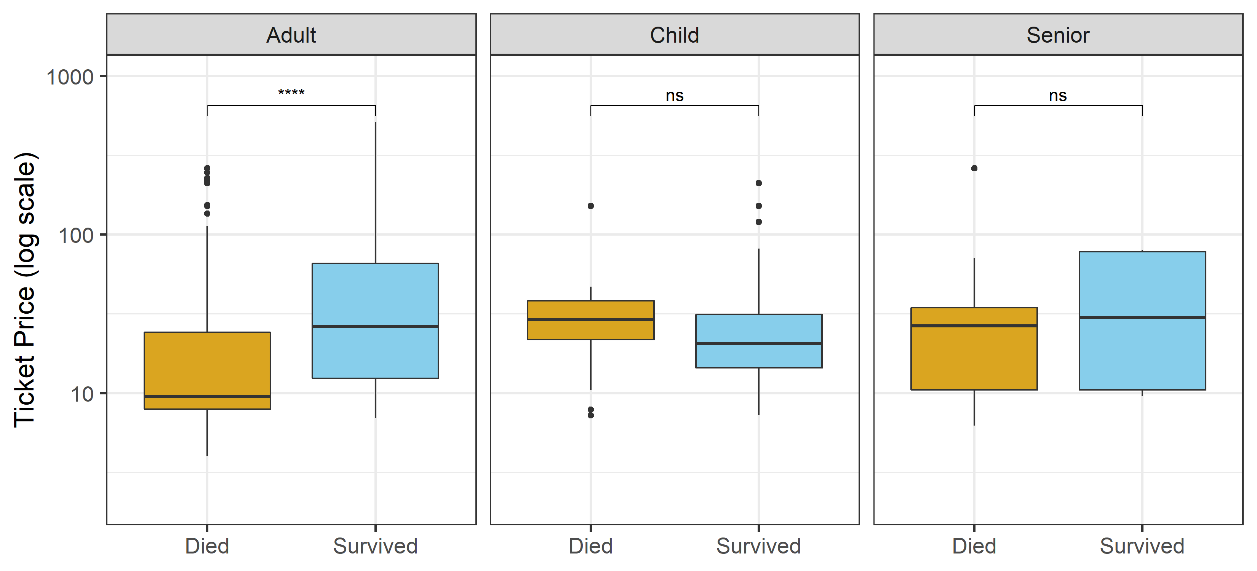

Slide 200
Questions?
Homework: Do Introduction to Tidyverse DataCamp course, then practice problems.

