Slide 1
Differenetial Expression Analysis
Bioinformatics Bootcamp
October 6, 2020

Slide 2
This hands-on session will NOT cover
From sequence data to gene expression
Lecture 11
Visualize RNA-seq data
Lecture 7 (Dr. Bunnik)
Functional Interpretation: Lecture 8
Where can you find other public-domain data
Lecture 9

Slide 3
RNA-seq
RNA-seq typically only looks coding region
Read counts summaried across all exons
Reads over intron/promote regions commonly are NOT coounted
RNA-seq may be extended to cover
Non-coding RNAs (Functional elements)
Small RNAs, etc
5’
3’
TSS
Promoter
Exon
Exon
Coding sequence (CDS)
Intron
Intergenic region

Slide 4
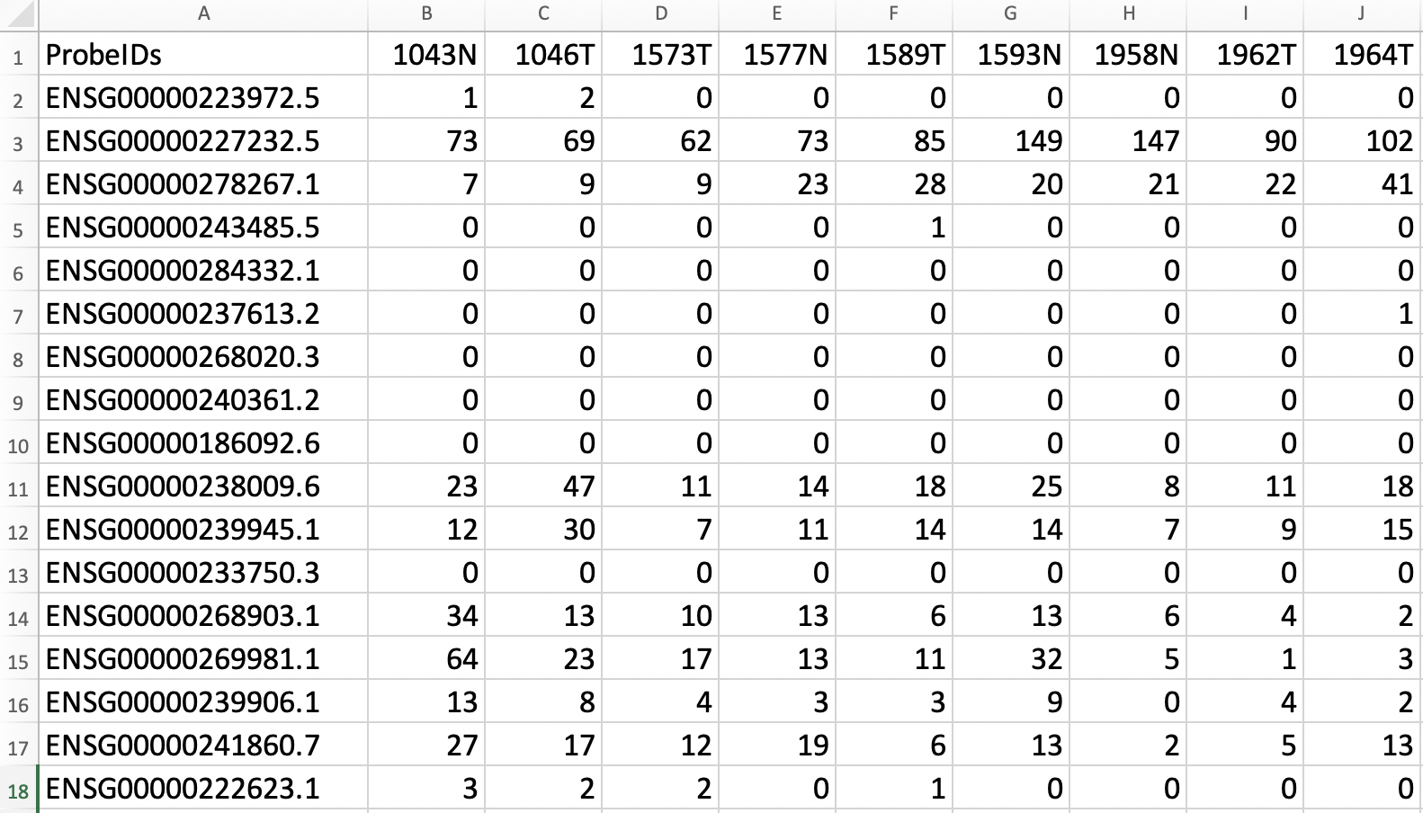
RNA-seq data example
Gene ID
# of sequence reads aligned to this gene
Sample name

Slide 5
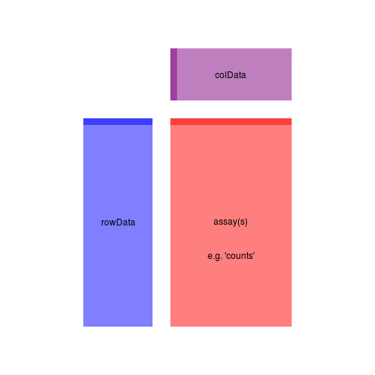
DESeq2 is built on SummarizedExperiment object
data( “airway”)
se <- airway
Try using command:
assay( se )
colData( se )
rowData( se )

