Slide 1


澳門科技大學
Macau University of Science and Technology
概率论与数理统计
王建州

Slide 2

Sample Space
澳門科技大學
一
Macau University of Science and Technology
一、
Probability theory is concerned with situations in which the outcomes occur randomly. Generically, such situations are called experiments, and the set of all possible outcomes is the sample space corresponding to an experiment. The sample space is denoted by , and an element of is denoted by .
Subsets of is events.

Slide 3
Sample Space
澳門科技大學
一
Macau University of Science and Technology
一、
Example A
Driving to work, a commuter passes through a sequence of three intersections with traffic lights. At each light, she either stops, , or continues, , The sample space is the set of all possible outcomes:
The event that the commuter stops at the first light is the subset of denoted by

Slide 4
Sample Space
澳門科技大學
一
Macau University of Science and Technology
一、
Example B
The number of jobs in a print queue of a mainframe computer may be modeled as random. Here the sample space can be taken as
The event that there are fewer than five jobs in the print queue can be denoted by

Slide 5
Sample Space
澳門科技大學
一
Macau University of Science and Technology
一、
Example C
Earthquakes exhibit very erratic behavior, which is sometimes modeled as random. For example, the length of time between successive earthquakes in a particular region that are greater in magnitude than a given threshold may be regarded as an experiment. Here is the set of all nonnegative real numbers:

Slide 6
Random experiment
澳門科技大學
一
Macau University of Science and Technology
一、
If a experiment meets the following conditions：
The experiment can be repeated in the same situation；
All possible results of the experiment are clearly known, and there is more than one；
Each experiment always happens to one of these possible results, but before a experiment, it is not certain which result will appear in this experiment.
Such a experiment is called a random experiment, and for convenience, it is also called a experiment for short.

Slide 7
Sample Space
澳門科技大學
一
Macau University of Science and Technology
一、
Basic event：Every possible outcome of a random experiment.
Sample space：The totality of all basic events.The symbol is commonly used.
Sample point：The basic event, represented by the symbol .
Complex event：An event consist of multiple basic events.
Random event：Whether it is a basic event or a complex event, they occur in the experiment or not is random, so they are random event, or simply called an event.
Traditionally, people often use capital letters to indicate events. In the experiment, if a basic event occurs and is contained in A, it is called A occurrence, and it is recorded as .

Slide 8
Sample Space
澳門科技大學
一
Macau University of Science and Technology
一、
Certain event ： is consist of all basic events, so in any experiment, one of the basic events must appear .
Impossible event ：In any experiment, there can be no . In other words, will never happen.

Slide 9
Event relationship
澳門科技大學
一
Macau University of Science and Technology
一、
If the occurrence of event A will inevitably lead to the occurrence of event B, it is said that event B includes event A, or that A is a specialness of B, and is recorded as or .
Because the impossible event does not contain any , for any
event A, we agree .
If and are both established，Then it is said that events A and B are equal, denoted as .
It is easy to know that two equal events A and B always occur at
the same time or do not occur at the same time.

Slide 10
The algebra of set theory
澳門科技大學
一
Macau University of Science and Technology
一、
Union: The union of two events, A and B, is the event C that either A occurs or B occurs or both occur: .
Intersection: The intersection of two events, , is the event that both A and B occur.
Complement: The complement of an event, , is the event that A does not occur and thus consists of all those elements in the sample space that are not in A.
Empty set: The empty set, , is the set with no elements; it is the event with no outcomes.
Disjoint: A and C have no outcomes in common, .

Slide 11
The algebra of set theory
澳門科技大學
一
Macau University of Science and Technology
一、
For example, if A is the event that the commuter stops at the first light (listed before), and if B is the event that she stops at the third light,
,
C is the event that she stops at the first light or stops at the third light and consists of the outcomes that are in A or in B or in both:
C is the event that the commuter stops at the first light and stops at the third light and thus consists of those outcomes that are common to both A and B:
The complement of the event A that the commuter stops at the first light is the event that she continues at the first light:

Slide 12
Event calculation
澳門科技大學
一
Macau University of Science and Technology
Union：At least one of events A and B occurs, denoted as .
Intersection：Events A and B occur at the same time, denoted
as or .
Difference：If event A occurs but B does not occur, denoted as .
Mutually incompatible：Event A and B cannot happen at the same time, that is to say is an impossible event, denoted as .
Opposing event or adverse event：If ，In an experiment, if A occurs, then must not occur (and vice versa), then A and are opposing events. Obviously .
一、

Slide 13
Event calculation
澳門科技大學
一
Macau University of Science and Technology
一、
If there are n events: , "at least one of them occurred",Such events are called unions of and are recorded as .
"Happening at the same time", such an event is called the Intersection of and is recorded as or .
or

Slide 14
Event calculation
澳門科技大學
一
Macau University of Science and Technology
一、
Example 1.5 Suppose A, B, and C are random events in , then
The event "A and B happen, C does not happen" can be expressed as ;
"At least two of A, B, and C occur" can be expressed as ;
"Exactly two of A, B, and C occur" can be expressed as ;
"There is no more than one event in A, B, C" can be expressed as .

Slide 15
Laws of set theory
澳門科技大學
一
Macau University of Science and Technology
一、
Commutative Laws:
Associative Laws:
Distributive Laws:

Slide 16
Event calculation rule
澳門科技大學
一
Macau University of Science and Technology
一、
Commutative law：
Associative law：
Distribution law：
De Morgan Theorem (dual principle)：

Slide 17
Event calculation rule
澳門科技大學
一
Macau University of Science and Technology
一、
Prove：
Assume ，then ，
If ， is established at the same time,so
are both true, that is .
If ，This shows that at the same time are established ，Thus is established .
So no matter , is established,
This shows that is established.
or
or

Slide 18
Event calculation rule
澳門科技大學
一
Macau University of Science and Technology
Conversely, suppose there is ，Then
are both true.
If , then , obviously established.
If , then we know that there must be at the same time .
So , then , which means
Since there is a relationship of " " and " " at the same time, so
一、

Slide 19
Event calculation rule
澳門科技大學
一
Macau University of Science and Technology
Prove：
Assume ， ，This shows that does not belong to Any one,That is ，or ，established at the same time,so ,then
is established.
一、

Slide 20
Event calculation rule
澳門科技大學
一
Macau University of Science and Technology
Conversely, assume , then , so at the
same time , which shows that does not belong to any of , that is , which is , which shows
that is established, so there is .
So it is proved.
一、

Slide 21
Probability Measures
澳門科技大學
一
Macau University of Science and Technology
一、
A probability measure on ,is a function P from subsets of , to the real numbers that satisfies the following axioms:
1.
2. If , then .
3. If and are disjoint, then
More generally, if , are mutually disjoint, then

Slide 22
Properties of probability measures
澳門科技大學
一
Macau University of Science and Technology
一、
1.
Since A and are disjoint with and thus, .
2.
Since and thus, .
3. If , then .
B can be expressed as the union of two disjoint sets: ,
, and thus .
4. Addition law:

Slide 23
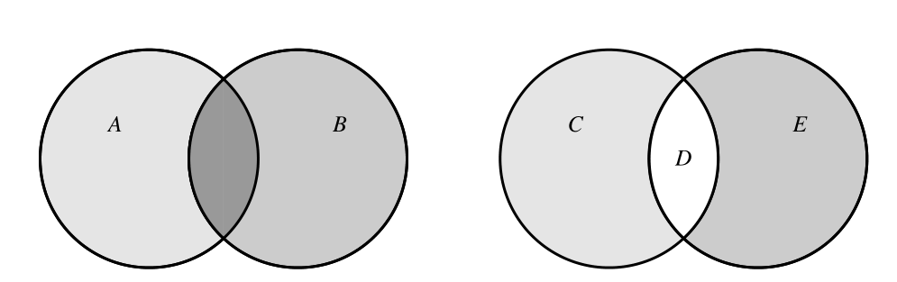
Event calculation rule
澳門科技大學
一
Macau University of Science and Technology
一、

Slide 24
Example
澳門科技大學
一
Macau University of Science and Technology
一、
Suppose that a fair coin is thrown twice. Let A denote the event of heads on the first toss, and let B denote the event of heads on the second toss. The sample space is .
We assume that each elementary outcome in is equally likely and has
probability , is the event that heads comes up on the first toss or on the second toss. Clearly, . Rather, since
is the event that heads comes up on the first toss and on the second toss,

Slide 25
Probability and frequency
澳門科技大學
一
Macau University of Science and Technology
Probability: A measure (numerical value) of the probability of occurrence of a random event A, called the occurrence of A Probability, denoted as .
Frequency: If the random event A occurs time in n repeated trials, it is said is the frequency of A.
Frequency properties: 1. Non-negativity: .
2. Normative: If is an inevitable event, then .
3. Limited additivity: if A and B are incompatible
with each other( ), then
一、

Slide 26
Probability and frequency
澳門科技大學
一
Macau University of Science and Technology
一、
Other properties of frequency:
1.The frequency of impossible events is zero,
2.If ,then ，For any event A,
3.For a limited number of incompatible events (any two events are incompatible with each other), the frequency is additive. If ，then
1≤ i, j ≤m,i≠j

Slide 27
Axiomatic definition of probability
澳門科技大學
一
Macau University of Science and Technology
一、
Probability is a non-negative, canonical, listable and additive set function defined in -Algebra .
The nature of probability:
1. The probability of an impossible event is 0,
Prove：Because ,so ，
then
2. Limited additivity, if ,then
Prove：Because ，From the additivity
and , we get

Slide 28
Axiomatic definition of probability
澳門科技大學
一
Macau University of Science and Technology
一、
3. For any random event A，
Prove： Because , so
4. If ，then
Prove： Because when there is , there is ,and
By limited additivity :
After shifting the term, the equation to be proved can be obtained, and the following system can be obtained from this.
System1 For any two events A, B，
System2 If , then

Slide 29
Axiomatic definition of probability
澳門科技大學
一
Macau University of Science and Technology
5. For any two events A, B，
Prove： Because
so ，also because
then
System 3
The induction method is extended to any limited number of events, assuming
is n random events,then
一、
General addition formula of probability
1≤i<j<k≤n
1≤i<j<k≤n

Slide 30
Example
澳門科技大學
一
Macau University of Science and Technology
一、
Someone write n letters and n envelopes at a time, if he arbitrarily puts n pieces of letter paper into n envelopes. What is the probability that the letter paper and envelope of at least one letter are the same?
Solution : Assume
The required probability is ，then
{The i-th letter just fits into the i-th envelope}

Slide 31
Example
澳門科技大學
一
Macau University of Science and Technology
一、
The same reason：
General addition formula by probability:
(Obviously, when n is sufficiently large, it is approximately )
1≤i<j<k≤n

Slide 32
Computing Probabilities: Counting Methods
澳門科技大學
一
Macau University of Science and Technology
一、
Probabilities are especially easy to compute for finite sample spaces. Suppose that and that .To find the probability of an event A, we simply add the probabilities of the that constitute A.
The elements of all have equal probability; so if there are N elements in ,
each of them has probability .
If A can occur in any of n mutually exclusive ways, then , or
Note that this formula holds only if all the outcomes are equally likely.

Slide 33
Classical Probability
澳門科技大學
一
Macau University of Science and Technology
1. There are only a limited number of elements ( basic events) in the sample space. May wish to set as n, and remember them as .
2. The probability of each basic event is equal, that is, there is
Call this equivalent mathematical model the classical probabilistic model.
Sample space： ,Finite additivity:
then
For any random event, if A is the sum of k basic events,
then
一、
The number of basic events in A
The number of favorable events is the number of basic events contained in A.
Number of basic events
Number of favorable events in A
Number of basic events

Slide 34

Example
澳門科技大學
一
Macau University of Science and Technology
There are ten identical balls in the box, which are marked as number
respectively. Take any ball from them and find the probability that the number is an even number?
Solution : Assume ,then
Assume ，obviously
So
Solution two: Assume ，
From symmetry:
一、
i = {The number of the ball is i} , i = 1,2,...,10
A = {The ball number is even}
A = {The ball number is even}
A = {The ball number is odd}

Slide 35
Example
澳門科技大學
一
Macau University of Science and Technology
一、
A set of five-volume anthologies, randomly placed on the shelf, find the probability that each volume is exactly 1, 2, 3, 4, 5 from left to right or right to left.
Solution: Using a, b, c, d, and e to represent the volume numbers of the books arranged from left to right. At this time, a placement method corresponds to a vector (a, b, c, d, e), and a, b, c, d, and e can only take values among 1, 2, 3, 4, and 5 (and it is not allowed to take a certain value repeatedly), so there are a total of such vectors, because each volume is placed It’s random, so these 120 ways are equally possible. At this time, we get a classical probability of .
And there are only two situations for the occurrence of favorable event A: or the arrangement of the volume number is 1, 2, 3, 4, 5, or 5, 4, 3, 2, 1, so

Slide 36
Example
澳門科技大學
一
Macau University of Science and Technology
Suppose that there are n people, and everyone can be allocated to any one of the N rooms to live in ( ), find the probability of the following events:
(1) There is one person living in each of the n designated rooms;
(2) There are exactly n rooms, each of which lives one person.
Solution: Because each person has N rooms to choose from, there is a total of
ways for n persons to live, and they are equally possible. In the first question, there is one person living in each of the n designated rooms, and the total number of possible n persons is , so .
一、

Slide 37
Example
澳門科技大學
一
Macau University of Science and Technology
Suppose that there are n people, and everyone can be allocated to any one of the N rooms to live in ( ), find the probability of the following events:
(1) There is one person living in each of the n designated rooms;
(2) There are exactly n rooms, each of which lives one person.
In the second question, n rooms can be arbitrarily selected from N rooms, and the total number is . For the selected n rooms, according to the aforementioned discussion, there are ways of allocation, so there are exactly n rooms. Among them, the probability of living alone is
一、

Slide 38
Example
澳門科技大學
一
Macau University of Science and Technology
一、
There are n people in a class ( ). What is the probability that at least two people have their birthdays on the same day?
Solution: Assuming that a year is calculated as 365 days, and 365 days are regarded as 365 "rooms", then the problem can be reduced to Example 1.8. At this time, "n people’s birthdays are all different" is equivalent to (2) in Example 1.8: "There are exactly n rooms, each of which lives one person." make , then ,
Because ，so
A={At least two people have the same birthday}
{Everyone has different birthdays}

Slide 39
Example
澳門科技大學
一
Macau University of Science and Technology
Both A and B toss the coins evenly, where A toss n+1 times, and B toss n times. Find the probability of the event that "A's number of front is greater than B's number of front"?
Solution: Assume
The probability of the desired event is ，obviously,
From symmetry: So,
一、
A1=The number of times A throws front
A2=The number of times A throws obverse
B1=The number of times B throws front
B2=The number of times B throws obverse
P( A1 > B1 )
Ω - { A1 > B1 } = { A1 ≤ B1} = { A2 > B2 }
P( A1 > B1 ) = P( A2 > B2 )
P( A1 > B1 ) = 0.5

Slide 40
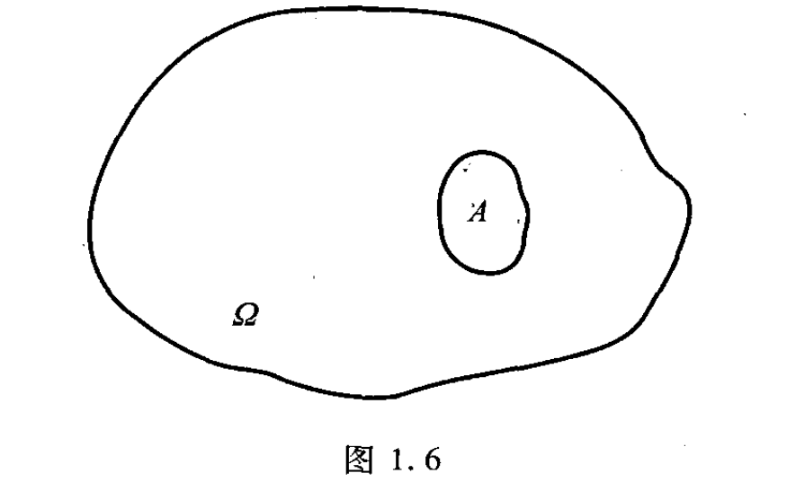
Geometric probability
澳門科技大學
一
Macau University of Science and Technology
一、
If we are in a region with an area of , we can cast points arbitrarily (see Figure 1.6). The exact meaning of "equal possibility" here refers to: suppose there is any small area A in area , if its area is , the probability that the point falls into A is proportional to , and is proportional to the position of A And the shape has nothing to do. If the random event "the point falls into the small area A" is still recorded as A, then from , we can get
This type of probability is usually called geometric probability. Please note that if you cast points on a line segment, the area should be changed to length; if you cast points in a cube, the area should be changed to volume; and so on.

Slide 41
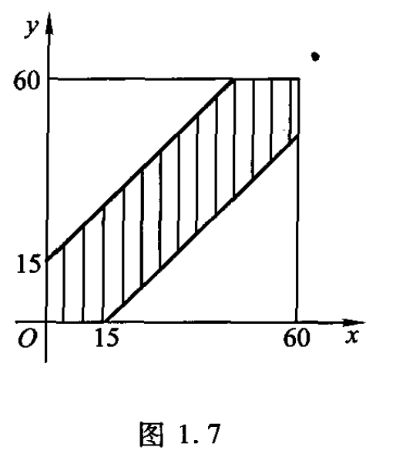
Example
澳門科技大學
一
Macau University of Science and Technology
A and B agreed to meet somewhere between 6 o'clock and 7 o'clock, and agreed that the first person should wait a quarter of an hour for the other person, and then they can leave. Find the probability that the two will meet.
Solution: Use x and y to represent the time when A and B arrived at the appointment place. The necessary and sufficient condition for the two to meet is and the rectangular coordinate system is established on the plane as shown in Figure 1.7. Then all possible results of are a square with a side length of 60, and the possible meeting time is represented by the shaded part in the figure. This is a geometric probability problem, known from equal probability:
一、
If the date is not on time, the probability that the two will meet is no more than 50%.

Slide 42
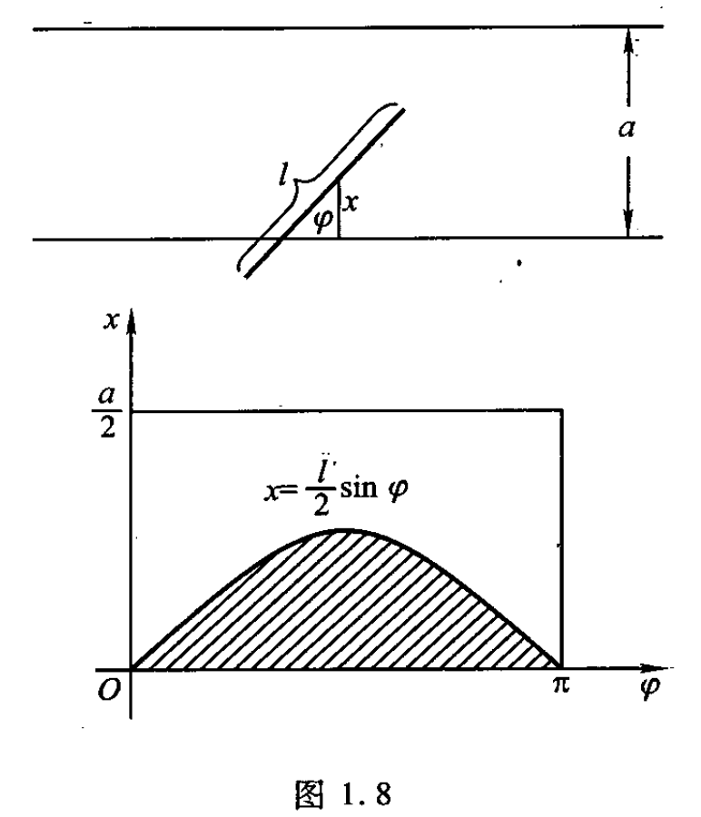
Example
澳門科技大學
一
Macau University of Science and Technology
一、
Parallel lines of equal distance are drawn on the plane, and the distance between the parallel lines is . Throw a needle of length to the plane at will, and try to find the probability that the needle intersects the parallel line.
Solution: Use x to indicate the distance between the midpoint of the needle and the nearest parallel line, and to indicate the angle of intersection between the needle and this straight line ( Figure 1.8).
It is easy to know that there are , and these
two formulas can determine the plane rectangle
0 ≤ x ≤ , 0 ≤ ≤

Slide 43
Example
澳門科技大學
一
Macau University of Science and Technology
一、
Parallel lines of equal distance are drawn on the plane, and the distance between the parallel lines is . Throw a needle of length to the plane at will, and try to find the probability that the needle intersects the parallel line.
At this time, in order for the needle to intersect theparallel line,the necessary and sufficient condition is .
The area A represented by this inequality is the shaded part in Figure 1.8. Knowing from the possibility of waiting:
x ≤

Slide 44
Conditional Probability
澳門科技大學
一
Macau University of Science and Technology
一、
Conditional probability
Let A and B be two events with . The conditional probability of A given B is defined to be .
Let A and B be events and assume . Then .
Multiplication law

Slide 45
Example
澳門科技大學
一
Macau University of Science and Technology
Digitalis therapy is often beneficial to patients who have suffered congestive heart failure, but there is the risk of digitalis intoxication, a serious side effect that is difficult to diagnose. To improve the chances of a correct diagnosis, the concentration of digitalis in the blood can be measured. Bellar et al. (1971) conducted a study of the relation of the concentration of digitalis in the blood to digitalis intoxication in 135 patients. Their results are simplified slightly in the following table, where this notation is used:
一、
 | D+ | D− | Total
T+ | 25 | 14 | 39
T− | 18 | 78 | 96
Total | 43 | 92 | 135
 | D+ | D− | Total
T+ | .185 | .104 | .289
T− | .133 | .578 | .711
Total | .318 | .682 | 1.000

Slide 46
Example
澳門科技大學
一
Macau University of Science and Technology
一、
An urn contains three red balls and one blue ball. Two balls are selected without replacement. What is the probability that they are both red?
Let and denote the events that a red ball is drawn on the first trial and on the second trial, respectively.
From the multiplication law,
is clearly , and if a red ball has been removed on the first trial, there are two red balls and one blue ball left. Therefore, .
Thus, .
Suppose that if it is cloudy , the probability that it is raining is 0.3, and that the probability that it is cloudy is . The probability that it is cloudy and raining is

Slide 47
Example
澳門科技大學
一
Macau University of Science and Technology
There are 40 students in a class, and 15 of them are sports enthusiasts. The class is divided into four groups. The first group has 10 students, including 4 sports enthusiasts. If you choose one person in the class to be the student representative, then the probability that this representative happens to be in the first group is . Now we have to choose a sports enthusiast as a representative in the class. What is the probability that this representative happens to be in the first group? Most readers must immediately calculate that this probability is . It is easy to understand that these two probabilities are not the same, because in the second question, the selected student must be a sports enthusiast, which has one more "additional" condition than the first question.
If we remember
In the first question, is obtained, and in the second question, under the additional condition of "known event B occurs", the probability of occurrence of A：
一、
A = {Choose one student, the student belongs to the first group}
B = {Choose a student, the student is a sports enthusiast}

Slide 48
Conditional Probability
澳門科技大學
一
Macau University of Science and Technology
一、
If is a probability space, and , then for any Let
be the conditional probability of event A occurring under the condition that event B is known to occur.
Features: 1. Non-negativity: for random ，
2. Normative:
3. Listable additivity: for any list of incompatible events
，then

Slide 49
Example
澳門科技大學
一
Macau University of Science and Technology
一、
There are two children in a family, and one of them is known to be a girl. What is the probability that the other child is also a girl? (Assuming that one child is a male or female, it is equally possible)
Solution: According to the meaning of the question, the sample space is:
The required probability is:
Ω = {(boy,boy),(boy,girl),(girl,boy),(girl,girl)}
A = {There is a girl known}={(boy,girl),(girl,boy),(girl,girl)}
B = {The other is also a girl}={(girl,girl)}

Slide 50
Multiplication formula
澳門科技大學
一
Macau University of Science and Technology
一、
For any two events A and B, if , there are
Call the above formula the multiplication formula of probability.
Generalized to the multiplication formula of n events:

Slide 51
Example
澳門科技大學
一
Macau University of Science and Technology
一、
There is a chapter in "The Scholars" is about Fan Jin's story, which is actually a question of probability. Now let's calculate, what is the probability that Fan Jin will be elected in his later years?
Suppose that Fan Jin has a probability of 0.3 (very small) in each township examination. Let denote "the i-th township examination did not pass the exam", then the probability that he failed the exam ten times:
The probability of passing the exam is 97.18%.

Slide 52
Multiplication formula
澳門科技大學
一
Macau University of Science and Technology
一、
There are three boxes of balls of the same shape, 10 in each box. Among them, 7 balls in the first box are marked with the letter A, 3 balls are marked with the letter B; in the second box there are 5 red balls and 5 white balls; in the third box there are 8 red balls and 8 white balls 2 pcs. The experiment is carried out according to the following rules: first take any ball in the first box, if you get a ball marked with the letter A, then take any ball from the second box; if you get the ball marked with the letter B for the first time , Then take any ball in the third box. If the red ball is taken out for the second time, the experiment is said to be successful. Find the probability of a successful experiment.
Solution: Assume
A={Take the ball with the letter A from the first box}
B={Take the ball with the letter B from the first box}
R={The ball taken for the second time is red}
W={The ball taken for the second time is white}

Slide 53
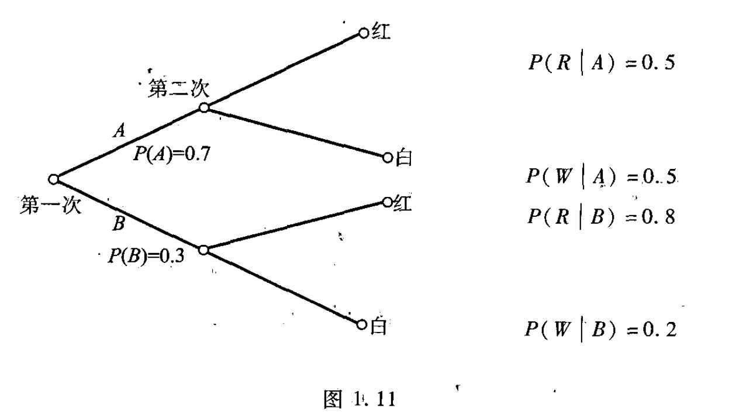
Example
澳門科技大學
一
Macau University of Science and Technology
一、
Easy to get
Therefore, the probability of a successful experiment is:
Probability tree

Slide 54
Conditional Probability
澳門科技大學
一
Macau University of Science and Technology
Law of total probability
一、
Let be such that and for , with
for all i. Then, for any event A, .
Proof
Before going through a formal proof, it is helpful to state the result in words. The
are mutually disjoint events whose union is . To find the probability of an event A, we sum the conditional probabilities of A given , weighted by . Now, for the proof, we first observe that
. Since the events are
disjoint, .

Slide 55
Example
澳門科技大學
一
Macau University of Science and Technology
一、
Suppose that occupations are grouped into upper , middle , and lower levels.
will denote the event that a father’s occupation is upper-level; will denote the event that a son’s occupation is upper-level, etc. (The subscripts index generations.) Glass and Hall (1954) compiled the following statistics on occupational mobility in England and Wales:
Suppose that of the father’s generation, 10% are in U, 40% in M, and 50% in L. What is the probability that a son in the next generation is in U?
Applying the law of total probability, we have

Slide 56
Total probability formula
澳門科技大學
一
Macau University of Science and Technology
一、
Let be a list of mutually incompatible events, and there are
,
Then for any event A, there is
This formula is usually called the total probability formula.
Prove:

Slide 57
Example
澳門科技大學
一
Macau University of Science and Technology
A factory has four production lines producing the same product. The output of the four production lines accounts for 15%, 20%, 30%, and 35% of the total output. The nonconforming product rates of these four production lines are 0.05, 0.04, 0.03, and 0.02. Now take any one of the products from the factory and ask what is the probability of getting a non-conforming product?
Solution:
From the total probability formula:
一、
Assume:
A={Take any one, just get the unqualified product},
B={Take any product that happens to be drawn to the i-th assembly line},(i=1,2,3,4)

Slide 58
Conditional Probability
澳門科技大學
一
Macau University of Science and Technology
一、
Bayes’ rule
Let A and be events where the are disjoint, ,
and for all i. Then

Slide 59
Example
澳門科技大學
一
Macau University of Science and Technology
一、
A procedure called cardiac fluoroscopy is used to determine whether there is calcification of coronary arteries and thereby to diagnose coronary artery disease. From the test, it can be determined if 0, 1, 2, or 3 coronary arteries are calcified. Let denote these events. Let or denote the event that disease is present or absent, respectively. Diamond and Forrester presented the following table, based on medical studies:
Let us consider two specific cases. For the first, suppose that a male between the ages of 30 and 39 suffers from nonanginal chest pain. For such a patient, it is known from medical statistics that .
Suppose that the test shows that no arteries are calcified.
It is unlikely that the patient has coronary artery disease.

Slide 60
Example
澳門科技大學
一
Macau University of Science and Technology
一、
On the other hand, suppose that the test shows that one artery is calcified. Then
Now it is more likely that this patient has coronary artery disease, but by no means certain.
As a second case, suppose that the patient is a male between ages 50 and 59 who suffers typical angina. For such a patient, . For him, we find that
Comparing the two patients, we see the strong influence of the prior probability,
.
Note that different investigators will have different prior probabilities for different suspects, and thus different posterior probabilities.

Slide 61
Example
澳門科技大學
一
Macau University of Science and Technology
Polygraph tests (lie-detector tests) are often routinely administered to employees or prospective employees in sensitive positions. Let + denote the event that the polygraph reading is positive, indicating that the subject is lying; let T denote the event that the subject is telling the truth; and let L denote the event that the subject is lying. According to studies of polygraph reliability (Gastwirth 1987),
Now suppose that polygraphs are routinely administered to screen employees for security reasons, and that on a particular question the vast majority of subjects have no reason to lie so that . A subject produces a positive response on the polygraph. What is the probability that the polygraph is incorrect and that she is in fact telling the truth?
一、
Thus, in screening this population of largely innocent people, 94% of the positive polygraph readings will be in error.

Slide 62
Bayesian formula
澳門科技大學
一
Macau University of Science and Technology
If is a list of mutually incompatible events, and
Then for any event A, there is
Priori probability: the probability known before the experiment. In fact, it is a reflection of the production situation that has been mastered in the past and provides certain information on the results of the experiment.
Posterior probability: After the experiment, the size of the various possibilities of the "source" of occurrence of A.
一、

Slide 63
Example
澳門科技大學
一
Macau University of Science and Technology
In the example of the full probability formula, if the factory stipulates that if a non-conforming product is released, the relevant assembly line will be held accountable for economic responsibility. Now any one of the factory products is taken, and it turns out to be a non-conforming product, but the mark of which assembly line the product is produced has fallen off. It is reasonable to ask the factory how to deal with this non-conforming product? For example, how much responsibility should the fourth (or 1, 2, 3) assembly line bear?
Solution: From the perspective of probability theory, the economic responsibility of the i-th ( ) pipeline can be investigated according to the probability of . For example, for the fourth pipeline, from the definition of conditional probability:
一、

Slide 64
Example
澳門科技大學
一
Macau University of Science and Technology
In the previous calculations, the total probability formula has been used to obtain:
and
then
It can be seen that the fourth pipeline should bear 22.2% of the responsibility. This result is easy to understand. Although the output of the fourth assembly line accounts for 35% of the total output, its non-conforming product rate is relatively low, and the non-conforming products it produces only account for 22.2% of the total non-conforming products.
一、

Slide 65
Independence
澳門科技大學
一
Macau University of Science and Technology
一、
Definition:
A and B are said to be independent events if .
Things become more complicated when we consider more than two events. For example, suppose we know that events A, B, and C are pairwise independent (any two are independent). However, pairwise independence does not guarantee mutual independence.
Mutually independent :
we define a collection of events, , to be mutually independent if for any subcollection, , .

Slide 66
Example
澳門科技大學
一
Macau University of Science and Technology
一、
A card is selected randomly from a deck. Let A denote the event that it is an ace and D the event that it is a diamond. Knowing that the card is an ace gives no information about its suit. Checking formally that the events are independent, we have , and
. Also, is the event that the card is the ace of diamonds and
Since , the events are in fact independent.
A fair coin is tossed twice. Let A denote the event of heads on the first toss, B the event of heads on the second toss, and C the event that exactly one head is thrown. A and B are clearly independent, and . To see that A and C are independent, we observe that . But .

Slide 67
Multiplication formula
澳門科技大學
一
Macau University of Science and Technology
一、
Suppose that a system consists of components connected in a series, so the system fails if any one component fails. If there are n mutually independent components and each fails with probability p, what is the probability that the system will fail?
It is easier to find the probability of the complement of this event; the system works if and only if all the components work, and this situation has probability .
The probability that the system fails is then .
Suppose, instead, that the components are connected in parallel, so the system fails only when all components fail. In this case, the probability that the system fails is only .

Slide 68
Independence
澳門科技大學
一
Macau University of Science and Technology
For any two events A and B, if is true, then it is said events A and B are independent of each other, referred to as independent for short.
It is not difficult to verify: if A and B are independent of each other, then any one of
and Any one of is still independent of each other.
Events A, B, and C are independent of each other, and by definition, there are the following three equations:
It is true at the same time, but these three equations cannot guarantee
.Conversely, if is true, there is no guarantee that the above three equations are true.
一、

Slide 69
Multiplication formula
澳門科技大學
一
Macau University of Science and Technology
For any three events A, B, C, if there are
If the four equations are established at the same time, it is said that events A, B, and C are independent of each other.
General situation: Assuming is n events, if for any and any set of , there is
If it is true, it is said that is n mutually independent events.The mutual independence of n events requires equations to ensure.
一、
1<
≤

Slide 70
Multiplication formula
澳門科技大學
一
Macau University of Science and Technology
一、
If is n mutually independent events,
If any event is selected, the n events obtained are still independent of each other. In particular:
is n mutually independent events.

Slide 71
Example
澳門科技大學
一
Macau University of Science and Technology
一、
There are several children in a family. It is assumed that the birth of a boy and a girl are equally possible, so
In the following two situations, discuss the independence of A and B:
(1) There are two children in the family; (2) There are three children in the family.
Solution: (1) A family with two children, sample space is
There are 4 basic events, each of which has a probability of 1/4 from the equal probability:
, from this we can see
Therefore, events A and B are not independent of each other.
A={There are boys and girls in a family}，B={There is at most one girl in a family}
Ω={(boy,boy),(boy,girl),
(girl,boy),(girl,girl)}
A={(boy,girl),(girl,boy)};B={(boy,boy),(boy,girl),(girl,boy)};
AB={(boy,girl),(girl,boy)}

Slide 72
Example
澳門科技大學
一
Macau University of Science and Technology
一、
(2) For a family with three children, the sample space is
From the equal probability, the probability of these 8 basic events are all 1/8,
Thus events A and B are independent of each other.
Ω = { (female,female,female),(male,male,female),(male,female,male),(female,male,male),
(male,female,female),(female,male,female),(female,female,male),(male,male,male)}

Slide 73
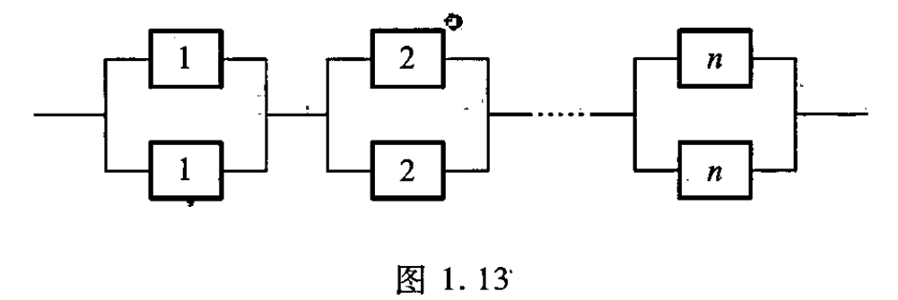
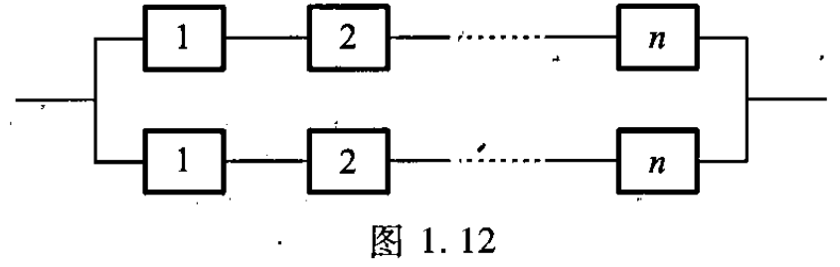
Example
澳門科技大學
一
Macau University of Science and Technology
一、
Using 2n identical components (such as rectifier diodes) to form a system, there are two different connection methods, the first type is to connect in series and then in parallel (as shown in 1.12); the second type is to connect in parallel and then in series (as shown in 1.13). If each component can work normally is independent of each other, the probability of each component working normally is r (the probability of a component or system working normally is usually called reliability), please compare which of the two systems is more reliable ?

Slide 74
Example
澳門科技大學
一
Macau University of Science and Technology
Solution: For system I, it has two paths to work, and the reliability of these two paths is
and respectively. Each path can work normally if and only if all the components on the path can work normally, and the reliability of each path can be known from the independence . So the reliability of system Ⅰ
For system II, first find the reliability of each section in parallel. From the independence, the reliability of each section is and the entire system is made up of the same n sections in series. Once again, the independence can be used to obtain the system. The reliability of Ⅱ
Using mathematical induction, it can be proved that when is always true,
is always true. So when
There are , therefore, System II is more reliable than System I.
一、
（1≤i≤n）

Slide 75
Bernoulli Probability Model
澳門科技大學
一
Macau University of Science and Technology
一、
Generally speaking, if there are only two possible results for experiment E: A and , and , , ( ), the experiment of E independently repeated n times constitutes a experiment, this experiment is called n-weight Bernoulli experiment, sometimes referred to as Bernoulli experimentor Bernoulli probability model, and recorded as

Slide 76
Multiplication formula
澳門科技大學
一
Macau University of Science and Technology
一、
The result of a Bernoulli experiment can be written as: , where
is either A or , so there are in total for such , and if k of
are A, there must be n-k . From Independence :
（1≤i≤n）
Require the probability of the event "k occurrences of event A in the n-weight Bernoulli experiment ":
Denoted as
{Event A occurred k times in the experiment}
（0 ≤ k ≤ n）

Slide 77
Multiplication formula
澳門科技大學
一
Macau University of Science and Technology
There are 10 machines of the same type in the workshop. Each machine is equipped with a motor power of 10 kilowatts. It is known that when each machine is working, it actually starts for an average of 12 minutes per hour, and whether it is started or not is independent of each other. Due to the shortage of local power supply, the power supply department only provides 50 kilowatts of power to these 10 machine tools. What is the probability that these 10 machine tools can work normally?
Solution: 50 kilowatts of electricity can supply 5 machine tools to start at the same time, so when the number of 10 machine tools is not more than 5 at the same time, it can work normally. And each machine tool has only two situations: "start" and "not start", and the probability of "start" is and the probability of "not start" is . Suppose the number of machine tools in operation among 10 machine tools is :
一、
0 ≤ k ≤ 10

Slide 78
Multiplication formula
澳門科技大學
一
Macau University of Science and Technology
一、
Therefore, the probability that the number of machine tools that are running at the same time does not exceed 5 is:
The probability that these 10 machine tools can work normally is 0.994, which means that the work of these 10 machine tools is basically not affected by the shortage of power supply. Because under the condition of a power supply of 50 kilowatts, the probability that the machine cannot work normally is only 0.006, which is equivalent to only (minutes) of non-working time within 8 hours of a work shift, which is less than 3 minutes.

Slide 79
Multiplication formula
澳門科技大學
一
Macau University of Science and Technology
一、
The school table tennis team competed with the table tennis team of the School of Mathematics. The former is stronger than the latter, and the probability of the school team winning in the game is 0.6. Now the two sides have discussed the way of the game and proposed three options:
(1) There are 3 players from each side to compare three rounds;
(2) There are 5 players from each side to compare 5 games;
(3) There are 7 players from each side, and the 7 games are compared.
In the three schemes, the team with the largest number of winners in the game wins. Question: Which option is beneficial to the team?

Slide 80
Multiplication formula
澳門科技大學
一
Macau University of Science and Technology
一、
Solution: Suppose the number of winning teams is , then in the above three scenarios, the probability of winning the team is:
It can be seen that the first option is most beneficial to the department (of course, the most unfavorable to the school team).

Slide 81
Multiplication formula
澳門科技大學
一
Macau University of Science and Technology
Someone has a bunch of m keys with the same shape, and only one of them can open the door. One day the person went home after being drunk, and subconsciously took one of the m keys to open the door every time, and asked how likely is the person to open the door at the k-th time?
Solution: Because the person takes any one of the m keys each time (puts it back), the probability that a key that can open the house is selected in each trial is , which is a Bernoulli test. The door is opened only at the kth time, which means that the previous k-1 times have not been opened, so according to independence:
一、
P (The door is opened at the kth time)

Slide 82
澳門科技大學
Macau University of Science and Technology
王建州

