Slide 1



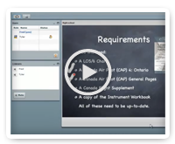


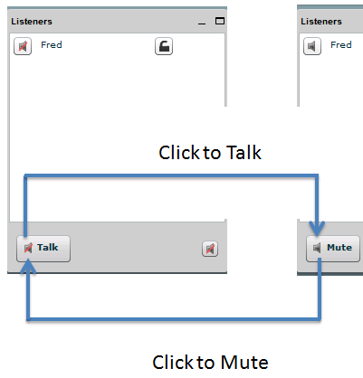

Welcome to
BigBlueButton
If it’s your first time using this software, we recommend
you to watch the following videos.
Teacher Overview
Student Overview
Teacher:
You can mute any student by clicking their speaker icon in the listeners window.
You can mute all users by clicking the ‘mute all’ button. (The above video shows more of this.)
Everyone:
Use the Talk/Mute button to mute yourself to minimize background noise.

