Slide 1
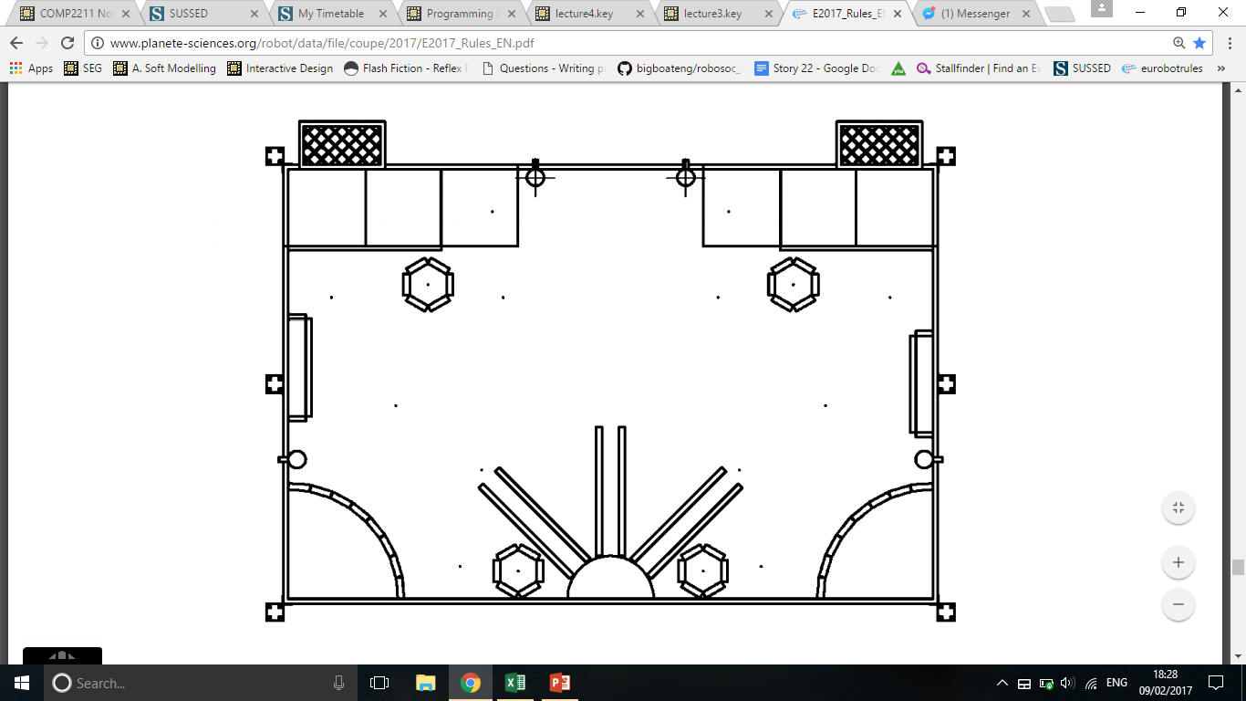
A
3000, 2000
Net
A
A
B
C
B
A
C
F
D
B
E
Ramp
A
B
B
90°
B
B
0°
Ramp
E
A
B
F
D
C
A
B
C
A
B
Net
A
A
x
0,0
Cylinders
Rocket Towers
Big Moon Rocks
y
Moon Bases
Small Moon Rocks

