Slide 1

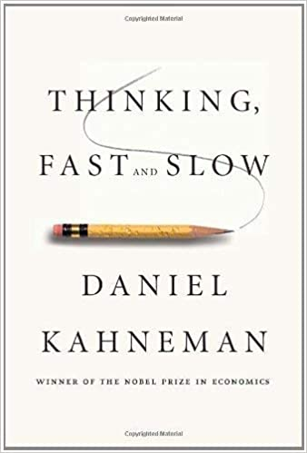
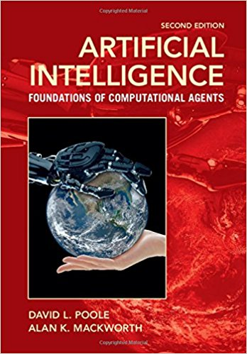
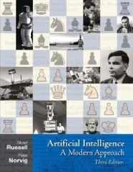
AI Fundamentals: an introduction
Maria Simi

Slide 2
AI Fundamentals: context
Ai in industry and society
AI curriculum

Slide 3
Summary
The AI revolution and how we got here
Deep learning and AI
Thinking fast and slow
The role of AIF in the AI curriculum
Symbolic AI and the physical symbol system hypothesis
AI fundamentals at a glance
Methodology and evaluation
Necessary background
Notes:
Zooming in the AIF course contents …

Slide 4
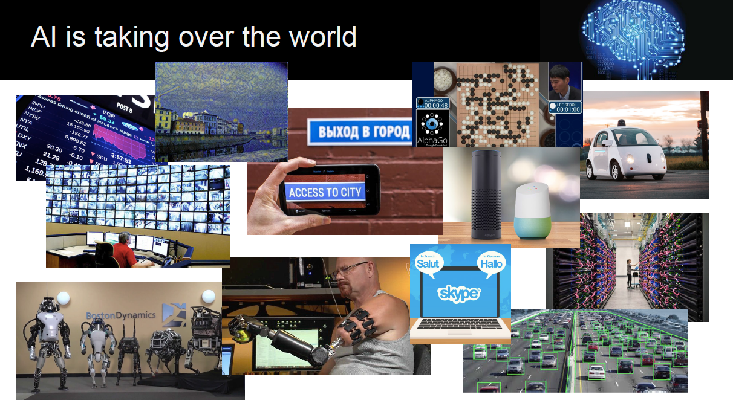
AI is booming [again]
Credit: Vincenzo Gervasi
Notes:
AI is already transforming web search, advertising, e-commerce, finance, logistics, media, industry, transportation, home management, art and more.
The slide is taken by a presentation of the Ai curriculum by prof. Gervasi.

Slide 5
AI timeline: milestones
1943
Mc Culloch & Pitts: first work on neural networks
Turing test
The birth of Artificial Intelligence (Dartmouth college)
Theorem proving (Newell & Simon), games … symbolic reasoning
The AI winter. The Lighhill report in UK.
The expert systems era begins … industrial applications
Deep Blue defeats world chess champion G. Kasparov
1950
1956
1973
1969
1997
Notes:
How did we get here?

Slide 6
AI timeline: milestones (cnt.)
1986
CYC: commonsense knowledge
Intelligent agents. AI: a modern approach.
The RoboCup challenge. RoboCup rescue.
The AI revolution begins … (AI is all around us, Wired).
Watson defeats human champion at Jeopardy!
The era of deep learning starts …
DeepMind (Google) masters Go …
1995
1997
2011
2016
Notes:
Un programma per l’antico gioco cinese del Go ha battuto il campione europeo di Go. Go ultimo baluardo dei giochi, un compito considerato molto difficile.
Il programma AlphaGo è stato costruito da DeepMind una società di Google con sede a Londra.
A Marzo la sfida con il sud-coreano Lee Sedol, considerato il giocatore più forte al mondo.
La novità è che non era pre-programmato ma il risultato è stato raggiunto con un meccanismo generale di riconoscimento di schemi,
per apprendimento con rinforzo osservando molte configurazioni e giocando molte partite con se’ stesso e altri programmi.
“Deep learning is killing every problem in AI.”

Slide 7
The deep learning tsunami
Deep Learning waves have lapped at the shores of computational linguistics for several years now, but 2015 seems like the year when the full force of the tsunami hit the major Natural Language Processing (NLP) conferences. [C. Manning]
Previous successes in the fields of image classification and speech …
Top experts in the field (LeCun, Hinton, Bengio) underline that there will be important developments in text and video understanding, machine translation, question answering … [Turing award 2019]
Google masters GO: Deep-learning software defeats human professional for the first time. AlphaGo. Nature 529, 445–446 (28 January 2016). In March 2016, Lee Sedol defeated by AlphaGo.
In 2017 AlphaGo-Zero learns to play “from zero”, just by playing against itself.
Notes:
La novità è che non era pre-programmato ma il risultato è stato raggiunto con un meccanismo generale di riconoscimento di schemi,
per apprendimento con rinforzo osservando molte configurazioni e giocando molte partite con se’ stesso e altri programmi.
“Deep learning is killing every problem in AI.”

Slide 8
This year’s milestones
GPT3 (Generative Pre-trained Transformer), produced by OpenAI
May 2020: a larger and richer language model
175 billion machine learning parameters
used for automatic text generation, translation, user interface synthesis
syntactically correct, very imaginative, … not necessarily true [News1, Video]
DARPA challenge (AlphaDogFights) with simulated F-16 Air Fighters
August 18-20 2020: Final event.
Eight AI system against each other; the winner was a system by Heron Systems
The Heron’s system defeated a human expert top gun fighter 5-0!!!
Deep reinforcement learning [News]
Notes:
A dogfight here is an aerial battle among two fighters. Simulated.
Gpt3 does not know what it is talking about. Still need for improvement.

Slide 9
Is Deep Learning the final solution to A.I.?
Andrew Ng
Founder of the Google Brain team.
Former director of the Stanford Artificial Intelligence Laboratory and professor
Lead of Baidu’s AI (1,200 people)
Has directed many of the world’s leading AI groups and built many AI products that are used by hundreds of millions of people
His answer:
AI will transform many industries. But it’s not magic.
Almost all of AI’s recent progress is based on one type of AI, in which some input data (A) is used to quickly generate some simple response (B) [A → B]
[https://hbr.org/2016/11/what-artificial-intelligence-can-and-cant-do-right-now]

Slide 10
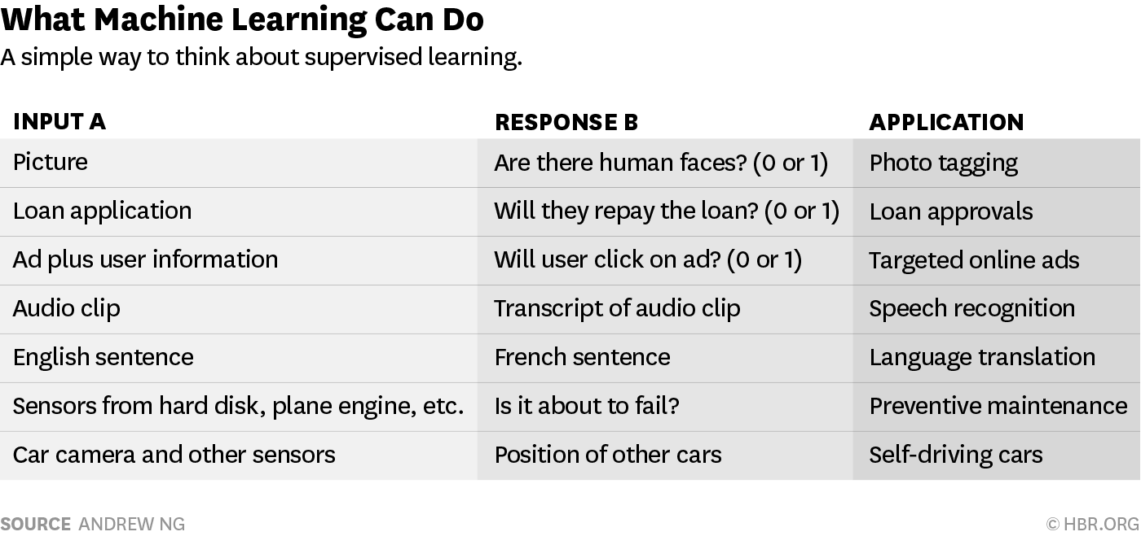
Notes:
The most powerful technique to do supervised learning today is deep learning.

Slide 11
What this AI can do
Supervised learning Achilles’ heel: it requires a huge amount of data.
building a photo tagger requires anywhere from tens to hundreds of thousands of pictures (A) as well as labels or tags telling you if there are people in them (B)
AI work requires carefully choosing A and B and providing the necessary data to help the AI figure out the A→B relationship.
So what is the potential of implementing the mapping A→B?
Ng’s rule of tumb:
If a typical person can do a mental task with less than one second of thought, we can probably automate it using AI either now or in the near future.
Choosing A and B creatively has already revolutionized many industries. It is poised to revolutionize many more.
Notes:
A lot of valuable work currently done by humans — examining security video to detect suspicious behaviors, deciding if a car is about to hit a pedestrian, finding and eliminating abusive online posts — can be done in less than one second. These tasks are ripe for automation.

Slide 12
Issues for effective use of AI
Software. Not a problem: the community is quite open. Among leading AI teams, many can likely replicate others’ software in, at most, 1–2 years ...
Data. … But it is exceedingly difficult to get access to someone else’s data. Thus data, rather than software, is the defensible barrier for many businesses.
Talent. Simply downloading and “applying” open-source software to your data won’t work. AI needs to be customized to your business context and data. This is why there is currently a war for the scarce AI talent that can do this work.
I would add to this …
Computational resources.

Slide 13
Deep learning and AI
Deep learning is only one approach inside the much wider field of machine learning and …
Machine learning is one approach within the wider field of AI
Ng: Many researchers are exploring other forms of AI, some of which have proved useful in limited contexts; there may well be a breakthrough that makes higher levels of intelligence possible, but there is still no clear path yet to this goal
Thinking fast and slow …

Slide 14
Thinking fast and slow
Daniel Kahneman, 2011 [PDF in Bibliography]
Recipient of Nobel Prize for Economics in 2002
System1/System2 distinction.
Two systems/agents in the brain to account for perception and intuition (fast thinking) and complex reasoning (slow thinking) …

Slide 15
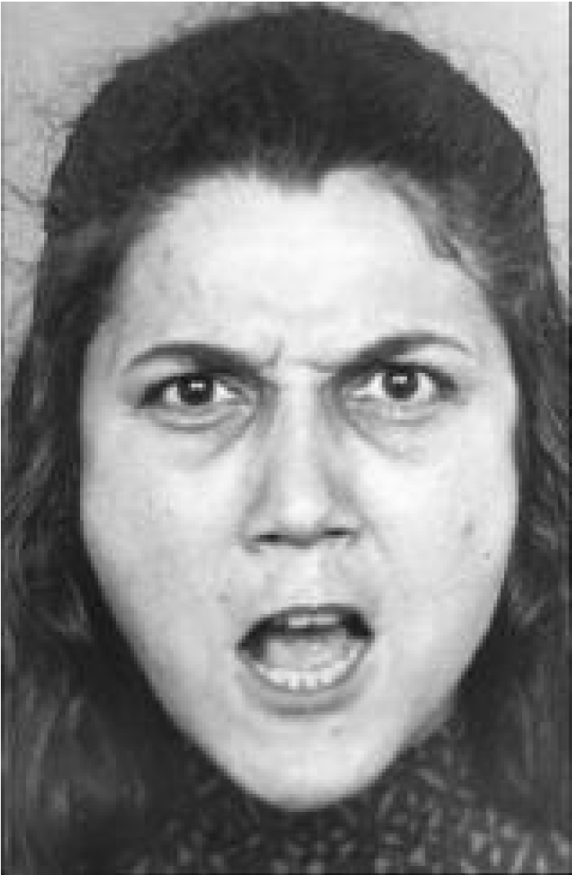
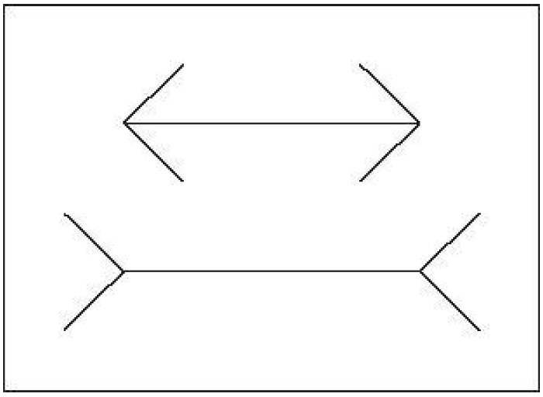
System 1 System 2
Task: compute 17 x 24
1. Could it be 12609?
2. Could it be 123?
3. Could it be 568?
Notes:
System 1: Muller-Lyer illusion. A fallacy of our perception system.
There also cognitive illusions pro vided by our experience but contradicted by statistics,
The answer is 408 but it requires consciuos mental effort, maybe the help of paper and pencil, it even has effect on your body: you body tense, you heart beat increases, the pupils in your eyes brcome larger ,,,

Slide 16
System 1 System 2
Perceptual tasks
Simple computations
Understanding simple sentences
Tasks that become mechanical by training and do not require attention
For experts is different
Tasks that require attention and conscious effort
Complex computations
Recalling from memory
Complex logical argumentation
Reasoned justifications
Controlling instinctual reactions
Notes:
System 2 action tasks require attention and engagement. They need concentration …. That’s why you should not talk on phone when driving in a hughway.

Slide 17
Selective attention test
https://www.youtube.com/watch?v=vJG698U2Mvo
A test to demonstrate that certain tasks absorb you mental faculties.
A variant:
https://www.youtube.com/watch?v=IGQmdoK_ZfY

Slide 18
Is A.I. all about Machine Learning?
Possible arguments against ML in some applications:
Explanation and accountability: ML systems are not (yet?) able to justify in human terms their results. For some application it is essential.
Knowledge must be meaningful to humans to be able to generate explanations?
Some regulations requires the right to an explanation in decision-making, and seek to prevent discrimination based on race, opinions, health, sex … (e.g. GDPR)
AI for decision support for humans? Yes, but …
ML systems learn what’s in the data, without understanding what's true or false, real or imaginary, fair or unfair
Most popular opinion in the training data; possible to develop bad/unfair models
People are generally more critical about information
Notes:
The General Data Protection Regulation (GDPR) (Regulation (EU) 2016/679) is a regulation by which the European Parliament, the Council of the European Union and the European Commission intend to strengthen and unify data protection for all individuals within the European Union (EU). The regulation was adopted on 27 April 2016. It becomes enforceable from 25 May 2018.

Slide 19
My intermediate conclusions
The goal of building AI systems is far from being solved and is still quite challenging in its own.
Building complex AI systems requires the combination of several techniques and approaches, not only ML.
One of the most challenging tasks ahead of us is integration of perception and reasoning in AI systems

Slide 20
AI fundamentals
AI fundamentals is mostly about “Slow thinking” or “Reasoning”
AI fundamentals has the role, within the AI curriculum, of teaching you about the foundations of a discipline which is now 60 year old.
We will cover different approaches, also some coming of the “Good Old-Fashioned Artificial Intelligence” (GOFAI) or “symbolic AI”.

Slide 21
Symbolic AI
High-level "symbolic" (human-readable) representations of problems, the general paradigm of searching for a solution, knowledge representation and reasoning, planning.
Symbolic AI was the dominant paradigm of AI research from the mid-1950s until the late 1980s.
Central to the building of AI systems is the Physical symbol systems hypothesis, formulated by Newell and Simon.
[Computer Science as Empirical Inquiry: Symbols and Search, Newell&Simon]

Slide 22
Physical symbol systems hypothesis (PSSH)
The approach is based on the assumption that many aspects of intelligence can be achieved by the manipulation of symbols (the physical symbol system hypothesis):
“A physical symbol system has the necessary and sufficient means for general intelligent action” [Allen Newell, Herbert A. Simon]
Human thinking is a kind of symbol manipulation system (a symbol system is necessary for intelligence).
Machines can be intelligent (a symbol system is sufficient for intelligence)
The hypothesis cannot be proven, we can only collect empirical evidence.
Observations and experiments on human behavior in tasks requiring intelligence. Computational models.
Solving tasks of increasing complexity.
Notes:
A symbol is a meaningful pattern that can be manipulated. A physical symbol system is a system able to process (physically) symbolic structures to produce other structures.
Symbols are representations with denotations, they usually stand for objects outside the system itself.
They can be anything also strings of 0 and 1. They can also represent internal states.
Newell & Simon at the time talk mainly about symbolic reasoning in the classical sense but their vision includes low level representations and they do not exclude learning approaches. They say:
“ … knowledge of a large number of relevant patterns may be the key to intelligent behavior”.
This claim implies both that human thinking is a kind of symbol manipulation (because a symbol system is necessary for intelligence) and that machines can be intelligent (because a symbol system is sufficient for intelligence)

Slide 23
Strong versus weak AI
The Chinese room argument by John Searle [https://www.britannica.com/biography/John-Searle/Philosophy-of-mind]
Video
Searle introduced the following distinction:
Strong AI relies on the strong assumption that human intelligence can be reproduced in all its aspects (general A.I.). It includes adaptivity, learning, consciousness … not only pre-programmed behavior.
Weak AI: simulation of human-like behavior, without effective thinking/understanding; no claim that it works like human mind. The dominant approach today.

Slide 24
Challenges to PSSH and to strong AI
Robot says: Whatever (Margaret Boden)
What stands in the way of all-powerful AI isn't a lack of smarts: it's that computers can't have needs, cravings or desires
Abraham Maslow’s ‘hierarchy of [human] needs’:
Biological needs (food, sleep, sex, …)
Safety, protection from environment
Love and belonging, friendship
Self esteem and respect from others
Self-actualization
https://aeon.co/amp/essays/the-robots-wont-take-over-because-they-couldnt-care-less
Notes:
She wrote the book “AI: Its Nature and Future” (2016).

Slide 25
The AI curriculum

Slide 26
AI curriculum: structure
CFU
Curriculum specific courses (caratterizzanti) | 45
Artificial Intelligence Fundamentals (sem 1) | 6
Machine Learning (sem 1) | 9
Computational mathematics for learning and data analysis (sem 1) | 9
Natural Languages Technologies (sem 2) | 9
Distributed systems: paradigms and models (sem 2) | 9
Intelligent Systems for Pattern Recognition (sem 2) | 6
Smart Applications (sem 3) | 9
Electives | 30
Free choice | 9
Thesis | 24
Total | 120
Notes:
Caratterizzanti (57) + 30 + 9 + 24 = 120

Slide 27
AI curriculum: electives
Curriculum electives | 30
Algorithm engineering [from KD] (1 sem) | 9
Data mining [from KD] (1 sem) | 9
Mobile and cyber-physical systems [from ICT] (2 sem) | 9
Information retrieval [from KD] (1 sem) | 6
Computational neuroscience [from ING] (2 sem) | 6
Social and ethical issues in computer technology (2 sem) | 6
Robotics [S. Anna] (2 sem) | 6
Semantic web [CNR] (1 sem) | 6
Computational Models for Complex Systems (2 sem) | 6
Free choice | 9
Total | 39
Notes:
DEFAULT: 2*9 CFU + 2*6 CFU +1*9 CFU (free choice)
Other combination should be possible.
Not selecting a curriculum is also possible.
Allowed combination for electives to have recognition for the AI curriculum
2*9 CFU + 2*6 CFU +1*9 CFU (free choice)
3*9 CFU +1*6 CFU + 1*6 CFU (free choice) at the expense of some “freedom” ???
1*9 CFU + 4*6 CFU + 1*6 CFU (free choice) at the expense of some “freedom” ???
2*9 CFU + 2*6 CFU +2*6 CFU (free choice) 3 extra credits
... possibly other ???
Does not qualify for the Ai curriculum:
1*9 CFU + 3*6 CFU+ 2*6 CFU (free choice)
0*9 CFU + 5*6 CFU + 1*9 CFU (free choice) ???

Slide 28
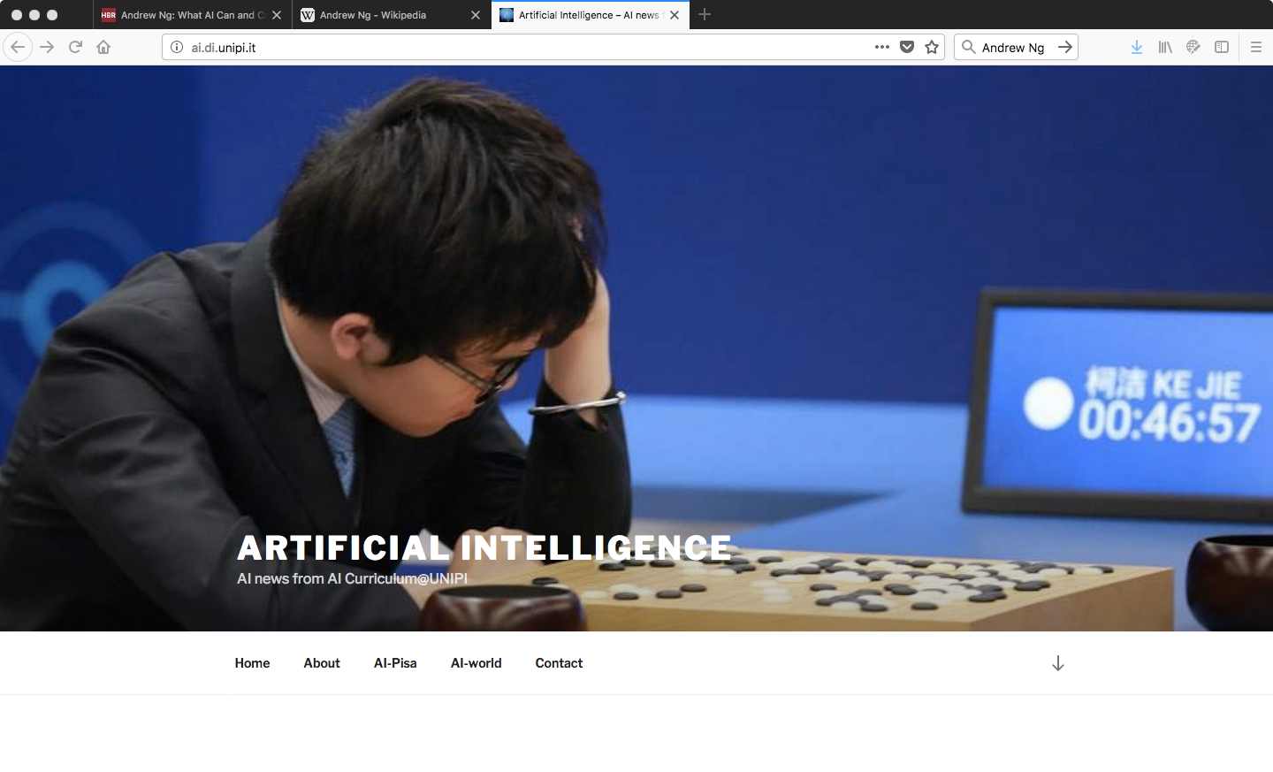
The blog of the AI curriculum
http://ai.di.unipi.it

Slide 29
AI Fundamentals at a glance
The structure of the course
Teaching methodology

Slide 30
The main topics
Prerequisites: algorithms, logic, programming, basic probability.
The course will not assume an introduction to AI as a prerequisite.
Introduction and agents (2)
I - Constraint satisfaction (4)
II - Knowledge representation and reasoning (6)
III - Reasoning under uncertainty (4)
IV - Rule based systems (4)
V - Planning (4)
Total: 24 (48 hours)

Slide 31
I - Constraint Satisfaction Problems
Problem solving as search. Problem formulation as CSP.
Problem reduction, consistency checking techniques
Heuristic and efficient search.
Local repair methods; problem structure.
Review and exercises
Review of the basics: problem solving as search
problem formulation
search algorithms in a state space
heuristic search
local search

Slide 32
II – Knowledge representation and reasoning
The KR&R hypothesis. Review of fundamental trade-off. Reasoning in classical logic.
Knowledge engineering vs ontology engineering.
Reasoning about change: the situation calculus and the “frame problem”. Temporal reasoning.
Non-monotonic reasoning. Reason Maintenance Systems.
Reasoning about knowledge and belief.
Semantic networks and frames.
Reasoning about ontologies and description logics.
Review and exercises.

Slide 33
III - Reasoning under uncertainty
Representing uncertain knowledge and probabilistic reasoning.
Belief networks and inference
Reasoning over time
Review and exercises

Slide 34
IV - Rule based systems
Logic programming and rule based production systems.
Uncertainty in rule based systems; efficient implementation.
Constraint logic programming
Answer Set Programming
Review and exercises

Slide 35
V - Planning
The planning problem, representation for actions. Planning as state-space search, regressive planning.
Partial order planning, planning graphs. GraphPlan.
Planning in the real world: dealing with temporal and resource constraints, hierarchical planning, planning in non-deterministic domains, multi-agent planning.
Review and exercises

Slide 36
Main books for the course
[AI-FCA] David L. Poole, Alan K. Mackworth. Artificial Intelligence: foundations of computational agents, Cambridge University Press, 2017. http://artint.info/2e/html/ArtInt2e.html (online version)
[AIMA] Stuart J. Russell and Peter Norvig. Artificial Intelligence: A Modern Approach (3rd edition). Pearson Education, 2010.
[KR&R] Ronald Brachman and Hector Levesque. Knowledge Representation and Reasoning. Morgan Kaufmann Publishers Inc., San Francisco, CA, USA. 2004.
[AI-LF] Genesereth, M., and Nilsson, N., Logical Foundations of Artificial Intelligence, San Francisco: Morgan Kaufmann, 1987.
[AI-NS] Nils Nilsson, N., Artificial Intelligence: A New Synthesis, San Francisco: Morgan Kaufmann, 1998.

Slide 37
Moodle platform
Register into the Moodle platform, course AIF-20:
https://elearning.di.unipi.it/course/view.php?id=197
If not yet a student of UNIPI you can enter as guest with password: *****

Slide 38
AI Fundamentals: necessary background
What you need to know
How to fill the gaps

Slide 39
Prerequisites
Expected background from computer science
Algorithms and complexity
Formal logic
Computability
Elements of probability calculus
A basic course in Artificial Intelligence (useful)
Problem solving as search
Representation and reasoning in classical logic

Slide 40
Evaluation
Final written test (via Moodle), followed by an oral exam
I will propose small tasks (readings, quiz, open questions, exercises) during the lectures (Your turn activities)
Examples of exam questions at the end of each section.
We will have time for a final simulation of exam in December.
Notes:
You evaluate me on the ability to get students involved, I evaluate you in the degree of involvement. Do I evaluate myself?

Slide 41
Your turn
Read chapter 1 and chapter 2 of “Thinking Fast and slow”.
Small test about the System 1 and System 2 distinction (see Moodle).
Review/study (if needed) the following:
Problem formulation according to the paradigm of problem solving as search. AIMA ch. 3 – Lecture slides IIA-2019, Lecture 3
Searching for solutions: basic search algorithms, heuristic search algorithms (A* and variants) AIMA ch. 3. Lecture slides IIA-2019, Lecture 3-4.
Local search algorithms: AIMA cap. 4.1, Lecture slides IIA-2019, Lecture 5.

Slide 42
Next
AI means building intelligent computational agents
Unified vision of the enterprise of building AI systems.
We are only interested in their external behavior in terms of actions, whether they do the right thing or not.
Dimensions of complexity following Poole&Macworth AI-FCA.
We will follow the online book “Artificial Intelligence: Foundations of Computational Agents” by Poole and Macworth http://artint.info/2e/html/ArtInt2e.html

