Slide 1


AI Fundamentals: agents
Maria Simi

Slide 2
AI as building intelligent computational agents
LESSON 2: Artificial intelligence and agents
(AI-FCA, Chapter 1)

Slide 3
AI means building computational agents
Artificial intelligence, or AI, is the field that studies the synthesis and analysis of computational agents that act intelligently.
An agent is something that acts in an environment/it does something.
We are interested in what an agent does; that is, how it acts. We judge an agent by its actions.
An agent acts intelligently when
what it does is appropriate given the circumstances and its goals
it is flexible to changing environments and changing goals
it learns from experience
it makes appropriate choices given its perceptual and computational limitations.
Notes:
The view of intelligent agents provides the field with an all encompassing view. AI as an integrated science.
Agents include worms, dogs, thermostats, airplanes, robots, humans, companies, and countries.

Slide 4
Computational agents
A computational agent is an agent whose decisions about its actions can be explained in terms of computation
The central scientific goal of AI is to understand the principles that make intelligent behavior possible in natural or artificial systems.
The central engineering goal of AI is the design and synthesis of useful, intelligent artefacts, agents, that are useful in many applications.
This is done by
the analysis of natural and artificial agents;
formulating and testing hypotheses about what it takes to construct intelligent agents;
designing, building, and experimenting with computational systems that perform tasks commonly viewed as requiring intelligence.
Notes:
Computational: the decision can be broken down into primitive operation that can be implemented in a physical device.

Slide 5
The term “Artificial Intelligence”
Artificial vs natural intelligence
Artificial Intelligence is not the opposite of real Intelligence (not fake vs real).
Intelligence cannot be fake. If an artificial agent behaves intelligently, it is intelligent. It is only the external behavior that defines intelligence (weak AI).
Artificial intelligence is real intelligence created artificially.
Turing test: only external behavior counts
Winograd schemas as a test of intelligence:
The city councilmen refused the demonstrators a permit because they feared violence. Who feared violence?
The city councilmen refused the demonstrators a permit because they advocated violence. Who advocated violence?

Slide 6
Human intelligence
The obvious naturally intelligent agent is the human being. Human intelligence comes from three main sources:
biology: Humans have evolved into adaptable animals that can survive in various habitats.
culture: Culture provides not only language, but also useful tools, useful concepts, and the wisdom that is passed from parents and teachers to children. Language, which is part of culture, provides distinctions in the world that should be noticed for learning.
life-long learning (experience): Humans learn throughout their life and accumulate knowledge and skills.
Another form of intelligence is social intelligence, the one exhibited by communities and organizations.

Slide 7
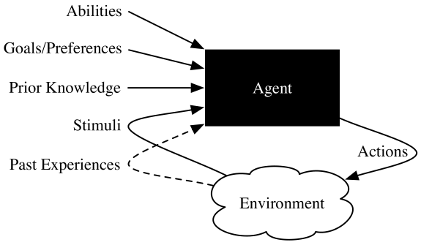
Agents Situated in Environments
Belief state
Belief state
Purposive agents
Notes:
A black box view of an agent in terms of its inputs and outputs. At any time, what an agent does depends on:
• prior knowledge about the agent and the environment
• history of interaction with the environment, which is composed of
– stimuli received from the current environment, which can include observations about the environment, as well as actions that the environment imposes on the agent and
– past experiences of previous actions and stimuli, or other data, from which it can learn
• goals that it must try to achieve or preferences over states of the world
• abilities, the primitive actions the agent is capable of carrying out.
Inside the black box, an agent has some internal belief state that can encode beliefs about its environment, what it has learned, what it is trying to do, and what it intends to do. An agent updates this internal state based on stimuli. It uses the belief state and stimuli to decide on its actions. Much of this book is about what is inside this black box.
This is an all-encompassing view of intelligent agents varying in complexity from a simple thermostat, to a diagnostic advising system whose perceptions and actions are mediated by human beings, to a team of mobile robots, to society itself.
Purposive agents have preferences or goals. They prefer some states of the world to other states, and they act to try to achieve the states they prefer most. The non-purposive agents are grouped together and called nature. Whether or not an agent is purposive is a modeling assumption that may, or may not, be appropriate. For example, for some applications it may be appropriate to model a dog as purposive, and for others it may suffice to model a dog as non-purposive.

Slide 8
Design process for agents
Three aspects of computation that must be distinguished:
Design time computation, that goes into the design of the agent
Offline computation, that the agent can do before acting in the world
Online computation, the computation that is done by the agent as it is acting.
Designing an intelligent agent that can adapt to complex environments and changing goals is a major challenge.
To reach this ultimate goal, two strategies are possible:
simplify environments and build complex reasoning systems for these simple environments;
build simple agents for natural/complex environments, simplifying the tasks
Notes:
Agents are designed for specific tasks and the nature of task influences their design.
If most knowledge is given either at design time or offline, the agent is highly specialized and simple but may lack flexibility.
Offline computation includes compilation, building a knowledge base, learning a model, planning in advance.

Slide 9
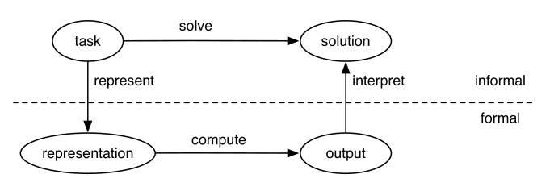
Steps in the design process
Define the task: specify what needs to be computed
Define what constitutes a solution and its quality: optimal solution, satisficing solution, approximately optimal solution, probable solution.
Choose a formal representation for the task; this means choosing how to represent knowledge for the task. This includes representations suitable for learning. Level of abstraction (next).
Compute an output
Interpret output as a solution
Notes:
Dominant approach of AI: define the goal (not the recipe) and search for a solution in a space of possibilites (search).

Slide 10
Levels of abstraction
A model of the world is a symbolic representation of the beliefs of the agents about the world.
It is necessarily an abstraction
More abstract representations are simpler and human-understandable. But they may be not effective enough.
Low level descriptions are more detailed and accurate but introduce complexity.
Multiple level of abstractions are possible (hierarchical design).
Two levels that are usually considered:
The knowledge level: what the agent knows and its goals
The symbol level: the internal representation and reasoning algorithms

Slide 11
Agent design space: dimensions of complexity
Modularity
Planning Horizon: how far ahead to plan
Representation: how to describe the world
Computational limits: real agents have limited computational resources
Learning: how to learn from experience
Uncertainty, in both perception and the effects of actions
Preference: the structure of goals or preferences
Number of Agents
Interaction

Slide 12
Modularity
Modularity is the extent to which a system can be decomposed into interacting modules and it is a key factor for reducing complexity.
In the modularity dimension, an agent’s structure is one of the following:
flat – there is no organizational structure
modular – the system is decomposed into interacting modules that can be understood on their own
hierarchical – the system is modular, and the modules themselves are decomposed into simpler modules. The agent reasons at multiple levels of abstraction.
Example: planning a trip

Slide 13
Planning Horizon
The planning horizon dimension is how far ahead in time the agent plans.
In this dimension an agent is one of the following:
Non-planning agent: does not look at the future.
Finite horizon planner: agent that looks for a fixed finite number of stages. Greedy if only looks one time step ahead.
Indefinite horizon planner is an agent that looks ahead some finite, but not predetermined, number of stages.
Infinite horizon planner is an agent that keeps planning forever. Ex. stabilization module of a legged robot

Slide 14
Representation
The representation dimension concerns how the state of the world is described. A state of the world specifies the agent’s internal state (its belief state) and the environment state.
From simple to complex:
Atomic states, as in problem solving.
Feature-based representation: set of propositions that are true or false of the state, properties with a set of possible values. (PROP, CSP, most machine learning).
Individuals and relations (often called relational representations). Representations at the expressive level of FOL (or contractions)

Slide 15
Computational limits
An agent must decide on its best action within time constraints or other constraints in computational resources (memory, precision, …)
The computational limits dimension determines whether an agent has
perfect rationality, where an agent is able to reasons about the best action without constraints
bounded rationality, where an agent decides on the best action that it can find given its computational limitations.
An anytime algorithm is an algorithm where the solution quality improves with time. To take into account bounded rationality, an agent must decide whether it should act or reason for longer.

Slide 16
Learning
Learning is necessary when the designer does not have a good model.
The learning dimension determines whether
knowledge is given in advance, or
knowledge is learned (from data or past experience).
Learning typically means finding the best model that fits the data and produces a good predictive model.
Modelling formalisms and approaches are dealt in this course. All the issues concerned with learning are dealt in the Machine Learning course.

Slide 17
Uncertainty
Uncertainty is divided into two dimensions:
uncertainty from sensing/perception (fully observable, partially observable states)
uncertainty about the effects of actions (deterministic, stochastic).
When the effect is stochastic, there is only a probability distribution over the resulting states.
We will deal with uncertainty in Section III.

Slide 18
Preference
The preference dimension considers whether the agent has goals or richer preferences:
A goal is either an achievement goal, which is a proposition to be true in some final state, or a maintenance goal, a proposition that must be true in all visited states.
Complex preferences involve trade-offs among the desirability of various outcomes, perhaps at different times.
An ordinal preference is where only the ordering of the preferences is important.
A cardinal preference is where the magnitude of the values matters. States are evaluated by utility functions.

Slide 19
Number of agents
The number of agents dimension considers whether the agent explicitly considers other agents:
Single agent reasoning means the agent assumes that there are no other agents in the environment or that all other agents are “part of nature”, and so are non-purposive.
Multiple agent reasoning (or multi-agent reasoning) means the agent takes the reasoning of other agents into account. This occurs when there are other intelligent agents whose goals or preferences depend, in part, on what the agent does or if the agent must communicate with other agents.

Slide 20
Interaction
The interaction dimension considers whether the agent does
offline reasoning: the agent determines what to do before interacting with the environment, or
online reasoning: the agent must determine what action to do while interacting in the environment, and needs to make timely decisions.
More sophisticated agents reason while acting; this includes long-range strategic reasoning as well as reasoning for reacting in a timely manner to the environment.

Slide 21
Prototypical Applications
Autonomous delivery robot
Diagnostic assistant
Tutoring system
Trading agent
Smart house

Slide 22
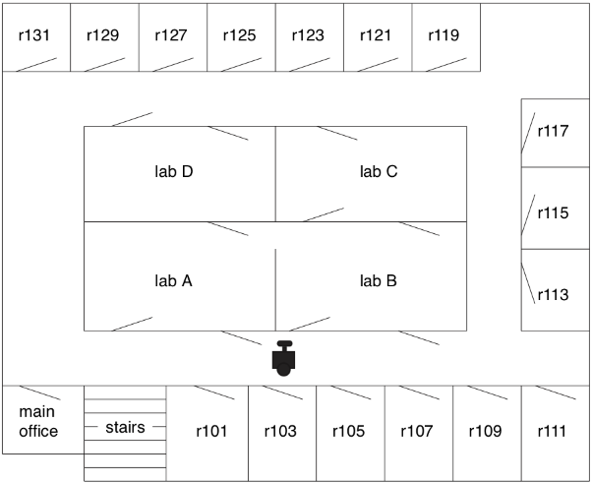
The delivery robot
An autonomous delivery robot moves around a building delivering packages and coffee.
It has sensors to avoid obstacles, the ability to carry objects, and wheels to move around.
This delivery agent should be able to:
find paths
allocate resources
receive requests from people [in NL]
make decisions about priorities
deliver packages
avoid injuring people or itself.

Slide 23
Delivery robot as a black box
Input:
Prior knowledge, provided by the agent designer, about the environment and agent’s capabilities
Past experience about the environment
Stimuli from sensors or other input devices: infrared, cameras, touch, whiskers, voice input, keyboards …
Goals: what needs to be delivered and when. Preferences.
Output:
Wheel controls, gripper movements, speech, video displays …
Notes:
prior knowledge, provided by the agent designer, about the agent’s capabilities, what objects it may encounter and have to differentiate, what requests mean, and perhaps about its environment, such as a map
• past experience obtained while acting, for instance, about the effects of its actions, what objects are common in the world, and what requests to expect at different times of the day
• goals in terms of what it should deliver and when, as well as preferences specifying trade-offs, such as when it must forgo one goal to pursue another, or the trade-off between acting quickly and acting safely, and
• stimuli about its environment from observations from input devices such as cameras, sonar, touch, sound, laser range finders, or keyboards as well as stimuli such as the agent being forcibly moved or crashing.
The robot’s outputs are motor controls specifying how its wheels should turn, where its limbs should move, and what it should do with its grippers. Other outputs may include speech and a video display.

Slide 24
Delivery Robot: dimensions of complexity
Simplest scenario: flat system, finite set of atomic states, no uncertainty, simple recognition of goal states, no preferences => planning as graph search
Complexity may arise in all dimensions:
Modularity: it may necessary to build a hierarchy of modules.
Representation: states represented as set of features, or a set of related objects => planning requires specialized techniques
Goals may be more complex and conflicting, with preferences and trade-offs
Uncertainty in sensors
Uncertainty in the result of actions.
Multiple robots in the same environments that need to cooperate and compete for plugs
There is a lot to learn from experience on how to improve performance.
If the environment is unpredictable you cannot plan in advance, you have to be able to adapt

Slide 25
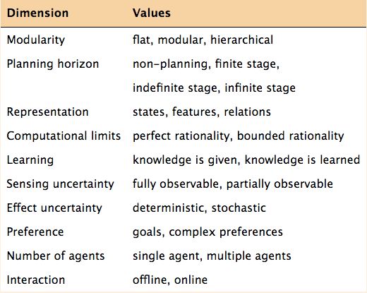
Summary

Slide 26
Your turn
Read the introduction of the online book “Artificial Intelligence: Foundations of Computational Agents” by Poole and Macworth http://artint.info/2e/html/ArtInt2e.html
Study one of the examples in the introduction (1.6 Prototypical Applications) and be prepared to discuss related dimensions of complexity.

Slide 27
Agent architectures
Lesson 2: agent Functions, Agent architectures, hierarchical control (AI-FCA: CHAPTER 2)

Slide 28
Agents
An agent is something that interacts with an environment, receiving information through its sensors and acts in the world through actuators (effectors)
A robot is an artificial purposive embodied agent
A computer program is a software agent.

Slide 29
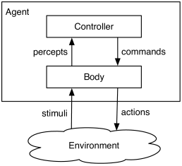
Agent systems
An agent is made up of a body and a controller. The controller receives percepts from the body and sends commands to the body.
A body includes sensors that convert stimuli into percepts and actuators that convert commands into actions.
Both sensor and actuators can be uncertain
The controller is the brain of an agent.
An agent system includes an agent and the environment in which it acts.
sensors
actuators

Slide 30
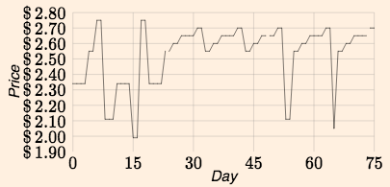
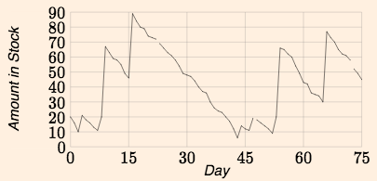
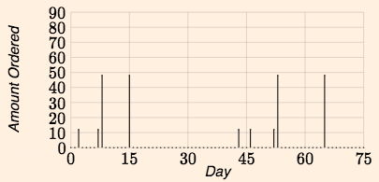
Agents in time
Agents act in time. T is the set of time points. Assume that T has a start (0) is totally ordered, discrete, and each t has a next time t +1
Percept trace/stream: a function of time into percepts
Command trace: a function of time into commands
Agent history at time t : percepts up to t and commands up to t−1
Causal transduction: a function from history to commands
The term transduction comes from Finite State Transducers, where both new states and commands are emitted.
“Causal” because only previous and current percepts and previous commands can be considered
A controller ideally implements a causal transduction
Notes:
The scale of time depends on the application: it can be measured in seconds, days, years …
In the example we try to decide how much paper toilet to order each day, taking into account the price and the amount in stock.
Price is the percept sequence/trace/stream
Amount in stock is another precept sequence
Command trace (can correspond to the actual ordered paper or not).

Slide 31
Command/agent function
However, complete history is usually not available … only the memory of it
The memory or belief state of an agent at time t is all the information the agent has remembered from the previous times.
The behavior of an agent is described by two functions:
A belief state transition function:
remember: S ×P → S S is the set of belief states, P the set of percepts
A command function:
command: S ×P → C C is the set of commands
The controller implements a command function (an approximation of a causal transduction).
Notes:
The notion of belief state here is quite general. It may be:
A program counter, the position of the robot.
A model of the state of the world (even if partial).
A probability distribution over possible worlds.
Goals and desires.

Slide 32
Example: trading agent
How much toilet paper the agent should buy depends on the price history, the history of the commodity in stock and the past history of buying.
Suppose amount to buy depends on the average price in the last 20 days.
A causal transducer may recompute the average
average := average + (new − old)/20
Command function may be based on maintaining in memory a single quantity ave which is only an approximation of average
ave := ave + (new −ave)/20
We have a finite state controller when there are a finite number of belief states.

Slide 33
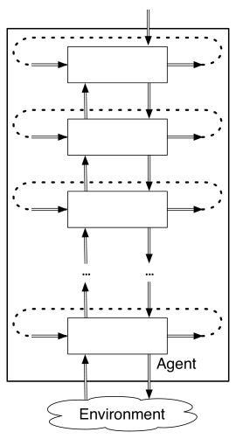
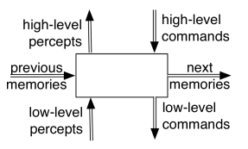
Hierarchical control
With a single controller … it is difficult to reconcile the slow reasoning about complex high-level goals with the fast reaction that an agent needs for lower-level tasks such as avoiding obstacles.
Notes:
Different layers have different planning horizons.
the lower level, is fast, automatic, parallel, intuitive, instinctive, emotional, and not open to introspection,
the higher level, is slow, deliberate, serial, open to introspection, and based on reasoning.

Slide 34
Functions for layered control
Functions to be implemented at each layer: (l : lower; h : higher)
remember: S × P_{l} × C_{h} → S belief state transition function
command: S × P_{l} × C_{h} → C_{l} command function
higher_percept: S × P_{l} × C_{h} → P_{h} percept function
where:
S is the belief state of the level
C_{h} is the set of commands from the higher layer
P_{l} is the set of percepts from the lower layer
C_{l} is the set of commands for the lower layer
P_{h} is the set of percepts for the higher layer

Slide 35
Hybrid systems
high-level reasoning, is often discrete and qualitative
low-level reasoning is often continuous and quantitative
A controller that reasons in terms of both discrete and continuous values is called a hybrid system.

Slide 36
Example: delivery robot
The robot is given a plan consisting of a sequence of named locations for the robot to go to, avoiding obstacles.
It has wheels and three actions: go straight, go right, go left. (Its velocity doesn’t change).
It has a single whisker sensor pointing forward and to the right. The robot can detect if the whisker hits an object.
The robot knows where it is but it has no map.
The obstacles and locations can be moved dynamically.
Obstacles and new locations can be created dynamically.

Slide 37
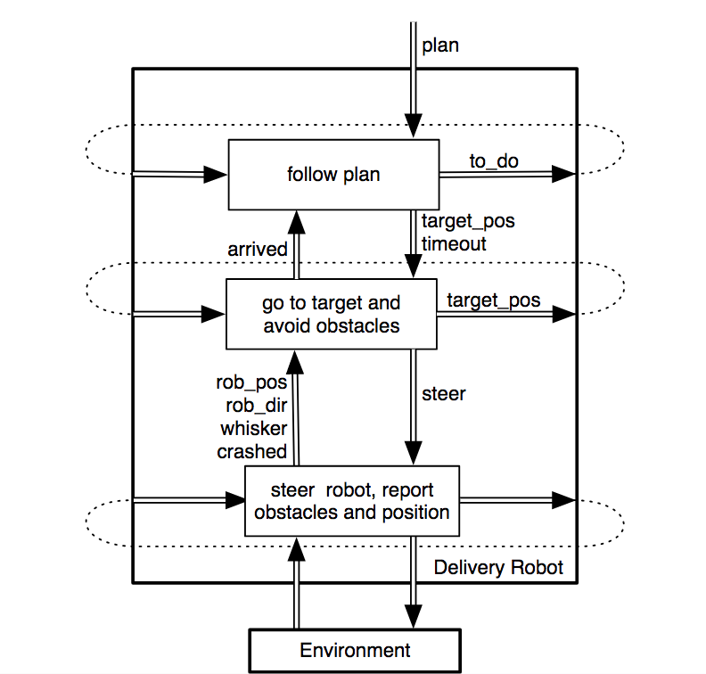
A decomposition for the Delivery Robot
Three layers

Slide 38
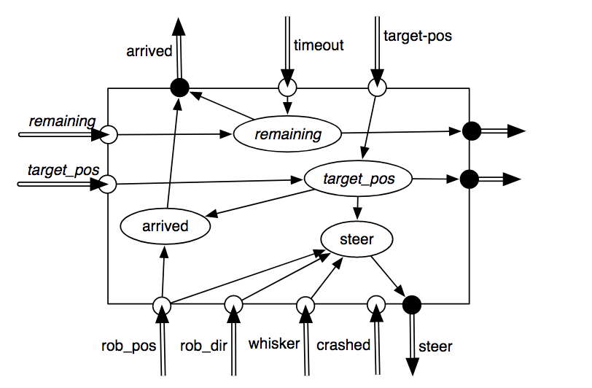
The middle layer

Slide 39
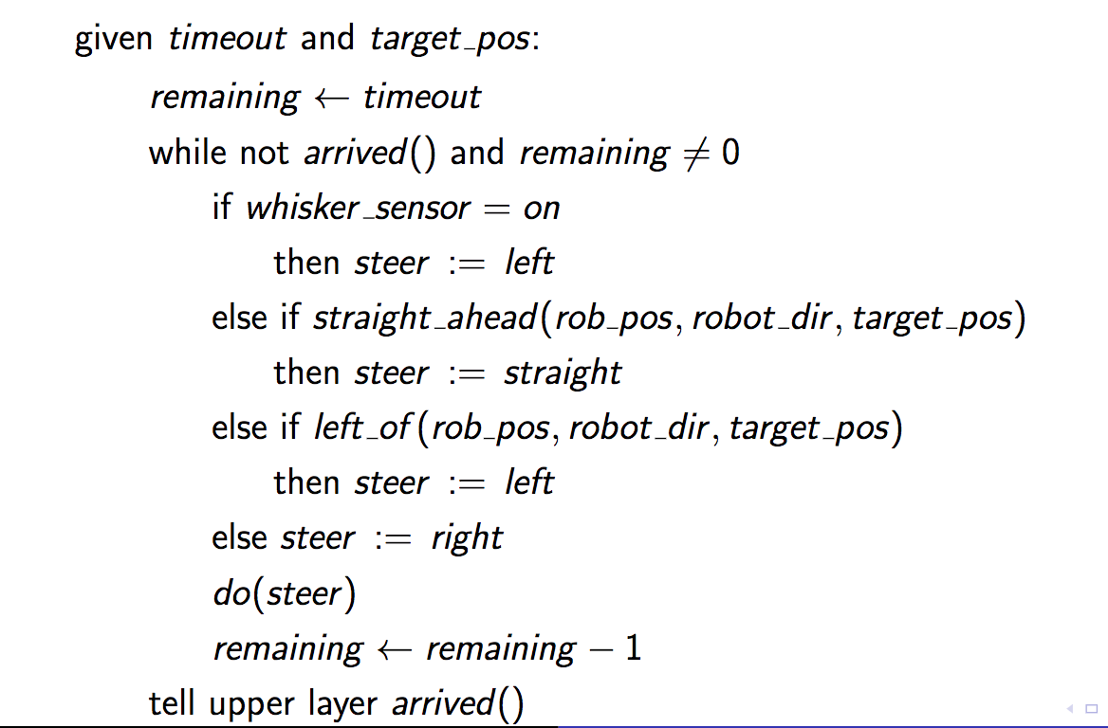
A controller for the middle layer

Slide 40
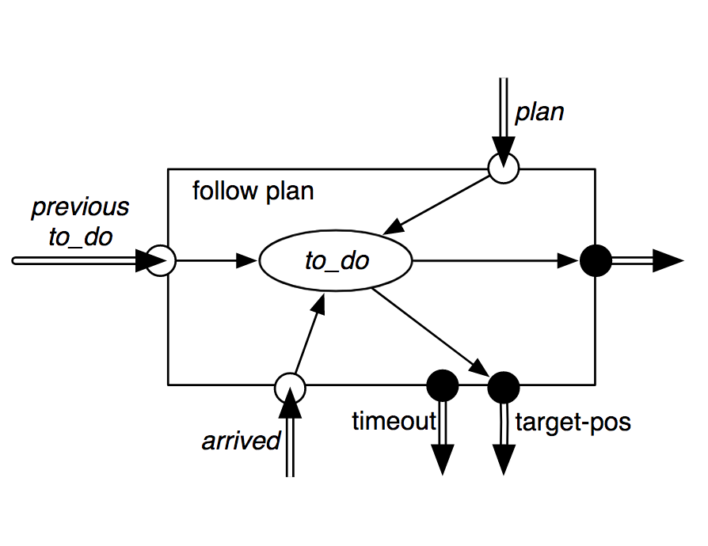
Top layer
The top layer is given a plan which is a sequence of named locations.
The top layer tells the middle layer the target position for the current location and a timeout
It has to remember the current goal position and the locations still to visit.
When the middle layer reports the robot has arrived, the top layer takes the next location from the list of positions to visit, and this is the new target position.

Slide 41
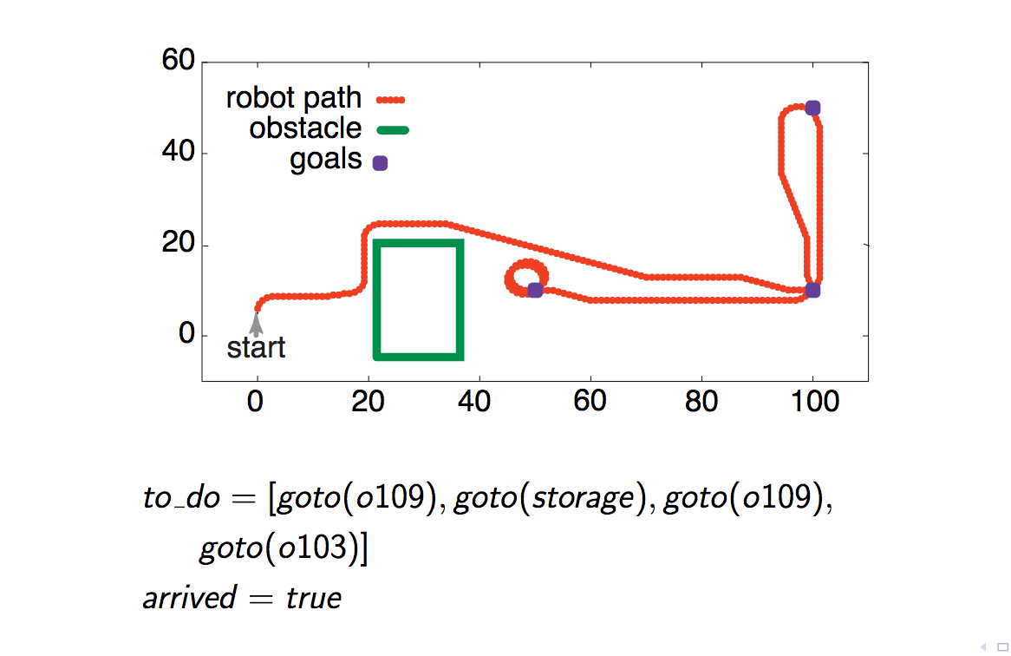
A simulation for the Delivery Robot

Slide 42
Knowledge requirements
The notion of belief state is quite general, most agents need to keep a model of the word and update it while acting.
Two extremes:
The agent possess a very good predictive model: it does not need to use perceptions to update the model
Purely reactive systems do not have a model, and decide only on the basis of perceptions
In the general case the agent uses a combination of prediction and sensing:
In Bayesian reasoning (under uncertain information) the estimation of the next belief state is called filtering.
In alternative, more complex models of the world can be kept and updated, for example through vision and image processing.

Slide 43
Knowledge and action
Knowledge of a specific domain may also be represented explicitly and used to decide the action.
The knowledge base contains general rules and specific/contingent facts in declarative form.
The KB is built offline, built by designers or learned from data. A Domain Ontology gives meaning to symbols used to represent knowledge.
Knowledge may be then updated and used to decide actions during operation.
We will talk about knowledge based systems in section 2 of the course.

Slide 44
Conclusions
We introduced a vision of AI as an integrated science whose goal is to build intelligent computational agents.
The design of an intelligent system involves several dimension of complexity that will be further addressed in the course.
The design of complex AI systems may require working at different levels of abstractions, possibly with different techniques at different levels.

Slide 45
References
[AI-FCA] David L. Poole, Alan K. Mackworth. Artificial Intelligence: foundations of computational agents, Cambridge University Press, 2017. http://artint.info/2e/html/ArtInt2e.html (online version)
Chapter 1: Artificial Intelligence and agents
Chapter 2: Agent architectures and hierarchical control
Next
We will review the AI paradigm of problem solving as search in state space
We will focus to the techniques developed for CSP problems, which adopt a featured representation for states.

