Slide 1
Smart parking lot
Yan Yu

Slide 2
proposal
The goal of this project is to make a hands-free, automatic parking lot.
This project will capture license plate number by using a camera when the sensor detected a car is at the entry point, then after the number has been successfully read into the system, parking lot gate will open.

Slide 3
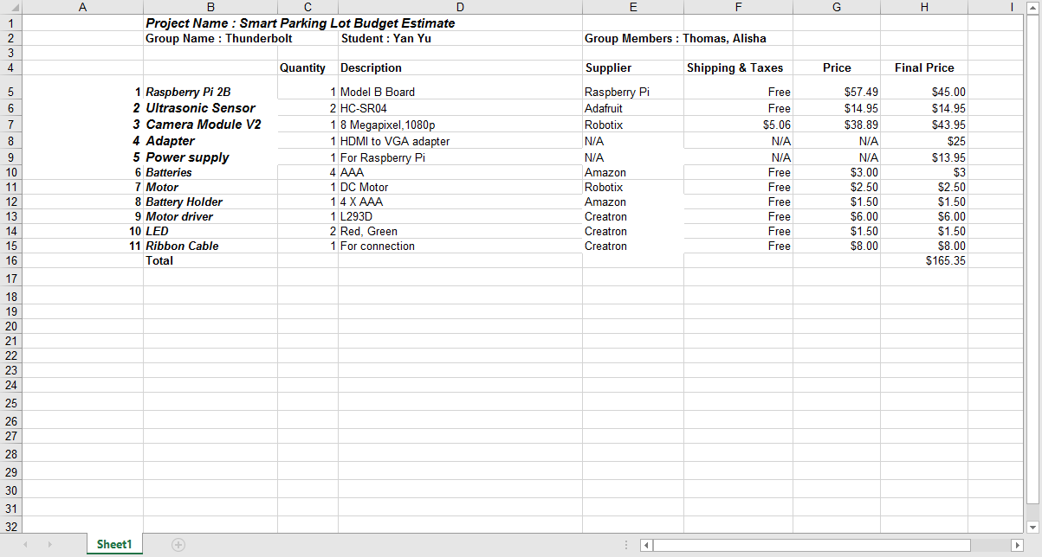
budget

Slide 4
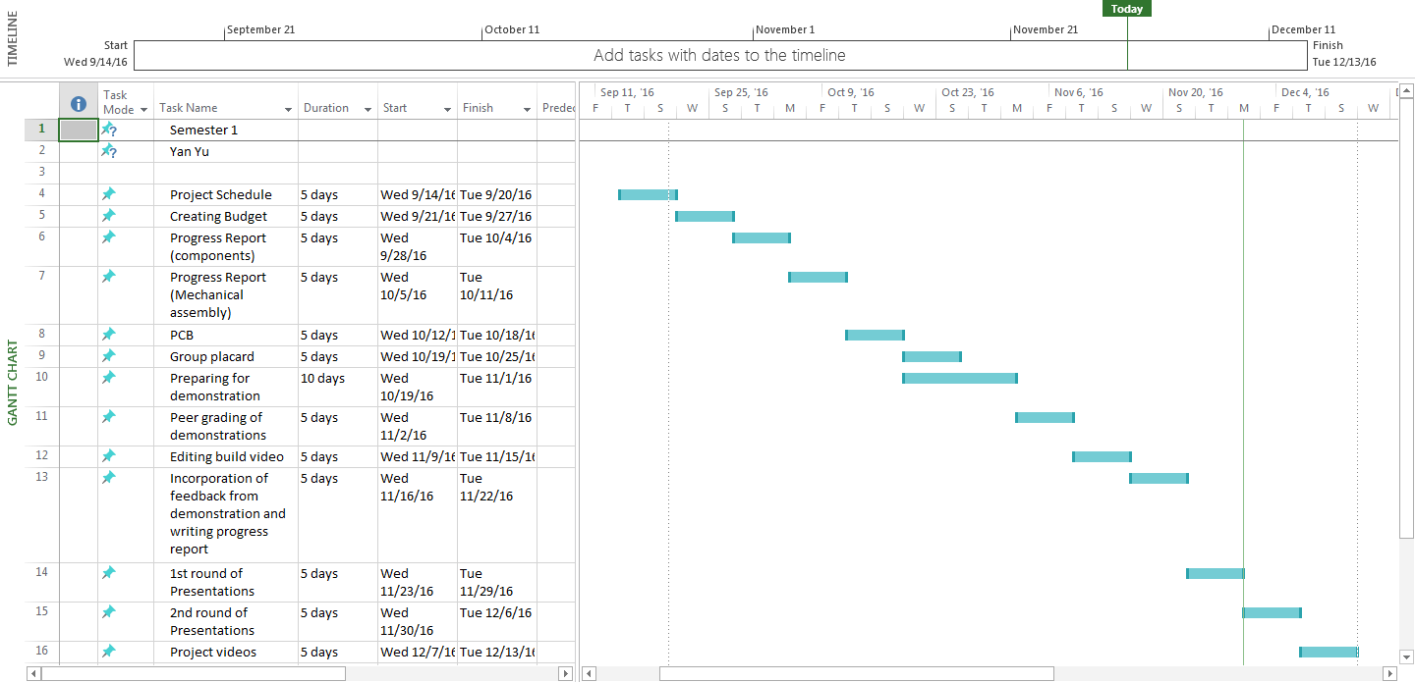
schedule

Slide 5
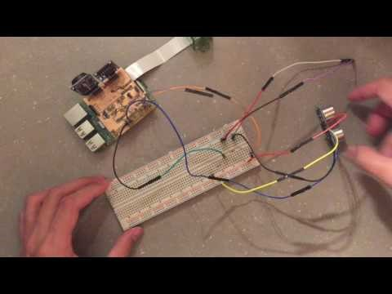
Build video

Slide 6
Course knowledge utilized
Internet Programming, html
Electronic devices and circuits
C
Java, database
python

