Slide 1
Review
(a)
sum = 0
for num in range(1,11):
sum = sum + num
print(sum)
1+2+3+4+…+10=?
Which code will print out the above summation?
(b)
sum = 0
for num in range(1,10):
sum = sum + num
print(sum)
sum = 0
for num in range(1,10):
sum = num
print(sum)
(c)

Slide 2
Lecture05: Conditional Statements

Slide 3
if statements
Try this out!
Python supports the usual logical conditions from mathematics:
Equals: a == b
Not Equals: a != b
Less than: a < b
Less than or equal to: a <= b
Greater than: a > b
Greater than or equal to: a >= b
age = input("please enter your age? \n")
if int(age)<11:
print("You are still a child!")
elif int(age)>18:
print("You are adult!")
else:
print("You are teenage!")
The elif keyword is pythons way of saying "if the previous conditions were not true, then try this condition".

Slide 4
if statements
Try this out!
The elif keyword is pythons way of saying "if the previous conditions were not true, then try this condition".
age = input("please enter your age? \n")
if int(age)<11:
print("You are still a child!")
elif int(age)>18:
print("You are adult!")
else:
print("You are teenage!")
The else keyword catches anything which isn't caught by the preceding conditions.

Slide 5
While loops
while loops keep looping while a condition is true
while condition:
code_to_excecute()
Try this out!
while True:
name = input(“Who are you?”)
if name != “Jim”:
continue
password = input(“Hello, Jim. What is the password?”)
if password == “123456”:
break
print(“Access granted”)

Slide 6

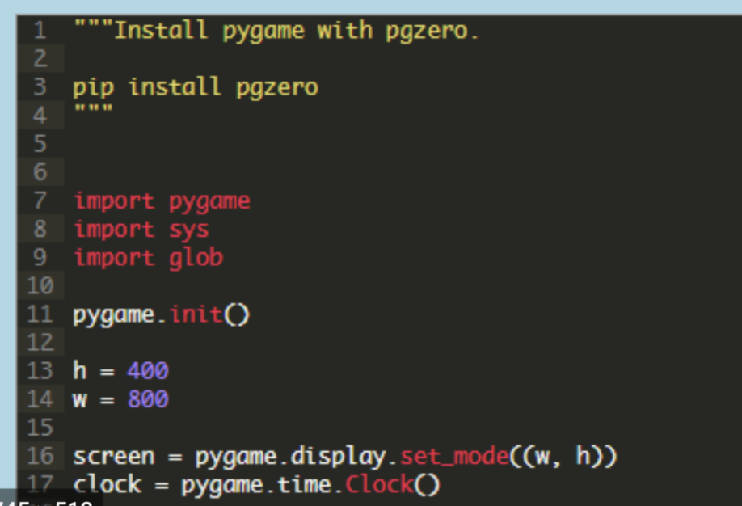



What we will learn in the coming week?
Don’t forget to register the course!

