Slide 1
Review: function
def keyword
arguments
def add(number1,number2):
function name

Slide 2
Animation and game design with functions and objects: tkinter
https://github.com/bigbrainacademy/python4kids
Ref: https://www.geeksforgeeks.org/python-gui-tkinter/

Slide 3
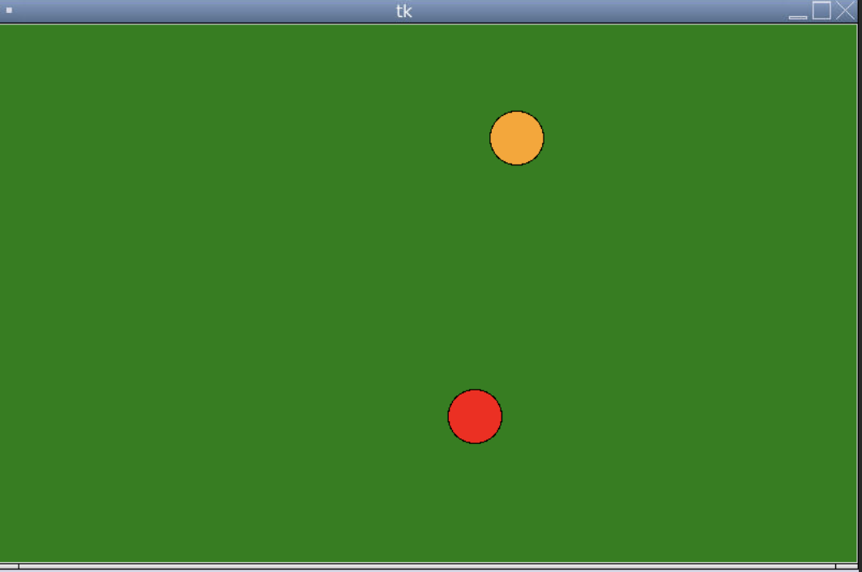
Project: bouncing ball

Slide 4
tkinter
from tkinter import *
# To create a main window,
tk = Tk()
canvas = Canvas(tk, width=800, height=500, bg=”green")
canvas.pack()
Tk
width
Canvas
height

Slide 5
bouncing ball
self.shape = canvas.create_oval(0, 0, SIZE, SIZE, fill=“orange”)
(X0,y0)
pos=(x0,y0,x1,y1)
(X1,y1)
pos[0]
pos[3]

Slide 6
bouncing ball
self.shape = canvas.create_oval(0, 0, SIZE, SIZE, fill=“orange”)
if pos[2] >= width:
self.speedx = - self.speedx
speedx
speedy

Slide 7
bouncing ball
self.shape = canvas.create_oval(0, 0, SIZE, SIZE, fill=“orange”)
if pos[0] <= 0:
self.speedx = - self.speedx
speedx
speedy

Slide 8
bouncing ball
self.shape = canvas.create_oval(0, 0, SIZE, SIZE, fill=“orange”)
if pos[3] >= height:
self.speedy = - self.speedy
speedx
if pos[3] >= height
speedy

Slide 9
bouncing ball
self.shape = canvas.create_oval(0, 0, SIZE, SIZE, fill=“orange”)
speedy
if pos[1] <= 0:
speedx
self.speedy = - self.speedy

Slide 10
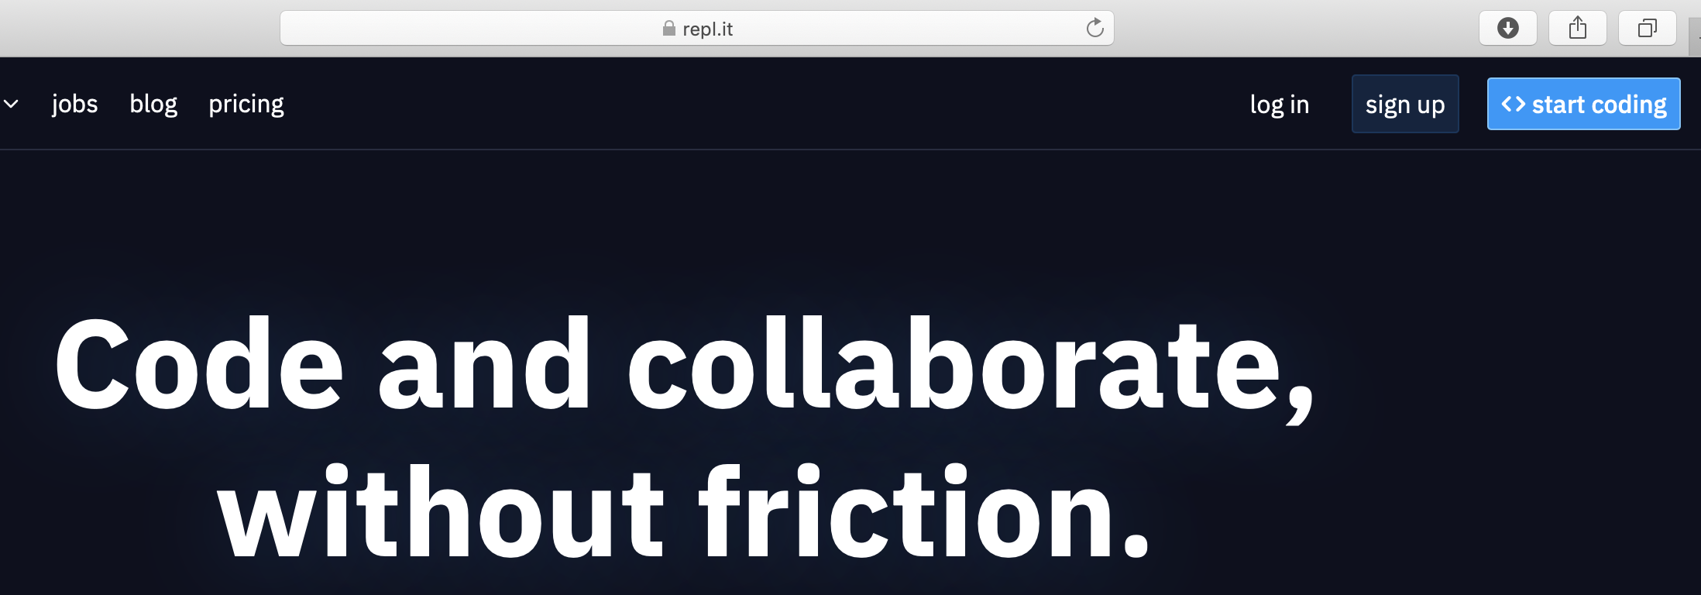
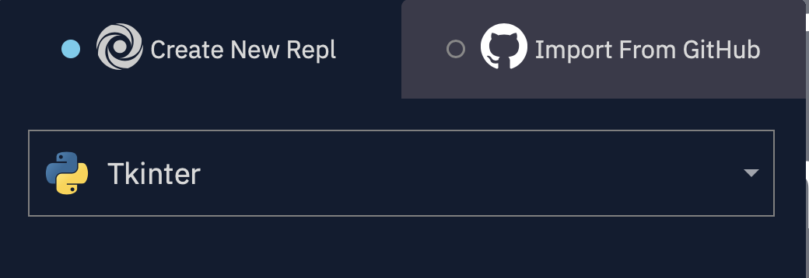
Run our code on repl.it
Go to repl.it
Click start coding
Choose Tkinter
Let’s try!

Slide 11
Create Game window
from tkinter import *
import random
tk = Tk()
canvas = Canvas(tk, width=500, height=400)
tk.title(“Drawing”)
canvas.pack()
canvas.create_line(0,0,500,400)
canvas.create_rectangle(100,100,250,250,fill=“blue”)
canvas.create_oval(10,10,50,50,fill=“green”)
canvas.create_polygon(400,10,300,300,500,300,fill=“purple”)
tk.mainloop()

Slide 12
Shape Animation
from tkinter import *
import random
tk = Tk()
Height = 400
Width = 500
canvas = Canvas(tk, width=Width, height=Height)
tk.title(“Drawing”)
canvas.pack()
ball = canvas.create_oval(10,10,60,60,fill=“orange”)
tk.mainloop()
xspeed = 4
yspeed = 5
While True:
canvas.move(ball,xspeed,yspeed)
pos = canvas.cords(ball)
if pos[3] >= Height or pos[1] <= 0:
yspeed = -yspeed
if pos[2] >= Width or pos[0] <= 0:
xspeed = -xspeed
tk.update()
time.sleep(0.01)

