Slide 1
Schedule
1:00 – 1:40 class time
10 minutes break
1:50 – 2:30 class time
10 minutes break
2:40 – 3:00 class time

Slide 2
Review
String
print()
input()
“\n”
Which one is correct?
(a) name = input(R2D2: What's your name?)
(b) name = input (”R2D2: What's your name?”)
(c) name = input(”R2D2: What's your name?” \n)
(d) name = input (”R2D2: What's your name?\n”)

Slide 3
Lecture 2
Turtle Graphics: Drawing with Python
https://github.com/bigbrainacademy/python4kids/tree/master/lec01

Slide 4
Turtle package
Write instructions that tell a virtual turtle to move around the screen.
The turtle carries a pen, and you can instruct the turtle to use its pen to draw lines wherever it goes.
By writing code to move the turtle around in cool patterns, you can make it draw amazing pictures.

Slide 5
(x,y) coordinates on the screen
The screen is divided into four quadrants.
The point where the turtle is initially positioned at the beginning of your program is (0,0). This is called Home.
To move the turtle to any other area on the screen, you use goto() and enter the coordinates like this:
Home
t =turtle.Turtle()
t.goto(100,100)

Slide 6
(x,y) coordinates on the screen
90
90
90
90

Slide 7
Basic methods
https://www.tutorialspoint.com/turtle-programming-in-python
(-200,200)
(200,200)
import turtle
t = turtle.Turtle()
Import turtle graphics (package)
rename the method turtle.Turtle() simply as t.
(0, 0)
(-200,-200)
(200,-200)

Slide 8
Draw a square
https://www.tutorialspoint.com/turtle-programming-in-python
(-200,200)
(200,200)
import turtle
t = turtle.Turtle()
t.forward(100) t.left(90)
t.forward(100)
t.left(90)
t.forward(100)
t.left(90)
t.forward(100)
(0, 100)
(100, 100)
(0, 0)
(0, 100)
(-200,-200)
(200,-200)

Slide 9
Project: Draw a house
https://www.tutorialspoint.com/turtle-programming-in-python
# plot a small square
t.pencolor("red")
t.forward(50)
t.left(90)
t.forward(50)
t.left(90)
t.forward(50)
t.left(90)
t.forward(50)
t.left(90)
(-200,200)
(200,200)
120
120
150
120
100
100
# triangle
t.pencolor("green")
t.left(120)
t.forward(150)
t.left(120)
t.forward(150)
50
50
50
(-200,-200)
(200,-200)

Slide 10
Project: Draw snow flakes
https://www.tutorialspoint.com/turtle-programming-in-python
(-200,200)
(200,200)
# diamond
elsa.forward(100)
elsa.right(60)
elsa.forward(100)
elsa.right(120)
elsa.forward(100)
elsa.right(60)
elsa.forward(100)
100
100
100
100
60(deg)
120(deg)
(-200,-200)
(200,-200)

Slide 11

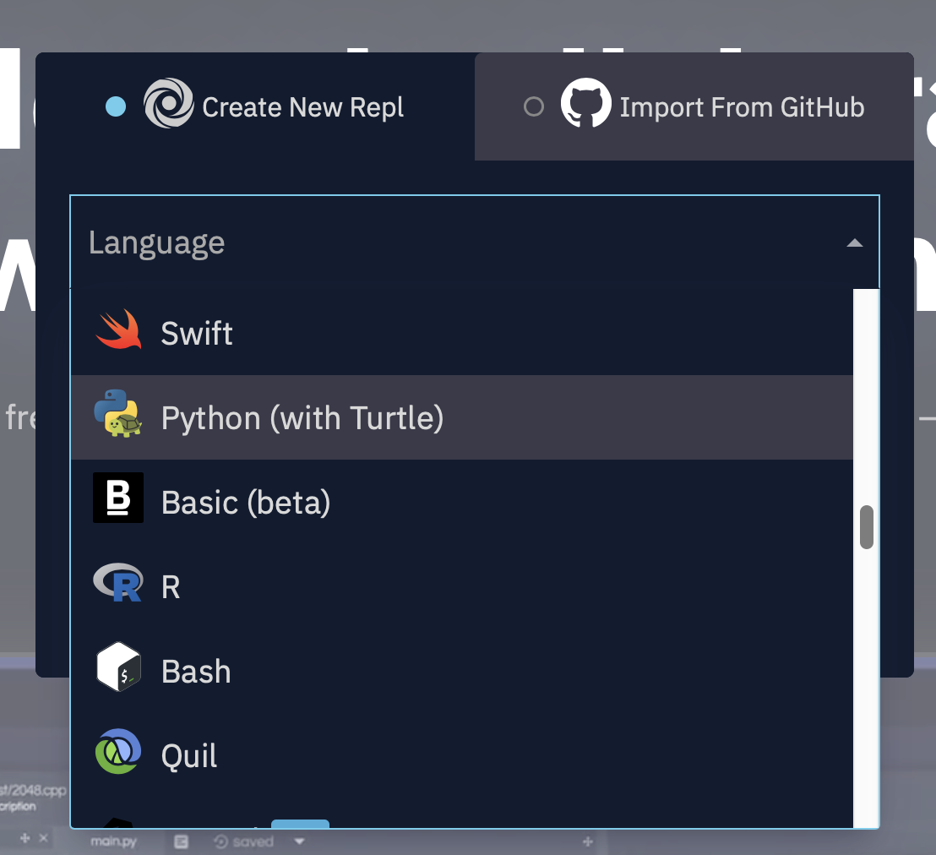
Run our code on repl.it
Go to repl.it
Click start coding
Choose Python (with Turtle)
Let’s try!

Slide 12
Shapes and angles
Regular shapes: angle (degree) = (n-2)*180/n

