Slide 1
Review
t = turtle.Turtle()
t.forward(distance)
t.left(angle)
t.circle(radius)
Which one is wrong?
(a) t.forward(100)
(b) t.forward(“100”)
(c) t.left(90)
(d) t.left(-90)

Slide 2
Lecture 3: Variables and NumberGame
https://github.com/bigbrainacademy/python4kids/tree/master/lec01

Slide 3
Variables and Data type
A variable is something you want the computer to remember while your program is running
Try this out!
Variables are containers for storing data values.
name = input("What’s your name? \n")
print("Hello, ", name)
string4age = input("How old are you? \n")
age = int(string4age)
print("Next year you will be", age + 1)
print(type(name))
print(type(string4age))
print(type(age))
A variable is created the moment you first assign a value to it.
Data type: string, integer, …
Text Type: | str
Numeric Types: | int, float, complex
What’s the difference between “10” and 10 ?
get the data type of any object by using the type() function

Slide 4
Change data type of variables
Try this out!
using constructor functions:
num4age = int(string4age)
print(type(string4age))
print(type(num4age))
x = str("s1") # x will be 's1’
y = str(2) # y will be '2’
z = str(3.0) # z will be '3.0'
int(): constructs an integer number from other data type.
str(): constructs a string from from other data type.

Slide 5
Operators
Try this out!
Operators are used to perform operations on variables and values.
x = 5
y = 3
z = x + y
print(z)
- Assignment Operators
x = 5
y=3
assign values to variables
- common mathematical operations
Addition (+)
Subtraction (-)
Multiplication (*)
Division (/)
x + y

Slide 6
Operators
Try this out!
Booleans represent one of two values: True or False.
print(10 > 9) # True print(10 == 9) # False print(10 < 9) # False
Question: what will be printed out? True or False?
x = 5
y=3
print(x>y)

Slide 7
How to choose a name for your variable?
Always begin variable names with a letter.
The rest of the characters must be letters, numbers, or the underscore symbol “_”.
Don’t use space or “-” in a variable name!
Python are case sensitive! Pay attention to the use of uppercase and lowercase. My_Name is different from my_name.
Which ones are invalid for a variable name?
My_Students, MyStudents, My-students, My Students

Slide 8
random.randint()
The random.randint(start, stop) method returns an integer number selected element from the specified range.
import random print(random.randint(3, 9))
# Return a number between 3 and 9 (both included)
3
4,5,6,7,8
9
Start
number
Stop
Number

Slide 9
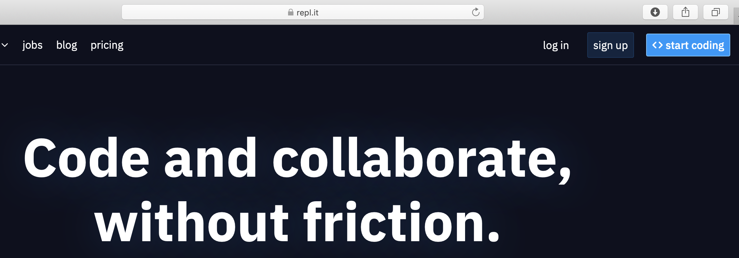
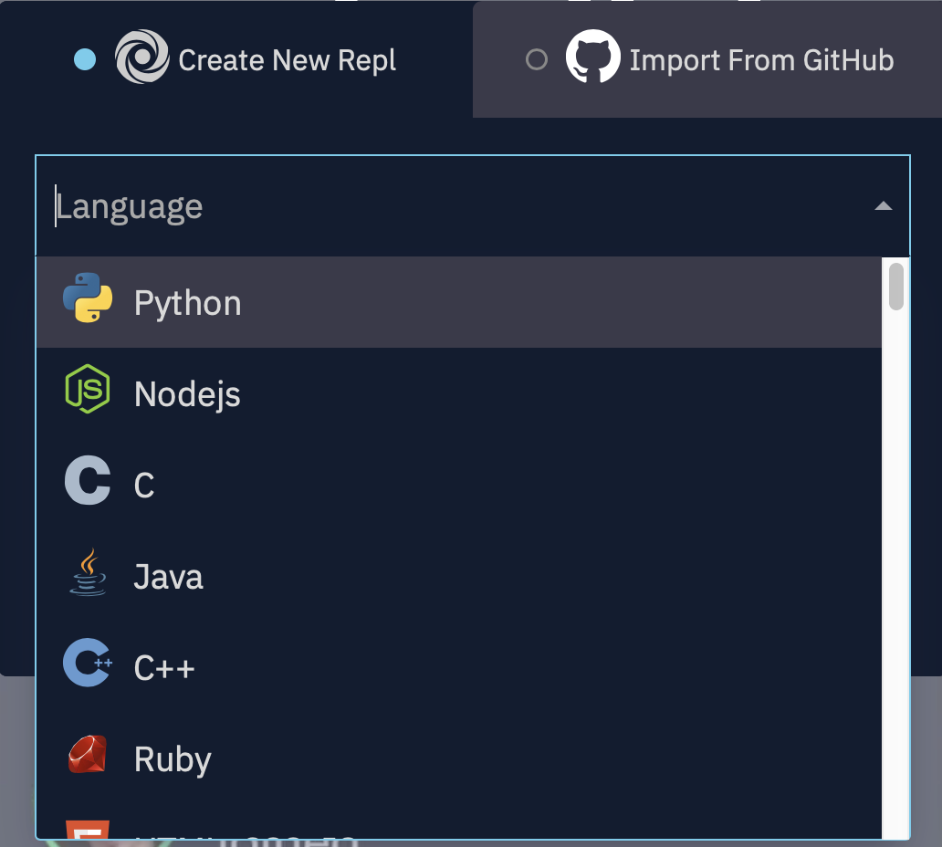
Run our code on repl.it
Go to repl.it
Click start coding
Choose Python
Let’s try!

Slide 10
Challenge: dictionary
Try this out!
A dictionary is a collection which is unordered, changeable and indexed. In Python dictionaries are written with curly brackets, and they have keys and values.
student = { "name": "Alice", "grade": 3, "year": 2020 } print(student)
- Create and print a dictionary
- Accessing Items
access the items of a dictionary by referring to its key name
x = student["name"]

Slide 11
Challenge: List
- A list is a collection which is ordered and changeable.
- written with square brackets [].
You access the list items by referring to the index number:
thislist = ["apple", "banana", "cherry"] print(thislist[1])
You can specify a range of indexes by specifying where to start and where to end the range.
thislist = ["apple", "banana", "cherry", "orange", "kiwi", "melon", "mango"] print(thislist[2:5])

