Slide 1
Introduction to Pygame
https://github.com/bigbrainacademy/python4kids

Slide 2
Pygame
Pygame is a “game library” - a set of tools to help programmers making games. Some of these things are:
Graphics and animation
Sound (including music)
Control (keyboard, mouse, gamepad, etc.)

Slide 3
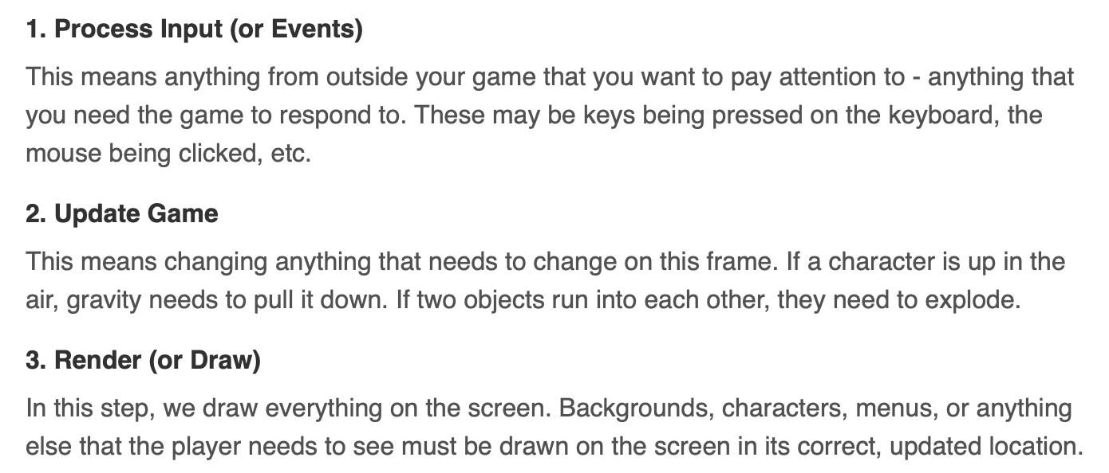
Pygame
Game Loop
At the heart of every game is a loop, which we call the “Game Loop”. This loop is constantly running, over and over again, doing all the things that are needed to make the game work. Each time the game goes through this loop is called a frame.

Slide 4
Pygame
Clock
One other important aspect of the loop is controlling how fast the whole loop runs. You may have heard the term FPS, which stands for Frames Per Second.

Slide 5
Getting started with pygame
import pygame
WIDTH = 360 # width of our game window
HEIGHT = 480 # height of our game window
FPS = 30 # frames per second
# initialize pygame and create window
pygame.init()
pygame.mixer.init() # for sound
screen = pygame.display.set_mode((WIDTH, HEIGHT))
pygame.display.set_caption("My Game")
clock = pygame.time.Clock()
# using clock() to make sure our game runs at the FPS we want

Slide 6
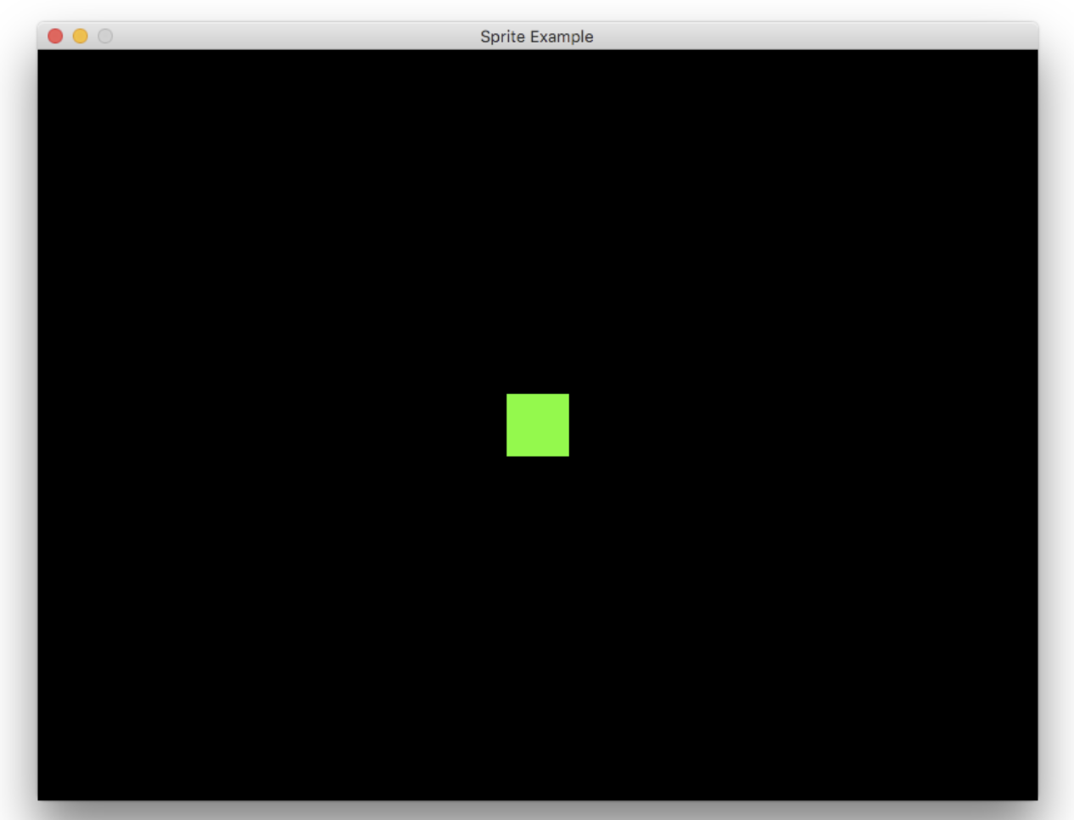
Getting started with pygame
# Game loop
running = True
while running:
# keep loop running at the right speed
clock.tick(FPS)
# Process input (events)
for event in pygame.event.get():
# check for closing window
if event.type == pygame.QUIT:
running = False
# Update
# Draw / render
screen.fill(BLACK)
# *after* drawing everything, flip the display
pygame.display.flip()
pygame.quit()

Slide 7
Working with Sprites
A sprite is a computer graphics term for any object on the screen that can move around. When you play any 2D game, all the objects you see on the screen are sprites.
clock = pygame.time.Clock()
all_sprites = pygame.sprite.Group()
# Update
all_sprites.update()
# Draw / render
screen.fill(BLACK)
all_sprites.draw(screen)
A sprite group is just a collection of sprites that you can act on all at the same time.
For every sprite that we create we just make sure we add it to the all_sprites group, and it will automatically be drawn on the screen and updated each time through the loop.

Slide 8
Creat Sprites
In Pygame, sprites are objects.
class Player(pygame.sprite.Sprite):
def __init__(self):
pygame.sprite.Sprite.__init__(self)
self.image = pygame.Surface((50, 50))
self.image.fill(GREEN)
self.rect = self.image.get_rect()
self.rect = self.image.get_rect()
self.rect.center = (WIDTH / 2, HEIGHT / 2)
define the image property - in this case, we’re just creating a simple 50 x 50 square and filling it with the color GREEN
Rectangles are used all over the place in Pygame to keep track of an object’s coordinates.
all_sprites = pygame.sprite.Group()
player = Player()
all_sprites.add(player)
create it by making an instance of the Player class. We also need to make sure we add the sprite to the all_sprites group:

Slide 9
Sprite movement
def update(self):
self.rect.x += 5 # self.rect.x = self.rect.x + 5
if self.rect.left > WIDTH:
self.rect.right = 0

