Slide 1
AP Statistics Review Chapters 2 - 17
Part I & Part II & Part III & Part IV:
Exploring and Understanding Data
Exploring Relationships Between Variables
Gathering Data
Randomness and Probability

Slide 2
Exploring and understanding data
Part I:
Chapters 2 - 6

Slide 3
Graphical Displays

Slide 4
The W’s Of Data
To understand a data set, answer;
Who
What
When
Where
How
Why

Slide 5
Who
Individuals – people, objects, etc. that want information about.
Know the population of interest.

Slide 6
What
Variable – information on each individual
Categorical (qualitative) Data – fall into separate, non-overlapping categories.
Numerical (quantitative) Data – have measurement units and can be averaged.

Slide 7
When, Where, How, Why
When and Where
Gives context to data for better understanding.
How
Sample method (possible bias), makes a difference in analysis of data.
Why
Helps interpret the data.

Slide 8
Frequency Distributions
Tabular display of data.
Both qualitative and quantitative data.
Summarize the data.
Help ID distinctive features.
Used to graph data.
Categories/Classes – non-overlapping, each datum falls into only one.
Frequency – number of counts in each category/class.
Relative Frequency – fraction or ratio of category/class frequency to total frequency.

Slide 9
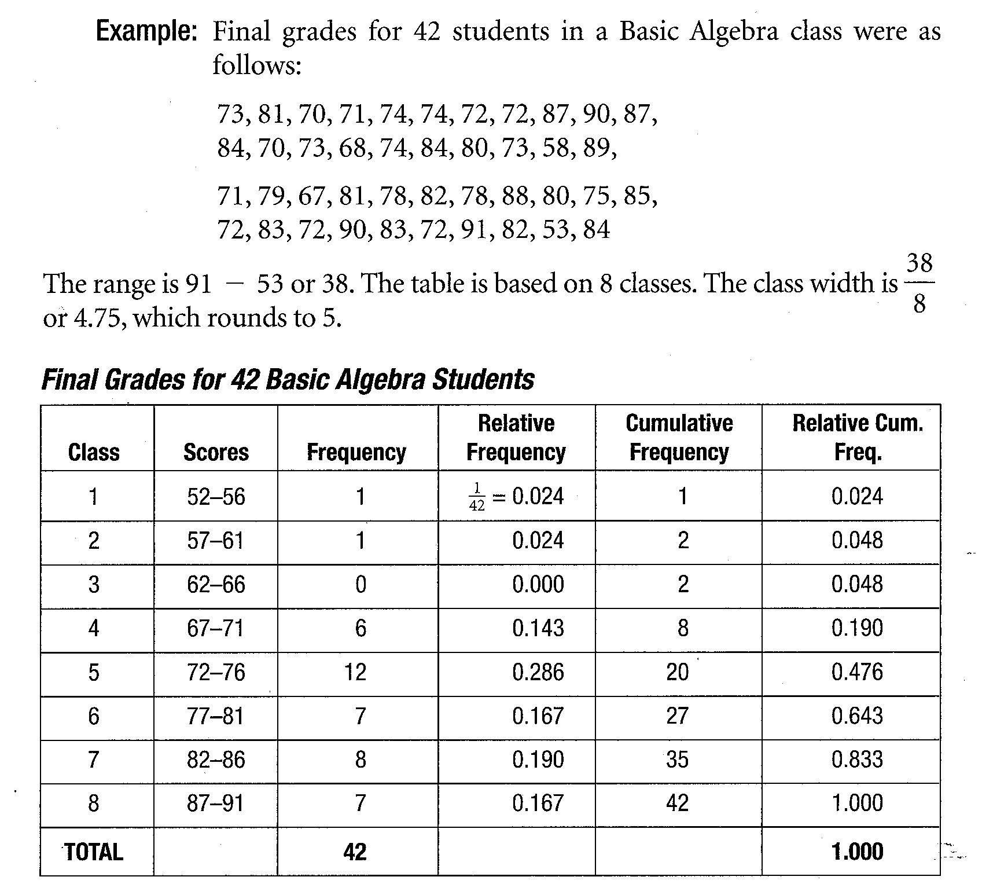
Frequency Distribution

Slide 10
Graphs of Categorical Data
Bar Chart/Graph
Pie Chart/Graph
Describe the distribution in the CONTEXT of the data.
Not appropriate to describe the shape of the distribution. Descriptions such as “symmetric” or “skewed” would not make sense, since the ordering of the categories is arbitrary.

Slide 11
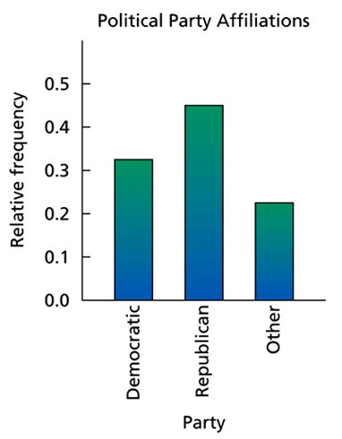
Bar Graph
Have spaces between each category.
Order of the categories not important.
Either frequency (counts) or relative frequency (proportions) can be shown on the y-axis.
Title, both axes labeled and have appropriate scales.

Slide 12
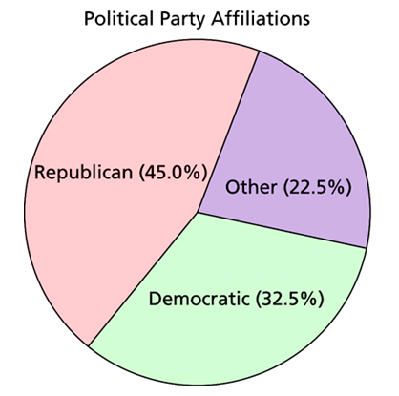
Pie Chart
Commonly used for presenting relative frequency distributions for qualitative data.
Slice the circle into pieces whose size is proportional to the fraction of the whole in each category.
Title, label sectors (included proportion).

Slide 13
Two-Variable Categorical Data
Contingency Table (2-way table)
Conditional Distributions
Marginal Distributions
Segmented Bar Graphs
Display association between variables

Slide 14
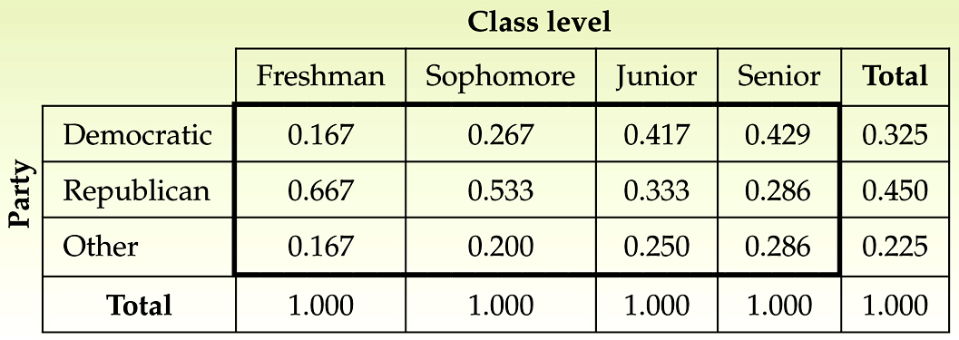
Contingency Table
Association
the variables “political party affiliation” and “class level” are associated because knowing the value of the variable “class level” imparts information about the value of the variable “political party affiliation. If we do not know the class level of a student in the course, there is a 32.5% chance that the student is a Democrat. But, if we know that the student is a junior, there is a 41.7% chance that the student is a Democrat.
If the variables “political party affiliation” and “class level” were not associated, the four conditional distributions of political party affiliation would be the same as each other and as the marginal distribution of political party affiliation; in other words, all five columns would be identical.

Slide 15
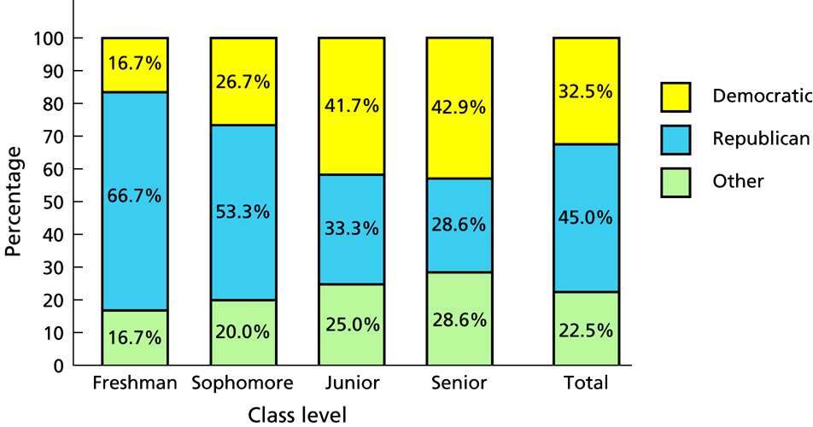
Segmented Bar Graphs
Association
A segmented bar graph lets us visualize the concept of association. The first four bars of the segmented bar graph show the conditional distributions and the fifth bar gives the marginal distribution of political party affiliation.
If political party affiliation and class level were not associated, the four bars displaying the conditional distributions of political party affiliation would be the same as each other and as the bar displaying the marginal distribution of political party affiliation; in other words, all five bars would be identical. That political party affiliation and class level are in fact associated is illustrated by the nonidentical bars.

Slide 16
Quantitative Data
One-Variable
Graphs
Histogram
Ogive
Stem-and-Leaf Plot
Dotplot

Slide 17
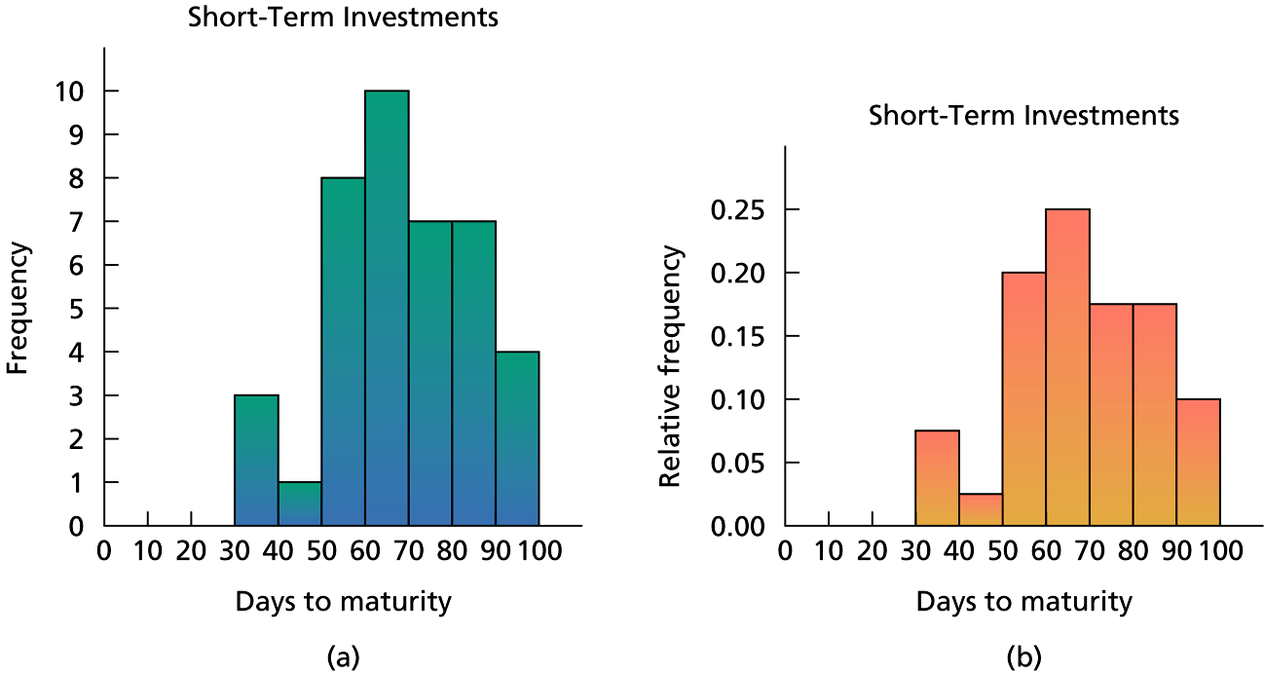
Histogram
Group data into classes of equal width.
The counts in each class is the height of the bar.
Describe distribution by; shape, center, spread.
Unusual features should also be noted; gaps, clusters, outliers.
Relative freq. and freq. histograms look the same except the vertical axis scale.
Remember to describe the shape, center, and spread in the CONTEXT of the problem.

Slide 18
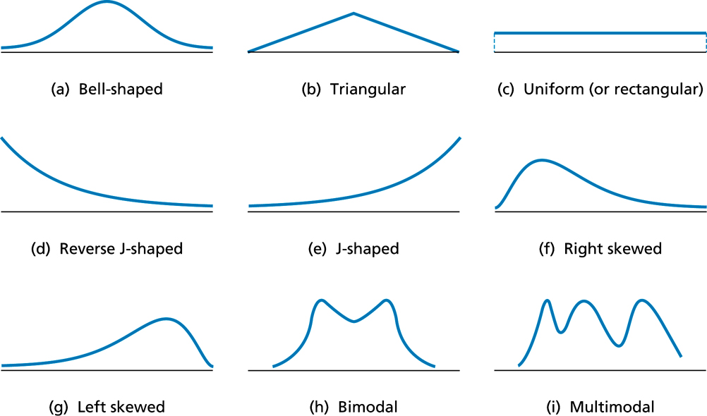
Common Distribution Shapes

Slide 19
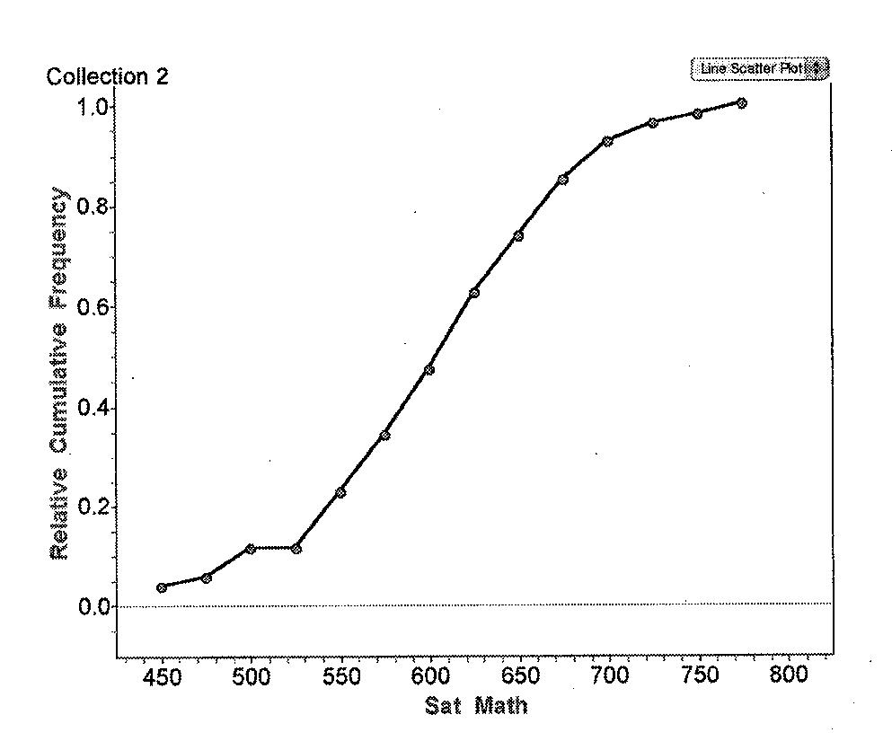
Ogive
Displays the relative standing (percentile, quartile, etc.) of an individual observation.
Label and scale the axes and title the graph. Horizontal axis “classes” and vertical axis “cumulative frequency or relative cumulative frequency”.
Begin the ogive at zero on the vertical axis and lower boundary of the first class on the horizontal axis. Then graph each additional Upper class boundary vs. cumulative frequency for that class.

Slide 20
Stem-and-Leaf Plot
Contains all the information of histograms.
Advantage – individual data values are preserved.
Used for small data sets.
The leading digit(s) are the “stems,” and the trailing digits (rounded to one digit) are the “leaves.”
Back-to-Back Stem-and-leaf Plots are used to compare related data sets.

Slide 21
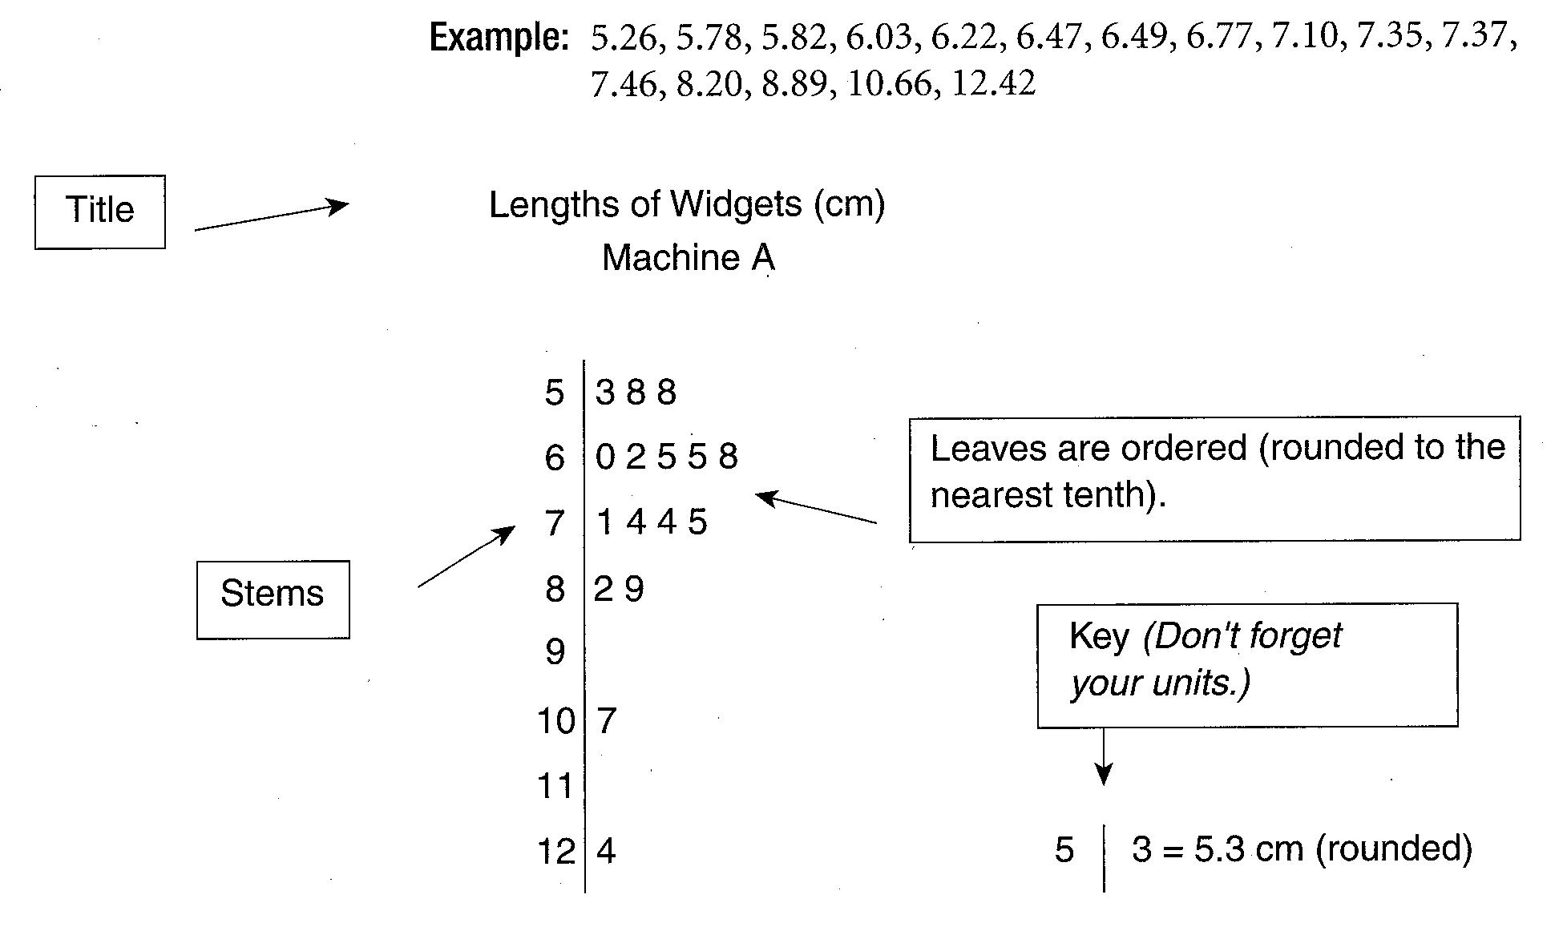
Stem-and-Leaf Plot

Slide 22
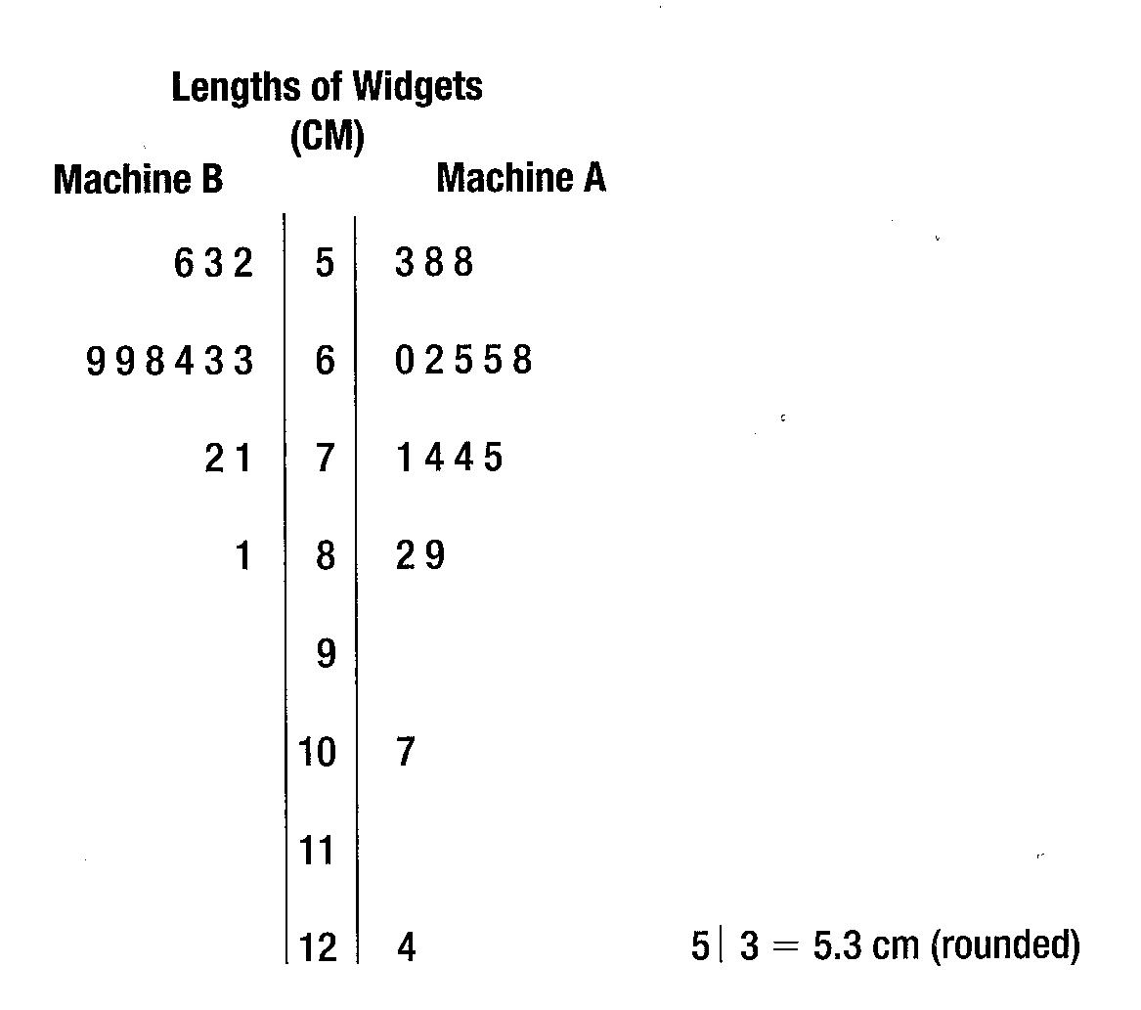
Back-to-Back Stem-and-Leaf Plot

Slide 23
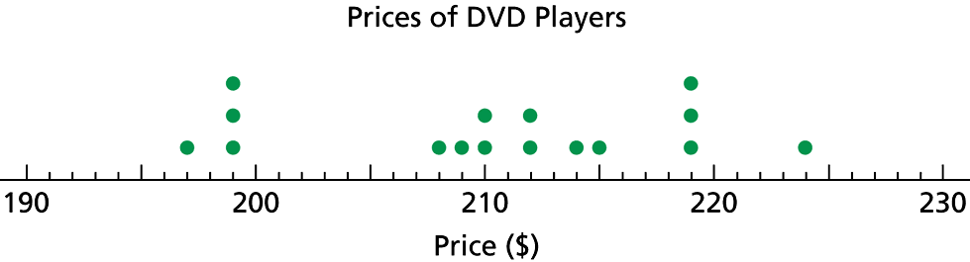
Dataplot
Quick and easy display of distribution.
Good for displaying small data sets.
Individual data values are preserved.
Construct a dotplot by drawing a horizontal axis and scale. Then record each data value by placing a dot over the appropriate value on the horizontal axis.

Slide 24
Describing Distributions numerically

Slide 25
Five-Number Symmary
Minimum value, Quartile 1 (Q1) (25th percentile), median, Quartile 3 (Q3) (75th percentile), maximum. In that order.
Boxplot is a visual display of the five-number summary.
Interquartile Range (IQR) – difference between the quartiles, IQR = Q3 – Q1. Used as a measure of spread.

Slide 26
Checking for Outliers
Values that are more than 1.5 times the IQR below Q1 or Q3 are outliers.
Calculate upper fence: Q3 + 1.5(IQR)
Calculate lower fence: Q1 – 1.5(IQR)
Any value outside the fences is an outlier.

Slide 27
Boxplot
A box goes from the Q1 to Q3.
A line is drawn inside the box at the median.
A line goes from the lower end of the box to the smallest observation that is not a potential outlier and from the upper end of the box to the largest observation that is not a potential outlier.
The potential outliers are shown separately.
Title and number line scale.

Slide 28
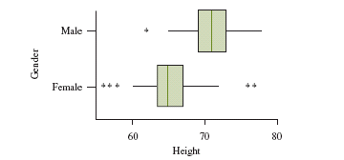
Side-by-Side Boxplot
Box Plots do not display the shape of the distribution as clearly as histograms, but are useful for making graphical comparisons of two or more distributions.
Allows us to see which distribution has the higher median, which has the greater IOR and which has the greater overall range.

Slide 29
Measures of Center
Mean:
Good measure of center when the shape of the distribution is approximately unimodal and symmetric.
Non-resistant.
Median: The middle of a ordered set of data.
Resistant.
Note: While the median and the mean are approximately equal for unimodal and symmetric distributions, there is more that we can do and say with the mean than with the median. The mean is important in inferential statistics.

Slide 30
Relationship Measures of Center
Left-Skewed
Symmetric
Right-Skewed
Mean
Median
Mode
Mean
=
Median
=
Mode
Mode
Median
Mean
Notes:
Shape
Concerned with extent to which values are symmetrically distributed.
Kurtosis
The extent to which a distribution is peaked (flatter or taller).
For example, a distribution could be more peaked than a normal distribution (still may be ‘bell-shaped). If values are negative, then distribution is less peaked than a normal distribution.
Skew
The extent to which a distribution is symmetric or has a tail. Values are 0 if normal distribution. If the values are negative, then negative or left-skewed.

Slide 31
Measures of Spread (Variation)
Standard Deviation:
The square root of the average of the deviations from the mean. Contains the mean, so is non-resistant.
The square root of the variance.
Used for unimodal, symmetric data.
Use when using the mean as the measure of center.
Will equal zero only if all data values are equal.
Interquartile Range (IQR): Q3 – Q1
Gives the spread of the middle 50%.
B/C it doesn’t use extreme values, it is resistant.
Used when outliers are present or with skewed data.
Use when using the median as the measure of center.
Range: Max. value – Min. value.
Single number and very sensitive to extreme values.
Supplementary piece of info, not a stand alone measure of spread.

Slide 32
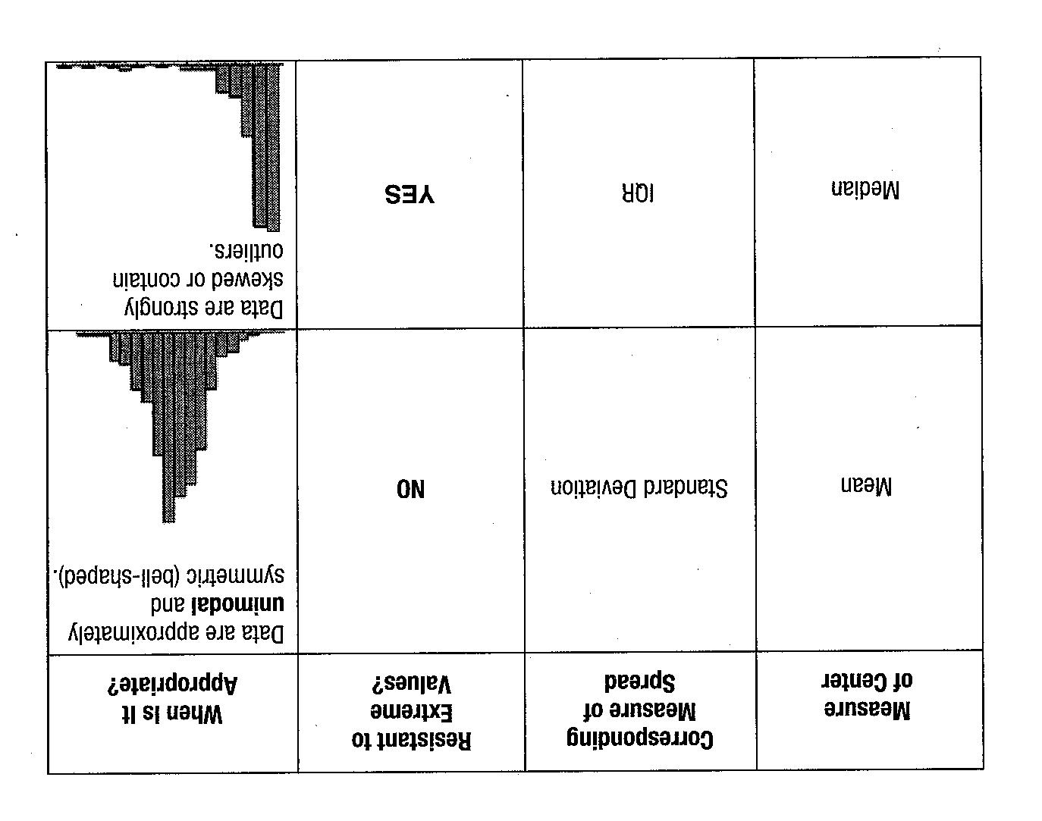
Summary

Slide 33
Standard Deviation as a Ruler: Z-scores
Z-score: Standardized value, using units of standard deviation.
Standardizing – shifts the data by subtracting the mean and rescales the values by dividing by the SD.
Adding (or subtracting) a constant to each value of a data set adds (or subtracts) the same constant to the mean or median. Measures of spread (SD and IQR) remain unchanged.
Multiplying (or dividing) a constant to each value of a data set changes both the measures of center (mean and median) and spread (SD and IQR). These measures are multiplied (or divided) by the same constant.

Slide 34
Normal Models
Distributions whose shapes are unimodal and roughly symmetric (bell-shaped).
Described by 2 parameters, mean and SD. Notation: N(μ, σ).
68-95-99.7 (Empirical) Rule: Thumb rule for normal distributions.
Standard Normal Distribution: N(0, 1).
2 types of problems.
Finding normal percentiles.
Finding a value given a proportion.
Assessing Normality
Picture – histogram, stem-and-leaf, boxplot, dotplot.
Normal Probability Plot on the graphing calculator.

Slide 35
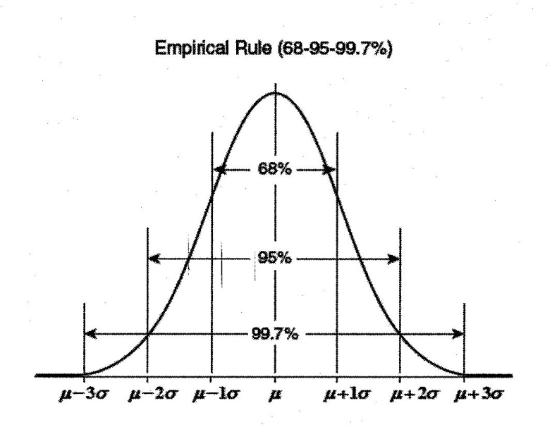

Slide 36
What You need to Know
Identify the individuals and variables in a set of data.
Classify, each variable as categorical or quantitative. Identify the units in which each quantitative variable is measured.
Answer the key questions-who, what, why, when, where, how, and by whom?-about a given set of data.
Make a bar graph of the distribution of a categorical variable. Interpret bar graphs.
Make a dotplot of the distribution of a quantitative variable. Describe what you see.
Make a histogram of the distribution of a quantitative variable.

Slide 37
What You need to Know
Construct and interpret an ogive of a set of quantitative data.
Make a stemplot of the distribution of a quantitative variable. Trim the numbers or split stems as needed to make an effective stemplot.
Look for the overall pattern and for major deviations from the pattern.
Assess from a dotplot, stemplot, or histogram whether the shape of a distribution is roughly symmetric, distinctly skewed, or neither. Assess whether the distribution has one or more major modes.

Slide 38
What You need to Know
Describe the overall pattern by giving numerical measures of center and spread in addition to a verbal description of shape.
Decide which measures of center and spread are more appropriate: the mean and standard deviation (especially for symmetric distributions) or the five-number summary (especially for skewed distributions).
Recognize outliers.
Make a time plot of data, with the time of each observation on the horizontal axis and the value of the observed variable on the vertical axis.
Recognize strong trends or other patterns in a time plot.

Slide 39
What You need to Know
Find the mean x of a set of observations.
Find the median M of a set of observations.
Understand that the median is more resistant (less affected by extreme observations) than the mean. Recognize that skewness in a distribution moves the mean away from the median toward the long tail.
Find the quartiles Q₁ and Q₃ for a set of observations.
Give the five-number summary and draw a boxplot; assess center, spread, symmetry, and skewness from a boxplot. Determine outliers.
Using a calculator or software, find the standard deviation s for a set of observations.

Slide 40

What You need to Know
Know the basic properties of s: s + always; s = 0 only when all observations are identical; s increases as the spread increases; s has the same units as the original measurements; s is increased by outliers or skewness.
Determine the effect of a linear transformation on measures of center and spread.
Describe a change in units of measurement in terms of a linear transformation of the form $x_{new}=a+bx$.
Use side-by-side bar graphs to compare distributions of categorical data.
Make back-to-back stemplots and side-by-side boxplots to compare distributions of quantitative variables.

Slide 41
What You need to Know
Write narrative comparisons of the shape, center, spread, and outliers for two or more quantitative distributions.
From a two-way table of counts, find the marginal distribution s of both variables by obtaining the row sums and column sums.
Describe the relationship between two categorical variables by computing and comparing percents. Often this involves comparing the conditional distributions of one variable for the different categories of the other variable. Construct bar graphs when appropriate.
Recognize Simpson's paradox and be able to explain it.

Slide 42
Practice Problems

Slide 43
#1
Given the first type of plot indicated in each pair, which of the second plots could not always be generated from it?
dot plot -> histogram
stem and leaf -> dot plot
dot plot -> box plot
histogram -> stem and leaf plot
All of these can always be generated

Slide 44
#2
If the largest value of a data set is doubled, which of the following is not true?
The mean increases
The standard deviation increases
The interquartile range increases
The range increases
The median remains unchanged

Slide 45
#3
If the test scores of a class of 30 students have a mean of 75.6 and the test scores of another class of 24 students have a mean of 68.4, then the mean of the combined group is
a. 72
b. 72.4
c. 72.8
d. 74.2
e. None of these

Slide 46
#4
If a distribution is relatively symmetric and bell-shaped, order (from least to greatest) the following positions:
1. a z-score of 1
2. the value of Q3
3. a value in the 70th percentile
a. 1, 2, 3
b. 1, 3, 2
c. 3, 2, 1
d. 3, 1, 2
e. 2, 3, 1

Slide 47
#5
If each value of a data set is increased by 10%, the effects on the mean and standard deviation can be summarized as
mean increases by 10%; st. dev remains unchanged
mean remains unchanged; st. dev increases by 10%
mean increases by 10%; st. dev increases by 10%
mean remains unchanged; st. dev remains unchanged
the effect depends on the type of distribution

Slide 48
#6
If all values in a data set are converted into standard scores (z-scores) then which of the following statements is not true?
Conversion to standard scores is not possible for some data sets.
The mean and st. dev of the transformed data are 0 and 1 respectively only for symmetric and bell-shaped distributions
The empirical rule applies consistently to both the original and transformed data sets.
The z-scores represent how many standard deviations each value is from the mean
All of these are true statements

Slide 49
#7
In skewed right distributions, what is most frequently the relationship of the mean, median, and mode?
mean > median > mode
median > mean > mode
mode > median > mean
mode > mean > median
mean > mode > median

Slide 50
#8
A random survey was conducted to determine the cost of residential gas heat. Analysis of the survey results indicated that the mean monthly cost of gas was $125, with a standard deviation of $10. If the distribution is approximately normal, what percent of homes will have a monthly bill of more than $115?
a. 34%
b. 50%
c. 68%
d. 84%
e. 97.5%

Slide 51
#9
The average life expectancy of males in a particular town is 75 years, with a standard deviation of 5 years. Assuming that the distribution is approximately normal, the approximate 15th percentile in the age distribution is: (Hint: percentile rank is “at or below” that value)
a. 60
b. 65
c. 70
d. 75
e. 80

Slide 52
Exploring Relationships between variables
Part II
Chapters 7 - 10

Slide 53
Scatterplots

Slide 54
Scatterplots
Used to display the relationship between two quantitative variables.
Explanatory or predictor variable on the x-axis.
Response variable (the variable you hope to predict or explain) on the y-axis.
When analyzing a scatterplot, you want to discuss:
Direction
Form
Strength

Slide 55
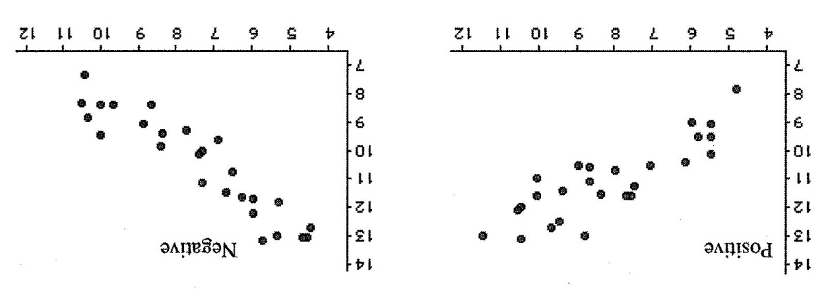
Direction

Slide 56
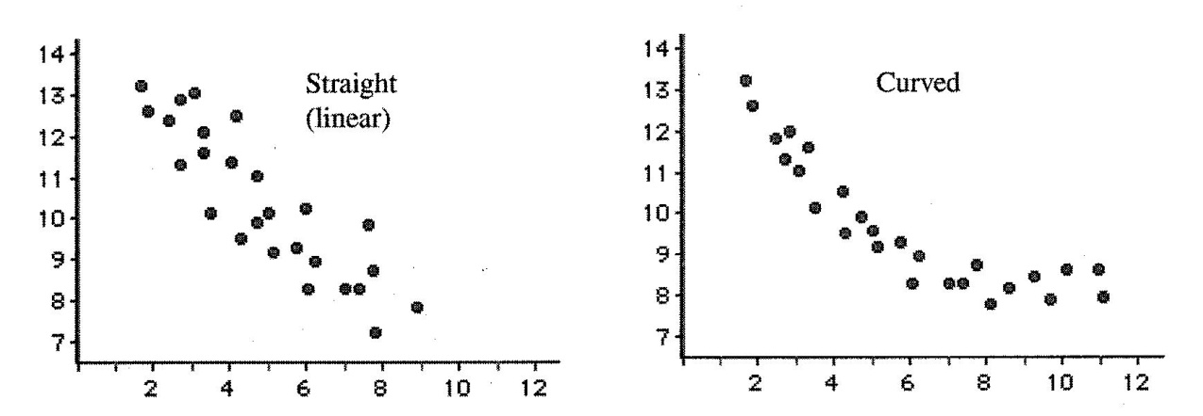
Form

Slide 57
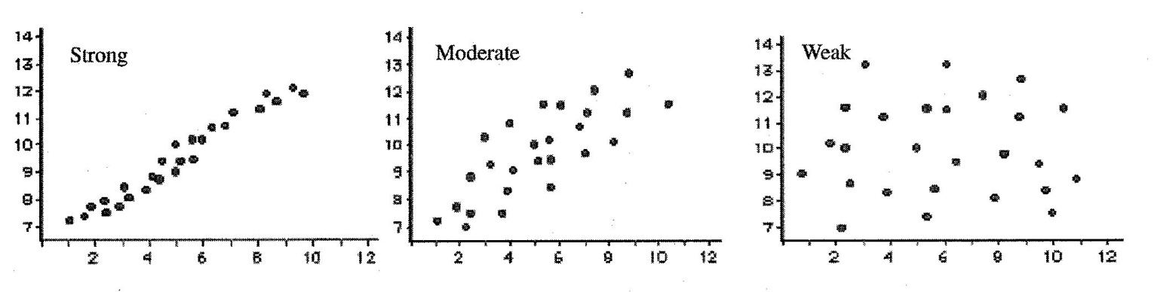
Strength
Association does not imply causation. The only way to assess causation is through a randomized, controlled experiment.

Slide 58
Correlation
Describes a linear relationship between two quantitative variables.
Direction (sign) and strength (value).
Correlation Coefficient (r):

Slide 59
Facts About the Correlation Coefficient (r)
Formula uses standardized observations, so it has no units.
Makes no distinction between explanatory and response variables – correlation (x, y) = correlation (y, x).
Correlation does require both variables be quantitative.
The sign of r indicates the direction of association.
-1≤r≤1: The magnitude of r reflects the strength of the linear association as viewed in a scatterplot. (0≤r<.25 no correlation, .25≤r<.5 weak correlation, .5≤r<.75 moderate correlation, .75≤r<1 strong correlation).
r measures only the strength of a linear relationship. It does not describe a curved relationship.
r is not resistant to outliers since it is calculated using the mean and SD.
r is not affected by changes in scale or center (uses standardized values).
A scatterplot or correlation alone cannot demonstrate causation.

Slide 60
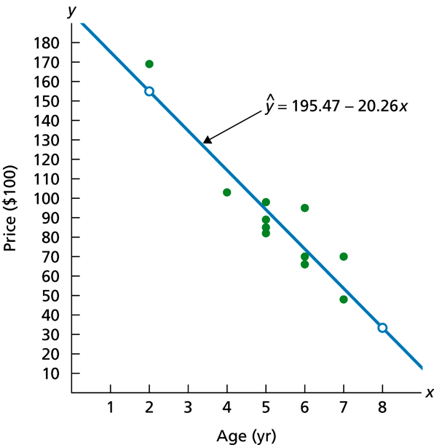
Least Squares Regression Line (LSRL)
LSRL is the line that minimizes the sum of the squared residuals.
It is a linear model of the form:

Slide 61
Facts About the LSRL
The slope is:
Every LSRL goes through the point . Substituting into the equation of the LSRL the y-intercept is:
R², the coefficient of determination, indicates how well the model fits the data.
R² gives the fraction of the variability of y that is explained or accounted for by the least squares linear regression line is in relating y to x.
Causation cannot be demonstrated by the coefficient of determination.
Residuals are what are left over after fitting the model. They are the difference between the observed values and the corresponding predicted values.
The sum of the residuals is always equal to zero.

Slide 62
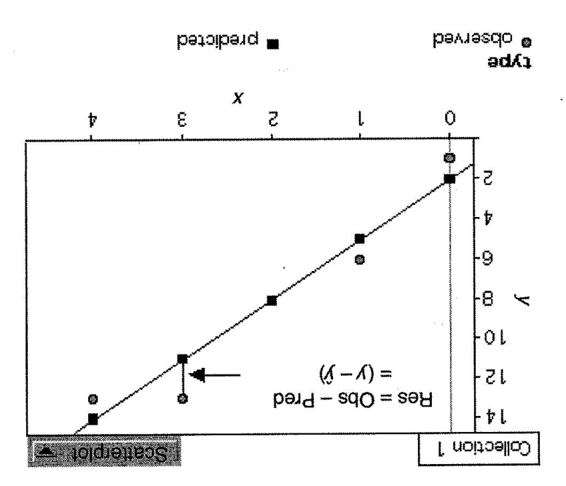
Residuals

Slide 63
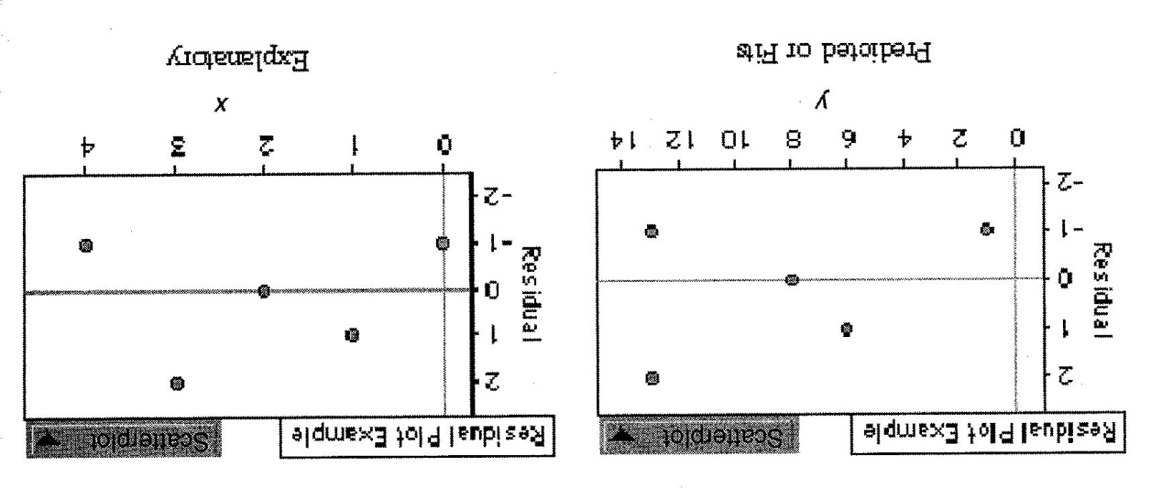
Residual Plot
The residual is the directed distance between the observed and predicted value.
A residual plot graphs these directed distances against either the explanatory or the predicted variable.
No regression analysis is complete without a residual plot to check that the model is reasonable.
A reasonable model is one whose residual plot shows no discernible pattern.
Any function is linear if plotted over a small enough interval. A residual plot will help you see patterns in the data that may not be apparent in the original graph.

Slide 64
Extrapolation
Making predictions for x-values that lie far from the data we used to build the regression model is highly dangerous. There are no guarantees that the pattern we see in the model will continue.

Slide 65
Outliers and Influential Points
Outliers can strongly influence regression.
Can have outliers in the x-value, the y-value, or from the overall pattern (x and y values).
A point has leverage and is called an influential point if its removal causes a dramatic change in the slope of the regression line.

Slide 66
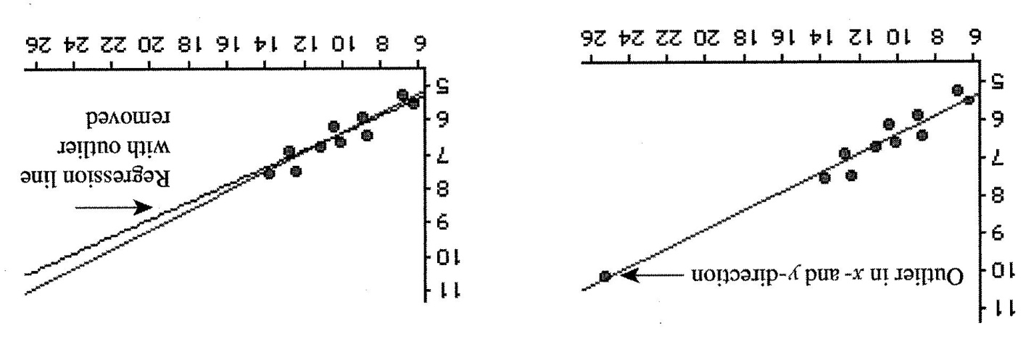
Outliers and Influential Points
The indicated outlier lies outside the overall pattern of the data, its removal has little effect on the slope of the regression line. It would not be considered an influential point.

Slide 67
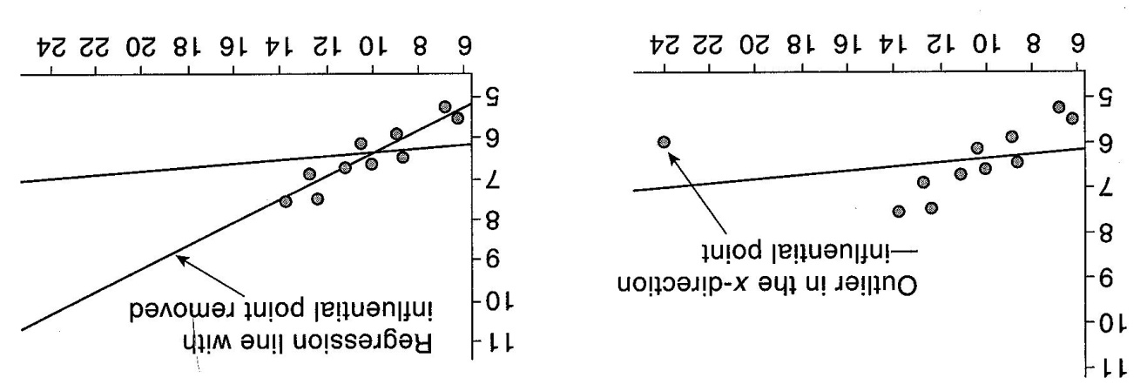
Outliers and Influential Points
The outlier in the x direction, if removed causes a dramatic change in the slope of the regression line. This point has leverage and is an influential point.

Slide 68
Creating and Using a LSRL
Conditions for regression.
Data follow a straight-line pattern.
No outliers.
Residual plot shows no obvious patterns.

Slide 69
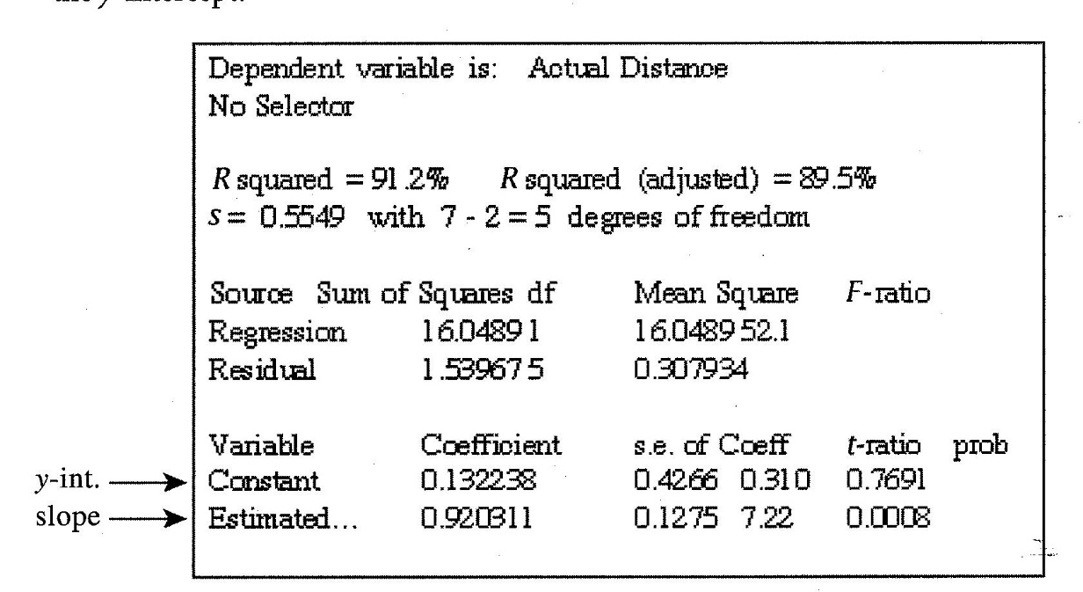
Computer Outputs
It is necessary to be able to read computer outputs to be successful on the AP exam.
There will be things on the printout that you might not be familiar with. Don’t worry about those values. Focus on finding the information you need to write the equation of the LSRL and describe the strength of the relationship.

Slide 70
Typical Questions Regarding the LSRL
State the equation of the LSRL. Define any variables used.
Interpret the slope and the y-intercept of the LSRL.
State and interpret the correlation coefficient.
State and interpret the coefficient of determination
Predict a response value using the LSRL.
Calculate a residual.

Slide 71
Re-expressing Data: Strengthening Relationships
Used to create a graph that is more linear.
The process is often one of trail and error.
Get a “feel” for a model, try it, then check the residual plot and the coefficient of determination for appropriateness of the model.

Slide 72
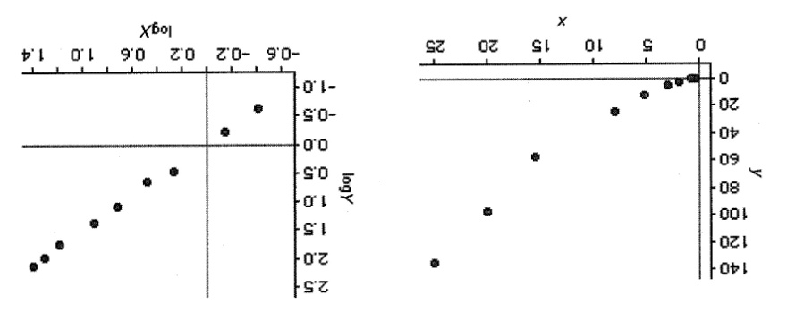
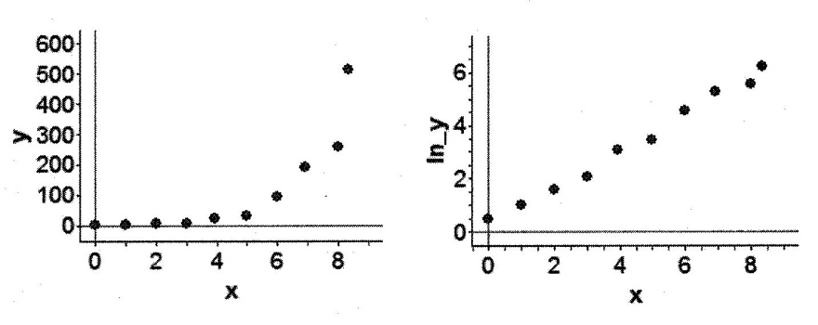
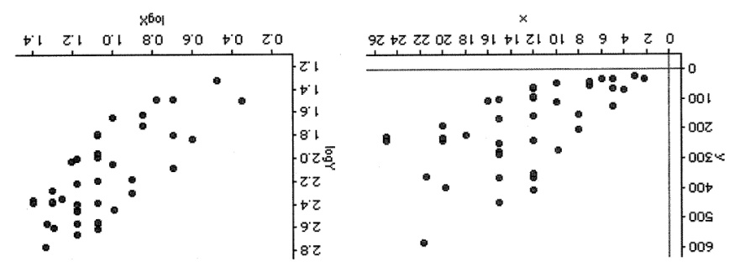
Why Re-express Data?
To make the form of a scatterplot more nearly linear. Take the log of the x or y or both.
To make a scatterplot have a more constant spread throughout rather than follow a fan shape. Take the log of both the x and y.

Slide 73
Why Re-express Data?
Correlation and regression are used only to describe linear relationships. Transformations provide us with a method for straightening curved data so that we can use the tools of linear regression to summarize and analyze curved data.
If the data changes direction (curve downward then upward or vice versa), it cannot be transformed to make it linear.

Slide 74
Using logarithms to Transformation Data
Remember, after making a transformation, reexamine a residual plot to check for the desired effect.
When you use transformed data to create a linear model, your regression equation is not in terms of (x, y) but in terms of the transformed variable.
After finding a LSRL on the transformed data, conduct an inverse transformation of the LSRL to obtain a model for the original data.

Slide 75
What You Need to Know
Recognize whether each variable is quantitative or categorical.
Identify the explanatory and response variables in situations where one variable explains or influences another.
Make a scatterplot to display the relationship between two quantitative variables. Place the explanatory variable (if any) on the horizontal scale of the plot.
Add a categorical variable to a scatterplot by using a different plotting symbol or color.

Slide 76
What You Need to Know
Describe the direction, form, and strength of the overall pattern of a scatterplot. In particular, recognize positive or negative association and linear (straight-line) patterns. Recognize outliers in a scatterplot.
Using a calculator, find the correlation r between two quantitative variables.
Know the basic properties of correlation: r measures the strength and direction of linear relationships only; -1 ≤ r ≤ 1 always; r = ± 1 only for perfect straight-line relations; r moves away from O toward ± 1 as the linear relation gets stronger.

Slide 77
What You Need to Know
Explain what the slope b and the y intercept a mean in the equation y = a + bx of a regression line.
Using a calculator, find the least-squares regression line for predicting values of a response variable y from an explanatory variable x from data.
Find the slope and intercept of the least-squares regression line from the means and standard deviations of x and y and their correlation .
Use the regression line to predict y for a given x. Recognize extrapolation and be aware of its dangers.

Slide 78
What You Need to Know
Calculate the residuals and plot them against the explanatory variable x or against other variables. Recognize unusual patterns.
Use r 2 to describe how much of the variation in one variable can be accounted for by a straight-line relationship with another variable.
Recognize outliers and potentially influential observations from a scatterplot with the regression line drawn on it.
Understand that both r and the least-squares regression line can be strongly influenced by a few extreme observations.

Slide 79
What You Need to Know
Recognize possible lurking variables that may explain the correlation between two variables x and y.
Use powers to transform nonlinear data to achieve linearity. Then fit a linear model to the transformed data.
Recognize that, when a variable is multiplied by a fixed number in each equal time period, exponential growth results and that, when one variable is proportional to a power of a second variable, a power law model results.
In the case of both exponential growth and power functions, perform a logarithmic transformation and obtain points that lie in a linear pat­ tern. Then use least-squares regression on the transformed data. Carry out an inverse transformation to produce a curve that models the original data.

Slide 80
What You Need to Know
Know that deviations from the overall pattern are most easily examined by fitting a line to the transformed points and plotting the residuals from this line against the explanatory variable (or fitted values).
Recognize possible lurking variables that may help explain the observed association between two variables x and y.
Determine whether the relationship between two variables is most likely due to causation, common response, or confounding.
Understand that even a strong association does not mean that there is a cause-and-effect relationship between x and y.

Slide 81
Practice Problems

Slide 82
#1
Given a set of ordered pairs (x, y) so that s_{x}=1.6, s_{y}=0.75, and r=0.55, what is the slope of the LSRL?
a) 1.82
b) 1.17
c) 2.18
d) 0.26
e) 0.78

Slide 83
#2
A study found a correlation of r=-0.58 between hours spent watching television and hours per week spent exercising. Which of the following statements is most accurate?
a) About 1/3 of the variation in hours spent exercising can be explained by hours spent watching TV.
b) A person who watches less television will exercise more.
c) For each hour spent watching television, the predicted decrease in hours spent exercising is 0.58 hours.
d) There is a cause and effect relationship between hours spent watching TV and a decline in hours spent exercising.
e) 58% of the hours spent exercising can be explained by the number of hours watching TV.

Slide 84
#3
There is an approximate linear relationship between the height of females and their age (from 5 to 18 years) described by: height = 50.3 + 6.01(age) where height is measured in cm and age in years. Which of the following is not correct?
a) The estimated slope is 6.01 which implies that children increase by about 6 cm for each year they grow older.
b) The estimated height of a child who is 10 years old is about 110 cm.
c) The estimated intercept is 50.3 cm which implies that children reach this height when they are 50.3/6.01=8.4 years old.
d) The average height of children when they are 5 years old is about 50% of the average height when they are 18 years old.
e) My niece is about 8 years old and is about 115 cm tall. She is taller than average.

Slide 85
#4
A correlation between college entrance exam grades and scholastic achievement was found to be -1.08. On the basis of this you would tell the university that:
a. the entrance exam is a good predictor of success.
b. they should hire a new statistician.
c. the exam is a poor predictor of success.
d. students who do best on this exam will make the worst students.
e. students at this school are underachieving.

Slide 86
#5
Under a "scatter diagram" there is a notation that the coefficient of correlation is .10. What does this mean?
a. plus and minus 10% from the means includes about 68% of the cases
b. one-tenth of the variance of one variable is shared with the other variable
c. one-tenth of one variable is caused by the other variable
d. on a scale from -1 to +1, the degree of linear relationship between the two variables is +.10

Slide 87
#6
The correlation coefficient for X and Y is known to be zero. We then can conclude that:
a. X and Y have standard distributions
b. the variances of X and Y are equal
c. there exists no relationship between X and Y
d. there exists no linear relationship between X and Y
e. none of these

Slide 88
#7
Suppose the correlation coefficient between height as measured in feet versus weight as measured in pounds is 0.40. What is the correlation coefficient of height measured in inches versus weight measured in ounces? [12 inches = one foot; 16 ounces = one pound]
a. .4
b. .3
c. .533
d. cannot be determined from information given
e. none of these

Slide 89
#8
A coefficient of correlation of -.80
a. is lower than r=+.80
b. is the same degree of relationship as r=+.80
c. is higher than r=+.80
d. no comparison can be made between r=-.80 and r=+.80

Slide 90
#9
A random sample of 35 world-ranked chess players provides the following:
Hours of study: avg=6.2, s=1.3
Winnings: avg=$208,000, s=42,000
Correlation=0.15
Find the equation of the LSRL.
a. Winnings=178,000+4850(Hours)
b. Winnings=169,000+6300(Hours)
c. Winnings=14,550+31,200(Hours)
d. Winnings=7750+32,300(Hours)
e. Winnings=-52,400+42,000(Hours)

Slide 91
Gathering Data
Part III:
Chapters 11 - 13

Slide 92
Understanding Randomness

Slide 93
Random Outcomes
A random event is one whose outcome we cannot predict.
This may suggest that random events are totally chaotic and therefore not useful in modeling real-world situations – not so.
Although the outcomes of individual trials of a random event are unknown, over the long run there is a pattern.
It is this long-run predictability that makes randomess a useful tool in reaching conclusions.

Slide 94
Simulation
Is a powerful tool for gaining insight into events whose outcomes are random.
Preforming a Simulation
Identify the event to be repeated.
Outcomes, state how you will model the random occurrence of an outcome (assign digits to outcomes).
Trial, explain how you will simulate a trial and what the response variable is.
Run several trials and tabulate the results.
Conclusion, summarize your results and draw your conclusion in the context of the problem.

Slide 95
Example
Your school decided to hold a raffle to defray the cost of tickets to the senior prom. The breakdown of ticket sales was; Students: 650 and Faculty: 325. At an assembly, the principal reached into a jar and drew three winning tickets. To everyone’s dismay, all three winners were members of the faculty. The students cried foul. Their argument was that, given the breakdown of sales between the two groups, it would be highly unlikely for all three winners to be faculty members.
Conduct a simulation, using 10 trials and starting on line 130 of the random digit table, to determine if the outcome of the drawing was fair.

Slide 96
Solution
ID event being repeated – selecting a ticket from the jar.
Outcomes
000 – 649 student ticket
650 – 974 faculty ticket
975 – 999 skip
If a number appears more than once in a trial it is ignored. Can’t select the same ticket twice.

Slide 97
Solution
Trial | Outcomes | All Faculty
1 | FSS | no
2 | FSS | no
3 | SSS | no
4 | SFS | no
5 | FSS | no
6 | SSS | no
7 | SFS | no
8 | SSS | no
9 | FFF | no
10 | SSF | no
Trial
Select 3 tickets and determine if student or faculty.
Response variable – whether are not all 3 tickets drawn belong to a member of the faculty or not (yes/no).
Conclusion: In our simulation all 3 winners were faculty members only 10% of the time. While this result is unlikely, we might suspicious, but would need to run many more trials and a smaller percent of all faculty winners before we make an accusation of unfairness.

Slide 98
Sample Surveys

Slide 99
Producing Data
To draw meaningful conclusions from measured or observed data, it is essential that we understand proper data-collection methods.
Bad sample designs yield worthless data.
There is no way to correct for a bad sample.

Slide 100
Basic Concepts of Sampling
Population – the entire group of individuals whom we hope to learn about. The population is determined by what we want to know.
Sample – a smaller group of individuals selected from the population. The sample size is determined by what is practical and representative of the population we are interested in learning about.

Slide 101
Terminology of Sampling
Sampling Frame – a list of individuals from the population of interest from which the sample is drawn.
Census – a sample that consists of the entire population.
Sampling Variability – the natural tendency of randomly drawn samples to differ, one from the another. Sampling variability is not an error, just the natural result of random sampling. Although samples vary, they do not vary haphazardly but rather according to the laws of probability.

Slide 102
Parameters and Statistics
Parameter:
A number that characterizes some aspect of the population such as the mean or standard deviation of some variable of the population.
We rarely know the true value of a population parameter.
Denote with Greek letters.
Statistic:
Values calculated from sample data.
Use statistics to estimate values in the population (parameters).
Denote statistics with standard letters.

Slide 103
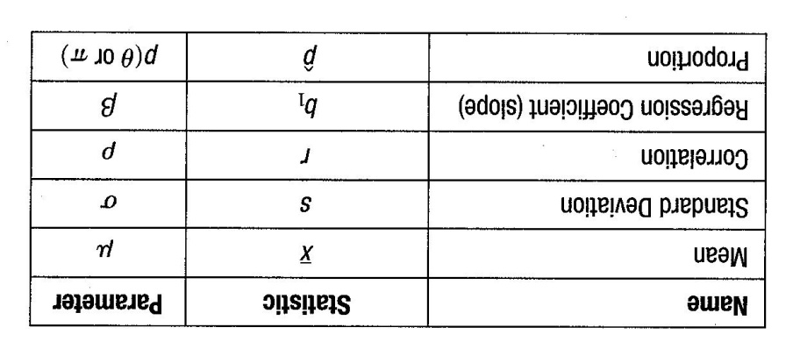
Parameters and Statistics

Slide 104
Sample Size
The number of individuals selected from our sampling frame.
The size of the population does not dictate the size of a sample.
The general rule is that the sample size should be no more than 10% of the population size (10n<N).

Slide 105
Sample Designs
The method used to choose the sample.
Incorporate the idea that chance, rather choice, is used to select the sample.
Probability Sample – chosen using a random mechanism in such a way that each individual or group of individuals has the same chance of being selected.
Random Sample – chosen using a random mechanism in such a way that the probability of each sample being selected can be computed.
May be drawn with or without replacements.

Slide 106
Sample Designs (cont.)
Simple Random Sample (SRS) – a random sample chosen without replacement and meets the following rules for a SRS of size n;
Each individual has an equal chance of selection.
Each possible set of n individuals has an equal chance of selection.
Stratified Random Sampling – divides the population into homogeneous groups called strata.
Strata are made up of individuals similar in a way that may effect the response variable.
SRS is applied within each stratum before the results are combined.

Slide 107
Sample Designs (cont.)
Cluster Sample – when the population exists in readily defined heterogeneous groups or clusters, a cluster sample is an SRS of the clusters.
This method of sampling uses the data from all of the individuals from the selected clusters.
Often used to reduce the cost of obtaining a sample.

Slide 108
Sample Designs (cont.)
Systematic Sample – selected according to a predetermined scheme.
Can be random if the starting point of the scheme is randomly selected.
Can never produce a SRS because each sample of size n does not have an equal chance of being chosen.
Often used to simplify the sampling process.
When the order of the list is not associated with the responses sought, this method gives a representative sample.

Slide 109
Sample Designs (cont.)
Multistage Sampling – produces a final sample in stages, taking each sample from the one before it.
May combine several methods of sampling.
Can be random but will not produce a SRS.
Convenience Sample – obtained exactly as its name suggests, by sampling individuals who are conveniently available.
Unlikely to represent the population of interest because it is unlikely that every member of this population is conveniently available.
Are not probability samples nor are they random.
May lead to bias.

Slide 110
Bias
Bias is any systematic failure of a sample to represent its population of interest.
Very important to reduce bias.
Best defense against bias is randomization.
There is no way to recover from a biased sample.
Remember, you can reduce bias, but you can never completely eliminate it

Slide 111
Sources of Bias
Undercoverage Bias – excluding or underrepresenting some part of the population.
Response Bias – anything that influences responses.
Examples; question bias and interviewer bias.
Nonresponse Bias – occurs when individuals selected for the sample fail to respond, cannot be contacted, or decline to participate.
Voluntary Response Bias – when choice rather than randomization is used to obtain a sample.
People with strong opinions tend to be overrepresented.

Slide 112
Design of Experiments

Slide 113
Observational Study
Researchers observe individuals and record variables of interest but do not impose a treatment.
It is not possible to prove a cause-and-effect relationship with an observational study.

Slide 114
Experiment
An experiment differs from an observational study in that the researcher deliberately imposes a treatment.
An experiment must have at least one explanatory variable to manipulate and at least one response variable to measure.
In an experiment, it is possible to determine a cause-and-effect relationship between the explanatory and respons variables.

Slide 115
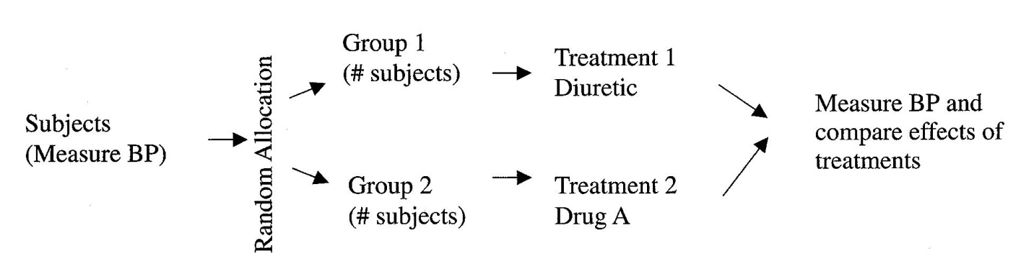
Completely Randomized Experiment
Subjects are randomly assigned to a treatment group.
The researcher then compares the subject groups’ responses to each treatment.
It is not necessary to start with a random selection of subjects.
The randomization occurs in the random assignment to treatment groups.

Slide 116
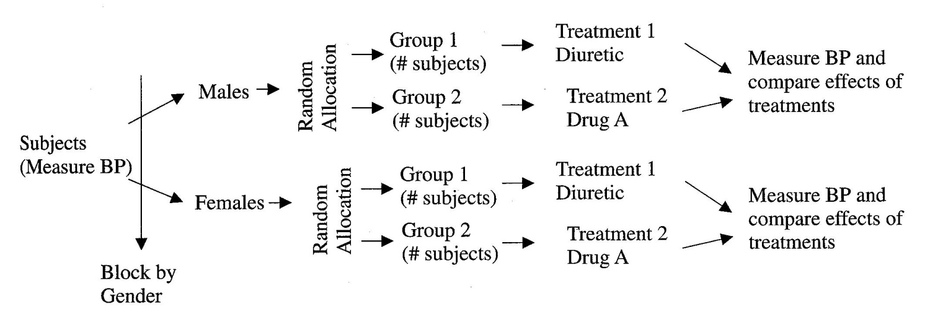
Block Design
If our experimental units differ in some characteristic that may affect the results of our experiment, we should separate the groups into blocks based on that characteristic and then randomly assign the subjects within each block.
In effect, we are conducting parallel experiments.
Blocks reduce variability so that the effects of the treatments can be seen.
Blocks themselves are not treatments.
Blocking is to experimental design as stratifying is to sampling design.

Slide 117
Matched-Pairs Design
Is a form of block design.
Two types:
One Subject: Uses just one subject, who receives both treatments. The order in which the subject receives the treatments is randomized.
Two Subjects: Two subjects are paired based on common characteristics that might affect the response variable. One subject from each pair is randomly assigned to each of the treatments. The response variable is then the difference in the response to the two treatments for each pair.

Slide 118
Four Principles of Experimental Design
Control – Reduces variability by controlling the sources of variation.
Comparison is an important form of control.
Every experiment must have at least two groups so that the effect of a new treatment can be compared with either the effect of a traditional treatment or the effect of no treatment at all.
The control group is the group given the traditional treatment, no treatment, or a placebo (a treatment known to have no effect).

Slide 119
Four Principles of Experimental Design (cont.)
Randomize – randomization to treatment groups reduces bias by equalizing the effects of lurking variables.
Lurking Variables are variables that we did not think to measure but can affect the response variable.
Does not eliminate unknown or uncontrollable sources of variation but spreads them out across the treatment levels and makes it easier to detect differences caused by the treatments.

Slide 120
Four Principles of Experimental Design (cont.)
Replicate – One or two subjects do not constitute an experiment. We should include many subjects in a comparative experiment. Experiments should be design in such a way that other researchers can replicate our results.
Block – Although blocking is not required in an experimental design, it may improve the design. If the experimental units are different in some way that may affect the results of the experiment, the groups should be separated into blocks based on that characteristic.

Slide 121
Other Considerations in the Design of Experiments
Blinding
Single-Blind: The subjects of the experiment do not know which treatment group they have been assigned or those who evaluate the results of the experiment do not know how the subjects have been assigned to the groups.
Double-Blind: Neither the subjects nor the evaluators know how the subjects have been allocated to treatment groups.
Confounding – An experiment is said to be confounded if we cannot separate the effect of a treatment (explanatory variable) from the effects of other influences (confounding variables) on the response variable.

Slide 122
Other Considerations in the Design of Experiments (cont.)
Statistical Significance – When an observed difference is too large for us to believe that it is likely to have occurred by chance alone, we consider the difference to be statistically significant.
Placebo Effect – The tendency in humans to show a response whenever they think a treatment is in effect.
Well designed experiments use a control group so that the placebo effect operates equally on both the treatment group and the control group, thus allowing us to attribute changes in the response variable to the explanatory variable.

Slide 123
What You need to Know
Identify the population in a sampling situation.
Recognize bias due to voluntary response sampling and other inferior sampling methods.
Select a simple random sample (SRS) from a population.
Recognize cluster sampling and how it differs from other sampling methods.
Recognize the presence of undercoverage and nonresponse as sources of error in a sample survey. Recognize the effect of the wording of questions on the response.
Use random digits to select a stratified random sample from a population when the strata are identified.

Slide 124
What You need to Know
Recognize whether a study is an observational study or an experiment.
Recognize bias clue to confounding of explanatory variables with lurking variables in either an observational study or an experiment.
Identify the factors (explanatory variables), treatments, response variables, and experimental units or subjects in an experiment.
Outline the design of a completely randomized experiment using a diagram. The diagram in a specific case should show the sizes of the groups, the specific treatments, and the response variable(s).

Slide 125
What You need to Know
Carry out the random assignment of subjects to groups in a completely randomized experiment.
Recognize the placebo effect. Recognize when the double-blind technique should be used.
Recognize a block design and when it would be appropriate. Know when a matched pairs design would be appropriate and how to design a matched pairs experiment.
Explain why a randomized comparative experiment can give good evidence for cause-and-effect relationships.

Slide 126
What You need to Know
Recognize that many random phenomena can be investigated by means of a carefully designed simulation.
Use the following steps to construct and run a simulation:
State the problem or describe the random phenomenon.
State the assumptions.
Assign digits to represent outcomes.
Simulate many repetitions.
Calculate relative frequencies and state your conclusions.

Slide 127
What You need to Know
Use a random number table, the TI-84, or a computer, or a spreadsheet to conduct simulations.
Use simulation methods and the law of large numbers to approximate the mean of a distribution.

Slide 128
Practice Problems

Slide 129
#1
In one study on the effect of niacin on cholesterol level, 100 subjects who acknowledged being long-time niacin takers had their cholesterol levels compared with those of 100 people who had never taken niacin. In a second study, 50 subjects were randomly chosen to receive niacin and 50 were chosen to receive a placebo.
a) The first study was a controlled experiment, while the second was an observational study.
b) The first study was an observational study, while the second was a controlled experiment.
c) Both studies were controlled experiments
d) Both studies were observational studies.

Slide 130
#2
Each of the 29 NBA teams has 12 players. A sample of 58 players is to be chosen as follows. Each team will be asked to place 12 cards with their players names into a hat and randomly draw out two names. The two names from each team will be combined to make up the sample. Will this method result in a SRS of the players?
a) Yes, because each player has the same chance of being selected.
b) Yes, because each team is equally represented.
c) Yes, because this is an example of stratified sampling, which is a special case of SRS.
d) No, because the teams are not chosen randomly.
e) No, because not each group of players has the same chance of being selected.

Slide 131
#3
A consumer product agency tests miles per gallon for a sample of automobiles using each of four different octane of gasoline. Which of the following is true?
a) There are four explanatory variables and one response variable.
b) There is one explanatory variable with four levels of response.
c) Miles per gallon is the only explanatory variable, but there are four response variables
d) There are four levels of a single explanatory variable.
e) Each explanatory level has an associated level of response.

Slide 132
#4
Your company has developed a new treatment for acne. You think men and women might react differently to the medication, so you separate them into two groups. Then the men are randomly assigned into two groups and the women are randomly assigned into two groups. One of the two groups is given the medicine, the other is given a placebo. The basic design of this study is:
a) completely randomized
b) randomized block, blocked by gender
c) completely randomized, stratified by gender
d) randomized block, blocked by gender and type of medication.
e) a matched pairs design

Slide 133
#5
A double-blind design is important in an experiment because:
a) There is a natural tendency for subjects in an experiment to want to please the researcher.
b) It helps control for the placebo effect.
c) Evaluators of the responses in a study can influence the outcomes if they know which treatment the subject received.
d) Subjects in a study might react different if they knew which treatment they were receiving.
e) All of the above reasons are valid.

Slide 134
#6
A school committee member is lobbying for an increase in the gasoline tax to support the county school system. The local newspaper conducted a survey of country residents to assess their support for such an increase. What is the population of interest here?
a) All school-aged children.
b) All county residents
c) All county residents with school-aged children
d) All county residents with children in the school system.
e) All county school system teachers.

Slide 135
#7
An experiment was designed to test the effect of 3 different types of paints on the durability of wooden toys. Since boys and girls tend to play differently with toys, a randomly selected group of children was divided into 2 groups by gender. Which of the following statements about this experiment is true.
a) Type of paint is a blocking factor
b) Gender is a blocking factor
c) This is a completely randomized design
d) This is a matched-pairs design in which one boy and one girl are matched to form a pair

Slide 136
#8
Which of the following is not a source of bias in a survey?
a) non-response
b) wording of the question
c) voluntary response
d) use of a telephone survey
e) all are sources of bias

Slide 137
#9
Which of the following is not a valid sampling design
a) Number every member of the population and select 100 randomly chosen members
b) Divide a population by gender and select 50 individuals randomly from each group
c) Select every 20th person, starting at a random point.
d) Select five homerooms at random from all the homerooms in a large high school
e) All of these are valid.

Slide 138
Randomness and Probability
Part IV:
Chapters 14 - 17

Slide 139
probability

Slide 140
Probability
The probability of an event is its long-run relative frequency.

Slide 141
Vocabulary
Trial – a single attempt or realization of a random phenomenon.
Outcome – is the value measured, observed, or reported for each trial.
Sample Space – the set of all possible outcomes.
Event – a collection of outcomes. Usually designated by capital letters.
Independence – Two events are independent if the occurrence of one event does not alter the probability that the other event occurs.

Slide 142
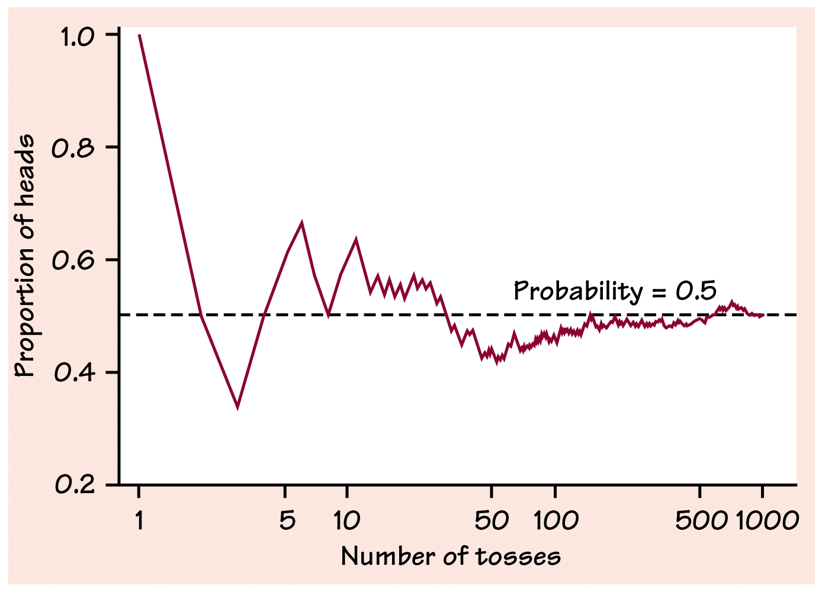
Vocabulary
Law of Large Numbers – The long-run relative frequency of repeated independent events gets closer and closer to the true relative frequency as the number of trials increases.

Slide 143
Probability Rules
The probability of an event is a number from 0 to 1 that reports the likelihood of the event’s occurrence. 0≤P(A)≤1
Theoretical Probability of an Event A (when all possible outcomes are equally likely):
Empirical (Experimental) Probability of an Event A:
An experimental probability arrived at by simulation will probably not be exactly equal to the corresponding theoretical value, but it should approach this value in the long run.

Slide 144
Probability Rules (cont.)
The probability of the set of all possible outcomes of a trial (sample space) must equal 1. P(S)=1
The Complement of an Event A: (A^{c}, A’) is the set of all possible outcomes that are not in event A.
The probability of the complement of an event is 1 minus the probability that the event occurs. P(A^{c})=1-P(A)

Slide 145
Probability Rules (cont.)
Addition Rule for Disjoint (Mutually Exclusive) Events: Two events, A and B, are disjoint if they cannot occur together. The probability that one or the other or both occur is the sum of the probabilities of the two events. P(A or B)=P(A⋃B)=P(A)+P(B)
General Addition Rule: P(A or B)=P(A⋃B)=P(A)+P(B)-P(A⋂B)

Slide 146
Probability Rules (cont.)
Multiplication Rule for Independent Events: For two independent events A and B, the probability that both A and B occur is the product of the two probabilities. P(A and B)=P(A⋂B)=P(A)⤫P(B)
Conditional Probability and the General Multiplication Rule: When the events are not independent.
Conditional Probability: When the probability of the second event is conditioned upon the first event having occurred. Notation P(B|A)

Slide 147
Probability Rules (cont.)
General Multiplication Rule: The probability that events A and B both occur is the probability that A occurs times the probability that B occurs given that A has already occurred. P(A and B)=P(AB)=P(A)⤫P(B|A)
Formal Definition of Independence: Two events are independent if the outcome of one event does not influence the probability of the other. P(B|A)=P(B)
Disjoint events cannot be independent.

Slide 148
Random variables

Slide 149
Random Variables
A random variable assumes any of several different values as a result of some random event.
Random variables are denoted by capital letters such as X, and the values that the random variable can take on are denoted by the same lowercase variable (x₁, x₂,…).
All possible values that the random variable can assume, with their associated probabilities, form the probability distribution for the random variable.

Slide 150
Types of Random Variables
Continuous Random Variable – Is a random variable that can take on any numeric value within a range of values.
The probability distribution of a continuous random variable is described by a density curve (mathematical model).
The probability of any given event is the area under the curve over the values of x that make up the event.
A density curve lies above the x-axis and has an area beneath it of 1.
Discrete Random Variable – is a random variable that can take on a finite number of distinct outcomes.

Slide 151
Discrete Random Variable
Expected Value – The theoretical long-run average of a random value, a weighted average. μ=E(X)=ΣxP(X)
Standard Deviation –
When calculating the expected winnings for a game of chance, don’t forget to take into account the cost to play the game.

Slide 152
Operations on Random Variables
Let X be a random variable with mean μ_{x} and variance σ²_{x} and let Y be a new random variable such that Y=a±bx. The mean (expected value) and variance of this new random variable are given by the following.

Slide 153
More About Means and Variances
The mean of the sum of two random variables is the sum of the means of the random variables.
The mean of the difference of two random variables is the difference of the means of the two random variables.
μ_{X±Y}=E(X±Y)=E(X)±E(Y)
If the random variables are independent, the variance of their sum or difference is always the sum of the variances.
σ²_{X±Y}=Var(X±Y)=Var(X)+Var(Y)
Variances of independent variables add; Standard Deviations DO NOT ADD!

Slide 154
Probability models

Slide 155
Geometric Model
Each observation falls into one of two settings: success or failure.
The probability of success, p, is the same for each observation.
The observations are independent.
The variable of interest is the number of trials required to obtain the first success.

Slide 156
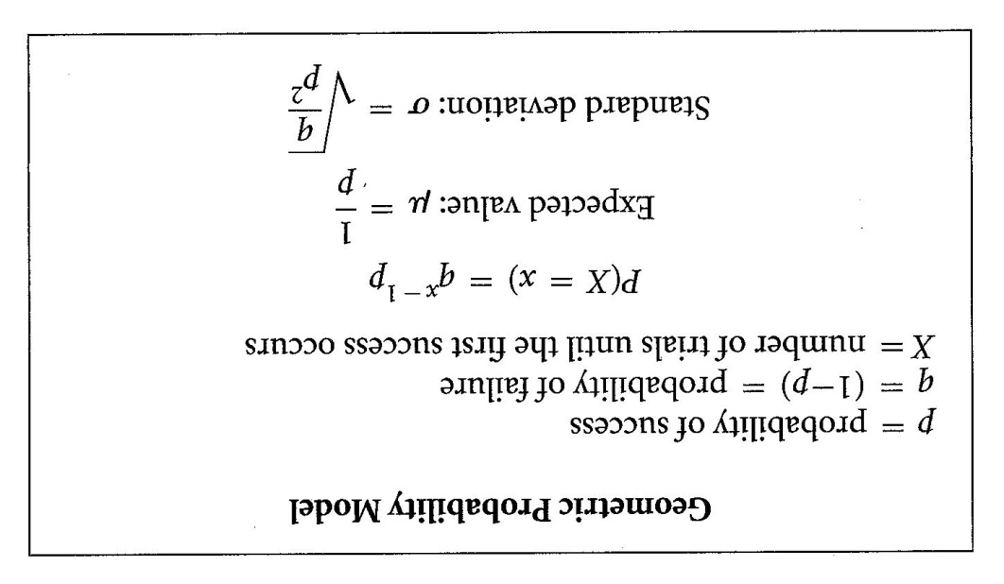
Geometric Model

Slide 157
Binomial Model
Each observation falls into one of two settings: success or failure.
There is a fixed number n of observations.
The n observations are all independent.
The probability of success, p, is the same for each observation.

Slide 158
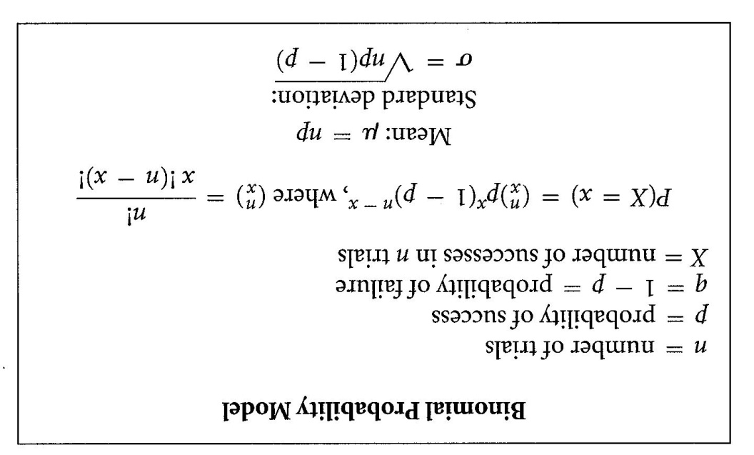
Binomial Model

Slide 159
Geometric vs. Binomial Models
The difference in conditions between the binomial and geometric models is in the number of trials.
The binomial requires a fixed number of trials to be set in advance.
The geometric has no fixed number of trials and is often used to model wait-time.
In other words, we continue conducting trials until we get our first success.

Slide 160
Normal Model as an Approximation to the Binomial
The Normal distribution can be used as an approximation for the binomial distribution provided that the number of successes and failures is at least ten (np≥10 and nq≥10).
It is convenient to use this method of approximation when the number of trials is large and beyond the ability of the calculator to compute probabilities.

Slide 161
What You need to Know
Describe the sample space of a random phenomenon. For a finite number of outcomes, use the multiplication principle to determine the number of outcomes, and use counting techniques, Venn diagrams, and tree diagrams to determine simple probabilities. For the continuous case, use geometric areas to find probabilities (areas under simple density curves) of events (intervals on the horizontal axis).
Know the probability rules and be able to apply them to determine probabilities of defined events. In particular, determine if a given assignment of probabilities is valid.

Slide 162
What You need to Know
Determine if two events are disjoint, complementary, or independent. Find unions and intersections of two or more events.
Use Venn diagrams to picture relationships among several events.
Use the general addition rule to find probabilities that involve intersecting events.
Understand the idea of independence. Judge when it is reasonable to assume independence as part of a probability model.
Use the multiplication rule for independent events to find the probability that all of several independent events occur.

Slide 163
What You need to Know
Use the multiplication rule for independent events in combination with other probability rules to find the probabilities of complex events.
Understand the idea of conditional probability. Find conditional probabilities for individuals chosen at random from a table of counts of possible outcomes.
Use the general multiplication rule to find the joint probability P(A ⋂ B) from P(A) and the conditional probability P(B I A) .
Construct tree diagrams to organize the use of the multiplication and addition rules to solve problems with several stages.

Slide 164
What You need to Know
Recognize and define a discrete random variable, and construct a probability distribution table and a probability histogram for the random variable.
Recognize and define a continuous random variable, and determine probabilities of events as areas under density curves.
Given a Normal random variable, use the standard Normal table or a graphing calculator to find probabilities of events as areas under the standard Normal distribution curve.
Calculate the mean and variance of a discrete random variable. Find the expected payout in a raffle or similar game of chance.

Slide 165
What You need to Know
Use rules for means and rules for variances to solve problems involving sums, differences, and linear combinations of random variables.
Identify a random variable as binomial by verifying four conditions: two out­ comes (success and failure); fixed number of trials; independent trials; and the same probability of success for each trial.
Use technology or the formula to determine binomial probabilities and to construct probability distribution tables and histograms.
Calculate cumulative distribution functions for binomial random variables, and construct cumulative distribution tables and histograms.

Slide 166
What You need to Know
Calculate means (expected values) and standard deviations of binomial random variables.
Use a Normal approximation to the binomial distribution to compute probabilities.
Identify a random variable as geometric by verifying four conditions: two out­ comes (success and failure); independent trials; the same probability of success for each trial; and the count of interest is the number of trials required to get the first success.
Use formulas or technology to determine geometric probabilities and to construct probability distribution tables and histograms.

Slide 167
What You need to Know
Calculate cumulative distribution functions for geometric random variables, and construct cumulative distribution tables and histograms.
Calculate expected values and standard deviations of geometric random variables.

Slide 168
Practice Problems

Slide 169
#1
If P(A) = 0.5, P(B) = 0.6, and P(A ∩ B) = 0.3, then P(A ∪ B) is
0.8
0.5
0.6
0

Slide 170
#2
If P(A) = 0.5, P(B) = 0.4, and P(B|A) = 0.3, then P(A ∩ B) is
0.75
0.6
0.12
0.15

Slide 171
#3
If A and B are mutually excusive events and P(A) = 0.2 and P(B) = 0.7, then
P (A ∩ B) is
0.14
0
0.9
0.2857

Slide 172
#4
In a particular rural region, 65% of the residents are smokers, and research indicates that 15 percent of the smokers have some form of lung cancer. The probability of a resident is a smoker and has lung cancer is
0.0975
0.2308
0.15
0.65

Slide 173
#5
In a 1974 “Dear Abby” letter, a woman lamented that she had just given birth to her eighth child and all were girls! Her doctor had assured her that the chance of an 8th girl was only 1 in 100. What was the real probability that the eighth child would be a girl? Before the birth of the first child, what was the probability that the woman would have eight girls in a row?
a) .5, .0039
b) .0039, .0039
c) .5, .5
d) .0039, .4
e) .5, .01

Slide 174
#6
A randomly selected student is asked to respond to yes, no, or maybe to the question, “Do you intend to vote in the next presidential election?” The sample space is {yes, no, maybe}. Which of the following represents a legitimate assignment of probabilities for this sample space?
.4, .4, .2
.4, .6, .4
.3, .3, .3
.5, .3, -.2
None of the above

Slide 175
#7
If you choose a card at random from a well-shuffled deck of 52 cards, what is the probability that the card chosen is not a heart?
.25
.50
.75
1

Slide 176
#8
You play tennis regularly with a friend, and from past experience, you believe that the outcome of each match is independent. For any given match you have a probability of 0.6 of winning. The probability that you win the next two matches is
0.16
0.36
0.4
0.6
1.2

Slide 177
#9
Suppose that, in a certain part of the world, in any 50 year period, the probability of a major plague is 0.39, the probability of a major famine is 0.52, and the probability of both a plague and a famine is 0.15. What is the probability of a famine given that there is a plague?
0.24
0.288
0.37
0.385
0.76

Slide 178
#10
There are two games involving flipping a coin. In the first game you win a prize if you can throw between 40% and 60% heads. In the second game you win if you can throw more than 75% heads. For each game would you rather flip the coin 50 times or 500 times?
a) 50 times for each game.
b) 500 times for each game
c) 50 times for the first game, 500 for the second
d) 500 times for the first game, 50 for the second
e) The outcomes of the games do not depend on the number of flips.

Slide 179
#11
Of the coral reef species on the Green Barrier Reef off Australia, 73% are poisonous. If a tourist boat taking divers to different points off the reef encounters an average of 25 coral reef species, what are the mean and standard deviation for the expected number of poisonous species seen?
Mu=6.75, sigma=4.93
Mu=18.25, sigma=2.22
Mu=18.25, sigma=4.93
Mu=18.25, sigma=8.88
None of the above

Slide 180
#12
According to a CBS/New York Times poll taken in 1992, 15% of the public have responded to a telephone call-in poll. In a random group of five people, what is the probability that exactly two have responded to a call-in poll.
.138
.165
.300
.835
.973

Slide 181
#13
A television game show has three payoffs. Sixty percent of the players win nothing. 30% of the player win $1000. The remaining 10% win $10,000. What are the mean and standard deviation of the winnings?
Mean=1300, st. dev=2934
Mean=1300, st. dev=8802
Mean=3667, st. dev=4497
Mean=3667, st. dev=5508
None of the above

Slide 182
#14
An inspection procedure at a manufacturing plant involves picking three items at random and then accepting the whole lot if at least two of the three items are in perfect condition. If in reality, 90% of the whole lot are perfect, what is the probability that the lot will be accepted?
.600
.667
.729
.810
.972

Slide 183
#15
At a warehouse sale 100 customers are invited to choose one of 100 identical boxes. Five boxes contain $700 color TV sets, 25 boxes contain $540 camcorders, and the remaining boxes contain $260 cameras. What should a customer be willing to pay to participate in the sale?
$260
$352
$500
$540
$699

Slide 184
#17
Suppose the average height of policemen is 71 inches with a standard deviation of 4 inches, while the average for policewomen is 66 inches with standard deviation of 3 inches. What is the mean and standard deviation for the difference in heights between the policemen and policewomen?
Mean=5, st. dev=1
Mean=5, st. dev=3.5
Mean=5, st. dev=5
Mean=68.5, st. dev=1
Mean=68.5, st. dev=3.5

