Slide 1
MAIN IRS Administrative datasets
Business Master File (phone book of all tax-exempt orgs)
Pub 78 – list of all nonprofits eligible to receive tax-deductible donations
990 Filers
990N (postcard) filers – below $50k in revenue, no financial provided
990EZ – smaller orgs, simpler tax forms
990 – larger orgs, regular tax forms
990 SOI Extract
Dataset of limited financial variables created by the IRS for all active filers
SOI = Statistics of Income – a research/reporting division of the IRS
990 Efile Database
All data from all parts of the 990 released in XML format starting in 2011
Form 1023 – IRS application for tax-exempt status
Churches don’t have to file
IRS releases 1023-EZ metadata
Revocations database
Nonprofits that have lost their tax-exempt status
527 Political Organizations(Form 8871 and 8872)

Slide 2
Data User
Guides
Business Master File
“population”
Data is wonky, sample frameworks are complex
paper filers
990N
Postcard
Filers
990-EZ
1023-EZ
Filers
efilers
revocations
990

Slide 3
DATA “SCOPE”
Nonprofits that can also receive tax-exempt
donations: “501c3 Charities”
All Nonprofits
Business Master File: ALL NONPROFITS
phone book of all tax-exempt orgs
comprehensive but contemporaneous only
does NOT include nonprofits without federal tax-exempt status
Pub 78: ALL CHARITIES
list of all eligible to receive tax-deductible donations
limited primarily to 501c3 orgs
foundations can be private (990PF filers) or public community foundations (990 filers)
does not include EIN or orgs with affiliate GEN (group exemption number)
BMF
All 501c(X) Orgs
Pub 78: 501c3’s
CORE-2015-CHARITIES-501C3-PC.csv
CORE-2015-CHARITIES-501C3-PZ.csv
CORE-2015-NONPROFIT-501CE-PZ.csv
CORE-2015-NONPROFIT-501CE-PZ.csv
CORE-2015-PRIVFOUND-501C3-PF.csv
*501CE: E = everything other than 501c3
*501CX: X = everything

Slide 4
Data Series
Tax Year
Type of 501c (tscope)
Type of Form (fscope)
CORE-2015-501C3-CHARITIES-PC.csv
CORE-2015-501C3-CHARITIES-PZ.csv
CORE-2015-501C3-PRIVFOUND-PF.csv
CORE-2015-501CE-NONPROFIT-PZ.csv
CORE-2015-501CE-NONPROFIT-PZ.csv
https://github.com/UI-Research/R-Plumber-Demo

Slide 5
TSCOPE
 | PRIVFOUND (501c3) | CHARITY (501c3) | NONPROFIT (501cE)
LARGE | Form 990PF | Form 990 | Form 990
MEDIUM (rev < $200k, assets < $500k) | Form 990PF | 990EZ, 990 | 990EZ, 990
SMALL (rev < $50k) | Form 990PF | 990N, 990EZ, 990 | 990N, 990EZ, 990
PC Scope
PZ Scope
FSCOPE

Slide 6
DATA SCOPE: FORMS
ALL FIELDS ON 990
990N
Full 990
PZ Scope
PC+EZ
PC Scope
990 Filers
990EZ – smaller orgs, simpler tax forms
990 – larger orgs, regular tax forms
990PF – private foundations (all 501c3)
990N Filers
990N (postcard) filers – below $50k in revenue, no financial provided
Example edge cases
Religious organizations that are eligible automatically
no official status, but may file
apply to have status recognized, but are not required to file
501c4 social welfare “self-declaration” with form 8976
are required to file 990 if they self-declare, but no official status in the BMF
990EZ
Community
Foundations
990PF: Private
Foundations
PF Scope
EZ Scope
on Efile
Concordance
PC: Nonprofits that file the full 990
EZ: File the smaller version
PZ: Variables on both PC and EZ versions
PF: Private foundations

Slide 7
Data harmonization
ADDRESS
FIELDS
MISSION CODES
HEADER FIELDS
BMF FIELDS
Financial Variables:
X1, X2, X3
2010 CORE
Financial Variables:
V1, V2, V3
2011 CORE

Slide 8
New metadata
geocrosswalk
tract
level
census data
ORGID
(EIN)
GEOID
(FIPS)
+ census tables
metro
level
census data
data
table
Org Type
name disambiguation
group affiliate codes
Nonprofit
Name
Etc…

Slide 9
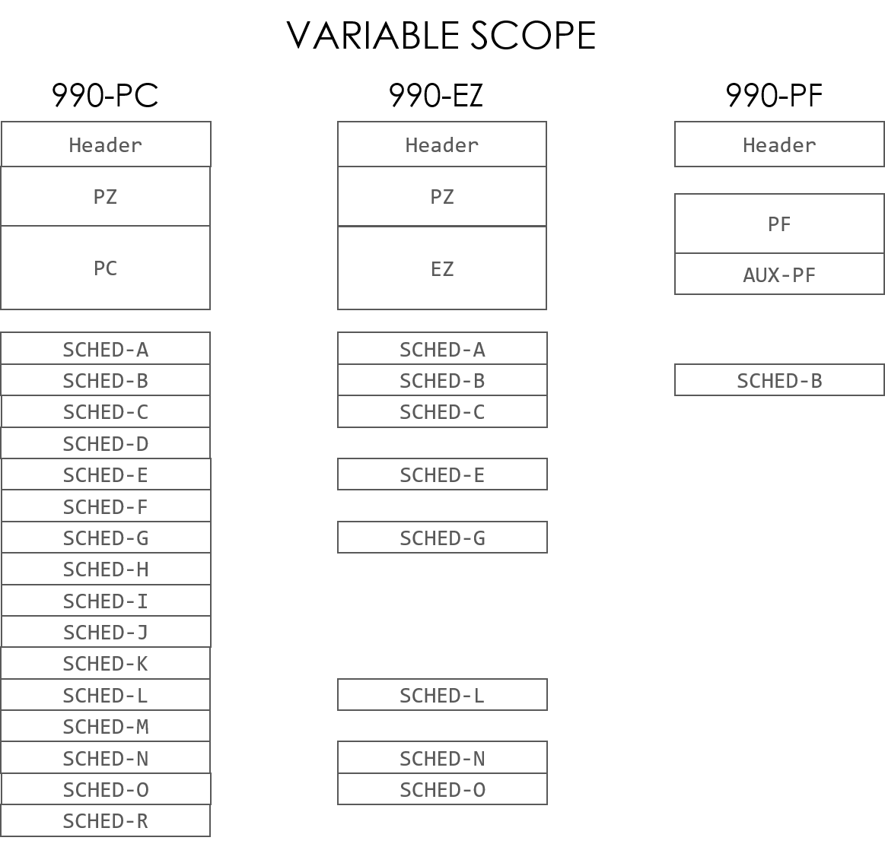
DATA SCOPE: SCHEDULES
Each schedule has distinct requirements for including in 990 filing.
Example: hospitals file schedule H, schools file schedule E, if you lobby you file schedule C.
Meaning of missing: Hospitals must use form 990, not 990EZ
https://github.com/Nonprofit-Open-Data-Collective/irs-efile-master-concordance-file

Slide 10
METADATA
geocrosswalk
tract
level
census data
ORGID
(EIN)
GEOID
(FIPS)
+ census tables
metro
level
census data
data
table
Org Type
EZ to PC Part 1 Crosswalk
Affiliate Status
Etc…

Slide 11
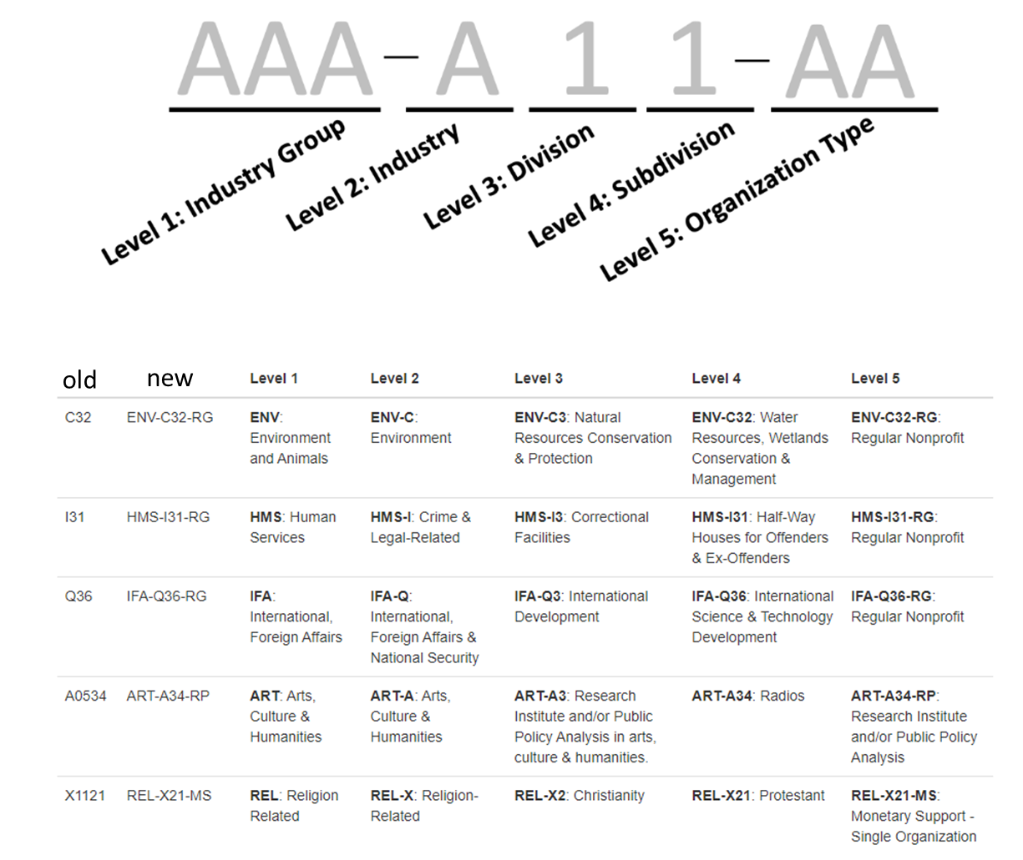
OLD NTEE
NEW NTEE

Slide 12
new
metadata
research notes
data ingestion package
data
packages
AWS S3:
raw/nccsdata
cleaning/
refinement
datagood validation pipeline
AWS S3:
public/ nccsdata
data
APIs
docu-mentation
library
docu-mentation
data
stories
new data portal
(website)

Slide 13
new
metadata
research notes
legacy nccs data
harmonization
of legacy data
data
packages
configure data collectors (lambda tasks)
AWS S3:
raw/nccsdata
AWS S3:
public/ nccsdata
datagood validation pipeline
data
APIs
new data ingestion packages
docu-mentation
library
docu-mentation
data
stories
new data portal
(website)

