Slide 1
Final Presentation for Analysts
Predict the 2016 NCAA Basketball Tournament
EMC Education Services
Data Science & Big Data Analytics
12.01.2017
Notes:
EMC Ed Services CA and DCA Launch Master V8

Slide 2
Project Goals
Predict winners and losers of the men's 2016 NCAA basketball tournament.

Slide 3
Situation & Project Goals
Situation
There are statistics of regular games and basketball championships since 1983.
Before 2004 data has little details
We can use any other data sources
Goals of YoyoDyne “Churn Project”
Build and test model against the previous four tournaments
Predict the outcome of the 2016 tournament

Slide 4
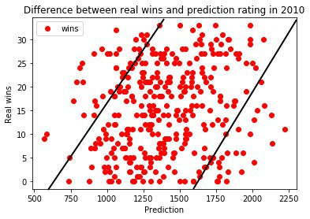
Executive Summary
Our result log loss 0.557638 was higher than the Median Submission benchmark, which means that our predictions come true more often
A smaller log loss is better. Games which are not played are ignored in the scoring. Play-in games are also ignored (only the games among the final 64 teams are scored). The use of the logarithm provides extreme punishments for being both confident and wrong. In the worst possible case, a prediction that something is true when it is actually false will add infinite to your error score. In order to prevent this, predictions are bounded away from the extremes by a small value.

Slide 5
Approach
Splitting a training file in parts depending on the year.
For each year we use rating Elo on the basis of the previous, it is written as a new features for the next years.
Then we process the data (average the balls, number of fouls, etc.) using the exponential model. They also use as new features.
Add various ratings agencies, as well as the normalized distance from the home team to the point where they now play as a feature.
Then we split our sample into a training for a number of parts and produce stacking.

Slide 6
Approach
If we split the sample into (x + 1) parts, then we take from 1 to x parts and train them, and predict x + 1 (also predict a test sample), then take from 1 to x-1 parts and (x + 1) and are trained and x often we predict (and the test sample).
Thus we get that every part has 1 more fiche, and on the test have x features.
We average them and get 1 extra feature. All we are doing by stacking algorithms XGbooost, RandomForest, KNS and neural network, using two intermediate layer neurons, and get 4 additional features.

Slide 7
Model Description
Overview of Basic Methodology: submit predicted probabilities for every possible matchup before the 2016 tournament begins.
Model: XGbooost, RandomForest, KNS and neural network, using two intermediate layer neurons
Dependent variable: Whether the team wins 1 team 2
Scope:
  31 seasons of historical data from 1985 to 2015
  Each year, it includes all games played from daynum 0 through 132 (which by definition is "Selection Sunday," the day that tournament pairings are announced).
Sampling
  Training sample: 110,000 subscribers
  Testing sample: 5,400 subscribers
Our model has predictive power, better than the Median Submission benchmark

Slide 8
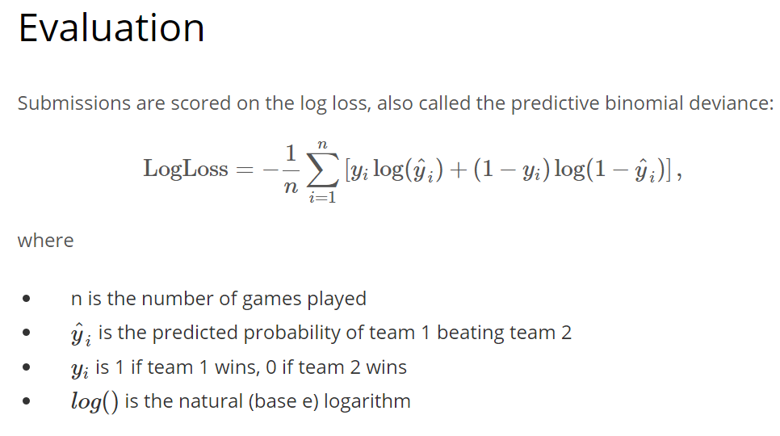
Model Details
A smaller log loss is better. Games which are not played are ignored in the scoring. Play-in games are also ignored (only the games among the final 64 teams are scored). The use of the logarithm provides extreme punishments for being both confident and wrong. In the worst possible case, a prediction that something is true when it is actually false will add infinite to your error score. In order to prevent this, predictions are bounded away from the extremes by a small value.

