Slide 1
머신러닝기반 데이터분석
Day 16

Slide 2
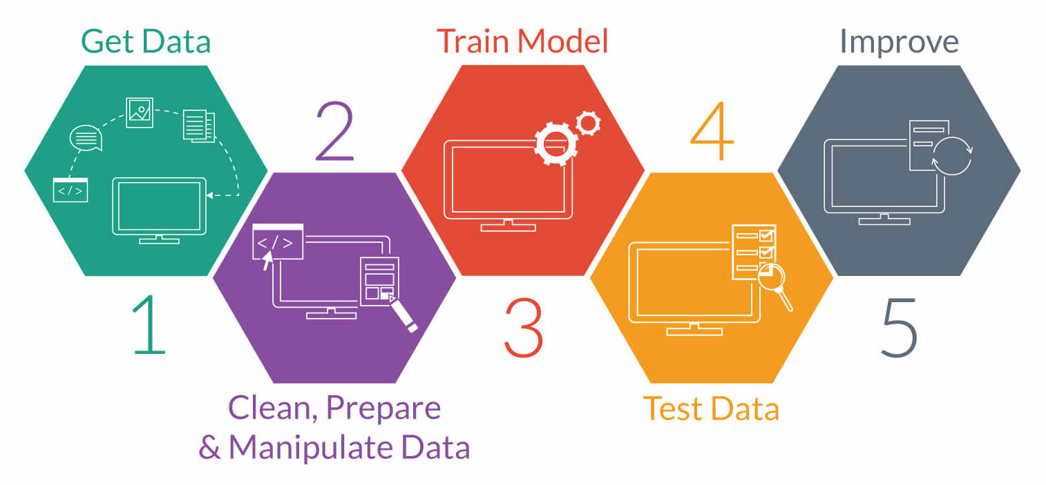
Machine Learning Process (기계학습절차)
Select the right machine learning algorithm to build a predictive model. Visualize the results to gain insights

Slide 3
Machine Learning
A field of computer science that gives computer systems the ability to "learn" (i.e., progressively improve performance on a specific task) with data, without being explicitly programmed

Slide 4
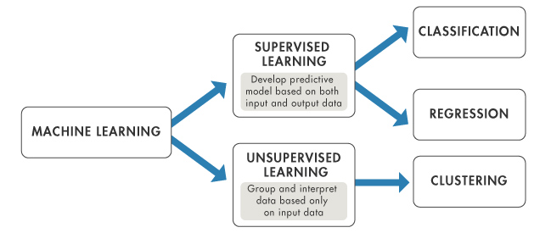
Supervised vs. Unsupervised Learning (지도학습과 비지도학습)

Slide 5
Classification
A machine learning technique that uses known data to determine how the new data should be classified into a set of existing categories.

Slide 6
Decision Trees (의사결정트리)
A type of supervised learning algorithm which is mostly used in classification problems
Split the sample into two or more homogeneous sub-groups based on most significant splitter in input variables

Slide 7
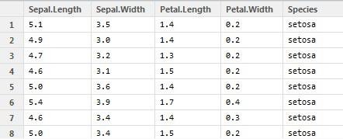
Iris Dataset
from sklearn import datasets
iris = datasets.load_iris()

Slide 8
Iris Flowers Example
The dataset contains 150 observations of iris flowers. There are four attributes of measurements of the flowers in centimeters: sepal length, sepal width, petal length, petal width. The fifth attribute is the species of the flower: Setosa, Versicolour, Virginica. Build a model to predict species of plants.

Slide 9
Exercise #16
Load the iris dataset and create a data frame named df (including target and feature names)
Summarize the data frame
Shape, head(20), describe(), groupby(‘class’).size()
Data visualization
Univariate plot – boxplot, histogram
Multivariate plot – scatter_matrix

Slide 10

Class Distribution
Each class has the same number of instances (40 or 33% of the dataset)

Slide 11
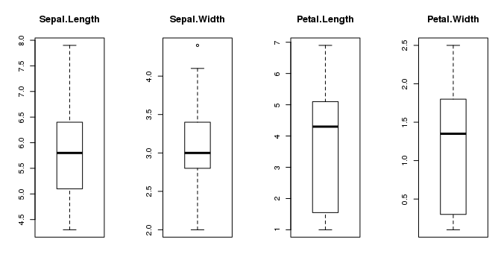
Univariate Plots
Plots of each individual variable.

Slide 12
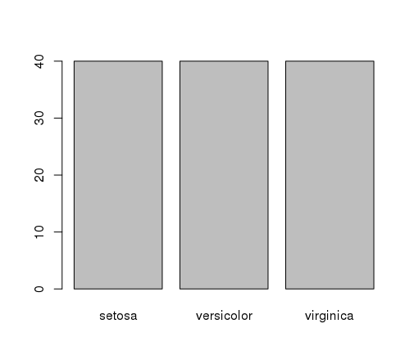
Class Distribution
The instances are evenly distributed across the three class.

Slide 13
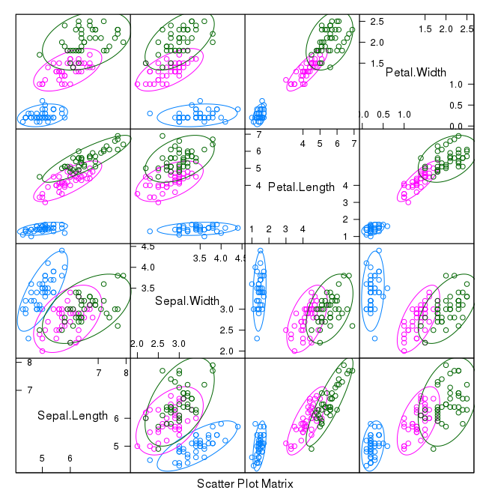
Scatter Matrix Plot
All pairs of attributes and color the points by class and draw ellipses around them
Notes:
Caret package

Slide 14
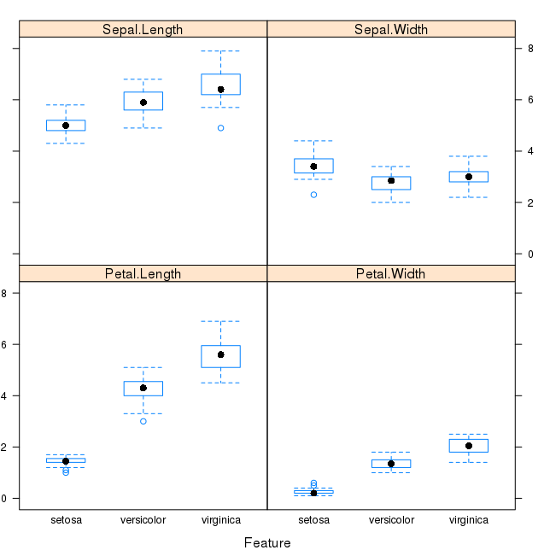
Box and Whisker Plots
Show the distributions of the attributes for each class value.

Slide 15
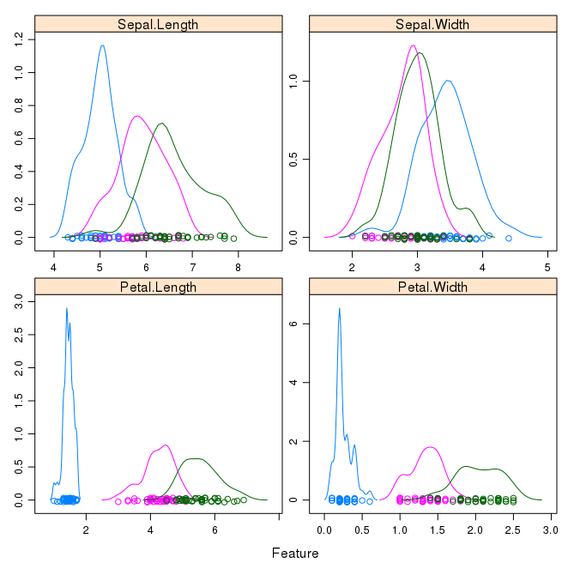
Density Plot
Show the distribution of each attribute by class value

Slide 16
Exercise #16
Splitting Dataset (test size=.2)
Linear Regression
Model evaluation (r2 score)
Cross validation (5 fold)
Decision Tree
Model evaluation (r2 score, accuracy score)
Cross validation (5 fold)
Decision tree visualization (max depth=3)
Random Forest
Model evaluation (r2 score, accuracy score)
Cross validation (5 fold)

Slide 17
IV and DV Split
x = df.drop('class', axis=1)
y = df['class']

Slide 18
Splitting Dataset
Split the dataset into two, 80% of which we will use to train the models and 20% that we will hold back as a test dataset.
from sklearn import model_selection
x_train, x_test, y_train, y_test = model_selection.train_test_split(x, y, test_size=.2, random_state=7)

Slide 19
Random Number Seed
Reset the random number before building models to ensure the results are directly comparable.
random_state=7

Slide 20
Linear Regression
from sklearn.linear_model import LinearRegression
lm_reg = LinearRegression()
lm_reg.fit(x_train, y_train)
pred = lm_reg.predict(x_test)
pred

Slide 21
Model Evaluation
from sklearn.metrics import r2_score, accuracy_score
r2_score(y_train, lm_reg.predict(x_train))
http://scikit-learn.org/stable/modules/model_evaluation.html

Slide 22
R² (결정계수)
R Squared, also called the coefficient of determination
Provides a “goodness of fit” measure for the predictions to the observations.

Slide 23
Cross Validation
A techniques to build robust models which are not prone to overfitting
Iterate over various models to find a better performing model
Leave one out cross validation (LOOCV)
K-fold cross validation

Slide 24
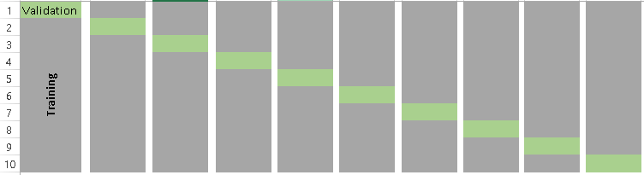
k-fold Cross Validation
The data set is divided into k subsets. One of the k subsets is used as the test set and the other k-1 subsets are put together to form a training set.

Slide 25
Leave One Out Cross Validation
The extreme case of k-fold cross validation
k equal to n, the number of data points in the set.

Slide 26
Holdout Method
The simplest kind of cross validation
The dataset is divided into two groups: training set and test set.
Training set is used to develop a prediction model and testing set to evaluate the model

Slide 27
Cross Validation
from sklearn.model_selection import cross_val_score
cross_val_score(lm_reg, x_train, y_train, cv=5, scoring ='r2')

Slide 28
Sample Code for Decision Tree
from sklearn.tree import DecisionTreeClassifier
dtree_class = DecisionTreeClassifier(random_state=0)
pred = dtree_class.predict(x_test)
pred
You can also import DecisionTreeRegressor from sklearn.tree if you want to use a decision tree to predict a numerical target variable.

Slide 29
Model Evaluation for Decision Tree
dtree_class.fit(x_train, y_train)
accuracy_score(y_train, dtree_class.predict(x_train))
r2_score(y_train, dtree_class.predict(x_train))
cross_val_score(dtree_class, x_train, y_train, cv=5, scoring ='r2')

Slide 30
Accuracy (정확도)
The percentage of correctly classifies instances out of all instances.
It is more useful on a binary classification than multi-class classification problems

Slide 31
Decision Tree Visualization
Graphviz is a tool for drawing graphics using dot files. Pydotplus is a module to Graphviz’s Dot language.
from IPython.display import Image
from sklearn import tree
import pydotplus
dot_data = tree.export_graphviz(dtree_class, out_file=None,feature_names=iris.feature_names, class_names=iris.target_names)
graph = pydotplus.graph_from_dot_data(dot_data)
Image(graph.create_png())

Slide 32
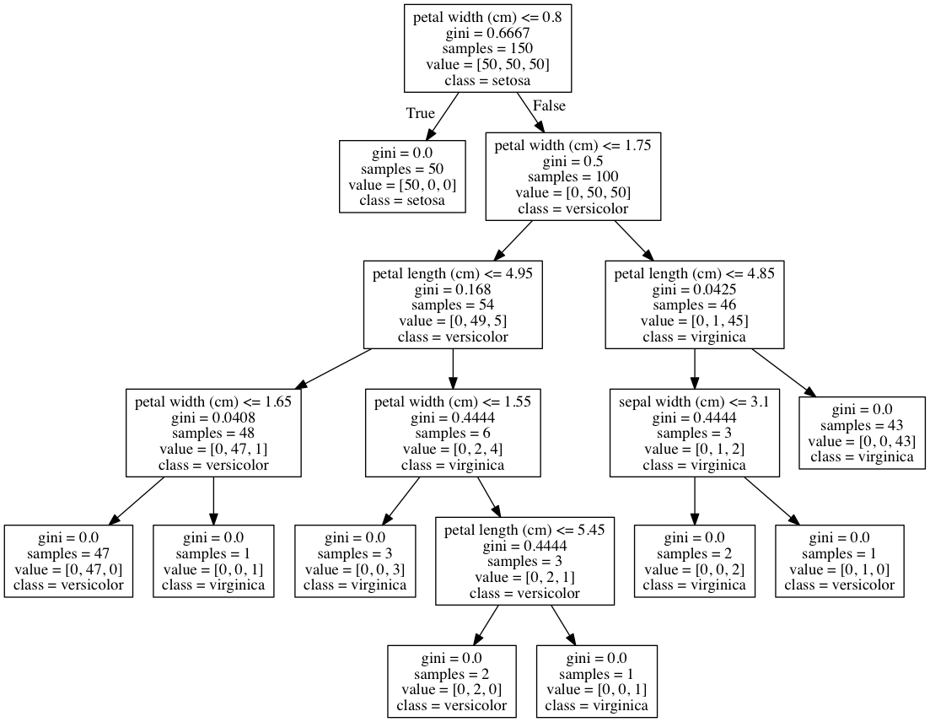
Basic Decision Tree
dtree_class = DecisionTreeClassifier(random_state=0)

Slide 33
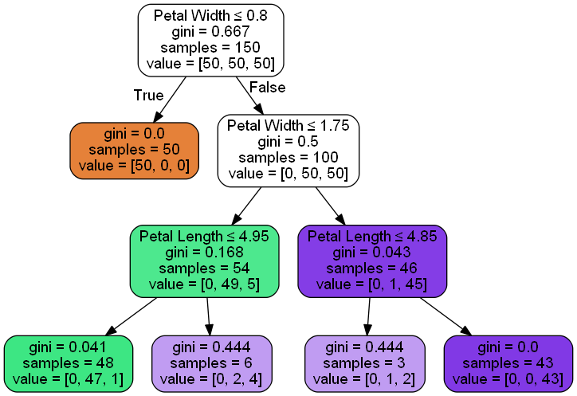
Decision Tree with Options
dtree_class=DecisionTreeClassifier(max_depth=3, random_state=0)
data_feature_names = ['Sepal Lenth', 'Sepal Width', 'Petal Length', 'Petal Width']
dot_data = export_graphviz(dtree_class, feature_names=data_feature_names, out_file=None, filled=True, rounded=True, special_characters=True)
graph = pydotplus.graph_from_dot_data(dot_data)
Image(graph.create_png())

Slide 34
Save Image To File
# Create PDF
graph.write_pdf("iris.pdf")
# Create PNG
graph.write_png("iris.png")

Slide 35
Criterion
The function to measure the quality of a split.
Supported criteria are “gini” for the Gini impurity and “entropy” for the information gain.
http://scikit-learn.org/stable/modules/generated/sklearn.tree.DecisionTreeClassifier.html

Slide 36

Gini Index
The name of the cost function used to evaluate splits in the dataset.
Compute the weighted average of the Gini index of both attributes

Slide 37
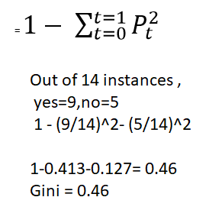
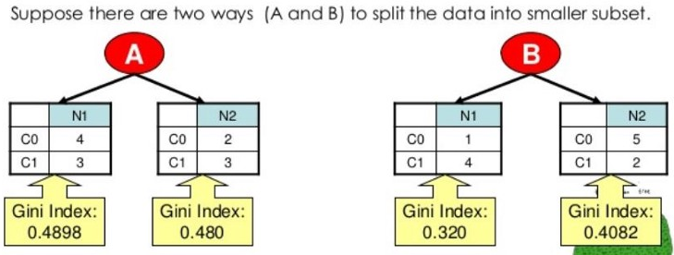
Example

Slide 38
Information Gain
Measures how well a given attribute separates the training examples according to their target classification
This measure is used to select among the candidate attributes at each step while growing the tree
Measures the expected reduction in entropy, or uncertainty.

Slide 39
Entropy
A measure of homogeneity of the set of examples.
Suppose S has 25 examples, 15 positive and 10 negatives [15+, 10-]. Then the entropy of S relative to this classification is
E(S)=-(15/25) log2(15/25) - (10/25) log2 (10/25)

Slide 40
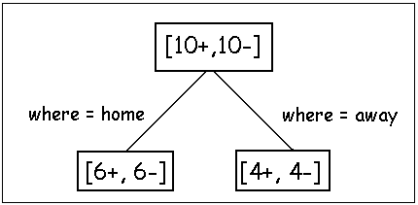
Examples
Before partitioning, the entropy is
H(10/20, 10/20) = - 10/20 log(10/20) - 10/20 log(10/20) = 1
Using the ``where’’ attribute, divide into 2 subsets
Entropy of the first set H(home) = - 6/12 log(6/12) - 6/12 log(6/12) = 1
Entropy of the second set H(away) = - 4/8 log(6/8) - 4/8 log(4/8) = 1
Expected entropy after partitioning
12/20 * H(home) + 8/20 * H(away) = 1

Slide 41
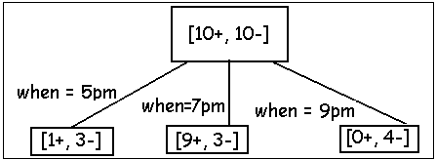
Example
Using the ``when’’ attribute, divide into 3 subsets
Entropy of the first set H(5pm) = - 1/4 log(1/4) - 3/4 log(3/4);
Entropy of the second set H(7pm) = - 9/12 log(9/12) - 3/12 log(3/12);
Entropy of the second set H(9pm) = - 0/4 log(0/4) - 4/4 log(4/4) = 0
Expected entropy after partitioning
4/20 * H(1/4, 3/4) + 12/20 * H(9/12, 3/12) + 4/20 * H(0/4, 4/4) = 0.65
Information gain 1-0.65 = 0.35

Slide 42

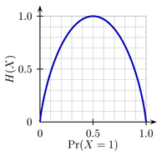
Low vs High Entropy
Entropy of a 2-class problem with regard to the portion of one of the two groups
The entropy is 0 if the outcome is ``certain’’.
The entropy is maximum if we have no knowledge of the system (or any outcome is equally possible).

Slide 43
Decision Tree Example
Split your data into groups such that every element in one group belongs to the same category.

Slide 44
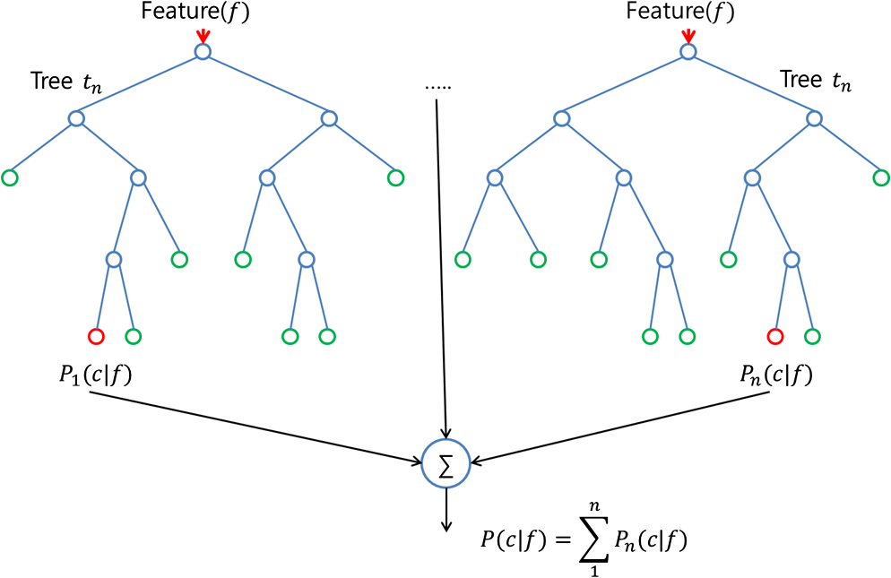
Random Forest
A collection of classification tree
An ensemble tool which takes a subset of observations and a subset of variables to build a decision trees

Slide 45
Library for Random Forest
randomForest package for random forest algorithms
from sklearn.ensemble import RandomForestClassifier

Slide 46
Random Forest Model
Builds multiple decision tree and amalgamate them together to get a more accurate and stable prediction
rf_class = RandomForestClassifier(n_estimators=100, max_depth=10)
rf_class.fit(x_train,y_train)
rf_class.predict(x_test)
n_estimators - number of trees to be grown in the forest

Slide 47
Model Evaluation
r2_score(y_train, rf_class.predict(x_train))
accuracy_score(y_train, rf_class.predict(x_train))

Slide 48
Exercise #16
Import the pima indians diabetes and create a data frame named df (adding column names)
Summarize the data frame
Shape, head(20), describe(), groupby(‘Outcome’).size()
Data visualization
Univariate plot – boxplot, histogram
Multivariate plot – scatter_matrix

Slide 49
Fields Description
preg = Number of times pregnant
plas = Plasma glucose concentration a 2 hours in an oral glucose tolerance test
pres = Diastolic blood pressure (mm Hg)
skin = Triceps skin fold thickness (mm)
test = 2-Hour serum insulin (mu U/ml)
mass = Body mass index (weight in kg/(height in m)^2)
pedi = Diabetes pedigree function
age = Age (years)
class = Class variable (1:tested positive for diabetes, 0: tested negative for diabetes)

Slide 50
Exercise #16
Splitting Dataset (decide the test size)
Linear Regression
Model evaluation (r2 score)
Cross validation (decide the fold)
Decision Tree
Model evaluation (r2 score, accuracy score)
Cross validation (decide the fold)
Decision tree visualization (decide the max depth)
Random Forest
Model evaluation (r2 score, accuracy score)
Cross validation (decide the fold)

Slide 51
Classification Algorithms
Linear
LDA
Nonlinear
CART, kNN
Complex nonlinear
SVM, RF

Slide 52
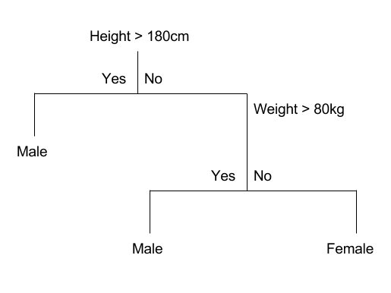
Classification and Regression Trees (CART)
Find a tree that separates two or more classes of objects
from sklearn.tree import DecisionTreeClassifier
dtree = DecisionTreeClassifier()
dtree.fit(x_train, y_train)

Slide 53
Random Forest
Builds multiple decision tree and amalgamate them together to get a more accurate and stable prediction
from sklearn.ensemble import RandomForestClassifier
rf_class = RandomForestClassifier(n_estimators=100, max_depth=10)

Slide 54
Linear Discriminant Analysis (LDA)
A well-known scheme for feature extraction and dimension reduction 속성추출, 차원촉소에 사용
Widely used in high dimensional data such as face recognition and image retrieval 얼굴인지, 이미지검색

Slide 55
Code for LDA
Find a linear combination of features that separates two or more classes of objects 두개이상의 클래스들을 구별해주는 속성들의 조합
from sklearn.discriminant_analysis import LinearDiscriminantAnalysis
lda = LinearDiscriminantAnalysis()
lda.fit(x_train, y_train)

Slide 56
LDA Algorithms
Compute d-dimensional mean vectors for different classes from the dataset, where d is the dimension of feature space. 각 클래스로부터 속성의 차원을 가진 평균벡터들을 계산
Compute in-between class and with-in class scatter matrices. 클래스사이의와 클래스안에서의 scatter matrix들을 계산
Compute eigen vectors and corresponding eigen values for the scatter matrices. 아이간벡터들과 스케터메트릭스에 대응하는 아이간밸류들을 계산
Choose k eigen vectors corresponding to top k eigen values to form a transformation matrix of dimension d x https://www.python-course.eu/linear_discriminant_analysis.phpk. 상위 k개의 아이간밸류들을 선택하여 d x k개를 가진 변환메트릭스 생성
Transform the d-dimensional feature space X to k-dimensional feature space X_lda via the transformation matrix. 평균벡터를 변환메트릭스를 통해 변환

Slide 57
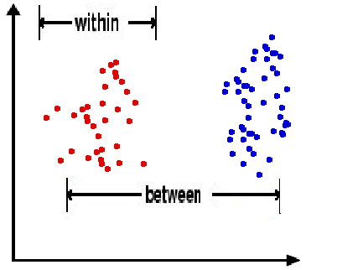
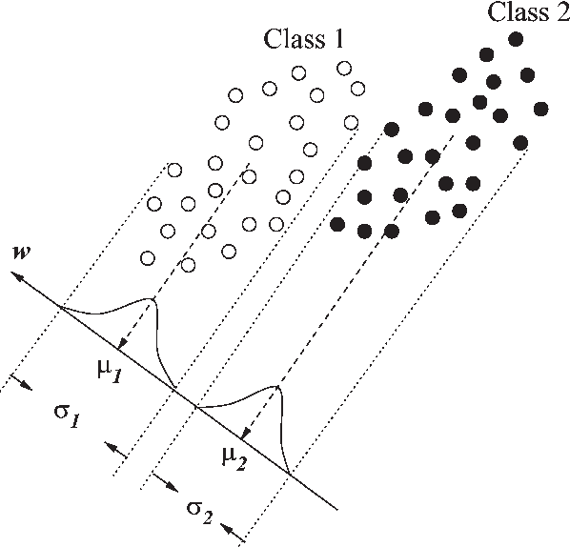
Dimension Reduction 차원축소
Minimize
Maximize

Slide 58
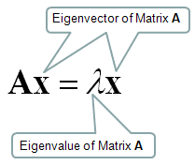


Eigenvalues and Eigenvectors
Eigenvector
Eigenvalues
In linear algebra, an eigenvector or characteristic vector of a linear transformation is a non-zero vector that changes by only a scalar factor when that linear transformation is applied to it. 숫자와 아이간벡터에 적용했을 때 원 벡터에서 아이간벡터를 적용한 값이 나와서 아이간벡터를 이용하여 선형변형을 할수있음
$$\left(\begin{matrix}3 & 2 \\ 3 & −2\end{matrix}\right)\left(\begin{aligned}2 \\ 1\end{aligned}\right) =4\left(\begin{aligned}2 \\ 1\end{aligned}\right)$$
$$\left(\begin{aligned}8 \\ 4\end{aligned}\right)=\left(\begin{aligned}8 \\ 4\end{aligned}\right)$$

Slide 59



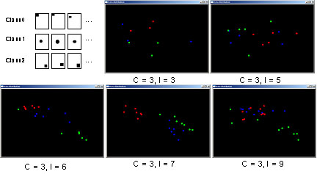
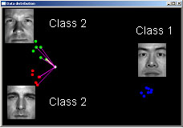

Training Set
Dimension Reduction
3-Class/ 2-Dimension Map
Testing Image
Applying Weighted K-Nearst Neighborhood
Notes:
https://www.cc.gatech.edu/~kihwan23/face_recog_gsvd.htm

Slide 60
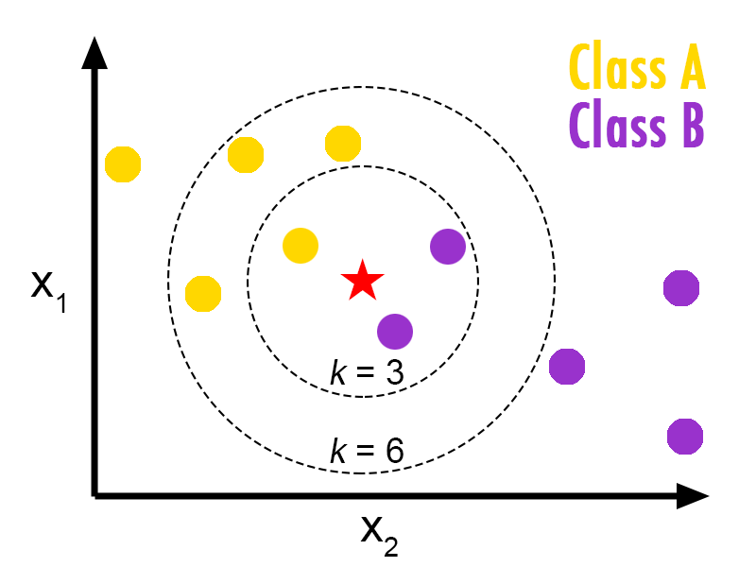
k-Nearest Neighbors (kNN)
The case is assigned to the class that most common amongst its K nearest neighbors measured by a distance function 거리에 따라 가까운 k개의 이웃들을 정하고 그 이웃들의 클래스를 따름
The distance functions can be Euclidean, Manhattan, Minkowski (for continuous variables) and Hamming distance (for categorical variables)

Slide 61
Code for kNN
Used for both classification and regression problems.
from sklearn.neighbors import KNeighborsClassifier
knn = KNeighborsClassifier()
knn.fit(x_train, y_train)

Slide 62
kNN Algorithm
Load the data
Initialize the value of k
For getting the predicted class, iterate from 1 to total number of training data points 전체 데이터의 갯수만큼 계산함
Calculate the distance between test data and each row of training data. Here we will use Euclidean distance as our distance metric since it’s the most popular method. The other metrics that can be used are Chebyshev, cosine, etc. 거리계산
Sort the calculated distances in ascending order based on distance values 정렬
Get top k rows from the sorted array 상위k개를 수집
Get the most frequent class of these rows 가장 빈도가 높은 클래스를 정함
Return the predicted class 정해진 클래스를 리턴

Slide 63
Support Vector Machines (SVM) with Linear Kernel
A supervised machine learning algorithm which can be used for both classification or regression challenges
from sklearn.svm import SVC
svm = SVC()
svm.fit(x_train, y_train)

Slide 64
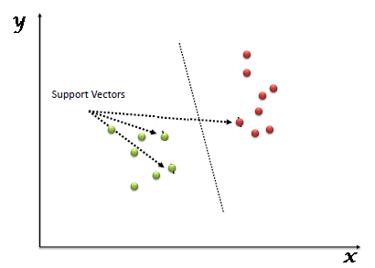
Algorithms of SVM
Plot each data item as a point in n-dimensional space where n is number of features you have. 변수들의 공간안에 모든 데이터포인트들을 그림
Then, perform classification by finding the hyper-plane that maximize the distances between nearest data point (margin) 가장 가까운 데이터포인트들의 거리를 최대화시킬수 있는 하이퍼플레인을 찾아 분류하는 방법

Slide 65
Predictions and Evaluation
pred = lda.predict(x_test)
Pred
r2_score(y_test, lda.predict(x_test))
accuracy_score(y_test, lda.predict(x_test))
cross_val_score(lda,x_train, y_train, cv=10, scoring='accuracy')

Slide 66
Confusion Matrix (Contingency Table)
Predicted
 | negative | positive
negative | TN | FP
positive | FN | TP
Actual

Slide 67
Confusion Matrix Example
201 1’s correctly classified as “1”
85 1’s incorrectly classified as “0”
25 0’s incorrectly classified as “1”
2689 0’s correctly classified as “0”

Slide 68
Error Rate
Overall error rate = (25+85)/3000 = 3.67%
Accuracy = 1 – err = (201+2689)/3000 = 96.33%
Multiple classes
error rate = (sum of misclassified records)/(total records)

Slide 69
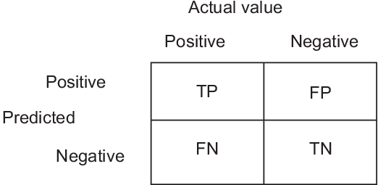
Alternate Accuracy Measures
sensitivity = true positive fraction = 1 – false negative fraction = TP / (TP + FN) 맞는게 진짜 맞는것에 속하는지 봄
specificity = true negative fraction = 1 – false positive fraction = TN / (TN + FP) 틀린게 진짜 틀리것에 속하는지 봄
accuracy = (TP + TN) / (TP + TN + FP + FN) 전체에서 맞는게 얼마나 되는지 봄
False positive rate = 1- specificity

Slide 70

Code For Confusion Matrix
confusion_matrix(y_test,lda.predict(x_test))

Slide 71
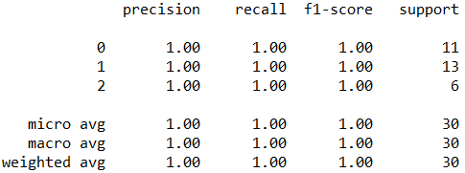
Classification Report
print(classification_report(y_test,lda.predict(x_test)))

Slide 72
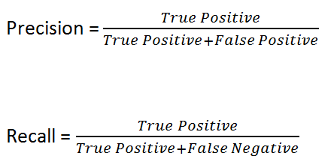
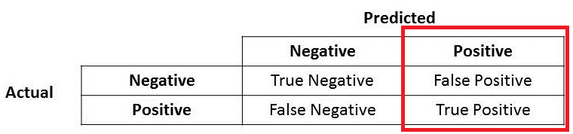
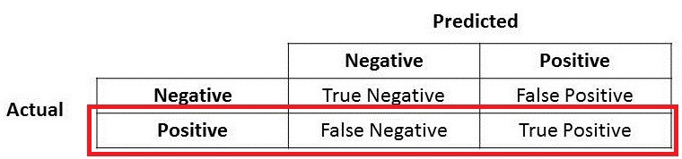

Precision and Recall
양성이라고 나온 사람중에 진짜 양성
진짜 양성인 사람중에 진짜 양성
F1-Score = 0 ---> Poor (P=0 or R=0)
F1-Score = 1 ---> Perfect (P=1 or R=1)

Slide 73
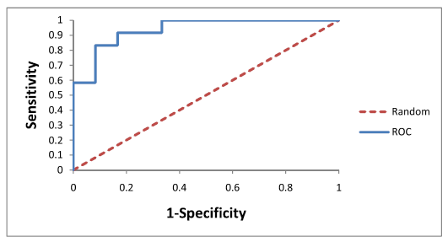
ROC Curve
True Positive Rate
Visualize the performance of a binary classification method
False Positive Rate

Slide 74
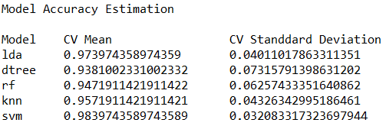
Model Evaluation Summary
Compare the models to each other and select the most accurate.

Slide 75
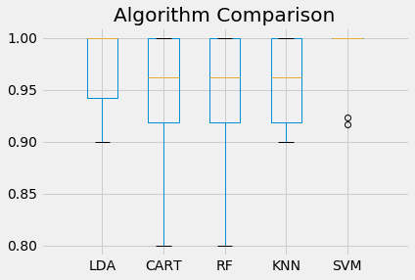
Algorithm Comparison
Many samples achieving 100% accuracy.

Slide 76
Exercise #16
Load an iris flowers dataset and create 5 machine learning models, pick the best and build confidence that the accuracy is reliable.
Use 10-fold cross validation
LDA, CART, kNN, SVM with linear kernel and RF
Use accuracy and r2 to compare the models
Validate the best model using the test dataset.

Slide 77
Exercise #16
Import the pima indians diabetes and create 5 machine learning models, pick the best and build confidence that the accuracy is reliable.
Use 10-fold cross validation
LDA, CART, kNN, SVM with linear kernel, RF
Use accuracy and r2 to compare the models
Validate the best model using the test dataset.

Slide 78
Exercise #16
Complete the ROC curve tutorial on https://stackabuse.com/understanding-roc-curves-with-python/

Slide 79
Preprocessing

Slide 80
Mean Removal
It involves removing the mean from each feature so that it is centered on zero.
Removes any bias from the features.
import numpy as np
from sklearn.preprocessing import scale
input_data = np.array([[3, -1.5, 3, -6.4], [0, 3, -1.3, 4.1], [1, 2.3, -2.9, -4.3]])
data_standardized = scale(input_data)

Slide 81
Scaling
The values of every feature in a data point can vary between random values.
Scales them to match specified rules.
from sklearn.preprocessing import MinMaxScaler
data_scaler = MinMaxScaler(feature_range = (0, 1))
data_scaled = data_scaler.fit_transform(input_data)

Slide 82
Normalization
Involves adjusting the values in the feature vector so as to measure them on a common scale.
Adjusts so that they sum up to 1.
from sklearn.preprocessing import normalize
data_normalized = normalize(input_data, norm = 'l1') #l1 uses absolute value, l2 uses square root

Slide 83
Binarization
Used to convert a numerical feature vector into a Boolean vector.
from sklearn.preprocessing import Binarizer
data_binarized = Binarizer(threshold=1.4).transform(input_data)

Slide 84
Standardization
Transforms attributes with a Gaussian distribution and differing means and standard deviations to a standard Gaussian distribution with a mean of 0 and a standard deviation of 1.
from sklearn.preprocessing import StandardScaler scalar = StandardScaler()
input_standard = scaler.transform(input_data)

Slide 85
Exercise #16
Open pima indian data and rescale data (between 0 and 1)
Binarize data
Standardize data (0 mean, 1 stdev)

Slide 86

Neural Network
기계학습과 인지과학에서 생물학의 신경망(동물의 중추신경계중 특히 뇌)에서 영감을 얻은 통계학적 학습 알고리즘

Slide 87
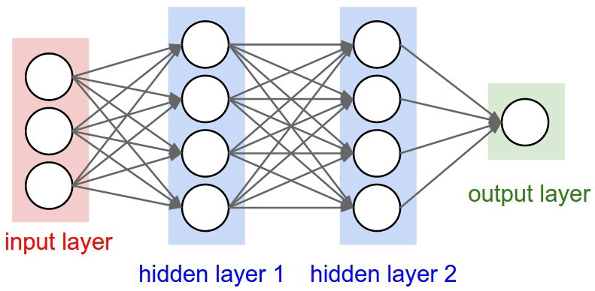
Components of Neural Networks
An input layer, x
An arbitrary amount of hidden layers
An output layer, ŷ
Each column is a layer. The first layer of your data is the input layer. Then, all the layers between the input layer and the output layer are the hidden layers

Slide 88
Neural Network Model
from sklearn.neural_network import MLPClassifier
mlp = MLPClassifier(hidden_layer_sizes=(10,10,10),max_iter=500) mlp.fit(x_train,y_train)

Slide 89
Prediction
pred = mlp.predict(x_test)r2_score(y_test, mlp.predict(x_test))
pred
Import mglearn
mglearn.plots.plot_2d_separator(mlp, x_train, fill=True, alpha=.3)
mglearn.discrete_scatter(x_train[:,0], x_train[:,1], y_train)

Slide 90
Predictions and Evaluation
pred = mlp.predict(x_test)
pred
r2_score(y_test, mlp.predict(x_test))
accuracy_score(y_test, mlp.predict(x_test))
cross_val_score(mlp,x_train, y_train, cv=10, scoring='accuracy')
confusion_matrix(y_test, mlp.predict(x_test))
print(classification_report(y_test, mlp.predict(x_test)))

Slide 91
Exercise #16
Use College Data Set which has several features of a college and a categorical column and build a predictive model to determine whether or not the School is Public or Private
Normalize before building model
Train and test split

Slide 92
Exercise #16
The Boston dataset is a collection of data about housing values in the suburbs of Boston. Use the Boston dataset and predict the median value of owner-occupied homes (medv) using all the other continuous variables available.

Slide 93
Exercise #16
Build a prediction model for AirPassengers Monthly Airline Passenger Numbers 1949-1960
Build a prediction model for Breast cancer (load_breast_cancer() in sklearn.datasets)

