Slide 1
Day 15
Reinforcement Learning

Slide 2
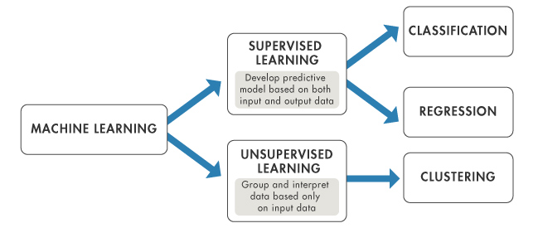
Machine Learning Algorithm
One of three basic machine learning paradigms, alongside supervised learning and unsupervised learning. 지도학습, 비지도학습과 함께 기계학습 방법의 하나
Reinforcement Learning

Slide 3
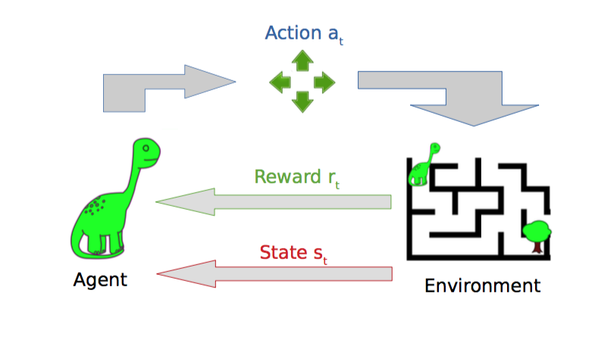
Reinforcement Learning
Learning series of action using reward system
보상시스템을 이용하여 액션을 배움

Slide 4
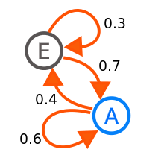
Markov Chain
A mathematical model that experiences transition of states with probabilistic rules. 확률로 상태의 변환을 나타낸 수학적 모델
For example, the probabilities of going from E to A is 70% E에서 A로 갈 확률 70%

Slide 5

Markov Chain Parameters

Slide 6
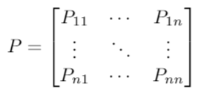
Transition Probability
The transition probability of going from state s to state s’ through action a. 액션 a를 통해서 현재상태에서 다음상태로 가는 전환확률

Slide 7
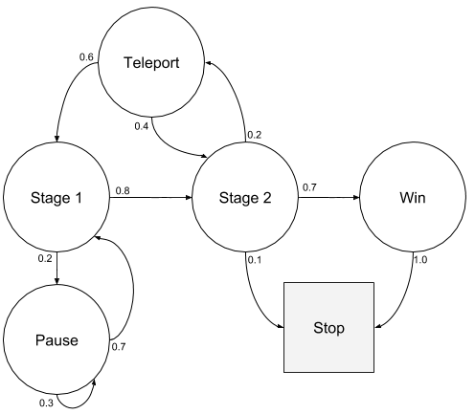
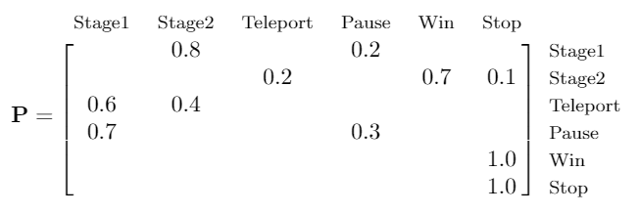
Transition Probability on Graph
Sample episode
- S1 S2 Win Stop - S1 S2 Teleport S2 Win Stop - S1 Pause S1 S2 Win Stop

Slide 8
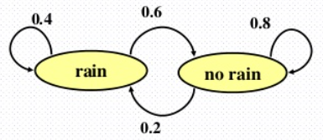
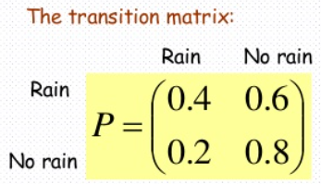
Weather Example
Today | Tomorrow
Rain | Rain | 40%
 | No train | 60%
No rain | Rain | 20%
 | No Rain | 80%

Slide 9
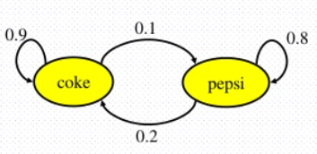
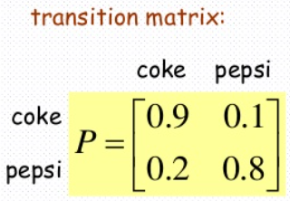
Coke and Pepsi Example
Last Purchase | Next Purchase
Coke | Coke | 90%
 | Pepsi | 10%
Pepsi | Coke | 20%
 | Pepsi | 80%
t = [[.9, .1],
[.2, .8]]

Slide 10
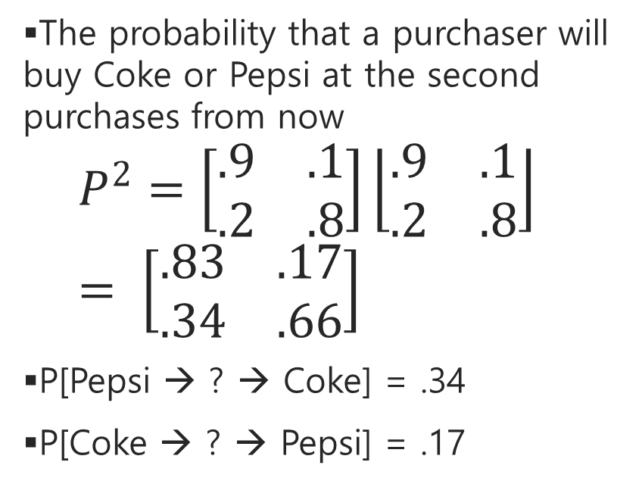
Probability to Purchase
The probability that a purchaser will buy Coke or Pepsi at the second purchases from now
$$P^{2}=\left[\begin{matrix}.9 & .1 \\ .2 & .8\end{matrix}\right]\left\lfloor \begin{matrix}.9 & .1 \\ .2 & .8\end{matrix}\right\rfloor = \left[\begin{matrix}.83 & .17 \\ .34 & .66\end{matrix}\right]$$
P[Pepsi → ? → Coke] = .34
P[Coke → ? → Pepsi] = .17
import numpy as np
t2 = np.dot(t,t)

Slide 11
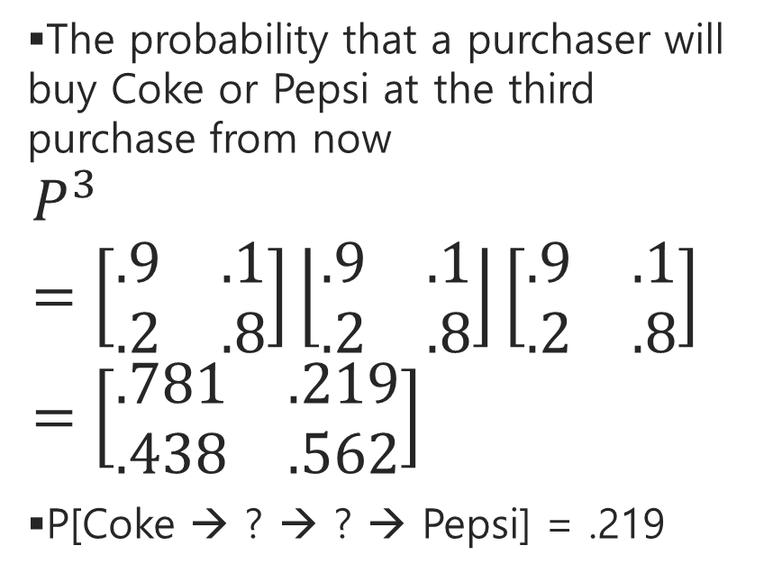
Probability to Purchase
The probability that a purchaser will buy Coke or Pepsi at the third purchase from now
$$P^{3}=\left[\begin{matrix}.9 & .1 \\ .2 & .8\end{matrix}\right]\left\lfloor \begin{matrix}.9 & .1 \\ .2 & .8\end{matrix}\right\rfloor \left[\begin{matrix}.9 & .1 \\ .2 & .8\end{matrix}\right]=\left[\begin{matrix}.781 & .219 \\ .438 & .562\end{matrix}\right]$$
P[Coke → ? → ? → Pepsi] = .219
import numpy as np
t3 = np.dot(t2,t)

Slide 12

Probability to Purchase with Proportion
Suppose 60% of all people now drink Coke, and 40% drink Pepsi. What fraction of people will be drinking Coke or Pepsi three weeks from now? 현재 콕을 마시는 사람은 60프로, 펩시를 마시는 사람은 40%. 다다음 구매시 콕이나 펩시를 살 확률은?
$\left[\begin{matrix}.6 & .4\end{matrix}\right]\left[\begin{matrix}.781 & .219 \\ .438 & .562\end{matrix}\right]$= $\left[\begin{matrix}.6438 & .3562\end{matrix}\right]$
$P\left[X_{3}=Coke\right]= .6438$
$P\left[X_{3}=Pepsi\right]= .3562$
s1 = np.dot(s,t3)

Slide 13

Markov Reward Process
A stochastic process which extends a Markov chain by adding a reward rate to each state. 마코프체인의 각 상태에 보상을 더한 확률과정
An additional variable records the reward accumulated up to the current time. 추가변수는 현재까지 보상의 총합을 기록함

Slide 14
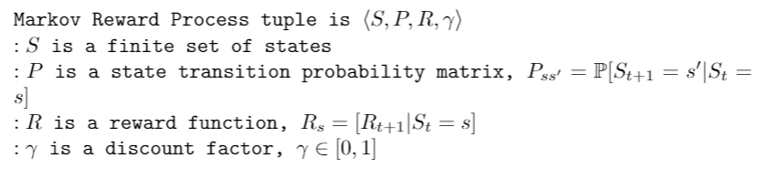
Markov Reward Process Parameters

Slide 15
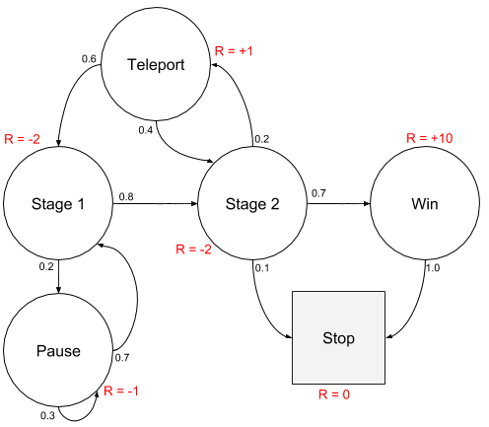
Rewards on Graph
Reward - A feedback from the environment for going from one state to another taking one action. 한 상태에서 다른 상태로 가는 행동에 대한 피드백

Slide 16

Rewards
The feedback from the environment that tells us how good we are doing. 얼마나 잘했는지 환경이 주는 피드백
Our goal is to maximize the total reward. 전체 보상을 최대화하는 것이 목표
Uses a decreasing (discount) factor for future rewards. 미래의 보상를 줄여주는 요소
γ between 0 and 1

Slide 17
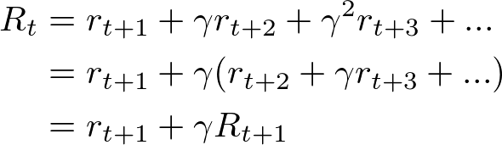
Bellman Equation
One of the fundamental elements of reinforcement learning. 강화학습에서 가장 기본적인 요소
Tells us what long-term reward can we expect, given the state we are in 현재 있는 상태에서 기대할수 있는 장기보상

Slide 18
Expected Reward
Expected immediate reward for going from state s to state s’ through action a. a액션을 취해서 s상태에서 s’로 가는 즉각적인 보상

Slide 19

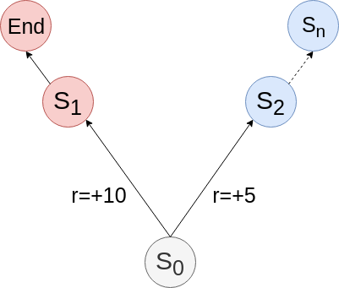
State Value Function
How good some state is 현재상태가 얼마나 좋은지 평가
The value of a state is the expected total reward we can get starting from that state. 현상태의 가치는 현상태에서 사작해서 받을 것이라고 기대하는 총보상
It depends on the policy which tells how to take decisions. 결정을 내리는 정책에 따라 달라짐
Notes:
Value function - a way to measure the “value”

Slide 20
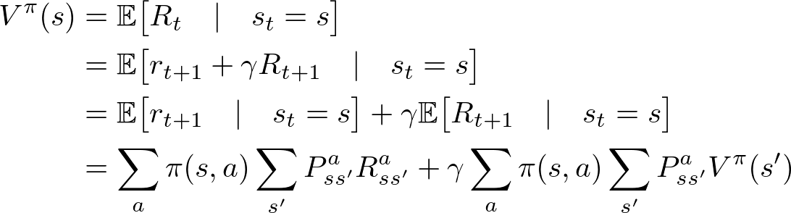
State Value Function with Bellman Equation

Slide 21
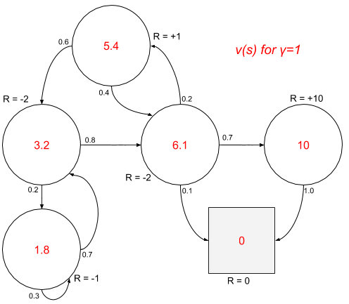
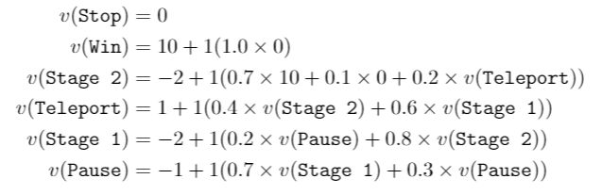
State Values on Graph

Slide 22
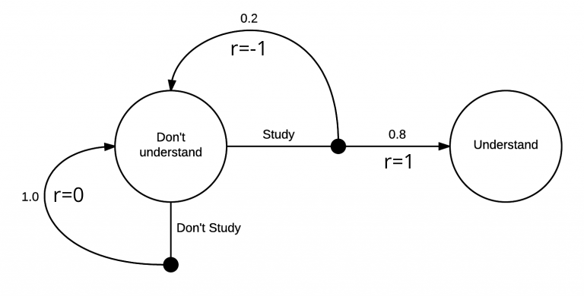
Markov Decision Process
An extension of the Markov chain 마코프체인의 연장
Used to model more complex environments. 더 복잡한 환경에 사용

Slide 23
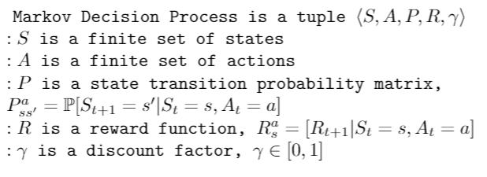
Markov Decision Process Parameters

Slide 24
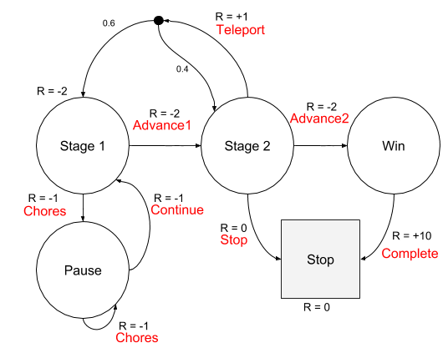
Actions on Graph
Action - The possibility to make a choice at every state 각 상태에서 내릴수 있는 선택과 그에 대한 확률

Slide 25
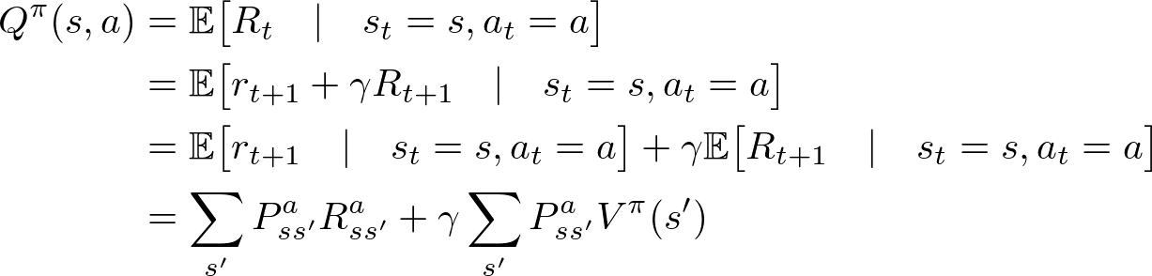
Action Value Function
How good some action is 그 행동이 얼마나 좋은지 평가
The value of an action taken in some state is the expected total reward we can get, starting from that state and taking that action. 그 액션을 취함으로써 현상태로부터 기대되는 총보상
It also depends on the policy. 정책에 따라 달라짐

Slide 26

Policy
A distribution over actions given states. 어떤 상태에서 취할수 있는 액션의 분포
Denoted π(s,a)
Find the policy that maximizes the reward function 보상을 최대화 하는 정책을 찾아야 함

Slide 27


Action Value Function with Bellman Equation
현재상태의 가치
액션가치함수의 최대값
현재상태에서 어떤 액션을 취했을때 가질수 있는 보상의 최대값

Slide 28

Reinforcement Learning
An area of machine learning concerned with how software agents ought to take actions in an environment in order to maximize some notion of cumulative reward. 누적보상을 최대화하기 위해 소프트웨어 에이전트가 어떤 환경에서 어떤 행동을 취해야 하는 지를 배우는 기계학습방법

Slide 29
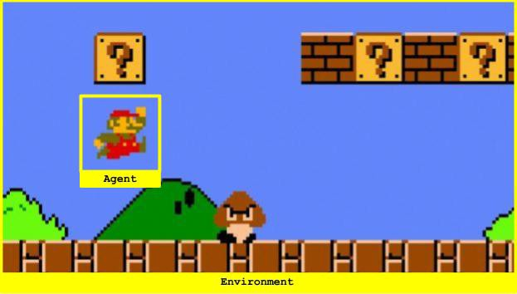
Agent
The component that makes the decision of what action to take. 무슨 행동을 할지 결정하는 구성요소
To make a decision, the agent is allowed to use any observation from the environment and any internal rules that it has. 환경으로부터 관찰을 사용하고, 자신이 가진 룰을 사용
For example: In a maze game, the goal of the agent is to solve this maze by taking optimal actions. 미로게임의 경우 목표는 최적의 행동을 해서 미로게임을 해결하는 것

Slide 30
Environment
A task or simulation 하나의 시뮬레이션
The agent, AI algorithm, interacts with the environment and tries to solve it. 에이전트는 환경과 상호작용을 해서 문제를 해결함
An environment receives the action from the agent and emits a new observation Oₜ and scalar reward Rₜ. 에이전트의 액션을 받아 새로운 관측과 보상을 되돌려줌

Slide 31

Simple Driving Problem
An environment consists of a 5-by-5 grid. A treasure (T) is placed at the bottom right corner of the grid. The agent (O) starts at the top left corner of the grid. Four available actions are left, right, up, down. If the agent takes an action that leads him directly to T, he gets a reward of 1, otherwise a reward of 0. 5x5그리드 오른쪽 아래에 보물이 있고, 에이전트는 왼쪽 위에서 시작한다. T에 도착하면 1의 보상을 받게 되고 아니면 보상은 0 이다.

Slide 32
Initialization
height = 5 #그리드 설정
Width = 5
posX = 0 #시작점 설정
posY = 0
endX = width-1 #도착점 설정
endY = height-1
actions = [0, 1, 2, 3] #액션 설정
stateCount = height*width #총 상태갯수
actionCount = len(actions) #총 액션갯수

Slide 33
Take Actions
posX = 0
posY = 0
done = False;
while not done:
action = np.random.choice(actions) #임의의 액션
if action==0: posX = posX-1 if posX>0 else posX # left
if action==1: posX = posX+1 if posX<width-1 else posX# right
if action==2: posY = posY-1 if posY>0 else posY# up
if action==3: posY = posY+1 if posY<height-1 else posY# down
done = posX==endX and posY==endY #도착하면 done
nextState = width*posY + posX #각 위치를 25개의 숫자로 매치시켜줌
reward = 1 if done else 0 #도착했으면 보상

Slide 34
Drawing
for i in range(height):
for j in range(width):
if posY==i and posX==j:
print("O", end=''); #시작점에 동그라미
elif endY==I and endX==j:
print(“T”, end=‘’); #끝나는 점에 T
else:
print(".", end=''); #나머지는 점
print("");

Slide 35
Pygame
import pygame
pygame.init() #초기화
Screen = pygame.display.set_mode([500,500]) #화면
Screen.fill(0) #화면색
player = pygame.image.load('images/dude.png') #이미지로딩
flag = False
while 1:
for event in pygame.event.get():
if event.type == pygame.QUIT:
flag = True
pygame.quit()
exit(0) #게임 끝내기
screen.blit(player, (posX*100, posY*100)) #플레이이어 그리기
pygame.display.update() #보여주기

Slide 36
Q-Learning
An off policy reinforcement learning algorithm that seeks to find the best action to take given the current state. 현재 상태에서 가장 베스트한 액션을 발견하기 위한 강화학습 알고리즘
Seeks to learn a policy that maximizes the total reward. 총 보상을 최대화하는 정책을 찾음

Slide 37
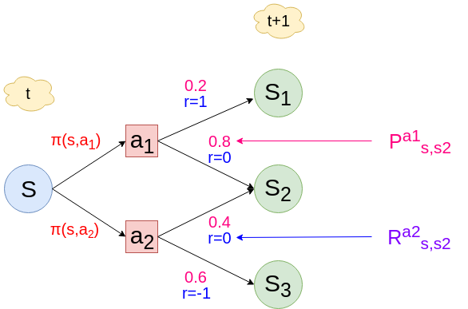
Summary of Q Learning Notation

Slide 38
Q-Table
The shape is [state size, action size]
Initialize all values using random numbers 상태와 액션의 크기로 매트릭스를 만들고 랜덤넘벌ㄹ 줌
import numpy as np
# Initialize q-table values to 0
qtable = np.random.rand(env.stateCount, env.actionCount).tolist()

Slide 39
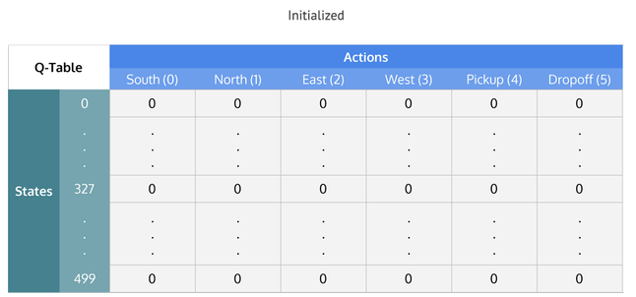
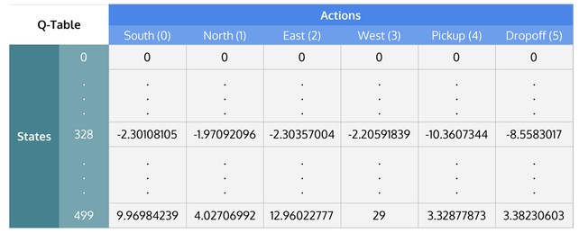
Training Q-Table

Slide 40
Calculating Q-Table

Slide 41
Taking Action: Explore or Exploit
Explore - act randomly 난수를 생성해서 행동
Exploit - use the q-table as a reference and view all possible actions for a given state 큐테이블을 참조하여 주어진 상태에서 가능한 모든 행동을 고려
import random
# Set the percent you want to explore
epsilon = 0.2
if random.uniform(0, 1) < epsilon:
#Explore: select a random action
else:
#Exploit: select the action with max value (future reward)

Slide 42
Updating Q-Table
Agent starts in a state (s1) takes an action (a1) and receives a reward (r1) 현재 보상
Agent selects action by referencing Q-table with highest value (max) OR by random (epsilon, ε) 다음 상태에서 받을수 있는 최대보상있는 행동이나 랜덤행동
Update q-values 큐값 업데이트
Q[state, action] = Q[state, action] + lr * (reward + gamma * np.max(Q[new_state, :]) — Q[state, action])

Slide 43
Exercise #15
Complete the Q-Learning tutorial on https://medium.com/datadriveninvestor/math-of-q-learning-python-code-5dcbdc49b6f6

Slide 44
OpenAI Gym
Gym provides a toolkit to benchmark AI-based tasks.
pip install gym
import gym
CartPole
Pendulum
Space Invaders
Lunar Lander
Ant
Mountain Car
Acrobot
Car Racing
Bipedal Walker

Slide 45
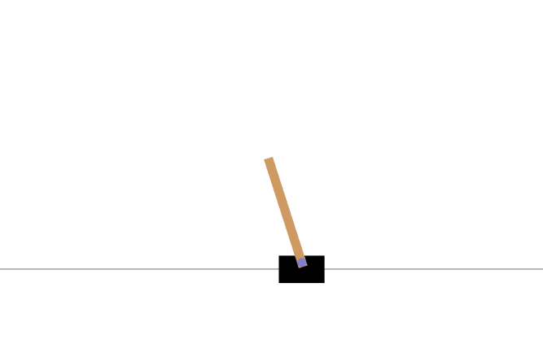
CartPole Example
import gym
env = gym.make('CartPole-v0')
env.reset()
for _ in range(100):
env.render()
env.step(env.action_space.sample())

Slide 46
CartPole States and Actions
Observation:
Type: Box(4)
Num Observation Min Max
0 Cart Position -4.8 4.8
1 Cart Velocity -Inf Inf
2 Pole Angle -24 deg 24 deg
3 Pole Velocity At Tip -Inf Inf
Actions:
Type: Discrete(2)
Num Action
0 Push cart to the left
1 Push cart to the right

Slide 47
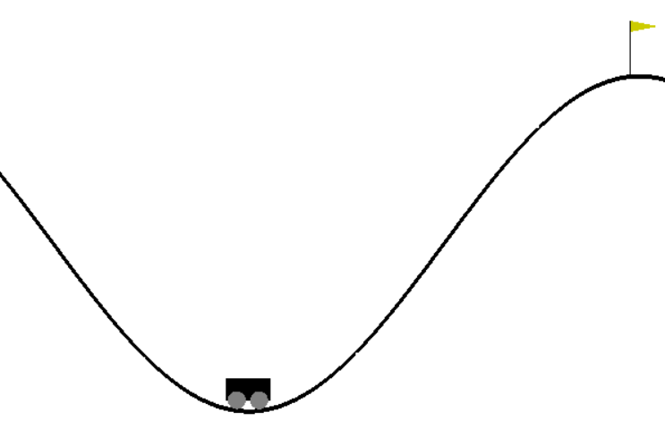
MountainCar Example
import gym
env = gym.make("MountainCar-v0")
env.reset()
done = False
while not done:
action = 2 # always go right!
env.step(action)
env.render()

Slide 48
CartPole with Basic Policy
import gym
env = gym.make("CartPole-v0")
def basic_policy(obs):
angle = obs[2]
return 0 if angle < 0 else 1
totals =[]
for episode in range(500):
episode_rewards=0
obs = env.reset()
for step in range(1000):
action = basic_policy(obs)
obs,reward,done,info=env.step(action)
episode_rewards+=reward
if done:
break
totals.append(episode_rewards)
#summary
import numpy as np
np.mean(totals), np.std(totals), np.min(totals), np.max(totals)

Slide 49
Exercise #15
Complete the gym tutorial on https://3months.tistory.com/173
Randomly generate actions
Use q-table to generate actions

Slide 50

Deep Q Networks (DQN)
Replace the Q table with a neural network that tries to approximate Q Values. Q값을 찾기위해 신경망을 사용
Cost function

Slide 51
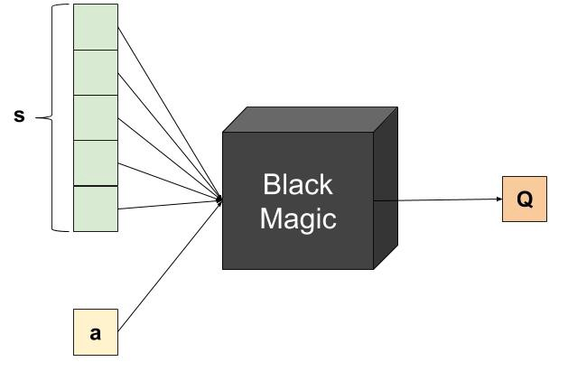
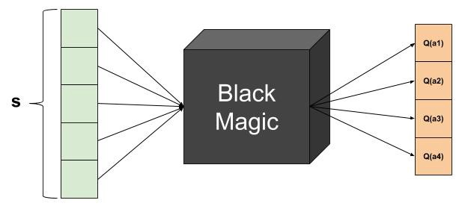
Q Table vs Neural Network

Slide 52
NN Model for Deep Q Learning
model = Sequential()
model.add(Dense(24, input_shape=(observation_space,), activation="relu"))
model.add(Dense(24, activation="relu"))
model.add(Dense(self.action_space, activation="linear"))
model.compile(loss="mse", optimizer=Adam(lr=0.001))
model.summary()

Slide 53
Memorize State, Action, Reward, Next State, Done
memory = [(state, action, reward, next_state, done)...]
def remember(self, state, action, reward, next_state, done):
self.memory.append((state, action, reward, next_state, done))
if len(self.memory) > self.train_start:
if self.epsilon > self.epsilon_min:
self.epsilon *= self.epsilon_decay

Slide 54
Data Preparation
minibatch = random.sample(self.memory, min(len(self.memory), self.batch_size))
for i in range(self.batch_size):
state[i] = minibatch[i][0]
action.append(minibatch[i][1])
reward.append(minibatch[i][2])
next_state[i] = minibatch[i][3]
done.append(minibatch[i][4])
target = model.predict(state)
target_next = model.predict(next_state)
model.fit(state, target, batch_size=self.batch_size, verbose=0)

Slide 55
Exercise #15
Complete DQN tutorial on https://pylessons.com/CartPole-reinforcement-learning/
Complete Taxi-v2 tutorial on https://www.learndatasci.com/tutorials/reinforcement-q-learning-scratch-python-openai-gym/

