Slide 1

Using R for data wrangling
Reading and Cleaning Data
Exam 1

Slide 2
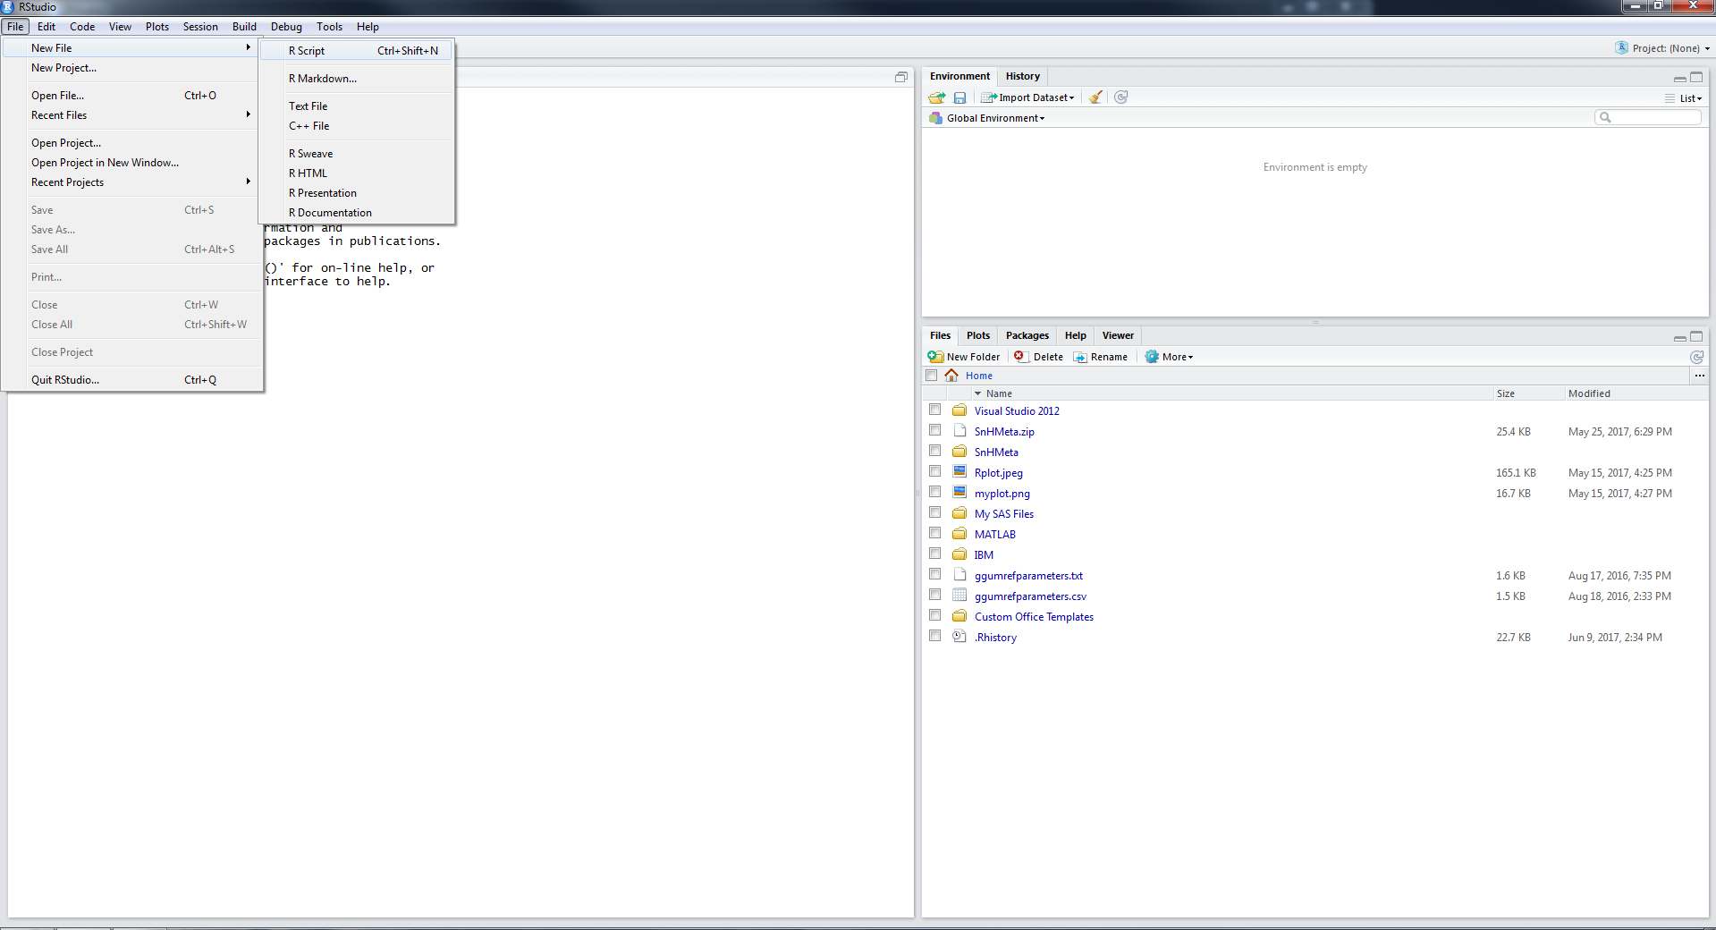
Starting Out
Select new R Script
Select new R Markdown

Slide 3
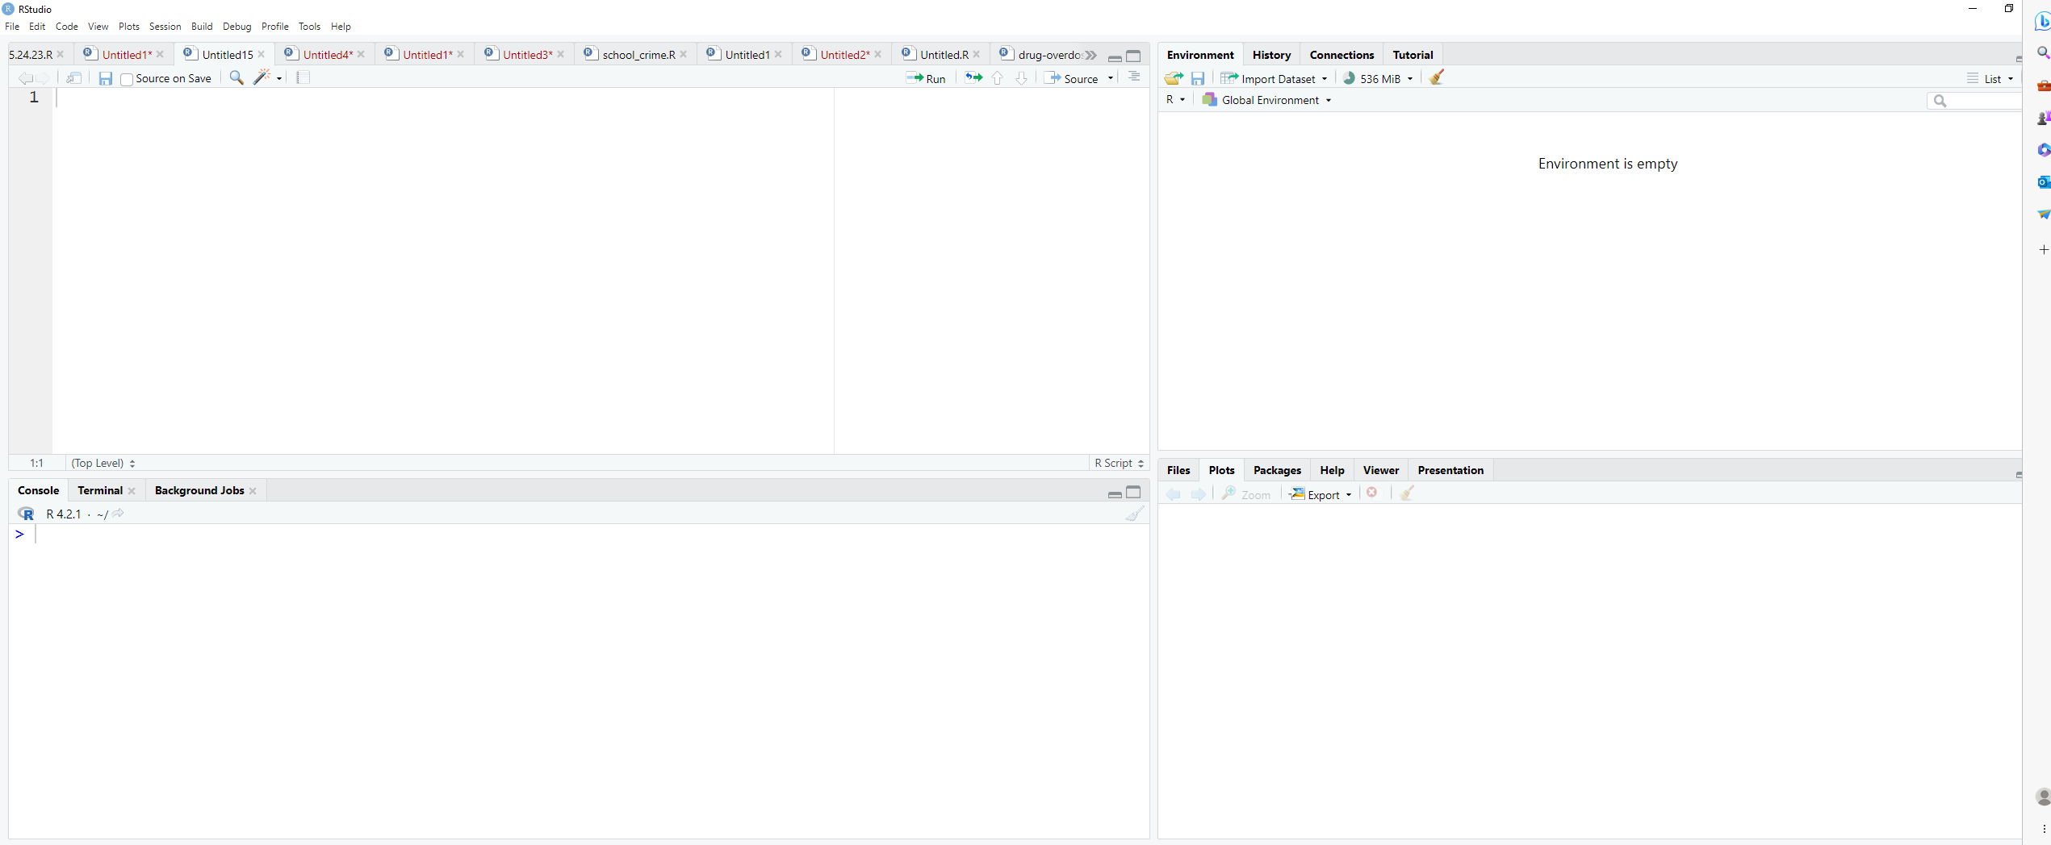
Run whole Script or highlighted section
The editor is where you can write R code that can be saved and reran.
Press CTRL + Enter to run highlighted code
Environment tab shows all active objects.
History tab shows list of commands used so far.
Files tab shows files and folders in your current workspace.
Plots tab shows all your graphs.
Packages tab shows available packages to run certain functions.
Help tab provides additional info.
Viewer tab is built-in browser.
The console is where you see output and can also type R code.

Slide 4
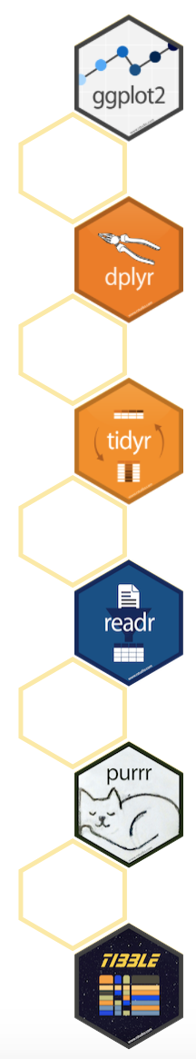
Getting started with packages
Packages are extensions to base R. They contain additional functions, documentation for using them, and sample data.
Packages are available from the Comprehensive R Archive Network (CRAN).
https://cran.r-project.org/web/packages/available_packages_by_name.html
The “tidyverse” is a set of packages for data manipulation, exploration, and visualization. They share a common design and work in harmony (this also means that there is overlap which can cause issues).
#Install and load the package 'tidyverse'
install.packages(“tidyverse”) # only need to run once (the checkbox is a comment)
library(tidyverse) #run at start of every R session to use
https://www.tidyverse.org/

Slide 5
Important Libraries (not in Base R)
Data Wrangling | Plotting | Descriptive Statistics | Mapping/GIS
dplyr, tidyr, plyr | ggplot2 | Hmisc | tmap & tmaptools
janitor | lattice | psych | ggmaps
tidyverse | patchwork | summarytools | sf
stringr |  | tableone | tidycensus
readr |  | desctable
foreign |  | GGally
remotes
Note: R is case sensitive. The packages must be typed exactly as shown above.

Slide 6
Syntax for packages
Developers of different packages may use the same function name.
Good coding practice to specify package::function() to be explicit:
# Instead of:
filter()
# Specify the package for that function:
dplyr::filter()
Hint: after typing the package press the tab button to see a list of functions
Hint: after typing the object press the tab button to see a list of ‘children’

Slide 7
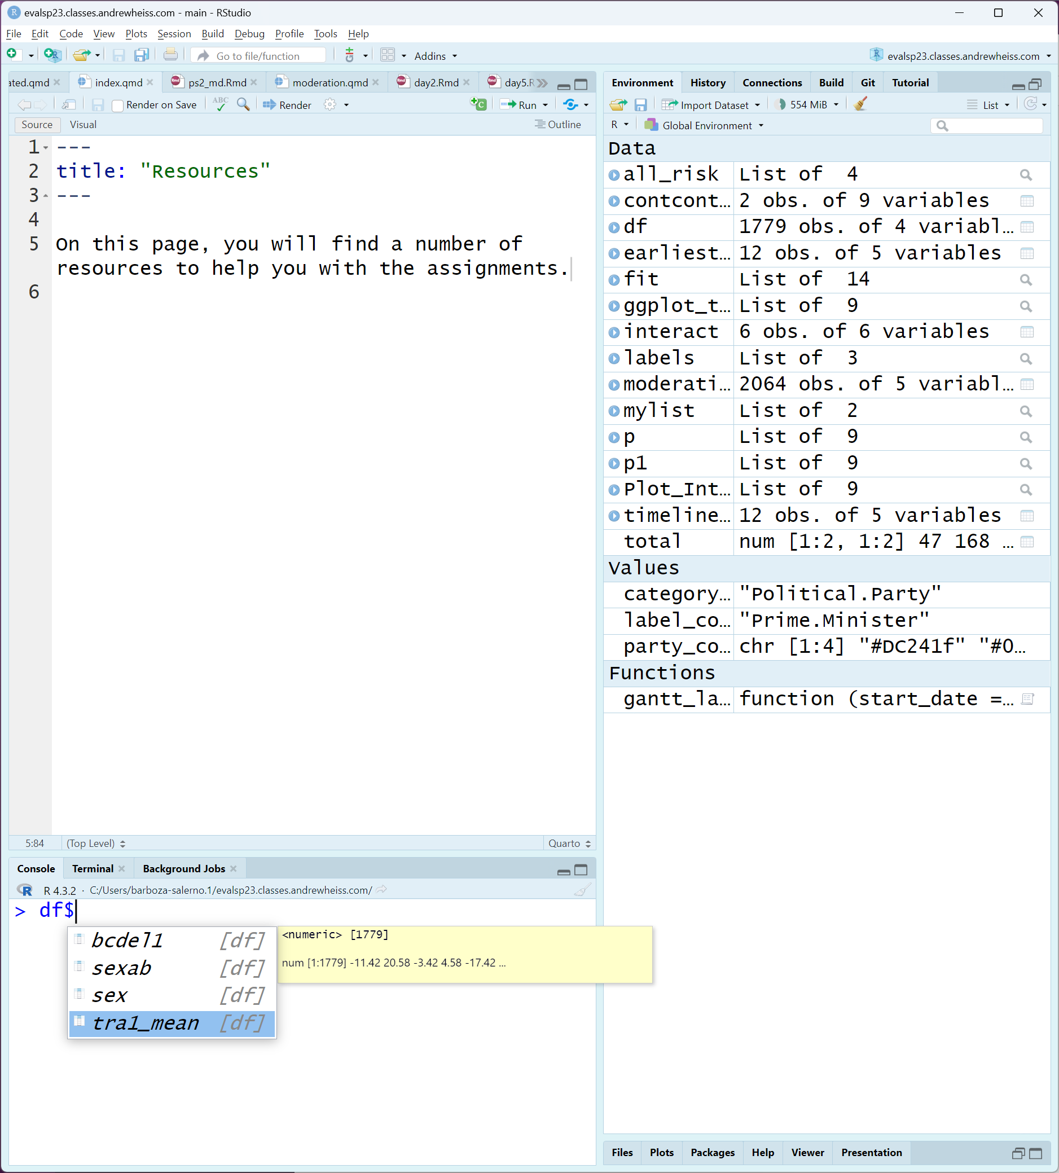
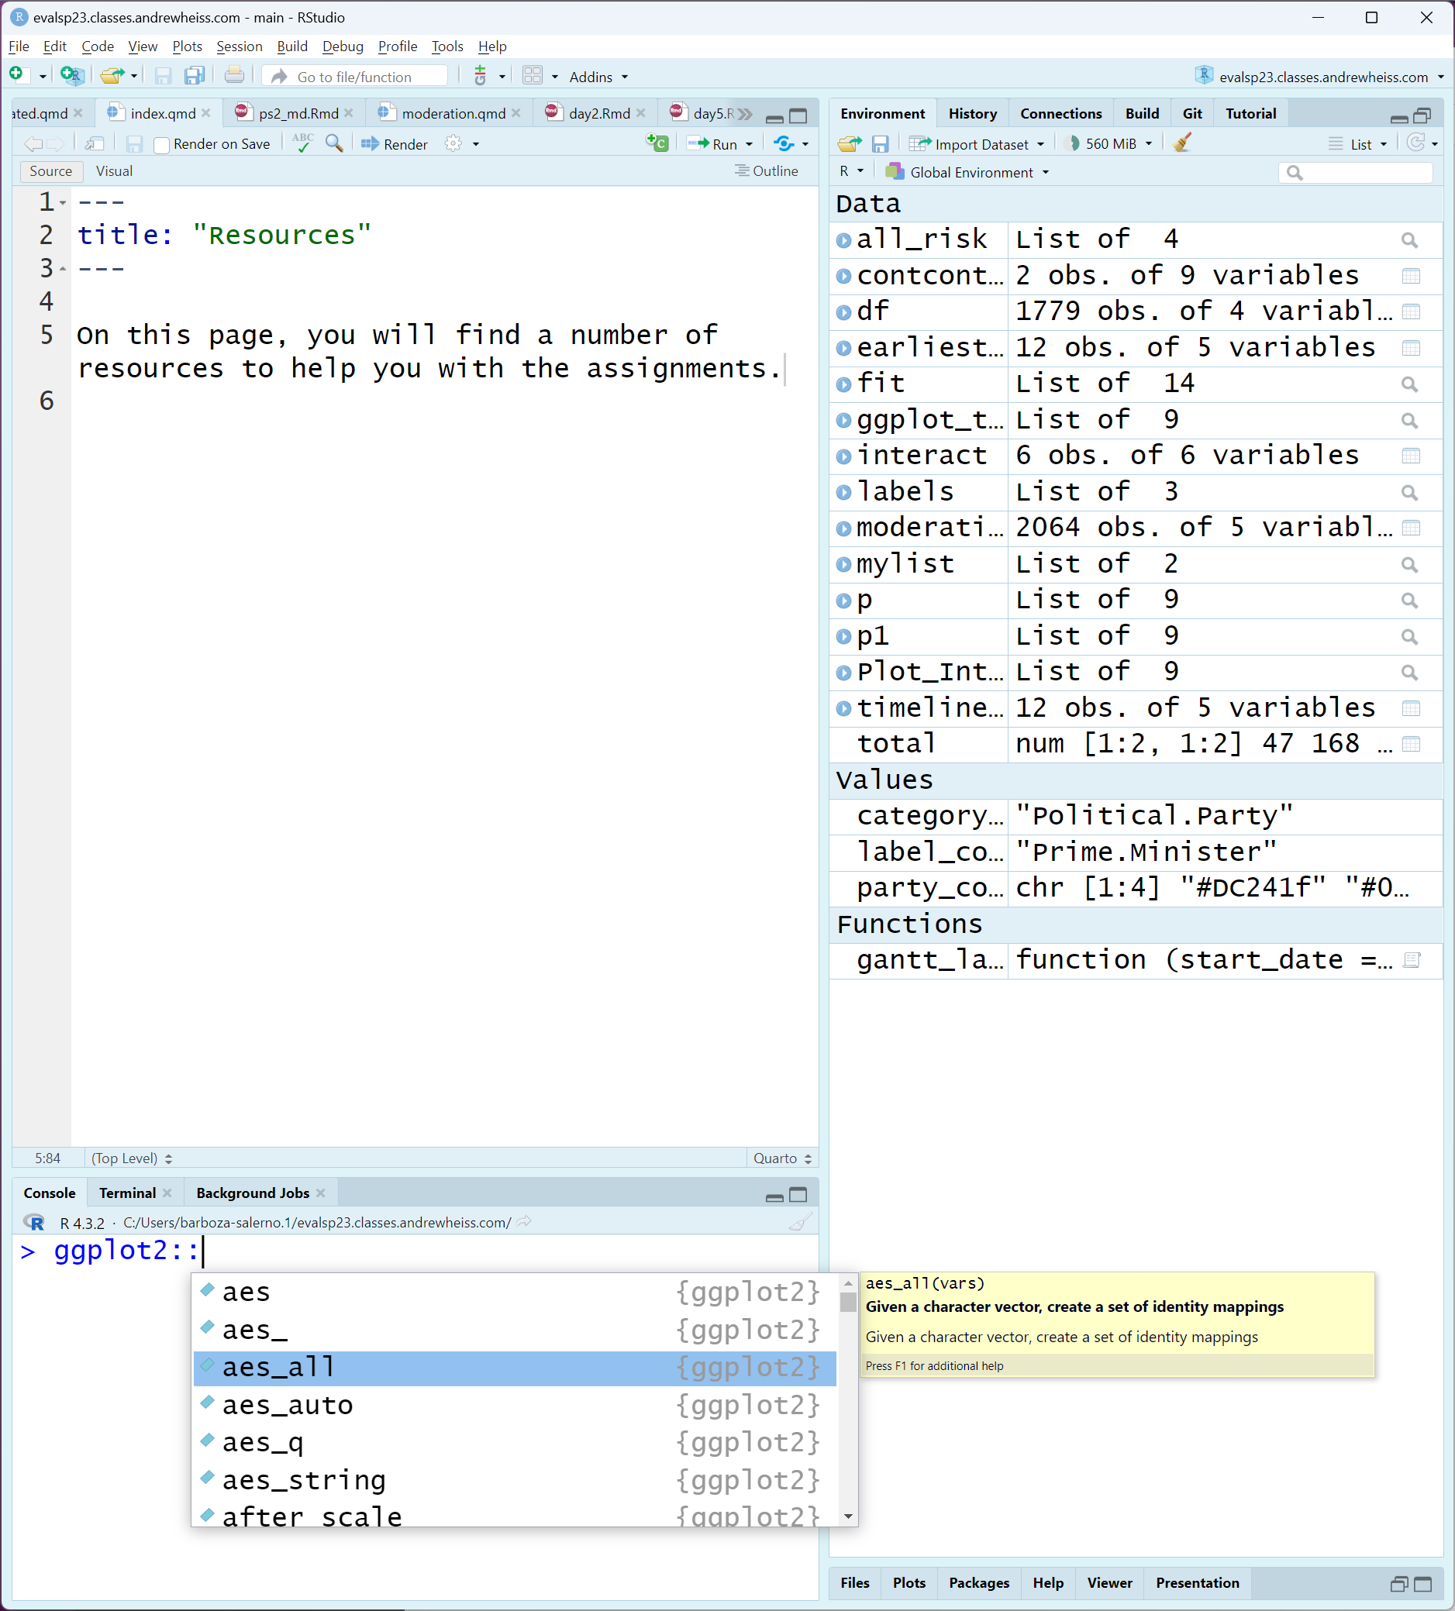
Press ‘Tab’
Press ‘Tab’

Slide 8
Data structure
Two helpful slogans to understand R computations
Anything that exists is an object
Dataset
The results of a statistical test
Graph
Anything that happens is a function call
R has several types of data values
You’ll likely deal with these the three in the table
Type | Example
Character | “A”, “b”, “Portland, OR”
Numeric | 2, 15.5
Logical | TRUE, FALSE

Slide 9
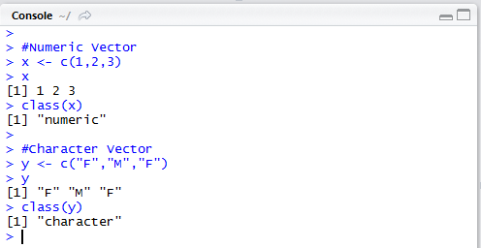
Data Structures
Vector
Values of all same data type
Numeric Character
1
M
2
F
3
M

Slide 10
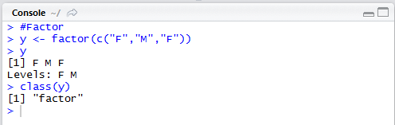
Data Structures
Factor
Collection of values that have fixed set of possible values
Similar to vector
Represents categorical variables
M
F
M
Your character variables must be factored in some instances, or you will get an error!!

Slide 11
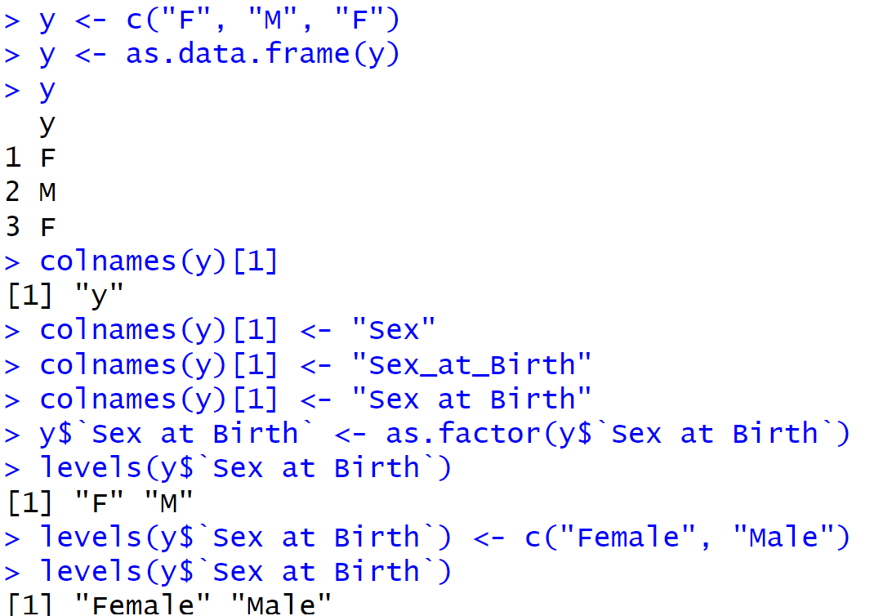

Slide 12
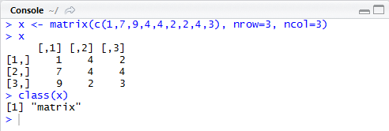
Data Structures
Matrices
Two-dimensional collection of values of same type
Array can extend this to more than two dimensions
1
4
2
7
4
4
9
2
3

Slide 13
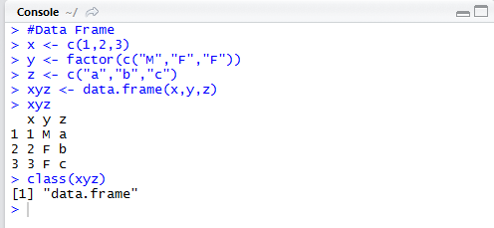
Data Structures
Data frames
Collection of vectors that all have same length
Columns can have different data types
Array can extend this to more than two dimensions
1
M
a
2
F
b
3
F
c

Slide 14
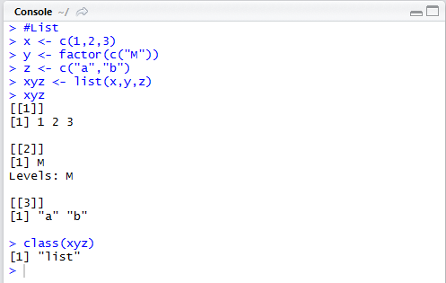
Data Structures
Lists
Similar to data frame, but columns can have varying lengths
1
M
a
2
b
3

Slide 15

Things to Note When Writing Code
Syntax is case-sensitive
Typing in “Mydf” to call an object named “mydf” is wrong
Object names consist of letters, numbers, underscores “_” and periods “.”
You can use either ‘<-’ or ‘=‘ to assign objects value
a <- c(1,2,3)
a = c(1,2,3) ← do not do
Functions can stand on their own or be an object
1 + 2
a <- 1 + 2
Important to consider later on when we do analyses

Slide 16
Create a simple dataset in R (by hand)
sex_at_birth <- c(“male”, “male”, “female”, “male”, “female”, “female”)
age <- c(10, 12, 3, 0, 1, 16)
cbl_score <- c(50, 39, 48, 54, 70, 55)
dep_score <- c(40, 29, 37, 44, 60, 45)
total_score <- cbl_score + dep_score
mydat <- data.frame(sex_at_birth, age, cbl_score, dep_score, total_score)
str(mydat)
View(mydat)
Use the ‘str’ command to check what the computer understands to be the contents of your data-this matters when you analyze (‘factor’ plots and adds differently than ‘integer’ or ‘number’)
Things to note
WARNING: DO NOT COPY AND PASTE

Slide 17
table(mydat$sex_at_birth)

Slide 18
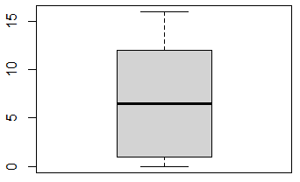
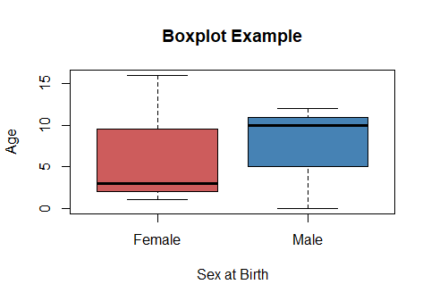
Basic Plotting (Base R)
boxplot(age ~ sex_at_birth,
data=mydat,
ylab="Age",
xlab = "Sex at Birth",
col=c("red", "steelblue"),
names = c("Female", "Male"),
main = "Boxplot Example")
The plot and hist functions present users with options to customize their graphs (note: R has extensive help pages or search web for examples)
plot(mydat$sex_at_birth)
Awful
Default: Awful!
Nice!

Slide 19
Take it one step at a time
boxplot(mydat$age, xlab = "Age", col = "steelblue")
boxplot(mydat$age ~ mydat$sex_at_birth, ylab="Age")
boxplot(age ~ sex_at_birth, data=mydat, ylab="Age")
boxplot(age ~ sex_at_birth, data=mydat, ylab="Age", col="steelblue")
boxplot(age ~ sex_at_birth, data=mydat, ylab="Age", col=c("indianred", "steelblue")

Slide 20
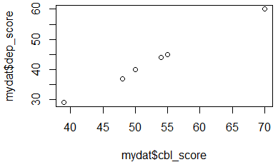
Scatterplots

Slide 21
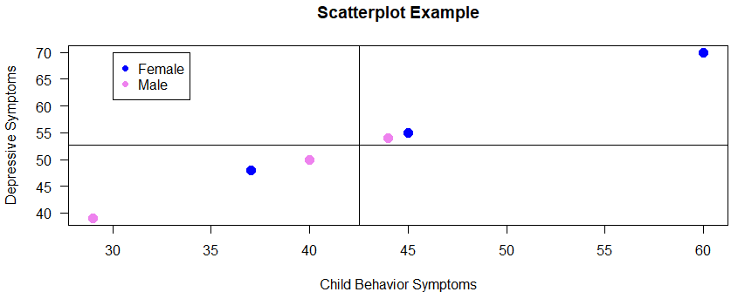
plot(cbl_score ~ dep_score,
data=mydat,
pch=19,
col = c("blue", "violet")[mydat$sex_at_birth],
ylab="Depressive Symptoms",
xlab="Child Behavior Symptoms",
las=1,
cex = 1.5,
main = "Scatterplot Example")
legend(30,70,c("Female","Male"),col=c("blue", "violet"),pch=19)
abline(h=mean(mydat$cbl_score),v=mean(mydat$dep_score))

Slide 22
Importing Data
R can read a variety of datasets
The most important dataset is a csv file
mydat <- read.csv(“PATH TO FILE”)
mydat <- read.csv(“C:/Users/barboza-salerno.1/Documents/mydat.csv”)
NOTE: R is case sensitive and uses forward slashes
Note: the file NAME must be in quotes
Also, once you type the “/” you can hit the tab key to autofill
mydat <- read.csv("mydat.csv")
mydat <- read.csv("C:/Users/barboza-salerno.1/OneDrive - The Ohio State University/Documents/mydat.csv”)

Slide 23
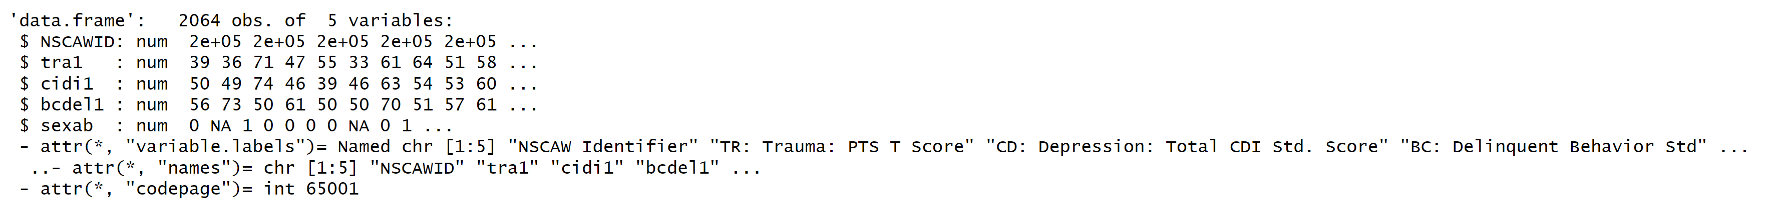
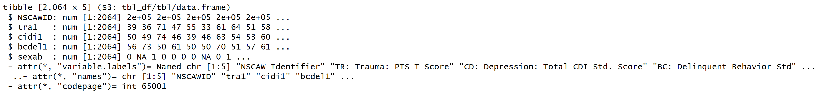
dfs and tibbles

Slide 24
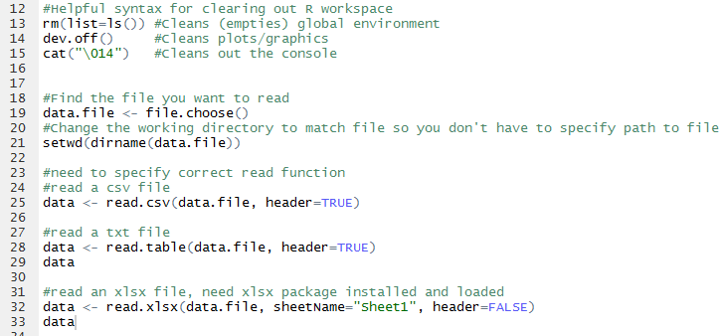
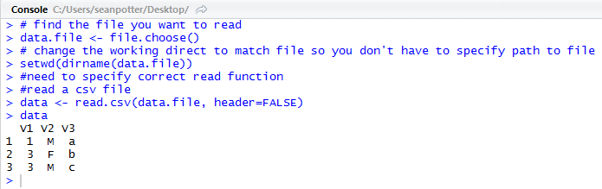
Importing Data Using Syntax
Example .csv import

Slide 25
Other file types
Excel
library(xlsx)
mydat <- read.xlsx(“name of file.xlsx”, sheetName = “Sheet 1”, header = T)
SPSS, STATA, SAS
library(haven)
mydat <- read_sav("PATH_OR_URL_TO_SAS_FILE/file.sav")
mydat <- read_sas(" 'PATH_OR_URL_TO_SAS_FILE/file.sas7bdat")
mydat <- read_dta('PATH_OR_URL_TO_STATA_FILE /file.dta')

Slide 26
2. Intro to the tidyverse

Slide 27
The Tidyverse
A collection of packages for data manipulation, exploration, and visualization.
Share a common philosophy of R programming and work in harmony.
Core tidyverse packages:
readr dplyr tidyr ggplot2 tibble purrr

Slide 28

Data Manipulation with dplyr
Very useful package for exploring and managing your data.
“A grammar of data manipulation, providing a consistent set of verbs that help you solve the most common data manipulation challenges.”
Resources for getting started:
http://dplyr.tidyverse.org/
https://cran.r-project.org/web/packages/dplyr/vignettes/dplyr.html
https://www.rstudio.com/wp-content/uploads/2015/02/data-wrangling-cheatsheet.pdf
http://r4ds.had.co.nz/transform.html

Slide 29
3. dplyr code structure

Slide 30
dplyr Key Functions
select()
filter()
arrange()
summarise()
mutate()
group_by()
More helpful info here: https://www.rstudio.com/wp-content/uploads/2015/02/data-wrangling-cheatsheet.pdf

Slide 31

dplyr Key Functions
select()
Picks variables (columns) based on their names.
df %>% dplyr::select(c(2:3, 5))
names(df)
names(df) [1] "bcdel1" "sexab" "sex" "tra1_mean"
df %>% dplyr::select("sex")
Query: why will the following code throw an error?
df %>% dplyr::select(c(2:3, 5))
df %>% dplyr::select("sex", "tra1_mean")
df_sub <- df %>% dplyr::select("sex", "tra1_mean")
names(df_sub) [1] "sex" "tra1_mean"

Slide 32

dplyr Key Functions
filter()
Picks observations (rows) based on their values.
df %>% filter(tra1_mean < 4)

Slide 33
dplyr Key Functions
arrange()
Changes the ordering of the rows based on their values.

Slide 34

dplyr Key Functions
summarise()
Reduces multiple values down to a single summary value.
df %>% summarise(del = mean(bcdel1, rm.na=T)) # A tibble: 1 × 1 del <dbl> 1 NA
df %>% summarise(del = mean(bcdel1, na.rm =T)) # A tibble: 1 × 1 del <dbl> 1 60.8

Slide 35

dplyr Key Functions
mutate()
Adds new variables that are functions of existing variables.

Slide 36
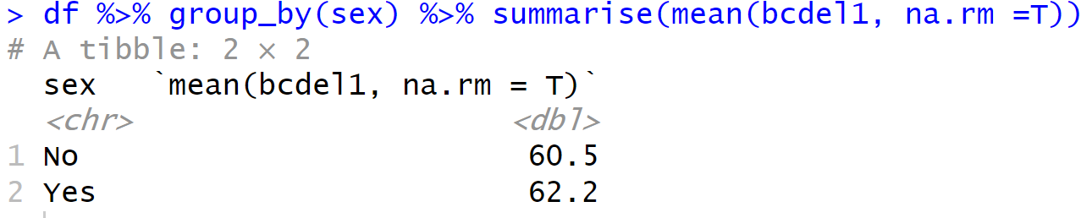
dplyr Key Functions
group_by()
Performs data operations on groups that are defined by variables.

Slide 37
Key Functions
select()
Picks variables (columns) based on their names
filter()
Picks observations (rows) based on their values
arrange()
Changes the ordering of the rows
summarise()
Reduces multiple values down to a single summary value
mutate()
Adds new variables that are functions of existing variables
group_by()
Performs data operations on groups that are defined by variables

Slide 38
Key Operator: The Pipe %>%
A common paradigm in all tidyverse R libraries is to use the pipe operator, %>%, which allows us to chain or pipe functions together
Enables you to pass the object on left hand side as first argument of function on the right-hand side
Goal of making our code more efficient and easier to read

Slide 39
Basic Structure
Use the key functions and pipe to chain together multiple simple steps to achieve a more complicated result.
Dataset %>%
Select rows or filter columns %>%
Arrange or group the data %>%
Calculate statistics or new variables of interest

Slide 40
Basic Structure
#Prints output to the console:
#Creates a new R object:
Dataset %>%
Select rows or columns %>%
Arrange or group the data %>%
Calculate statistics or new variables
new_obj <-
Dataset %>%
Select rows or columns %>%
Arrange or group the data %>%
Calculate statistics or new variables

Slide 41
Reading files from the web
You are interested in exploring the relationship between early race and infant mortality in the city of Chicago. You need to find data. You remember that you had this amazing professor for research methods who told you about the Cook County medical examiner’s case file. You decide to impress your colleagues at the Ivy league school where you were recently tenured (and secured the schools largest NIH award!). First, begin by downloading, preparing and exploring some key variables by race.
Data manipulation: Create an analytic dataset that is a subset of the observations and variables in the original death data, specific to your research question.
Summary statistics: Explore the variables corresponding to race, and manner of death.

Slide 42
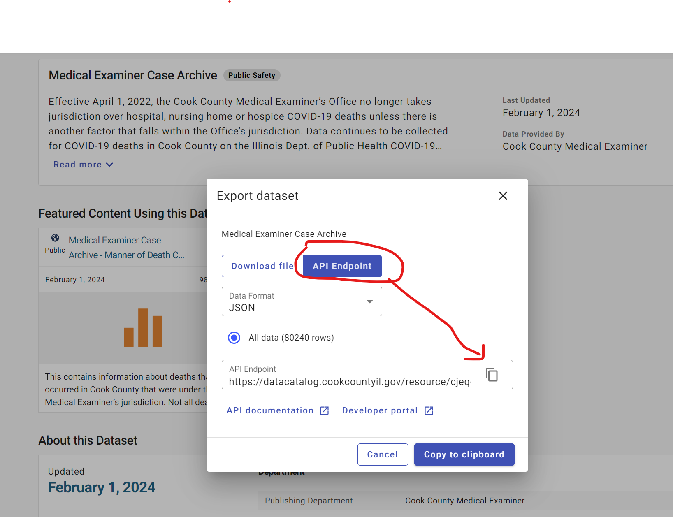
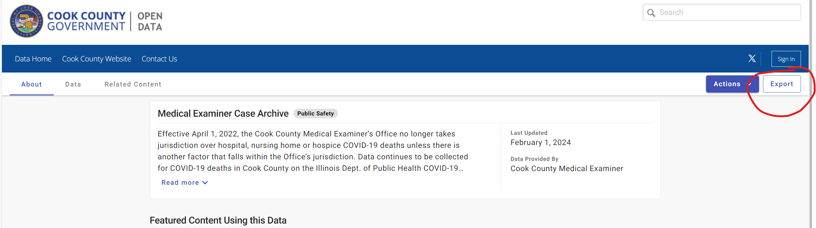
Reading files from the web
Medical Examiner Case Archive | Cook County Open Data (cookcountyil.gov)
https://datacatalog.cookcountyil.gov/resource/cjeq-bs86.json
library(RSocrata)
options(scipen=10000)
#https://datacatalog.cookcountyil.gov/api/odata/v4/cjeq-bs86
child_homicide <- read.socrata("https://datacatalog.cookcountyil.gov/api/odata/v4/cjeq-bs86")

