Slide 1

Research Methods Mediation, Moderation and Conditional Process Models
Day 4

Slide 2
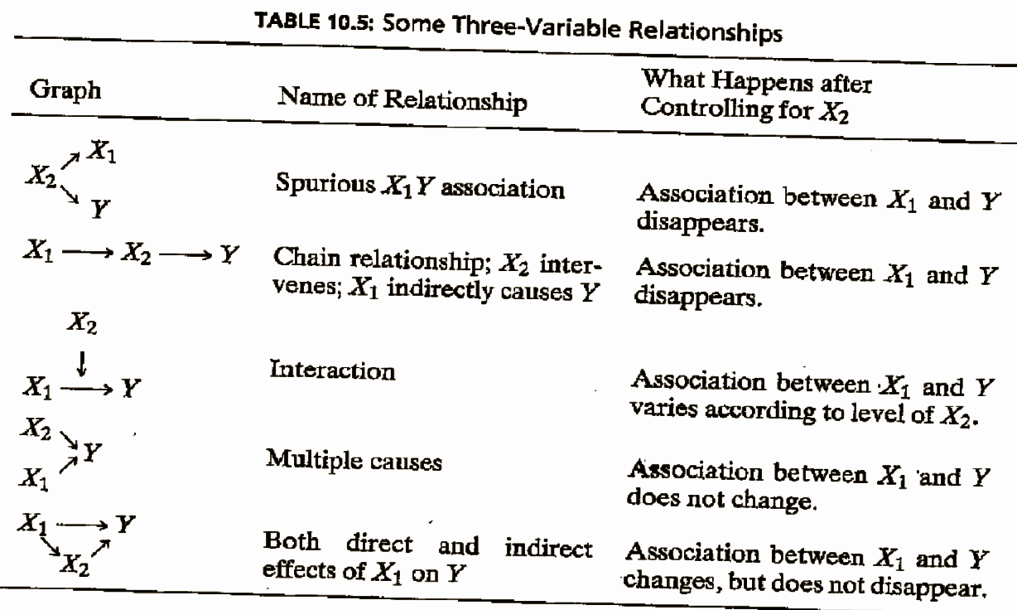
Confounding
Complete
Mediation
Moderation
Independence
Partial
Mediation

Slide 3
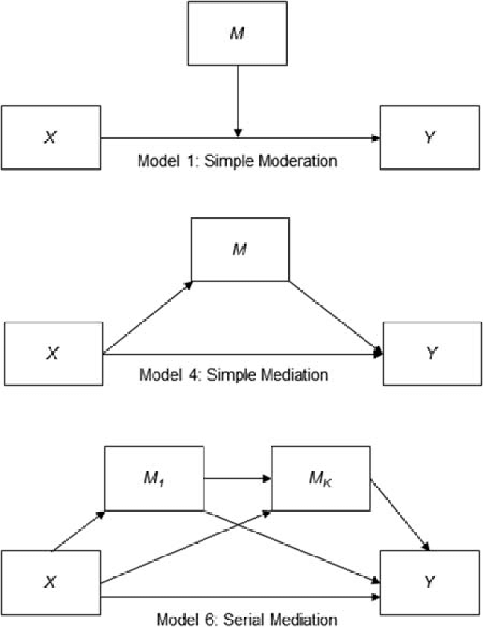
Interaction Effect (Moderation)
Mediation Effect
W

Slide 4
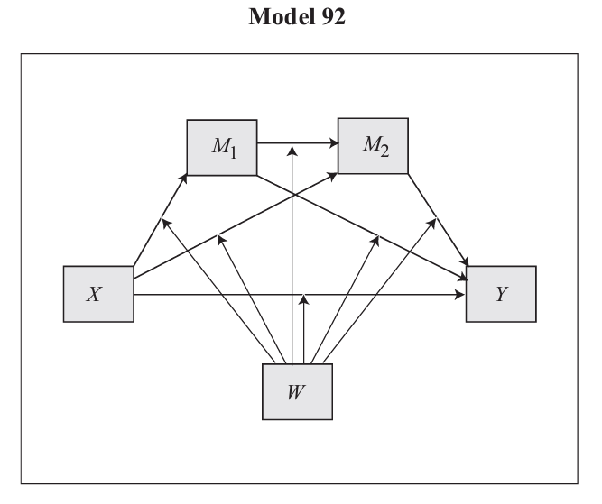
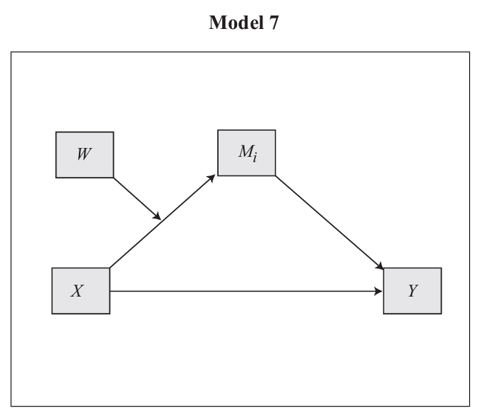
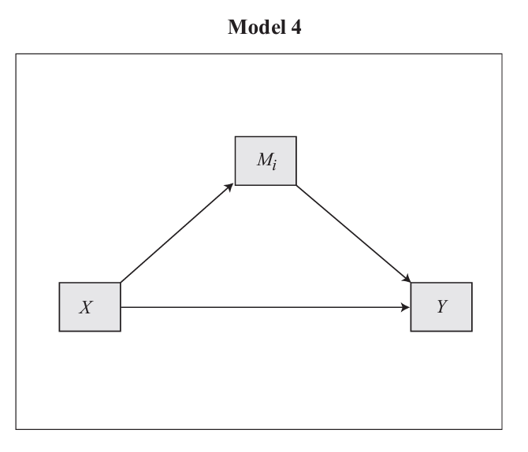
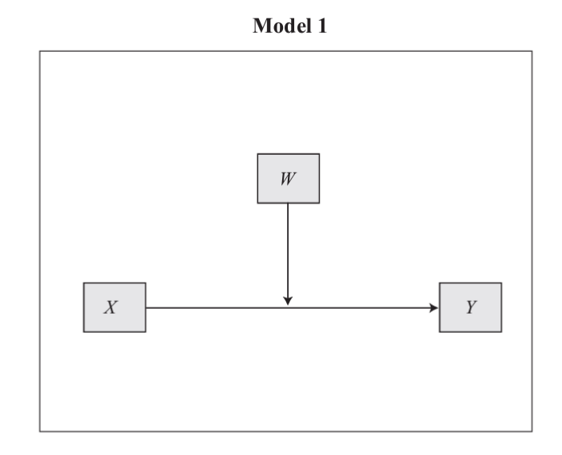
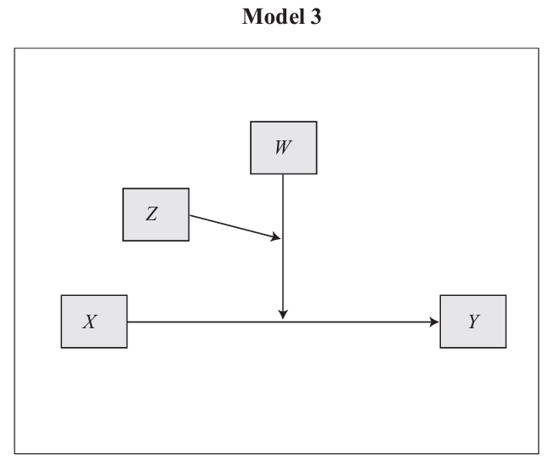
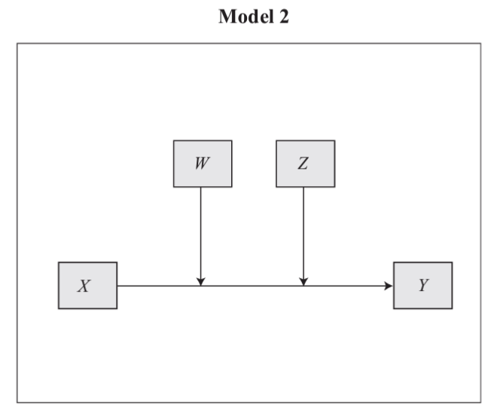
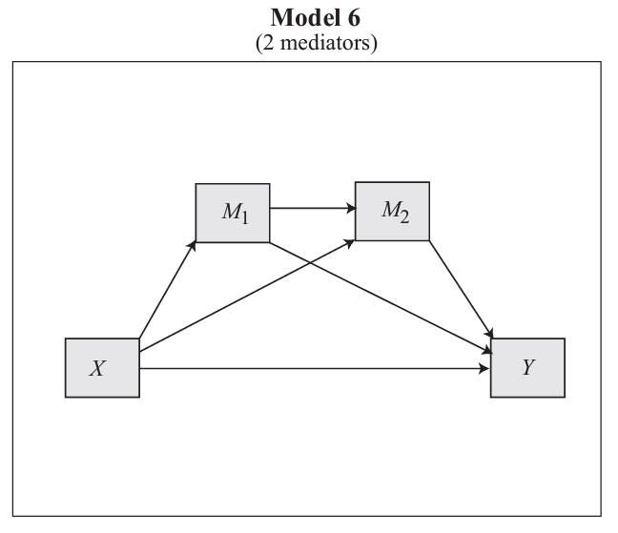
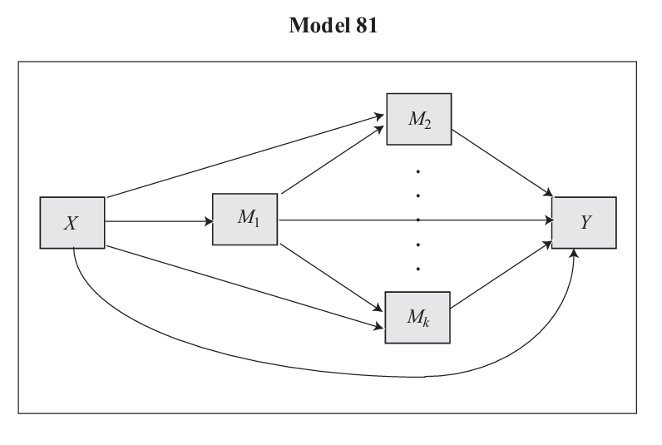
The Process Macro by Andrew Hayes
Download - The PROCESS macro for SPSS, SAS, and R
templates.pdf (mathpsy.com)

Slide 5







Ordinary Least Squares Regression
The SLR model (which can be extended to the multivariate case) is:
β₁ > 0 ⇒ Positive Association
β₁ < 0 ⇒ Negative Association
β₁ = 0 ⇒ No Association
$$Y_{i}=β_{0}+β_{1}X_{i}+ε_{i}$$
$${E(Y}_{i})=β_{0}+β_{1}X_{i}+ε_{i}$$
$$Y_{i}$$
The observed response for the ith trial (or row of data)
$$X_{i}$$
A known constant, the level of the predictor in the ith trial
$β_{0}$, $β_{1}$
Unknown regression parameters
$$ε_{i}$$
Error term, independently and normally distributed, N(0, $σ^{2}$)
$$i$$
The index for the total number of cases in your data, i = 1, … N
Notes:
Independent means the outcome of any one trial has no effect on the error term for any other trial
The regression is simple, linear in the parameters and linear in the predictor
Explanatory and Response Variables are Numeric
Relationship between the mean of the response variable and the level of the explanatory variable assumed to be approximately linear (straight line)

Slide 6
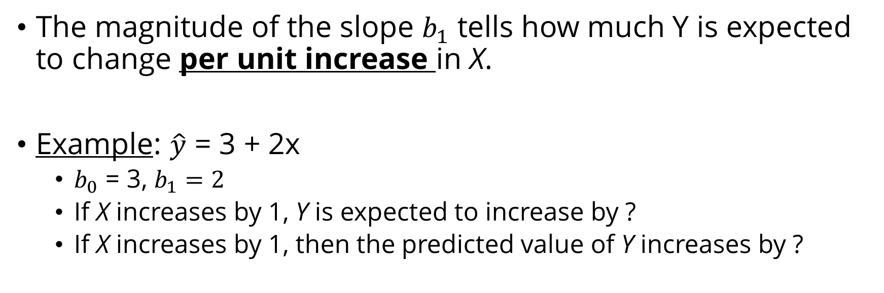

Interpretation of Regression Equation
$$\hat{y}=b_{0}+b_{1}x$$
The magnitude of the slope $b_{1}$ tells how much Y is expected to change per unit increase in X.
Example: $\hat{y}$ = 3 + 2x
$b_{0}$ = 3, $b_{1}=2$
If X increases by 1, Y is expected to increase by ?
If X increases by 1, then the predicted value of Y increases by ?
Notes:
2
2

Slide 7
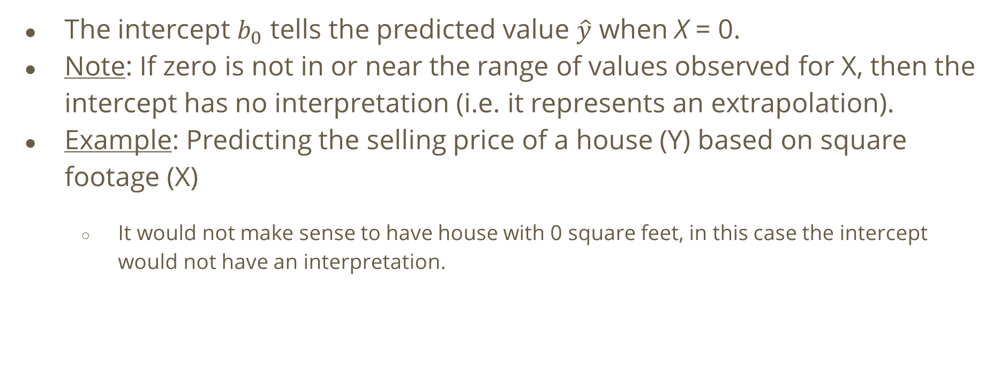
Interpreting the Intercept
The intercept $b_{0}$ tells the predicted value $\hat{y}$ when X = 0.
Note: If zero is not in or near the range of values observed for X, then the intercept has no interpretation (i.e. it represents an extrapolation).
Example: Predicting the selling price of a house (Y) based on square footage (X)
It would not make sense to have house with 0 square feet, in this case the intercept would not have an interpretation.

Slide 8
Standardizing Variables
We might rescale all variables in the equation to have a mean of 0.0 and a standard deviation of 1.0 before running a regression analysis.
Why might it be useful to standardize variables? What is the purpose of standardization?
The most common reason to use standardized coefficients is in order to have a common scale with which to evaluate the contribution of each of the independent variables (IVs).
Not necessary to standardize the variables (Hayes, 2013) since standardized coefficients are hard to interpret when dealing with interaction terms.

Slide 9
Interaction Effects with Centering
Alternatively, we can center continuous IVs first (i.e. subtract the mean from each observation), then compute the interaction term and estimate the model. Centering is a good idea to avoid having to interpret the effects of β when X = 0.
β (slope) can be interpreted as the average change in DEL when (PTSS−mean(PTSS)) increases by 1 unit, which is equivalent to the average change in DEL when PTSS increases by 1 unit. Hence, when we center the IV, the interpretation of β remains the same.
Note that the intercept parameter has changed. Using the centered variable, the interpretation of β₀ is now the mean level of DEL for children who have PTSS scores that are equal to the sample average.

Slide 10
Including an Interaction Term
What does it mean for two predictors in a regression model "to interact"?
Two predictors interact if the effect on the response variable of one predictor depends on the value of the other predictor.
Review: interpreting the slope coefficient in a simple and multivariate linear regression
If an interaction effect is included in the model, the slope parameter can no longer be interpreted as the change in the mean response for each unit increase in the predictor, while the other predictors are held constant.

Slide 11
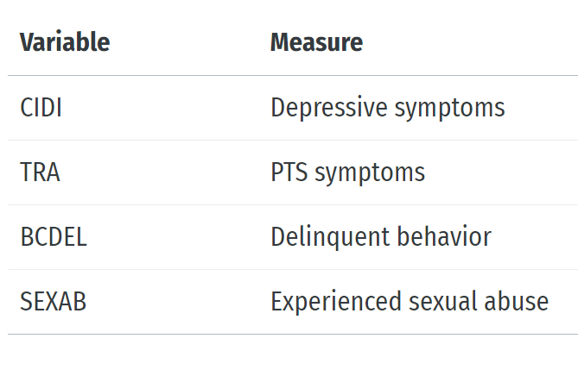
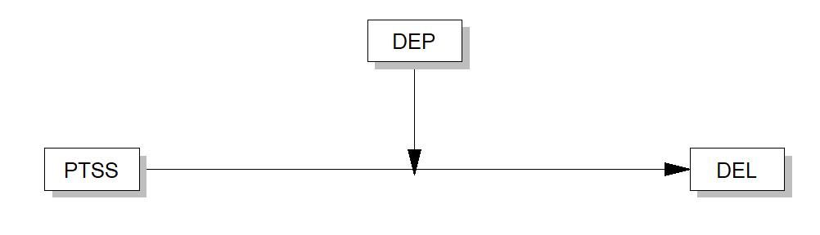
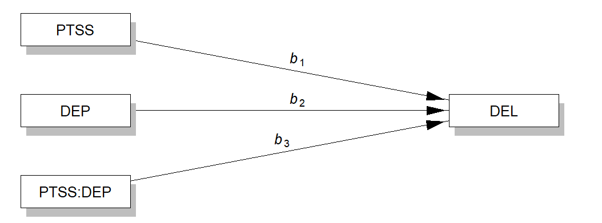
NSCAW I Example
Conceptual Model
Statistical Model
RQ: Do depressive symptoms moderate
the effect of post-traumatic stress disorder
on delinquent behavior among youth involved
in the child welfare system?

Slide 12

c
$DELINQ= b_{0}+b_{1}$PTSS + $b_{2}$DEPRESS
$DEL= b_{0}+b_{1}$PTSS + $b_{2}$DEPRESS + $b_{3}\text{PTSS} X\text{DEPRESS}$
Interaction Model: Include a two-way interaction term of PTSS X DEPRESS
For a model with interaction, we want to examine if `PTSS` effects on `DEL` depend, or are conditonal, on level of `DEPRESS`.
Main Effects Model
For a model without interaction, we assume that the effect of `PTSS` on `DEL` is the same regardless of the level of depressive symptoms experienced among respondents.

Slide 13
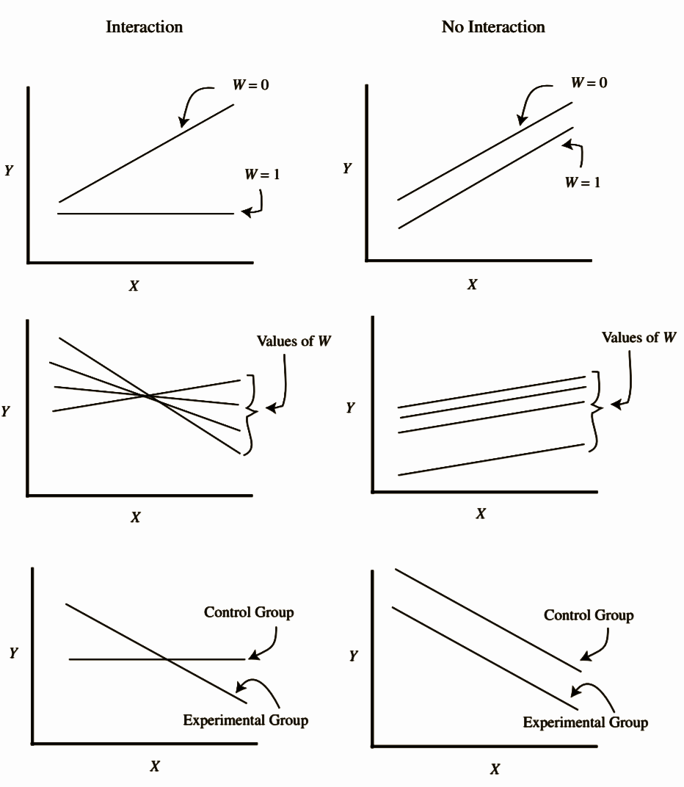
Two-way interactions:
Continuous x Continuous?
Categorical x Categorical?
Categorical x Continuous?
Interaction effects:
→ Change in slope (b₁)
→ Change in direction (sign)
→ Change in intercept (b₀)

Slide 14
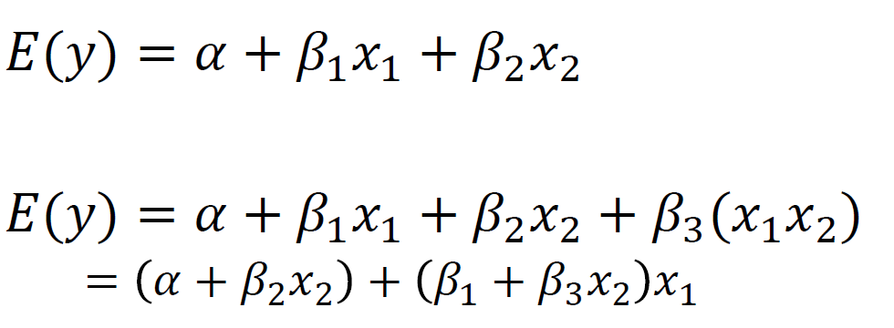
Interaction Term = Cross‐Product Term
To model interaction, we can include cross‐product terms of two independent variables into the multiple regression models

Slide 15
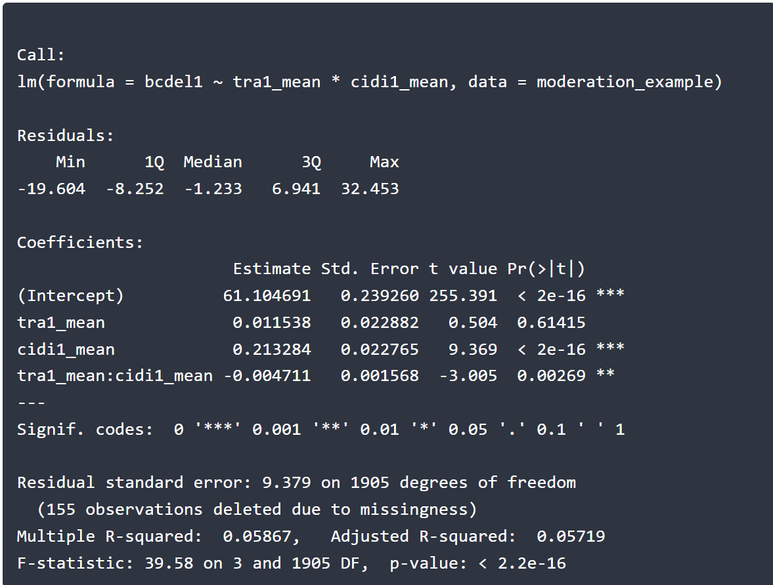
Interaction: E(DEL)=β₀+β₁PTSS+β₂DEPRESS + β₃PTSS*DEPRESS + ϵ
Interpret the coefficient on PTSS (TRA) and Depressive symptoms (CIDI)
What is the expected DEL score for welfare involved youth who have a PTSS score of 45 and a Depressive symptoms score of 50?
How to interpret the interaction between PTSS and TRA?

Slide 16
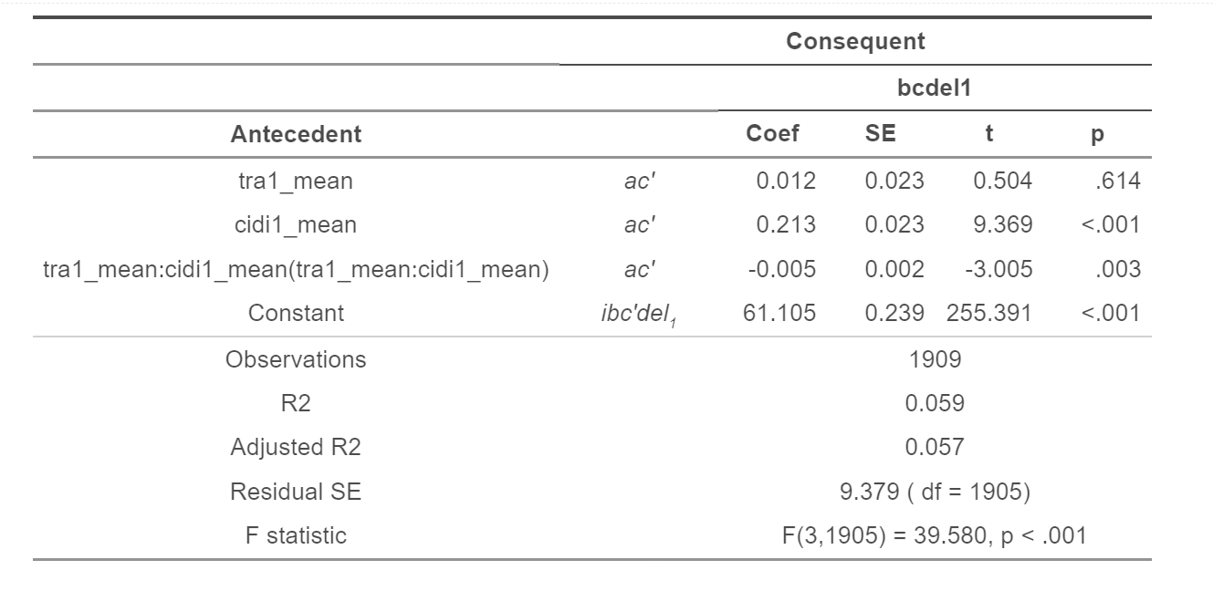
Compare Hayes book with R result

Slide 17
Interpretation of the Intercept
The intercept tells us the expected DEL score (~61.1) for the "average" welfare-involved child:
A child with an average level of PTSS symptoms,
A child with an average level of depressive symptoms

Slide 18
Interpretation of Regression Coefficients (Main Effects)
The coefficient for PTSS (0.0115) is the average difference between the delinquency scores for children who have an additional symptom. Hence, a one unit (i.e., one additional symptom) increase in post-traumatic stress is associated with a 0.0115-unit increase in the average DEL score, holding DEPRESS constant at its mean

Slide 19
Interpretation of the Interaction Term
Controlling other variables constant, the results show that while a one-unit increase in PTSS is associated with a 0.0115 unit increase in the average DEL score (i.e., the main effect), the interaction term (PTSS X DEPRESS) is statistically significant at the 0.05 level, meaning that there is an interaction effect between PTSS and DEPRESS, i.e., the effect of PTSS on DEL is conditional on level of depressive symptoms the child is experiencing – the effect of PTSS is different for different values of DEPRESS.
This means that, as DEPRESS increases, a one-unit increase in PTSS decreases DEL scores, holding other variables constant. This is because the coefficient on the interaction term is negative.

Slide 20
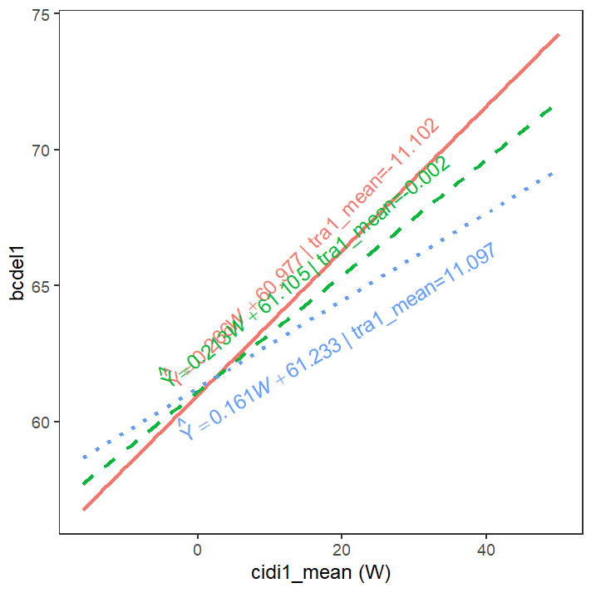
Alternatively:
The effect of PTSS on DEL is different for different values of DEPRESS.
When PTSS increases by 1 unit, the coefficient (=slope) of DEPRESS for DEL decreases by 0.86 units (.2132 - .0047) = 0.2085), compared to the coefficients of DEPRESS (i.e., .2132) for children who have average level of PTSS.
This is an odd finding: depressive symptoms are protective for delinquent behavior among youth with PTSS (?)

Slide 21
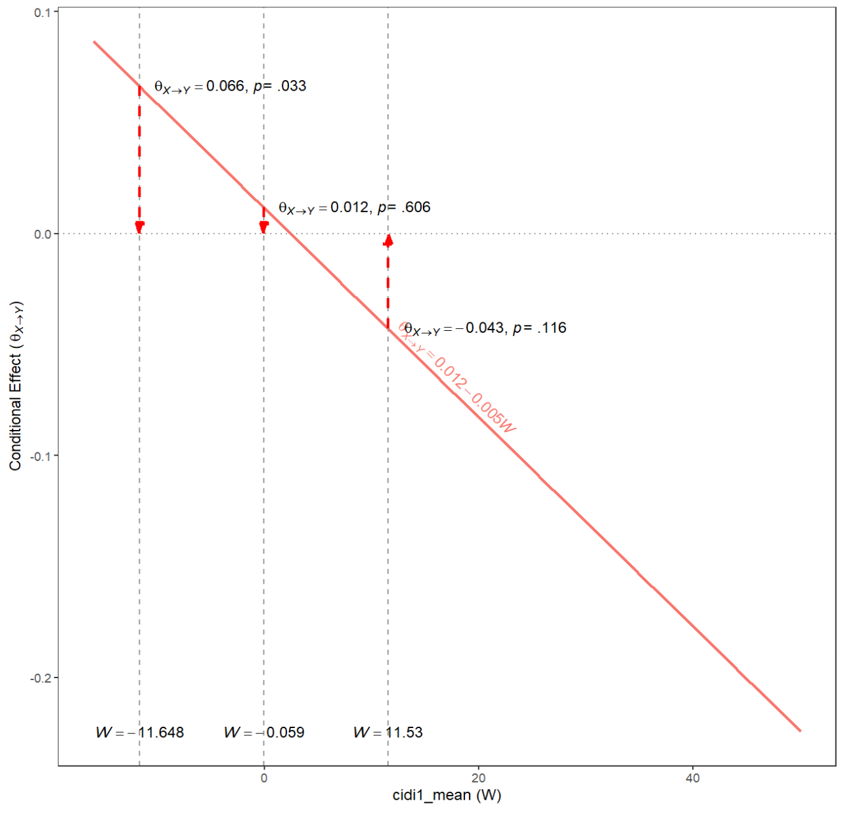
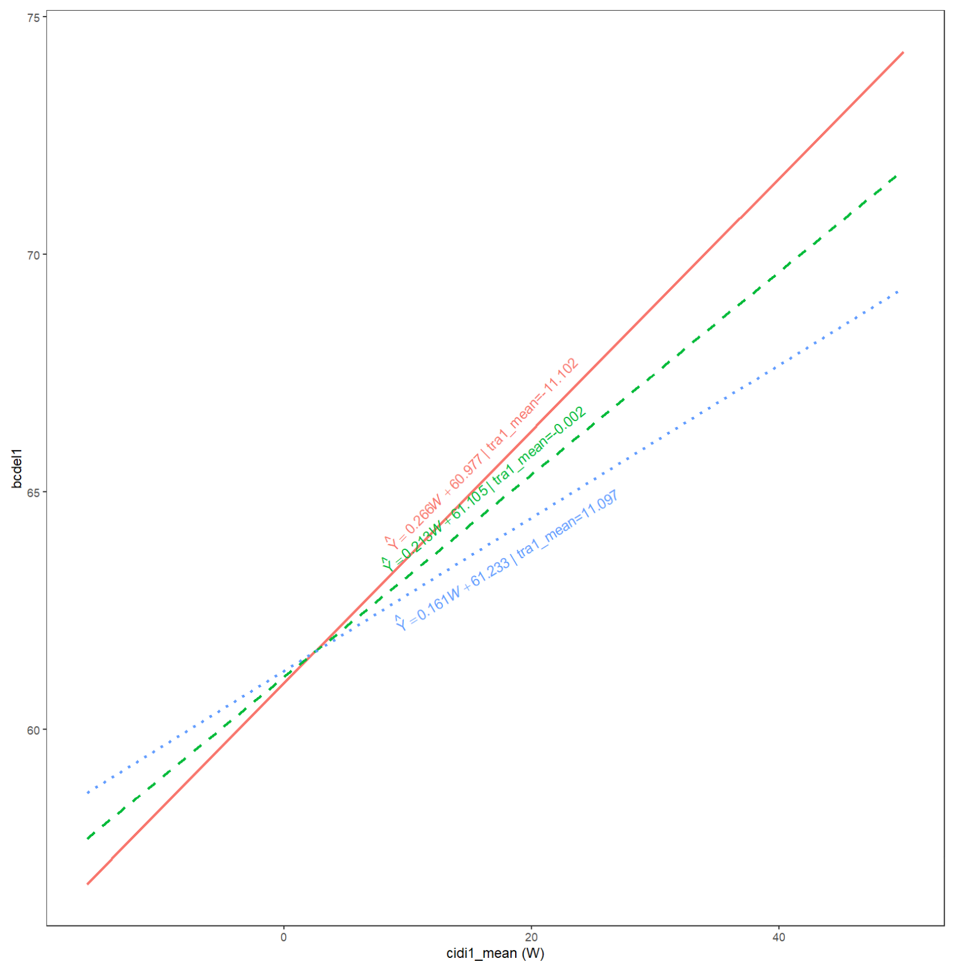
When DEP is low, children with lower PTSS (BLUE LINE) have higher DEL scores
BUT the impact of increasing DEP on DEL is greater for those with lower PTSS levels (RED LINE IS GREATER THAN BLUE LINE NOW)
As depressive symptoms increase the impact of PTSS on DEL is reduced

Slide 22
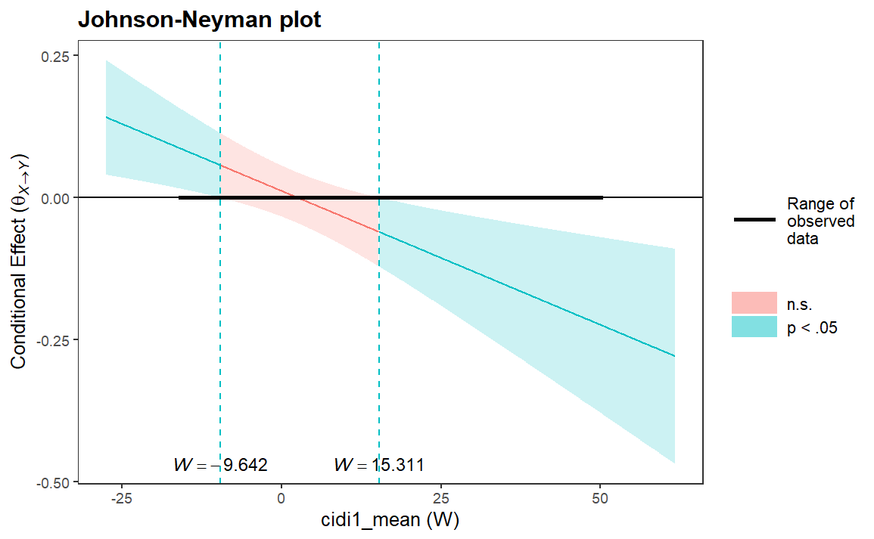

Slide 23
I used these methods in the following paper
Barboza-Salerno, G. E., & Remillard, A. (2023). Early Child Adversity and Delinquent Behavior in Foster Care Youth: Do Future Expectations and Sexual Identity Moderate the Mediating Role of Posttraumatic Stress?. Journal of Child & Adolescent Trauma, 1-13.

Slide 24
What is Mediation?
Ordinary Least Squares regression examines whether independent variables have a “direct” effect on a dependent variable. Direct effects are common in public health, social work, etc. research, but “indirect” effects are also common.
The terms “indirect effects” and “mediation” are used interchangeably. To remember what mediation is, think about how mediators are people who work between two people to resolve a dispute. In statistics, mediators come between two variables.
Mediation is present in statistics when the effects of an independent variable on a dependent variable occur fully or partially through its effects on another variable.

Slide 25
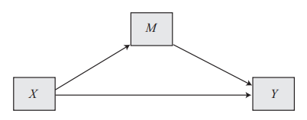
What is Mediation?
Mediation analysis is a statistical method used to evaluate evidence from studies designed to test hypotheses about how some causal antecedent variable X transmits its effect on a consequent variable Y
Note: Hayes is a psychologist, and they have different terminology, don’t be confused, antecedent means independent variable
RQ: What is the mechanism, be it emotional, cognitive, biological, or otherwise, by which X influences Y?
Indirect Effect
Direct Effect

Slide 26
Conceptualizing a Mediation Process
Mediation is ultimately a causal explanation hence the assumptions are that
The relationships in the system are causal
M is causally located between X and Y
X causes M, which in turn causes Y → M is located causally between X and Y
Note about cross-sectional data

Slide 27
Demonstrating Causation​
4 requirements to logically infer a causal relationship​
Covariation
A statistical association: if A changes, B must also change.
This is necessary, but not sufficient, i.e., not enough alone to show cause
Time order
IV must come before DV​
big problem in cross-sectional surveys
Note: sometimes you can make reasonable inferences​
Nonspurious--no third factor can explain the covariation​
Storks and babies
Theory

Slide 28
What is Mediation?
Mediation refers to the effect of an independent variable (X) on a dependent variable (Y) is transmitted through a third intervening/mediating variable (M). In other words, an indirect effect is when X affects M, which in turn affects Y, other things being equal. Hence, we say M mediates the effect of x1 on y.
Note: M is just another independent variable in your model.
Any examples you can think of?
Parent education → ___________ → Poverty

Slide 29
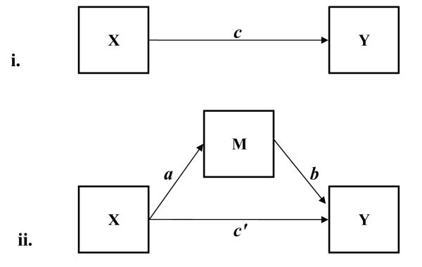
Path diagrams
Total Effect Model:
Basic Mediation Model:
Notes:
http://www.public.asu.edu/~davidpm/classes/publications/2008BehaviorResearchMethods.pdf

Slide 30
Total Effect of X on Y in Mediation Analysis c = ab + c′
c = the total effect of X on Y
c’= the direct effect of X on Y after controlling for M
ab= indirect/mediation effect of X on Y via M
Notes:
http://www.public.asu.edu/~davidpm/classes/publications/2008BehaviorResearchMethods.pdf

Slide 31
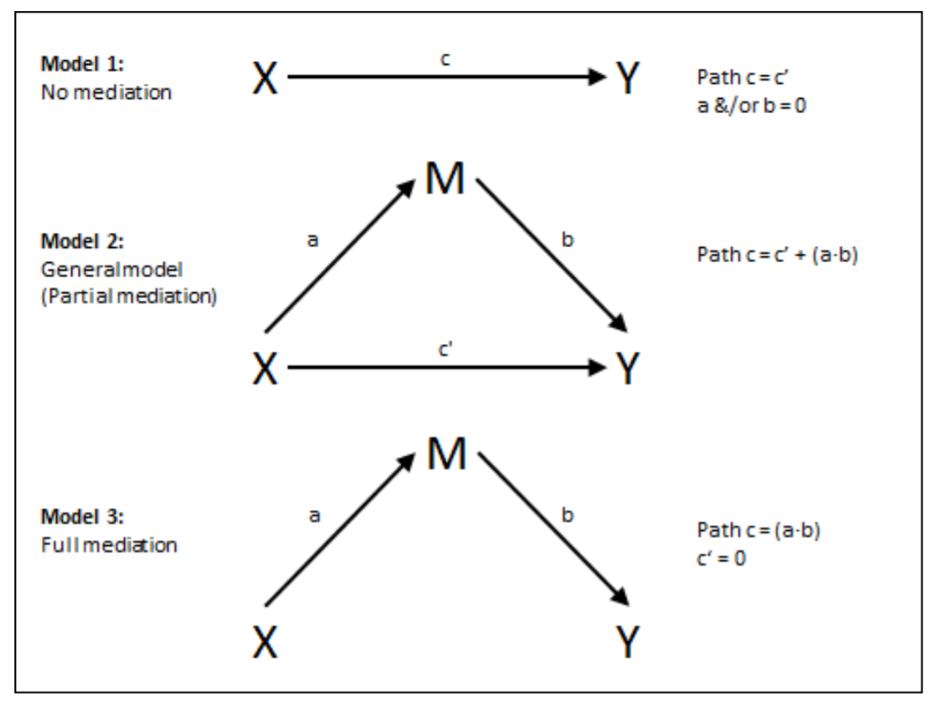
No Mediation, Partial Mediation & Full Mediation
Model 1 (No Mediation) shows the total effect between X and Y.
Model 2 (Partial Mediation) has both direct and indirect effects between X and Y. (1) X relates to Y directly via pathway c’; (2) X correlates with M (mediator) through pathway a; and M relates to Y via pathway b. Pathways a and b multiply to signify the indirect effect.
Model 3 (Full Mediation) depicts the indirect effect without the direct effect of X on Y.
→ Check the changes in coefficients to see if mediation happens, if so, which type.
https://journals.uair.arizona.edu/index.php/jmmss/article/viewFile/17761/17484

Slide 32
Simple Linear Regression (in a diagram)
Nonresident Partner
(stressor)
x
Supportive Mothering
Y
-
Race
Age
Sex

Slide 33
Nonresident Partner
(stressor)
x
Social Behavior
Y
-
P<.05
Supportive Mothering
mediator
P<.05
P<.05
Nonresident Partner
(stressor)
x
Social Behavior
y
P=.57

Slide 34
Mediation Model Based on Stress Theory
Supportive Mothering
mediator
Nonresident Partner
(stressor)
x
Social Behavior
y
Partial mediation
Full mediation
The dotted line indicates no significant direct effect.

Slide 35
Identifying Mediation Through Regression Results
Regression equations have only one dependent variable. We can’t test a mediation model in one analysis because two variables are dependent in the figure.
Which variables are dependent variables in the model (which are predicted by other variables)?
Which variable is both a
predictor and a predicted
variable in the figure?
Supportive Mothering
mediator
Nonresident Partner
(stressor)
x
Social Behavior
y
Partial mediation
Full mediation

Slide 36
What about Suppression?
With suppression, the addition of a third variable increases the effect of the original independent variable. Suppression is not examined as often as mediation effects, so it isn’t clear how common it is.
Suppression can also be tested efficiently with “hierarchical” regression.
The test would proceed the same as the sequence of mediation tests we just looked at. Evidence of suppression would be that a small or nonsignificant effect of an IV (like nonresident partner) in one model becomes larger and statistically significant with the addition of a variable (like supportive mothering) in a subsequent model.

