Slide 1
Week 9 Testing Group Means
Stats I

Slide 2
Statistical Inference
For the rest of the semester, we will focus on conducting statistical inferences for the following tasks:
Estimating one population mean and proportion (last time)
Comparing two population means Comparing more than two population means
Estimating population proportions
Estimating relationship between two quantitative variables (correlation, regression, mediation, moderation)
Estimating relationship between one qualitative and one or more quantitative variables (logistic regression)

Slide 3
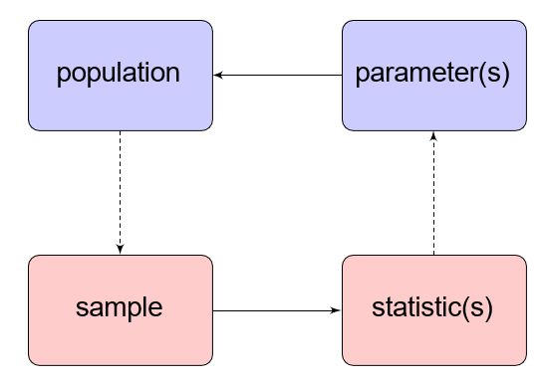
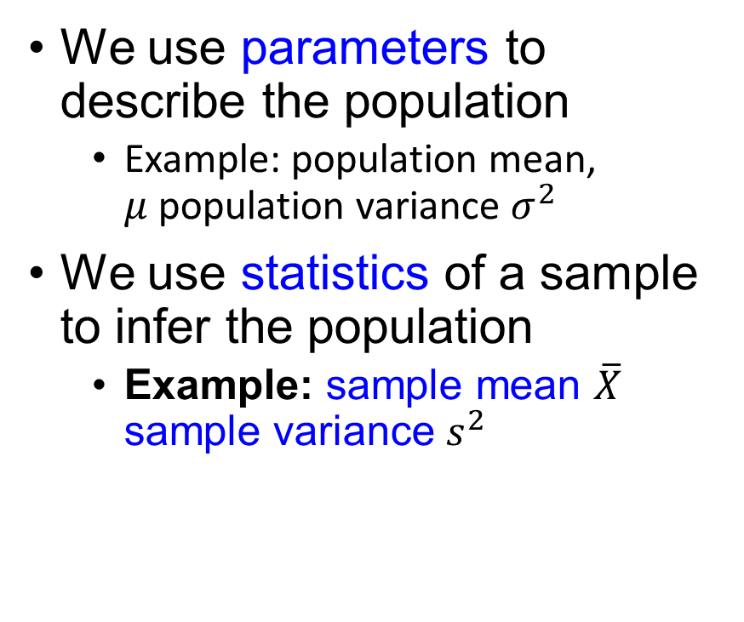
Statistical Inference, Cont’d
We use parameters to describe the population
Example: population mean, $μ$population variance $σ^{2}$
We use statistics of a sample to infer the population
Example: sample mean $\overline{X}$ sample variance $s^{2}$
Sampling
Inference

Slide 4
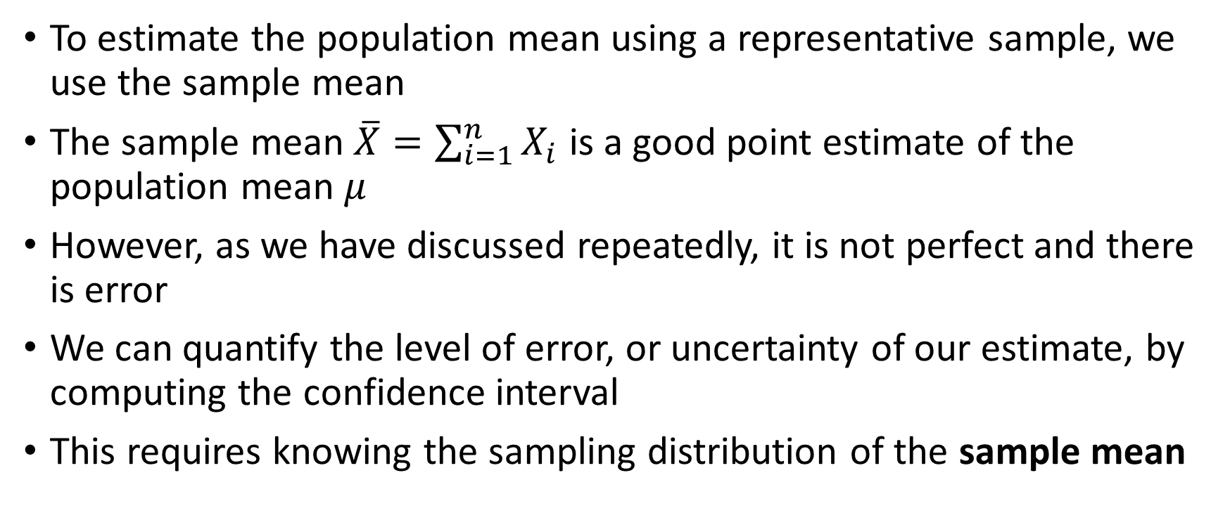
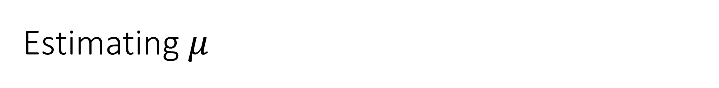
Estimating $μ$
To estimate the population mean using a representative sample, we use the sample mean
The sample mean $\overline{X}=\sum_{i=1}^{n}{X_{i}}$ is a good point estimate of the population mean $μ$
However, as we have discussed repeatedly, it is not perfect and there is error
We can quantify the level of error, or uncertainty of our estimate, by computing the confidence interval
This requires knowing the sampling distribution of the sample mean

Slide 5
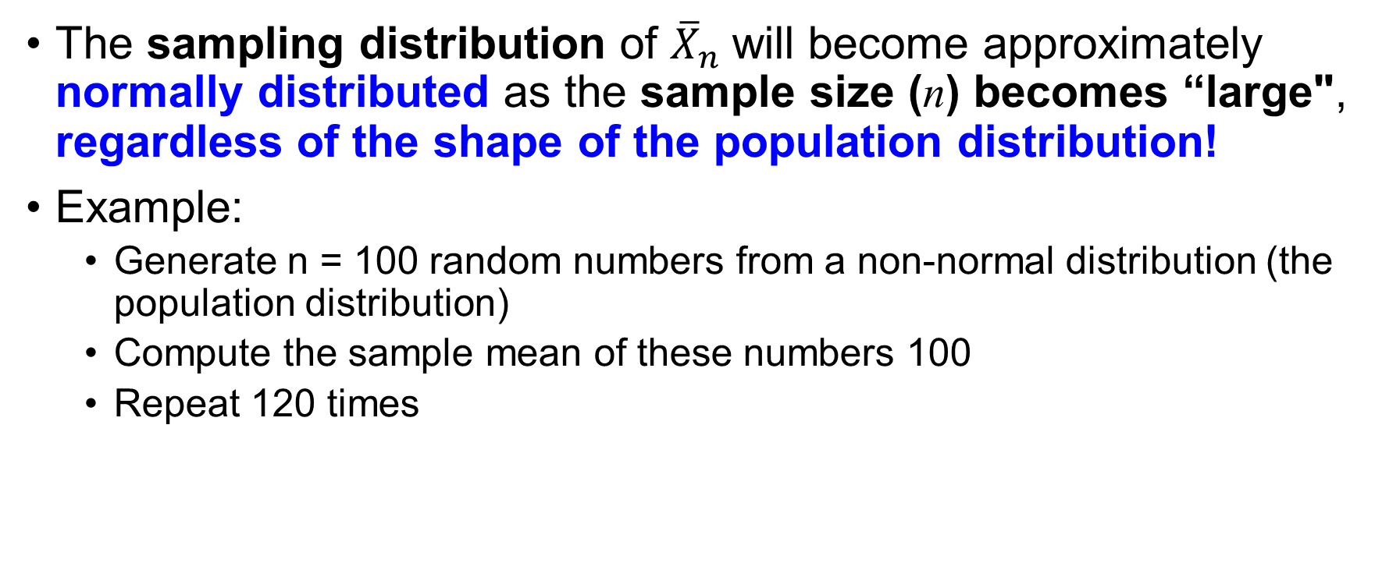
Recall the Central Limit Theorem (CLT)
The sampling distribution of ${\overline{X}}_{n}$ will become approximately normally distributed as the sample size (n) becomes “large", regardless of the shape of the population distribution!
Example:
Generate n = 100 random numbers from a non-normal distribution (the population distribution)
Compute the sample mean of these numbers 100
Repeat 120 times

Slide 6
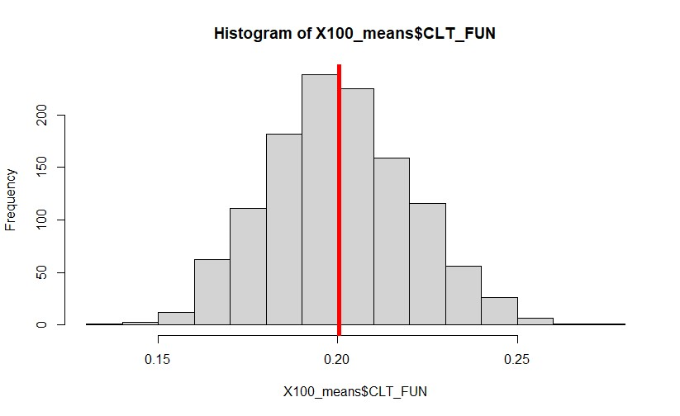
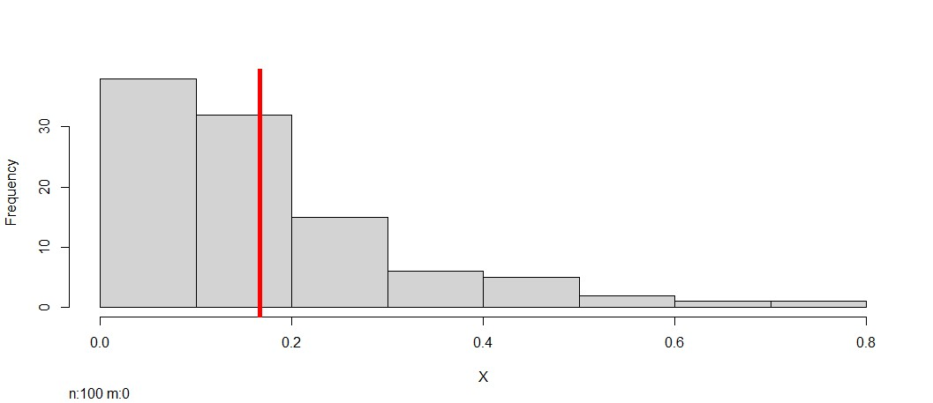
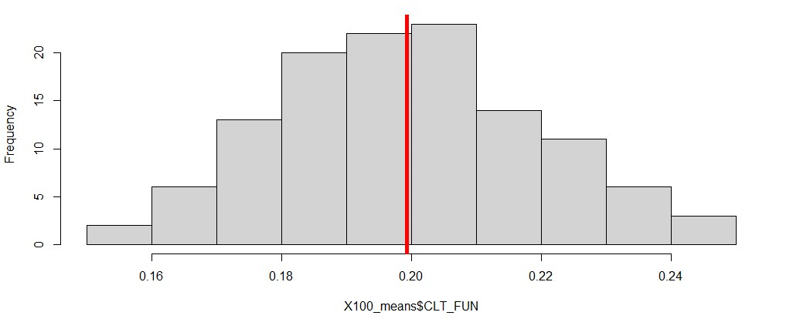
Example
See my R code called clt_fun.R
I took n = 100 observations from an exponential distribution with mean = .20 and plotted it (to the left)
Then I repeated this process 120 times (took 120 samples of n = 100 observations) and plotted it – according to the CLT this plot should look normal ☺
Mean of 120 samples of n = 100 observations from
an exponential distribution
Exponential Distribution (n = 100 observations)
Try increasing the number of samples from 120 to 1200

Slide 7
Summary of this experiment
The CLT tells us that the distribution of the sample mean is centered around the true mean
The variance of the sample mean decreases as n increases
With normality approximation of the sampling distribution we can perform interval estimation around the population mean

Slide 8
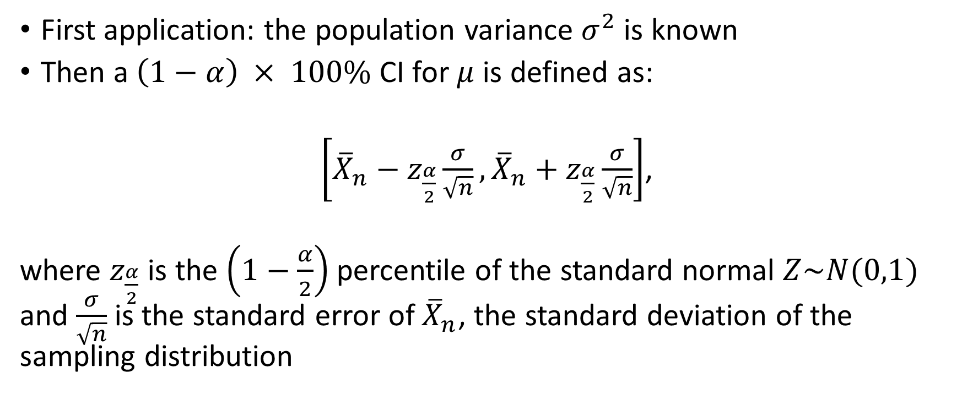
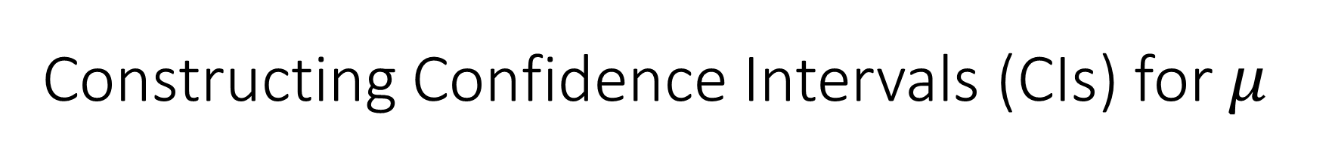
Constructing Confidence Intervals (CIs) for $μ$
First application: the population variance $σ^{2}$is known
Then a $\left(1−α\right) × 100\%$ CI for $μ$ is defined as:
$\left[{\overline{X}}_{n}−z_{\frac{α}{2}}\frac{σ}{\sqrt{n}},{\overline{X}}_{n}+z_{\frac{α}{2}}\frac{σ}{\sqrt{n}}\right]$,
where $z_{\frac{α}{2}}$ is the $\left(1−\frac{α}{2}\right)$percentile of the standard normal $Z\sim N(0,1)$ and $\frac{σ}{\sqrt{n}}$ is the standard error of ${\overline{X}}_{n}$, the standard deviation of the sampling distribution

Slide 9
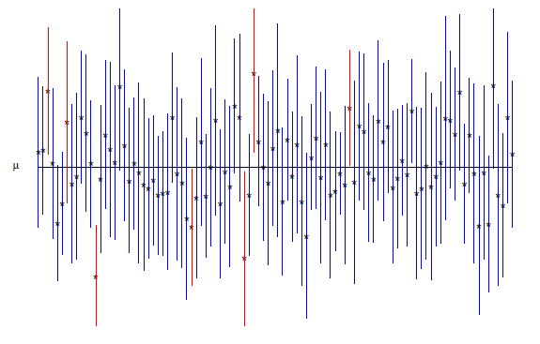
Conceptual Understanding of CIs

Slide 10

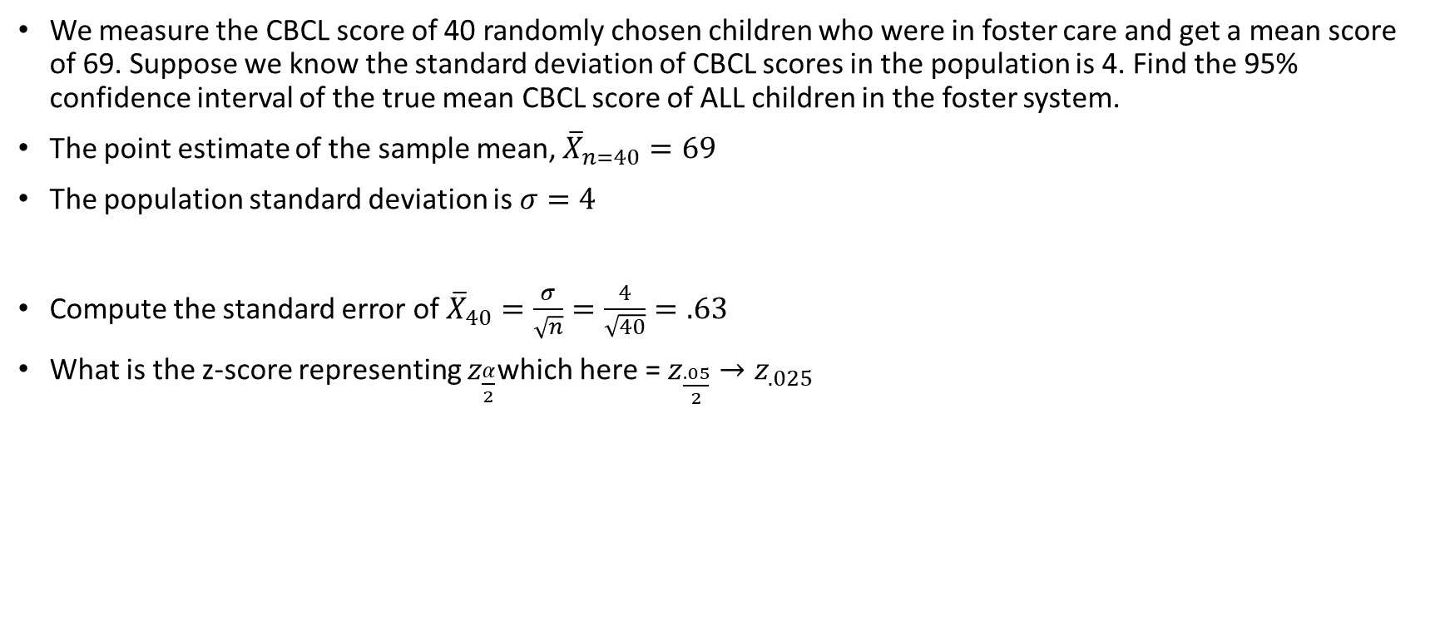
Example
We measure the CBCL score of 40 randomly chosen children who were in foster care and get a mean score of 69. Suppose we know the standard deviation of CBCL scores in the population is 4. Find the 95% confidence interval of the true mean CBCL score of ALL children in the foster system.
The point estimate of the sample mean, ${\overline{X}}_{n=40}=69$
The population standard deviation is $σ=4$
Compute the standard error of ${\overline{X}}_{40}=\frac{σ}{\sqrt{n}}=\frac{4}{\sqrt{40}}=.63$
What is the z-score representing $z_{\frac{α}{2}}$which here = $z_{\frac{.05}{2}}{→z}_{.025}$
$$\left[{\overline{X}}_{n}−z_{\frac{α}{2}}\frac{σ}{\sqrt{n}},{\overline{X}}_{n}+z_{\frac{α}{2}}\frac{σ}{\sqrt{n}}\right]$$
$$\left[69−1.96(.63),69+1.96(.63) \right]$$
$$\left[67.77, 70.23\right]$$
Reflects the uncertainty of our estimate

Slide 11
Note the interpretation carefully
In general, If we were to take random samples over and over again, then (1 −𝛼 )% of these confidence intervals will contain the true 𝜇
[67.77, 70.23] (?)
This means that we are 95% confidence intervals that the true population mean lies in the interval [67.77, 70.23]
Note: there is a relationship between the confidence interval and hypothesis testing
By definition, any value lying outside of the confidence interval is in our rejection region (?)
So the confidence interval represents the outermost limits of statistical significance
This means
A CBCL score of 65 is too unlikely to occur by chance and is significantly different than the population mean of 69
What about a score of 70?
Perform a test of these two hypotheses and verify I am correct now.

Slide 12
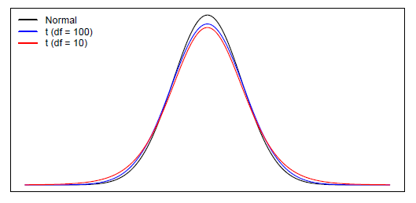
Using the t-distribution to compute CIs
In practice, it is unlikely that is available to us
One reasonable option is to replace with s, the sample standard deviation
We need to account for this added uncertainty with a (slightly) different sampling distribution that has fatter tails

Slide 13
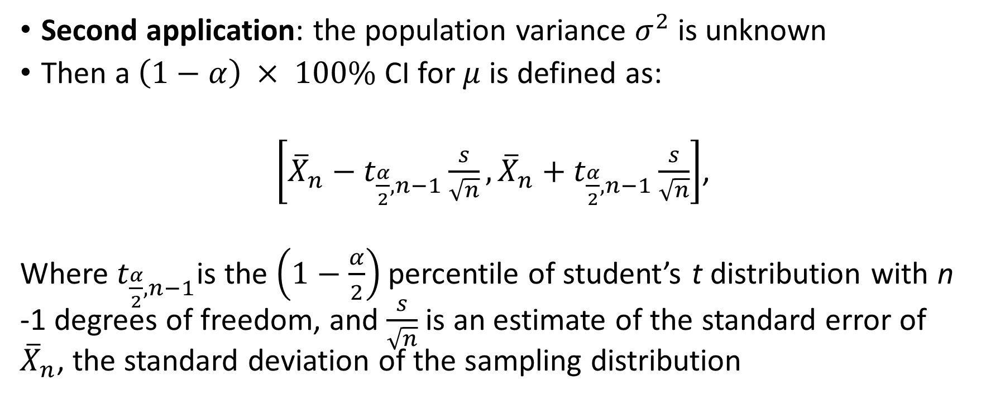
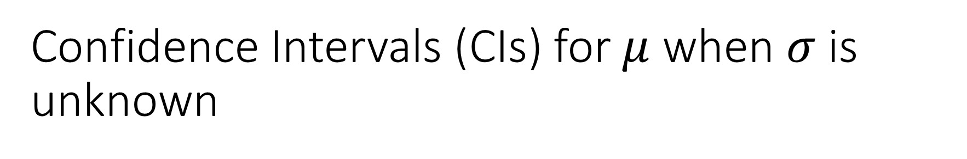
Confidence Intervals (CIs) for $μ$ when $σ$ is unknown
Second application: the population variance $σ^{2}$is unknown
Then a $\left(1−α\right) × 100\%$ CI for $μ$ is defined as:
$\left[{\overline{X}}_{n}−t_{\frac{α}{2},n−1}\frac{s}{\sqrt{n}},{\overline{X}}_{n}+t_{\frac{α}{2},n−1}\frac{s}{\sqrt{n}}\right]$,
Where $t_{\frac{α}{2},n−1}$is the $\left(1−\frac{α}{2}\right)$percentile of student’s t distribution with n -1 degrees of freedom, and $\frac{s}{\sqrt{n}}$ is an estimate of the standard error of ${\overline{X}}_{n}$, the standard deviation of the sampling distribution

Slide 14
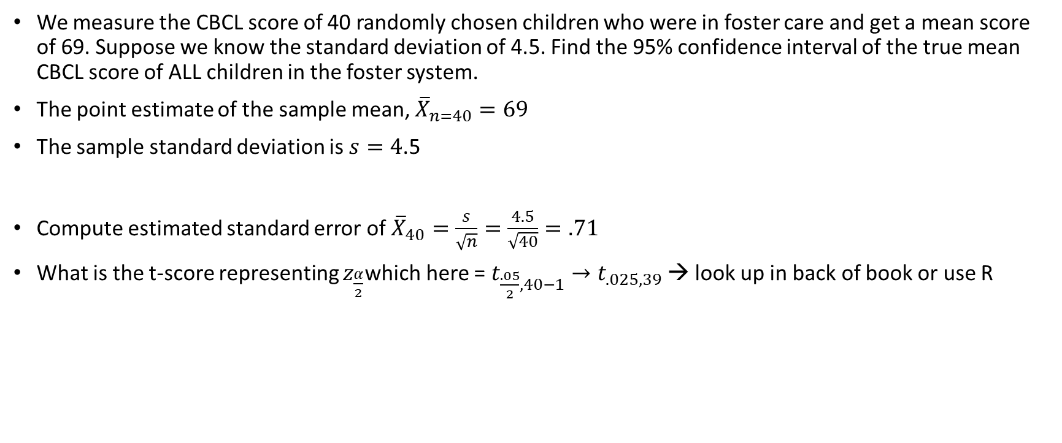
Example
We measure the CBCL score of 40 randomly chosen children who were in foster care and get a mean score of 69. Suppose we know the standard deviation of 4.5. Find the 95% confidence interval of the true mean CBCL score of ALL children in the foster system.
The point estimate of the sample mean, ${\overline{X}}_{n=40}=69$
The sample standard deviation is $s=4$.5
Compute estimated standard error of ${\overline{X}}_{40}=\frac{s}{\sqrt{n}}=\frac{4.5}{\sqrt{40}}=.71$
What is the t-score representing $z_{\frac{α}{2}}$which here = $t_{\frac{.05}{2},40−1}{→t}_{.025,39}$ → look up in back of book or use R
qt(.025, df=39)
$$\left[69−2.02(.71),69+2.02(.71),\right]$$
$$\left[67.57, 70.43\right]$$
Understanding the t-distribution in R - GeeksforGeeks

Slide 15
Independent and Dependent Samples t Tests
Both are tests of means
Independent t test
Tests mean difference of two independent samples
Dependent t test
Tests mean difference of two dependent samples

Slide 16
Comparing Two Population Means
We are often interested in comparing two groups
Does a particular intervention decrease depressive symptoms more than another?
Do PTSD symptoms differ among males and females following a traumatic experience?
These questions can be addressed by conducting statistical inferences of two different populations from two independent samples (e.g., males v females)
Note, you have to have only two groups to use this procedure

Slide 17

Notation
Parameters
Population means: $μ_{1},μ_{2}$
Population standard deviations: $σ_{1},σ_{2}$
Statistics
Sample means: ${\overline{X}}_{1},{\overline{X}}_{2}$
Sample standard deviations: $s_{1},s_{2}$
Sample sizes$: N_{1},N_{2}$

Slide 18

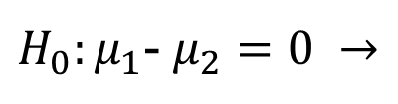

Assumptions (similar to one sample t-test)
Level of Measurement
Population Distribution
Sampling Method
$H_{0}:μ_{1}=$ $μ_{2}$
$H_{1}:μ_{1}≠$ $μ_{2}$
$H_{0}:μ_{1}$- $μ_{2}=0 →$
No Difference
Note: Even when the populations examined are not normally distributed, the sampling distribution of the difference between the sample means will be normally distributed if the N of cases for both samples is large. Why?

Slide 19
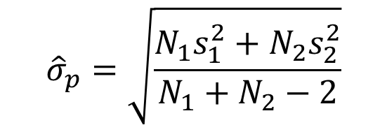

Two Approaches in calculating the standard error
Assumption 1:
Pooled variances: The two population distributions have equal sample means and equal variances (i.e the distributions are the same)
The error terms are homoscedastic
H_{0:}
$$σ_{1}^{2}=σ_{2}^{2}=σ^{2}$$
$${\hat{σ}}_{p}=\sqrt{\frac{N_{1}s_{1}^{2}+N_{2}s_{2}^{2}}{N_{1}+N_{2}−2}}$$
The reality is that this is rarely the case

Slide 20
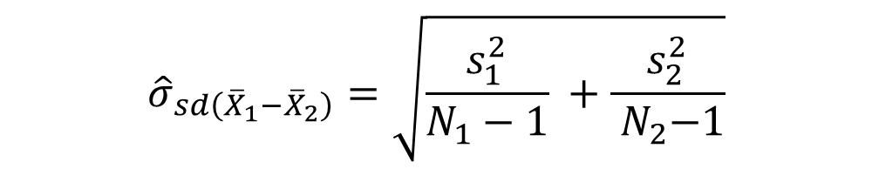
Two Approaches in calculating the standard error
Assumption 2:
Separate variances: The two population distributions have equal sample means but unequal variances (i.e the distributions are the same)
The error terms are heteroskedastic
$${\hat{σ}}_{sd\left({\overline{X}}_{1}−{\overline{X}}_{2}\right)}=\sqrt{\frac{s_{1}^{2}}{N_{1}−1} +\frac{s_{2}^{2}}{{ N}_{2}−1}}$$
Not to worry, we will test this hypothesis using software

Slide 21
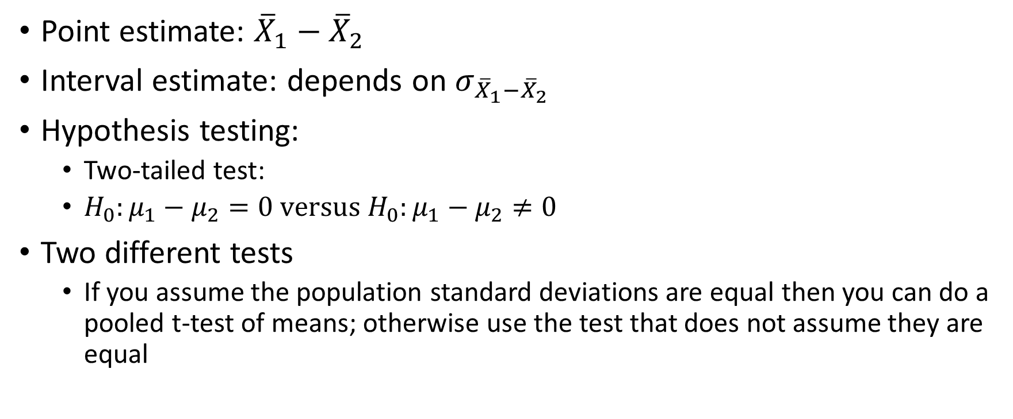
Statistical Inference
Point estimate: ${\overline{X}}_{1}−{\overline{X}}_{2}$
Interval estimate: depends on $σ_{{\overline{X}}_{1}−{\overline{X}}_{2}}$
Hypothesis testing:
Two-tailed test:
$H_{0}:μ_{1}−μ_{2}=0 versus{ H}_{0}:μ_{1}−μ_{2}≠0$
Two different tests
If you assume the population standard deviations are equal then you can do a pooled t-test of means; otherwise use the test that does not assume they are equal

Slide 22
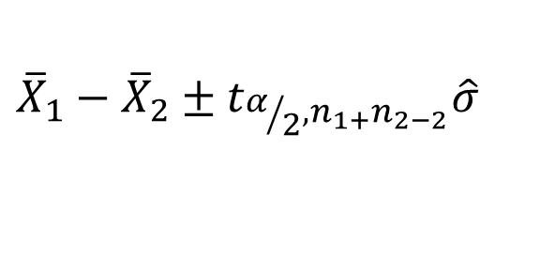
Pooled Estimates
If we assume that the estimates can be pooled then the derived standard error of the difference is
And the CI is defined as
Note: the software tests the hypothesis that the standard error of the difference is pooled versus it is not pooled and then we proceed accordingly
$${\overline{X}}_{1}−{\overline{X}}_{2}±t_{α/2,n_{1+}n_{2−2}}\hat{σ}$$
Point estimate
Margin of error

Slide 23
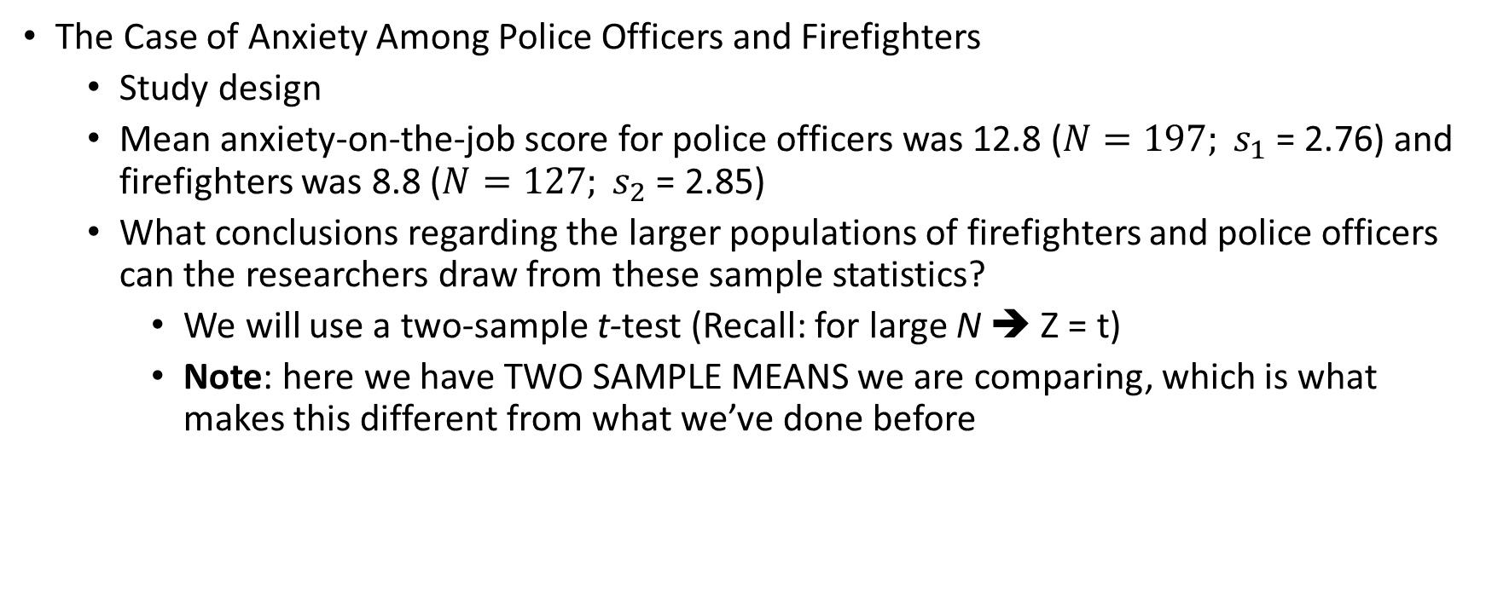
Comparing Sample Means
The Case of Anxiety Among Police Officers and Firefighters
Study design
Mean anxiety-on-the-job score for police officers was 12.8 (${N=197; s}_{1}$ = 2.76) and firefighters was 8.8 (${N=127; s}_{2}$ = 2.85)
What conclusions regarding the larger populations of firefighters and police officers can the researchers draw from these sample statistics?
We will use a two-sample t-test (Recall: for large N ➔ Z = t)
Note: here we have TWO SAMPLE MEANS we are comparing, which is what makes this different from what we’ve done before

Slide 24
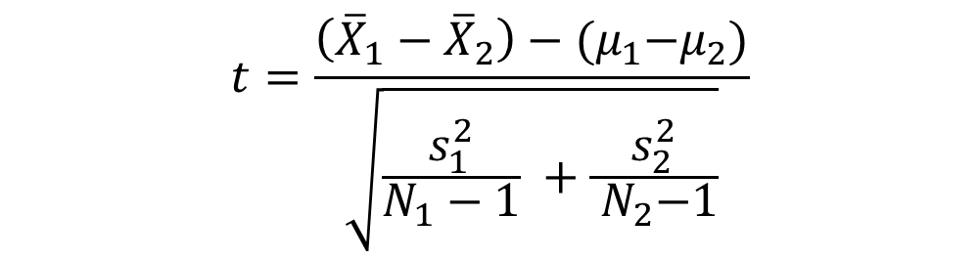
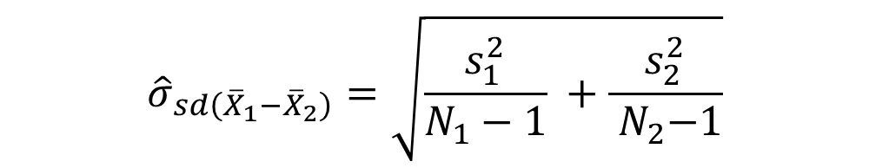
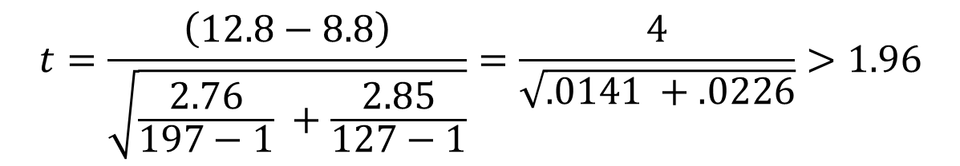
Calculating the test statistic
What is this equal to?
Significance Level, Rejection Region, Conclusion
$${\hat{σ}}_{sd\left({\overline{X}}_{1}−{\overline{X}}_{2}\right)}=\sqrt{\frac{s_{1}^{2}}{N_{1}−1} +\frac{s_{2}^{2}}{{ N}_{2}−1}}$$
$$t=\frac{\left({\overline{X}}_{1}−{\overline{X}}_{2}\right)−{(μ}_{1}−μ_{2})}{\sqrt{\frac{s_{1}^{2}}{N_{1}−1} +\frac{s_{2}^{2}}{{ N}_{2}−1}}}$$
$$t=\frac{\left(12.8−8.8\right)}{\sqrt{\frac{2.76}{197−1} +\frac{2.85}{127−1}}}=\frac{4}{\sqrt{.0141 +.0226}}>1.96$$

Slide 25
Example
An experiment was conducted to evaluate the effectiveness of a treatment for PTSD symptoms among veterans. A random sample of 24 veterans was randomly divided into two groups. Twelve were given the treatment (i.e., treatment group) and the remaining twelve were not untreated (control group). After a 6-month period, the symptoms were re-assessed. The JASP notebook called ptsd_vets.jasp contains the analysis of this problem.

Slide 26
Analysis of Variance (ANOVA)
Tests of two or more independent samples accomplished through partitioning variation

Slide 27
ONE-WAY ANOVA
Sometimes we want to know whether the mean level on one continuous variable (such as income) is different for each group relative to the others in a nominal variable (such as degree received)
We could use descriptive statistics (the mean income) to compare the groups (geography, polisci or social work BAs)
The one-way analysis of variance (ANOVA) is used to determine whether there are any statistically significant differences between the means of three or more independent (unrelated) groups

Slide 28
ONE-WAY ANOVA
ANOVA is an inferential statistics technique that allows you to compare the mean level on one interval-ratio variable (such as income) for each group relative to the others in a nominal variable (such as college major).
Note: If you had only two groups to compare, ANOVA would give the same answer as an independent samples t-test

Slide 29
Dependent/Response v Independent/Predictor
The dependent (response) variable is the variable you’re comparing
The independent (predictor, factor) variable is the categorical variable being used to define the groups
We will assume k samples (groups)
The one-way is because each value is classified in exactly one way
Examples include comparisons by gender, race, political party, color, etc.
If you were exploring mean differences across two groups its called 2- way ANOVA

Slide 30

ANOVA Intuition
How much confidence can we place in the observed means of our samples?
Sample estimates vary from sample to sample. If the sample means vary considerably, then we want to be cautious in drawing strong conclusions from our study.
As the differences between the means of samples become larger relative to the variability of scores within each sample, our confidence in making inferences grows.

Slide 31

ANOVA Intuition
ANOVA is a statistical technique used to determine whether a particular classification of the data is useful in understanding the variation of an outcome
Example: classification –
Example: outcome –
Example: we know that people drop out of school because they did poorly in school, but how much of the variability in school dropout can be explained by failing grades?
What other classifications may explain the variation in school dropouts?
Obviously people with high grades drop out of high school…

Slide 32
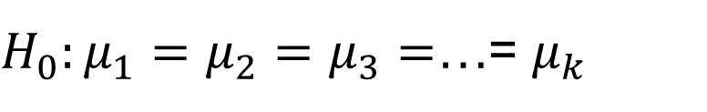
Hypotheses
The null hypothesis is that the means are all equal
The alternative hypothesis is that at least one of the means is different
Note carefully: Not all means have to be different for a significant test result, the test says that at least one of them are different.
This means that the ANOVA doesn’t test that one mean is less than another, only whether they’re all equal or at least one is different, we need to go back to the descriptives and do post-estimation to know which means differ (we’ll do that in JASP)
$H_{0}:μ_{1}=μ_{2}=$ $μ_{3}=$…= $μ_{k}$

Slide 33
Sampling Distribution
Recall the sampling distribution used for making decisions about hypotheses
In analysis of variance the sampling distribution is called the F distribution
The shape of the F distribution varies, depending on the number of degrees of freedom of the variance estimates being compared

Slide 34

One-Way ANOVA: Short Example Where you sit, performance on exam
A random sample of the students in each row was taken
The score for those students on the second exam was recorded
Front: 82, 83, 97, 93, 55, 67, 53
Middle: 83, 78, 68, 61, 77, 54, 69, 51, 63
Back: 38, 59, 55, 66, 45, 52, 52, 61

Slide 35
One-Way ANOVA
Row | Front | Middle | Back
Sample size | 7 | 9 | 8
Mean | 75.71 | 67.11 | 53.50
St. Dev | 17.63 | 10.95 | 8.96
Variance | 310.90 | 119.86 | 80.29
The summary statistics for the grades of each row are shown in the table below

Slide 36

More intuition – recall variance calculation
The variability between the groups studied is contrasted with the variability within these groups to produce a ratio
The larger this ratio—the larger the differences between the groups relative to the variability within them—the more confidence we can have in a conclusion that the population means are not equal.
$$\frac{σ_{betweem}^{2}}{σ_{within}^{2}}$$

Slide 37
MORE VARIABILITY BETWEEN THAN WITHIN = STATISTICALLY SIGNIFICANT RESULT

Slide 38
One-Way ANOVA
There are two sources of variation
The variation between the groups, SS(B), or the variation due to the factor (in this example, the factor is your place in the classroom – front, middle, back)
The variation within the groups, SS(W), or the variation that can’t be explained by the factor so it’s called the error or residual variation

Slide 39
One-Way ANOVA
Here is the basic one-way ANOVA table
Source | SS | df | MS | F | p
Between
Within (residual)
Total

Slide 40
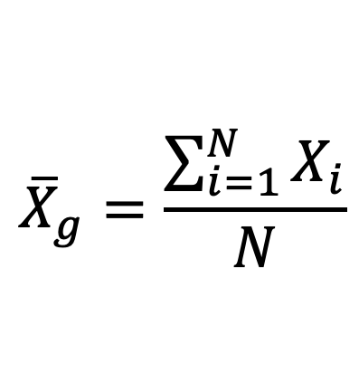
Grand Mean
The grand mean is the average of all the values when the factor is ignored
$${\overline{X}}_{g}=\frac{\sum_{i=1}^{N}{X_{i}}}{N}$$

Slide 41
Grand Mean
Row | Front | Middle | Back
Sample size | 7 | 9 | 8
Mean | 75.71 | 67.11 | 53.50
St. Dev | 17.63 | 10.95 | 8.96
Variance | 310.90 | 119.86 | 80.29

Slide 42
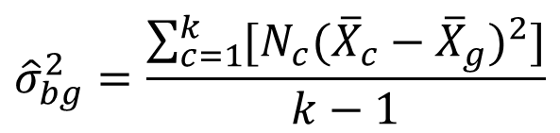
Between Group Variation, SS(B)
Between Group Variation, SS(bg)
The between group variation is the variation between each sample mean and the grand mean
Each individual variation is weighted by the df
$${\hat{σ}}_{bg}^{2}=\frac{\sum_{c=1}^{k}{[N_{c}{({\overline{X}}_{c}−{\overline{X}}_{g})}^{2}]}}{k−1}$$
Between-group variability is measured by first subtracting the grand mean, or overall mean, of the three samples from the mean of each sample.
This difference must then be adjusted to take into account the number of scores or observations in each sample
k is the total number of groups

Slide 43
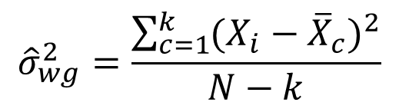
Within Group Variation
Within Group Variation, SS(W)
The Within Group Variation is the weighted total of the individual variations
The weighting is done with the degrees of freedom
$${\hat{σ}}_{wg}^{2}=\frac{\sum_{c=1}^{k}{{(X_{i}−{\overline{X}}_{c})}^{2}}}{N−k}$$
Within-group variability is identified by summing the difference be tween each subject’s score and the mean for the sample in which the subject is found.
For within-group variability, we have four calculations to carry out for each sample (group).

Slide 44
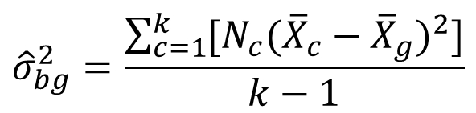
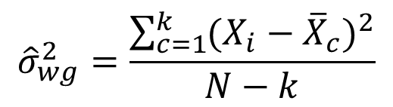
Developing Estimates of Population Variances
between-group estimate of variance ➔ df – k-1
within-group estimate of variance ➔ df = N - k
$${\hat{σ}}_{bg}^{2}=\frac{\sum_{c=1}^{k}{[N_{c}{({\overline{X}}_{c}−{\overline{X}}_{g})}^{2}]}}{k−1}$$
$${\hat{σ}}_{wg}^{2}=\frac{\sum_{c=1}^{k}{{(X_{i}−{\overline{X}}_{c})}^{2}}}{N−k}$$

Slide 45
One-Way ANOVA
Source | SS | df | MS | F | p
Between | 1901.52
Within | 3386.32
Total | 5287.84
After filling in the sum of squares, we have …

Slide 46
One-Way ANOVA
The between group df is one less than the number of groups
We have three groups, so k – 1 = 3 – 1 → df(bg) = 2
The within group df is the sum of the individual df’s of each group
The sample sizes are 7, 9, and 8
df(wg) = N - k = 24 – 3= 21
The total df is one less than the sample size
df(Total) = 24 – 1 = 23

Slide 47
One-Way ANOVA
Denominator
Variance
Numerator
Source | SS | df | MS | F | p
Between | 1901.52
Within | 3386.32 | 21
Total | 5287.84 | 23
Filling in the degrees of freedom gives this …

Slide 48
One-Way ANOVA
Variances
The variances are also called the Mean of the Squares and abbreviated by MS, often with an accompanying variable MS(B) or MS(W)
They are an average squared deviation from the mean and are found by dividing the variation by the degrees of freedom
MS = SS / df

Slide 49
One-Way ANOVA
MS(B) = 1929.68 / 2 = 964.84
MS(W) = 3386.32 / 21 = 161.25
MS(T) = 5316 / 23 = 231.13
Notice that the MS(Total) is NOT the sum of MS(Between) and MS(Within).
This works for the sum of squares SS(Total), but not the mean square MS(Total)
The MS(Total) isn’t usually shown

Slide 50
One-Way ANOVA
Source | SS | df | MS | F | p
Between | 1901.52 |  | 964.84
Within | 3386.32 | 21 | 161.25
Total | 5287.84 | 23 | 229.9
Completing the MS gives …
How do you suppose F is calculated?

Slide 51
One-Way ANOVA
F test statistic
An F test statistic is the ratio of two sample variances
The MS(bg) and MS(wg) are two sample variances and that’s what we divide to find F.
F = MS(B) / MS(W)
For our data, F = 964.84 / 161.25 = 5.98

Slide 52
One-Way ANOVA
Source | SS | df | MS | F | p
Between | 1901.52 |  | 964.84 | 5.9
Within | 3386.32 | 21 | 161.25
Total | 5287.84 | 23 | 229.9
Adding F to the table …

Slide 53
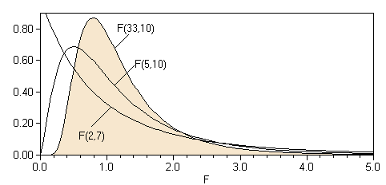
One-Way ANOVA
The F test is a right tail test
The F test statistic has an F distribution with df(B) numerator df and df(W) denominator df
The p-value is the area to the right of the test statistic
P(F2,21 > 5.9) = 0.009

Slide 54
One-Way ANOVA
Notice the between group variability is MUCH larger
Source | SS | df | MS | F | p
Between | 1901.52 |  | 964.84 | 5.9 | 0.009
Within | 3386.32 | 21 | 161.25
Total | 5287.84 | 23 | 229.9
Completing the table with the p-value
Conclusion?

Slide 55
One-Way ANOVA
The p-value is 0.009, which is less than the significance level of 0.05, so we reject the null hypothesis.
The null hypothesis is that the means of the three rows in class were the same, but we reject that, so at least one row has a different mean.
This test DOES NOT tell us which mean is higher, lower etc.

Slide 56
One-Way ANOVA
There is enough evidence to support the claim that there is a difference in the mean scores of the front, middle, and back rows in class.
The ANOVA doesn’t tell which row is different, you would need to look at confidence intervals or run post hoc tests to determine that

Slide 57
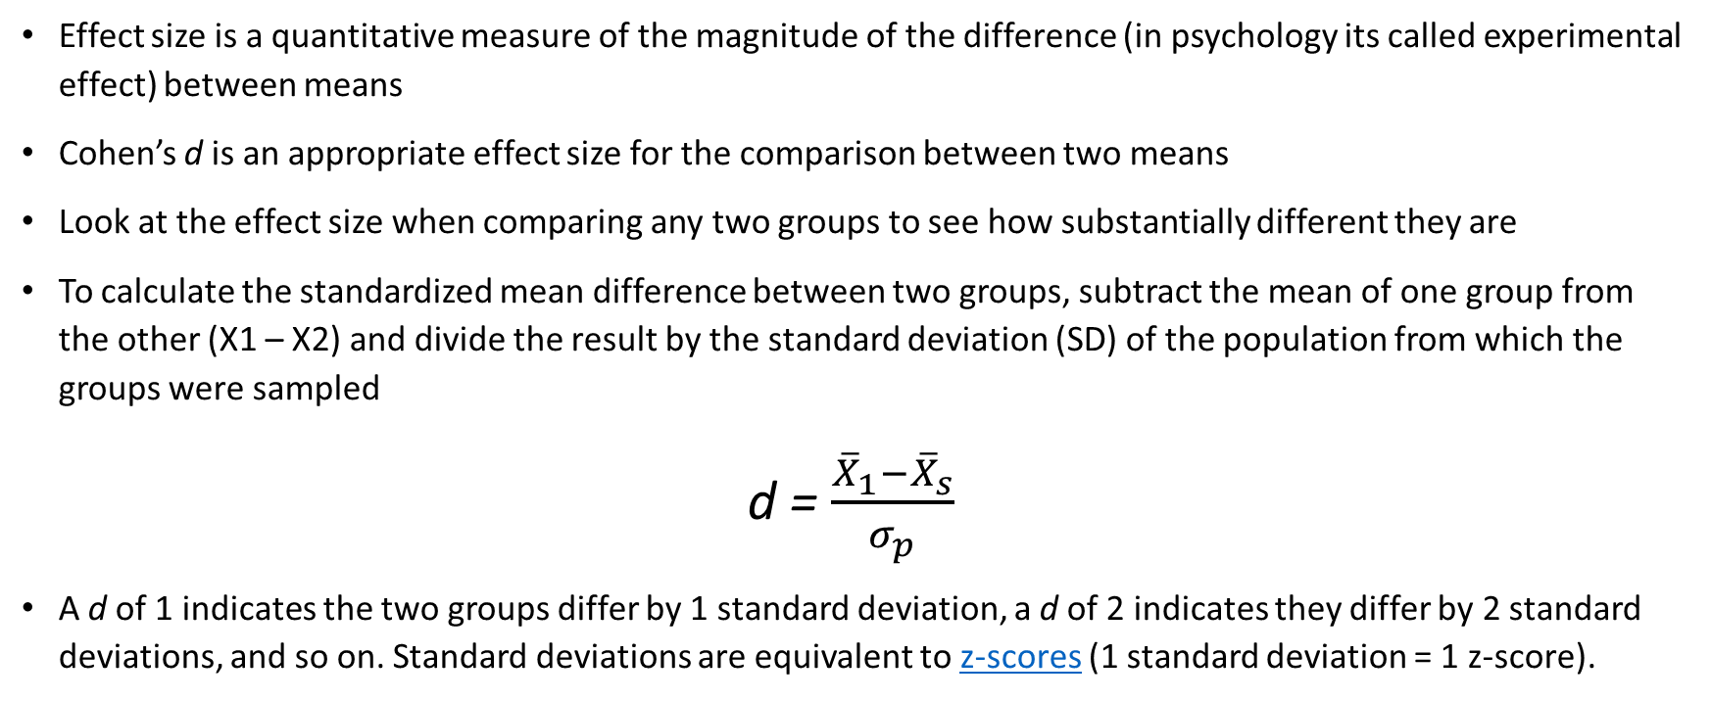
Cohen’s d
Effect size is a quantitative measure of the magnitude of the difference (in psychology its called experimental effect) between means
Cohen’s d is an appropriate effect size for the comparison between two means
Look at the effect size when comparing any two groups to see how substantially different they are
To calculate the standardized mean difference between two groups, subtract the mean of one group from the other (X1 – X2) and divide the result by the standard deviation (SD) of the population from which the groups were sampled
d = $\frac{{\overline{X}}_{1}−{\overline{X}}_{s}}{σ_{p}}$
A d of 1 indicates the two groups differ by 1 standard deviation, a d of 2 indicates they differ by 2 standard deviations, and so on. Standard deviations are equivalent to z-scores (1 standard deviation = 1 z-score).

Slide 58
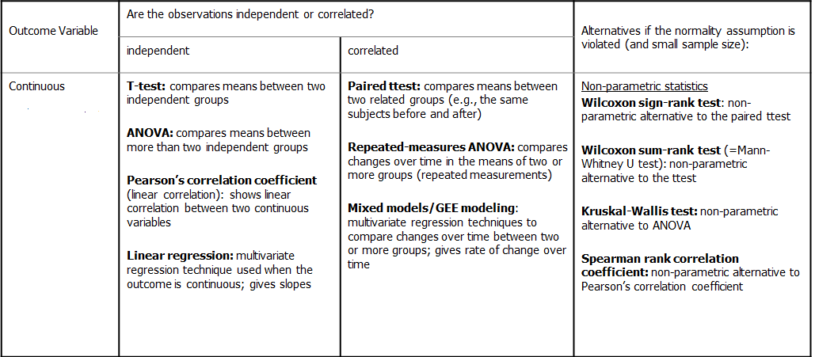
Basic Statistics for Continuous Variables

Slide 59
Correlation analysis
Measures the degree of linear relationship between two continuous variables, x and y
We have a linear relationship between x and y if a straight line drawn through the points provides the most appropriate approximation to the observed relationship
We measure how close the observations are to the straight line that best describes their linear relationship by calculating the Pearson product moment correlation coefficient, usually simply called the correlation coefficient, denoted “r” or “rho” (ρ)

Slide 60

Scatter Plots of Various Correlations
Linear relationships
Curvilinear relationships
Y
Y
$$ρ=0$$
X
X
Y
Y
X
X

Slide 61
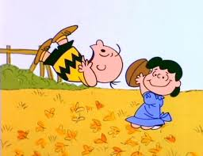
Faulty Analyses
Correlation does not equal causation
There are rules that determine causal effects
Data is often incorrectly analyzed in addition to presented in different ways

Slide 62
Demonstrating Causation
4 requirements to logically infer a causal relationship
Covariation--statistical association: if A changes, B must also change. This is necessary, but not sufficient.
Not enough alone to show cause.
Time order--IV must come before DV
big problem in cross-sectional surveys.
Note: sometimes you can make reasonable inferences
Nonspurious--no third factor can explain the covariation
Ice cream and violent crime
Theory--logical explanation of the relationship

Slide 63
Common misinterpretations: where does causation fail?
Poverty is a major source of child welfare involvement
Children who are abused have higher risk of adult criminal behavior
Victims of domestic violence are more likely to be housing insecure (i.e., be evicted)
Homeless individuals are likely to have physical and mental health problems
People who are highly educated make more money
Drug overdoses increased during the COVID-19 pandemic
Notes:
Oftentimes the effects are very small, some a “significant” finding must be interpreted in light of effect sizes → small effect sizes means that it works that way for some people not many
Oftentimes the effect of one factor on another is indirect, but you are observing a direct relationships
Oftentimes these relationships are taken to be deterministic when they are probabilistic

Slide 64
General Requirements
ID | Age | Score
1 | 8 | 7
2 | 6 | 2
3 | 9 | 6
4 | 7 | 6
5 | 7 | 8
6 | 8 | 5
7 | 5 | 3
8 | 5 | 5
Two or more continuous variables,
Not necessarily directional (one causes the other)
Linear Relationship (or at least ordinal)

Slide 65
Correlation
A correlation is a relationship between two variables. The data can be represented by the ordered pairs (x, y) where x is the independent (or explanatory) variable, and y is the dependent (or response) variable.
A scatter plot can be used to determine whether a linear (straight line) v. some other relationship exists between two variables.
y
Example:
2
x | 1 | 2 | 3 | 4 | 5
y | – 4 | – 2 | – 1 | 0 | 2
x
2
4
6
–2
– 4

Slide 66
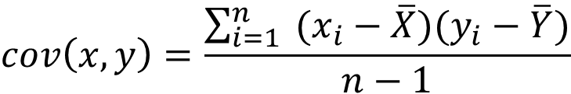
Covariance
cov(X,Y) > 0 → X and Y are positively correlated
cov(X,Y) < 0 → X and Y are inversely correlated
cov(X,Y) = 0 → X and Y are independent, or uncorrelated
$$cov\left(x,y\right)=\frac{\sum_{i=1}^{n}{ (x_{i}−\overline{X})(y_{i}−\overline{Y})}}{n−1}$$
Calculate the covariance between these two variables
x | 1 | 2 | 3 | 4 | 5
y | – 4 | – 2 | – 1 | 0 | 2

Slide 67
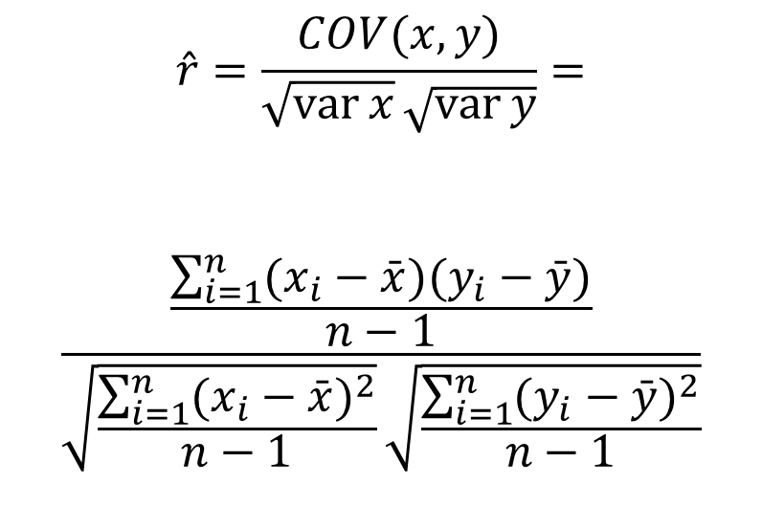
Correlation = Standardized Covariance
$$\hat{r}=\frac{COV(x,y)}{\sqrt{\operatorname{var}{x}}\sqrt{\operatorname{var}{y}}}=$$
$$\frac{\frac{\sum_{i=1}^{n}{(x_{i}−\bar{x})(y_{i}−\bar{y})}}{n−1}}{\sqrt{\frac{\sum_{i=1}^{n}{(x_{i}−\bar{x})^{2}}}{n−1}}\sqrt{\frac{\sum_{i=1}^{n}{(y_{i}−\bar{y})^{2}}}{n−1}}}$$

Slide 68
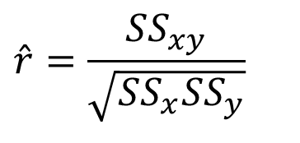
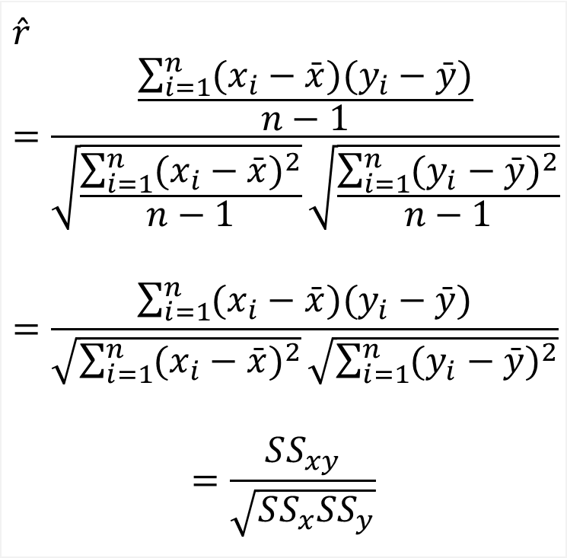
Simpler calculation formula…
$$\hat{r}=\frac{\frac{\sum_{i=1}^{n}{(x_{i}−\bar{x})(y_{i}−\bar{y})}}{n−1}}{\sqrt{\frac{\sum_{i=1}^{n}{(x_{i}−\bar{x})^{2}}}{n−1}}\sqrt{\frac{\sum_{i=1}^{n}{(y_{i}−\bar{y})^{2}}}{n−1}}}$$
$$=\frac{\sum_{i=1}^{n}{(x_{i}−\bar{x})(y_{i}−\bar{y})}}{\sqrt{\sum_{i=1}^{n}{(x_{i}−\bar{x})^{2}}}\sqrt{\sum_{i=1}^{n}{(y_{i}−\bar{y})^{2}}}}$$
$$=\frac{SS_{xy}}{\sqrt{SS_{x}SS_{y}}}$$
Numerator of covariance
$$\hat{r}=\frac{SS_{xy}}{\sqrt{SS_{x}SS_{y}}}$$
Numerators of variance

Slide 69
Yet another…
The formula can also be expressed as follows, by manipulating the terms
The range of the correlation coefficient is −1 to 1. If x and y have a strong positive linear correlation, r is close to 1. If x and y have a strong negative linear correlation, r is close to −1. If there is no linear correlation or a weak linear correlation, r is close to 0.

Slide 70
Calculating a Correlation Coefficient
Calculating a Correlation Coefficient
In Words In Symbols
Find the sum of the x-values.
Find the sum of the y-values.
Multiply each x-value by its corresponding y-value and find the sum.
Square each x-value and find the sum.
Square each y-value and find the sum.
Use these five sums to calculate the correlation coefficient.

Slide 71
Correlation Coefficient
Example:
Calculate the correlation coefficient r for the following data.
x | y | xy | x² | y²
1 | – 3 | – 3 | 1 | 9
2 | – 1 | – 2 | 4 | 1
3 | 0 | 0 | 9 | 0
4 | 1 | 4 | 16 | 1
5 | 2 | 10 | 25 | 4
There is a strong positive linear correlation between x and y.

