Slide 1
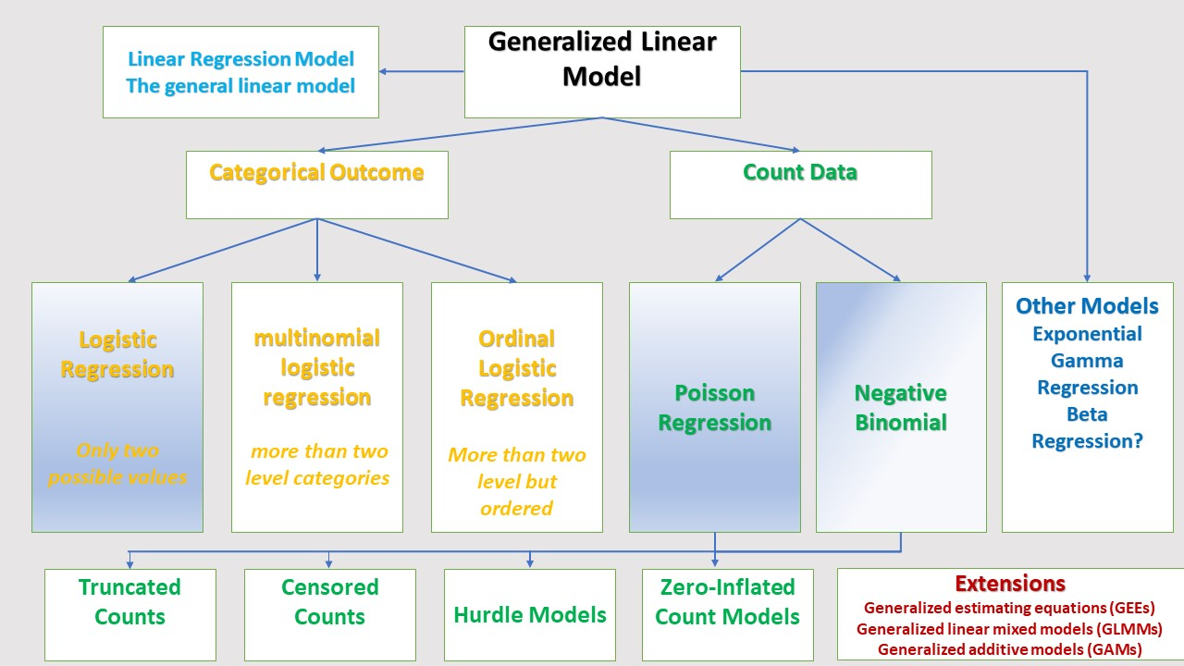
Introduction to Generalized Linear Regression Model in R

Slide 2
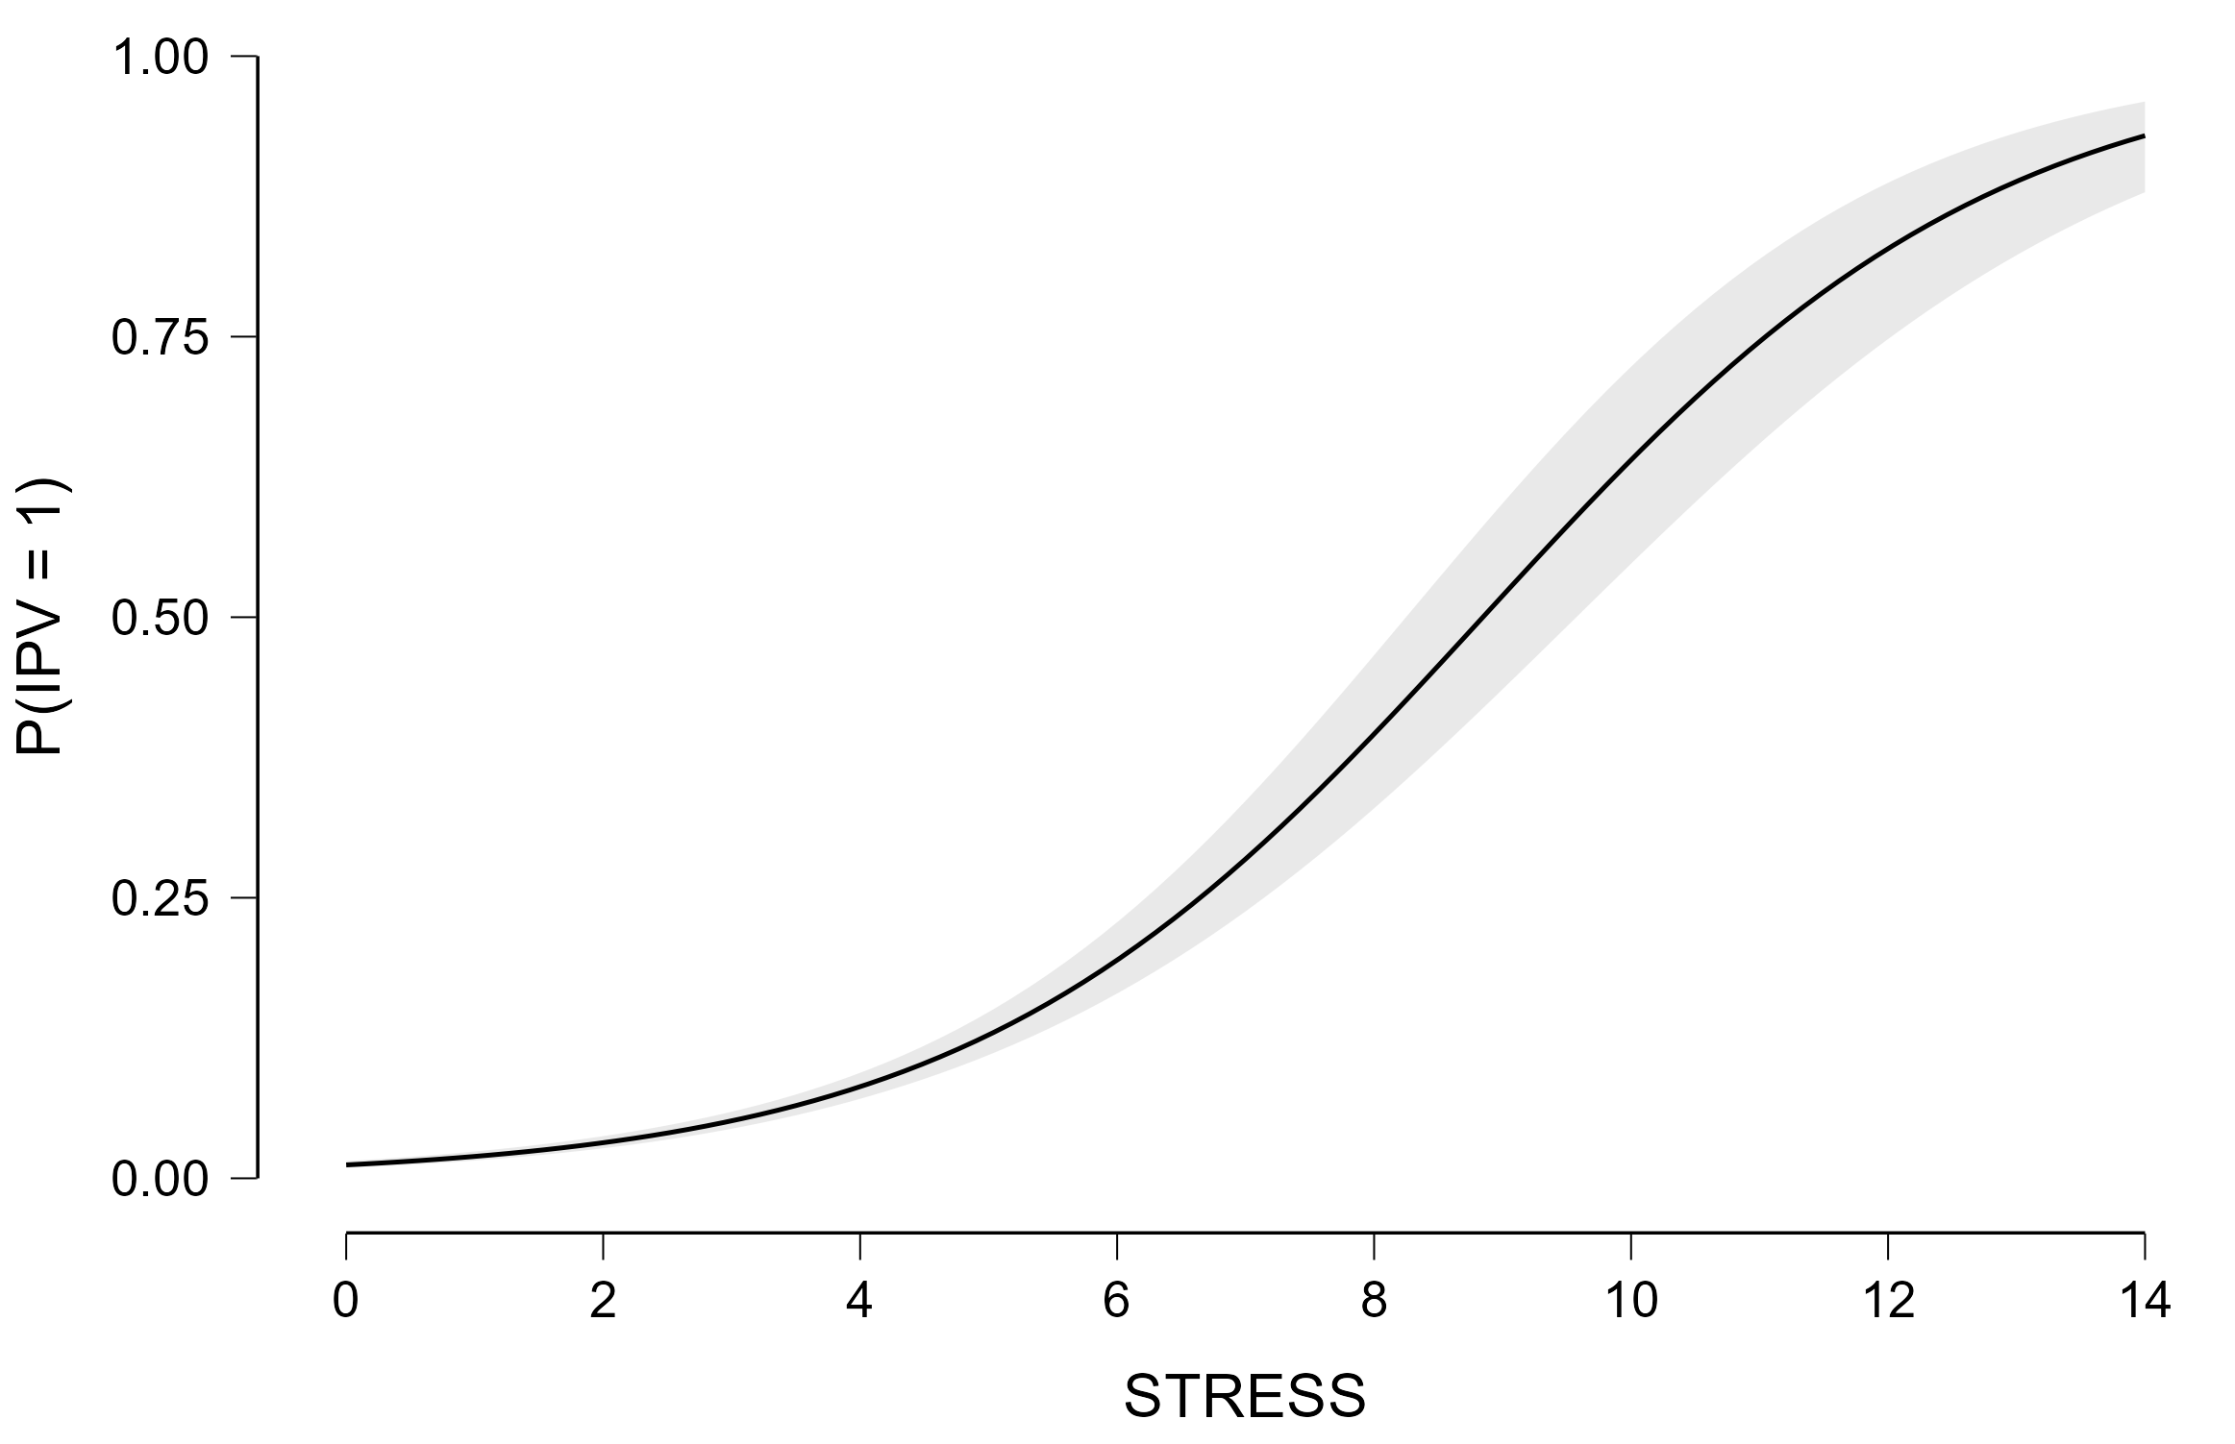
Maternal Stress During Pregnancy Highly Predictive of IPV During Pregnancy
KPRAMS_SUB_LOGISTIC.JASP

Slide 3
A note on transformations for linear models
It is common to transform variables when they are not linearly related to independent variables in a MLR
Transformations are useful for:
Normalizing a skewed distribution
Transforming a non-linear relationship between 2 variables into a linear one
Reducing heteroscedasticity of the residuals in linear regression
Two main transformations
A square root transformation
A log transformation
Dealing with major problems w/transformations
Data ‘trick’
Choose a different model that relaxes the normality assumption (e.g., logistic regression)
Model interpretation

Slide 4
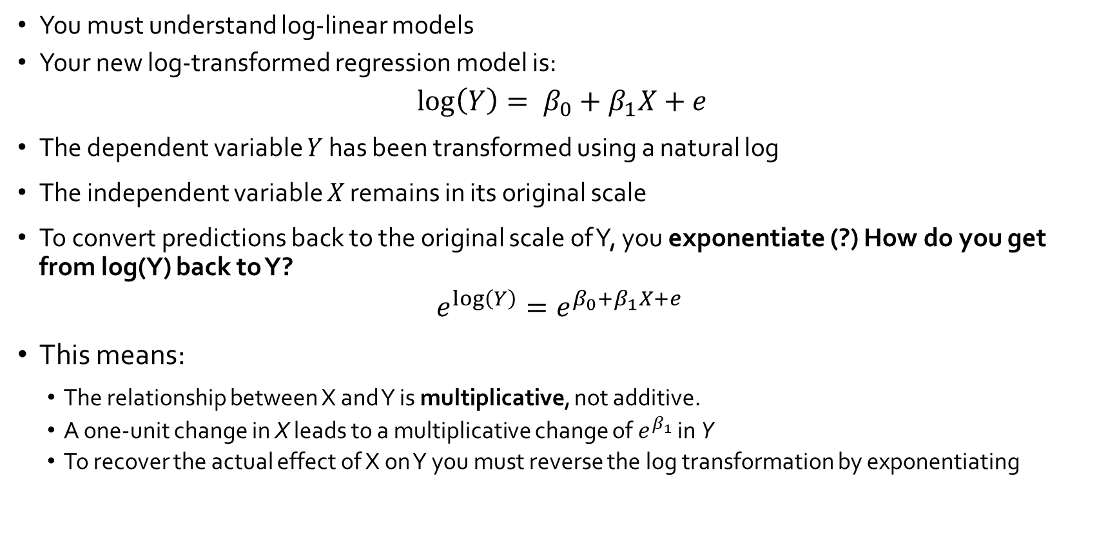
But note carefully, if you are going to transform you must be careful in interpreting the results
You must understand log-linear models
Your new log-transformed regression model is:
$$\log\left(Y\right)= β_{0}+β_{1}X+e$$
The dependent variable 𝑌 has been transformed using a natural log
The independent variable 𝑋 remains in its original scale
To convert predictions back to the original scale of Y, you exponentiate (?) How do you get from log(Y) back to Y?
$$e^{\log\left(Y\right)}=e^{β_{0}+β_{1}X+e }$$
This means:
The relationship between X and Y is multiplicative, not additive.
A one-unit change in X leads to a multiplicative change of $e^{β_{1}}$ in Y
To recover the actual effect of X on Y you must reverse the log transformation by exponentiating
Notes:
Hint: e^log(10) = e^2.302 = 10

Slide 5

Interpreting $β_{1}$after exponentiating
If, after log transforming Y, $β_{1}$=.05, then the proper interpretation is:
$$e^{β_{1}}=e^{.05}\sim 1.051$$
This means that a 1-unit change in X results in a 5.1% increase in Y
Now, assume that I took the square root:
Then: every unit increase in education increases income by (.05)²

Slide 6
Example
Use the data all-data.hti.sav
Look at the data
Area Level Deprivation Index (Financial Strength, Economic Inequality, Education)
Housing Transportation Index
Geocoded food banks computed distances to food banks from each home location where the child was maltreated
Computed distances to each SNAP retailer from each home location where the child was maltreated
I was given evictions and child welfare involvement from the NM data collaborative
We are going to run a few regressions and apply a log transform to these data
Regression 1: child maltreatment rate on three indices of area level deprivation
Regression 2: child maltreatment rate on three indices of area level deprivation, housing and food insecurity
Regression 3: maltreatment rate on three indices of area level deprivation, housing and food insecurity, and the HTI (the housing and transportation index)
Select regression 3, look at model diagnostics, transform dependent variable, re-run regression & interpret coefficients

Slide 7
What is Mediation?
The regression equations we have looked at so far examine whether independent variables have a “direct” effect on a dependent variable. Direct effects are common in social science research, but “indirect” effects are also common.
The terms “indirect effects” and “mediation” are used interchangeably. To remember what mediation is, think about how mediators are people who work between two people to resolve a dispute. In statistics, mediators come between two variables.
Mediation is present in statistics when the effects of an independent variable on a dependent variable occur fully or partially through its effects on another variable.

Slide 8
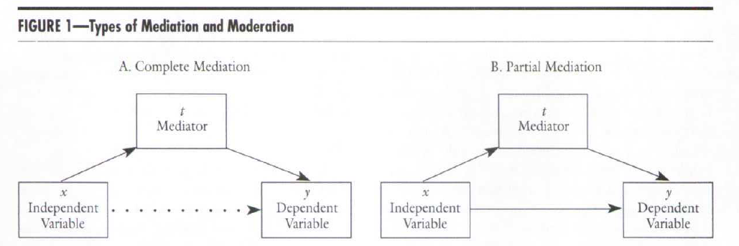
What is Mediation?
significant
significant
insignificant
These figures illustrate the classic depiction of statistical mediation.
Two possible mediation situations are pictured: complete (figure A) and partial (figure B) mediation. Complete mediation is present when the independent variable X has an indirect effect on the dependent variable through the mediator and no direct effect.
The dotted line in figure A conveys that there is no direct effect of x on y. In the analysis output, the regression coefficient for x is nonsignificant.
Notes:
Make it simple and intuitive: Complete mediation means that X significantly predicts Y until M is in the model, in which case X is no longer a significant predictor of Y.

Slide 9
What is Mediation?
Figure B illustrates partial mediation.
X has an indirect effect on Y through its effects on the mediator as in Figure A. It also has a direct effect (illustrated by the solid line from X to Y).
Its effect on Y is not totally explained by its effect on the mediator. We’ll see in a moment how to test for the indirect effect, but the direct effect is confirmed by a statistically significant coefficient for X in the regression output (as we have seen in regression output so far).

Slide 10
Simple Linear Regression (in a diagram)
Nonresident Partner
(stressor)
x
Supportive Mothering
Y
-
Race
Age
Sex

Slide 11
Mediation Model Based on Stress Theory
Nonresident Partner
(stressor)
X
Supportive Mothering
mediator
Social Behavior
Y
Parenting by mother with no partner is associated with preschooler’s lower school readiness as measured by social behavior. The relationship is explained by the effects on mothers of the stress of a nonresident parenting partner. The stress is hypothesized to lead to less supportive parenting, which in turns affects children’s social behavior.

Slide 12
Mediation Model Based on Stress Theory
Supportive Mothering
mediator
Nonresident Partner
(stressor)
x
Social Behavior
y
Partial mediation
Full mediation
The dotted line indicates no significant direct effect.

Slide 13
Full or partial?
Nonresident Partner
(stressor)
x
Social Behavior
Y
-
P<.001
Supportive Mothering
mediator
P<.001
Nonresident Partner
(stressor)
x
Social Behavior
y
P<.57

Slide 14
Identifying Mediation Through Regression Results
Regression equations have only one dependent variable. We can’t test a mediation model in one analysis because two variables are dependent in the figure.
Which variables are dependent variables in the model (which are predicted by other variables)?
Which variable is both a
predictor and a predicted
Variable in the figure?
Supportive Mothering
mediator
Nonresident Partner
(stressor)
x
Social Behavior
y
Partial mediation
Full mediation

Slide 15
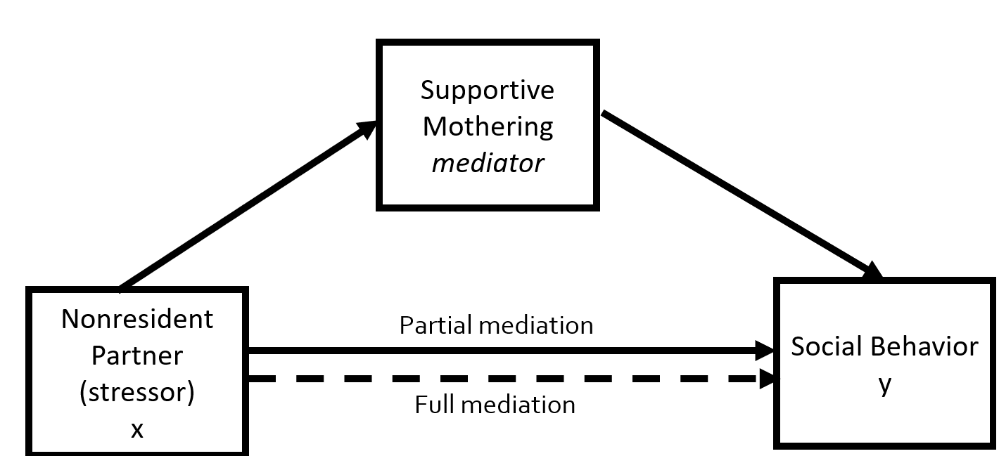


How We Used to Test for Mediation in Regression? Traditional Steps: Note that the distinction between full and partial is archaic.
1. Regress the DV on the IV and evaluate the IV’s coefficient: (Social Behavior on Nonresident Partner)
2. Regress the mediator on the IV and evaluate coefficient : (Supportive Mothering on Nonresident Partner)
3. Regress the DV on both the IV and the mediator
(Social Behavior on Nonresident Partner and Supportive Mothering)
4. Examine the magnitude and significance of the coefficients for both the IV and mediator
5. Test the significance of the two-part indirect path using the Sobel test

Slide 16
What about Suppression?
With suppression, adding a third variable increases the effect of the original independent variable. Suppression is not examined as often as mediation effects, so it isn’t clear how common it is.
Note: The only way to know whether a variable is a suppressor is to include it in the model and note its impact on the other variables. This is a useful way to use hierarchical regression approaches.
Evidence of suppression would be that a small or nonsignificant effect of an IV (like nonresident partner) in one model becomes larger and statistically significant with the addition of a variable (like supportive mothering) in a subsequent model.

Slide 17
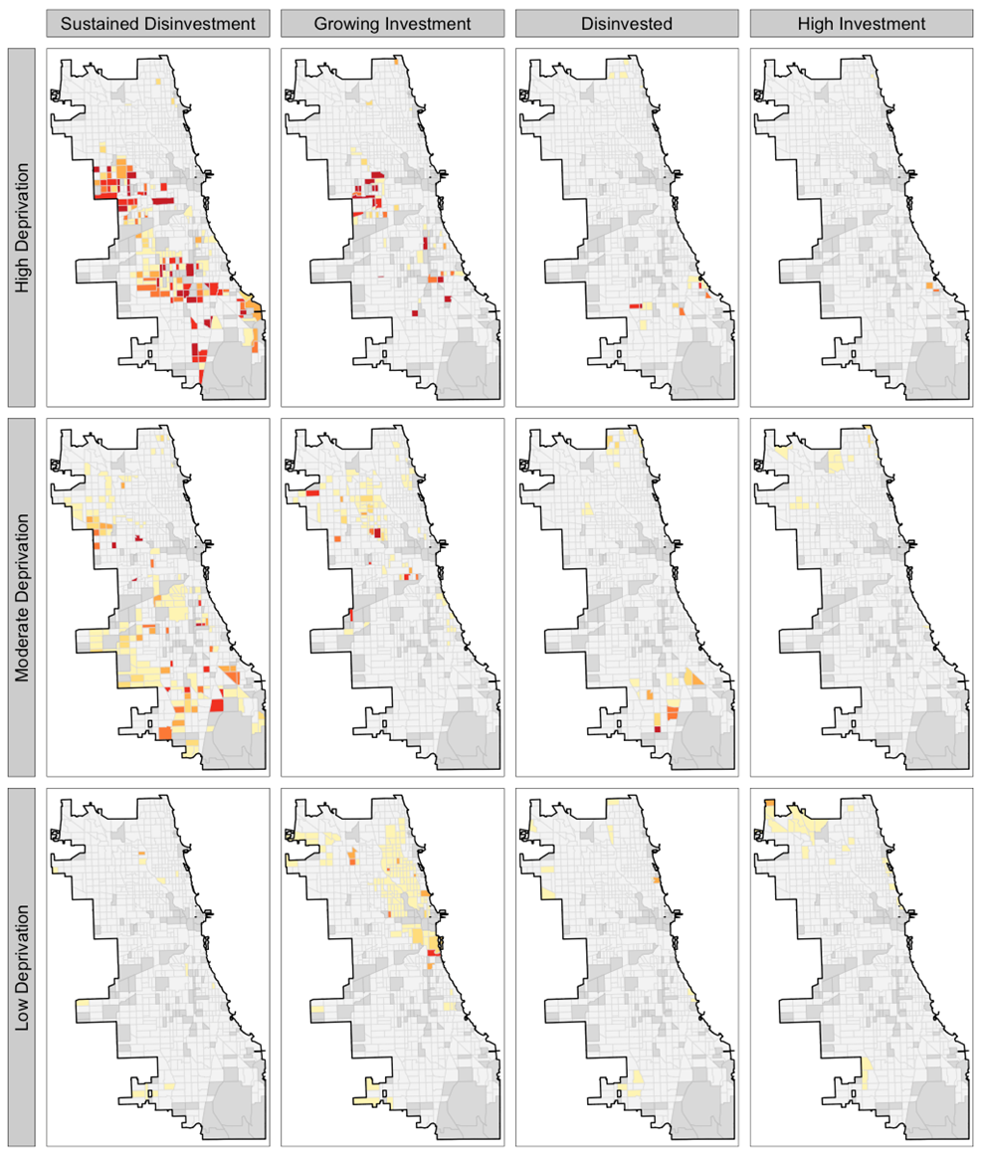
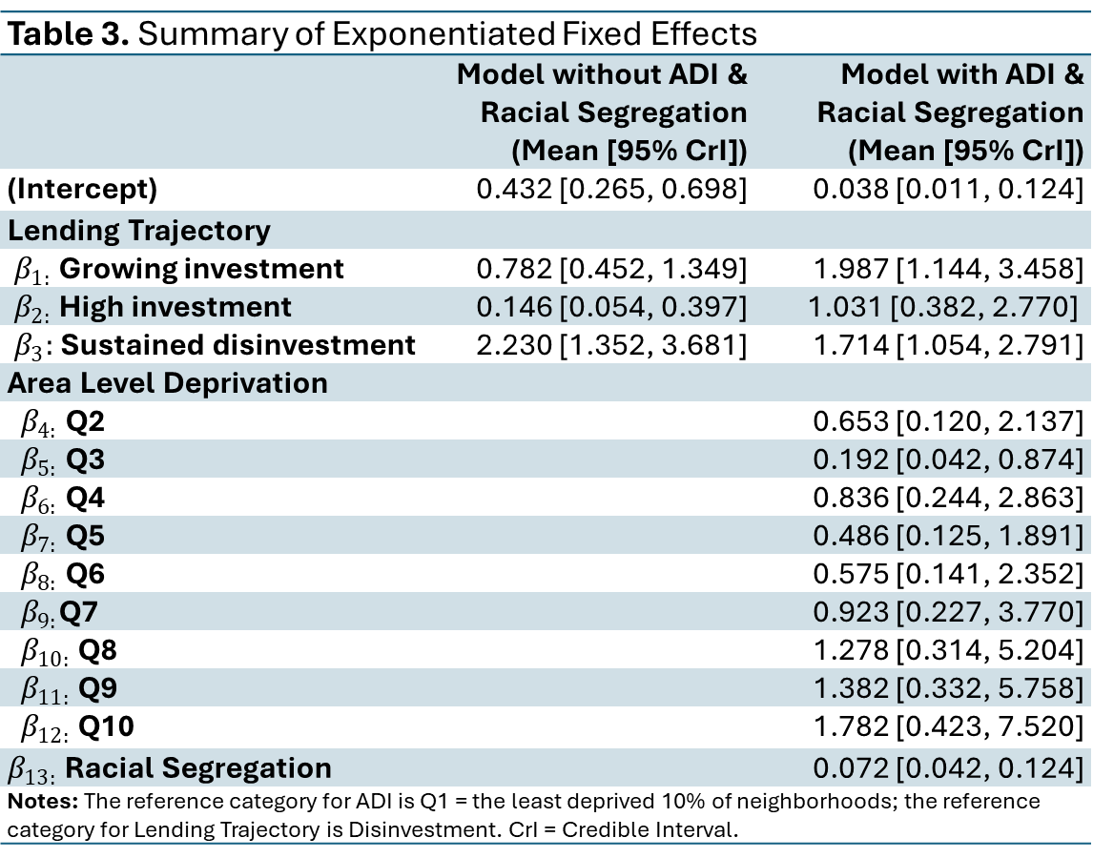
Recall our previous example: Does ADI act as a suppressor?
Table 3. Summary of Exponentiated Fixed Effects
 | Model without ADI & Racial Segregation (Mean [95% CrI]) | Model with ADI & Racial Segregation (Mean [95% CrI])
(Intercept) | 0.432 [0.265, 0.698] | 0.038 [0.011, 0.124]
Lending Trajectory
$β_{1:}$ Growing investment | 0.782 [0.452, 1.349] | 1.987 [1.144, 3.458]
$β_{2:}$High investment | 0.146 [0.054, 0.397] | 1.031 [0.382, 2.770]
$β_{3}:$Sustained disinvestment | 2.230 [1.352, 3.681] | 1.714 [1.054, 2.791]
Area Level Deprivation
$β_{4:}$Q2 |  | 0.653 [0.120, 2.137]
$β_{5:}$Q3 |  | 0.192 [0.042, 0.874]
$β_{6:}$Q4 |  | 0.836 [0.244, 2.863]
$β_{7:}$Q5 |  | 0.486 [0.125, 1.891]
$β_{8:}$Q6 |  | 0.575 [0.141, 2.352]
$β_{9:}$Q7 |  | 0.923 [0.227, 3.770]
$β_{10:}$Q8 |  | 1.278 [0.314, 5.204]
$β_{11:}$Q9 |  | 1.382 [0.332, 5.758]
$β_{12:}$Q10 |  | 1.782 [0.423, 7.520]
$β_{13:}$Racial Segregation |  | 0.072 [0.042, 0.124]
Notes: The reference category for ADI is Q1 = the least deprived 10% of neighborhoods; the reference category for Lending Trajectory is Disinvestment. CrI = Credible Interval.

Slide 18
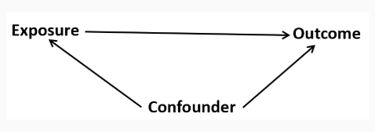
Recall our previous example: Confounding How is it different from mediation?
To be a confounding factor, two conditions must be met:
The confounding variable must be associated with the exposure (but not a consequence of the exposure)
The confounding variable must be associated with the outcome Independently of exposure
The confounding variable cannot be an intermediary step in the causal pathway from the exposure of interest to the outcome of interest.

Slide 19
Test yourself on full mediation, partial mediation, and supression
Before we continue ☺

Slide 20
Mediation, Moderation & Conditional Process Analysis
An introduction to structural equation modeling

Slide 21
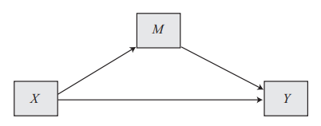
Introduction
Indirect Effect
Direct Effect
Mediation analysis is a statistical method used to evaluate evidence from studies designed to test hypotheses about how some causal antecedent variable X transmits its effect on a consequent variable Y
RQ: What is the mechanism, be it emotional, cognitive, biological, or otherwise, by which X influences Y?

Slide 22
Conceptualizing a Mediation Process
Indirect Effect
Direct Effect
Mediation is ultimately a causal explanation; hence these models have additional assumptions:
The relationships in the system are causal
M is causally located between X and Y
X causes M, which in turn causes Y → M is located causally between X and Y
Note about cross-sectional data

Slide 23
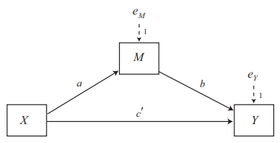
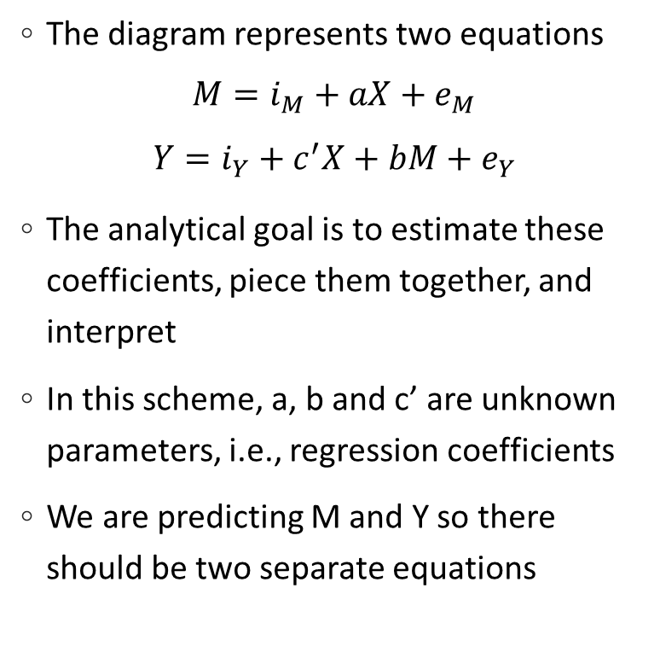
The Statistical Model
The diagram represents two equations
$$M=i_{M}+aX+e_{M}$$
$$Y=i_{Y}+c^{′}X+bM+e_{Y}$$
The analytical goal is to estimate these coefficients, piece them together, and interpret
In this scheme, a, b and c’ are unknown parameters, i.e., regression coefficients
We are predicting M and Y so there should be two separate equations
The indirect effect of X on Y
The direct effect of X on Y

Slide 24

The Direct effect of X on Y
c’ estimates the direct effect of X on Y
Interpretation: If two cases are the same on M but differ by one unit on X, the difference in Y is exactly c’
$$c^{′}=\left[\hat{Y} | \left(X=x, M=m\right)\right]−[\hat{Y}|(X=x−1, M=m)]$$
This just means: If you increase X by 1, keeping M the same, Y changes by 𝑐′
Think of 𝑐′ as the "pure" effect of X on Y, without M interfering!
Note: in the special case where X is dichotomous, c’ is the difference between the two groups’ means holding M constant
This is equivalent to an adjusted mean differences in ANOVA
Notes:
Another interpretation is: for every one unit increase in X, Y differs by c’ units holding M constant

Slide 25
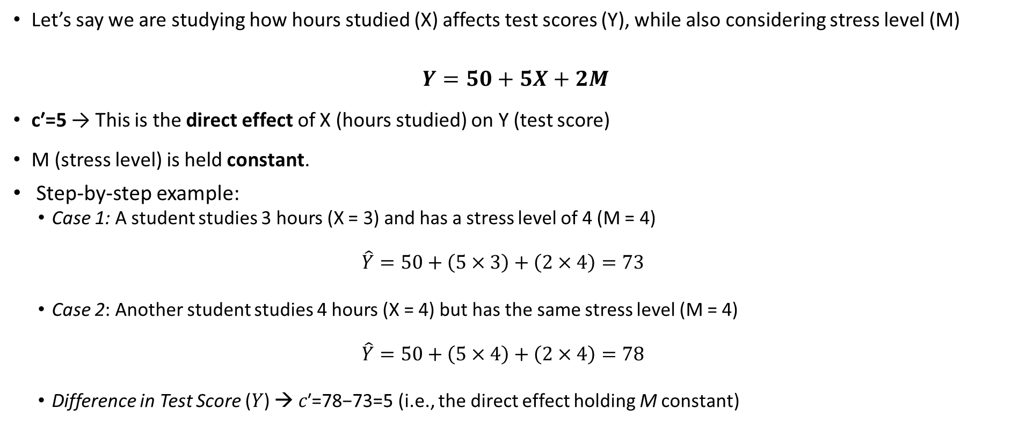
Simple Numeric Example
Let’s say we are studying how hours studied (X) affects test scores (Y), while also considering stress level (M)
$$Y=50+5X+2M$$
c′=5 → This is the direct effect of X (hours studied) on Y (test score)
M (stress level) is held constant.
Step-by-step example:
Case 1: A student studies 3 hours (X = 3) and has a stress level of 4 (M = 4)
$$\hat{Y}=50+\left(5×3\right)+\left(2×4\right)=73$$
Case 2: Another student studies 4 hours (X = 4) but has the same stress level (M = 4)
$$\hat{Y}=50+\left(5×4\right)+\left(2×4\right)=78$$
Difference in Test Score (𝑌) → 𝑐′=78−73=5 (i.e., the direct effect holding M constant)

Slide 26

The Indirect Effect of X on Y
a quantifies how much two cases that differ by one unit on X are estimated to differ on M
$$a=\left[\hat{M} | \left(X=x\right)\right]−\left[\hat{M} | \left(X=x−1\right)\right]$$
b quantifies how much two cases that differ by one unit on M but that are equal on X are estimated to differ by b units on Y
$$b=\left[\hat{Y} | \left(M=m,X=x\right)\right]−\left[\hat{Y} | \left(M=m−1, X=x\right)\right]$$
The indirect effect of X on Y through M is the product of a and b
The indirect effect tells us that two cases that differ by one unit on X are estimated to differ by ab units on Y as a result of the effect of X on M (which, in turn, affects Y)
Note: you must consider the signs of a and b when interpreting the indirect effect
Notes:
a represents the change in M for a one-unit increase in X
b represents the change in Y for a one unit increase in M holding X constant

Slide 27
Indirect Effects
In mediation analysis, the total effect of X on Y can be split into:
Direct Effect (c’): The effect of X on Y, ignoring M.
Indirect Effect (ab): The effect of X on Y that goes through M.
Path a: Effect of X on M
a tells us how much stress (M) changes when study hours (X) increase by 1
Example: M = 3 + 2X
If X = 3 → M = 3 + 2(3) = 9
If X = 4 → M = 3 + 2(4) = 11
a = 11 - 9 = 2
Interpretation: More studying increases stress by 2 units
Path b: Effect of M on Y
Example: Y = 50 + 5X - 3M
If M = 9 → Y = 50 + 5(3) - 3(9) = 38
If M = 10 → Y = 50 + 5(3) - 3(10) = 35
b = 35 - 38 = -3
Interpretation: More stress lowers test scores by 3 points.

Slide 28
What about the indirect effect?
Indirect Effect: a × b
ab = a × b = (2) × (-3) = -6
For every extra hour studied (X), test scores (Y) change by -6 points due to stress (M).
Since ab is negative, stress acts to reduce test scores, meaning that studying more indirectly lowers test scores through increased stress
What if the indirect effect was positive?

Slide 29

The Total Effect of X on Y
The total effect = the direct effect + the indirect effect
$$c=c^{′}+ab→ab=c−c′$$
The total effect c quantifies how much two cases that differ by one unit on X are estimated to differ on Y
c represents the change in Y for every 1-unit increase in X
$$c=[\hat{Y}|X=x)]−[\hat{Y}|X=x−1)]$$
The difference between the total effect and the direct effect is that the direct effect controls for M

Slide 30
Total Effect of X on Y
The total effect of X on Y is:
c = c’ + ab
If c’ = 5, then:
c = 5 + (-6) = -1
Interpretation:
The direct effect of studying is +5 (more hours → higher score)
The indirect effect (through stress) is -6 (more hours → more stress → lower score)
The net effect (i.e., total) of studying is slightly negative (-1), meaning stress cancels out the benefit of studying

Slide 31
Summary
a = 2 → More studying increases stress.
b = -3 → More stress lowers test scores.
ab = -6 → More studying indirectly reduces test scores due to stress.
If ab is negative, the indirect effect works against the direct effect.

Slide 32
The Process Macro
To run these models you need to download and install the Process macro written by Andrew Hayes
Download - The PROCESS macro for SPSS, SAS, and R
Unzip the file
From SPSS go to Extensions → Utilities → Install Custom Dialog Builder
Browse to the unzipped files and open the folder that contains the SPSS application (C:\...\Downloads\processv40\PROCESS v4.0 for SPSS\Custom dialog builder file\process)
The dialog files will be located in Analyze → Regression → process.spd
The latest version is 4.0

Slide 33
Example 1: Dichotomous Predictor, Simple Mediation The PMI study
The participants in this study (43 male and 80 female) read one of two newspaper articles describing an economic crisis that may affect the price and supply of sugar in Israel
Approximately half of the participants (n = 58) were given an article they were told would be appearing on the front page of a major Israeli newspaper (i.e., the ‘front-page’ condition).
The remaining participants (n = 65) were given the same article but were told it would appear in the middle of an economic supplement of this newspaper (i.e., the interior page condition)
The participants were asked about their reactions to the story including their intention to buy sugar (REACTION)
They were also asked questions about how much they believed others would buy sugar in the community (presumed media influence measured by PMI))
The research hypothesis was that individuals who read the article on the front page would be more likely to think others would promptly buy sugar which in turn would lead them to buy sugar

Slide 34
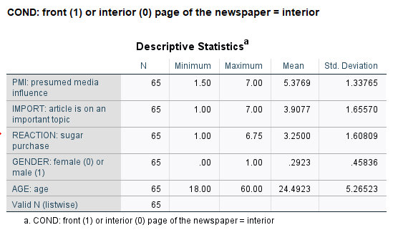
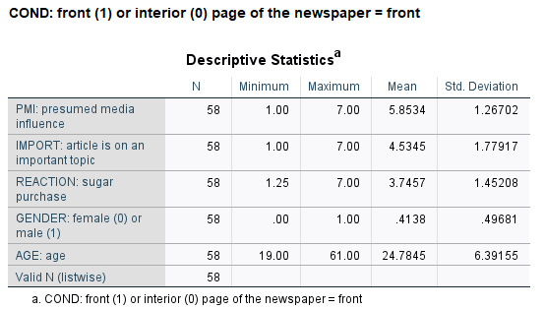
Descriptive Stats

Slide 35
Simple Mediation Model for PMI study
PMI
CONDITION
REACTION

Slide 36
Steps for Mediation, Moderation and Mediated Moderation
Select the model from the appendix
1
Specify the X, Y, M and W variables
2
Incorporate covariates/controls for M and Y
3
Open the process macro and run the analysis
4

Slide 37
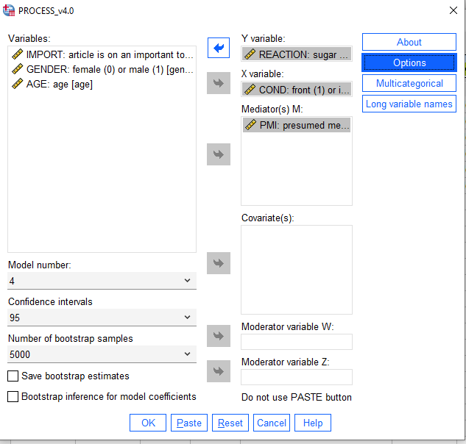
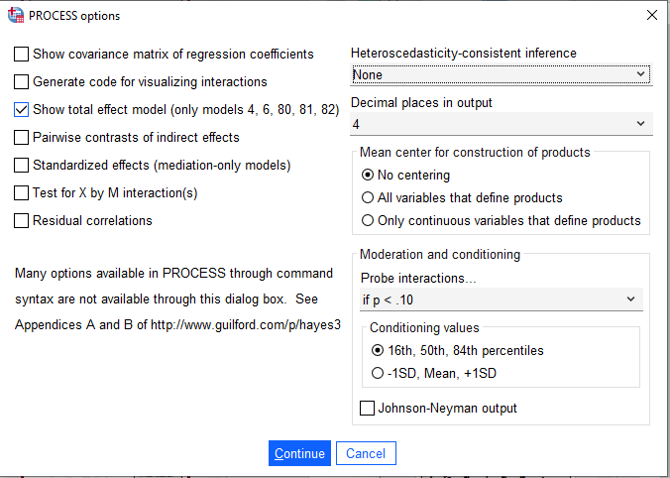

Slide 38
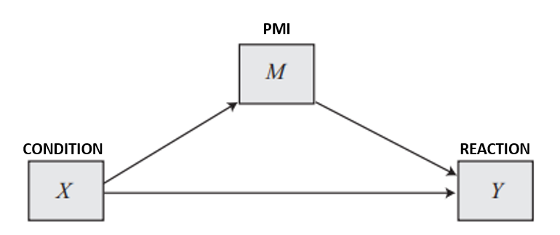

The Output
OUTCOME VARIABLE:
pmi – this is the mediator variable
Model Summary
R R-sq MSE F df1 df2 p
.1808 .0327 1.7026 4.0878 1.0000 121.0000 .0454
Model
coeff se t p LLCI ULCI
constant 5.3769 .1618 33.2222 .0000 5.0565 5.6973
cond .4765(a) .2357 2.0218 .0454 .0099 .9431
Students in the front-page article condition are .477 units higher on PMI, on average
$$\hat{M}=5.377+ .477X →$$
Notes:
Because the independent variable X is dichotomous this is interpreted as the difference in group means
Notice that the condition explains very little of the variation in PMI (here only about 3.3% of the variation in PMI is explained by article position)
Nevertheless, the effect is significant

Slide 39

The Output
OUTCOME VARIABLE:
reaction → the dependent variable (intention to buy)
Model Summary
R R-sq MSE F df1 df2 p
.4538 .2059 1.9404 15.5571 2.0000 120.0000 .0000
Model
coeff se t p LLCI ULCI
constant .5269 .5497 .9585 .3397 -.5615 1.6152
cond .2544(C’) .2558 .9943 .3221 -.2522 .7609
pmi .5064(b) .0970 5.2185 .0000 .3143 .6986
$$\hat{Y}=.527+ .254X+.506M →$$
The regression coefficient for presumed media influence, b = 0.506, means that two people assigned to the same experimental condition (i.e., equal on X) but that differ by one unit in their presumed media influence (M) are estimated to differ by 0.506 units in intention to buy sugar (Y)
Another way to state that is: every one-unit increase in presumed media influence leads to a .5064 increase in intention to buy sugar regardless of whether participants read the front-page condition or interior condition
Notes:
The regression coefficient for presumed media influence, b = 0.506, means that two people assigned to the same experimental condition (i.e., equal on X) but that differ by one unit in their presumed media influence (M) are estimated to differ by 0.506 units in intention to buy sugar (Y)
Another way to state that is: every one-unit increase in presumed media influence leads to a .5064 increase in intention to buy sugar regardless of whether participants read the front-page condition or interior condition

Slide 40

The Output
Direct effect of X on Y
Effect se t p LLCI ULCI
.2544 .2558 .9943 .3221 -.2522 .7609
Indirect effect(s) of X on Y:
Effect BootSE BootLLCI BootULCI
pmi .2413 .1291 .0017 .5098
$c=ab →.4765$ (.5064) = .2413
The effect of article condition on intention to buy operates through presumed media influence
The Bootstrap confidence interval does not contain 0 and hence the result is significant
Notes:
So relative to those assigned to the interior page condition, those who read an article they were told was to be published in the front page of the newspaper were, on average, 0.241 units higher in their likelihood of buying sugar

Slide 41
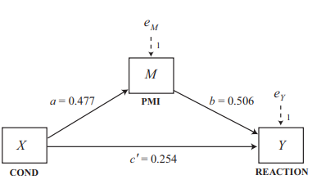
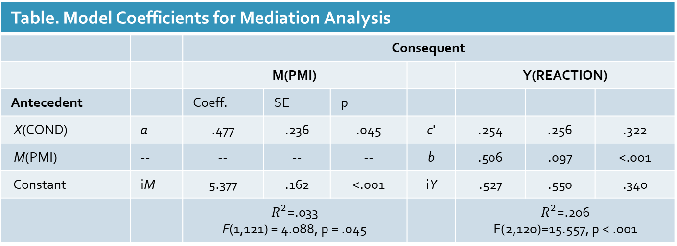
Importance of buying sugar
Location of newspaper article: front or back
It is important to buy sugar, so I buy sugar
Table. Model Coefficients for Mediation Analysis
 |  | Consequent
 |  | M(PMI) |  |  |  | Y(REACTION)
Antecedent |  | Coeff. | SE | p
X(COND) | a | .477 | .236 | .045 | c' | .254 | .256 | .322
M(PMI) | -- | -- | -- | -- | b | .506 | .097 | <.001
Constant | iM | 5.377 | .162 | <.001 | iY | .527 | .550 | .340
 |  | $R^{2}$=.033 F(1,121) = 4.088, p = .045 |  |  |  | $R^{2}$=.206 F(2,120)=15.557, p < .001

Slide 42
A mediation analysis was conducted to examine whether Presumed Media Influence (PMI) explains the relationship between article placement and people's intention to buy sugar. To test this, two regression models were estimated. First, PMI was regressed on article placement to determine whether placement influenced PMI (path 𝑎). Next, the intention to buy sugar was regressed on both article placement and PMI to test whether PMI predicted sugar purchase intention (path 𝑏) and whether article placement still had a direct effect on purchase intention after accounting for PMI (𝑐′). The indirect effect of article placement on purchase intention through PMI was calculated as the product of 𝑎 and 𝑏 (𝑎𝑏).
The results showed that article placement significantly predicted PMI (𝑎=0.477,𝑝=.045), indicating that placing an article on the front page was associated with higher presumed media influence. In the second regression model, PMI significantly predicted sugar purchase intention (𝑏=0.506, 𝑝<.001), meaning that greater perceived media influence led to a stronger intention to buy sugar. However, the direct effect of article placement on sugar purchase intention was not significant (𝑐′=0.254, 𝑝=.322), suggesting that once PMI was taken into account, where the article was placed no longer directly influenced purchase intentions. The indirect effect (𝑎𝑏=0.241) was significant, indicating that PMI fully mediated the relationship between article placement and sugar purchase intention. This suggests that front-page placement influences purchase intention because it increases presumed media influence, which in turn drives sugar-buying intentions. In other words, PMI is the mechanism explaining how article placement affects sugar purchase intention. If the goal is to influence people's buying decisions, enhancing the perceived influence of media coverage may be more impactful than simply changing article placement within a newspaper.

Slide 43
Example 2: Continuous Predictor with Controls Economic Stress Among Small Business Owners
Participants in this study were N = 262 entrepreneurs who were members of Business Networking International, a networking group for small-business owners, who responded to an online survey about recent performance of their business as well as their emotional and cognitive reactions to the economic climate
Participants were asked about how their business was doing (the measure of economic stress, ESTRESS) along with their feelings related to their business (AFFECT) and intentions to withdrawal from being a business owner (higher scores == more withdrawal intentions)
The hypothesis was that the effect of economic stress (X) on disengagement from entrepreneurial activities (Y) operates through depressed affect (M)
Notes:
More specifically, the experience of stress results in feelings of despondency and hopelessness, and higher levels of depressed affect will result in a greater the desire to withdraw from one’s role as a small-business owner

Slide 44
Simple Mediation Model for Economic Stress study
AFFECT
ESTRESS
WITHDRAWAL

Slide 45
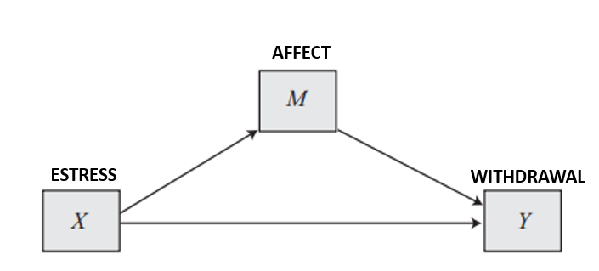

Results
OUTCOME VARIABLE:
affect
Model Summary
R R-sq MSE F df1 df2 p
.3401 .1156 .4650 33.9988 1.0000 260.0000 .0000
Model
coeff se t p LLCI ULCI
constant .7994 .1433 5.5777 .0000 .5172 1.0816
estress .1729(a) .0296 5.8308 .0000 .1145 .2313
$$\hat{M}=.799+ .173X →$$
Notes:
Business owners who differ on one unit of economic stress are .1729 points higher on depressed affect and the result is statistically significant

Slide 46

OUTCOME VARIABLE:
withdraw
Model Summary
R R-sq MSE F df1 df2 p
.4247 .1804 1.2841 28.4946 2.0000 259.0000 .0000
Model
coeff se t p LLCI ULCI
constant 1.4471 .2520 5.7420 .0000 .9508 1.9433
estress(c’) -.0768 .0524 -1.4667 .1437 -.1800 .0263
affect(b) .7691 .1031 7.4627 .0000 .5662 .9721
Recall: c’ is the direct effect
Total effect = direct + indirect effect
$$\hat{Y}=1.45− .077X+.769M →$$

Slide 47
Total effect of X on Y
Effect se t p LLCI ULCI
.0561 .0542 1.0353 .3015 -.0506 .1629
Note: -.0768 + .1330 = .0561
Direct effect of X on Y
Effect se t p LLCI ULCI
-.0768(c’) .0524 -1.4667 .1437 -.1800 .0263
Indirect effect(s) of X on Y:
Effect BootSE BootLLCI BootULCI
affect(ab) .1330 .0335 .0694 .2015
Every one-unit increase in economic stress leads to a .133 increase in intentions to withdraw as a result of the tendency for those under stress to have depressed affect
The total effect (c) is -.0768 + .1330=.056

Slide 48
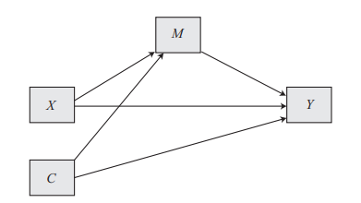

Adding to the Mediation Model, pt 1
It is very useful to remove the effect of confounding variables on the ‘causal’ associations between the variables
PROCESS allows us to include covariates on M, Y or both
q is the number of variables, C stands for ‘covariate,’ and f and g are unknown parameters
$$M=i_{M}+aX+\sum_{i=1}^{q}{f_{i}C_{i}+}e_{M}$$
$$Y=i_{Y}+c^{′}X+bM+\sum_{i=1}^{q}{g_{i}C_{i}+}e_{Y}$$

Slide 49
Model Interpretation
The interpretation of the direct, indirect, and total effects remains the same except now interpreted as the ceteris paribus effect, holding all C’s constant
Examples
The direct effect of X on Y is the change in Y given a one-unit increase in X controlling for M and C
The indirect effect, ab, quantifies the change in Y for a one unit increase in X as a result of the effect of X on M (which in turn affects Y) controlling for C
And the total effect of X, c, estimates the change in Y for a one-unit increase in X controlling for C.

Slide 50
Example 3: Continuous Predictor with Controls Economic Stress Among Small Business Owners with Covariates
Let’s add three covariates to the previous example exploring the mediating impact of affect on the relationship between economic stress and withdrawal tendency among business owners
Here we add: sex (Hayes refers to it as gender), self-efficacy and company tenure
Note: the theoretical and statistical model are the exact same for simple mediation without covariates but now our statistical model changes a bit. What we might expect
For self-efficacy (ESE): People who feel relatively more confident in their abilities may tend to feel relatively less stress in general, perhaps are less prone to feeling negative and down about their business under any circumstances, and enjoy their jobs relatively more than people who are less confident.
For tenure (TENURE): People who have been in business longer may tend to feel relative less stress due to their relative greater levels of experience handling negative situations (or they may feel more stress because they have more to lose)
For SEX:
Let’s run the model controlling for these effects on M and Y

Slide 51
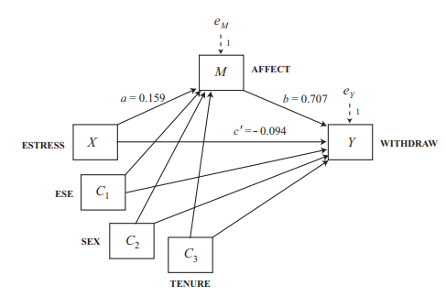

Example 3, cont’d
Statistical Model
Equation for the mediating effect
$$M=i_{M}+aX+\sum_{i=1}^{q}{f_{i}C_{i}+}e_{M}→q=3$$
$$M=i_{M}+aX+f_{1}C_{1}+f_{2}C_{2}+f_{3}C_{3}+e_{M}$$
Equation for the consequent
$$Y=i_{Y}+c^{′}X+bM+\sum_{i=1}^{q}{g_{i}C_{i}+}e_{Y}$$
$$Y=i_{Y}+c^{′}X+bM+g_{1}C_{1}+g_{2}C_{2}+g_{3}C_{3}+e_{Y}$$
A simple mediation model with q=3 antecedent X variables

Slide 52
Example 3: X on M
OUTCOME VARIABLE:
affect
Model Summary
R R-sq MSE F df1 df2 p
.4039 .1631 .4452 12.5231 4.0000 257.0000 .0000
Model
coeff se t p LLCI ULCI
Constant(iM) 1.7855 .3077 5.8033 .0000 1.1796 2.3914
estress(a) .1593 .0297 5.3612 .0000 .1008 .2179
Ese(f1) -.1549 .0444 -3.4892 .0006 -.2423 -.0675
sex(f2) .0148 .0857 .1726 .8631 -.1540 .1836
tenure(f3) -.0108 .0063 -1.7227 .0861 -.0232 .0016

Slide 53
Example 3: M on Y
OUTCOME VARIABLE:
withdraw
Model Summary
R R-sq MSE F df1 df2 p
.4539 .2060 1.2586 13.2824 5.0000 256.0000 .0000
Model
coeff se t p LLCI ULCI
constant (iY) 2.7461 .5502 4.9913 .0000 1.6626 3.8295
estress(c’) -.0935 .0527 -1.7751 .0771 -.1973 .0102
affect(b) .7071 .1049 6.7420 .0000 .5006 .9137
ese(g1) -.2121 .0764 -2.7769 .0059 -.3625 -.0617
sex(g2) .1274 .1441 .8838 .3776 -.1565 .4112
tenure(g3) -.0021 .0106 -.1940 .8463 -.0230 .0189

Slide 54
Example 3: Indirect Effect
Total effect of X on Y
Effect se t p LLCI ULCI
.0191 .0541 .3535 .7240 -.0874 .1257
Direct effect of X on Y
Effect se t p LLCI ULCI
-.0935 .0527 -1.7751 .0771 -.1973 .0102
Indirect effect(s) of X on Y:
Effect BootSE BootLLCI BootULCI
affect .1127 .0291 .0567 .1728
c = c ′ + ab → −0.094 + 0.113 =.019
Note: this relationship between the total, direct, and indirect effect of X applies to models with covariates so long as the covariates are included in the equations for both Y and M.
Notes:
Even after adjusting for the possibility of spurious or epiphenomenal association resulting from these three covariates, the indirect effect of economic stress on withdrawal intentions through depressed affect is positive and statistically different from zero (point estimate = 0.113, with a 95% bootstrap confidence interval of 0.058 to 0.173).

Slide 55
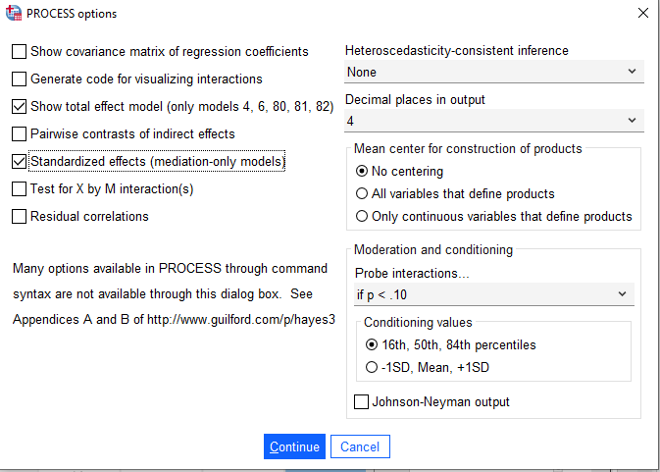
Effect Sizes
Are the observed effects large or small?
Process can print the partially standardized effect sizes to give it context relative to the variability in the outcome
The completely standardized indirect effect is .1518 and the completely standardized direct effect is -.0877
Completely standardized indirect effect(s) of X on Y:
Effect BootSE BootLLCI BootULCI
affect .1518 .0375 .0803 .2288
Standardized coefficients
coeff
estress -.0877
affect .4464
Notes:
This means that two entrepreneurs who differ by one unit in their economic stress differ by about one-fifeteenth of a standard deviation in their intentions to withdraw from entrepreneurship as a result of the effect of stress on depressed affect
Independent of this indirect mechanism, the entrepreneur one unit higher in economic stress is estimated to be 0.087 standard deviations lower in withdrawal intentions

Slide 56
Practice
I have longitudinal data from the NASCW that has information about children who have been investigated by CPS for different types of abuse or neglect
Let’s test the hypothesis that (1) children who have been investigated for abuse or neglect who have witnessed severe violence exposure at time 1 (EV_W1) are more likely to engage in externalizing behavior at time 3 (bcext3); and (2) the mechanism that links violence exposure to externalizing behavior is post-traumatic stress at Wave 1 (tra1)

Slide 57
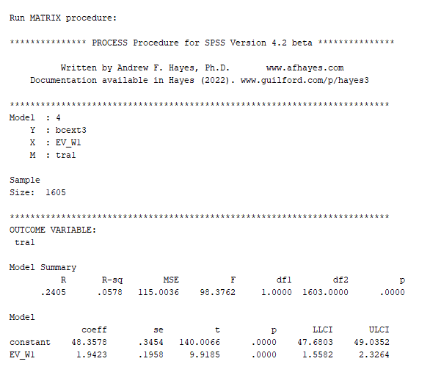
Step 4
Look at the regression of Wave 1 violence exposure on traumatic symptoms
Every one unit increase in violence exposure increases PTS symptoms by 1.9423 (p < .001)

Slide 58
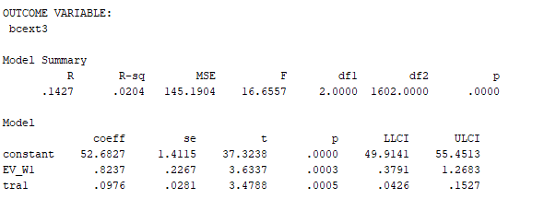
Step 2
Look at the regression of violence exposure and PTS on externalizing behavior at time 3
Both violence exposure and PTS at time 1 increase externalizing behavior at time 3

Slide 59
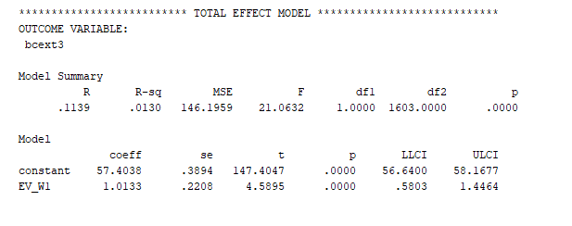
Step 3
Look at the ‘Total Effects’ output
The total effect of violence exposure on externalizing is equal to the indirect and direct effect

Slide 60
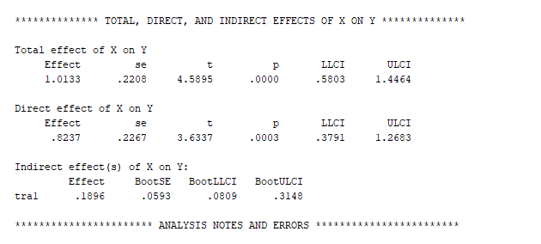
Step 4
Examine the indirect and direct effect in relation to the total effect
The indirect effect is .1896 and the confidence interval does not include 0 so it is significant
The direct effect is .8237
.8327 + .1896 = 1.0133

Slide 61
Draw conclusions
Traumatic symptoms is a mechanism that links violence exposure to externalizing problem behavior in childhood among youth with CPS involvement
The total effect of VIOL EX on EXT behavior 1.0133
This is broken down into both direct and indirect effects
Direct: controlling for the mediation, how the independent variable affects the outcome
Indirect: how the mediator effects the outcome
PTS explains .1896/1.0133 = .1871 → 18.71% of the total effect
This means that 18.71% of the total effect is explained by PTS symptoms
The proportion of indirect to direct effect is .1871 / .8372
Deal with child’s trauma from violence exposure to reduce long-term behavioral outcomes

